Slide 1
Anatomy of the Pelvis
Color Code
Important
Doctors Notes
Notes/Extra explanation
Please view our Editing File before studying this lecture to check for any changes.

Slide 2
Objectives
At the end of the lecture, students should be able to:
Describe the anatomy of the pelvic wall, bones, joints & muscles.
Describe the boundaries and subdivisions of the pelvis.
Differentiate the different types of the female pelvis.
Describe the pelvic walls & floor.
Describe the components & function of the pelvic diaphragm.
List the arterial & nerve supply
List the lymph & venous drainage of the pelvis.
ملاحظة: لما نكتب او نقصد موجود فقط في جسم النساء او الرجال
بينما اذا كتبنا او نقصد اختلاف في سلايدز المحاضرة بين الدكتور والدكتورة
In males
In females
Boys’ slides
Girls’ slides

Slide 3
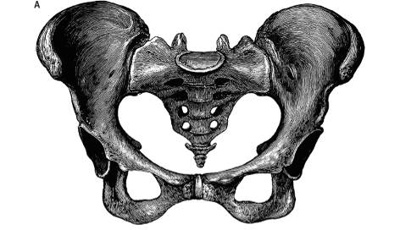
Introduction
The bony pelvis is composed of four bones:
Two hip bones, which form the anterior and lateral walls.
Sacrum and coccyx, which form the posterior wall.
These 4 bones are connected by 4 joints and lined by 4 muscles.
The bony pelvis with its joints and muscles form a strong basin-shaped (حوض) structure (with multiple foramina),
The pelvis contains and protects the:
(1) lower parts of the alimentary &
(2) urinary tracts &
(3) internal organs of reproduction.
The four joints are:
2- Two Sacroiliac joints. (Synovial joints)
Posteriolateraly
3- Sacrococcygeal joint (2ry Cartilaginous joint)
Posteriorly
Between sacrum & coccyx
1- Symphysis pubis (2ry Cartilaginous joint)
Anteriorly

Slide 4
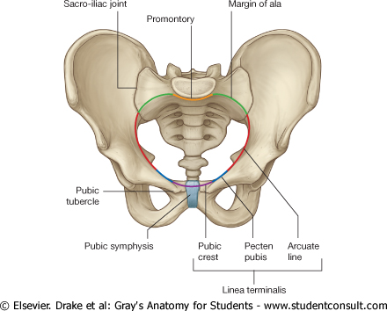
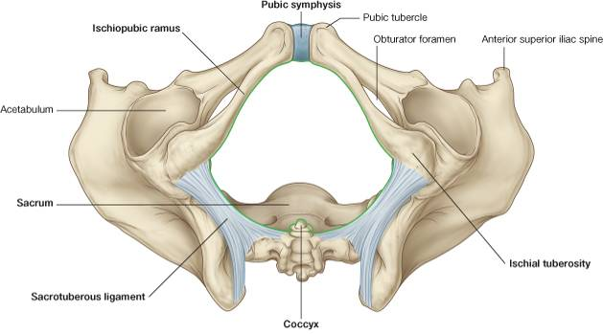
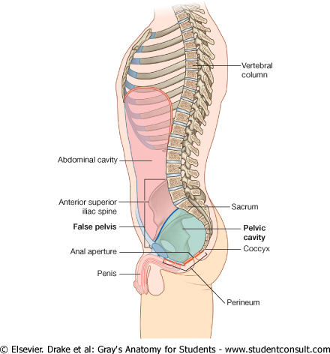
False pelvis
Inlet
True pelvis
Outlet
Perineum
Pelvis
بالترتيب يكون ←
The pelvis is divided into two parts by the pelvic brim or inlet:
False or greater pelvis Above the brim (part of the abdominal cavity) | True or lesser pelvis Below the brim. Has 3 parts:
Bounded by: Posteriorly: Lumbar vertebrae. Laterally: Iliac fossae and the iliacus muscle. Anteriorly: Lower part of the anterior abdominal wall. It supports the abdominal contents | 1. A Cavity: The cavity is a short, curved canal, with a shallow anterior wall and a deeper posterior wall. It lies between the inlet and the outlet.
 | 2. Inlet (oval shape) | 3. Outlet* (Diamond shape)
 | Anteriorly: Symphysis pubis (upper border) | Anteriorly: Symphysis pubis (lower border)
 | Posteriorly: Promontory of sacrum, ala of sacrum. | Posteriorly : Tip of Coccyx.
 | Laterally: (both sides) Ileopectineal (arcuate) lines. (Ileo = illum \ pectineal = pubis) | Anterolaterally: ischiopubic ramus. Posterolaterally: Sacrotuberous ligament & ischial tuberosities.
Pelvic brim
Extra
*recall these are the same boundaries as the perineum

Slide 5
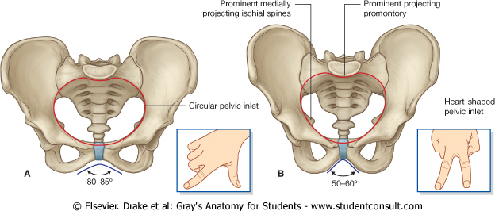
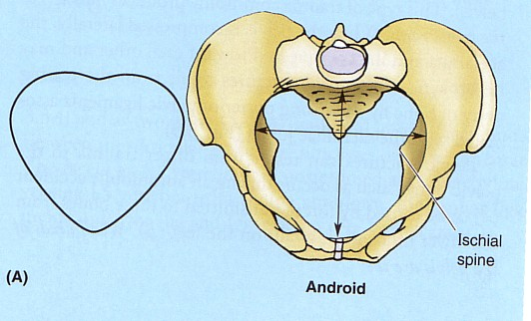
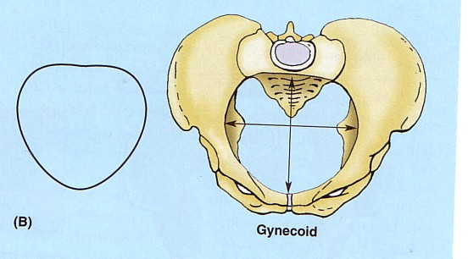
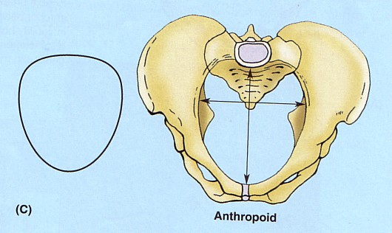
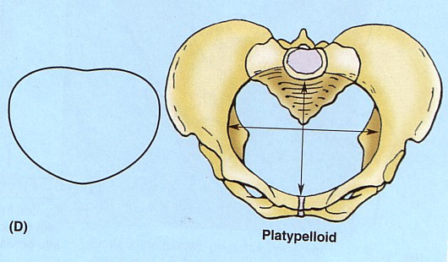
Pelvis
Female vs. Male
Types of Female Bony Pelvis
Information of the shape and dimensions of the female pelvis is of great importance for obstetrics.
Why? because it is the bony canal through which the child passes during birth.
There are 4 types:
Android (resembles male pelvis)
Gynecoid (typical female type)
Anthropoid (has both male and female characteristics)
Platypelloid (least common)
FEMALE
Oval shaped
MALE
Heart shaped
What is the main differences between male and female pelvis?
In female the Sacrum is usually wider and shorter, while in male is long and curved.
Also, the Angle of the pubic arch is wider.
The promontory and the ischial spines are less projecting, while the male is inverted.
**Gynecoid is the only type that can give normal birth , the other three types can’t.

Slide 6
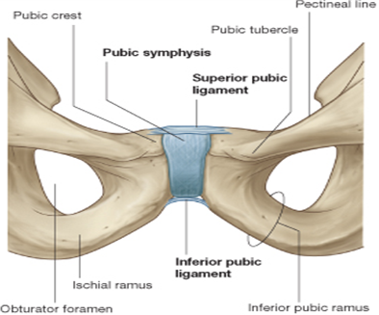
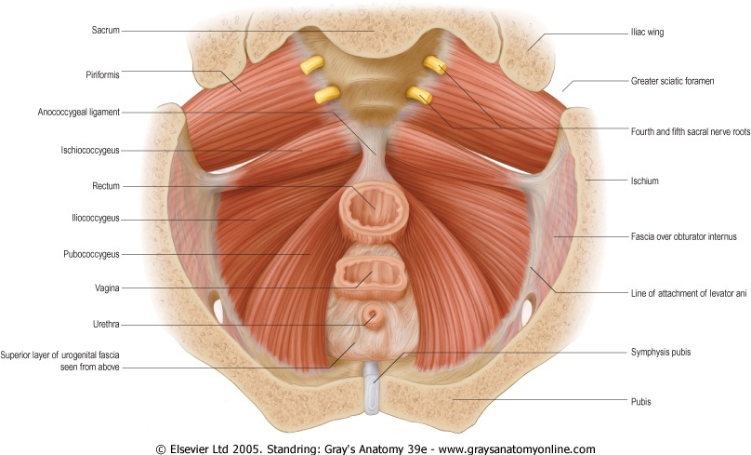
Pelvic Walls
10:26
The pelvis has 4 walls:
Anterior
Posterior
lateral
Inferior (floor)
The walls are formed by bones and ligaments that are lined with muscles covered with fascia and parietal peritoneum.
2. Posterior pelvic wall | 1. Anterior pelvic wall
It is large and deeper. Formed by: (1) sacrum, (2) coccyx , (3) piriformis muscles (right and left) and (4) their covering of parietal pelvic fascia. | It is the shallowest wall and is formed by only bones: (1) the posterior surfaces of the bodies of the pubic bones, (2) the 2 pubic rami, and (3) the symphysis pubis.

Slide 7
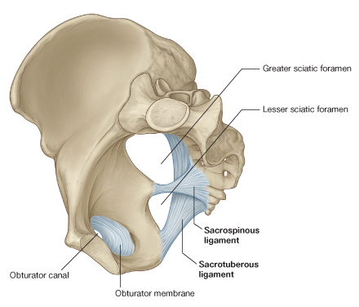
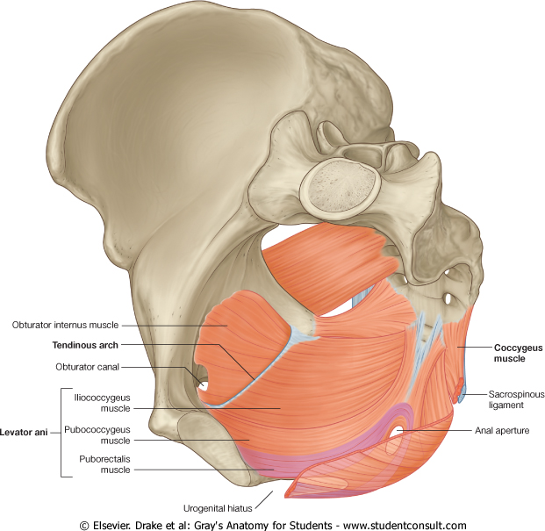
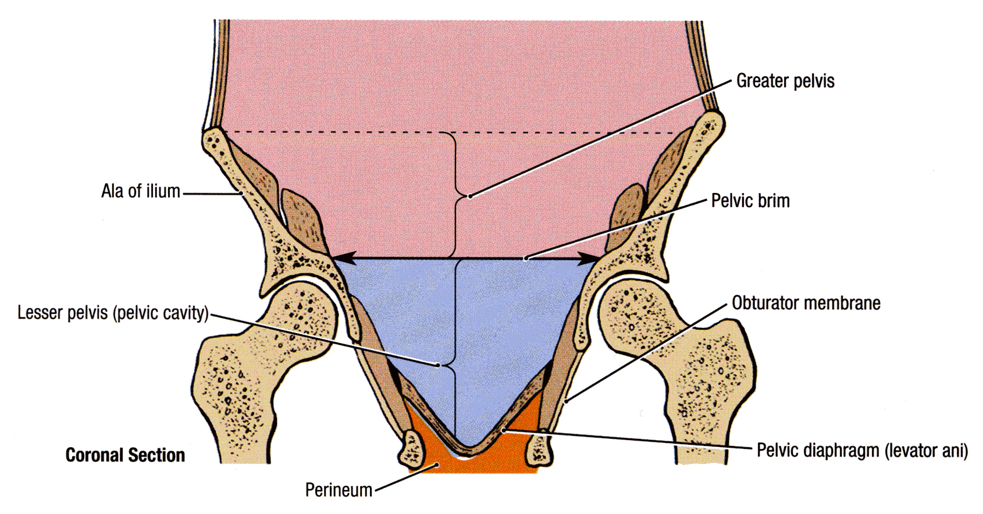
Pelvic Walls
4. Inferior pelvic wall (floor) | 3. Lateral pelvic wall
Basin-like structure which supports the pelvic viscera and is formed by the pelvic diaphragm. It stretches across the lower part of the true pelvis and divides it into: Main (true) pelvic cavity above, which contains the pelvic viscera Perineum below which carries the external genital organs. | It is formed by: Part of the hip bone below the pelvic inlet (the arrow), Obturator internus and its covering fascia, the obturator fascia. Sacrotuberous ligament. Sacrospinous ligament.

Slide 8
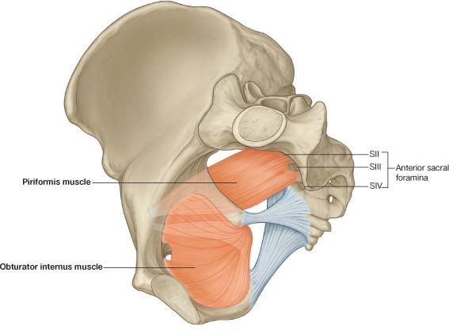
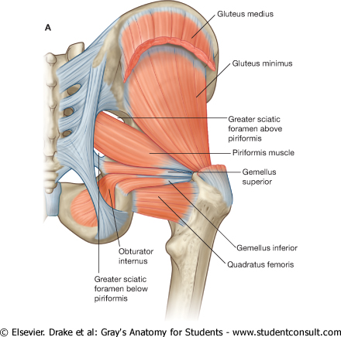
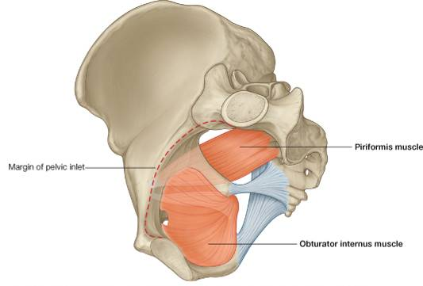
Pelvic Walls
Piriformis muscle (part of posterior pelvic wall)
Origin | Pelvic surface (in front of) the middle 3 sacral vertebrae. It leaves the pelvis through the greater sciatic foramen.
Insertion | Greater trochanter of the femur.
Action | Lateral rotator of the femur at the hip joint.
Innervation | Sacral plexus (lies in front of the muscles).
Obturator internus muscle (part of lateral pelvic wall)
Origin | Inner surface of the obturator membrane and the hip bone. It leaves the pelvis through the lesser sciatic foramen
Insertion | Greater trochanter of the femur.
Action | Lateral rotator of the femur at the hip joint.
Innervation | Nerve to obturator internus (from sacral plexus).

Slide 9
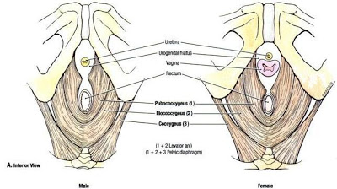
Pelvic Diaphragm
It is formed by the levator ani and the coccygeus muscles and their covering fasciae.
It is incomplete anteriorly to allow passage of:
the urethra in males and
urethra and vagina in females.
Posteriorly the muscles of each side meet together.

Slide 10
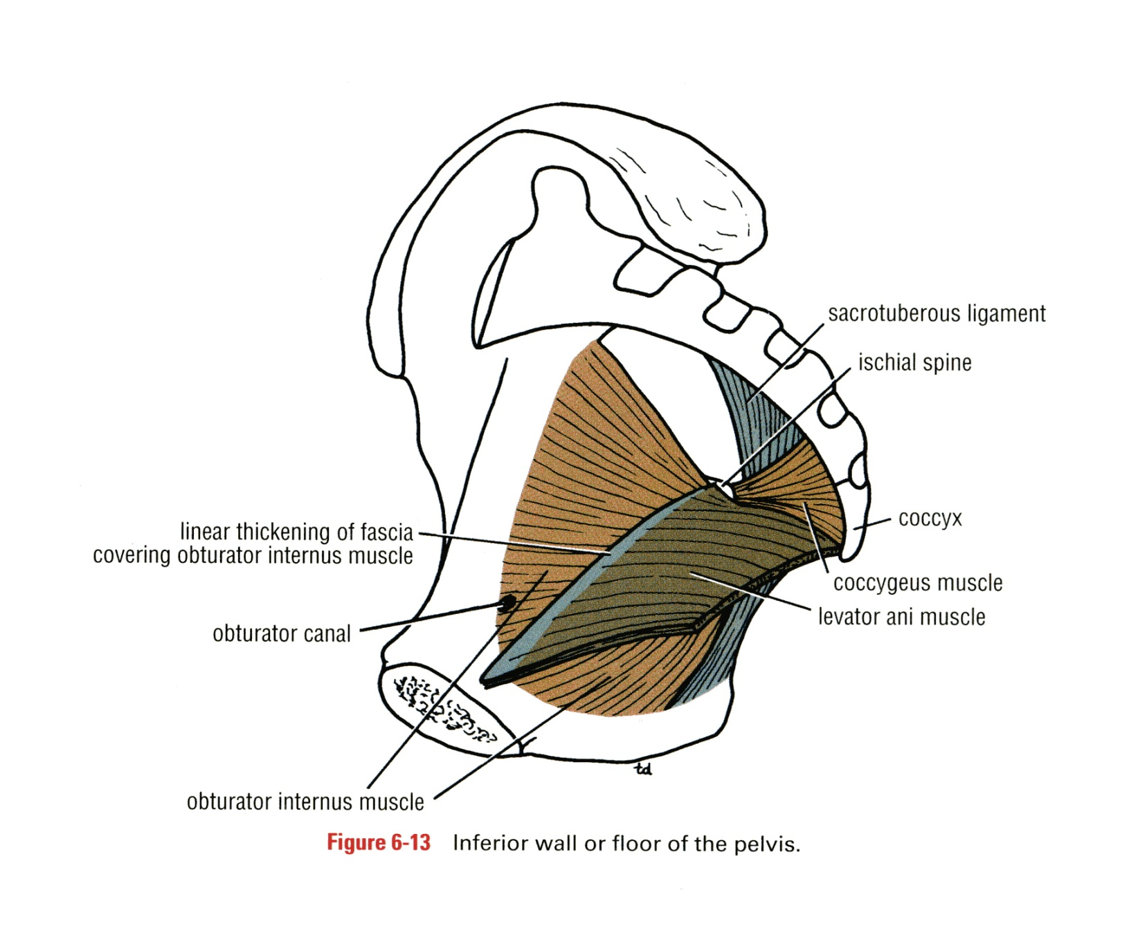
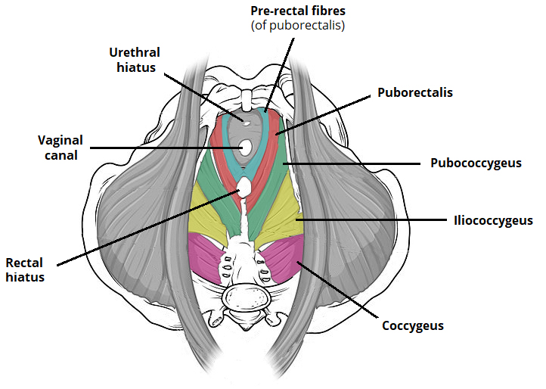
Pelvic Diaphragm
Levatores Ani Muscles
02:54
It is a wide thin sheet-like muscle that has a linear origin .
ORIGIN: (look at the dotted yellow line)
Back of the body of the pubis
Tendinous arch of the obturator fascia
Spine of the ischium (ischial spine).
Its fibers are divided into 3 parts:
Pubococcygeus
Puborectalis
Iliococcygeus (Ischiococcygeus)
Extra

Slide 11
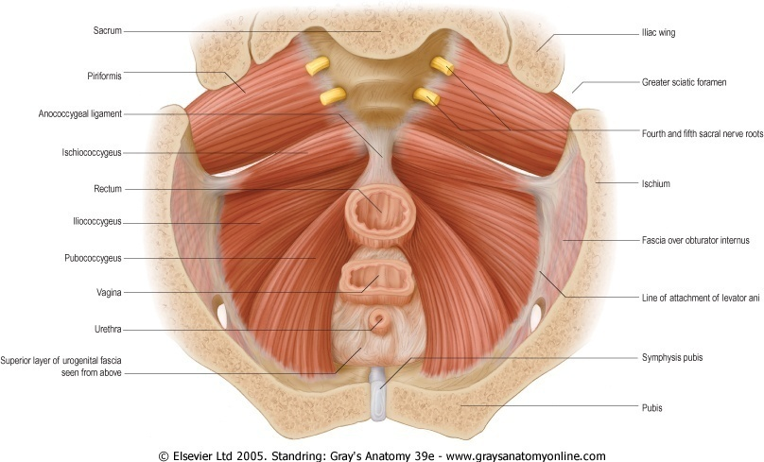
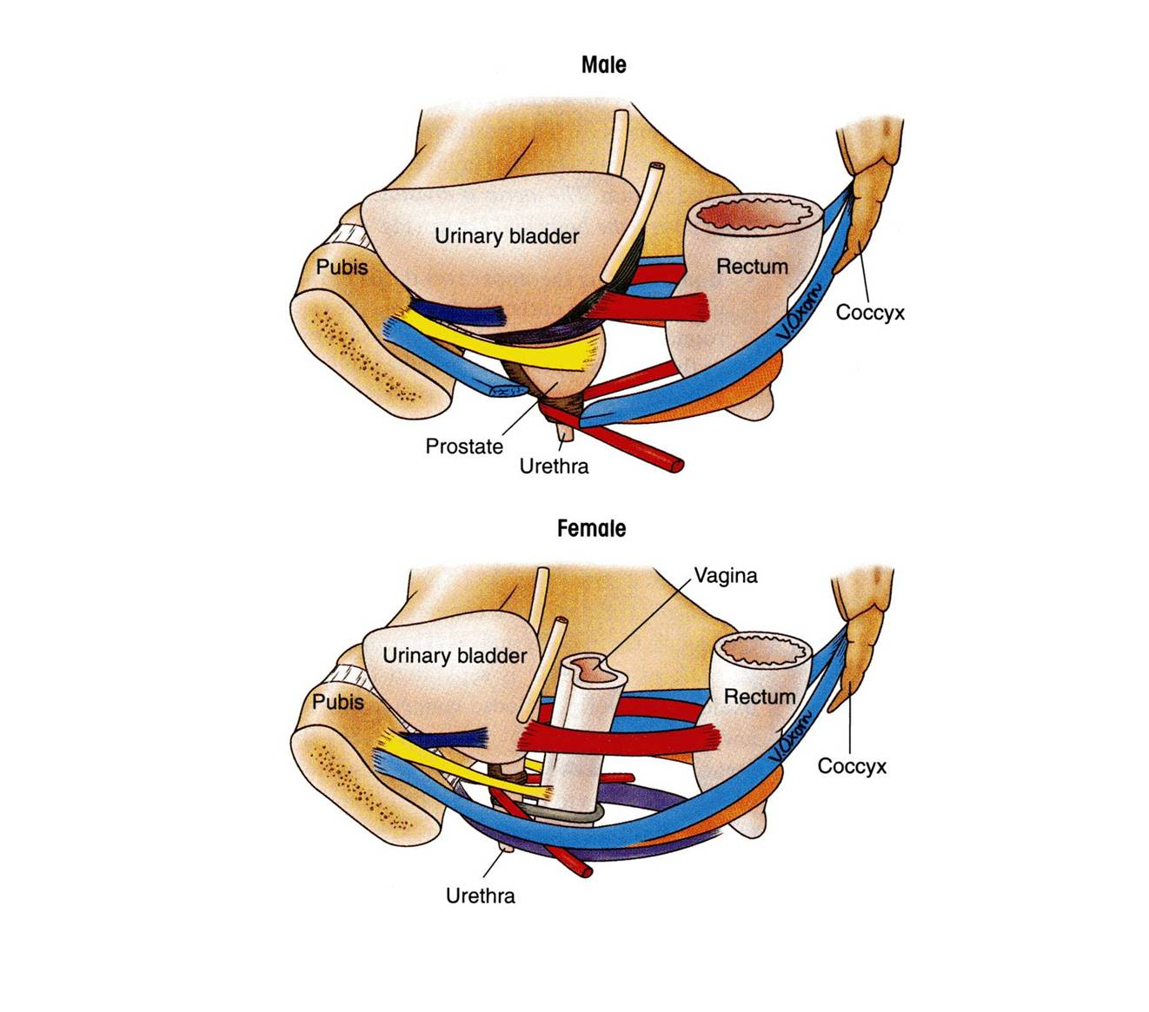
Levatores Ani Muscles
Anterior Fibers
Pubococcygeus
Origin: originates from the posterior surface of the body of the pubis and passes downward & medially
Insertion: inserted into the perineal body, anococcygeal body and coccyx.
Action:
forms a sling around the prostate or the vagina*:
In males
Levator prostate:
Supports prostate
Stabilizes perineal body
In females
Sphincter vaginae:
Supports vagina
Stabilizes perineal body
levator prostatae
Pubococcygeus
*While the muscle goes from origin to insertion it surrounds these 2 organs (prostate or vagina) and supports them.
sphincter vaginae

Slide 12
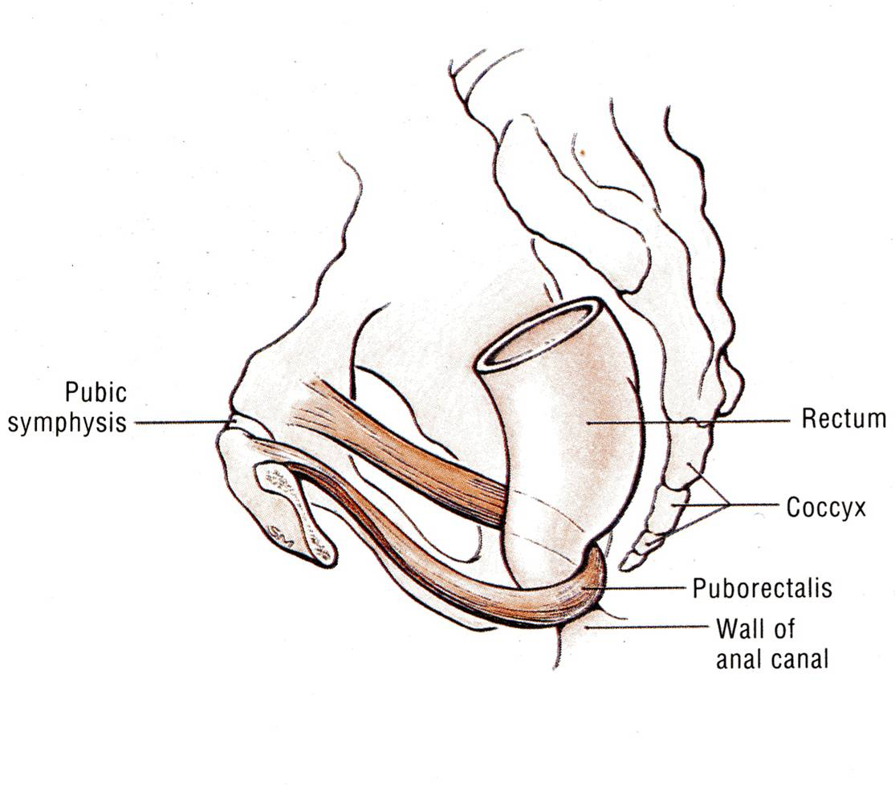
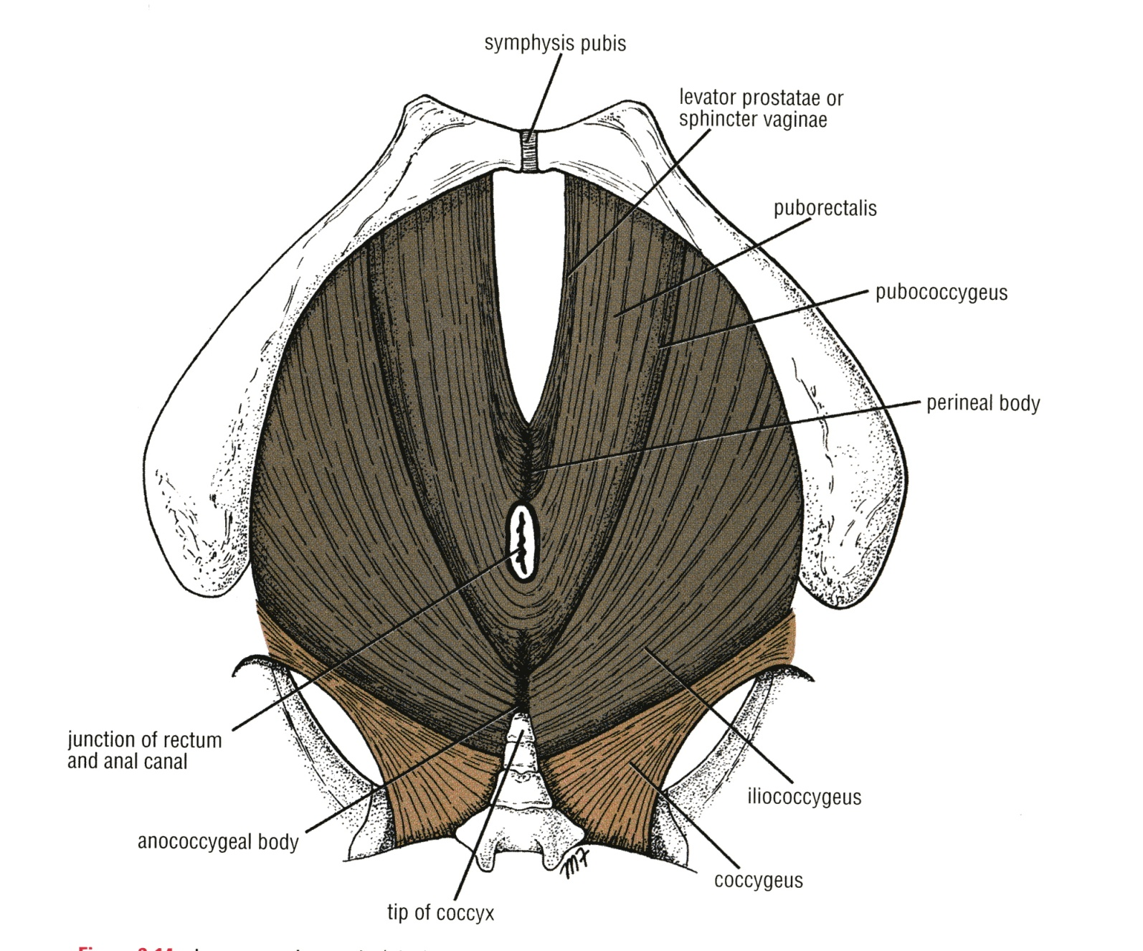
Levatores Ani Muscles
Intermediate Fibers
2. Puborectalis ((شكلها زي اللجام بتاع الخيل
forms a sling around the recto-anal Junction.
It has a very important role in maintaining fecal continence.
Its tone is important to maintain the angle between rectum & anal canal. When it relaxes, the angle is gone and defecation can occur
Posterior Fibers
3. Iliococcygeus
Origin: Inserted into the anococcygeal body and the coccyx
4. Ischiococcygeus* (only on the girls’ slides)
Origin: Arises from the ischial spine
Insertion: inserted into the anococcygeal body & coccyx.
coccygeus
iliococcygeus
* الدكاتره اختلفوا في هذه العضلة د.ابوالمكارم قال انها في اسم ثاني لـ موجوده في بعض الكتب. ود.جميلة تقول في اختلاف في الاراء بحيث البعض يعتبرها جزء من .
ريحوا بالكم وانسوا عنها. اهم شيئ ركزوا على الثلاثه الاولى لانها هي الاساسية

Slide 13
Levatores Ani Muscles
Supply & Action
Nerve supply to levator ani:
1. perineal branch of the fourth sacral nerve (S4) → upper surface.
2. perineal branch of the pudendal nerve → lower surface.
The importance of the different supplies is if one of these nerves is affected, the other is still intact
Actions of levator ani:
The muscles of the two sides form an efficient muscular sling that supports and maintains the pelvic viscera in position. (so if it is injured rectal or vaginal prolapse may occur)
They resist the rise in intra pelvic pressure during the straining and expulsive efforts of the abdominal muscles (as in coughing).
They have a very important role in maintaining fecal continence (puborectalis) by acting as a sphincter at the anorectal junction .
They serve as a vaginal sphincter in the female. (The most important muscle in labour is levator ani: should be relaxed so the vaginal sphincter isn’t closed)

Slide 14
This table is a summary of the slides before.
Muscle |  | Origin | Insertion | Action | Innervation
Levator Ani Muscle | Pubococcygeus | Back of the body of the pubis Tendinous arch of the obturator fascia Spine of the ischium. | perineal body anococcygeal body coccyx (forms a sling around the prostate or the vagina) | Support and maintain the pelvic viscera in position. They resist the rise in intra pelvic pressure during the straining and expulsive efforts of the abdominal muscles (as in coughing). Maintaining fecal continence. They serve as a vaginal sphincter in the female. | perineal branch of the fourth sacral nerve perineal branch of the pudendal nerve.
 | Puborectalis |  | forms a sling around the recto-anal Junction. It has a very important role in maintaining fecal continence.
 | Iliococcygeus |  | anococcygeal body coccyx
 | Ischiococcygeus |  | anococcygeal body coccyx
 | Ischiococcygeus

Slide 15
Pelvic Diaphragm
Coccygeus Muscle
This muscle is bigger in animals because they have tails.
Coccygeus: small triangular muscle.
Origin | Ischial spine | Coccygeus muscle has the same attachment as the sacrospinous ligament!
Insertion | Lower end of sacrum and coccyx
Action | Assist the levator ani in supporting the pelvic viscera
Innervation | branches of the 4th and 5th sacral nerves (S4 & S5).
Extra

Slide 16
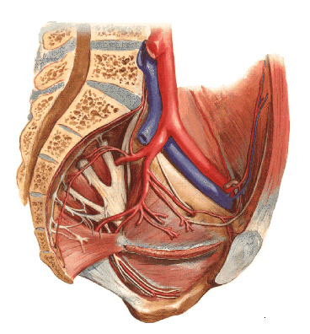
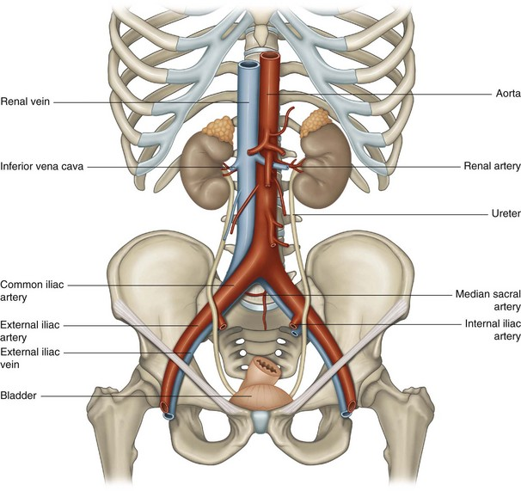
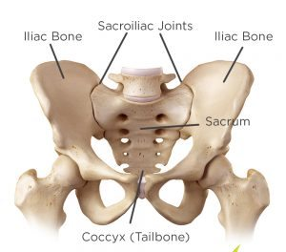
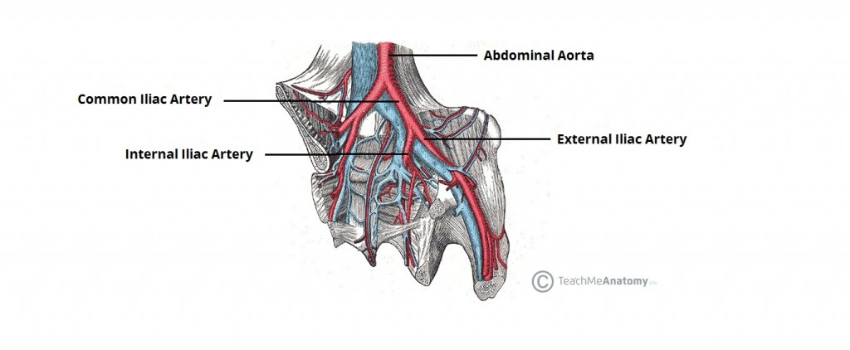
Arteries of the Pelvis
IIA
08:29
I) Internal iliac artery (IIA)
One of the 2 terminal branch of the Common iliac artery.
Course:
Arises in front of the sacroiliac joint
It descends downward & backwards over the pelvic inlet.
It divides at the upper border of the greater sciatic foramen into: Anterior & Posterior divisions.
A
P
Extra
II) Ovarian artery (in female):
Arises from the abdominal aorta.
Extra
Extra
The abdominal aorta divides into 2 common iliac arteries. Then at the sacroiliac joint the common iliac divides into external and internal iliac arteries. The external iliac continues as the femoral artery, while the internal iliac supplies the pelvis and perineum. Then at the greater sciatic foramen the internal iliac divides into anterior and posterior divisions.

Slide 17
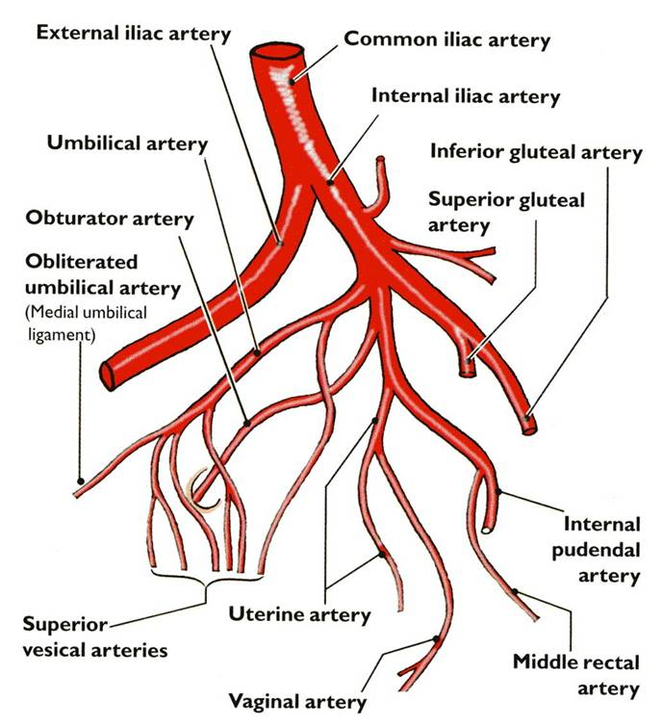
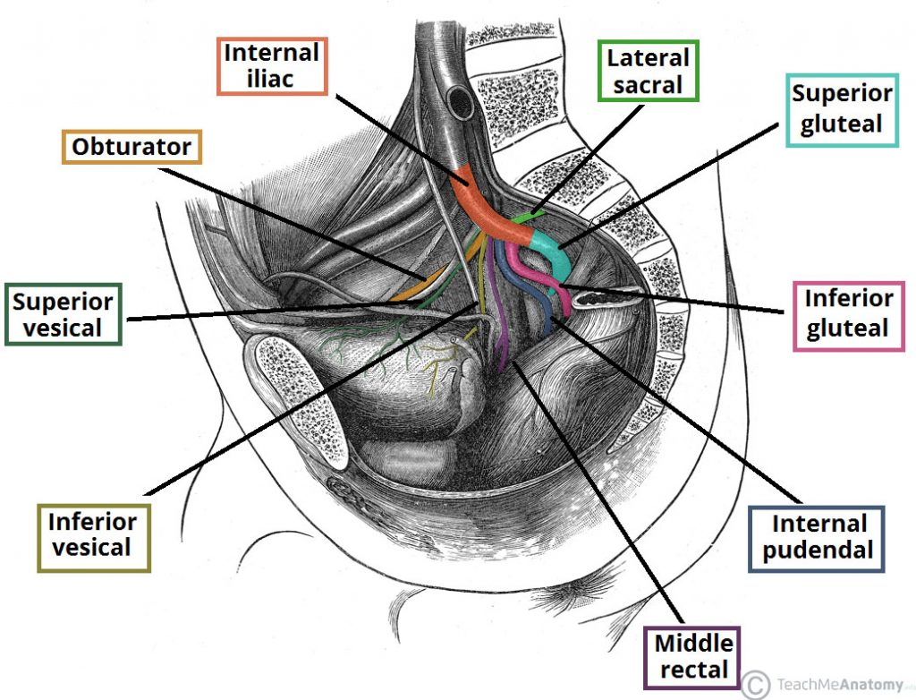
Arteries of the Pelvis Internal Iliac Artery
Posterior division Supplies: (supplies only walls)
Posterior abdominal wall.
Posterior pelvic wall.
Gluteal region.
Anterior division supplies: (supplies wall & viscera)
Gluteal region.
Perineum.
Pelvic viscera.
Medial (adductor) region of thigh (by obturator artery).
The fetus (through the umbilical arteries).
Extra

Slide 18
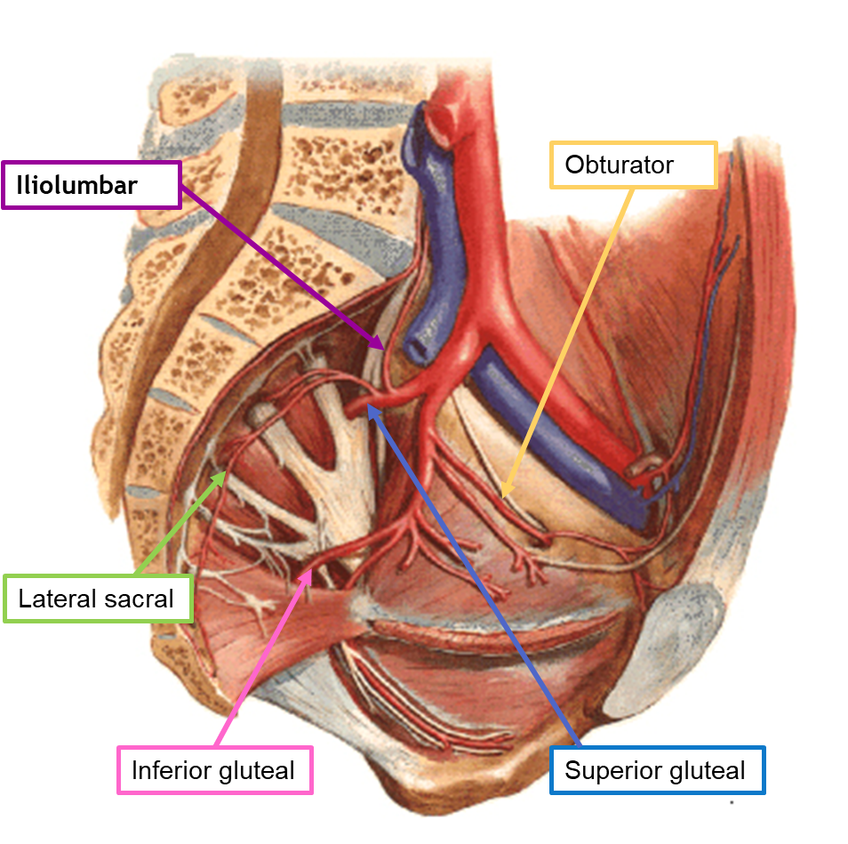
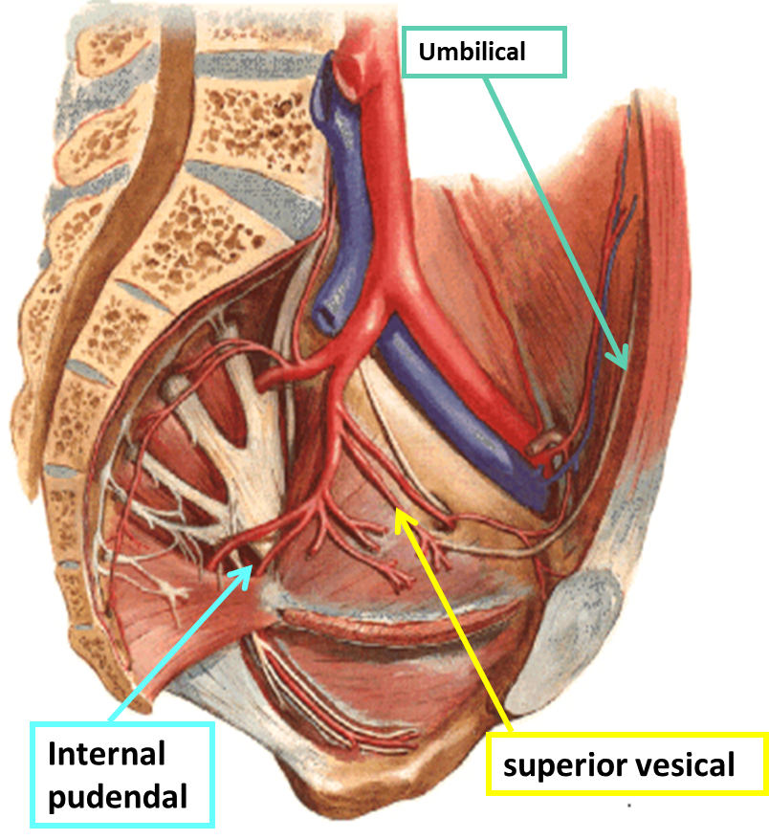
Arteries of the Pelvis Internal Iliac Artery
Parietal Branches
From posterior division | From anterior division:
Iliolumbar artery. Lateral sacral arteries (2 branches.) Superior gluteal artery. | 4. Obturator artery. 5. Inferior Gluteal artery.
Visceral Branches
(all from anterior division only)
1. Umbilical artery :Gives the superior vesical* artery: The distal part of this artery fibrosed and forms the Medial Umbilical Ligament. 2. Inferior Vesical artery in male or vaginal in female: In the male it supplies, the Prostate and the Seminal Vesicles. It also gives the artery of the Vas Deferens. 3. Middle rectal artery 4. Internal pudendal artery It is the main arterial supply to the perineum.
* Supplies urinary bladder:
In male (superior and inferior vesical arteries)
In female (superior vesical & vaginal artery)

Slide 19
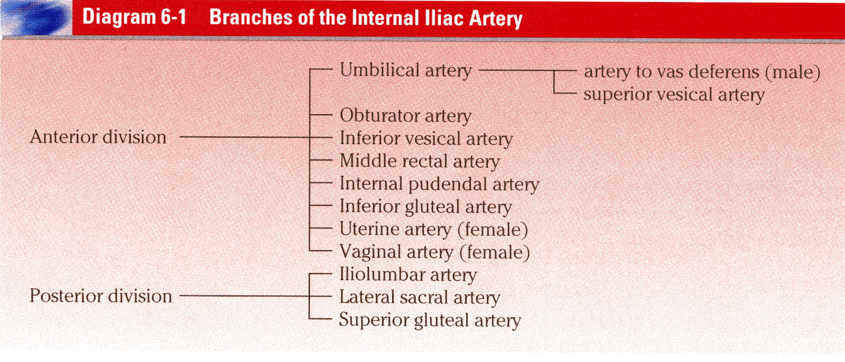
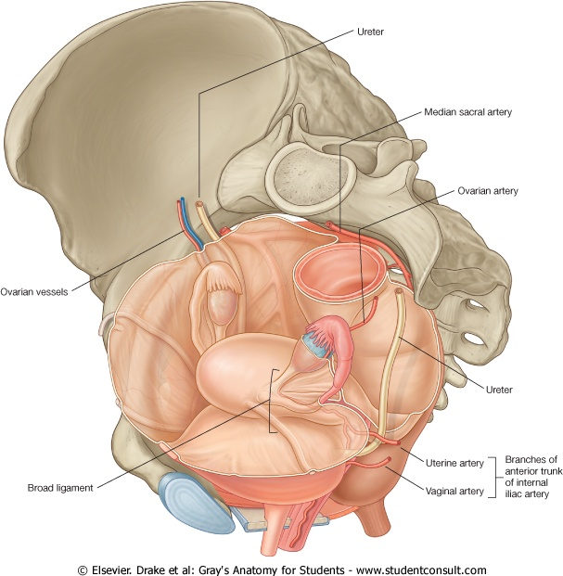
Arteries of the Pelvis Internal Iliac Artery
Summary of the Branches (only on the girls’ slides):
Visceral Branches (In Female)
Vaginal artery: Replaces the inferior vesical artery. Uterine artery: has tortuous* course Crosses the Ureter superiorly and supplies the uterus & uterine tubes. N.B. The ureter may be wrongly ligated (cut) in hysterectomy (removal of uterus)
3. Ovarian artery from abdominal aorta
*recall the arteries that have tortuous course:
Facial artery
Splenic artery
Uterine artery

Slide 20
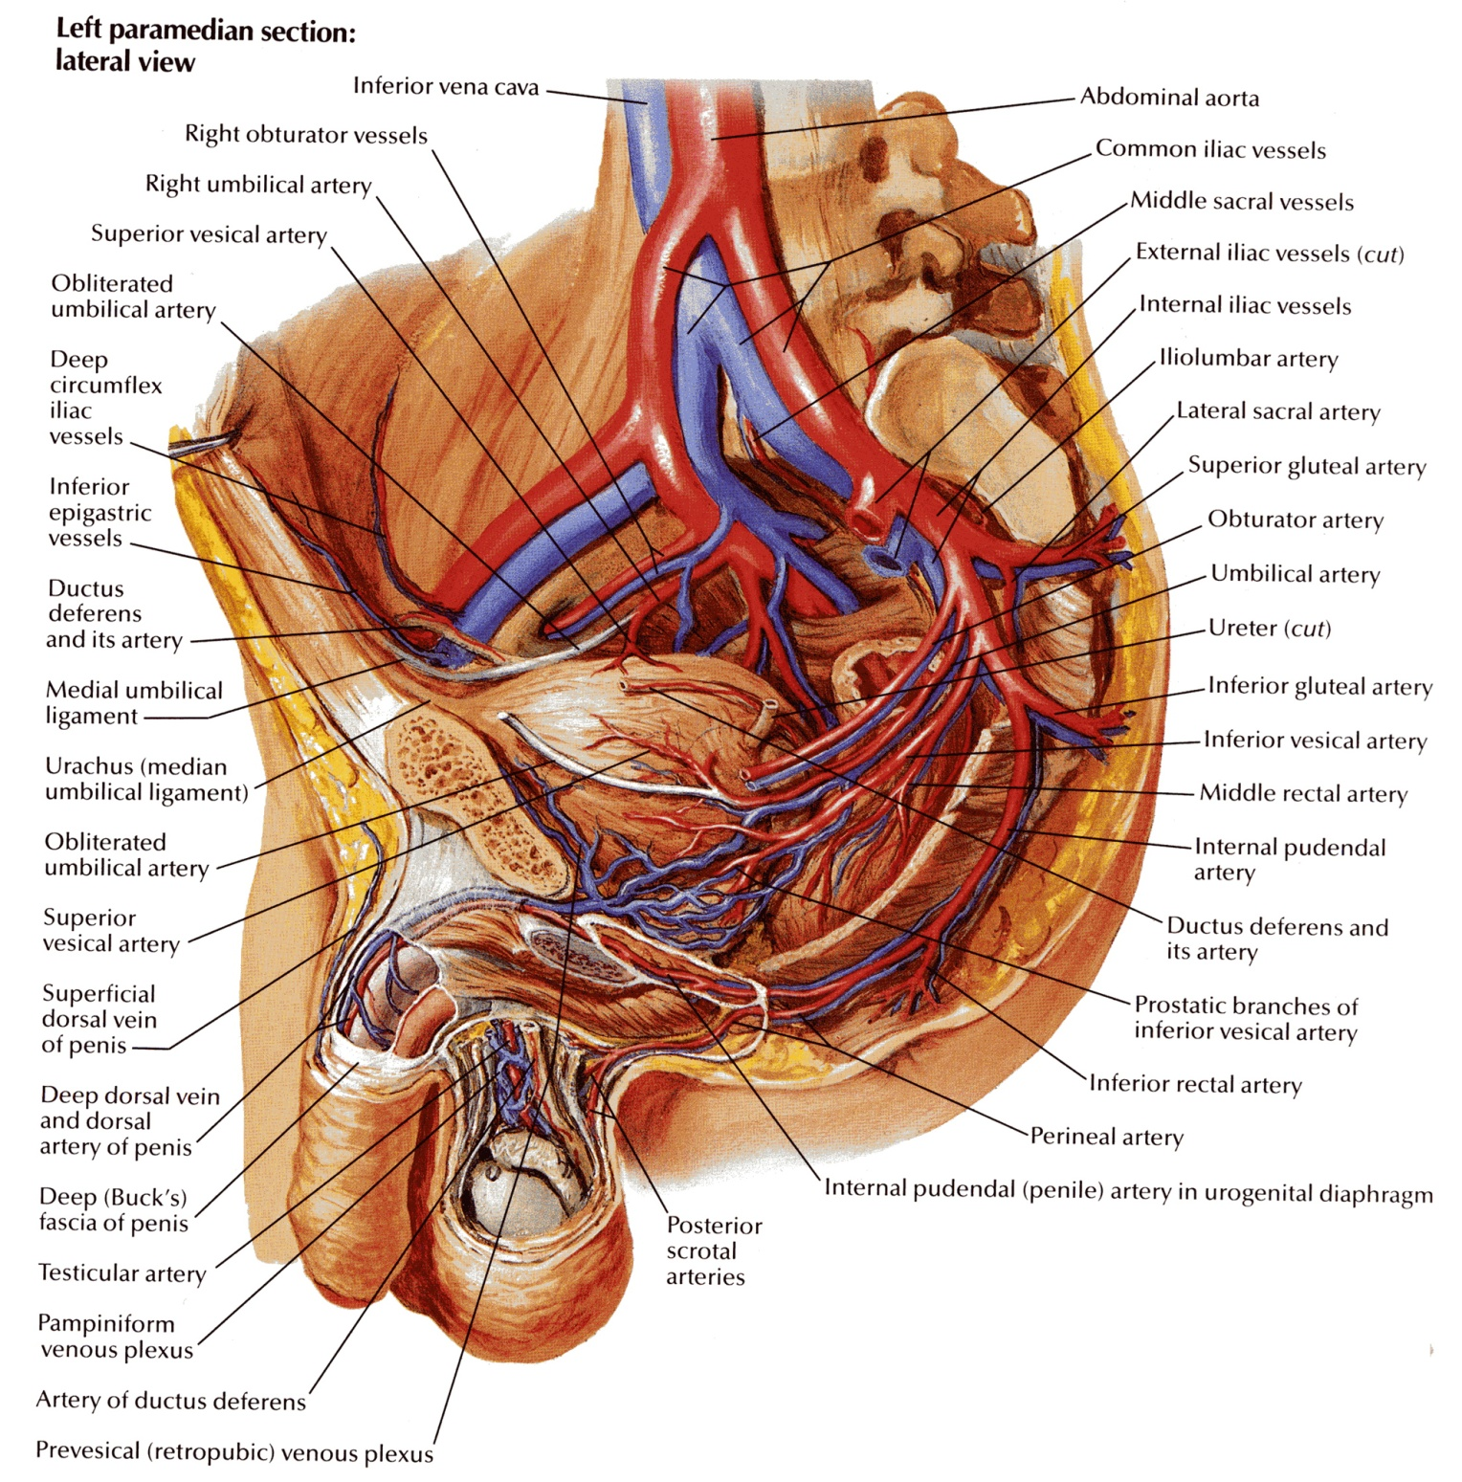
Supply of the Pelvis Venous Drainage
The veins correspond to the arteries.
1. Internal iliac veins:
It collect tributaries corresponding to the branches of the internal iliac artery.
joins the external iliac vein in front of the sacroiliac joint to form the common iliac vein (the common iliac veins join at the level of L5 to give the inferior vena cava).
2. Ovarian vein:
Right vein drains into IVC.
Left vein drains into left renal Vein.
Clinical point: There are venous plexuses around uterus, bladder, rectum…
Their importance is that they can drain to vertebral venous plexuses
So venous blood can shift to vertebral venous plexuses ascend through foramen magnum then to occipital sinus in cranium
That means if there is cancer in either uterus, bladder, rectum the metastasis reaches the brain quickly (faster than other places)

Slide 21
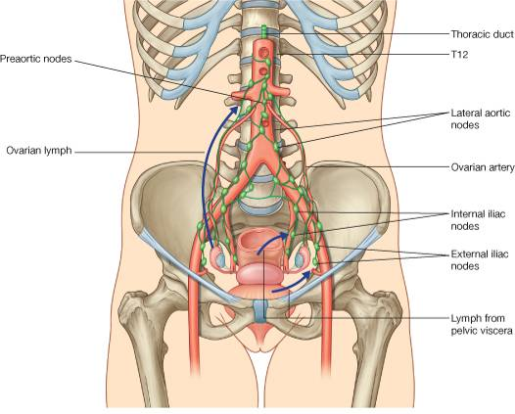
Supply of the Pelvis Lymphatic Drainage
The lymph nodes and vessels are arranged in a chain along the main blood vessels.
Thus, there are external iliac nodes, internal iliac nodes, and common iliac nodes.
Lymph from Common iliac nodes & the (Ovaries, uterine tubes & fundus of uterus) passes to Lateral aortic (paraortic) nodes which then passes to cisterna chyli (thoracic duct)

Slide 22
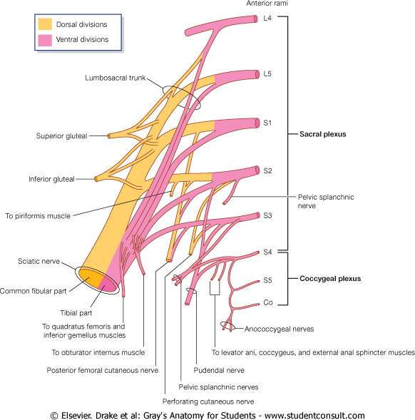
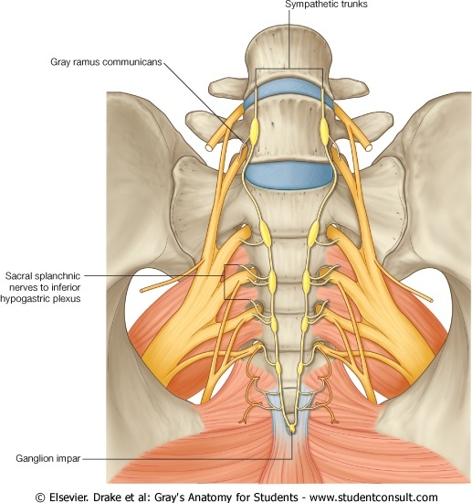
Supply of the Pelvis Nerve Supply
Nerve Supply
Somatic | Autonomic
Sacral plexus: from ventral (anterior rami) of L4 & L5 (lumbosacral trunk) + S1, S2, S3 and most of S4. It gives pudendal nerve to perineum. | Sympathetic: Pelvic part of sympathetic trunk: It is the continuation of the abdominal part of sympathetic trunk. It descends in front of the ala of the sacrum. The 2 sympathetic trunks unite inferiorly in front of the coccyx and form a single ganglion (Ganglion Impar). Superior & Inferior Hypogastric plexuses | Parasympathetic: Pelvic splanchnic nerves (From S 2 , 3 & 4): preganglionic fibers to pelvic viscera & hindgut

Slide 23
MCQs
1-The bony pelvis is composed of four bones :
A-are connected by 3 joints and lined by 4 muscles.
B-are connected by 4 joints and lined by 3 muscles.
C-are connected by 4 joints and lined by 4 muscles.
D-are connected by 2joints and lined by 8 muscles.
6- A 28 year old women ,school teacher from Dublin had a positive pregnancy test. Her obstetrician informed her that it is impossible for her to deliver normally because of the type of her bony pelvis , which of the following types of pelvis can have normal vaginal delivery?
A- Gynecoid Pelvis
B- Android Pelvis
C- Anthropoid Pelvis
D- Platypelloid Pelvis
2-The Sacroiliac joints is :
A- Anteriolateral cartilaginous join
B-posteriomedial cartilaginous joint
C- posteriolateral Synovial joint
D- Anteriomedial Synovial joint
7-No muscles are found in :
A- The anterior pelvic wall B- The posterior pelvic wall
C- The lateral pelvic wall D- The medial pelvic wall
3- The False pelvis is bounded by :
A- T11 B-C6 C-L1 D-S2
8-Which of the following is true about the piriformis muscle :
A- Origin from the Inner surface of the obturator membrane and the hip bone.
B- inserted in the pelvic surface of the middle 3 sacral vertebrae.
C- Supplied by the lumber plexus.
D- leaves the pelvis through the greater sciatic foramen.
4- Which of the following is true about the PELVIC INLET:
A- Bounded Posteriorly by the Coccyx
B- Bounded Anteriorly by the Ileopectineal (arcuate) lines.
C- Bounded lateraly by the Promontory of sacrum
D-Bounded posteriorly by the ala of sacrum.
9-Which of the following is true about the PELVIC DIAPHRAGM :
A- It is incomplete posteriorly to allow
passage of the anal canal.
B- it forms the INFERIOR PELVIC WALL.
C- Main (true) pelvic cavity below it.
D- formed by the levator ani and the coccygeus muscles without their covering
fasciae.
5-Which of the following is a female of the pubic arch angle:
A- 45 B- 65 C-75 D- 85
Answers: 1-C, 2-C, 3-C , 4-D, 5-D, 6-A, 7-A, 8-D, 9-B.

Slide 24
MCQs
10. Which one the following fibers of Levatores Ani muscles considered as the intermediate part?
Pubococcygeus
Ischiococcygeus
Iliococcygeus
14. The right ovarian vein drains into:
Renal vein
Common iliac vein
Inferior vena cava
15. The relaxation of which of the following muscle fibers lead to defecation?
Pubococcygeus
Puborectalis
Coccygeus
11. The Nerve supply to the Coccygeus muscle:
Branches of 4th and 5th sacral nerves
Branches of pudendal nerve
both
12: The medial umbilical ligament results from?
Fibrosed umbilical vein
Fibrosed umbilical artery
Superior vesical artery
16. The ovarian artery originate from:
Uterine artery
Abdominal aorta
Internal iliac artery
17. Woman is undergoing hysterectomy and during the ligation of uterine artery which of the following will be endanger:-
Ureter
Urinary bladder
Ovarian artery
13. Which of the following arteries supply the urinary bladder in female :
Uterine artery
Inferior vesical artery
Vaginal artery
Answers: 10:C, 11:A, 12:B, 13:C, 14:C, 15:B, 16:B, 17:A

Slide 25
SAQs
Q1: A 14 years old patient was diagnosed with osteosarcoma in the distal femur 3 months after starting the treatment the doctor found that the tumor have metastasized to the right
hip bone.
A-What forms the LATERAL PELVIC WALLLATERAL :
It is formed by:
1- Part of the hip bone below the pelvic inlet,
2- Obturator internus and its covering fascia & the obturator fascia.
3- Sacrotuberous ligament.
4- Sacrospinous ligament.
B- What is the action of the Obturator internus muscle:
Action: Lateral rotator of the femur at the hip joint.
Q2: What is the nerve supply of levator ani muscles?
1. perineal branch of the fourth sacral nerve.
2. perineal branch of the pudendal nerve.
Q3: The arterial supply of urinary bladder in male and female are:
In male : superior vesical artery + inferior vesical artery
In female : superior vesical artery + vaginal artery
Q4: Define the anterior divisions of Internal Iliac Artery :-
Obturator Artery - Inferior Gluteal Artery - Vaginal Artery - Middle Rectal Artery - Internal Pudendal Artery - Uterine Artery - Inferior Vesical Artery - Umbilical Artery Gives: superior vesical artery and Artery of vas deferens.
Q5: Describe nerve supply of the pelvis :-
Somatic > Sacral plexus
Autonomic >
Sympathetic: Pelvic part of sympathetic trunk
Parasympathetic: Pelvic splanchnic nerves From S 2 , 3 & 4.

Slide 26
SUMMARY
Pelvis composed of 4 bones : | 2hip bones Sacrum & coccyx
Connected by 4 joints : | Symphsis pubis (Ant.) Sacrococcygeal (Post.) 2 sacroiliac joints (potserolateraly)
Divides into : | False pelvis which bounded by | True pelvis Which has : Pelvic inlet,outlet,and cavity
 | Post. : lumber vertebrae Ant. : lower part of abdominal wall Laterally : iliac fossa & iliacus ms. |  | Pelvic inlet | Pelvic outlet
 |  | Anteriorly | symphysis pubis
 |  | Posteriorly | 1. Promontry of sacrum 2. Ala of sacrum | coccyx
 |  | Laterally | Arcuate lines | Anterolaterally : ischiopubic ramus Psterolaterally : sacrotuberous ligament
Arterial supply : | internal iliac artery divides to: anterior ( gives parietal & visceral branches) Posterior ( gives parietal branches)
Venous drainage : | internal iliac vein & ovarian vein
Lymphatic drainage : | external, internal and common iliac node
Nerve supply : | somatic : sacral plexus Autonomic : 1. sympathetic( pelvic part of sympathetic trunk , Superior and inferior hypogastric plexus) 2.Parasympthatic : pelvic splanchnic nerve (S2,3&4)
Cartilaginous
synovial

Slide 27
Members:
Ashwaq Almajed
Ameera Niazi
Dania Alkelabi
Do'aa abdulfattah
Muneerah Alzayed
Nourah Al Hogail
Nouf Aloqaili
Sarah Alshamrani
Leaders:
Nawaf AlKhudairy
Jawaher Abanumy
Feedback
References:
1- Girls’ & Boys’ Slides
2- Greys Anatomy for Students
3- TeachMeAnatomy.com
anatomyteam436@gmail.com
@anatomy436

