Slide 1


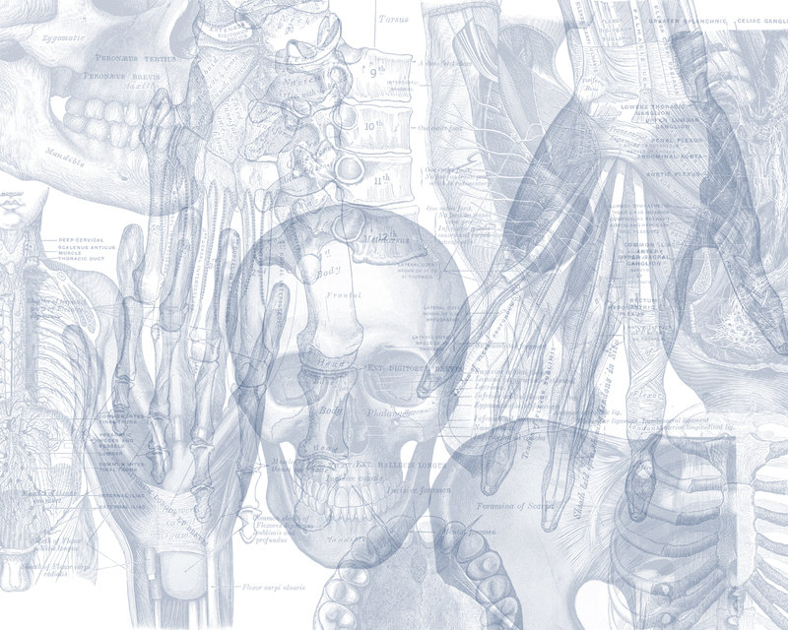


Male Reproductive System
Color Code
Important
Doctors Notes
Notes/Extra explanation
Please view our Editing File before studying this lecture to check for any changes.

Slide 2

Objectives
At the end of the lecture, students should be able to:
List the different components of the male reproductive system.
Describe the anatomy of the primary and the secondary sex organs regarding: (location, function, structure, blood supply & lymphatic drainage).
Describe the anatomy of the male external genital organs.
Great videos by AnatomyZone that give overview of the lecture →
03:45
07:10
03:46

Slide 3
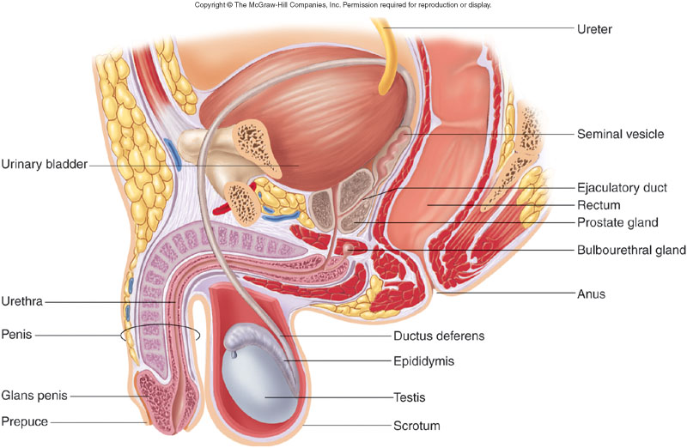
Components Of Male Reproductive System:
1. Primary Sex Organ:
Testis.
2. Reproductive Tract:
Epididymis.
Vas Deferens also called Ductus Deferens.
Spermatic cord.
3. Accessory Sex Glands:
Seminal vesicles.
Prostate gland.
Bulbourethral glands.
4. External Genitalia:
Penis
Urethra
(the vas deferens passes through it)
Components Of Male Reproductive System

Slide 4
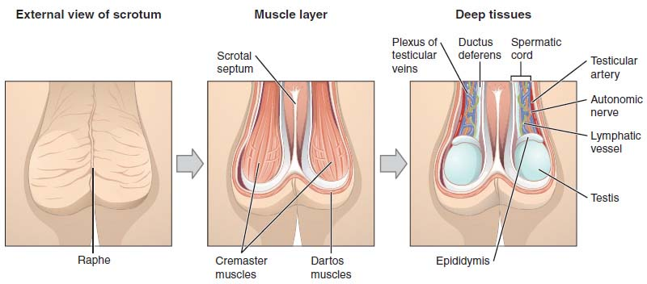
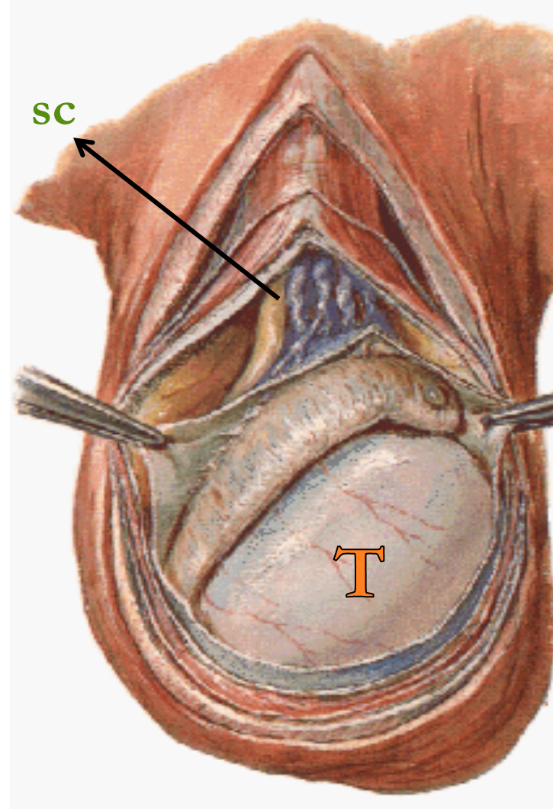
Scrotum
An out pouching of loose skin & superficial fascia.
The left scrotum is slightly lower than the right.
Functions:
  Houses and protects the testis.
  Regulates testicular temperature (no superficial fat).
  It has thin skin with sparse hairs and sweat glands.
  The Dartos muscle lies within the superficial fascia and replaces Scarp’s fascia* of the anterior abdominal wall.
*The fascia of Scarpa is the deep membranous layer (stratum membranosum), of the superficial fascia of the abdomen. It is a layer of the anterior abdominal wall. It is found deep to the Fascia of Camper and superficial to the external oblique muscle.
Extra
Testes
Testis or Testicle (singular), Testes (plural).
Paired almond-shape gonads that suspended in the scrotum by the spermatic cord.
Volume: about 20-25 ml / Length: 4 - 5 cm long / Weigh (10.5 – 14 g.).
Functions: exocrine & endocrine
  Spermatogenesis (primary sex organ).
  Hormone production: (Androgens--testosterone).

Slide 5
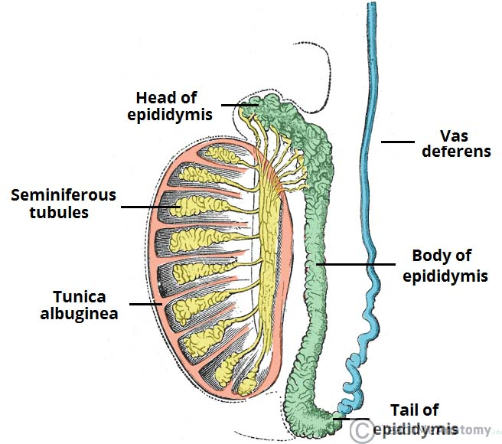
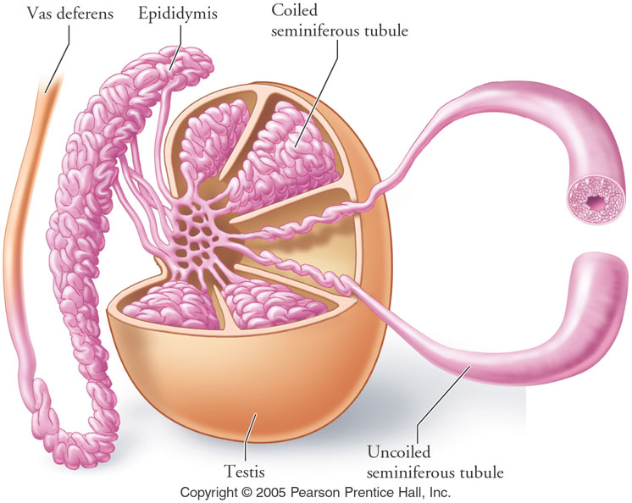
Testes
Coverings & Internal Structures
Coverings | Internal structure
1. Tunica Vaginalis: outer Peritoneal covering, formed of parietal and visceral layers. It surrounds testis & epididymis. It allows free movement of testis within the scrotum. | Fibrous septae extend from the capsule, dividing the testis into (200-300) lobules (average 250). Each lobule contains, (1-3) seminiferous tubules. Seminiferous tubules: (Each is a 60 cm coiled tubule). They are the site of spermatogenesis. They form the bulk (حجم) of testicular tissue. In between the seminiferous tubules lies the Interstitial cells of Leydig which secret Testosterone. Rete testis: A network of tubules. It is the site of merging of the Seminiferous tubules.
2. Tunica albuginea: inner It is a whitish fibrous capsule.
Extra
Tunica vaginalis

Slide 6
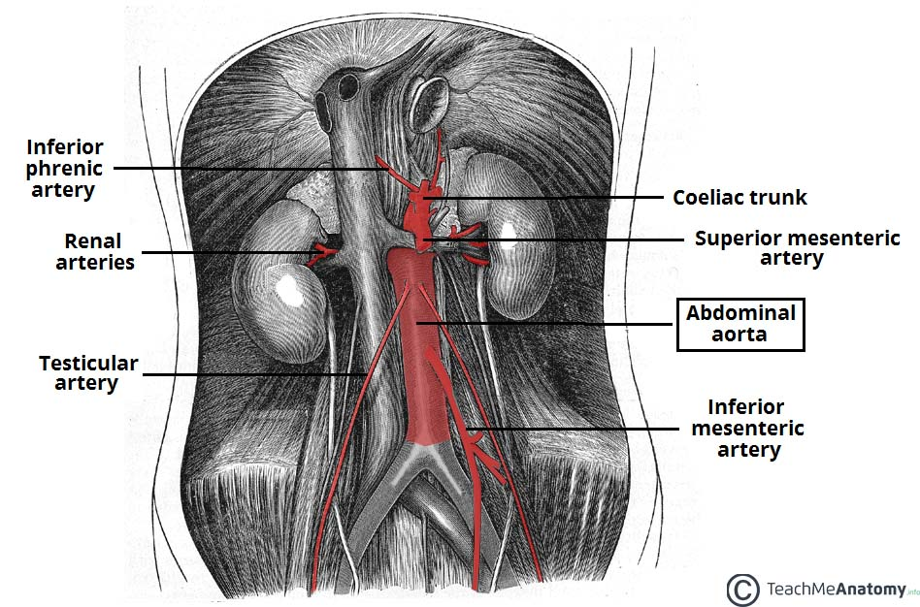
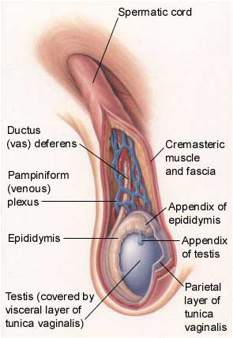
Testes
Supply
Arterial Supply | Testicular artery: It arises from the abdominal aorta at the level of L3.
Venous Drainage | Pampiniform plexus of veins: About dozen (12) veins which forms a network within the spermatic cord. They become larger as they approached the inguinal canal and converge (join) to form the Testicular vein: Right Vein drains into IVC. Left Vein drains into left renal vein.
Lymphatic Drainage | Testicular Lymphatics: Follow arteries and veins of the testis: End in Lumbar (par aortic) nodes. Scrotum, Penis and Prepuce (discussed in last slide): Terminate in Superficial inguinal nodes.
Extra

Slide 7
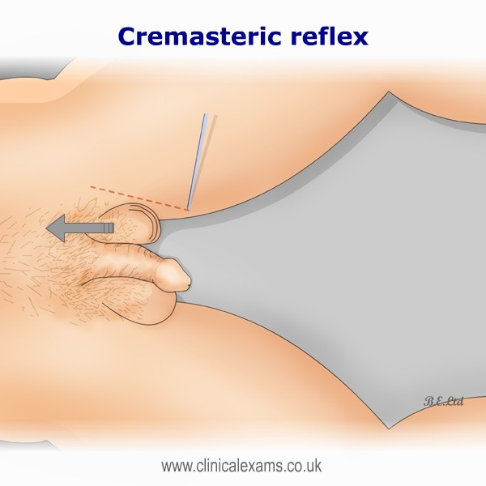
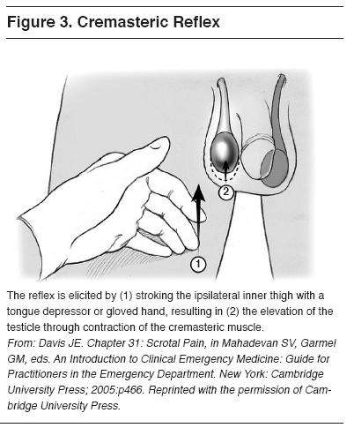
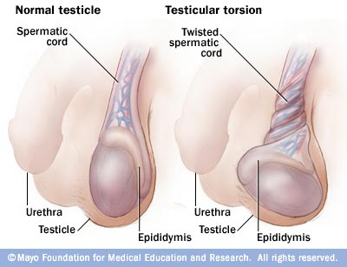
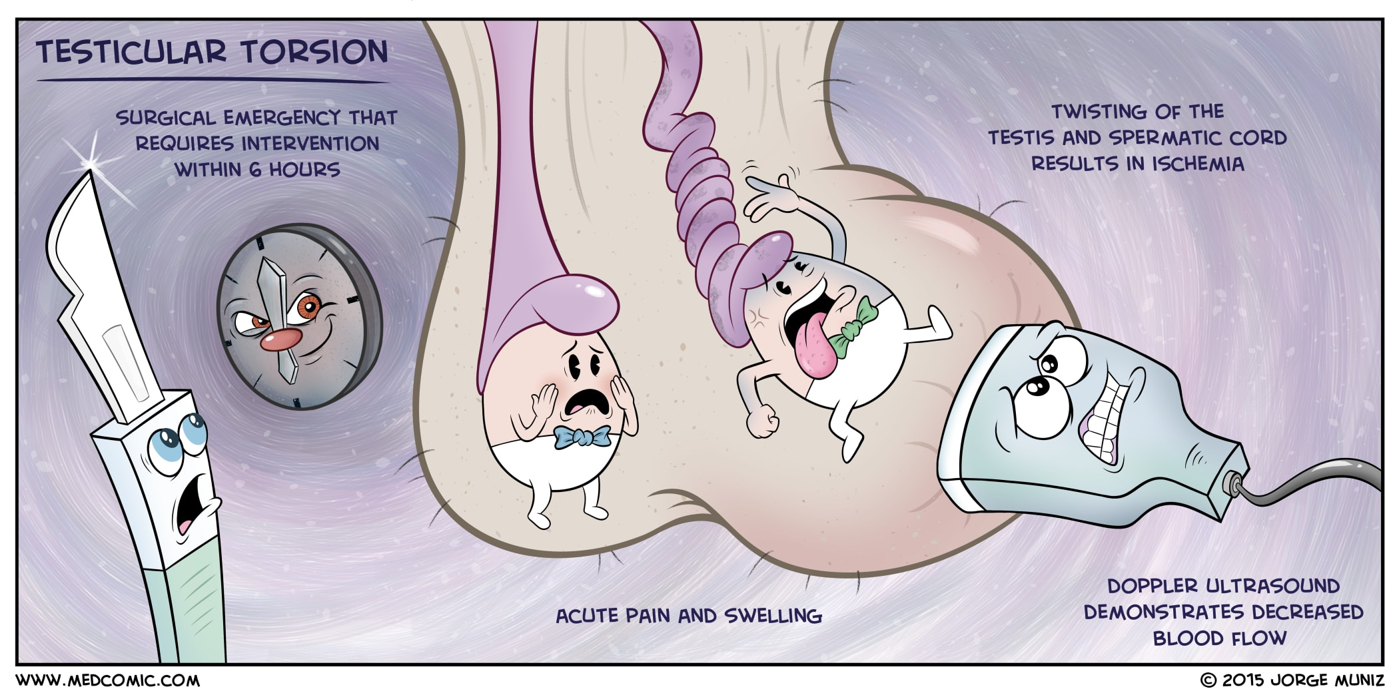
Cremasteric reflex
Indication | Evaluation of testicular pain* in case of (Testicular Torsion).
Technique | Examiner strokes or pinches the skin in the upper medial thigh. It causes contraction of the cremasteric muscle.
Observation | Rise of the Testicle on same side (normal) → +ve
Interpretation | NORMAL: It is present with Epididymitis.
 | ABSENT: (no Testicle rise), Is Suggestive of TESTICULAR TORSION. (Also absent in 50% of boys under age 30 months)
Do not use this test under age of 30 months (as the muscle has not fully developed yet).
Efficacy | Test Sensitivity for Testicular Torsion: 99% Assumes age over 30 months
Nerve involved | Genitofemoral (GFN), ( L 1, 2)
 | Sensory: Femoral branch of (GFN) & Ilioinguinal n. | Motor: Genital branch of (GFN).
*Epididymitis & testicular torsion have similar presentation so to differentiate between them we test the cremasteric reflex. If present = epididymitis & if its absent then = testicular torsion.
Testicular torsion occurs when the spermatic cord twists, cutting off the testicle's blood supply.
Extra

Slide 8
Epididymis
Shape | It is a single coiled tubule. 6 Meters long.
Location | the superior and posterior-lateral margins of the testis.
Divided into 3 parts | The Head receives efferent ductules from the testis (rete testis). Body The Tail is continuous with Vas Deferens.
Functions | Secretes and absorbs the nourishing fluid. Recycles damaged spermatozoa. Stores spermatozoa up to 2 weeks to allow for physiological maturation of sperms
head
Vas deferens
body
Tail

Slide 9
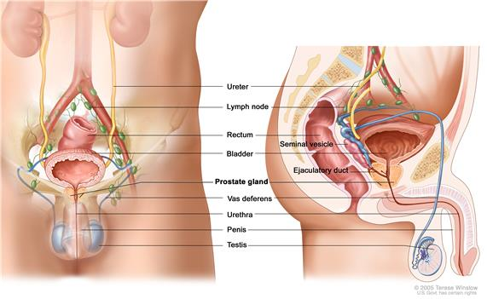
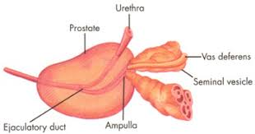
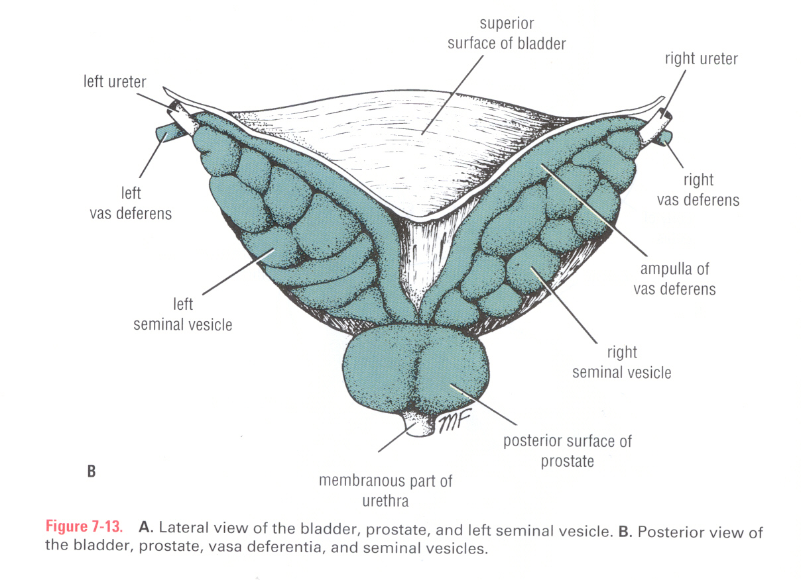
Vas Deferens
Shape
It is a muscular tube 45 cm long.
Function
Carries sperms from the epididymis to the pelvis.
Extra
Course
Passes through the inguinal canal as one of the contents of the spermatic cord . It crosses the lower end of the ureter*. Its terminal part is dilated to form the Ampulla of the vas deferens on the base of the urinary bladder. It joins the duct of the seminal vesicle to form ejaculatory duct which opens into the prostatic urethra.
*During vasectomy the surgeon may accidently cut it. (Remember in the female the ureter crossed the uterine artery.)
Vasectomy: Vasectomy is a surgical procedure for male sterilization or permanent contraception. During the procedure, the male vas deferens are cut and tied or sealed so as to prevent sperm from entering into the urethra and thereby prevent fertilization.
Ejaculatory Duct
Formed by the union of the lower end of the vas deferens and the duct of the seminal vesicle. Its length is about 2.5cm. The 2 ejaculatory ducts open into the prostatic urethra on both sides of the seminal colliculus. They drain the seminal fluid into the prostatic urethra.

Slide 10
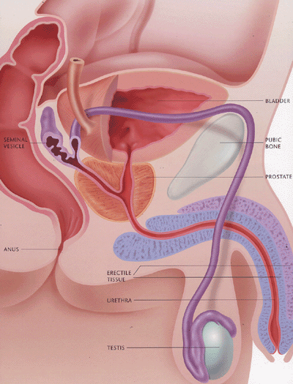
Accessory Sex Glands
Accessory Glands
1-Seminal vesicle. 2-Prostate. 3-Bulbourethral or Cooper’s glands
Functions | Secretion of the seminal fluid. Nourishing, activation of the sperms. Protection of the sperms.
1. Seminal Vesicles
Shape | Paired elongated glands (SV).
Location | posterior & inferior to the urinary bladder. Lies lateral to the vas deference.
Function | Secrete (60% of seminal fluid).
Base of the urinary bladder
Seminal vesicle
Vas deferens
prostate

Slide 11
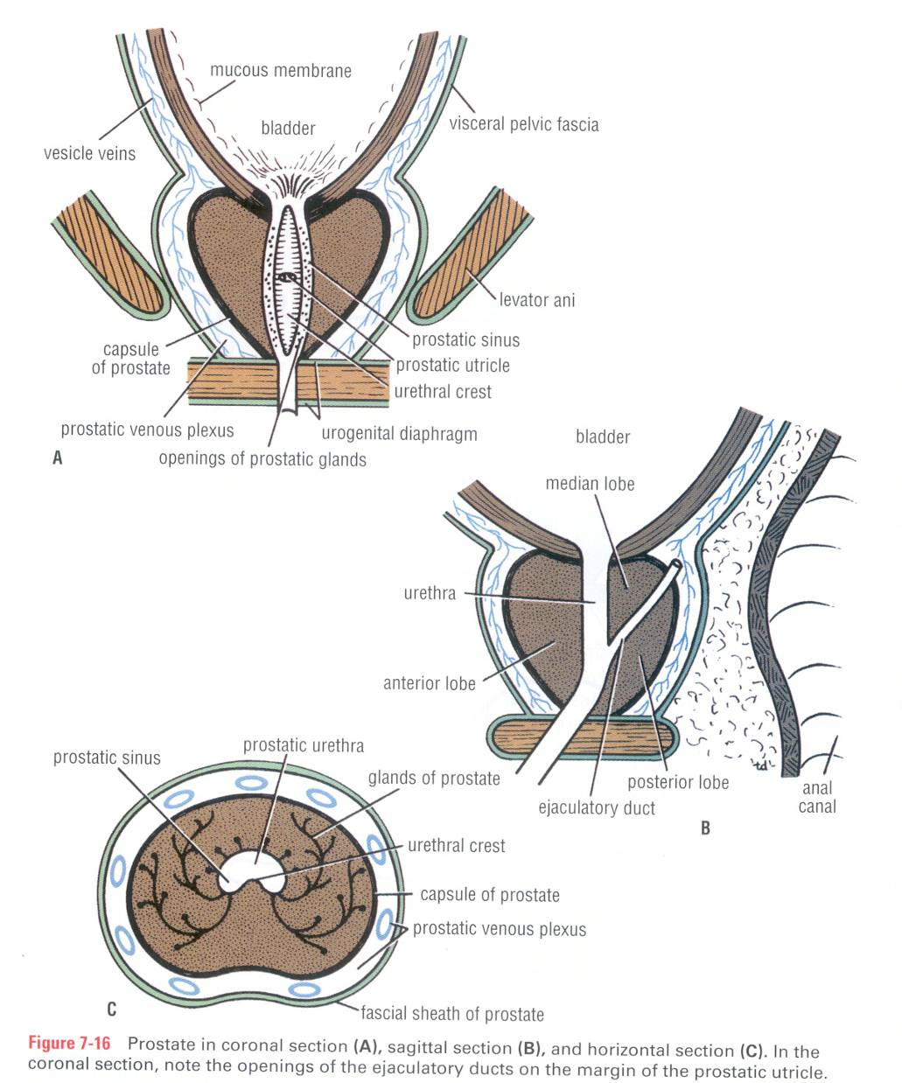
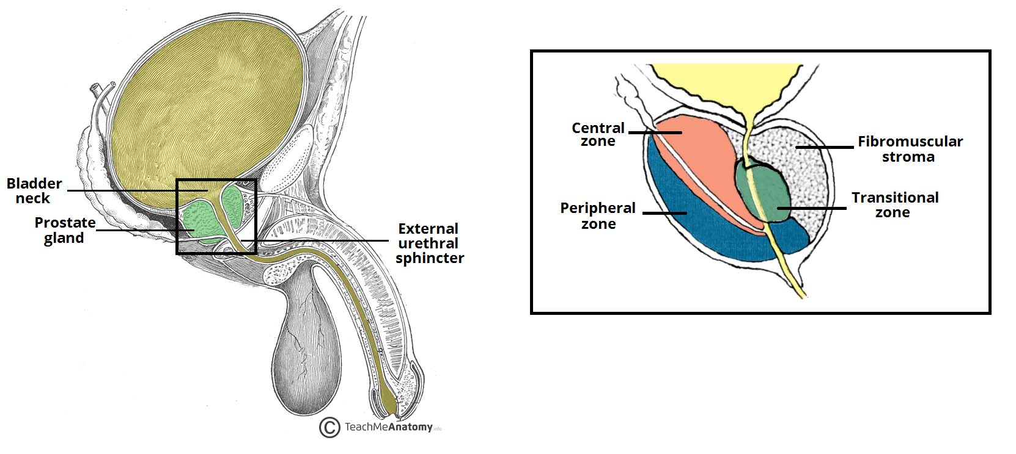
Accessory Sex Glands
2. Prostate Gland
Definition | The Largest male accessory gland. It is fibromuscular glandular tissue. It is a walnut (عين الجمل) size gland.
Location | It is located below the neck of bladder. It is traversed by the prostatic urethra.
Shape: CONICAL | Base (superior): Attached to neck of urinary bladder.
 | Apex (Inferior), rests on the Urogenital diaphragm.
 | Four Surfaces: Anterior, posterior and 2 lateral (Right & Left) surfaces.
Function | It secretes (20-30% of seminal fluid.) It secretes enzymes (acid phosphatase) which has the following functions: Aid in activating sperm motility. Mucus degradation. Antibiotic Neutralize the acidity of urine & female reproductive tract (Alkaline fluid).
Coronal section
Sagittal section
Horizontal section
Extra

Slide 12
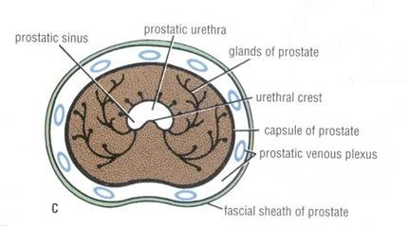
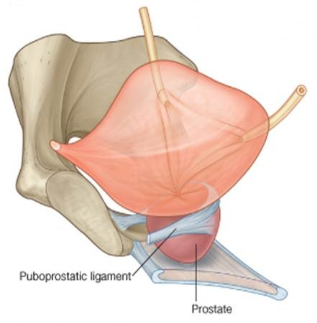
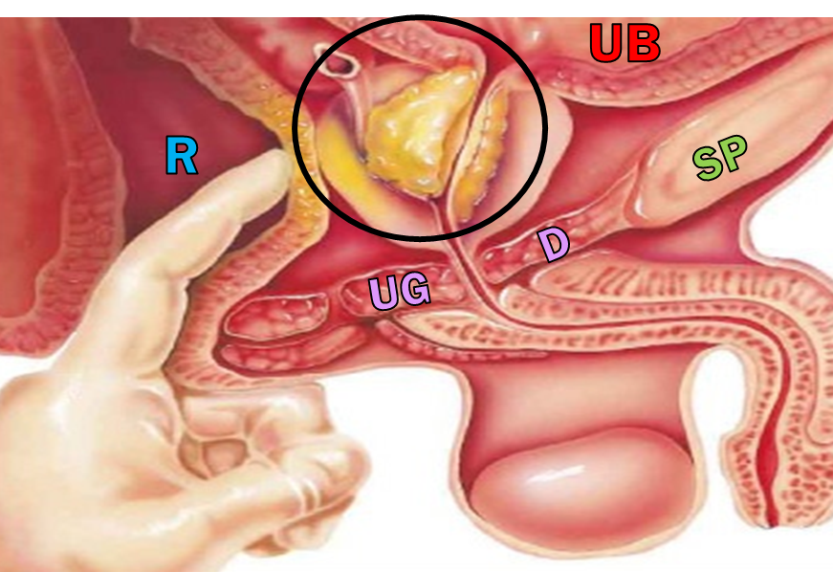
2. Prostate Gland
Capsule |  | Internally, it has a dense fibrous capsule (prostatic capsule), which is surrounded from outside (externally) by a fibrous prostatic sheath. The later (sheath) is continuous with the puboprostatic part of the levator ani muscle, (levator prostate). In between the prostatic capsule and the prostatic facial sheath lies the prostatic venous plexus.
Relations | Anterior | Symphysis pubis.
 | Posterior | Rectum (important for per rectal examination)
 | Superior | Neck of the bladder
 | Inferior | Urogenital diaphragm
 | Lateral | Medial margins of levator ani muscles (levator prostate)

Slide 13
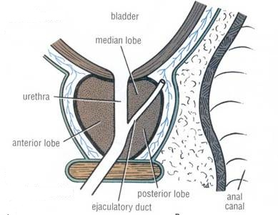
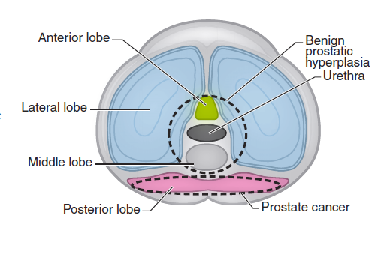
ANATOMICALLY = 5 Prostate lobes Relations to the urethra
Anterior lobe (isthmus) | Lies anterior to the urethra (fibromuscular)
Posterior lobe | Posterior to the urethra and inferior to the ejaculatory ducts.
Two lateral lobes | On each side of the urethra.
Middle (median) | Between the urethra and ejaculatory ducts & closely related to neck of urinary bladder. Usually it projects into lumen of the bladder it elevates fold of mucous membrane (uvulae vesicae) distorting the internal urethral sphincter, after the age of 40 years. The median & the 2 lateral lobes are rich in glandular tissue.
Urologists & Sonographers
They divide the prostate into Peripheral and Central (Internal) zones. The Central zone is represented by the Middle lobe. Within each lobe are four lobules, which are defined by the ducts and connective tissue
Extra

Slide 14
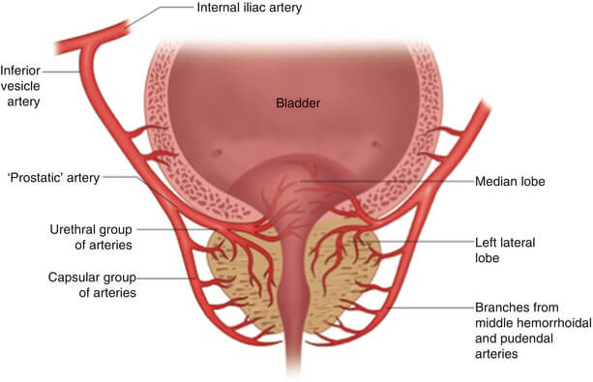
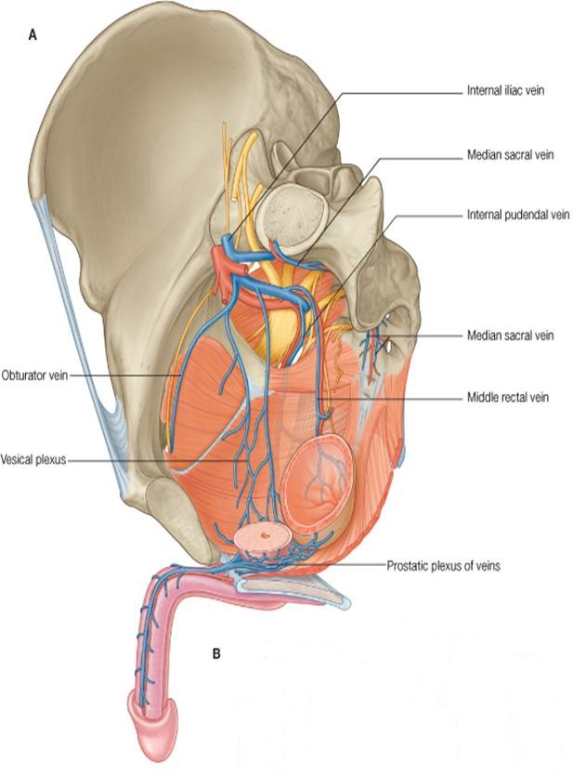
Prostatic Supply
Arterial supply | Inferior vesical artery from Internal Iliac Artery.
Venous plexus | Lies between the prostatic fibrous capsule and the prostatic sheath. It drains into the internal iliac veins. It is continuous superiorly with the vesical venous plexus (VVS) of the urinary bladder and posteriorly to the internal vertebral venous plexus (IVVP). Important for cancer & metastasis: prostate cancer can easily metastasize to the brain and vertebral column through these venous plexus.
Lymph drainage | Internal iliac lymph nodes.
VVS

Slide 15
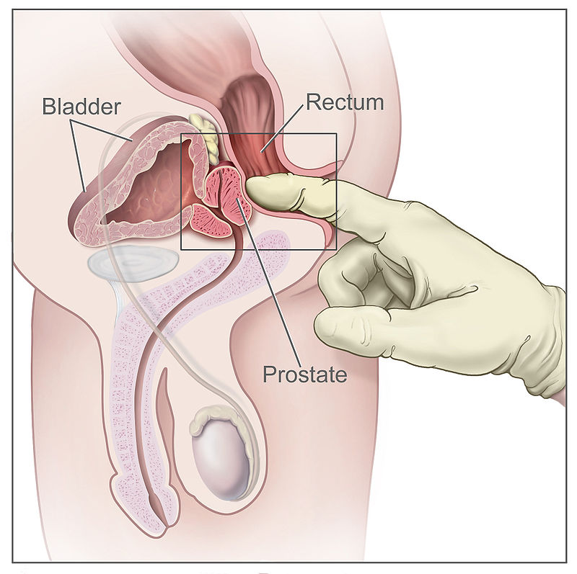
Hypertrophy of the Prostate
 | Benign | Malignant (prostatic carcinoma)
Age | Common after middle age | common after the age of 55
Metastasis | Does not metastasize | Lymphatic spread: metastasize first to internal iliac & sacral lymph nodes Venous spread: Later to distant nodes , bone & brain through (IVVP)
Relation to urethra | An enlarged prostate projects into the urinary bladder and distorts the prostatic urethra. | It can cause obstruction to urine flow because of its close relationship to the prostatic urethra
Notes | The middle lobe often enlarges and obstructs the internal urethral orifice, this leads to Nocturia, Dysuria, Frequency and Urgency | The malignant prostate is felt hard & irregular in Per- rectal examination (PR).
Extra

Slide 16
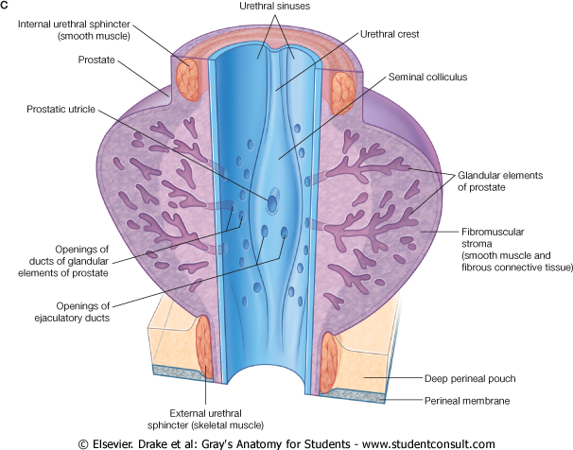
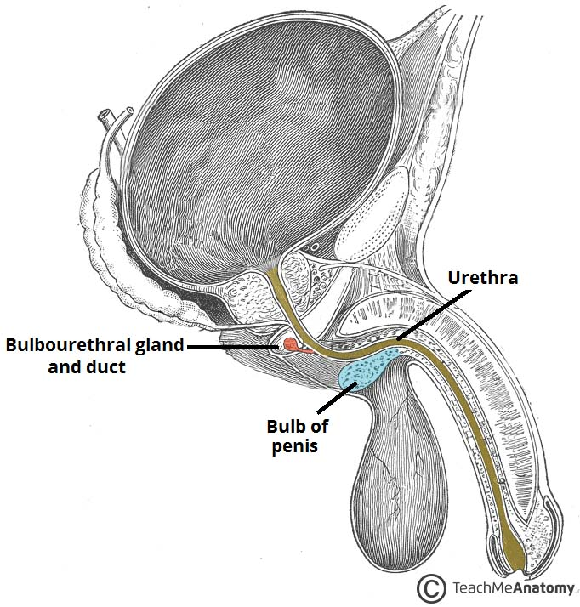
Prostatic Urethra
Structures seen on the posterior wall of the prostatic urethra:
Urethral crest:
A longitudinal elevated ridge.
Prostatic sinus: (Urethral sinus)
A groove on each side of the crest.
The prostatic gland opens into the prostatic sinus.
Prostatic utricle :
A depression on the summit of the urethral crest.
The ejaculatory ducts open on the sides of the utricle.
Seminal colliculus: a rounded eminence that opens into the prostatic utricle.
3. Bulbourethral or Cooper’s Gland
Shape | Small paired glands.
Location | Located at the base of the penis.
Function | Secrete alkaline mucus for: Neutralization of urinary acids &Lubrication.
prostate
urethra
Extra

Slide 17
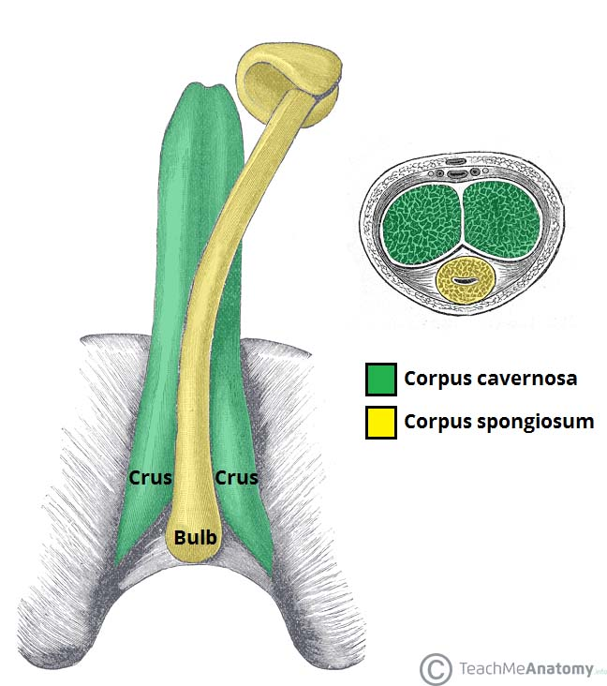
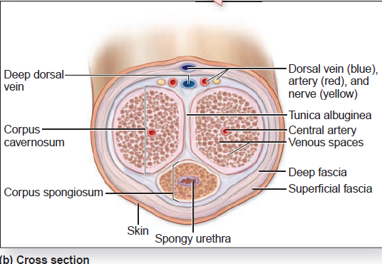
Penis
Corpus spongiosum
Excretory:
Penile urethra transmits urine & seminal fluid.
Copulatory:
Has (3) cylindrical masses of erectile tissue
  Two Corpora Cavernosa
  One Corpus spongiosum
A Copulatory (involved in sexual intercourse) & Excretory organ.
Corpora cavernosa

Slide 18
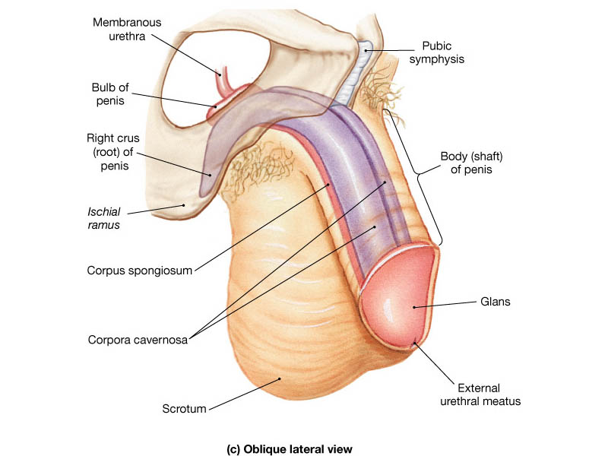
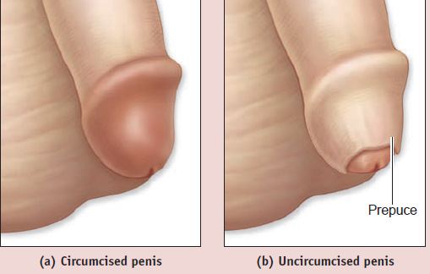
Penis
Erectile tissue
Corpora cavernosum | Corpora spongiosum
Two superior (right & left) masses of (Primary erectile tissue). They Provide the majority of rigidity & length of penis. Their posterior expansions, forms the 2 Crurae (anchor” tissue) against pelvic bone. | The single inferior mass (Secondary erectile tissue) It is traversed by the penile urethra. Its Anterior expansion forms the Glans penis. Its posterior expansion forms the bulb of the penis. Prepuce or foreskin: Fold of skin covering glans penis (before circumcision* ختان)
*In circumcision they cut this skin and reflect it on each side.

Slide 19
Summary
Primary Sex Organ | Reproductive Tract | Accessory Glands | External Genitalia
Testis | Epididymis | Seminal Vesicles | Penis
Function: Spermatogenesis & hormone production Suspended in scrotum* by spermatic cord Coverings: Tunica vaginalis Tunica albugenia Internal structures Seminiferous tubules Rete testis Supply: Arterial: testicular artery (from abdominal aorta) Venous: pampiniform plexus → testicular vein → IVC (right) & renal vein (left) Lymph: lumbar (paraortic) *scrotum: out pouching of loose skin, regulates testicular temperature. NO superficial fat but has dartos muscle in superficial fascia (replaces scarpa’s fascia) | Single coiled tube: Head: receives efferent ductules Body Tail: continuous with vas deferns Function: Stores spermatozoa & recycles and nourishes | Located posterior & inferior to urinary bladder | A Copulatory & Excretory organ. Has (3) cylindrical masses of erectile tissue: 2 Corpora Cavernosa: Primary erectile tissue Their posterior expansions: form crura Corpus Spongiosum: Secondary erectile tissue Traversed by the Penile urethra Anterior → glans Posterior → bulb
 |  | Prostate Gland
 |  | Relations: Anterior: symphysis pubis Posterior: rectum Superior: neck of bladder Inferior: urogenital diaphragm Lateral: levator ani muscles Supply: Arterial: inferior vesical artery Venous: prostatic venous plexus → internal iliac veins Lymph: internal iliac nodes Openings: Prostate gland → prostatic sinus
 | Vas Deferens
 | Muscular tube Crosses ureter Joins seminal duct to form ejaculatory duct which opens into prostatic urethra at prostatic utricle.
 |  | Bulbourethral Gland
 |  | Located at the base of the penis

Slide 20
MCQs
1.The lymphatic drainage of the scrotum is:
A- Superficial inguinal nodes
B- Deep inguinal nodes
C- Paraaortic nodes
D- Testicular nodes
2.What is the male primary sex organ :
A-vas deference
B-penis
C- testes
D-prostate
3.The … of the Epididymis receives efferent ductules from the testis
A-Head
B-Body
C-Tail
D-vas deferens
4.Which of the following lies lateral to the Vas deferens?
A- Cowper's glands
B- Prostate
C -Seminal vesicle
D-rectum
5.Which of the following related anteriorly to the prostate gland?
A- Neck of the bladder
B- Symphysis pubis (SP).
C- Urogenital diaphragm
D- Rectum
6.the ejaculatory duct drained into which of the following?
A- prostatic utricle
B- prostatic cleft
C- prostatic sinus
D- urethral cleft
7.testicular artery arises from :
A- ascending aorta
B- arch of aorta
C- abdominal aorta at the level of L3
D- abdominal aorta at the level of L5
8. cremasteric reflex is used to diagnose:
A- testicular torsion
B- seminoma
C- prostatitis
D- benign prostatic hyperplasia
Answers:
A
C
A
C
B
A
C
A

Slide 21



Leaders:
Nawaf AlKhudairy
Jawaher Abanumy
Members:
Hamad alkhudairy
Majed alzain
Abdulrahman almalki
Talal alhoqail
Mohammed nuser
Feedback
References:
1- Girls’ & Boys’ Slides
2- Greys Anatomy for Students
3- TeachMeAnatomy.com
anatomyteam436@gmail.com
@anatomy436

