Slide 1
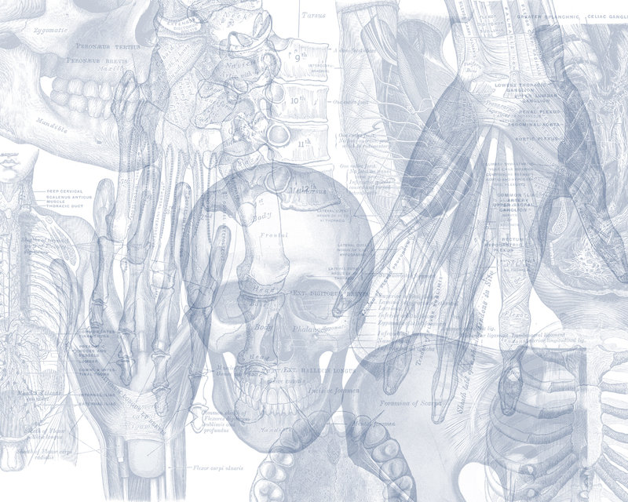
Anatomy of the Breast
Color Code
Important
Doctors Notes
Notes/Extra explanation
Please view our Editing File before studying this lecture to check for any changes.

Slide 2
Objectives
By the end of the lecture, the student should be able to:
Describe the shape and position of the female breast.
Describe the structure of the mammary gland.
List the blood supply of the female breast.
Describe the lymphatic drainage of the female breast.
Describe the applied anatomy in the female breast.

Slide 3
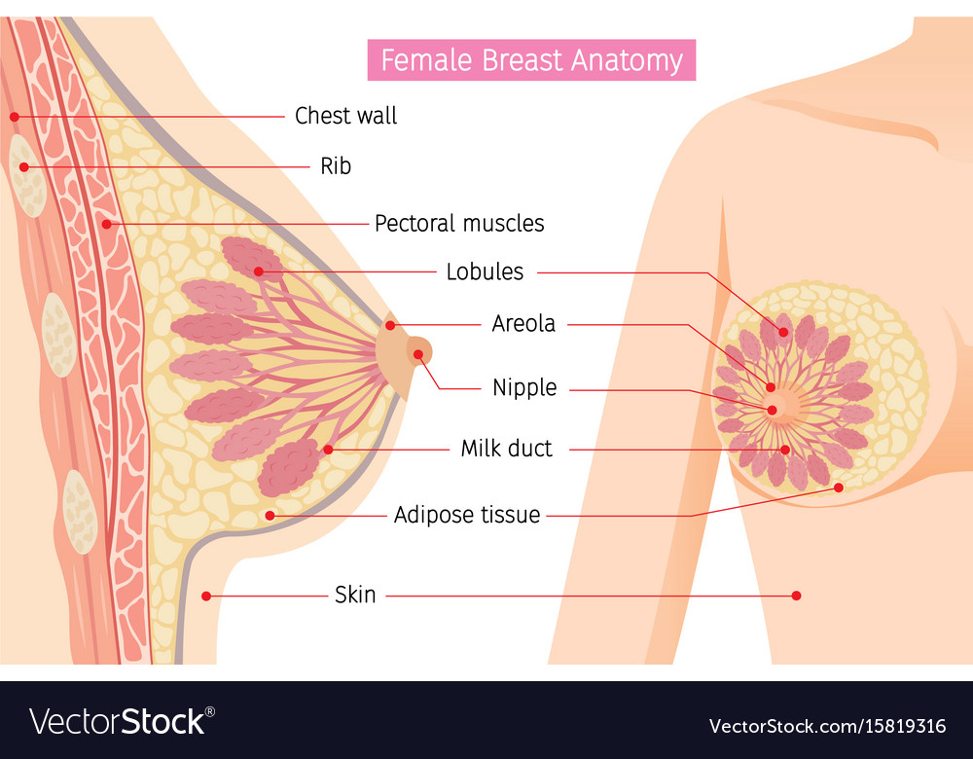
Introduction
Highly recommended →
06:26
Overview of the breast:
The breast (consists of mammary glands + associated skin & connective tissue) is a gland made up of lobes arranged radially (شعاعيا) around the nipple.
Each lobe is further divided into lobules. Between the lobes and lobules we have fat & ligaments called ligaments of cooper
These ligaments attach the skin to the muscle (beneath the breast) to give support to the breast.
Extra
Shape: it is conical* (مخروطي) in shape
Position: It lies in superficial fascia of the front of chest.
Parts: It has a:
Base → lies on muscles,
Apex → nipple (حلمة الثدي)
Tail → extend into axilla
*
Extra

Slide 4
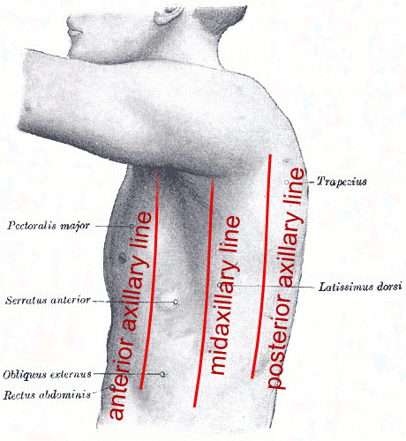
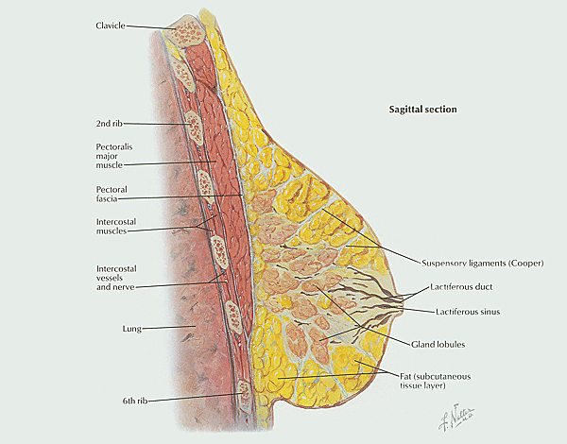
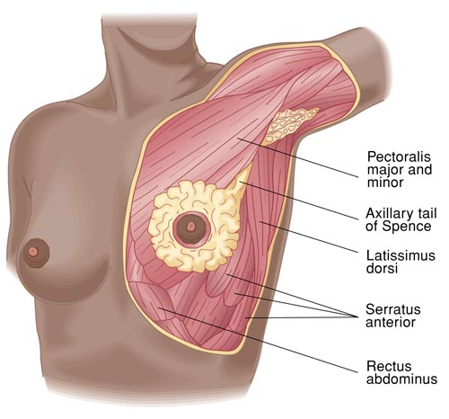
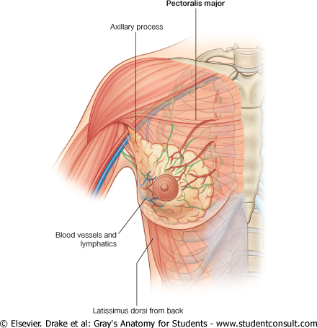
Position of Female Breast
Base
Nipple
Areola (حلقة ملونة)
Extends from 2nd to 6th ribs.
It extends from the lateral margin of sternum medially to the midaxillary line laterally.
It has no capsule.
It lies on 3 muscles:
2/3 of its base on → (1) pectoralis major* muscle,
inferolateral 1/3 on → (2) Serratus anterior & (3) External oblique muscles (muscle of anterior abdominal wall).
Its superolateral part sends a process into the axilla called the axillary tail or axillary process.
Extra
*The majority of the breast lies on pectoralis major.
Extra

Slide 5
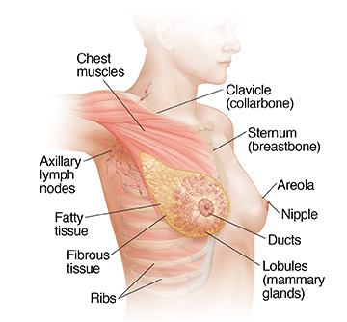
Position of Female Breast
Base
Nipple
Areola (حلقة ملونة)
Extra
It is a conical eminence that projects forwards from the anterior surface of the breast.
The nipple lies opposite 4th intercostal space. (normally this is in a woman who has not breast fed. The position is not constant & may change after breastfeeding)
It carries 15-20 narrow pores (openings) of the lactiferous ducts.
It is a dark pink brownish circular area of skin that surrounds the nipple.
The subcutaneous tissues of nipple & areola are devoid of fat.

Slide 6
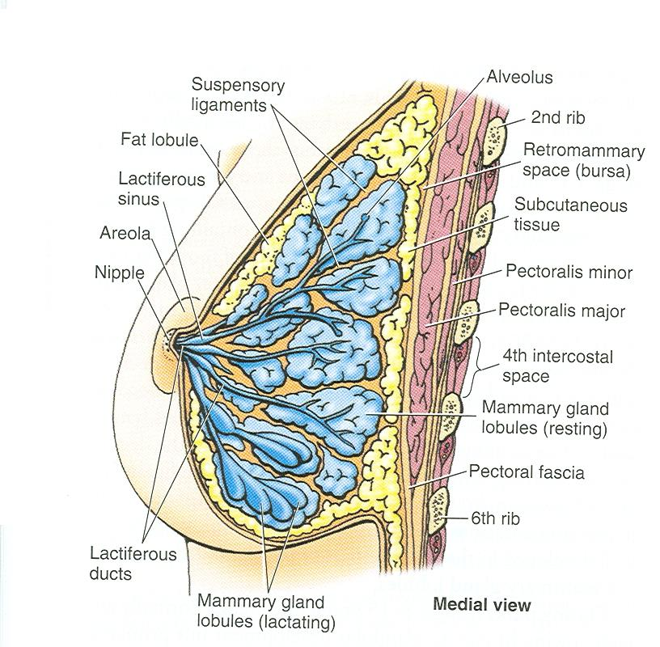
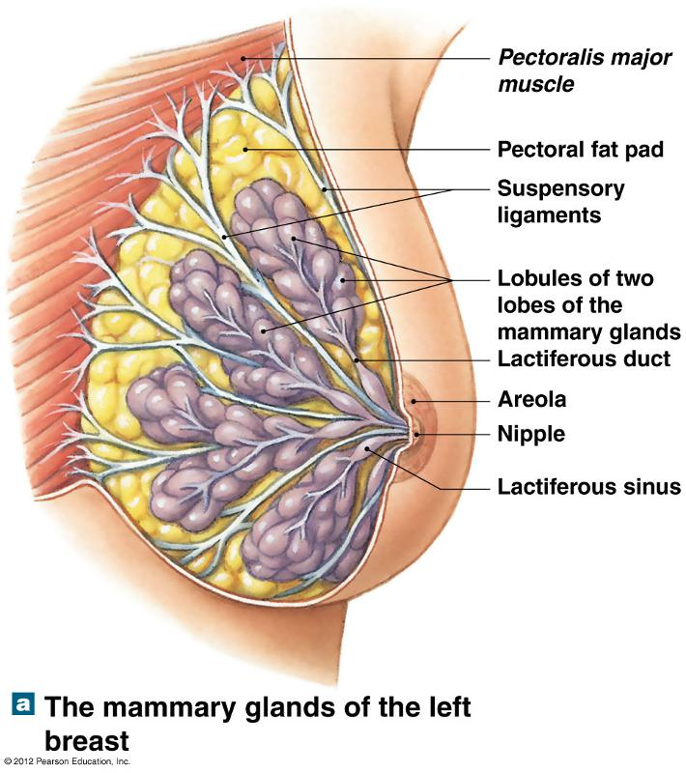
Structure of Mammary Gland
04:09
Capsule | It is non capsulated modified sweat gland.
Divisions | It is formed of 15-20 lobes and each lobe is formed of a number of lobules. The lobes and lobules are embedded in the subcutaneous fatty tissue of superficial fascia. The lobes and lobules are separated from each other by interlobar and interlobular fatty tissue & fibrous strands called ligaments of Cooper or suspensory ligaments. Importance? These ligaments run radially & give the breasts support by connecting the skin of the breast to the deep facia of underlying pectoralis muscle. Invasion of these ligaments causes peau d’orange.
Space | The gland is separated from the deep fascia of the underlying muscle (pectoralis major) by a layer of loose areolar tissue which forms the retromammary space. What is its Importance? (allows the breast to move freely).
Ducts | It has from 15-20 lactiferous ducts which open by the same number of openings on the summit (قمة) of the nipple. (each duct has its own opening)

Slide 7
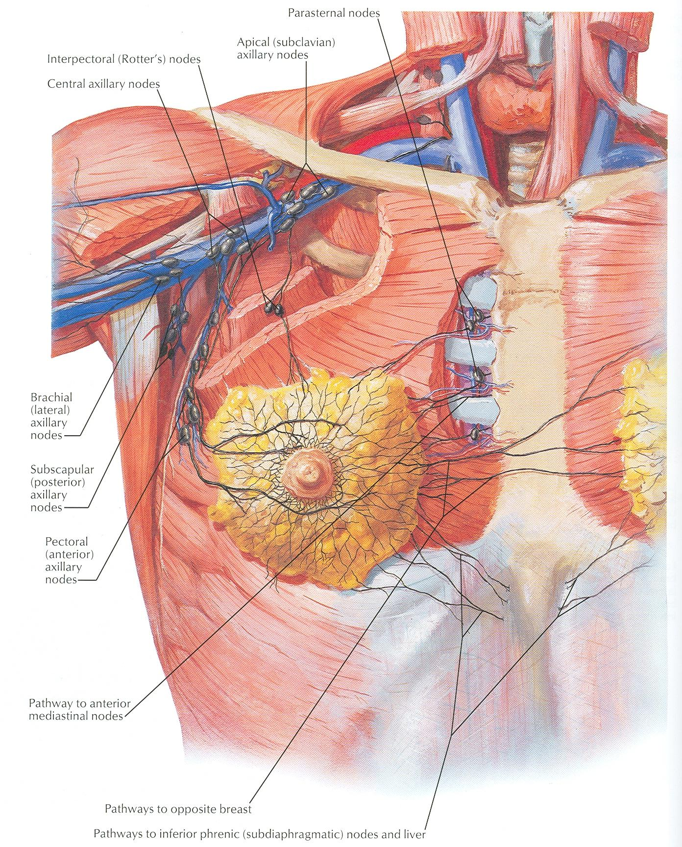
Female Breast Blood Supply
Arterial supply Important!
Venous drainage
Perforating branches and mammary branches of internal thoracic (internal mammary) artery.
Mammary branches of lateral thoracic artery.
Mammary branches of Intercostal arteries.
Veins are corresponding to the arteries.
Circular venous plexus are found at the base of nipple (called superficial venous plexus).
Finally, veins of this plexus drain into axillary* & internal thoracic veins.
*axillary vein continues as subclavian at level of the first rib

Slide 8
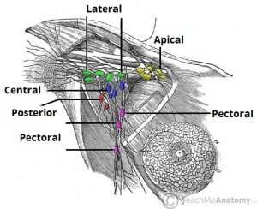
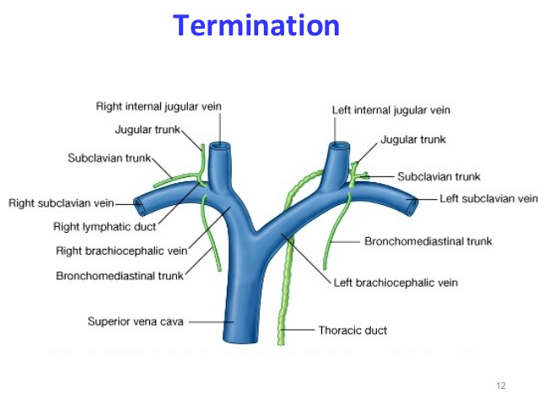
Axillary Lymph Nodes Important!
Before we talk about lymphatic drainage of the breast, lets see the axillary nodes since most of the breast drains into them.
They are arranged into 5 groups which lie in axillary fat:
Pectoral Group (Anterior) | Subscapular Group (Posterior) | Brachial Group (Lateral/ Humeral) | Central Group | Apical Group
Which lies on the pectoralis minor* along lateral thoracic vessels. | Which lies on posterior wall of axilla on lower border of subscapularis along subscapular vessels. | Lies on lateral wall of axilla along 3rd part of axillary vessels. | Lies in axillary fat at the base of axilla. They receive lymph from the pectoral, subscapular and humeral axillary lymph node groups. | Lies at apex of axilla. They receive lymph from the central axillary lymph nodes, therefore from all axillary lymph node groups.
All of them will go to: Subclavian lymph trunk: It is formed by union of efferent lymph vessels of apical group. On the right side, It usually opens in the subclavian vein (directly). On the left side it usually opens into the thoracic duct then into the left subclavian .
*Breast → pectoralis major
Axillary nodes → pectoralis minor
Extra
Extra
Extra

Slide 9
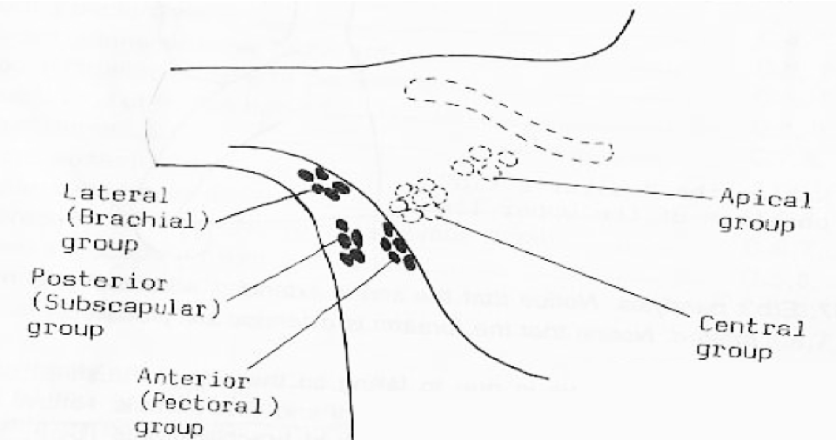
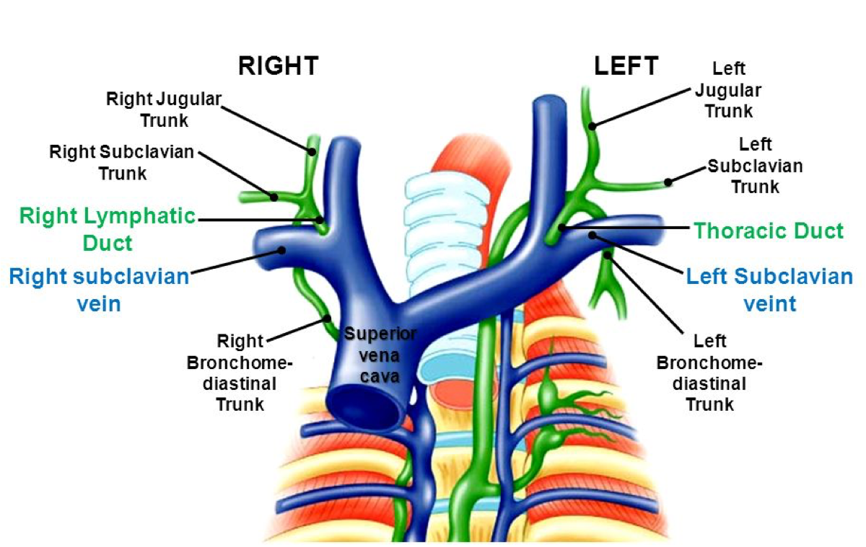
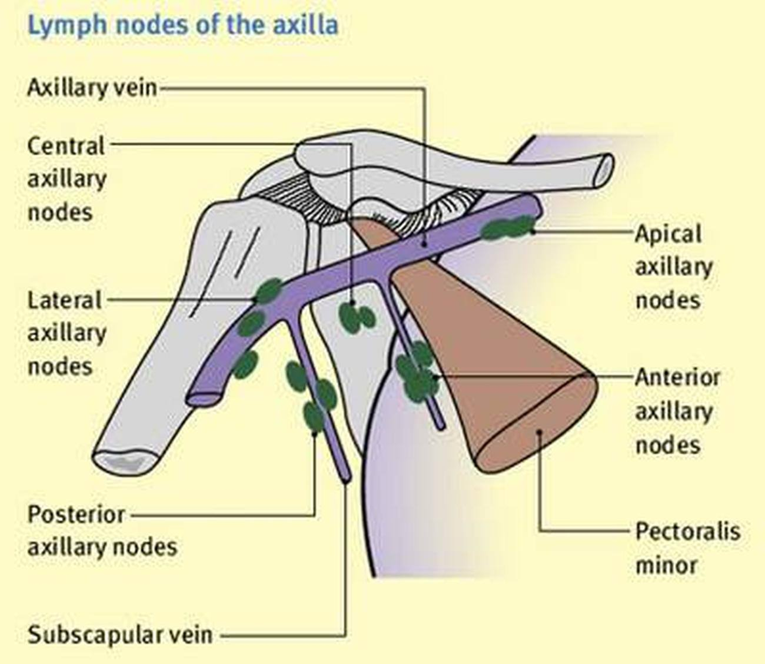
Axillary Lymph Nodes

Slide 10
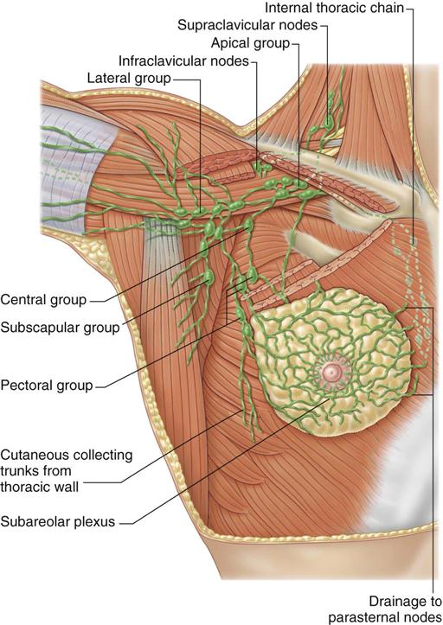
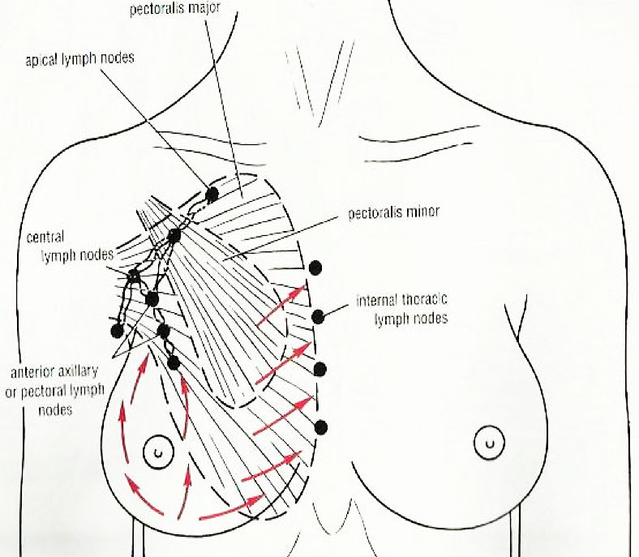
Female Breast Lymphatic Drainage of Breast
04:28
Lymphatic drainage
Subareolar lymphatic plexus:
Lies beneath the areola.
Deep lymphatic plexus:
Lies on the deep fascia covering pectoralis major.
Both plexuses radiate in many directions and drain into different lymph nodes (axillary groups (mainly) + internal thoracic lymph nodes).
Extra

Slide 11
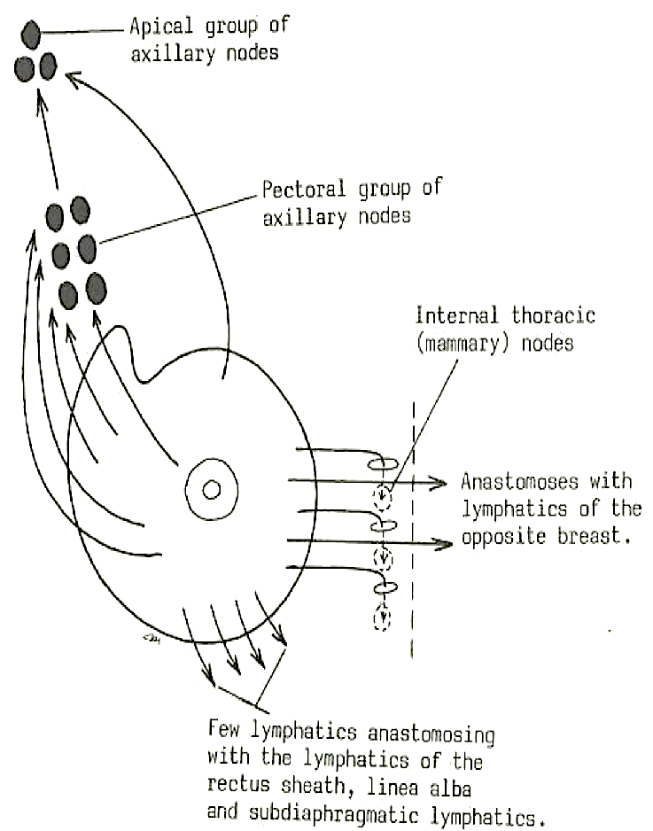
Female Breast Lymphatic Drainage
The breast is divided into parts (each has different drainage):
Gland Part | Drainage
Central & Lateral Parts | 75% drain into pectoral group of axillary lymph nodes then into apical
Upper Part | Drains into apical group (directly) of axillary lymph nodes.
Medial Part | Drains into internal thoracic (parasternal) lymph nodes, forming a chain along the internal thoracic vessels.
 | Some lymphatics from the medial part of the gland pass across the front of sternum to anastomose with that of opposite side. So cancer can spread from one breast to the other.
Inferomedial Part | Anastomose with lymphatics of rectus sheath & linea alba, and some vessels pass deeply to anastomose with the sub diaphragmatic lymphatics.

Slide 12
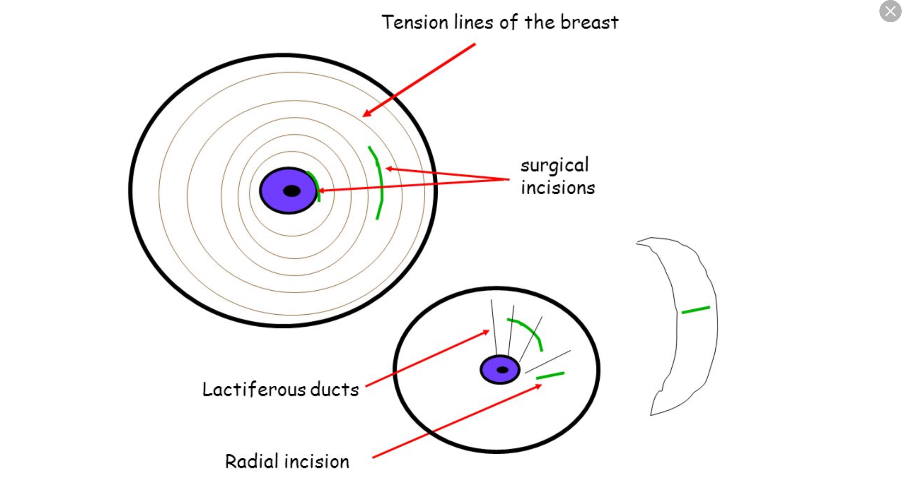
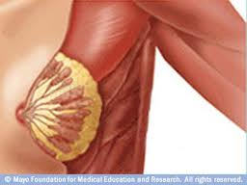
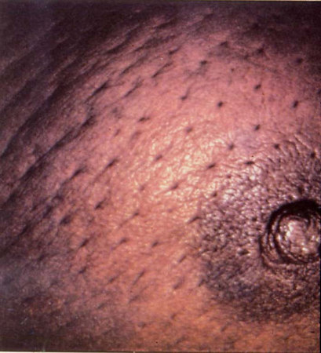
Applied Anatomy Important for SAQs
Breast Cancer
It is a common surgical condition.
60% of carcinomas of breast occur in the upper lateral quadrant (which goes to the pectoral group).
75% of lymph from the breast drains into the axillary lymph nodes.
In case of carcinoma of one breast, the other breast and the opposite axillary lymph nodes are affected because of the anastomosing lymphatics between both breasts.
In patients with localized cancer breast, a simple mastectomy (surgical removal of breast), followed by radiotherapy or chemotherapy to the axillary lymph nodes is the treatment of choice.
The lactiferous ducts are radially arranged (شعاعيا) from the nipple, so incision of the gland should be made in a radial direction to avoid cutting through multiple ducts.
Infiltration of the ligaments of Cooper by breast cancer leads to its shortening (so it pulls the skin inside) giving peau de’orange* (dimpling of skin) appearance of the breast.
* It is a French word meaning skin of orange

Slide 13
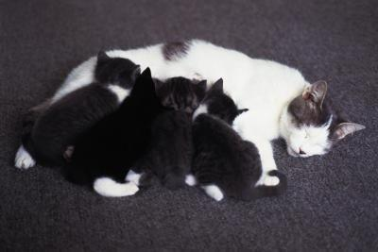
Mammary Ridge
Mammary ridge extends from the axilla to the groin (inguinal region).
In human, the ridge disappears EXCEPT for a small part in the pectoral region. (that’s why we have only 1 nipple on each side)
If some parts did not disappear the patient will have extra (accessory) nipples.
In animals (example: cats) it persists, so several mammary glands are formed along this ridge: and they have multiple nipples.

Slide 14
It has a base, apex and a tail. Base: extends from 2nd to 6th ribs. It extends from the sternum to the midaxillary line laterally. No capsule - 2/3 of its base lies on the pectoralis major muscle. - inferolateral 1/3 lies on: Serratus anterior & External oblique muscles. It has a process into the axilla called the axillary tail or axillary process. Nipple : conical eminence, lies opposite 4th intercostal space. Areola : It is a dark pink brownish circular area of skin that surrounds the nipple. • The subcutaneous tissues of nipple & areola are devoid of fat.
non capsulated modified sweat gland. It consists of lobes and lobules which are embedded in the subcutaneous fatty tissue. It has fibrous strands (ligaments of cooper) which connect the skin with deep fascia of pectoralis major. It is separated from the deep fascia by retromammary space. It is formed of 15-20 lobes, each has a number of lobules. The lobes and lobules are separated by interlobar and interlobular fatty tissue & fibrous stands called ligaments of Cooper. It has from 15-20 lactiferous ducts which open by the same number of openings on the summit of the nipple.
1. Perforating branches and mammary branches of internal thoracic (internal mammary) artery. 2. Mammary branches of lateral thoracic artery. 3. Mammary branches of Intercostal arteries. ------ - Veins are corresponding to the arteries. Circular venous plexus are found at the base of nipple, drain into axillary & internal thoracic veins.
LYMPHATIC DRAINAGE OF BREAST: Central & lateral → pectoral group Upper → apical group Middle → internal thoracic (parasternal) lymph nodes + anastamose. Inferiomedial → lymphatics of rectus sheath & linea alba + subdiaphragmatic lymphatics | AXILLARY LYMPH NODES: - Pectoral (anterior) group. - Subscabular (posterior) group. -brachial (lateral)group. - Central group. - Apical group: Its vessels union form subclavian lymph trunk.
FEMALE BREAST
MAMMARY GLAND
Summary
Arterial &
venous supply
Lymphatic drainage

Slide 15
MCQs
1. Where is the circular venous plexus are found? A. At the apices of nipple
B. At the base of nipple
C. At the base of the breast
D. Lateral to thoracic lymph nodes
2. Along lateral thoracic vessel located the pectoral group of axillary lymph nodes which lies on which of the following structure?
A. Serratus anterior
B. Subscapularis C. Pectoralis minor
D. Pectoralis major
3. Most of the carcinoma of breast occur in which quadrant?
A. Upper lateral
B. Lower lateral
C. Upper medial
D. Lower medial
4. The appearance of peadu’orange is caused by infiltration of what?
A. Lactiferous duct
B. Mammary ridge
C. Retromammary space
D. Ligament of cooper
5. The left subclavian trunk usually open into?
A. Internal thoracic vein
B. Internal jugular vein
C. Thoracic duct
D. Subclavian vein
6. The lactiferous ducts of mammary gland are:
A. Less than 10.
B. From 10‐15.
C. From 15‐20.
D. More than 20.
7. 2/3 of the breast’s base lies in which one of the following muscles?
A. Serratus anterior
B. External oblique
C. Pectoralis minor
D. Pectoralis major
8. The nipple of the breast lies opposite of?
A. 3rd costal cartilage
B. 3rd intercostal space
C. 4th intercostal space
D. 4th costal cartilage
Answers: 1. B, 2. C, 3. A, 4. D, 5. C, 6. B, 7. D, 8. C

Slide 16
SAQs
Q1: Enumerate the five groups of the axillary lymph nodes:
Pectoral (Anterior) group
Supscapular (posterior) group
Brachial (Lateral) group
Central group
Apical group
Q2: A patient had a tumor in the upper part of the breast, in which nodes will the surgeon find metastasis?
The apical group of the axillary lymph nodes.
Q3: How carcinoma of one breast spread to the opposite breast and its lymph nodes become affected?
Through the anastomosing lymphatics between both breasts.
Q4: A 44 year old female presented with a mass. Investigations showed it to be invasive ductal carcinoma. In which quadrant do the majority of breast carcinoma occur?
Upper lateral quadrant.
Q5: During mastectomy the incision should be made in which direction?
Radially.

Slide 17
Leaders:
Nawaf AlKhudairy
Jawaher Abanumy
Members:
Allulu Alsulayhim
Anwar Alajmi
Ghaida Alsaeed
Ghada Alothaim
Lama Alfawzan
Lama AlTamimi
Rawan AlWadee
Safa Al-Osaimi
Shatha Alghaihb
Feedback
References:
1- Girls’ & Boys’ Slides
2- Greys Anatomy for Students
3- TeachMeAnatomy.com
anatomyteam436@gmail.com
@anatomy436

Slide 18
!
Thank You!
!
تم بحمدالله كل الشكر و التقدير لكل من ساهم في إنجاز هذا العمل
إن أصبنا فمن الله وإن أخطأنا فمن انفسنا ومن الشيطان
عبدالمحسن الغنام
خالد العيدان
خالد الدخيل
ركان باهمام
ريان القرني
مساعد النويصر
محمد الدعيج
محمد الكحيل
مويد احمد
عبدالحكيم العنيق
عبدالعزيز العنقري
عبدالعزيز آل محمد
فهد الزهراني
عصام الشهراني
يزيد السحيباني
حمد الخضيري
طلال الحقيل
محمد حبيب
محمد نصر
محمد الغندور
محمد اليوسف
ماجد الزين
عبدالملك الهدلق
عبدالمحسن الخلف
عبدالعزيز السلمان
عبدالله هاشم
عبدالرحمن الراجحي
عبدالرحمن المالكي
عبدالله الجماح
روان الحربي
ريما الشايع
ريما العتيبي
سميه الغامدي
شوق البقمي
غادة المزروع
غاده الهدلق
لارا السليم
منيال باوزير
مها العيسى
نجد الذيب
نوره السهلي
نوره الشبيب
هبه الناصر
منيره الزايد
ندى الدخيل
نوره الحقيل
نوف العقيلي
وجدان الزيد
العنود الصيخان
امال الشيبي
بدريه الصباغ
جواهر الخيال
دانيه سجا
دينا النويصر
ذكريات عمر
رزان القحطاني
رنا باراسين
أشواق الماجد
العنود ابوحيمد
اللؤلؤ الصليهم
أميره نيازي
أنوار العجمي
دانية الكلابي
دعاء عبدالفتاح
روان الوادعي
ساره الشمراني
شذا الغيهب
صفاء العصيمي
غادة العثيم
غيداء السعيد
لمى التميمي
لمى الفوزان
قادة الفريق:
جواهر ابانمي و نواف الخضيري

