Slide 1

Biochemistry
Editing file
Say good bye to the basic sciences with doing your best in the last block ✌️
CAH and testicular feminization syndromes

Slide 2
By the end of this lecture, the students should be able to know:
Adrenal steroidogenesis
Congenital adrenal hyperplasia syndrome
Types
Biochemical characteristics
Clinical manifestations
Testicular feminization syndrome
CAH stands for Congenital adrenal hyperplasia

Slide 3
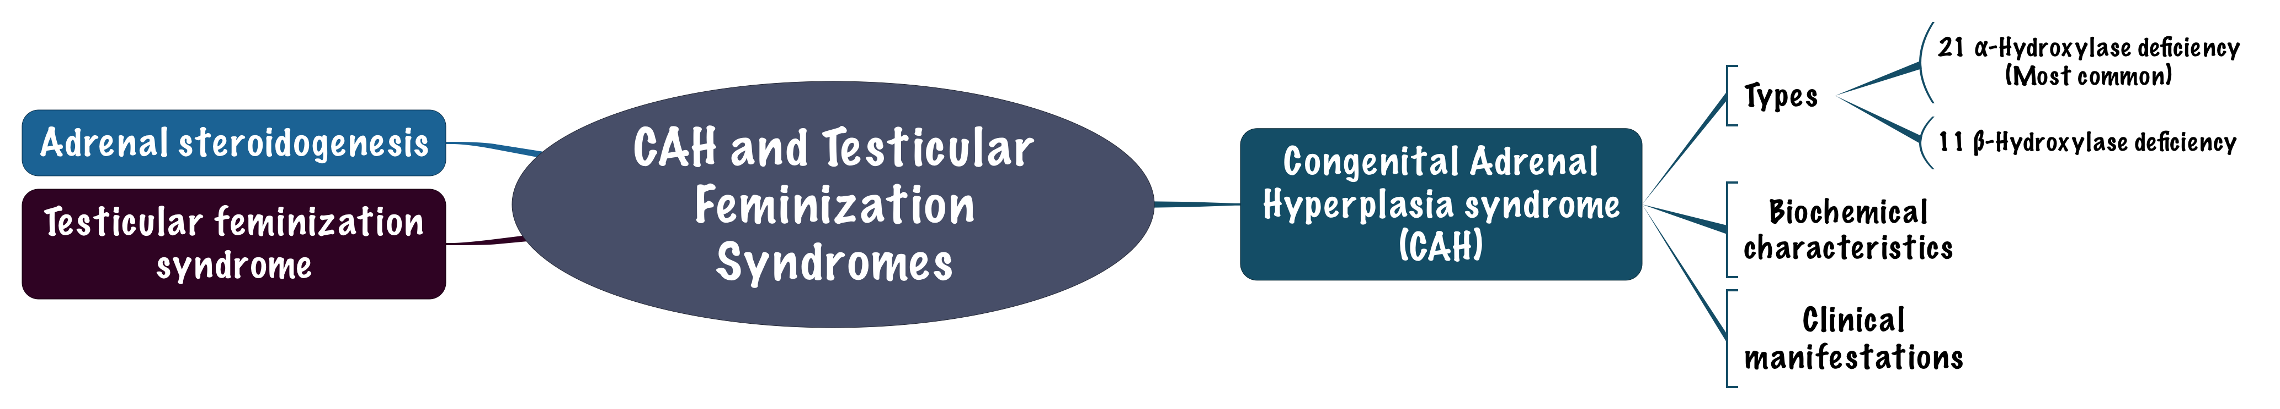
Overview

Slide 4
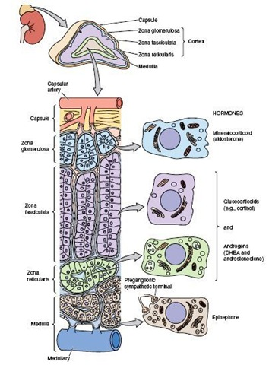

Adrenal Glands
“ to understand better”
The adrenal glands comprise 3 separate hormone systems
  Secrete aldosterone
Zona Glomerulosa
Adrenal Cortex
  secrete cortisol & the adrenal androgens
Fasciculata and Reticularis
  secretes catecholamines (mainly epinephrine)
Adrenal Medulla

Slide 5
Hermaphroditism or Intersex
Intersex: A person has neither standard male or standard female anatomy.
Discrepancy between type of gonads and external genitalia
Intersex (for example) : a male with normal testis but has female external genitalia (مخنث (
Female pseudo-hermaphrodite: a female with a male external genitalia
True hermaphrodite (rare) | (ovary plus testis)
Female pseudohermaphrodite | (FPH, only ovary)
Male pseudohermaphrodite | (MPH, only testis)
Recall what you studied before
Glucocorticoids | Steroids with cortisol-like activity Potent metabolic regulators & immunosuppressants
Mineralocorticoids | Steroids with aldosterone-like activity Promote renal sodium and water reabsorption, and excretion of potassium.

Slide 6
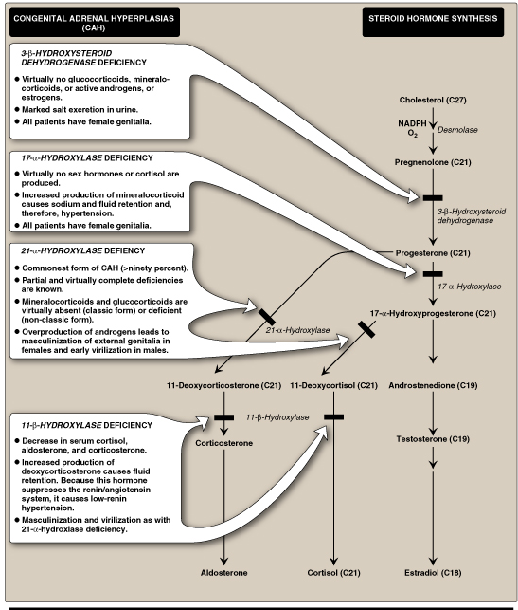
Steroidogenesis & CAH syndromes YOU NEED TO UNDERSTAN THESE TWO SLIDES ☺
In congenital adrenal hyperplasia we have enzymatic deficiency leading to appearance of signs and symptoms.
*Notice that any enzyme deficiency will lead to deficiency of cortisol.
*Remember the hypothalamic-pituitary-adrenal axis:
Hypothalamus (CRH) > Pituitary (ACTH) > Adrenal (cortisol) and high levels of cortisol will cause a negative feedback and stop the production of CRH and ACTH. So if we don’t have cortisol we don’t have negative feedback and ACTH will be continually produced leading to adrenal hyperplasia.
*Aldosterone does not cause negative feedback to CRH and ACTH, it only causes negative feedback to renin-angiotensin system.
*لازم نعرف اذا فيه طريق مسدود الطريق الثاني بيكون زايد، ولاحظوا ان كل مانزل البلوكج بيصير النقص أقل.
Congenital Adrenal Hyperplasia
Congenital : Due to mutation of the gene responsible for synthesis of the required enzymes
Hyperplasia : Because we don’t have cortisol

Slide 7
Steroidogenesis & CAH syndromes Cont.
As you can see in the picture, we have 4 enzymes that could be deficient (21-alpha-hydroxylase being the most common)
1- 3-beta-hydrxysteroid dehydrogenase: a deficiency in this enzyme will lead to deficiency to all the end products and accumulation of pregnenolone.
2- 17-alpha-hydroxylase: a deficiency in this enzyme will lead to deficiency of cortisol, testosterone and estradiol and accumulation of progesterone and aldosterone “Aldosterone accumulate because its pathway is the only pathway that remains intact so the whole amount of progesterone get converted to it”, leading to hypertension.
3- 21-alpha-hydroxylase: it catalyzes two reactions, so a deficiency in this enzyme will lead to deficiency of aldosterone and cortisol and accumulation of 17-alpha-hydroxyprogesterone leading to accumulation of testosterone and estradiol. ويصير شكل البنت زي الولد والولد شكله اكبر من عمره.
4- 11-beta-hydroxylase: a deficiency in this enzyme will lead to deficiency in cortisol and aldosterone and accumulation of 11-deoxycorticosterone (which has the same effect as aldosterone, but not stimulated by renin) and accumulation of 11-deoxycortisol and androstenedione leading to accumulation of testosterone and estradiol. The symptoms of this enzymatic deficiency are the same of that in 21-alpha-hydroxylase, the only difference is that 11-beta-hydroxylase deficiency patients have hypertension.

Slide 8
CAH syndromes
Congenital Adrenal Hyperplasia Syndromes
It is the result of an inherited enzyme defect in steroid biosynthesis The condition might be fatal unless diagnosed early due to water depletion and hypovolemia.
The adrenals | Cannot secrete cortisol → absent negative feedback to the pituitary) → ACTH continues to drive steroid biosynthesis → adrenal hyperplasia and accumulation of cortisol precursors (depending on which enzyme is lacking)
 | Cannot secrete aldosterone → electrolyte disturbances Hyponatremia Hyperkalemia
CAH Syndromes | 21 α-Hydroxylase deficiency 11 β-Hydroxylase deficiency 17 α-Hydroxylase deficiency 3 β-Hydroxysteroid dehydrogenase deficiency

Slide 9
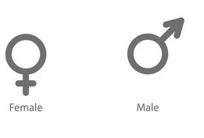
  21 α-Hydroxylase deficiency
The most common type of CAH (90%)
Clinically:
Complete enzyme defect: ↑ stimulation of adrenal androgen production → virilization in baby girls & precocious puberty in boys.
Partial enzyme defect → late onset form → menstrual irregularity & hirsutism in young females.
Laboratory diagnosis: ↑ plasma [17-hydroxyprogesterone] as early as 4 days after birth عادةً بعد يومين
In laboratory diagnosis, we measure the molecules not the enzymes.
The most important molecule to be measure is 17-hydroxyprogesterone.

Slide 10
  21 α-Hydroxylase deficiency
Autosomal recessive condition
Impaired synthesis of both cortisol & aldosterone
↓ [cortisol]→↑ ACTH secretion → Adrenal gland hyperplasia
Accumulated 17α-hydroxyprogesterone are diverted to the biosynthesis of sex hormones →signs of androgen excess:
  Ambiguous (we don’t know if it’s a female or a male) genitalia in newborn girls (FPH)
  Rapid postnatal growth in both sexes
Severe cases: mineralocorticoid deficiency → salt & H₂O loss → hypovolemia & shock → neonatal adrenal crisis
Late presentation (adult life) is possible in less severe cases
Genetics
Mutations in the CYP21 gene
  Deletions
  Nonsense
  Missense
DNA testing:
For prenatal diagnosis and confirmation of diagnosis

Slide 11
21 α-Hydroxylase Deficiency: Diagnosis
Serum sample taken at least 2 days after birth (earlier samples may contain maternally derived 17-hydroxyprogesterone)
Classic (complete) deficiency is characterized by markedly elevated serum levels of 17-hydroxyprogesterone
أحياناً لما يسوون الفحص يطلع عندنا borderline results فما نقدر نحدد هو مرتفع ولا نازل
وش نسوي طيب؟
ACTH is given to the patient and if the levels of 17-alpha-hydroxyprogesterone increase > the diagnosis is confirmed
Late-onset (partial) deficiency may require corticotropin (ACTH) stimulation test:
  Measure base-line and stimulated levels of. 17-hydroxyprogesterone.
  High level of 17-hydroxyprogesterone after stimulation is diagnostic

Slide 12
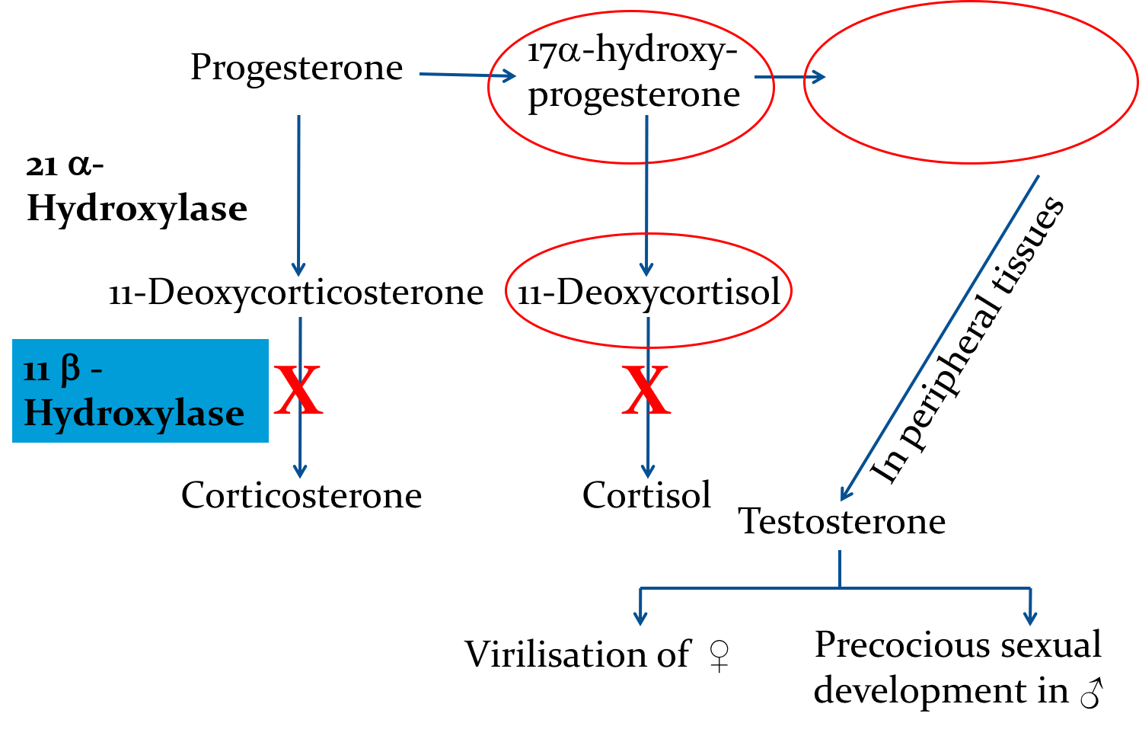
11 β -Hydroxylase Deficiency
leads to high concentrations of 11-deoxycortisol
Leads to high levels of 11-deoxy-corticosterone with mineralocorticoid effect (salt and water retention , hypertension)
Suppresses renin/angiotensin system low renin hypertension
Musculanization in females (FPH) and early virilization in males
Androstenedione

Slide 13
To summarize
Questions from this picture:
*Which enzymatic deficiency would cause virilization?
*Which enzymatic deficiency would cause deficiency of estradiol?

Slide 14
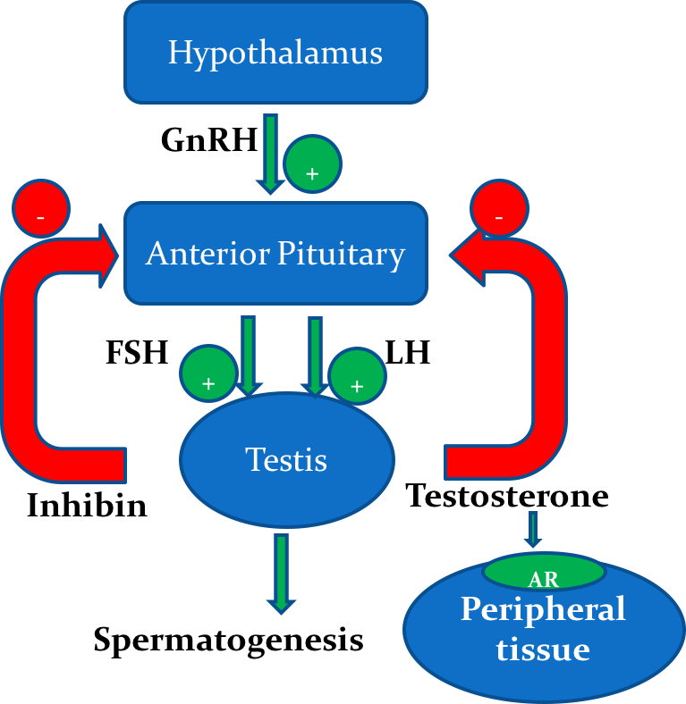
Testicular Feminization Syndrome (Androgen Insensitivity Syndrome)
Disorders of Male Sexual Differentiation
Control of testicular function by the gonadotrophins
They are rare group of disorders
The defect may be in:
  Testosterone production (impaired testosterone production)
  Androgen receptors (inactive androgen receptors → target tissues CANNOT respond to stimulation by circulating testosterone; e.g., Testicular feminization syndrome.

Slide 15
Testicular Feminization Syndrome
  46,XY karyotype
  X-linked recessive disorder
  Androgen receptor resistance leading to high testosterone blood level
  In peripheral tissue, testosterone will be converted by aromatase into estradiol = feminization
Clinical Picture
    Complete androgen insensitivity syndrome (CAIS): female external genitalia with normal labia, clitoris, and vaginal introitus (MPH)
    Partial androgen insensitivity syndrome (PAIS): mildly virilized female external genitalia (clitorimegaly without other external anomalies) to mildly undervirilized male external genitalia (hypospadias and/or diminished penile size)
Patients have normal testes & produce normal amounts of
müllerian-inhibiting factor (MIF) (the function of this factor is inhibition of the production of uterus and fallopian tubes), therefore, affected individuals Do Not have fallopian tubes, a uterus, or a proximal (upper) vagina.

Slide 16
Laboratory Diagnosis
  Karyotype: differentiate an undermasculinized male from a masculinized female.
  Fluorescent in situ hybridization (FISH): Presence of a Y chromosome can be confirmed by probes for the SRY region of the Y chromosome. These offer a much quicker turnaround time than conventional karyotypes.
  Increased (or normal) testosterone and dihydrotestosterone blood levels
  DNA tests and mutation analysis for androgen receptor gene:
    Complete or partial gene deletions, point mutations, or small insertions/deletions
  Imaging Studies “Pelvic ultrasound”:
    Absence of fallopian tubes and uterus

Slide 17
Summary
21-a-hydroxylase
Autosomal recessive
based on severity of enzyme defect:
complete enzyme defect
increase adrenal androgen production
partial defect
late onset (menstrual irregularity)
severe cases: mineralcorticoid defeciency leads to hypovolemia and shock (neonatal adrenal crisis)
Accumulated 17-a-hydroxyprogesterone > sex hormones
Signs: ambiguous genitalia and rapid postnatal growth
Lab:
high plasma 17 hydroxyprogesterone (4 days after birth)
classic: elevated serum levels of 17 hydroxyprogesterone
late onset: ACTH stimulation test shows high 17 hydroxyprogesterone
genetics: mutation in CYP21
prenatal testing to confirm and diagnose
11-B-hydroxylase
high levels of 11 deoxycortisol and 11 deoxy-corticosterone
salt and water retention
suppress renin/Ag system> low renin hypertension
Decrease in cortisol, aldosterone, and corticosterone
clinical picture: masculinization in females and early virilization in females

Slide 18
QUIZ
Q1 : Which of the following is the most common cause of congenital adrenal hyperplasia?
21 alpha hydroxylase deficiency
11 beta hydroxylase deficiency
17 alpha hydroxylase deficiency
23 beta hydroxylase deficiency
Q2 : Which of the following is a late complication of partial 21 alpha hydroxylase deficiency ?
Virillization in baby girls
Precocious puberty in boys
Gigantism
Hirsutism
Q3 : Which one of the following leads to high concentration of 11-deoxycortisol?
21 alpha hydroxylase deficiency
11 beta hydroxylase deficiency
17 alpha hydroxylase deficiency
23 beta hydroxylase deficiency
Q4 : Active estrogens absent glucocorticoids and absent mineral corticoids is related to which one of the following?
17-alpha hydroxylase deficiency
21-alpha hydroxylase deficiency
11-Beta hydroxylase deficiency
3 Beta hyroxysteroid dehydrogenase deficiency
Q5 : Which of the following explains testicular feminization syndrome ?
Androgen receptors resistance
Deficiency of hormones
Hypothalamus pituitary axis defect
X-linked dominant disorder
Q6 : Which of the following is correct about complete androgen insensitivity ?
XY karyotype with external female genitalia
Mildly virilized female external genitalia
Undervirilized male external genitalia
Hypospadias

Slide 19
QUIZ
Q7 : 8 month old infant was brought to your clinic with his mother.
She says that her son has weird looking genitalia for his gender, her husband told her that she is imagining things but she insisted on visiting a physician.
Upon clinical inspection and examination you found that her son has female genitalia.
Upon karyotyping, XY karyotype was found.
Mention the name of this condition.
Complete androgen insensitivity syndrome.
B) Explain the clinical presentation of this condition.
Male infant but with external female genitalia and female exterior caused by androgen receptor insensitivity.
C) Name 3 tests used to diagnose this condition.
Karyotype
FISH
DNA tests and maturation analysis for androgen receptor gene
D) How can we make sure of absence of uterus and Fallopian tubes in this condition?
Through imaging studies, specifically the pelvic ultrasound.
Suggestions and recommendations
1) A 2) D 3) B 4) D 5) A 6) A

Slide 20
Abdulaziz alhusaini
Mohannad alzahrani
Abdulrahman alrashed
Heba alnasser
Badriah alsabbagh
Najd altheeb

