Slide 1

Biochemistry
Editing file
The difference between the novice and the master is that the master has failed more times than the novice has tried
Investigating infertile couple

Slide 2
By the end of this lecture, the students should be able to know:
Identify the causes of infertility in men and women
Understand the diagnostic approaches to infertility in men and women
Interpret the results of investigation of infertility in men and women
We need egg and sperm & the place to make the fertilization happen.
So investigation will detect:
1- Ovum (ovulation).
2- Sperm (Quantity & quality).
3- Place or site of fertilization.

Slide 3
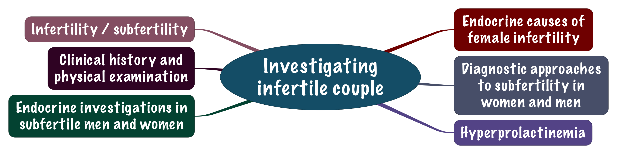
Overview

Slide 4
Infertility / subfertility
If a normal healthy couple comes to you and the female age is below 35 and has no complication but there is no pregnancy you will ask them to try one more year, if no pregnancy happens, you will start the investigations.
If the female is above 35 or the female or male have any problem that could affect the fertility then you have to do the investigations earlier (after 6 months).
If the female age is above 40-45 years old you will start the investigations right away.
It’s known as (Failure of a couple to conceive “becoming pregnant” after one year of regular, unprotected intercourse).
Infertility may be caused by endocrine problems:
  Common in females (1/3rd patients).
  Rare in males.
Hormone dysfunction is a rare cause of male infertility.
In some couples no cause can be identified. (Idiopathic)

Slide 5
Physical examination
First of all we take history, we ask about: Age, menstruation, medications, frequency and timing of sexual intercourse and if is it protected or not, previous pregnancy (to decide weather it is primary or secondary infertility), Chronic diseases (here we will have hormonal changes and oxidative stress and altered metabolism), risk factors (Inflammation, Sexual Transmitted Diseases, Smoking which increases oxidative stress, previous investigations and appointments, use of contraceptives, uterine device and previous exposure to chemotherapy and radiotherapy (It destroys the oocytes).
Physical examination
Information on physical examination should include
Hypothalamo-pituitary, thyroid disorders. Symptoms : Goiter Exophthalmos | Cushing’s syndrome Symptoms : Purple striea Central obesity | Galactorrhea Lactation in the absence of pregnancy. Most common due to hyperprolactinemia. Breast discharge | Hirsutism
- Primary infertility: Never get pregnant before
- Secondary infertility : got pregnant before

Slide 6
Endocrine investigations in subfertile woman
The first thing a should do is to ask about menstrual cycle if its regular or not.
Investigations are based on the phase of menstrual cycle
Serum progesterone should be measured in the middle of the luteal phase (day 21)
High progesterone (>30 nmol/L) indicates ovulation
In oligomenorrhea or amenorrhea, hormone measurement is needed
If the menstrual bleeding is accompanied by other usual symptoms of menstrual cycle as cramps and pain
it means that it is an ovulatory cycle.
Progesterone normally is increased in luteal phase
If the level is below 10, it means inovulatory cycle.
If the level inbetween 10-30, means ovulatory but there is a problem in the mid-luteal phase.
Amenorrhea:
No mensuration for at least 6 months or more.
Oligomenorrhea: 8 or less cycles in a year, with a gap at least 6 weeks.

Slide 7
Endocrine causes of female infertility
1. Excessive secretion of ovarian androgens (androgens affects the gonads directly) | Obesity
 | Insulin resistance
2. Primary ovarian failure | High gonadotrophins, low oestradiol (postmenopausal hormonal pattern) Also Called :Hypergonadotropic hypogonadism Hormone replacement therapy can be given (will not treat infertility) given for libido
3. Hyperprolactinemia 4. PCOS* 5. Cushing’s syndrome (Cortisol causes increased level of androgens). | 6. Hypogonadotrophic hypogonadism : Low gonadotrophin/oestradiol Rare Due to hypothalamic-pituitary lesion
* Polycystic Ovary Syndrome (PCOS)

Slide 8
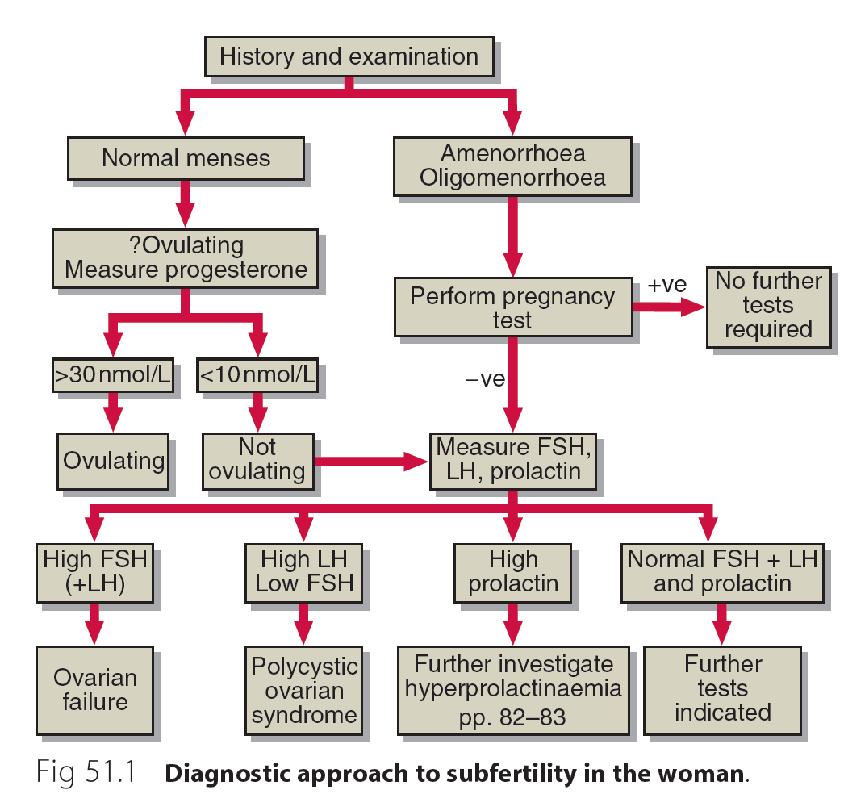
Investigation of female infertility
Follow the chart and know the investigations
With symptoms: pain and bloating
Because of the ovarian failure there is no secretion of estrogen and therefore there is no feedback inhibition on the anterior pituitary.

Slide 9
Anti-Mullerian hormone (AMH)
A polypeptide hormone called Mullerian-inhibiting substance.
Secreted by growing ovarian follicles.
Secretion is proportional to follicular development.
Helps assess ovarian reserve and female fertility.
Ovarian reserve: number and quality of oocytes in the ovaries.
In MALES it have another function which is to inhibit the female genitalia.
Oogonia then primordial then primary then secondary oocyte
In the ovary it inhibits the | Initial recruitment of primary follicles from primordial follicles. Sensitivity of antral follicles to FSH during cyclical recruitment.
AMH prevents premature depletion of follicles. The number of remaining primordial follicles correlate with the number of growing follicles. Since only growing follicles produce AMH, its plasma levels reflect the number of remaining primordial follicles. We can measure the antral follicles count by transvaginal ultrasound, They are more helpful if female is going for IVF.

Slide 10
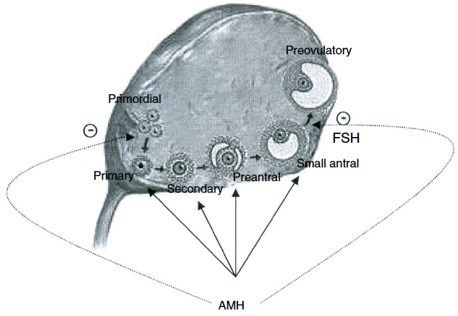
Anti-Mullerian hormone (AMH)
AMH and folliculogenesis
Female are born with around 1 million of Follicle .And It keeps reducing over time ,
By the time that female reach fertile age she will have around 300-400 thousands follicle.
AMH level gives an idea about The number of remaining primordial follicles which correlates with the number of growing follicles ..

Slide 11
Endocrine investigations in subfertile man
Eugonadal men with normal sperm analysis do not require endocrine investigations
Endocrine cause of infertility in men are rare
In hypogonadal men:
Testosterone.
Gonadotrophins should be measured.
Semen analysis
Volume. Normal range at least 1.5 ml
Liquefaction time. Normally 20-30 mins
Sperm count. At least 15 million/ml
Motility. 38%
Presence of abnormal spermatozoa.
pH. 7.2 – 8 (Acidity destroys the sperms)
WBCs. Represents infection, shouldn’t be present
Liquefaction time :
Time taken from sperm to convert form gel to liquid normally 20 to 30 minutes

Slide 12
Endocrine investigations in subfertile man
1. Primary testicular failure due to: | Damage in the testes (interstitial, tubular) if only FSH is increased it is tubular, if both LH and FSH are decreased it will be interstitial. Low levels of testosterone.
2. Hypothalamic-pituitary disease: | Decreased testosterone with low/normal gonadotrophins. Suggests hypogonadotrophic hypogonadism.
3. Hyperprolactinemia (a rare cause in men).

Slide 13
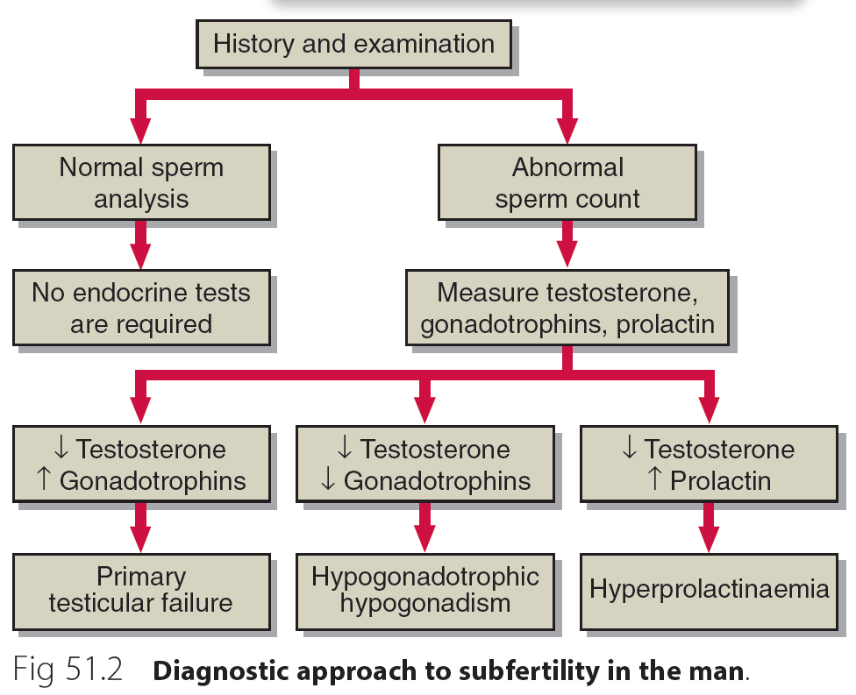
Investigation of male infertility
Investigation of male infertility
Follow the chart and know the investigations

Slide 14
Hyperprolactinemia
Prolactin is an anterior pituitary hormone
Its secretion is tightly regulated:
  Stimulated by TRH from the hypothalamus
  Inhibited by dopamine from hypothalamus
It acts directly on the mammary glands to control lactation
Follow the chart and know the investigations
Elevated circulating prolactin :
Causes infertility in both sexes due to gonadal function impairment
Early indication
In women : amenorrhea and galactorrhea
In men : none

Slide 15
Causes of hyperprolactinemia
Causes
Usually hyperprolactinemia shows symptoms in female (secretion of milk without pregnancy) but not in male unless it grows and compress the adjacent area.
Stress
Drugs (estrogens, phenothiazines, metoclopramide, α-methyl dopa)
Seizures
Primary hypothyroidism (prolactin is stimulated by raised TRH)
Other pituitary disease
Prolactinoma
Idiopathic hypersecretion (e.g. due to impaired secretion of dopamine that usually inhibits prolactin release)

Slide 16
Diagnosis of hyperprolactinemia
Exclude
Stress
Drugs
Other diseases
Differential diagnosis
Prolactinoma
Idiopathic hypersecretion
And you have to exclude any other stimulant like touching the breast and pelvic area which temporary increases prolactin levels.

Slide 17
Take Home Message
Endocrine causes of infertility are more common in women than men
In women serum progesterone >30nmol/L indicates ovulation
Hyperprolactinemia is a rare cause of male infertility

Slide 18
Summary

Slide 19
QUIZ
Q1 : Which one of the following prevents premature depletion of follicles?
Estrogen
Progesterone
Anti-Mullerian hormone
Mullerian hormone
Q2 : Which one of the following is correct in the investigations of female infertility?
If progesterone is <10 nmol/L it means the patient is ovulating
If patient has amenorrhea, there are no further tests required
If patient is not ovulating we need to perform pregnancy test
If patient has high FSH + LH diagnosis is Ovarian Failure
Q3 : Which one of the following is the least common cause in subfertility in men?
Damage in the testes
Hyperprolactinemia
Low levels of testosterone
Hypothalamic-Pituitary disease
Q4 : Which one of the following indicates Primary testicular failure?
Increased Testosterone, Decreased Gonadotrophins
Decreased Testosterone, Increased Prolactin
Decreased Testosterone, Increased Gonadotrophins
Decreased Testosterone, Decreased Gonadotrophins
Q5 : All of the following are correct about prolactin except?
Secretion is stimulated by TRH
Secretion is inhibited by dopamine
Acts directly on the mammary glands
Acts directly on the uterine glands
Q6 : Which one of the following would indicate subfertility on physical examination?
Cushing disease
Hirsutism
Both
Non of the above

Slide 20
QUIZ
Q7 : 27 year lady came to your clinic with complains of inability to become pregnant for the past 3 years, she also complained of disturbances in her period for the past 6 months.
Physical examination revealed that she has some hirsutism around the lips.
The investigations are indicated below:
Negative Pregnancy test
High LH levels, Low FSH levels, Normal Prolactin levels.
A) What is the probable diagnosis according to these findings?
Polycystic ovarian syndrome
B) Mention 3 other causes of infertility in women.
Hyperprolactinemia
Ovarian Failure
Cushing’s Syndrome
C) Mention 3 Hormones that are related to fertility.
Anti-Mullerian Hormone
Prolactin
Testosterone
FSH
LH
D) Mention 4 drugs that cause hyperprolactinemia
Estrogens
Phenothiazines
Metoclopramide
Alpha-Methyl Dopa
Suggestions and recommendations
1) C 2) D 3) B 4) C 5) C 6) B

Slide 21
Leen altamimi
Hanin bashaikh
Haifa alwaeel
Abdulrahman alrashed

