Slide 1

Biochemistry
Editing file
“The best view comes after the hardest climb”
Biomarkers of ovarian cancer and cysts

Slide 2
By the end of this lecture, the students should be able to know:
Discuss the risk factors and possible causes of polycystic ovarian syndrome (PCOS) and ovarian cancer.
Comprehend the role of insulin resistance and hypersecretion of androgens in the development of PCOS.
Identify avenues for the diagnosis and treatment of PCOS and ovarian cancer.
Assess the diagnostic significance of CA-125 in ovarian cancer.

Slide 3
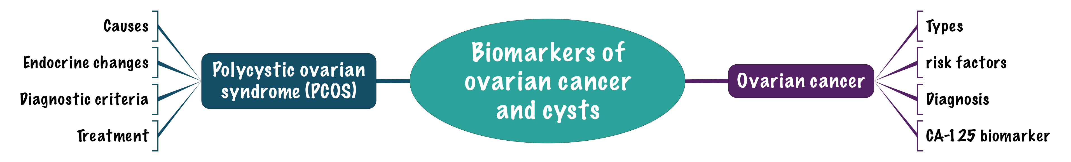
Overview

Slide 4
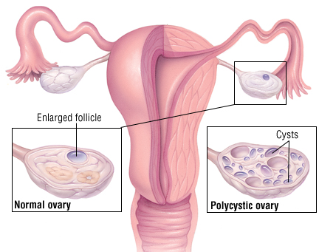
Polycystic ovarian syndrome
It has another name (Stein-Leventhal syndrome). right it is called polycystic ovarian syndrome but the cyst maybe there and may be not there (may be very small that is doesn't show in the ultrasound). These cysts are immature follicles whose growth has been arrested . and they will cause menstrual irregularities which may lead to chronic anovulation or oligo-ovulation.
Formation of multiple small cysts in the ovaries
Affects 5-10% of women (20% in some populations)
A major cause of infertility in women
Strongly correlated to
Family history
Obesity (40%)
Hirsutism because of androgen.
Chronic anovulation
Glucose intolerance
Insulin resistance
Hyperlipidemia
Hypertension
Menstrual disorders
Hypersecretion of leutinizing hormone (LH) and androgens (testosterone)
Low levels of SHBG (sex hormone-binding globulin) which is synthesized by liver.

Slide 5
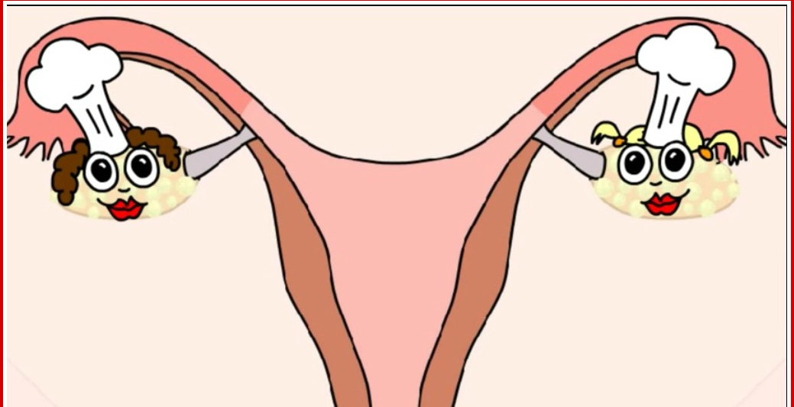
Polycystic ovarian syndrome
Polycystic ovarian syndrome
Exact cause of the syndrome is unknown¹ May be multifactorial (genetic and environmental)² The probable causes are
Insulin resistance causes excessive androgen production in ovaries (common)³ | Abnormalities in ovaries, adrenal and pituitary glands
1: it is a syndrome that consists of a bunch of many things .
2: when we say its genetic that means there is family history. Another thing is that when the pregnant mother has condition that increase her androgen level (e.g. Cushing syndrome) then the child will expose to this high amount of androgen and she (the child) may develop PCOS later.

Slide 6
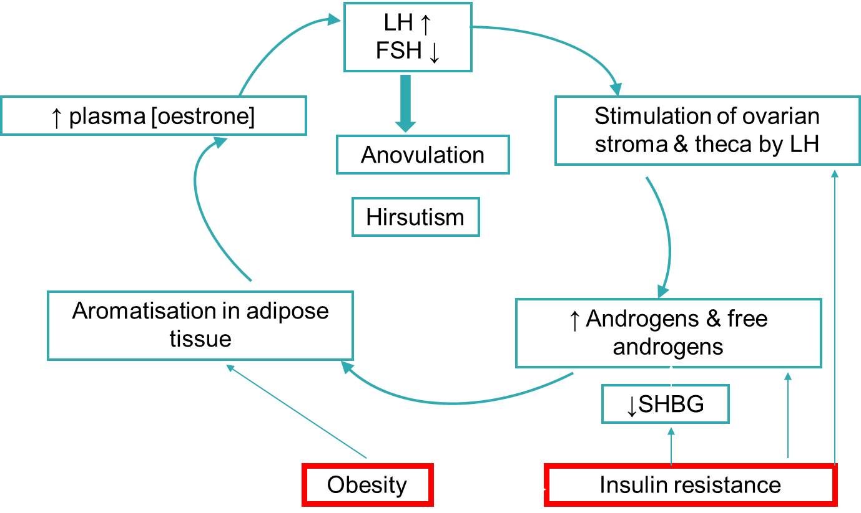
Endocrine changes in PCOS
When you have Androgen excess it may be because of high insulin amounts (because of obesity) that can lead to decreased production of the sex hormone binding globulin (SHBG), then you will have more Free (active) testosterone which will lead to the common symptoms of androgens like acne & male pattern of hair loss. These excess androgens will go to the adipose tissue and these adipose tissue has the enzyme aromatase which converts the testosterone to oestrone, which increases the release of LH and decrease the FSH.
FSH decrease will cause anovulation, while Increased LH will stimulate theca cells that produce more and more androgens and the cycle will repeat.
So, if you want to treat PCOS you have to break this cycle (details in the next slides)

Slide 7
Diagnostic criteria for PCOS
European Society for Human Reproduction & Embryology (ESHRE) and American Society for Reproductive Medicine (ASRM) recommendation:
At least TWO of the following features are required for PCOS diagnosis: (if she has only two she can be diagnosed by PCOS)
1. Oligo-ovulation or anovulation manifested as oligomenorrhea⁴ or amenorrhea
2. Hyperandrogenism (clinical and biochemical evidence of androgen excess)
3. Polycystic ovaries (as defined by ultrasonography)
4: No period for at least 6 months.

Slide 8
Polycystic ovarian syndrome
Diagnosis done by measuring:
Measuring the following | Free testosterone (total testosterone is less sensitive; androgens are increased in PCOS) Because there is low amount of SHBG, and because of this the androgens will be high.
 | Sex hormone-binding globulin (SHBG; decreased in PCOS)
 | Luteinizing hormone (LH; high in 60% cases)
 | Follicle stimulating hormone (FSH); usually normal in PCOS the LH to FSH Ratio is the most important thing
 | Fasting blood glucose
 | Insulin will increase
 | Lipids will increase (Hyperlipidemia)
Ovarian ultrasound | 30% of patients do not have ovarian cysts despite having symptoms (usually the size of the cyst is 2-6 mm)
Treatment of PCOS: Break the cycle

Slide 9
Treatment of PCOS
Aim of treatment: interrupt the cycle of obesity, insulin resistance, excess androgens.
Reduce LH levels (by oral contraceptives).
Reduce body weight which will increase insulin sensitivity. and you also can prescribe metformin.
Increase FSH levels (by clomiphene, etc.)
Estrogen replacement therapy: In select women after careful risk counseling.

Slide 10
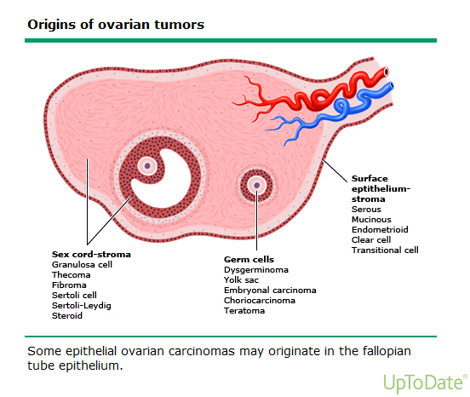
Ovarian cancer
A leading cause of death because of gynecologic cancer.
Due to malignant transformation of ovarian epithelial cells, there are other types but this is the most common.
Most common type of ovarian cancer.
Subtypes:
Serous (46%): surface epithelial tumors.
(most common)
2. Mucinous (36%): mucinous epithelial tumors.
3. Endometrioid (8%): endometrial tumors

Slide 11
Ovarian cancer
Risk factors:
Increase in Age is a risk factor and its important.
Nulliparity (woman with no child birth or pregnancy).
Family history of breast, ovarian, colorectal cancer. First degree relative, or the person herself had history of cancer.
Mutations in BRCA1 and BRCA2 genes (most common).
Carriers of BRCA1 mutations have a cancer risk of 44%.
Premenopausal breast cancer or ovarian cancer indicates higher risk for hereditary or breast cancer. If one of the family members developed cancer before menopause this increases the risk of cancer for other relatives.
Ashkenazi Jews have higher risk of ovarian cancer.

Slide 12
Ovarian cancer
Biomarkers and diagnosis:
Epithelial ovarian cancer is commonly diagnosed at a later stage.
Due to non-specific symptoms such as abdominal pain, blotting, early satiety, nausea, etc.
Most patients (75%) have advanced-stage tumor upon diagnosis (you will be able to feel an abdominal mass in clinical examinations)
Diagnosis includes:
1. History taking.
(Age of menarche any history of cancer)
2. Physical examination.
(mass , ascites, pleural effusion)
3. Ultrasound.
(transvaginal)
4. Measurement of serum CA-125 levels .

Slide 13
Cancer antigen 125 (CA-125)
The only serum marker of epithelial ovarian cancer.
A cell surface glycoprotein expressed in the epithelium of all tissues (Ovarian cells and other tissues).
Normally absent in serum.
If it’s high in blood it may indicate ovarian cancer especially in post-menopausal women, but in pre-menopausal it may be increase due to many situations like presence of fibroids, menstrual cycle or first trimester of pregnancy. So, it’s is not specific.. That's why they use it to follow up during treatment.
Recommended as an annual test for women with family history of ovarian cancer (you don’t screen the whole population for this marker except they are at high risk of developing ovarian cancer).
CA-125 is associated with stages of ovarian cancer.
CA-125 is elevated in ovarian cancer (>35 U/ml is considered positive).
Cancer antigen 125 (CA-125) is Elevated in:
50% of patients with stage I
90% of patients with stage II
>90% of patients with stage III and IV

Slide 14
Cancer antigen 125 (CA-125)
CA-125 is not a marker of choice for ovarian cancer screening due to:
1. High false-positive rate. | 2. Low prevalence of ovarian cancer
A non-specific marker. False positive CA-125 conc. are found in benign conditions: Endometriosis. Uterine leiomyomas. Pelvic inflammatory disease. During the first trimester of pregnancy. During menstruation. Some patients (< 50 years) have elevated CA-125 due to unrelated malignant mass especially if there is ascites. | -

Slide 15
Ovarian cancer
Cancer antigen 125 (CA-125) is useful in:
Monitoring patient’s response to chemotherapy.
Success of surgery (de-bulking procedures). removing the tumor masses
Annual testing for women with family history of ovarian cancer.

Slide 16

Take Home Message
PCOS is strongly correlated to insulin resistance and endocrine abnormalities.
Although a nonspecific biomarker, CA-125 is important for staging and follow-up of ovarian cancer treatment
مع تمنياتنا لكم بإجازة صيفية ممتعة 🌍🌍😃

Slide 17

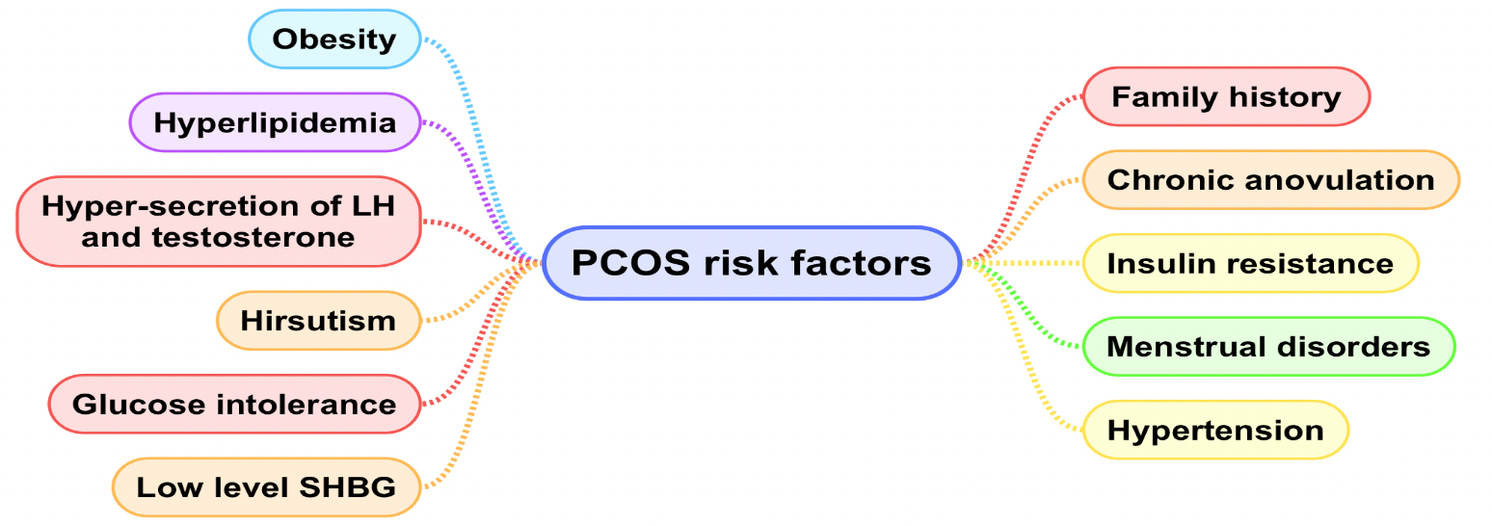
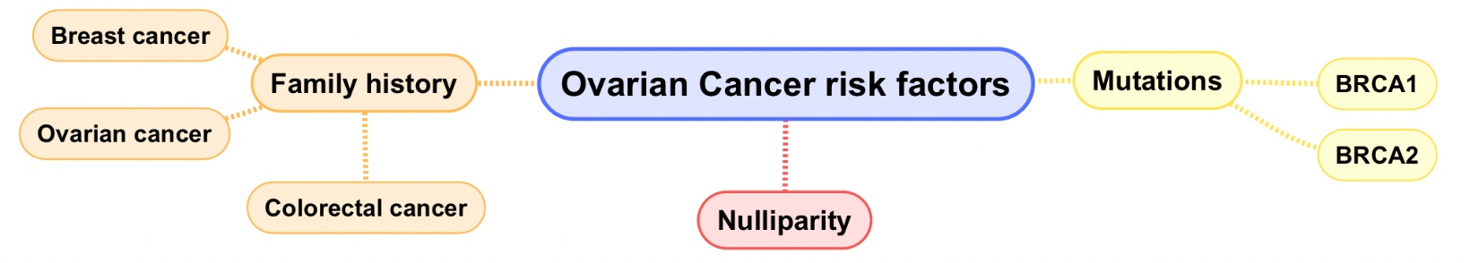
Changes in PCOS
↑LH
↓FSH
LH stimulates ovarian stroma & theca
↑Androgens
Aromatization in adipose tissue
↑Plasma oestrone
Formation of multiple small cysts in the ovaries
Polycystic Ovarian Syndrome
Affects 5-10%
Obesity
↓SHBG
Malignant transformation of ovarian epithelial cells
Ovarian Cancer
Serous (46%) – Mucinous (36%) – Endometrioid (8%)
Treatment:
Breaking the cycle
Insulin resistance
CA-125
Serum marker: A cell surface glycoprotein expressed in the epithelium of all tissues
Ovarian cancer+ >35 U/ml

Slide 18
QUIZ
Q1 : Which one of the following drugs is used in the treatment of polycystic ovarian syndrome to increase FSH levels?
Oral Contraceptives
Clomiphene
Estrogen replacement
Estradiol
Q2 : Which one of the following is correct in terms of the diagnostic criteria suggested by ESHRE & ASRM to diagnose Polycystic ovarian syndrome?
Oligo-ovulation + anovulation
Polycystic ovaries + Insulin resistance
Hyperandrogenism + obesity
Oligo-menorrhea + Hyperandrogenism
Q3 : Which one of the following is the most common subtype of ovarian cancer?
Serous
Mucinous
Clear cell
Endometrioid
Q4 : Which one of the following is a serum marker of epithelia ovarian cancer?
BRCA 1
BRCA 2
Cancer antigen 125
RIKA-B
Q5 : Which one of the following is a direct cause of hirsutism in Polycystic ovarian syndrome?
Increased plasma Oestrone
Anovulation
Increased LH
Increased Androgens
Q6 : A 39 nulliparous patient came in with complains of abdominal pain, upon ultrasound ovarian cysts were found.
Which one of the following findings would confirm the diagnosis as polycystic ovarian syndrome?
Amenorrhea
BRCA 1 mutation
Positive CA-125
Decreased LH

Slide 19
QUIZ
Q7 : You are a medical student that has finished the reproduction block biochemistry lectures and have become a very knowledgeable person.
As you are walking down the street with a friend you saw a woman with a mustache, your friend recalled a few questions to review your knowledge about biochemistry.
A) Name 7 criteria that are measured for the diagnosis of Polycystic ovarian syndrome and what is the finding if the pathology is present?
Free testosterone: Increased
Sex hormone-binding globulin: Decreased
Leutinizing hormone: Increased in 60% of cases
Follicle stimulating hormone: Normal
Fasting blood glucose: Increased
Insulin: Increased
Lipids: Increased
B) Mention 1 radiological method used for conformation of the diagnosis of PCOS.
Ovarian Ultrasound
C) Mention 3 situations that the CA-125 is useful in.
Monitoring patient’s response to chemotherapy
Success of surgery
Annual testing for women with family history of ovarian cancer
D) Mention 4 methods used in the treatment of polycystic ovarian syndrome.
Reduce LH levels: by using oral contraceptives.
Reduce body weight
Increase FSH level: by using Clomiphene
Estrogen replacement therapy
Suggestions and recommendations
1) B 2) D 3) A 4) C 5) D 6) A

Slide 20



فريق البايوكيمستري
بنهاية هذي المحاضرة نصير خلصنا كل محاضرات البايوكيمستري في سنوات العلوم الأساسية ومن هذا المنطلق نحب نشكر كل الأعضاء اللي مذكورة أسماؤهم على مساعدتهم لنا في التيم وتبرعهم بجزء وقتهم عشان يطلع التيم بالصورة اللي هو عليها من أول سلايد في أول بلوك لليوم 🌟🌟
شكرا جزيلا للجميع الله يسعدكم وينفع بأوقاتكم ويكتب أجركم ..
رانيا العيسى & محمد المطلق
مهند الزهراني ، عبدالعزيز الحسيني ، طراد الوكيل ، محمد حبيب ،
عبدالله المانع ، طلال الطخيم ، حسام الخثلان ، عبداللطيف العبداللطيف ، عبدالعزيز شديد ، فهد العتيبي ، محمد العسيري ، محمد المهوس ، هشام القوسي ، حاتم النداح ، محمد حكمي ، خالد الراجح ، عبدالعزيز الصومالي ، حمد الحسون ، خالد القحطاني ، حمد الحميدان ، فهد الزهراني ،
صالح التويجري ، طلال الحقيل ، سعود الشنيفي ، فيصل الفواز ،
قيس المهيدب ، ناصر ابو دجين ، عبدالرحمن الراشد ، عبدالرحمن المالكي ، فارس النفيسة ، خالد العيسى ، سعد الرشود ، عبد العزيز القرموشي
نورة الشبيب ، ريم السرجاني ، نورة السهلي ، ربا برناوي ، هيفاء الوعيل ، لمى الفوزان ، هبه الناصر ، روان الوادعي ، ربا السالم ، مها الغامدي ، شذى الغيهب ، لمى التميمي ، زينة الكاف ، ابتسام المطيري ،
بشرى قوقندي ، سمية الغامدي ، ريما الشايع ، رنا باراسين ، أمل القرني ،
هيفاء بن طالب ، ريما العتيبي ، حنين باشيخ ، لين التميمي ، عبير المطيري ، جواهر أبانمي ، جواهر الخيال ، غيداء السعيد ، أشواق الماجد ،
نجد الذيب ، حنين السبكي ، اللولو الصليهم ، غاده الهدلق ، منيرة الضفيان ، منيرة الزايد ، أميرة نيازي ، ليلى مذكور ، رحاب العنزي ، آمال الشيبي ،
لينا الوكيل ، بثينة الماجد

Slide 21
Laila mathkour
Haneen alsubki
Zainah alkaff
Abdulaziz alhusaini
Abdulrahman alrashed

