Slide 1
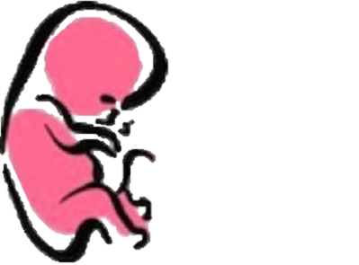
DEVELOPMENT OF FEMALE GENITAL SYSTEMS
﴿ إِنَّا خَلَقْنَا الإنسان مِنْ نُطْفَةٍ أَمْشَاجٍ نَبْتَلِيهِ فَجَعَلْنَاهُ سَمِيعًا بَصِيرًا ﴾
Embryology
436
Important
Dr. notes Explanation

Slide 2
O B J E C T I V E S
At the end of the lecture, students should be able to:
- Describe the development of gonads (indifferent& different stages)
- Describe the development of the female gonad (ovary).
- Describe the development of the internal genital organs (uterine tubes, uterus & vagina).
- Describe the development of the external genitalia.
- List the main congenital anomalies.
مانحتاج نذكركم ان الاوقات مهمة

Slide 3
Sex Determination
This slide is very important
- Chromosomal and genetic sex is established at fertilization and depends upon the presence of Y or X chromosome of the sperm.
- Development of female phenotype requires two X chromosomes.
- The type of sex chromosomes complex established at fertilization determine the type of gonad differentiated from the indifferent gonad. (testis determining factor ,TDF)
- The primary female sexual differentiation is determined by the presence of the X chromosome , and the absence of Y chromosome and does Not depend on hormonal effect.
- The type of gonad determines the type of sexual differentiation in the Sexual Ducts and External Genitalia.
شرح السلايد:
During fertilization if the sperm carry X -> so there will be two X and no chromosome Y (no testis determining factor ) -> so type of gonad is ovary
Its important to differentiate that type of gonads depend on chromosomes BUT female duct system and external genitalia depend on HORMONES .
Gonad -> chromosomes
External genitalia and sexual duct -> Hormones
حسب وقت الفيرتلازيشن ومين الكروموسوم الي يدخل (اكس او واي ) يتحدد عندي نوع الجوناد هل هو (اوفاري او تيستس)
- تتم عملية استكمال نمو الأعضاء اعتمادا على الهورمون
1-Gonad (ovary)
2-Genital duct
3-External genitlia
Development of Female Genital System:
It comprises the development of:
شرح السلايد:
هذول الثلاثة يدخلوا في مرحلة اسمها الاندفرنشيشن ستيج يكبروا كلهم لمرحلة معينة بس لسا مانقدر نفرق بين هل هو انثى او ذكر في الأسبوع السابع .
-They all first pass through an Indifferent Stage.
- The gonad acquires the female morphological characteristics about the 7th week.

Slide 4
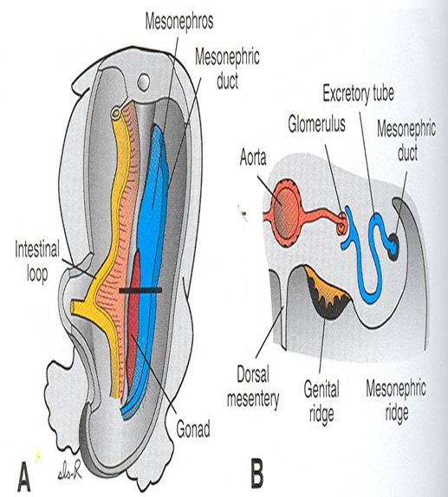
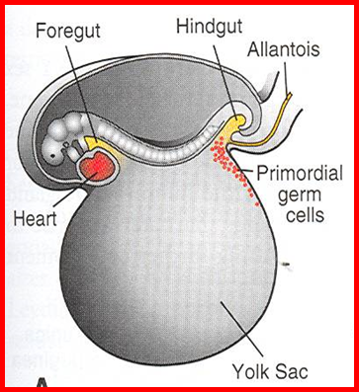
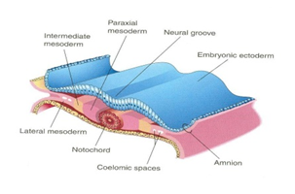
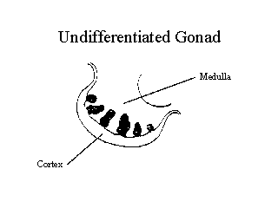
- (مهم جدا تفهموا هذي السلايد بتسهل عليكم فهم اللي جاي)
1-Development of Gonad
This slide is very important
Gonad Is derived from three sources :
Only in male’s slides
(mesodermal epithelium ) lining the posterior abdominal wall. | 1- Mesothelium
(underlying embryonic connective tissue). | 2. Mesenchyme
(appear among the Endodermal cell s in the wall of the yolk sac). | 3. Primordial Germ cells
Genital (Gonadal) Ridge:
(Also called Indifferent gonad This stage occur in both female and male)
- Gonadal ridge is formed due to Proliferation of (Mesothelium and Condensation of underlying Mesenchyme).
from the intermediate mesoderm | origin
Appears during the 5th week | Time
a pair of longitudinal ridges | Shape
on the medial side of the Mesonephros (nephrogenic cord)* | Position
*الجهاز البولي والتناسلي بينهم ارتباط وثيق لانهم متكونين من نفس المكان ونفس الاوريجن (intermediate mesoderm )
شرح السلايد (ركزوا معانا):
القوناد (تيستس او اوفاري) يتكون عندي من 3 أشياء
الميزوثيليم هي الطبقة الخارجية وهي تكون الكورتكس للاوفاري
المازينكايم هي الطبقة الداخلية عبارة عن كونكتف تيشو شكلها زي الأصابع وهي تكون الميدلا للاوفاري
طيب هذول الطبقتين مع بعض يكونوا (القونادال ريدج) -< (ميزوثليم+مازينكيم) او (كورتكس+ ميدلا)
البريمورديال سلز تهاجر وتروح لل القونادال ريدج

Slide 5
Cont..
This slide is very important
At the 4th week a special cells ( large spherical sex cells)starts to appear among endodermal cells in the wall of the yolk sac near origin of the allantois. Are called Primordial germ cells.
(During folding the dorsal part of the yolk sac is incorporated within the embryo.)
- The Primordial germ cells migrate along the dorsal mesentery to the Gonadal Ridges.
- At the 6th week Primordial germ cells migrate to the Gonadal Ridges.
allantois
Primordial germ cells
- The primordial germ cells have an Inductive Influence on the differentiation of the gonad into ovary or testis.
(تاثير مباشر)
- If they fail to reach the ridges, the gonad remains Indifferent or Absent.
شرح السلايد:
ابغاكم تعرفوا اول شي ان عندي شي اسمه يوك ساك هذا طالع من اندوديرم
المهم اثناء مايصيرفولدنق للجنين هذي اليوك ساك تنقسم الى 3 اقسام :
(ميدقت ,فورقت هندقت)
يهمنا الهندقت(dorsal part of yolk sac) عنده جزء اسمه الالنتويس (شوفوا الصورة)
هذا الالنتويس تبدا تظهر فيه بريمورديال سلز في الأسبوع الرابع
هنا نفسر ليش هذي السلز الاوريجن حقها اندوديرم
هذي السلز في الأسبوع السادس تبدا تهاجر للقونادال ريدج لكن قبل كدا وهي تمشي لازم تمر في معبر اسمه dorsal mesentry
طيب نتيجة هجرتها: رح تبدا عندي عملية الديفرنشيشن للقوناد
- طيب لو ماصار فيه هجرة لهذي الخلايا ايش رح يصير؟
1.Indifferent gonads ( not testis or ovary)
2.Absence of gonads in one side or both

Slide 6
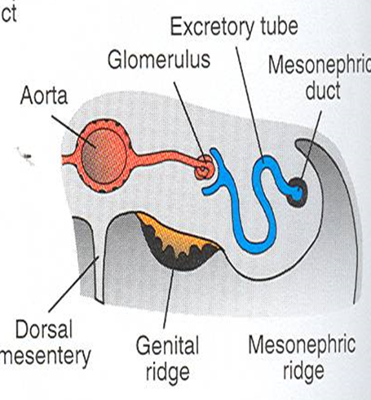
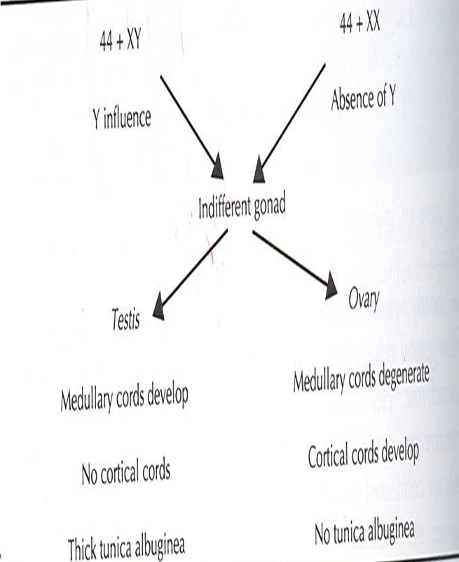
Cont..
This slide is very important
Structure of Indifferent Gonad:
The indifferent gonad consists of: External Cortex (C) and Internal Medulla (M).
( Embryos with XX chromosomes )
the Cortex differentiates into the Ovary and the medulla regresses.
(تضمحل)
( Embryos with an XY chromosomes )
the Medulla differentiates into Testis and the cortex regresses
(تضمحل)
- The gonad acquires the Female or Male morphological characteristics at about the 7th week.
عشان تحفظوها :
Male = Medulla will differentiate
Or
(COMT)
Cortex -> Ovary
Medulla -> Testis
المهم مايجتمعون مع بعض في جنس واحد إما الكورتس اللي تبقى أو الميدولا

Slide 7
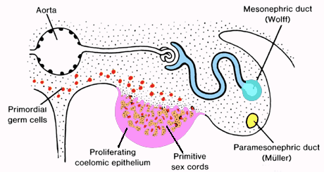
Gonad (development of The Ovary)
This slide is very important
اول مرحلة من تكون الاوفري هي تكوين: 1- Primitive (primary )sex cords
At the 10th week
Both the primary sex cords and rete ovarii degenerate and disappear | The Primary sex cords dissociate into (Rete ovarii) | Fingerlike epithelial cords (gonadal cords) grow from cortex of the indifferent gonad and extend into the medulla(mesenchyme) and form(Medullary Cords). زوائد نفس شكل الاصابع طالعه من الكورتكس وفاضية من داخل ومتجهه للميدولا
.
كل ماتقرب من الميدلا تنفصل اكثر عن الكورتكس وتتقطع لقطع صغيرة اللي نسميها ( rete ovarii)
بالأخير ثنيناتهم بيختفون ☺
2- Cortical (Secondary) Sex Cords
- They extend from the surface epithelium (mesothelium) into the underlying mesenchyme to replace the primary cords. - The primordial germ cells are incorporated into them - The ovary is identifiable histologically at the 10th week
Primary sex cord:
فاضية من جوا مافيها سلز يصيرلها ديجينراشن
محشية سلز عشان كذا مايصير لها ديجنريشن
هنا نفس primary sex cord رح يطلع زوائد نفس شكل الاصابع من الكورتكس بدل الباريمري كورد اللي اختفت بس ايش الفرق ؟
- هالمرة بتجي الprimordial germ cells وتدخل داخلها وهذي الخطوة مهمة عشان تميزها عن البرايمري ومايصير لها ديجنريشن
- ثاني اختلاف انها (وفية وتحب الكورتكس)رح تظل مرتبطة بالكورتكس وعشان كذا سميناها cortical sex cords
Secondary sex cord:

Slide 8
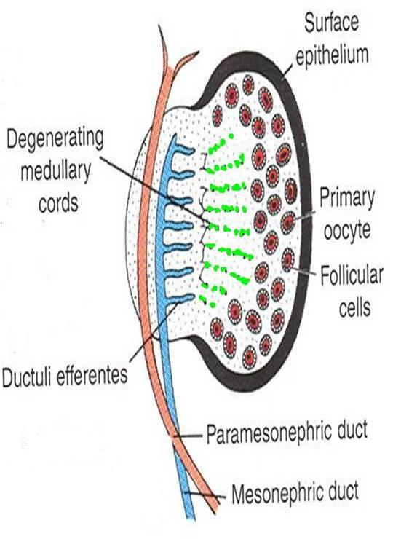
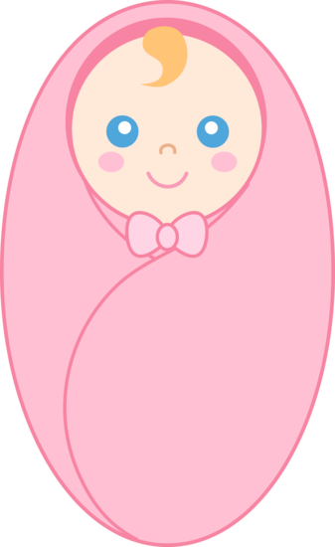
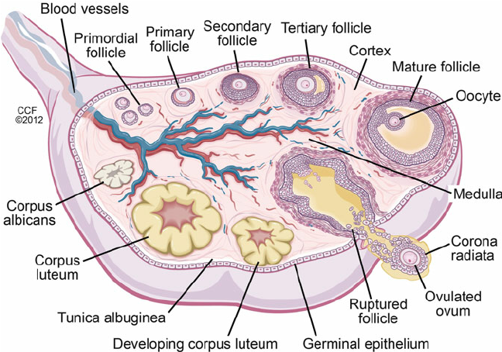
Primary Oocyte:
At 16th week , the cortical cords break up into isolated cell clusters: Primordial Follicles (Primary Oocytes)
Derived from the Primitive(primordial) Germ Cell | 1. Oogonium
A single layer of cells derived from the surface epithelium and surrounds the primordial follicle | 2.Follicular Cells
Active Mitosis of Oogonia occurs during fetal period producing thousands of primordial follicle
- (No New Oogonia Are Formed Postnatally) .
- Many oogonia degenerate .
- Two millions Oogonia (or so) enlarge to become Primary Oocytes (Before Birth).
شرح السلايد: (كل هالمراحل الي حتصير تكون قبل الولادة)
Cortical sex cord في الاسبوع 16 رح يبدا يتقطع الى قطع سميناها primary oocyte طيب ايش مكوناتها هذي ؟
شفتوا السكندري كورد كان مكون من surface epithelium و الخلايا اللي داخله primordial cells تمام ؟ تخيلوا انكم تقطعون هذا الكورد لقطع اكيد بتكون هالقطع نفس مكونات الكورد , فمن داخل بتكون primordial cells اللي بنسميها oogonium ويحيط فيه follicular cells اللي تكونت من ال surface epithelium
طيب ايش الفرق بين primordial follicle and primary oocyte and oogonia؟
ال primitive cells تعطينا oogonia وهي يصيرلها mitosis بحيث تنقسم ويزيد عددها و تنتج لي more oogonia بحيث الانثى تنولد بما يقارب 2 مليون
المهم oogonia لما يكبر حجمها يصير اسمها primary oocyte= primordial follicle
Postnatal Changes of the Ovary:
important
1.Surface Epithelium:
Flattened into a single layer and separated from follicles in the cortex by a thin tunica albuginea.
2. The ovaries descend:
from the posterior abdominal wall into the pelvis; just inferior to the pelvic brim(inlet).
شرح السلايد: (يعد الولادة)
بعد الولادة ايش التغيرات الي تصير للاوفاري؟
رح يغلف الاوفاري طبقة رقيقة لونها ابيض اسمها tunica albuginea
عكس عند ال male testis تكون سميكة و بعدين الاوفاري ينزل من الابدومن لل بلفس

Slide 9
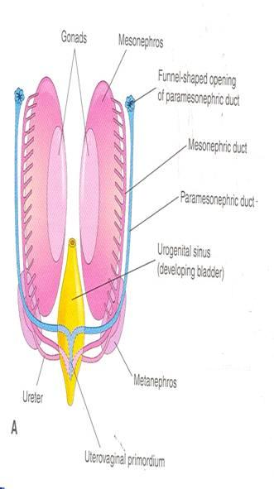
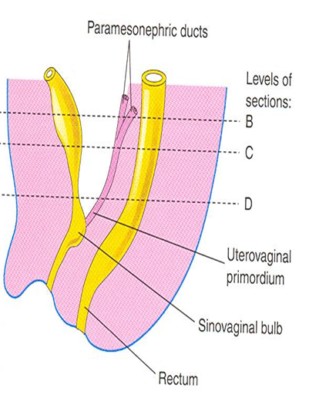
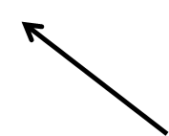
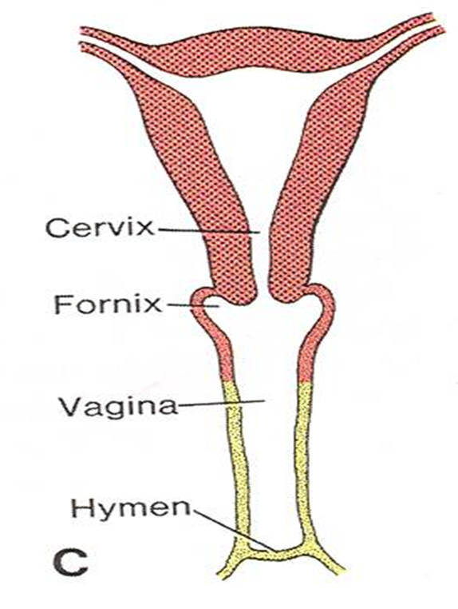
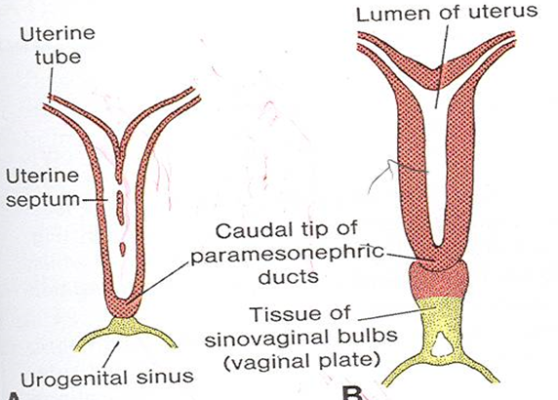
2- Development of the Female Duct System
لاتخافوا مرة السلايد بسيطة هي والي بعدها بتلاقوا شرحهم في سلايد رقم11
Derivatives Of Paramesonephric Ducts:
Uterine Tubes: develop from the cranial unfused parts of the ducts.
2. Uterovaginal Primordium:
It differentiates into:
Uterus (Body and Cervix)
Superior Portion of the Vagina.
- The endometrial stroma and myometrium are derived from the splanchinic mesoderm.
لو تذكرون lateral mesoderm رح ينقسم ل somatic and splanchnic :
Splanchinc اللي رح يكون المسؤول عن اللاينينق والمسل حقت اليوتيرس
Development of Lower Portion of Vagina
It is derived from the Urogenital Sinus:
- The contact of the uterovaginal primordium with the urogenital sinus induces formation of SinoVaginal Bulbs.
- The bulbs proliferate and fuse to form a solid Vaginal Plate.
اسمه كذا لان جزء منه رح يكون urethraوجزء بيكون famel genitalia
Differentiation of Vagina:
The central cells of the vaginal plate break down to form the lumen of the vagina.
The peripheral cells form the vaginal epithelium.
The lining of the entire vagina is derived from the Vaginal Plate (urogenital sinus).
The lumen of vagina is separated from the urogenital sinus by the Hymen
which remains as a thin fold of mucous membrane just within the vaginal orifice .
)غشاء البكارة)

Slide 10
Cont..
Both male and female embryo have two pair of genital ducts:
1- The mesonephric (wolffian’s ducts) for development of male reproductive system.
2- The paramesonephric (Müllerian’s ducts) for development of female reproductive system.
Only in male’s slide
- In female embryo:
1- The mesonephric ducts regressتضمحل)) due to absence of the testosterone hormone.
2-The paramesonephric ducts develop due to absence of MIS (Müllerian Inhibiting Substance).
- They do not depend on ovaries or hormones.
important
نتيجة لعدم وجود testosterone and MIS رح يطلع pair of duct موازيه لmesonephric duct اسمها mullerian or paramesonephric duct ف بما ان ظهورها يعتمد على غياب هذي الهرمونات فبالتالي مارح تطلع في الذكر لوجود هذي الهرمونات
The Paramesonephric Ducts:
- They form most of the female genital tract.
- They develop lateral to the gonads and mesonephric ducts.
- Their funnel-shaped cranial ends open into the peritoneal cavity.
- They pass caudally parallel to mesonephric ducts to reach the future pelvic region.
- They Cross ventral to the mesonephric ducts and approach each other in the median plane and fuse to form the Y shaped Uterovaginal Primordial.
(Uterovaginal Primordial: opens into the dorsal wall of the urogenital sinus and produces Paramesonephric (müllerian) Tubercle).

Slide 11
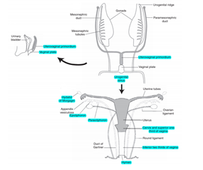
Explanation1
مافهمتوا اخر سلايدين ؟ حسيتوا ان الامبريو غثيث ؟ماعليكم الحل عندنا هنا الشرح لكن قبلها ضروري تشوفوا الفيديو
Very useful video
1. Paramesonephric duct will develop lateral to gonads and mesonephric duct
2. Paramesonephric duct:
Cranial part of Paramesonephric duct will open into peritoneal cavity and it will form the uterine tubes.
Caudal part of paramesonephric descend to pelvic رح يتلاقون from each side and they will form uterovaginal primoridium (Y shape) which then will differentiate into uterus and superior vagina.
Uterine tubes uterus and superior vagina are mesoderm in origin.
3. What about the lower vagina ?
Uterovaginal primordium will open into the dorsal wall of the urogenital sinus and the contact between them induces the formation of a pair of sinovaginal bulbs.
These bulbs are going to proliferate and fuse to from vaginal plate which is going to elongate and separate the upper vagina from lower vagina.
Central portion of Vaginal plate then is going to degenerate to form the lumen of the vagina.
A small portion will remain uncanalized called Hymen.
Lower vagina endoderm in origin.
)يعني رح يكون فاضي من داخل)

Slide 12
Explanation2
لسا مافهمتوا؟ هذا شرح مختصر وبشكل عام
شرح مختصر
الباراميزونفرك دكت عبارة عن 2 دكتس .. لهم (كرينيال ,ميدل,انفيريور بارتس)
اخر شي تعطينا شكل حرف Y تخيلوا:
- الكرينيال: كانها يدين - الميدل والانفيريور: كأنه جسم
- الجزئين الكرينال رح يكونوا منفصلين عن بعض ويفتحوا على البروتينم كافتي وبعدين رح يكونوا ( (uterine tubes
- الجزئين الميدل والانفيريور : رح يندمجوا مع بعض(يعني كانو 2 تيوب صاروا تيوب وحدة) وهذا التيوب نسميه (uterovaginal primoridium )
اللي بعدين رح يعطينا uterus and superior vagina
- اليوتيروفجاينال يروح يفتح داخل (urogenital sinus ) لما يفتح فيه يسويلي زي نتوء او جزء بارز اسمه (Tubercle)
اليوتيروفجانال يتكون جنبها من الجهتين (sinovaginal bulbs ) هذي البلب تمسك في بعض و تكون (vaginal plate )
هذي البليت تبدا تطول للاعلى تفصل اليوتيروفجانال عن اللور بارت
بعدين هذي البليت من الوسط تبدا تضمحل ويصير لها:
canalization -< lower vagina
ماعدا جزء فيها uncanalized -< Hymen

Slide 13
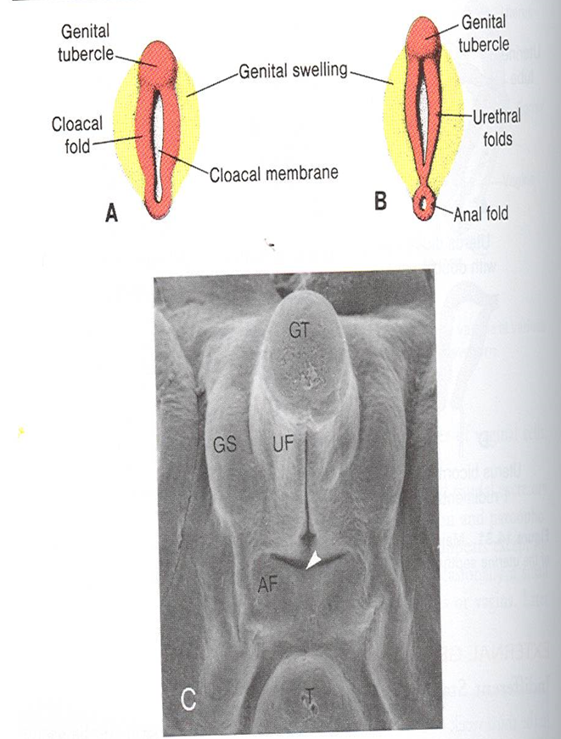
3- External Genitalia
Are Similar in both sexes up to the 7th week (indifferent stage).
Begin to differentiate in the 9th week
Fully differentiated by the 12th week
)المرحلة الجينتاليا ماصار فيها تغير ف لما الام تسوي سونوقرام ماتقدر نميز انثى او ذكر)
. ( تبدأ عملية التمايز لكن لسا الام ماتقدر تعرف نوع جنينها)
(هالمرحلة تتكتمل عملية التمايز أخيراً الام تعرف نوع جنينها)
Development of Female External Genitalia:
Proliferation of Mesenchyme at the Cranial end and sides of the Cloacal Membrane, forms:
1- Genital Tubercle) swelling in the tip of the cloacal membrane )
2. Urogenital Folds (Urethral Folds) internal
3. Labioscrotal Swellings (Genital Swellings) (GS) proliferate on Each Side of the cloacal membrane. external
- The ventral part of the cloacal membrane; the urogenital membrane lies in a median cleft the urogenital groove, the vestibule and bounded by the urogenital folds .
Very useful video
- هذي التغيرات تحصل بكلا الجنسين عشان كذا بالاسبوع السابع مانقدر نميز بينهم
Cloaca devided into two part :
Ventral part -> gives urinary bladder and urethra
Posterior part -> rectum and anal canal

Slide 14
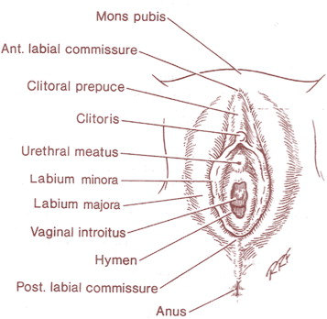
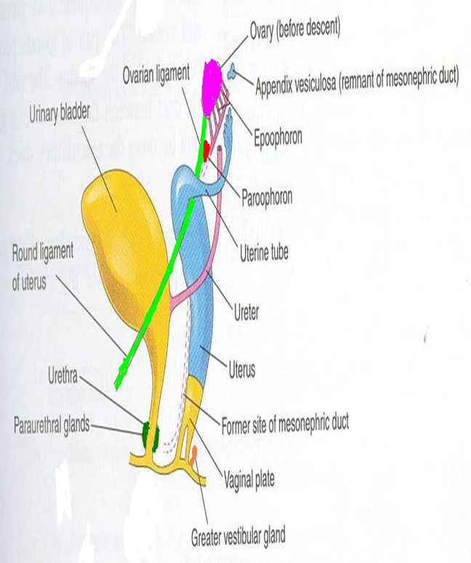
Feminization of External Genitalia )start at the 9th week)
تبدا عملية التمايز
Estrogen produced by both the placenta and the fetal ovaries has a role in feminization of the external genitalia.
The Genital Tubercle proliferates to form the Primordial Phalls.
(هذي المرحلة تصير في كلا الجنسين,التبركل تكبر شوية ويصير اسمها primordial phalls)
The phalls elongates slightly to form the Clitoris) in female).) In males elongate and form penis)
The Urethral Folds do not fuse and form the Labia Minora. )In males fused(
The Labioscrotal Folds form the Labia Majora , they fuse) anteriorly & posteriorly) to form the Posterior & the Anterior Labial Commissures.
Female Sex Glands
1. Urethral and Paraurethral Glands: (These glands are only in female)
grow as buds from the urethra, they are corresponding to the Prostate Gland of the male.
2. Greater Vestibular glands (Bartholin glands): (this gland is only in female)
Outgrowths of the urogenital sinus, they are corresponding to the Bulbourethral Glands of the male.
- بإختصار هنا يقولك كل قلاند في الفيميل و من فين تطلع؟ وايش يقابل هالقلاند في الميل

Slide 15
Congenital Anomalies
- Various types of anomalies can result due to:
1. Fusion of the two paramesonephric duct happen in the 8th week and failure of fusion will cause anomalies in uterus cervix , or upper vagina
4. Incomplete canalization⁴.
5. Failure of parts of one or both paramesonephric ducts to develop⁵.
3. Incomplete fusion of the paramesonephric ducts.
2. Incomplete development of the paramesonephric ducts².
1. Arrest of development of the uterovaginal primordium during the 8th week¹.
2 .One or both of them
بالتالي مارح يتكون عندي4. Cavity
Congenital Anomalies
مثلا لو ماتكون عندنا cranial part 5.
fallopian tube مارح يتكون

Slide 16
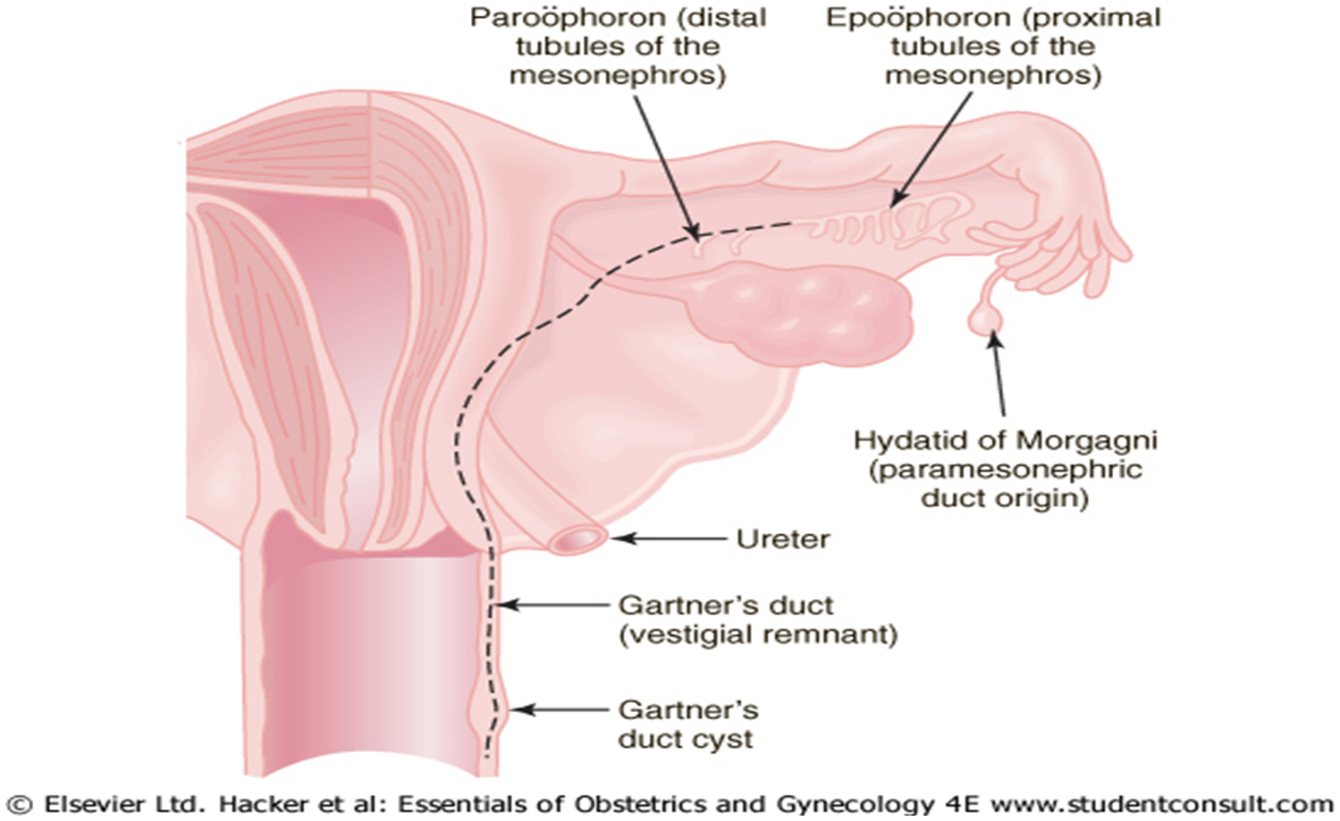
Congenital Anomalies
- Remnants of the mesonephric (wolffian) ducts may persist in the anterolateral wall of vagina or adjacent to the uterus within the broad ligament or mesosalpinx.
شرح السلايد: (امشوا مع الوان المربعات والصورة)
Mesonephric duct normally in female degenerate , but in male persist and become vas deferens
-هذي الدكت يطلع منها بروكسمال وديستال تيوبيول ايش يصير اذا بقت في الأنثى ؟
If distal persist:
We call it Paroophoron.
If proximal persist:
Appear like cyst lateral to uterus and called “epoophoron”.
طيب لو الدكت بكبرها بقت؟
نسميها gartner’s duct
واحيانا نهاية الدكت يكون فيها سيست هنا نسميها “” gartner’s duct cyst
و هذول مايعتبروا ورم وانما كونجينتال انوماليز بس

Slide 17
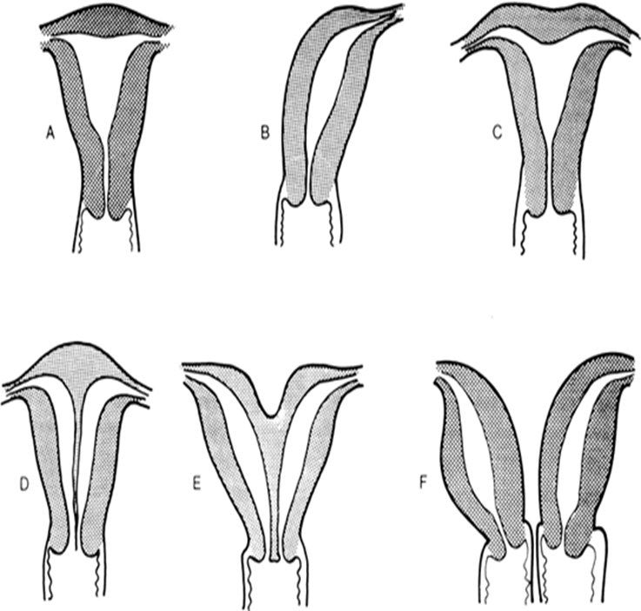
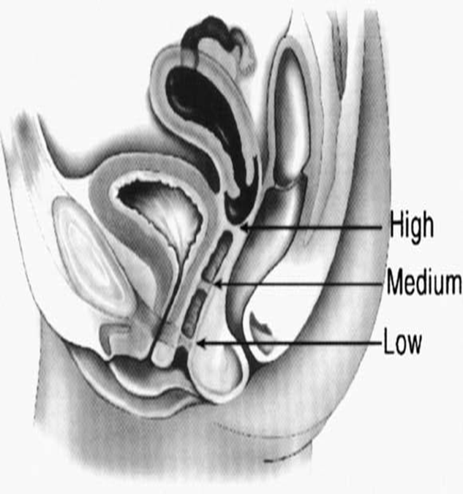
Congenital Anomalies
1- Uterine Malformations
Due to failure of fusion of inferior parts of the paramesonephric ducts. May be associated with a double or single vagina. | 1- Double uterus (Uterus Didelphys)(F)
The duplication involves the superior segment. No fusion of the upper part | 2. Bicornuate uterus(E)
One paramesonephric duct fails to develop | 3.Unicornuate Uterus(B)
 | 4. Arcuate Uterus(C)
2دكتس مارح يندمجوا ويكونوا الجزي السفلي ف كل دكت رح تسوي رحم لحالها
Normal
Unicornuate
Arcuate
ركزوا دكت وحدة ما تكونت مو المشكلة بالفيوجن
Septate
Bicornuate
Double
Upper segment curved like arch
2- Cervical Atresia
It may be combined with incomplete development of the upper vagina or lower uterus.
3- Vaginal Anomalies
3- Transversely septate vagina: results from faulty canalization of the fused müllerian ducts. | 2- Double vagina | 1-Atresia (Partial or complete).
No fusion of paramespnephric duct -> two vagina
ممكن هذي الانوملي ترتبط مع double uterus
مارح يكون فيه complete canalization فبالتالي بيكون فيه لفواصل (septa) ورح تعيق الحمل والولادة

Slide 18
Summary
4th week | Appearance of the Primordial germ cells
5th week | Appearance of the Gonadal Ridge
6th week | Migration of the Primordial germ cells to the Gonadal Ridge
7th week | The gonad acquires Female or Male morphological characteristics.
 | The external genitalia are similar in both sexes.
9th week | The external genitalia begin to differentiate
10th week | The ovary is identifiable histologically
12th week | The external genitalia are fully differentiated
16th week | The cortical cords break up into isolated cell clusters: Primordial Follicles (Primary Oocytes)
Before birth | About two million oogonia enlarge to become Primary Oocytes

Slide 19
Summary
Mullerian ducts (Paramesonephric Ducts) | Female internal genital Organs → Upper Vagina , Cervix, Uterus & Fallopian Tubes.
Urogenital sinus | Female external genitalia → Lower vagina.
Genital Tubercle | Primordial Phalls → Clitoris.
Urethral Folds | Labia Minora.
Labioscrotal Folds | Labia Majora.
SinoVaginal Bulbs | Vaginal Plate.
splanchinic mesoderm | endometrial stroma and myometrium .
intermediate mesoderm | Genital (Gonadal) Ridge.
Primitive Germ Cell | Oogonium.
surface epithelium (Sex Cord) | Follicular Cells.
Vaginal Plate | The lining of the entire vagina.
Anomalies summary
Uterus Didelphys | Due to failure of fusion of inferior parts of the paramesonephric ducts.
Bicornuate uterus | The duplication involves the superior segment.
Unicornuate Uterus | One paramesonephric duct fails to develop.
Cervical Atresia | incomplete development of the upper vagina or lower uterus
Transversely septate vagina | Results from faulty canalization of the fused mullerian ducts

Slide 20
MCQ’s
8- what is the origin of ovaries ?
a) endoderm b) intermediate mesoderm c) mesoderm d) ectoderm
9- what is the origin of Fallopian tube, body of uterus, cervix and upper part of vagina ?
a) endoderm b) intermediate mesoderm c) mesoderm d) ectoderm
10- What is the origin of lower vagina ?
a) endoderm b) intermediate mesoderm c) mesoderm d) ectoderm
11- what is the origin of the muscle layer and lining of uterus ?
a) endoderm b) intermediate mesoderm c) mesoderm d) splancnic mesoderm
12- failure of fusion of inferior parts of the paramesonephric ducts lead to:
a) double uterus (Uterus Didelphys) b) bicornuate uterus
c) unicornuate uterus d) arcuate uterus
13- external genitalia begins diﬀerentiation at:
7th week b) 8th week c) 9th week d) 12th week
14- faulty canalization of the fused müllerian ducts lead to:
a) cervical atresia b) vaginal atresia c) double vagina d) transversely septate vagina
1- at what week of pregnancy does the gonadal ridge appear ?
4th week b) 5th week c) 6th week d) 16th week
2- the primordial germ cells migrate to the gonadal ridge at :
a) 4th week b) 5th week c) 6th week d) 16th week
3- morphological characteristics of gonad are acquired at:
a) 5th week b) 6th week c) 7th week d) 10th week
4- female primary reproductive organ is histologicaly identiﬁable at:
a) 5th week b) 6th week c) 7th week d) 10th week
5- in any embryo degradation of mesonephric duct is due to:
a) presence of testosterone
b) absence of testosterone
c) presence of Müllerian Inhibiting Substance
d) absence of Müllerian Inhibiting Substance
6- in a female embryo failed to develop paramesonephric ducts, what went wrong ?
presence of testosterone
b) absence of testosterone
c) presence of Müllerian Inhibiting Substance
d) absence of Müllerian Inhibiting Substance
7- at what given week a mother can know the sex of her baby?
a) 7th week b) 8th week c) 9th week d) 12th week
1.b, 2.c, 3.c ,4.d, 5.b, 6.c, 7.d, 8.b, 9.c, 10.a, 11.d 12.a 13.c 14.d

Slide 21
References
ANY SUGGESTIONS OR ISSUES
Dr.slides (male and female).
Embryology team 435 .
USEFUL VIDEOS
https://www.youtube.com/watch?v=MureNA-RSZM
https://www.youtube.com/watch?v=EO6kRLtTZW0
https://www.youtube.com/watch?v=JPkljbZioIQ
@Embryology436
Embryology
436
Embryology436@gmail.com
Editing file
Your Suggestion here

Slide 22
TEAM MEMBERS
TEAM LEADERS :
Yazeed Almutairi
G I R L S :
Nehal Beyari
Razan Alotaibi
Do'aa Walid
Ohood Abdullah
Nouf Alogaily
Thikrayat Omar
Desgined by:
MUHANNED ALZAHRANI

