Slide 1

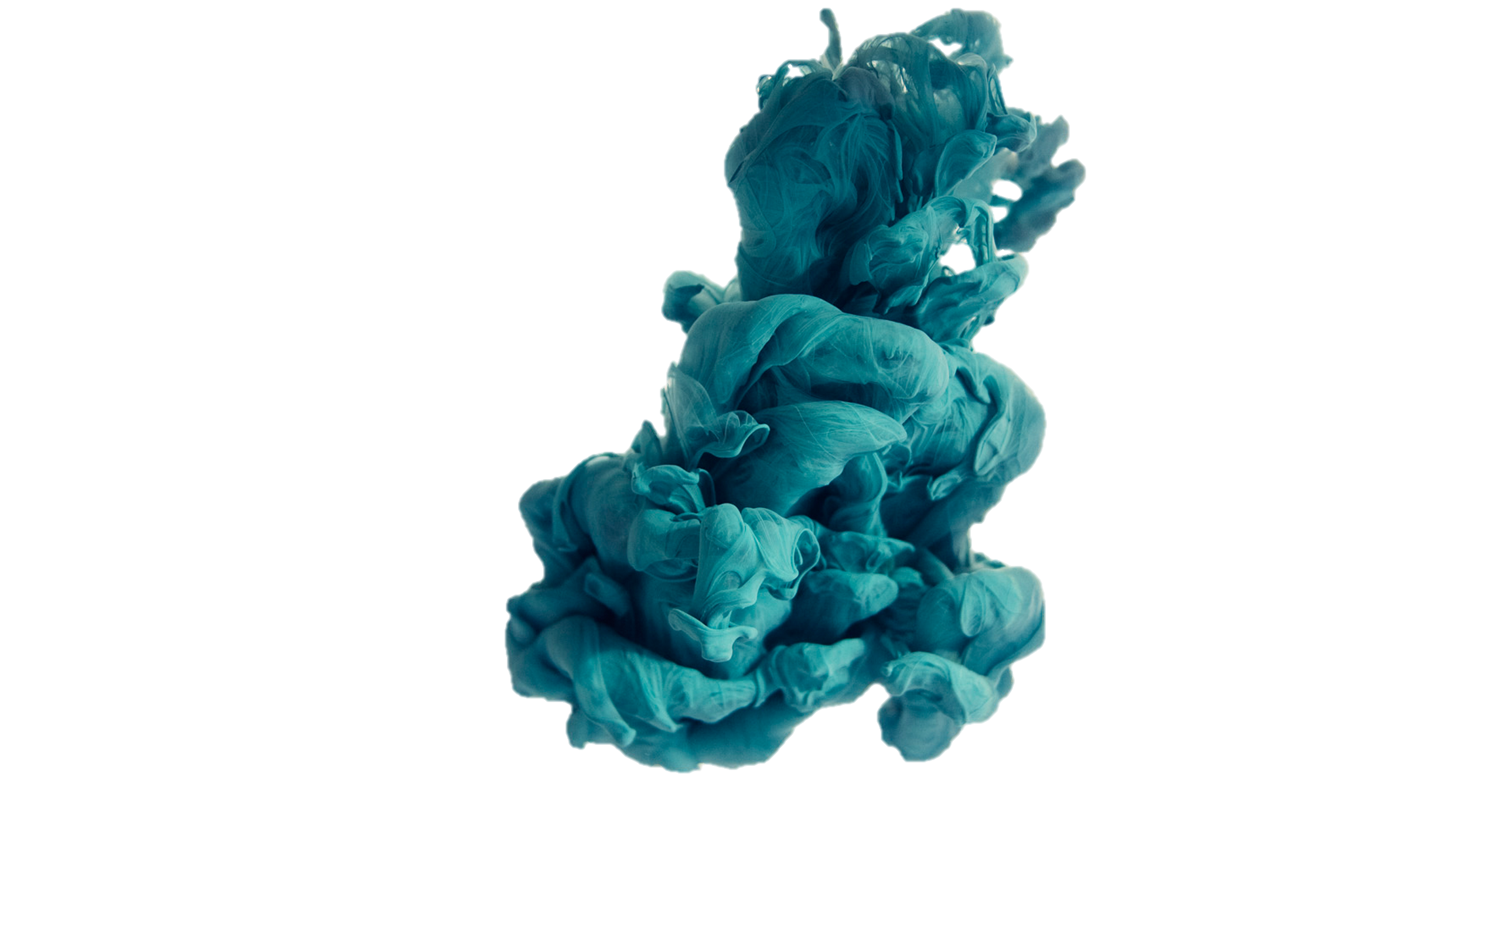

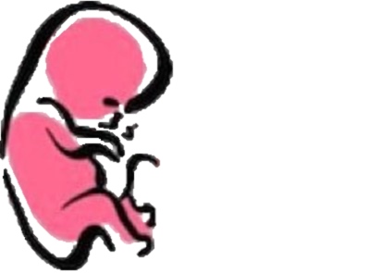



FERTILIZATION AND
IMPLANTATION
﴿ إِنَّا خَلَقْنَا الإنسان مِنْ نُطْفَةٍ أَمْشَاجٍ نَبْتَلِيهِ فَجَعَلْنَاهُ سَمِيعًا بَصِيرًا ﴾
Embryology
436
Important
Dr. notes Explanation

Slide 2
O B J E C T I V E S
At the end of the lecture, students should be able to:
•Identify fertilization and its site.
•List the phases of fertilization.
•Describe the results of fertilization.
•Describe the formation of blastocyst.
•Identify implantation and its site.
•Describe the mechanism of implantation.
•Describe the formation of primary chorionic villi.
•List the sites of ectopic pregnancy

Slide 3


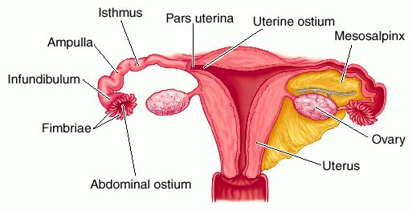
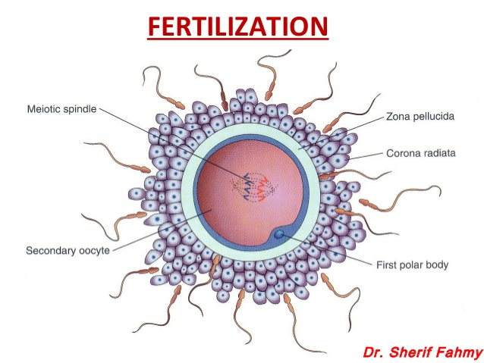
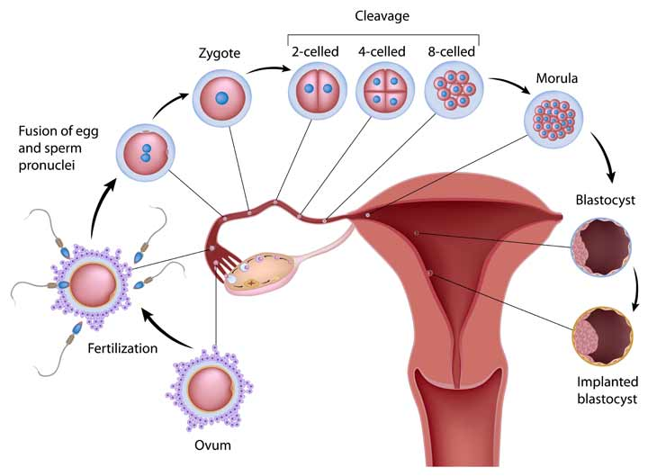
Fertilization
Fertilization:
It is the process during which a male gamete (sperm) unites with a female gamete (oocyte) to form a single cell (ZYGOTE).
Another Definition:
- It is a complex process.
- It begins with a contact between sperm & ovum.
- Ends up with intermingling ((اتحاد of the maternal and paternal chromosomes. 23 from each parent = 46 at the end
-Where does fertilization occur?(most common site)
-Usually in the ampulla widest and lateral part of the uterine tube (Fertilization may occur in any other part of tube).
-Never occurs in the uterine cavity.
ممكن يصير في أي مكان داخل اليوتراين تيوب لكن مستحيل يصير في اليوتراين كافيتي
-ايش الأشياء الي تساعد (guide) ال sperm انه يوصل لل utrine tube؟
1- Chemical signal from oocyte attracts the sperms. 2-by Tail of sperm 3-cilia of uterine tube 4- peristaltic movement of uterine tube.
Sperm Capacitation:
(متى وفين يقدر يتحرك ال sperm بحرية)؟
• Occurs in the female genital tract before fertilization
It is stimulated by secretions in the vagina, uterus, and uterine tubes.
•Naturally it takes 6-7 hours.
•Results in capability of the sperm to pass through the corona radiata.
•Involves removal of surface coatings and changes in plasma membrane.
•Can be produced in vitro(IVF) by washing with special solution.
شرح السلايد:
السبيرم قبل مايدخل female system يكون حركته ضعيفة . متى يقدر يتحرك؟ اذا دخل female system هذي العملية تاخد من 6-7 ساعات
كيف طيب؟الأعضاء التناسلية للفيميل تفرز زي انزيمات تروح تكسر القيود والغشاء حول السبيرم عشان يصير يقدر يتحرك اسرع ويقدر يخترق ال oocyte
-طيب لما يصير تلقيح صناعي برا الرحم ) IVF)في المختبرات ايش يسوا؟
يجيبوا انزايمز مشابهه تفرزها الأعضاء التناسلية للفيميل بحيث تسهل حركة السبيرم وتخليه يخترق الكرونا رايديتا بسهولة

Slide 4
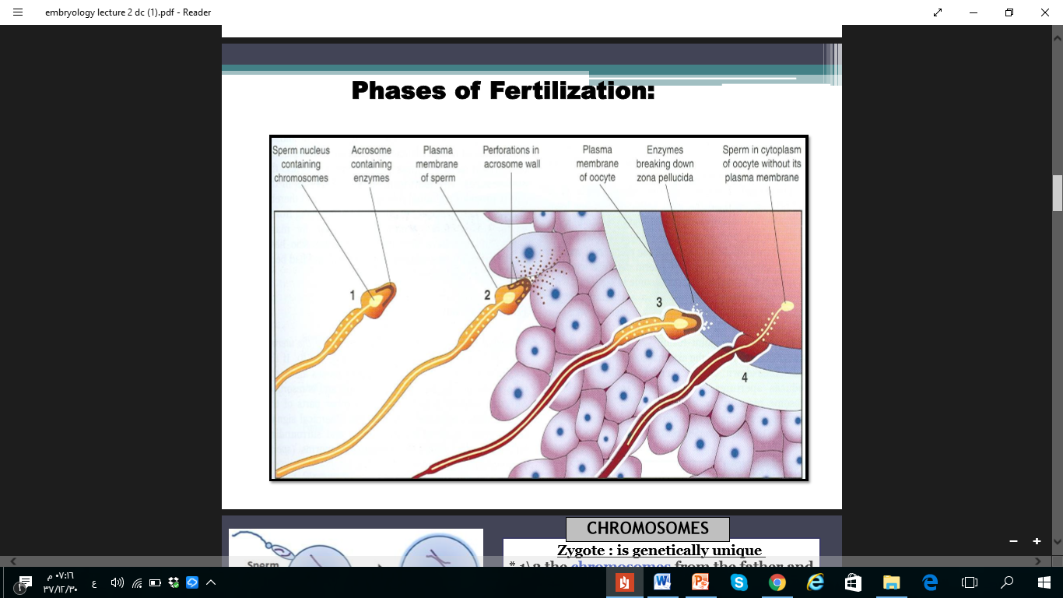
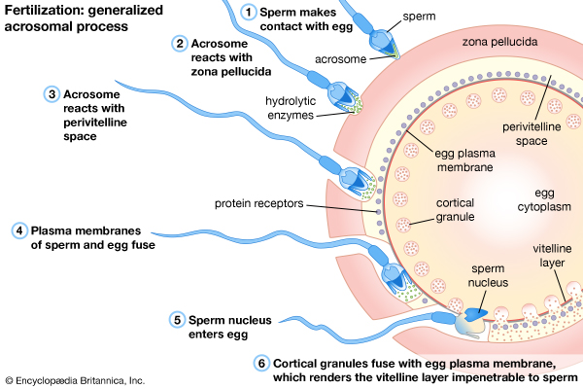
Phases of Fertilization
Very very important
-(انتبهوا في اول نقطتين بالذات على أسماء الانزايمز) بحطلكم هي باللون الأزرق
-(انتبهوا ان فكرة السلايد يقولكم كيف تصير عملية الفيرتلايزيشن؟)
Sperm pass through corona radiata by the effect of:
1-hyaluronidase enzyme secreted from the sperm 2-By movement of its tail
Penetration of the zona pellucida by acrosine
(substance secreted from acrosomal cap)
Fusion of the plasma membranes of the oocyte and the sperm
Union of the 2 pronuleii
Formation of the female pronucleus and male pronucleus
Completion of the second meiotic division of the oocyte*
1-Passage
2-Penetration
3-Fusion
4-Completion
5- Formation
*We have two stages of maturation (meiotic):
1- first meiotic division :arrest at prophase
2-second meiotic phase arrest at metaphase
-في مرحلة( 4) oocyte كانت واقفة عند ال metaphase اثناء عملية الفيرتلازيشن تكمل انقسامها يعد ال metaphase
6- Union

Slide 5
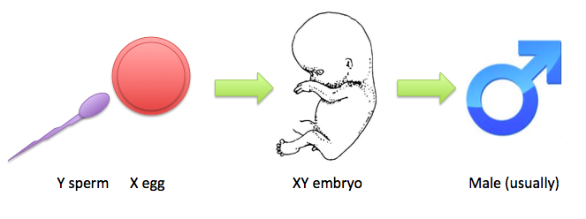
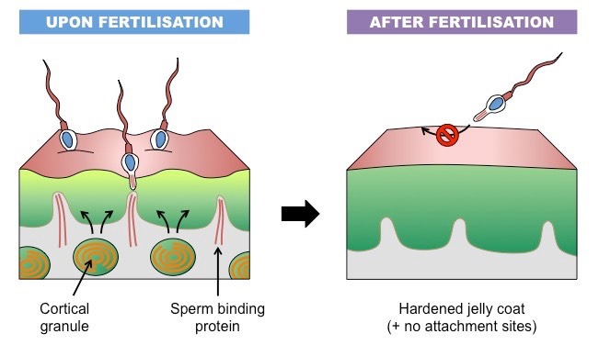
Chromosomes In The Zygote
Zygote is genetically unique.
Half of its chromosomes comes from the father and the other half comes from the mother.
New combination is formed which is different from either of the parents.
This mechanism forms biparental inheritance and leads to variation of the human species.
لما تجتمع23 كروموسوم تحتوي صفات الأم الجينية و23 كروموسوم من الاب تحمل صفاته
راح يطلع مخلوق جديد ب46 كروموسوم بصفات جديدة غير مطابقة تماما للام ولا للاب بل هي متكونة نتيجة لدمج جيناتهم
Sex of the Embryo:
•Embryo's chromosomal sex is determined at the time of fertilization.
•Sex is determined by the type of sperm (X or Y) that fertilizes the oocyte.
•So, it is the father whose gamete decides the sex.
(الأب هو اللي يحدد نوع الجنس)
Zonal reaction :
it is a change in properties of zona pellucida that makes it impermeable to other sperms.
اول ما يخترق السبيرم طبقة الزونا بليوسيدا هذي الطبقة يصير فيها تفاعلات بحيث تغير في خصاصها وتقفل على نفسها بحيث تمنع أي سبيرم ثاني يدخل

Slide 6
Results of Fertilization :
Very very important
(فرقوا بينها وبين سلايد4 هناك كان يتكلم عن المراحل اما هنا يتكلم عن النتيجة النهائية للفيرتيلايزيشن )
1.Stimulates the penetrated oocyte to complete its 2nd meiotic division
2.Restores the normal diploid(46 chromosome) number of chromosomes.
4.Initiates cleavage (cell division) of the zygote.
3.Determines the sex of the embryo.
- Zygote is formed by union of Female & Male pronucleus
ايش معنى هالكلام؟ يعني يتحدد الجنس كروموسوميا فقط اتذكروا اخذناه في محاضرات الميد ☹
يبدا الزيجوت أخيرا بالانقسام

Slide 7
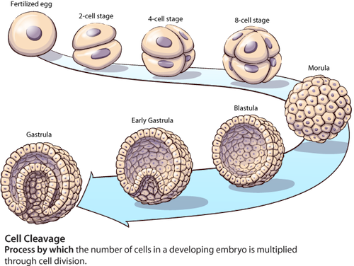
Cleavage of Zygote:
-(اهم شي ابغاكم تعرفوه اثناء الانقسام الزيجوت يكون محاط من برا بــ (zona pellucida
• It begins about 30 hours after fertilization.
• It is the repeated mitotic divisions ((زيادة في العددof the zygote.
• Site: in the uterine tube.
• Rapid increase in the number of the cells.
• These smaller embryonic cells are now called, Blastomeres.
• Zygote divides from one cell into 2, then 4, then 8, then 16 cells.
• Zygote lies within the thick zona pellucida during cleavage.
• Zygote migrates in the uterine tube during cleavage from lateral to medial (by cilia).
• Under the microscope, the zona pellucida is a translucent membrane
شرح السلايد:
طيب الزيجوت المسكينة☹ ترتاح وبعد 30 ساعه من بعد الفيرتلايزيشن تبدا تنقسم من خلية الى 2 ,4 ,8 ,16 ,هكذا كل مرة نضرب الناتج x2
-المهم كل ماتنقسم اكثر: 1- كل ماحجم الخلية تقل 2-كل ماتمشي الزيجوت المنقسمة from lateral to medial
-هذي الخلايا المنقسمة نسمها blastomeres ونجي للنقطة المهمة هذي السلز مغلفة من برا بـ thick zona pellucida
-طيب عملية الانقسام فين تصير؟
Utrine tube

Slide 8
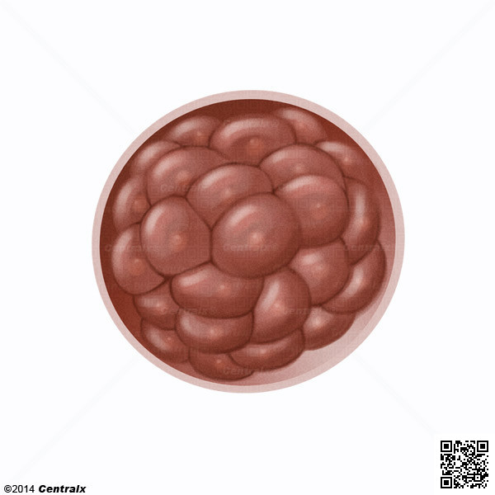
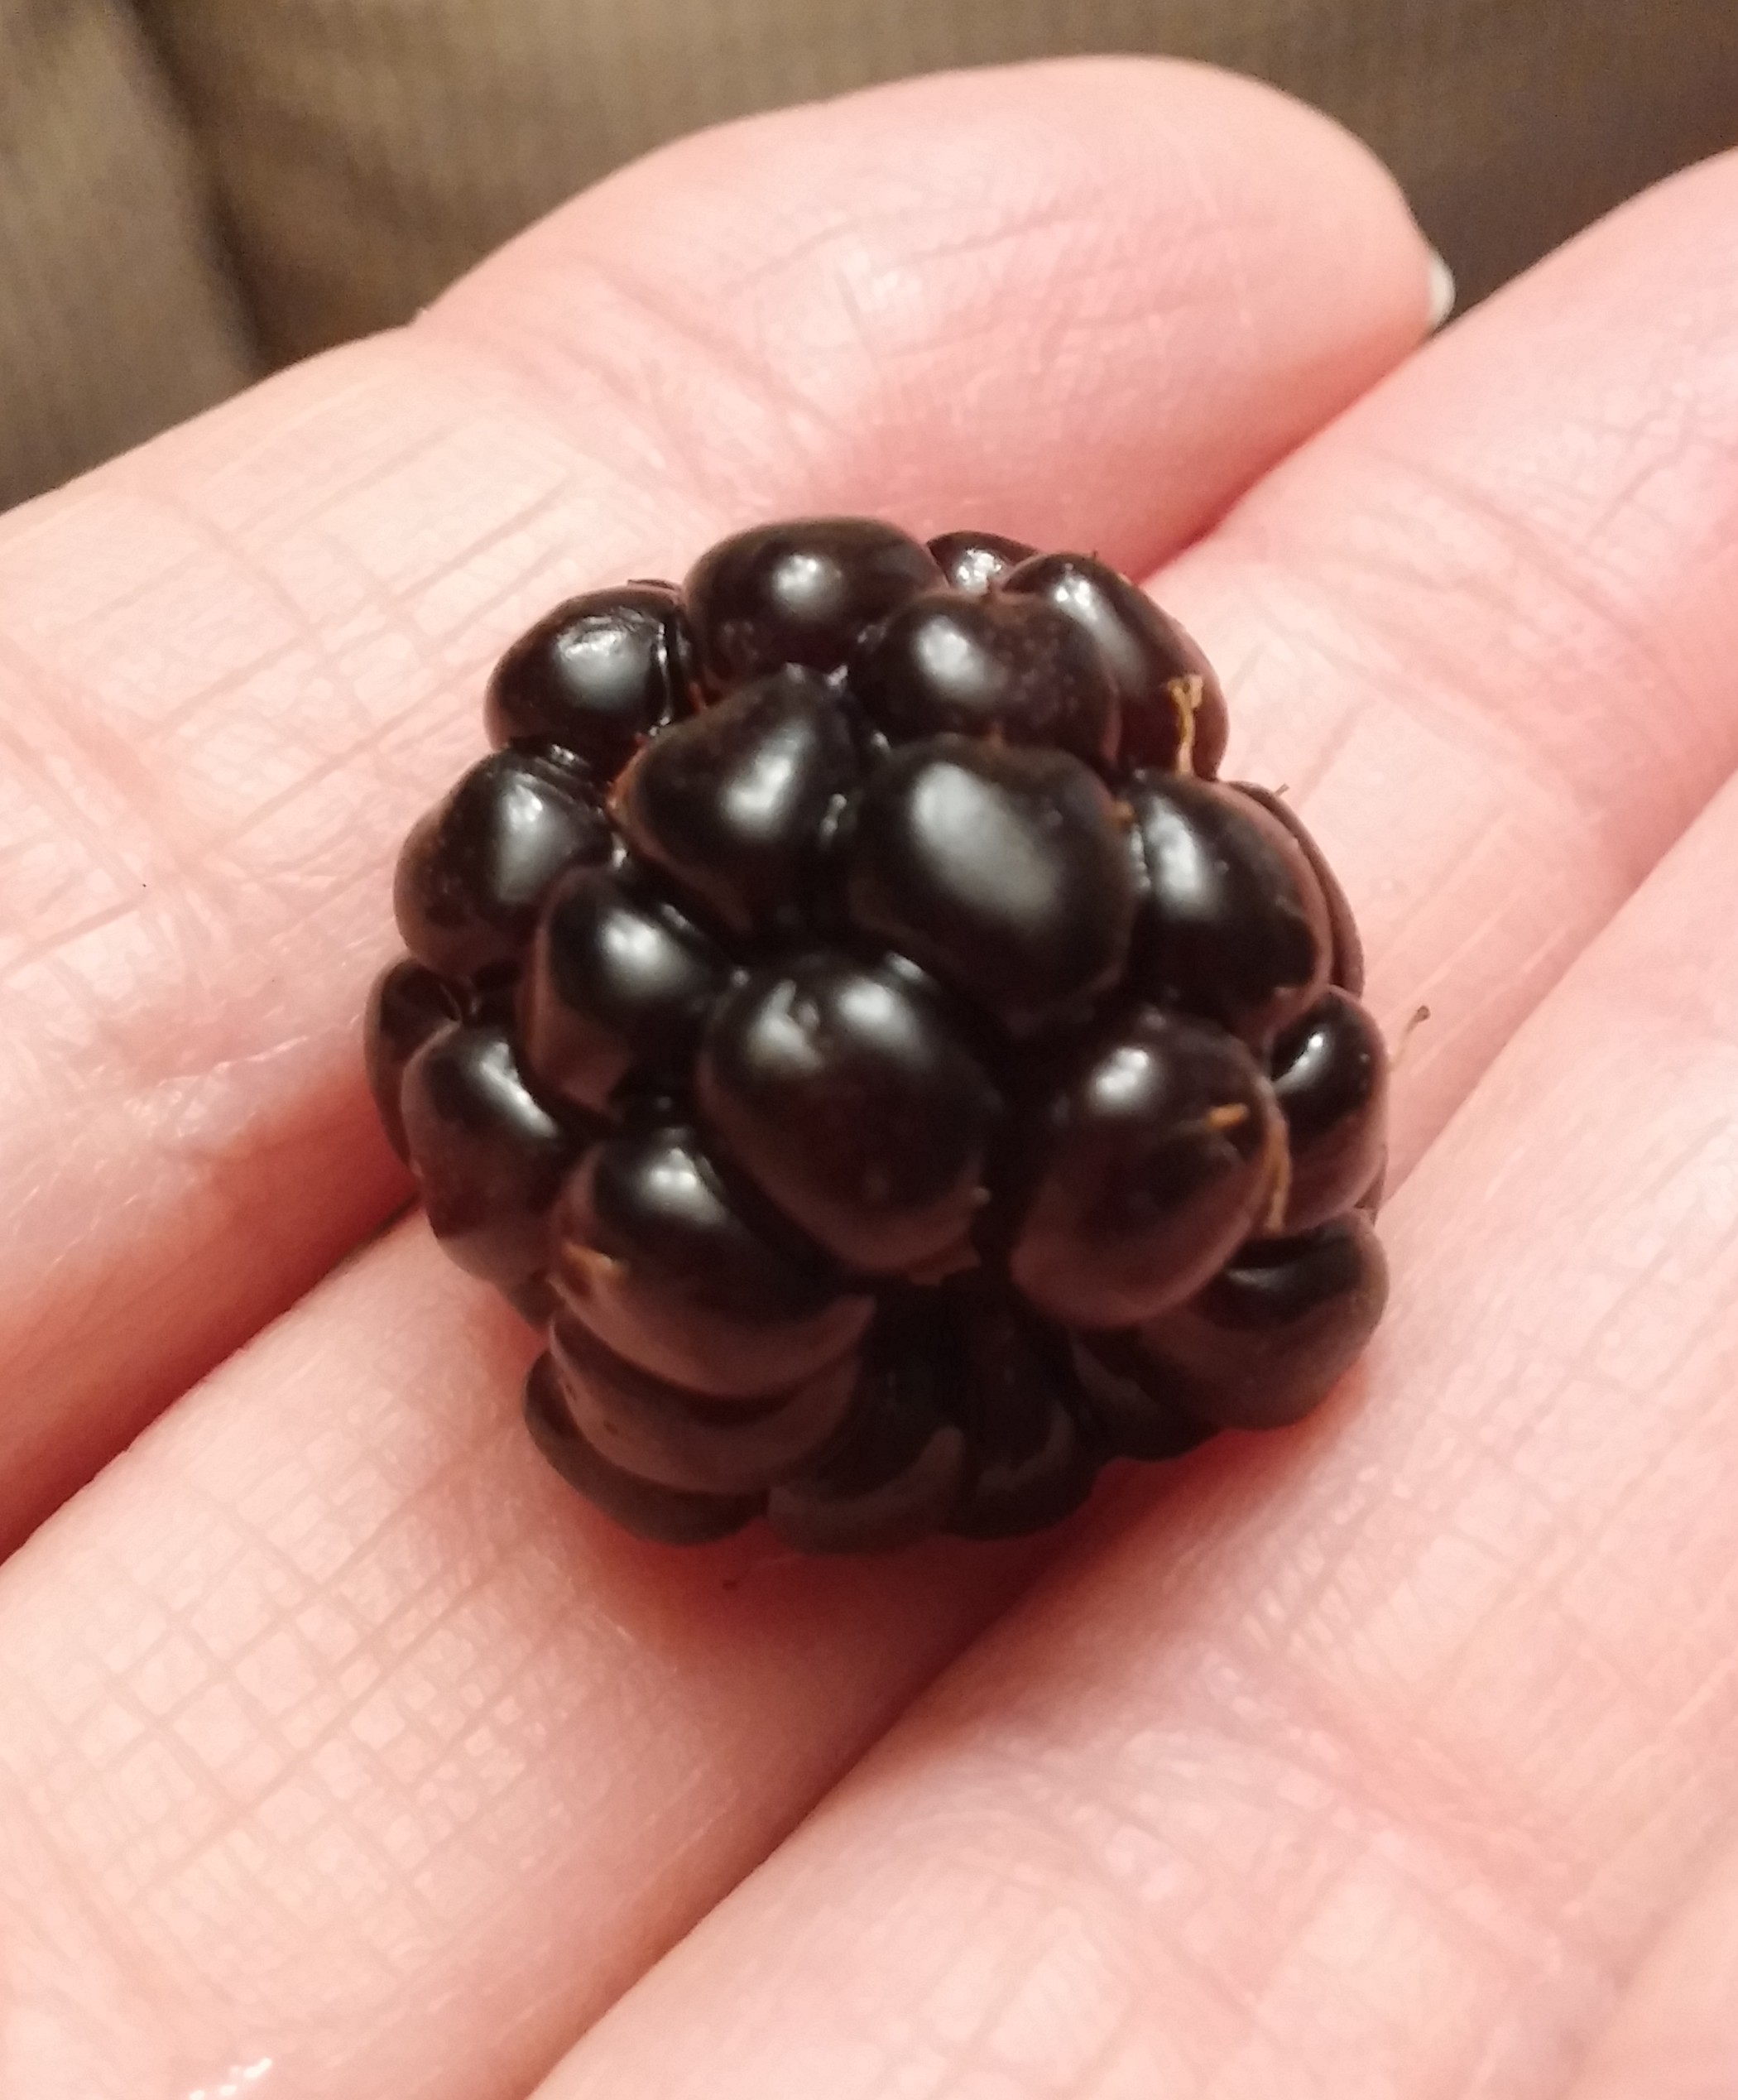
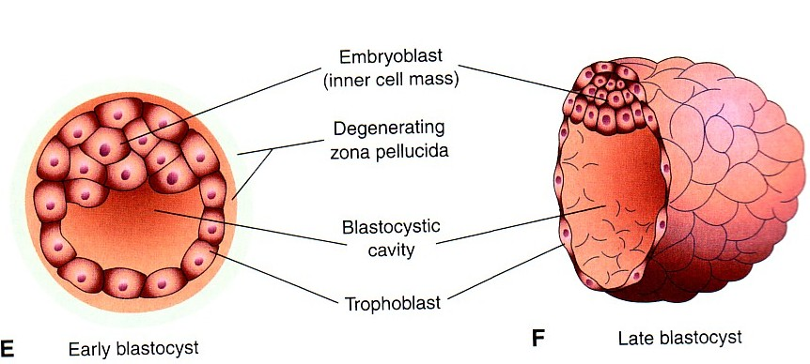
-Morula:
16-32 cells blastomeres + zona pellucida = Morula
- When there are 16-32 blastomeres the developing human is called MORULA.
-The spherical Morula is formed about 3 days after fertilization.
- It resembles mulberry or blackberry.
-Mechanism of blastocyst formation:
- The Morula reaches the uterine cavity by the 4th day after fertilization and remains free for one or two days.
Fluid passes from uterine cavity to the Morula.
By the 5th day the Zona pellucida degenerates.
- Now the morula called blastocyte
-Blastocyst:
A cavity appears within the morula dividing its cells into 2 groups:
1.Outer cell layer called trophoblast.
2.Inner cell layer (mass) called Embryoblast attached to one of the
poles of the blastocyst.
The cavity is called blastocystic cavity or blastocele.
شرح السلايد:
تتذكروا الزيجوت المنقسمة في السلايد الماضي اذا عدد الانقسامات صار (16-32) خلية هنا يصير اسمها Morula (ولاتنسوا انها محاطة بـ (zona pellucida
الmorula تتكون خلال 3 أيام بعد الفيرتلازيشن
- خلينا نتفق الى الان كل هالمراحل صارت في utrine tube
في اليوم الرابع الميريولا تنط داخل الutrine cavity وتجلس هناك ماتسوي شي لمدة يوم ليومين (نستكشف المكان).
Uterine cavity يفزر فلويد الميريولا تشرب تشرب هالفلويد ايش رح يصير لها؟ رح تسمن ☹ وتكون مليانة فلويد من جوا طيب تتذكروا الملابس الي كانت لابستها الميريولا؟(zona pellucida) هذي الملابس صارت ضيقة عليها ف اليوم الخامس رح تتقطع ويصيرلها degenration ☹
الميريولا عشان تخفي جريمتها تروح تتنكر و تغير تركيبهاو اسمها وتصير blastocyte
تعالوا نتكلم عن البلاستوسايت :تتذكروا المكان الي تجمع فيه الفلويد رح يصير من الداخل كافتي فاضي
رح تتكون عندي خلايا داخلية وخارجية . الداخلية: اسمها امبريو بلاست تتجمع في جهة وحدة من البلاستوسايت وهي الجهة الي بعدين تكون الجنين
الخلايا الخارجية : اسمها تروفوبلاست تعطيني الأشياء الي تدعم الجنين وتغذيه اثناء تكونه مثل :الامبلايكال كورد و البلاسينتا

Slide 9
Implantation
Implantation
Definition:
It is the process by which the Blastocyst penetrates the superficial (Compact) layer of the endometrium of the uterus.
Site:
The normal site of implantation is the posterior wall of the body of the uterus near the fundus.
Time:
It begins about the 6th day after fertilization.
•It is completed by the 11th or 12th day.
-Implantation = beginning of pregnancy, it is the penetration into endometrium

Slide 10
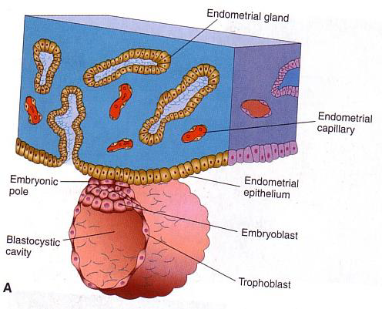
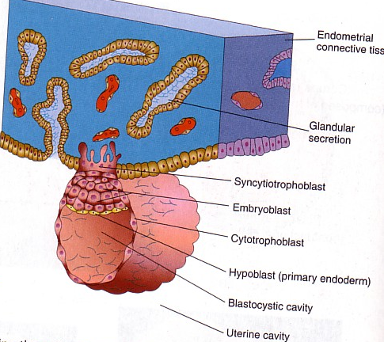
Mechanism of Implantation
Very very important
• Blastocyst begins implantation by the 6th day.
• Trophoblast cells (Finger like projection) penetrate the epithelium of the endometrium (utrine mucosa).
• Penetration results from proteolytic enzymes (eg.COX-2) produced by the trophoblast.
-So who begins implantation? Trophoblasts of the pole
•Zona pellucida degenerates & disappears by the 5th day to allows the blastocyst to increase in size and penetrates the endometrium.
•The embryoblast projects into the blastocystic cavity, while the trophoblast forms the wall of the blastocyst.
•By 6th day the blastocyst adheres to the endometrium and beginning of penetration.
•By 7th day, Trophoblast differentiated into 2 layers:
1- Cytotrophblast, inner layer, mitotically active.
2- Syncytiotrophoblast (outer multinucleated mass, with indistinct cell boundary) (Finger like projection)
(Invasion of endometrium continues with Syncytiotrophoblast)
By 8th day the blastocyst is superficially embedded in the compact layer of the endometrium.
شرح السلايد :
- تتذكروا ال )(zona pelucida) لماكانت موجودة كانت تحمي من عملية الالتصاق والامبلانتيشن لكن لما تختفي ع طول يصير امبلانتيشن )
- في اليوم السادس: البلاستوسيست تلتصق بجدار الرحم و تبدا عملية الامبلانتيشن
-التروفوبلاست تشبه الأصابع تروح تخترق جدار الرحم تفرز انزايمز يساعدها
- التروفوبلاست ينقسم الى نوعين في اليوم السابع
- ف اليوم الثامن هذي البلاستوسيست تسوي امبلانتيشن وتكون مرتبطة مع جدار الرحم بشكل سطحي

Slide 11
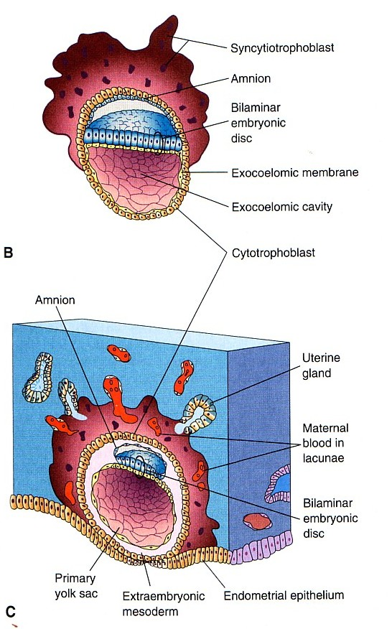
Cont..
• Endometrial cells undergo a process called apoptosis (programmed cell death) to facilitates invasion of endometrium by the Syncytiotrophoblast.
• Syncytiotrophoblast engulf these degenerated cells for nutrition of the embryo.
•Blood-filled Lacunae appear in the Syncytiotrophoblast which communicate forming
a network by the 10th or 11th day.
•Syncytiotrophoblast erodes the endothelial lining of the maternal capillaries which known as sinusoids.
Now blood of maternal capillaries reaches the lacunae so Uteroplacental circulation is established by 11th or 12th day.
Implantation:
can be detected by:
1- Ultrasonography. →Bulging area in uterine wall
2- hCG (human chorionic gonadotrophin which is secreted by the Syncytiotrophoblast) about the end of 2nd week
(HCG can measured in both the blood and urine to determine if a woman is pregnant)
Important!!
شرح السلايد :
احنا قلنا قبل ان التروفوبلاست في اليوم السابع انقسمت لنوعين : حنتكلم عن نوع فيهم
بعد الانقسام السينسيتيوتروفوبلاست تشبه الأصابع هي الي تكمل عملية الاختراق خلال هالعملية السلز الي في رحم الام جالسة تموت وفي نفس الوقت السينسيتيوتروفوبلاست تتغذا عليها
Lacunea: accumlaion of blood vessles

Slide 12


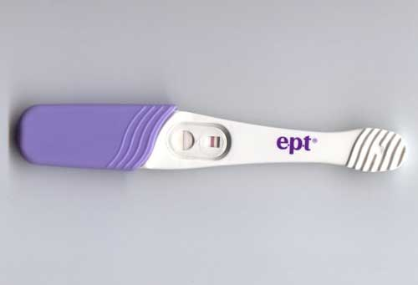
Early Pregnancy Factor (EPF)
important
•Is an immunosuppressant protein
(Function: is to prevent the immune system from attacking the new embryo).
•Secreted by trophoblast cells.
•Appears in maternal serum within 24-48 hrs., after implantation.
•It is the basis for EPT (Early pregnancy test) in the first 10 days of development.
*ليش تظهر؟ احنا نعرف أي شي يدخل جسمنا ويكون غريب مناعتنا واجسامنا تهاجمه عشان كذا سبحان الله تنفرز هالبروتينات عشان الجسم مايحارب الجنين
تفرزها التروفوبلاست بعد يوم الى يومين بعد الامبلانتيشن يعني(8-7 اياام بعد الفيرتلايزيشن) الى هذا الوقت بس هالمادة تبان عندي في الدم
-بعد 10 -14 يوم تقدر الام تسوي EBT ويبين في ال Urine

Slide 13
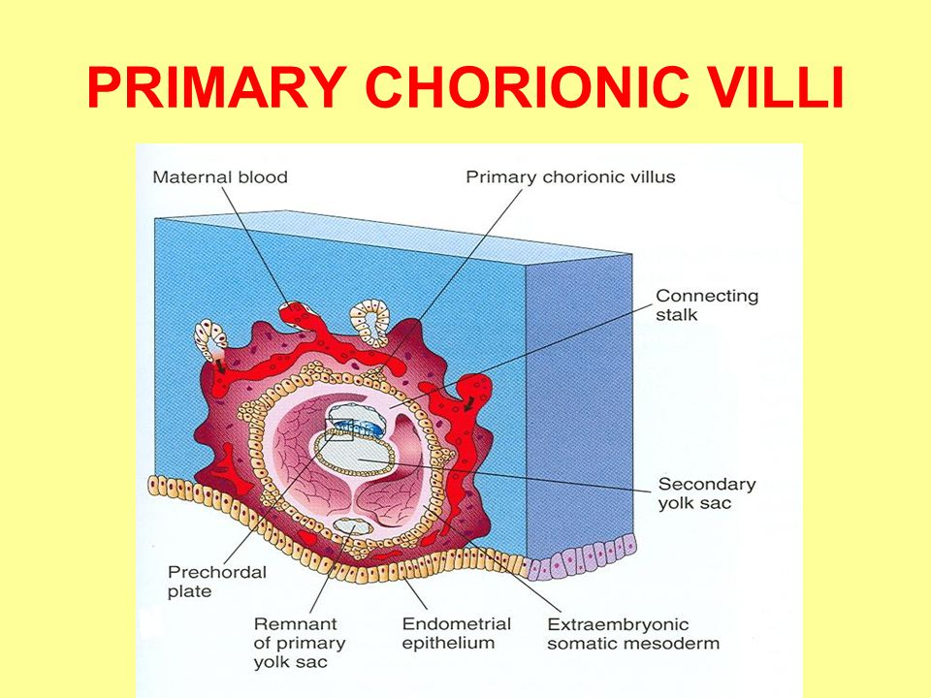
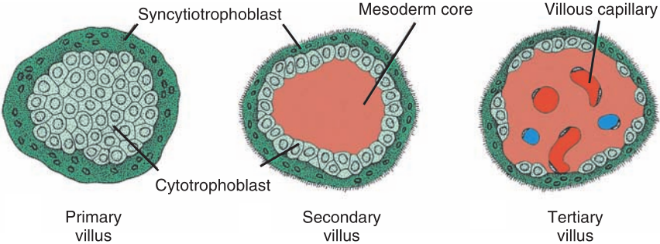
Formation of The Chorionic villi:
(ركزوا في الشرح لان محاضرة البلاسينتا تعتمد على هذي السلايد )
Very very very important
primary chorionic villi:
By the 13th day Proliferation of Cytotrophblast cells produce extension inside the Syncytiotrophoblast.
Secondary chorionic villi:
At the 14th day, the mesoderm will appear within the center of the cytotrophoblast .
Tertiary chorionic villi :
At the 15th day, few blood capillaries appear within the mesoderm .
شرح السلايد:
طبعا احنا نعرف ال syncytiotrophoblasts تكون شكل أصابع تخترق جدار الرحم تفرز انزايمز عشان تكسر السلز وفي نفس الوقت تتغذى على هذي السلز
بعدين تجي ال cytotrophoblastsتكبر وتمتد في نفس جهة ال syncytiotrophoblasts
Syncytiotrophoblasts - + cytotrophoblasts-< Primary villous
Syncytiotrophoblasts - + cytotrophoblasts+ C.T -< Secondary villous
Syncytiotrophoblasts - + cytotrophoblasts+ C.T + blood vessles -< Tertiary villous
- كل السابق هذي مراحل التكون واخر مرحلة هي الي تهمنا عشان في فسلز عشان نحافظ ع نمو وتغذية الجنين

Slide 14
Ectopic Implantation (Pregnancy)
The usual site of implantation is the posterior wall of the body of uterus (X).
Tubal pregnancy is the most common type of ectopic pregnancy (A).
يصير امبلانتيشن في uterine tube حيصير اجهاض وممكن ضرر على حياة الام لان ممكن يصير rupture for the tube
Ovarian pregnancy is the least common type of ectopic pregnancy (H).
يصير امبلانتيشن في الovary وحيصر اجهاض وممكن ضرر على حياة الام لانها ممكن تفقد her ovary

Slide 15
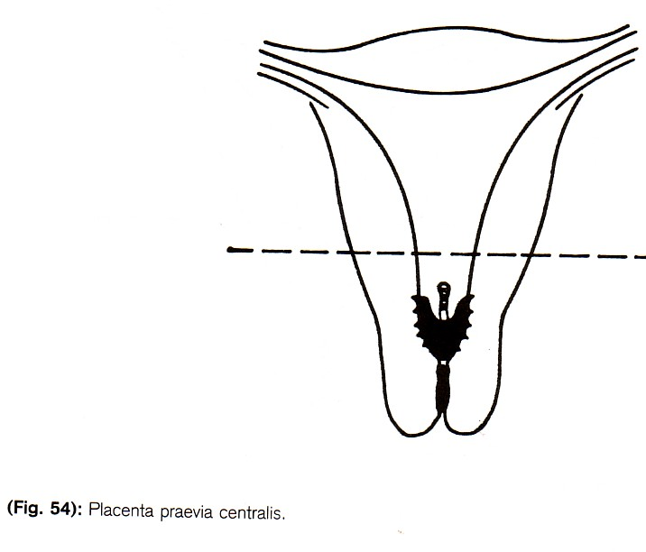
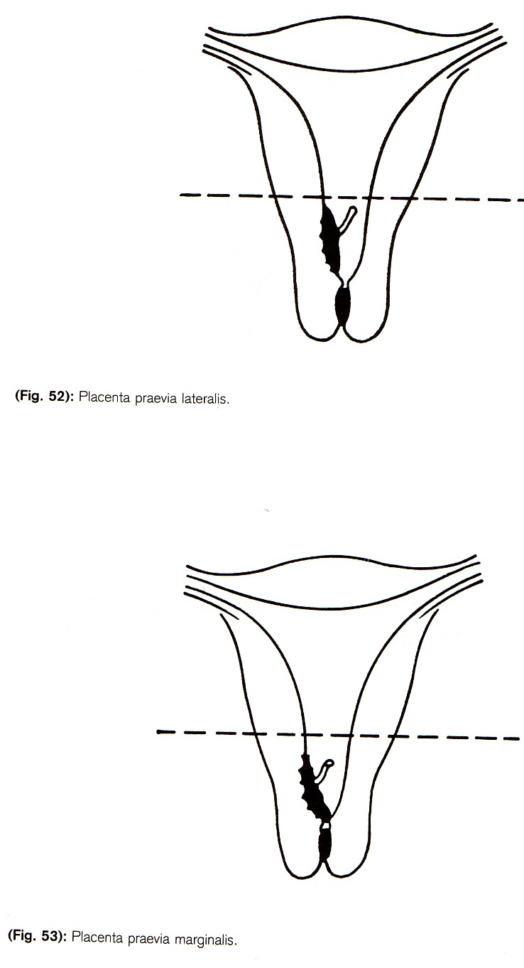
Ectopic Pregnancy
Ectopic pregnancy
Definition: It means implantation outside the uterine cavity.
Site of ectopic pregnancy
1- Placenta Previa | 2- Tubal (most common) | 3- Ovarian (less common)
4- Abdominal. | 5- Pelvic. | 6- Cervical.
Placenta Previa
Definition: Implantation occurs in the lower uterine segment.
Types of Placenta previa
Placenta previa centralis | Placenta previa lateralis | Placenta previa marginalis
-95 to 97% of ectopic pregnancies occurs in the uterine tube.
-Most are in the ampulla & isthmus.
(انتبهوا قصده يصير امبلانتيشن فيهم وهذا ابنورمال)
-Placenta previa = in lower part near the internal os of cervix
-Placenta previa Centralis= covering internal os
-Placenta previa Marginalis= edge attached to internal os

Slide 16
Summary
DATE | EVENT
within 24--48 hrs after implantation in blood | immunosuppressant protein Appears in maternal serum
30 hours after | Cleavage of Zygote
3 days after fertilizationby | Spherical Morula is formed
the 4th day after fertilization | The Morula reaches the uterine cavity and remains free for one or two days.
the 5th day | the Zona pellucida degenerates
It begins about the 6th day after fertilization | Blastocyst begins implantation
By 7th day | Trophoblast differentiated into 2 layers (Cytotrophblast – Syncytiotrophoblast)
By 8th day | the blastocyst is superficially embedded in the compact layer of the endometrium
by the 10th or 11th day | - Blood-filled Lacunae appear in the Syncytiotrophoblast which communicate forming a lacunar network

Slide 17
Summary
DATE | EVENT
EPT (Early pregnancy test) in urine | in the first 10 days of development
by 11th or 12th day | Uteroplacental circulation is established and the Implantation completed
about the end of 2nd week. | human chorionic gonadotrophin hormone is secreted by the Syncytiotrophoblast
By the 13th day | Proliferation of Cytotrophblast cells produce extension inside the Syncytiotrophoblast to form the (primary chorionic villi).
At the 14th day | The mesoderm will appear within the center of the cytotrophoplast (secondary chorionic villi)
At the 15th day | Few blood capillaries appear within the mesoderm(Tertiary chorionic villi)

Slide 18
Summary
EVENT | SITE
Fertilization | Ampulla
Cleavage of Zygote | uterine tube
Morula | uterine cavity
implantation | posterior wall of the body of the uterus near the fundus
ECTOPIC IMPLANTATION
Tubal pregnancy | most common type
Ovarian pregnancy | least common type of ectopic pregnancy
95 to 97% of ectopic pregnancies | occurs in the uterine tube
Placenta previa | occurs in the lower uterine segment

Slide 19
MCQ
1) Which of the following is the Site of fertilization :
A-Isthmus of fallopian tube B-Ampulla of Fallopian tube C-Placenta D-infundibulum of Fallopian tube
2) Fertilization Never occurs in the uterine cavity :
A-True B-False
3) Acrosin is secreted from :
A- nucleus B- Mitochondria C- Acrosomal cap D- Golgi apparatus
4) Acrosin aids in the penetration of the Zona Pellucida :
A- True B- False
5) Cleavage of Zygote Begins After …….. Hours of fertilization :
A- 10 Hours B- 15 hours C- 20 hours D-30 hours
6) The Morula reaches the uterine cavity by the ….. day after fertilization :
A- 3rd B- 4th C-5th D-2nd
7) Blastocyst is formed of an Outer cell layer called ……. and Inner cell layer called ……. :
A- trophoblast – Embryoblast B- Embryoblast – trophoblast C- Cytotrophblast - Syncytiotrophoblast
8) The normal site of implantation is the posterior wall of the body of the uterus near the fundus :
A- True B- False
9) When does Implantation begins :
A- The 4th day after fertilization B- The 5th day after fertilization C-The 6th day after fertilization D- The 7th day after fertilization
1) B
2) A
3) C
4) A
5) D
6) B
7) A
8) A
9) C

Slide 20




References
ANY SUGGESTIONS OR ISSUES
Dr.slides (male and female).
Embryology team 435 .
USEFUL VIDEOS
@Embryology436
Embryology
436
Embryology436@gmail.com
Editing file
Your Suggestion here

Slide 21
TEAM MEMBERS
TEAM LEADERS :
Girls:
Razan Alotaibi
Fatimah Altassan
Shatha Alghaihb
Yara Aldeaji
Yazeed Almutairi
Nehal Beyari
Boys:
Abdullah Almonif
Desgined by:
MUHANNED ALZAHRANI

