Slide 1
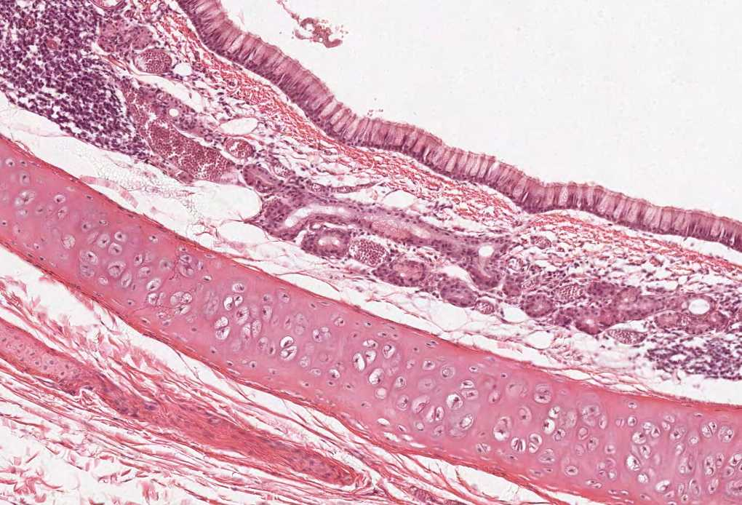
Female Reproductive System
By the end of this lecture, the student should be able to describe:
The Histological Structure And Fate Of Ovarian Follicles.
The Histological Structure Of:
Ovary.
Oviducts (Fallopian tubes).
Uterus.
Vagina.
Placenta.
Resting and lactating mammary gland.
Color index:
Slides.. Important ..Notes ..Extra..

Slide 2
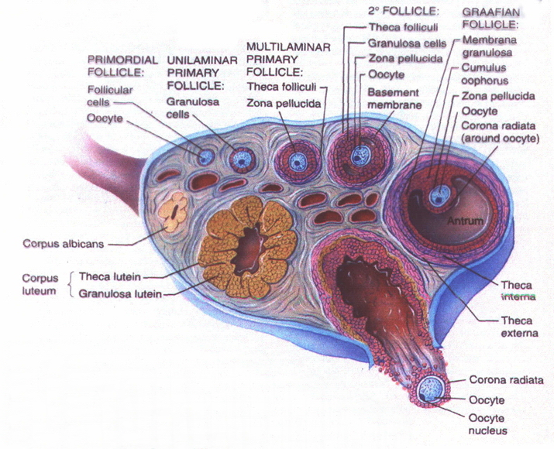
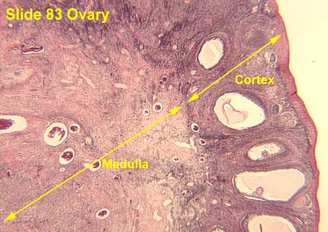
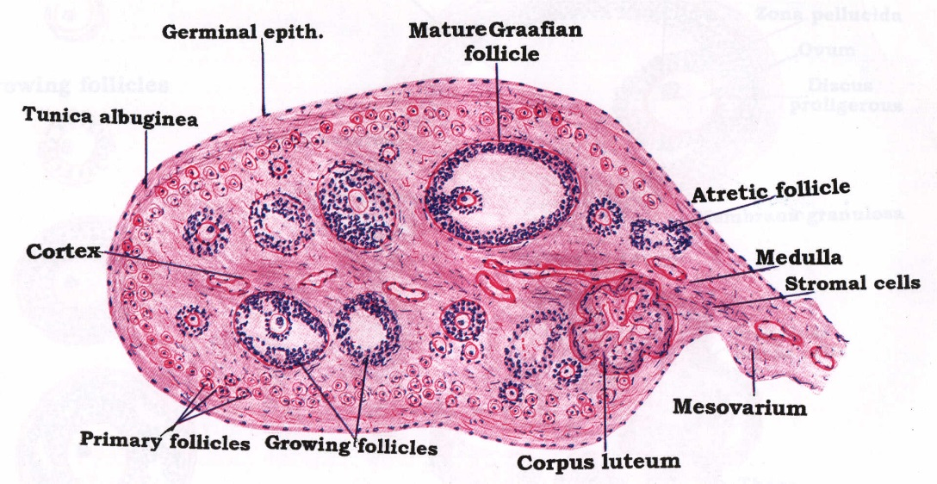
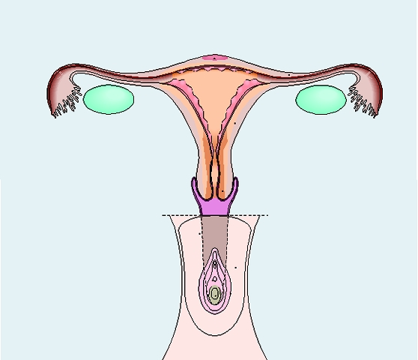
Female Reproductive System
Adult Ovary
Ovarian Cycle: Overview
Primary sex organs:
2 ovaries.
Secondary sex organs:
2 Fallopian tubes.
Uterus.
Vagina.
External genitalia.
2 mammary glands.
Germinal Epithelium: outer layer of flat cells.
Tunica Albuginea: dense C.T layer. Thick capsule covering the ovaries
Outer Cortex: ovarian follicles and interstitial cells.
Inner Medulla: highly vascular loose C.T. Its thickness depends on age (pre or post menopausal) and does NOT contain follicles
All the changes happening in the follicle are in:
1) size of oocytes
2) cells surrounding the oocytes

Slide 3
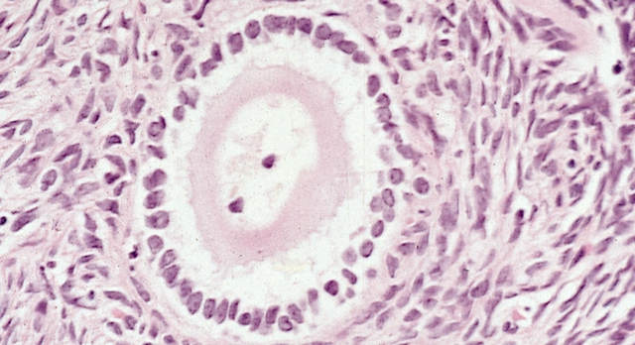
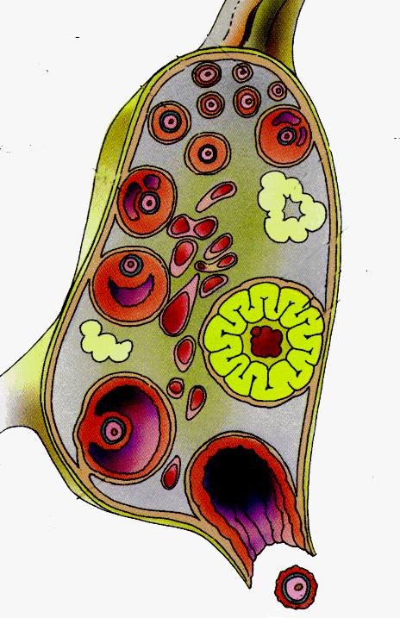
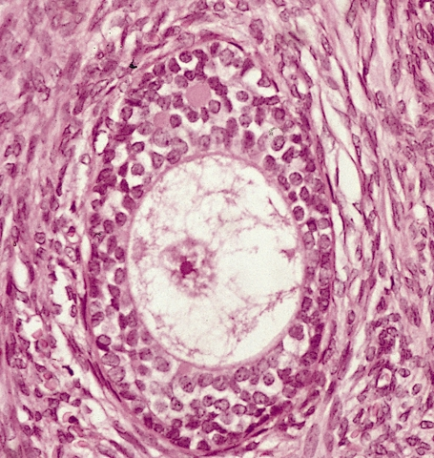
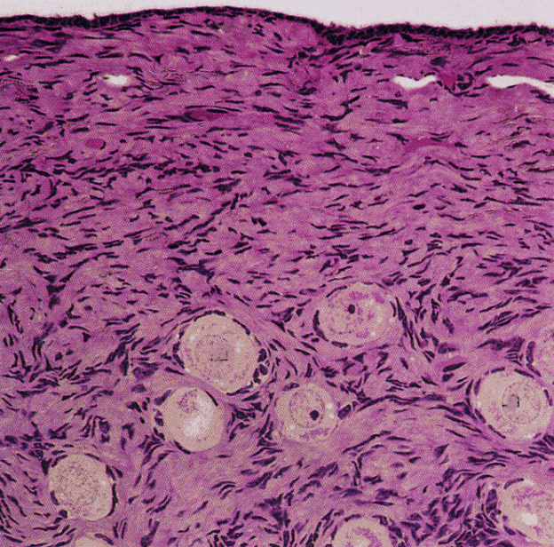
Ovarian Follicles
The cortex of the ovary in adults contains the following types (stages) of follicles:
1. PRIMORDIAL follicles.
2. PRIMARY follicles:
A. Unilaminar
B. Multilaminar
3. SECONDARY (ANTRAL) follicles.
4. MATURE Graafian follicles.
2. PRIMARY Follicles:
They develop from the primordial follicles,
at puberty under the effect of FSH.
A. Unilaminar primary follicles:
Are similar to primordial follicles, but:
The primary oocyte is larger (40 µm).
The follicular cells are cuboidal in shape.
one layer of cuboidal cells surrounding the oocytes
nuclei here are becoming round, representing that in the cuboidal cells
B. Multilaminar primary follicles:
1ry oocyte larger
Corona radiate
Granulosa cells
Zona pellucida
Theca folliculi
Follicular fluid (liquor folliculi)
more than one layer of cuboidal cells
surrounding the oocytes,
they could be as little as two layers
Theca lutein and granulosa lutein secrete
estrogen and progesterone
1. Primordial Follicles:
The only follicles present before puberty.
The earliest and most numerous stage.
Located superficially under the tunica albuginea.
Each is formed of a primary oocyte (25 µm), surrounded by a single layer of flat follicular cells.
the nuclei around the follicle
are forming only
one layer of cells

Slide 4
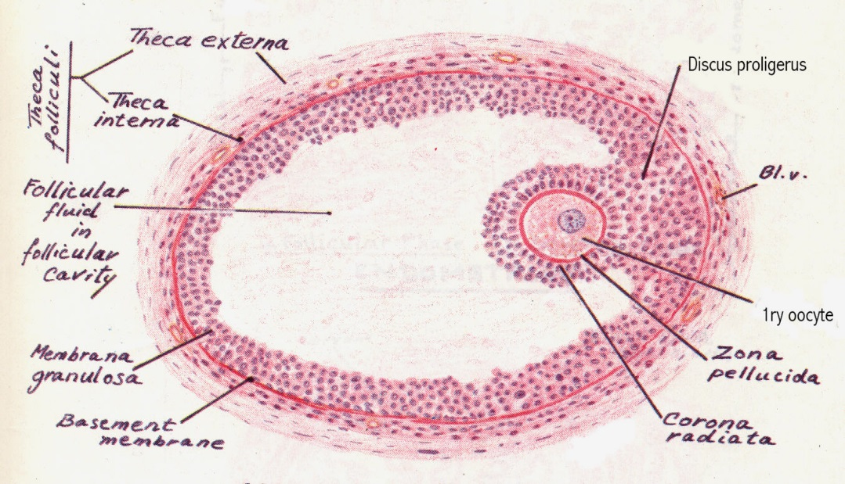
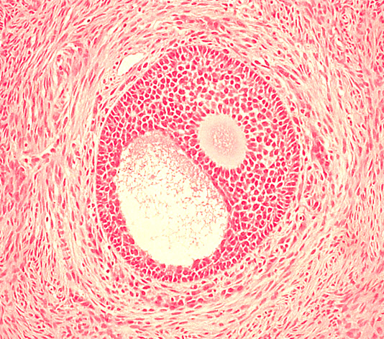
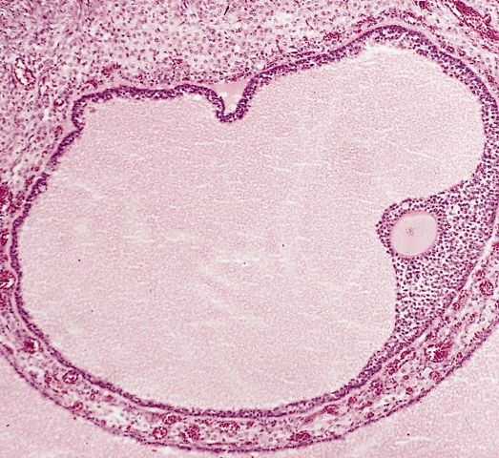
Ovarian Follicles cont.
4. Mature (Graafian) Follicle:
Large, thin walled
Wide follicular antrum
Large 1ry oocyte
Zona pellucida
Corona radiata
Cumulus oophorus
Zona granulosa
Basement membrane which separates granulosa (follicular / epithelial part) from the theca cells which is considered as C.T.
Theca folliculi: theca interna & theca externa
3. SECONDARY (ANTRAL) follicles:
Multilaminar primary follicles become secondary follicles when a complete antrum filled with liquor folliculi is formed.
1ry oocyte is larger & pushed to one side.
Theca folliculi differentiates into theca interna and theca externa.
has no surrounding capsule making it easier to rupture
Corona radiata
Zona granulosa
Follicular antrum
Corona radiata
1ry oocyte
Zona pellucida
Cumulus oophorus
Zona granulosa
1ry oocyte
Theca externa
Theca interna
Follicular antrum
Theca externa
Theca folliculi
Theca interna

Slide 5
Ovarian Follicles cont.
The more mature the follicle the closer it is to the wall of the ovary
You know the maturity of the follicle by the presence of large amount of fluid
In graafian follicle: the membrane granulosa cells are different than that in the corpus luteum (*YOU NEED TO DIFFERENTIATE)
The graafian follicle contains thinner cuboidal cells to be easily ruptured, and it has an antrum full of fluid زي البلونة تمتلي لين تنفجر
this fluid is produced normally by the granulosa cell, but the difference here is that it is collected together in a single place which is the antrum اقرأوا وطالعوا بالصورة عشان تقارنون
After the follicle ruptures, the oocytes and the cells surrounding them (corona radiata) go out of the ovary and the cells that are present in the follicle are called granulosa lutein cells become endocrine cells producing hormones until the follicle shrinks and forms corpus albicans مهم تفرقون بينها وبين اللي قبل

Slide 6
Atretic Follicles
Atretic follicle cont.
During growth of the ovarian follicles, many of them do not reach maturation and they degenerate, and are finally replaced completely by fibrous tissue and are called atretic follicles or corpora atretica.
Atretic = Atrophy = Follicles that didn’t complete maturation
These follicles secrete hormones for a short period of time before they shrink and form corpus albicans
You could be secreting as many as 1000 follicles:
Then they decrease to 100, 10 of those one-hundred become uni-laminar follicles
8 of those uni-laminar become multi-laminar follicles, then 6 of those become secondary follicles and only one will mature to a Graafian follicle.
The ones lost during these processes are called “atretic follicles” they secrete hormones for a short period then degenerate.

Slide 7
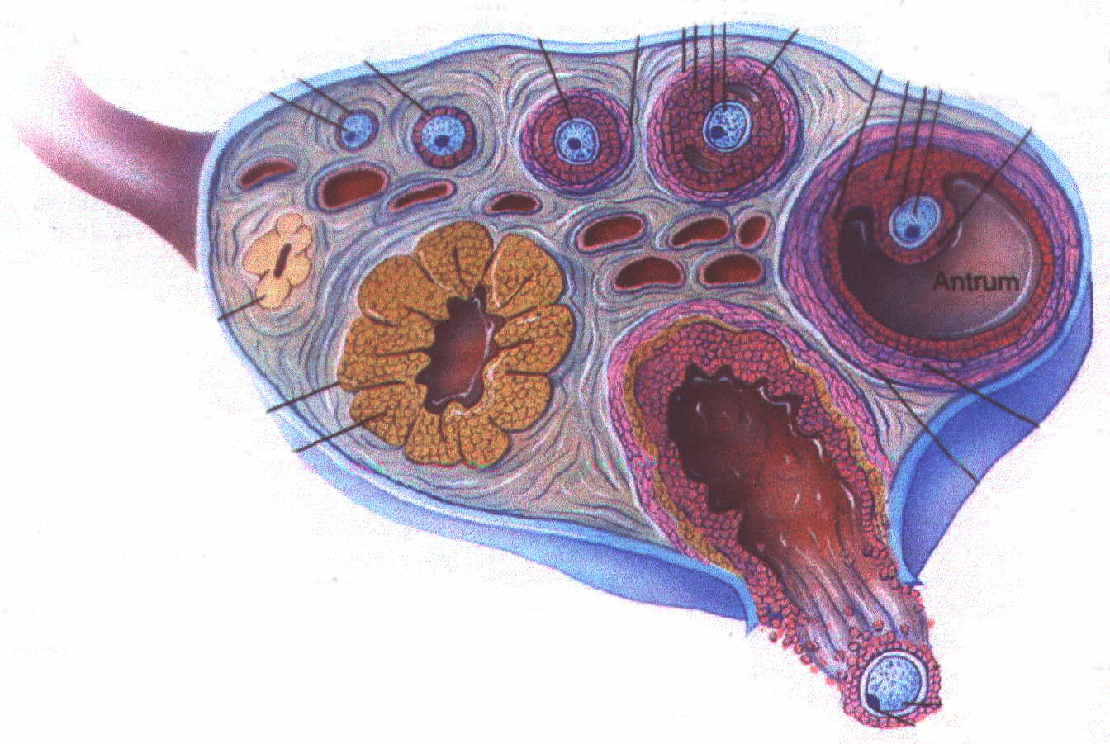
Ovulation and Corpus Luteum formation cont.
Ovulation and Corpus Luteum Formation
Ovulation occurs at day 14 of the cycle, under the effect of LH. (corpus luteum lives for 14 days)
The follicle collapses and forms a corpus luteum.
The corpus luteum lives on for 14 days, if the female isn’t pregnant it will become “corpus albican” > Remnants/scar.
Then it will be phagocytosed by macrophages.
During pregnancy; it lasts for 6 months, it will take up the majority of the ovary.
In pregnant females, the corpus luteum lasts longer hence it will cause a larger scar than in a non-pregnant female.

Slide 8
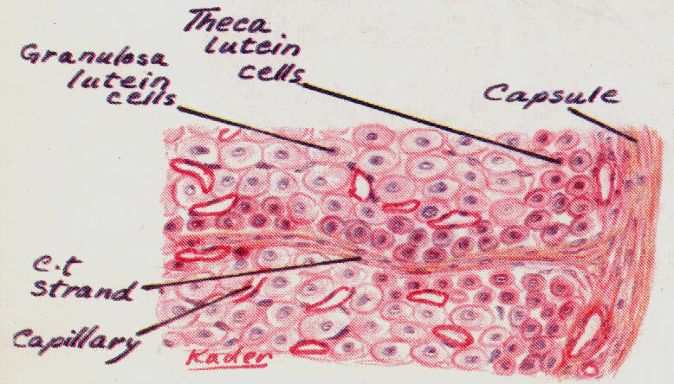
Corpus Luteum cont.
Corpus Albicans
Zona granulosa → granulosa lutein cells.
Theca interna → theca lutein cells.
Bleeding may occur → corpus haemorrhagicum.
Fertilization → corpus luteum of pregnancy.
No fertilization → corpus luteum of menstruation.
At the end → corpus albicans.
Corpus luteum of menstruation lasts about 10 days.
Corpus luteum of pregnancy persists for six months.
Fate of corpus luteum: formation of a white degenerated fibrous body, corpus albicans.
it forms corpus albicans but gives a larger scar due to its larger size
Function of corpus luteum:
Granulosa lutein cells: Secrete Progesterone.
Theca lutein cells: Secrete Estrogen.
It is a white degenerated fibrous body formed by involution of corpus luteum (degenerated corpus luteum).
Secretory cells of corpus luteum degenerate and are phagocytosed by macrophages.

Slide 9
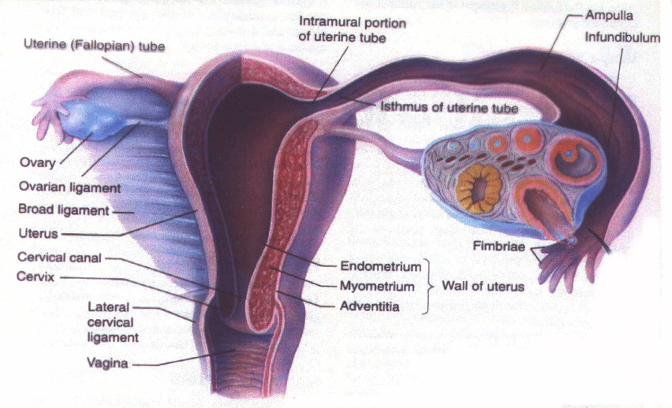
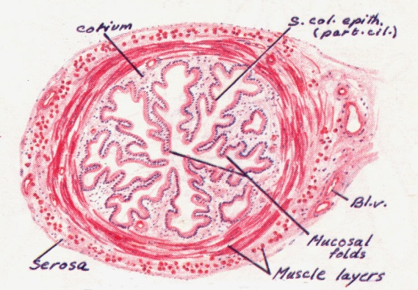
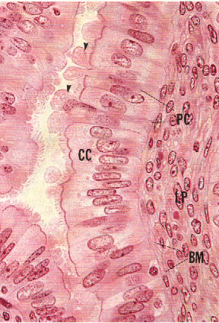
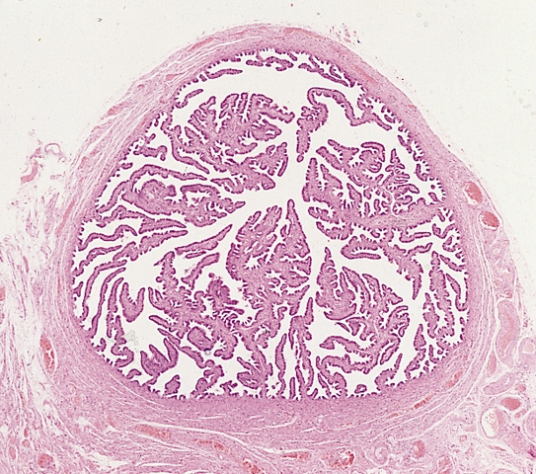
OVIDUCTS (FALLOPIAN TUBES)
It has a peristaltic movement but not as strong as the uterus
Mucosa
Highly folded therefore it has a thin lumen Epithelium: Simple columnar partially ciliated. Corium of C.T.
Musculosa
Inner circular. Outer longitudinal.
Serosa because we have peritoneum covering it
Ciliated cells:
Non-secretory. Cilia beat toward uterus They’re responsible for the movement of the ova, but during fertilization the sperm will drift against the beat of the cilia.
Non-ciliated cells:
Thinner, also called peg cells. Secretory cells. Apices bulge above ciliated cells. Their apices contain nutritive material to nourish gametes (ova and sperm) the sperm gets its strength from these material, so without it the sperm dies.

Slide 10
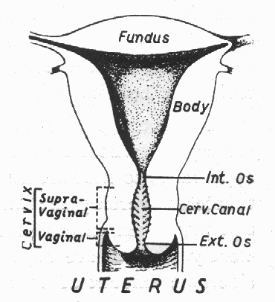
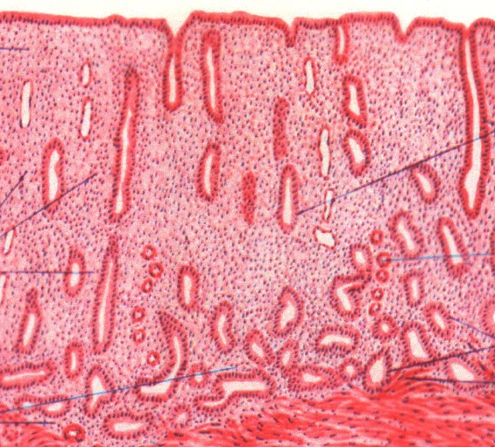
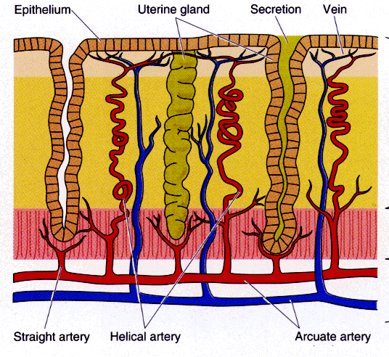
Uterus
The vaginal end of the cervix has the same epithelium as that in the vagina.
Thick-walled muscular organ.
Inverted pear shape.
Anatomically:
Body: upper 2/3.
Cervix: lower 1/3.
Fundus: the rounded dome-shaped top of the body.
Fundus & Body Consist of:
Endo-metrium (mucosa)
Myo-metrium (muscu-losa)
Peri-metrium (serosa)
Coiled arteries become longer when the wall of the uterus thickens. During menstruation, only the superficial part detaches and not the basal part.
Endometrium (mucosa): has the same mucosa of the fallopian tube but not folded, only forms invaginations
Blood supply | Corium | Epithelium
Two types of arteries derived from vessels in the myometrium: Coiled arteries: Extend into the functional zone. Cyclic changes. Straight arteries: Terminate in basal zone. No cyclic changes. | Endometrial glands: simple tubular. Stromal cells. Blood vessels. Leukocytes. Reticular fibers. | simple columnar partially ciliated.

Slide 11
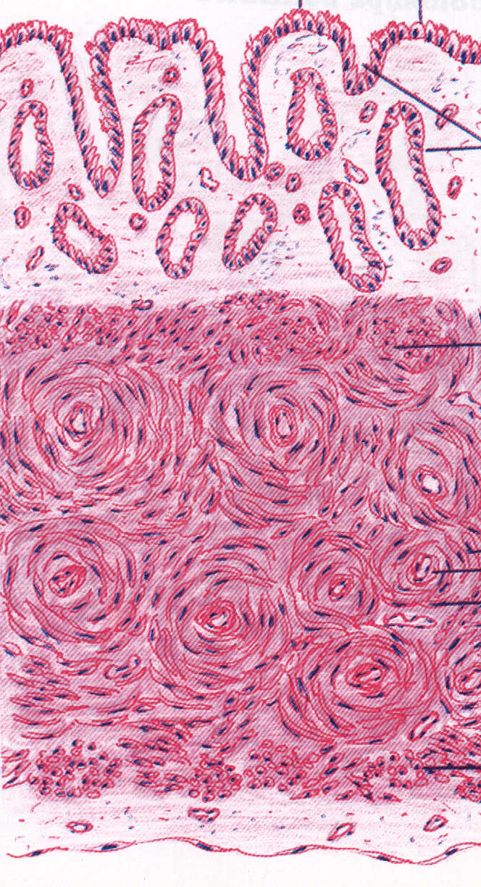
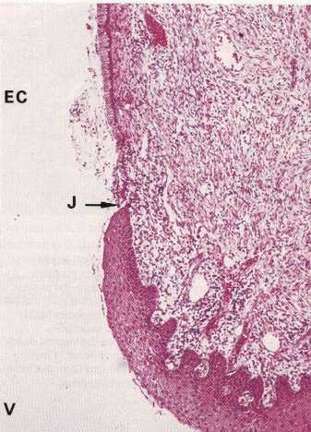
Uterus cont…
Myometrium (musculosa) Thickest layer
3 ill-defined smooth muscle layers: Stratum submucosum: longitudinal. Stratum vasculare: circular smooth muscle fibres in figure of 8 arrangement around large blood vessels. Stratum supravasculare: longitudinal
The circular muscles are important during menstruation and labor, because blood vessels are partially cut off and these muscles contract to close the vessels and prevent bleeding.
Uterine Cervix
Substance of the cervix: | Mucosa: since a part of the cervix protrudes the vagina, they’ll both have the same epithelium
Dense fibrous tissue with few smooth muscle fibers | Epithelium: simple columnar in the cervical canal, but it changes to stratified squamous epith. (non-keratinized) at the external os. Corium: CT containing tubulo-alveolar glands.

Slide 12
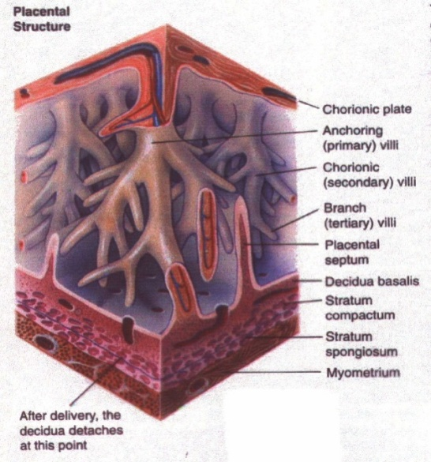
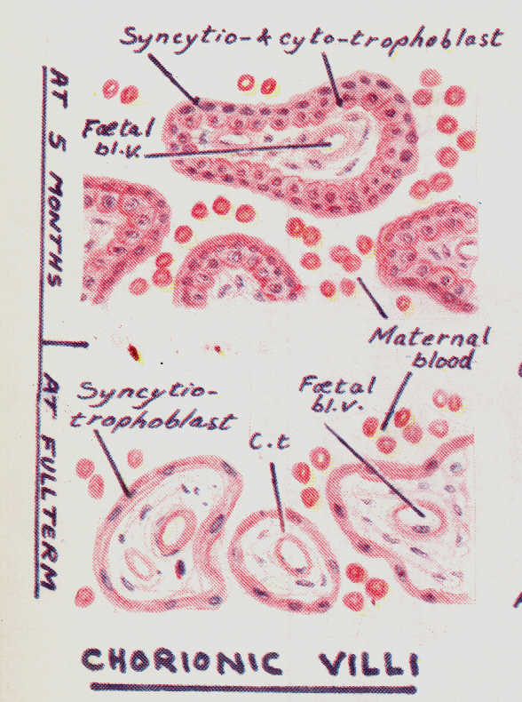
Placenta
Placental Barrier
The placenta is a disk like structure present between the fetus and the mother
It is connected to the fetus by the umbilical cord and connected to the mother by penetrations to the uterus
Placenta has two parts:
Maternal part (decidua basalis)
Foetal part (chorionic villi )
It is the barrier between the maternal and foetal blood.
It consists of:
1.The trophoblast covering the villus.
2.The basement membrane of the trophoblast.
3.The C.T. core of the villus.
4.The basement membrane of foetal capillaries.
5.The endothelium of foetal capillaries.
The fetal blood vessels are surrounded by trophoblasts forming a barrier that doesn’t allow the passage of any materials.
But the maternal blood is exposed directly to the Chorionic villi without any barriers.
Foetal part (chorionic villi)
Finger-like projections separated by intervillous spaces containing maternal blood. Each chorionic villus consists of:
Epithelial covering (trophoblast), made of 2 layers: a) Outer syncytiotrophoblast: deeply stained with no cell boundaries. b) Inner cytotrophoblast: disappears late in pregnancy | Mesenchymal CT core containing fetal blood vessels.
Syncytio-cyto-trophoblast has no lateral boundaries but contains a basal part with cytoplasm.
Syncytio-trophoblast contains mainly one layer and is found in the late periods of pregnancy.

Slide 13
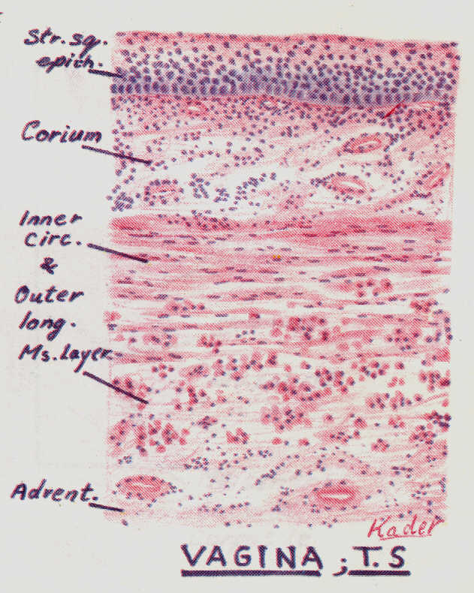
VAGINA
Adventitia | Musculosa | Mucosa
formed of loose C.T. | formed of interlacing inner circular and outer longitudinal layers of smooth muscle fibres. | shows transverse folds and is made of: Epithelium: stratified squamous epithelium non-keratinized, rich in glycogen. Corium: of dense C.T., very rich in blood vessels, elastic fibres and leucocytes.
Source of wetness of the vagina: the uterus and blood vessels (by effusion)
The vagina has an adventitia and not serosa because it is present in the pelvis which is not surrounded by peritoneum

Slide 14
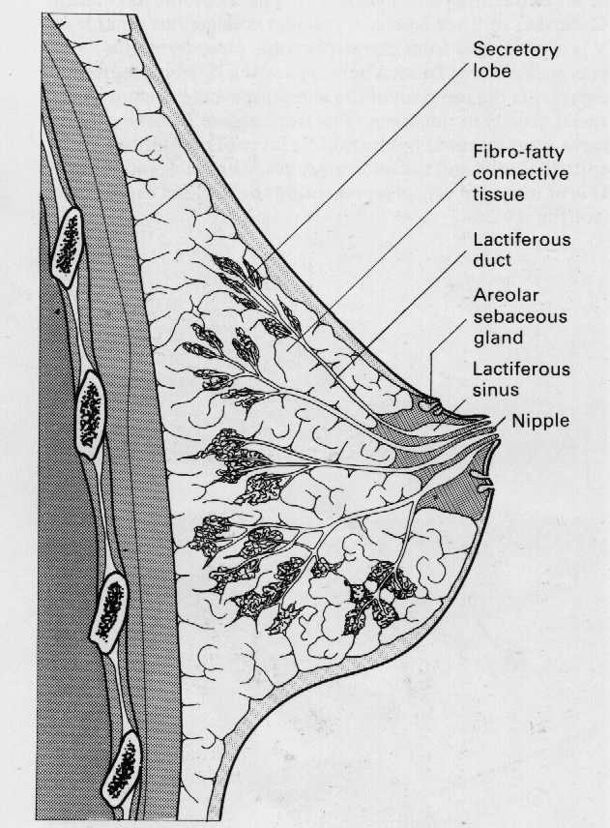
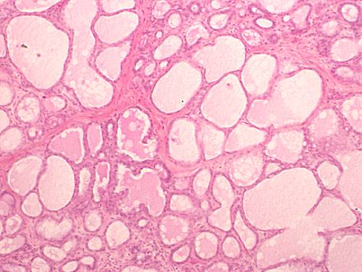
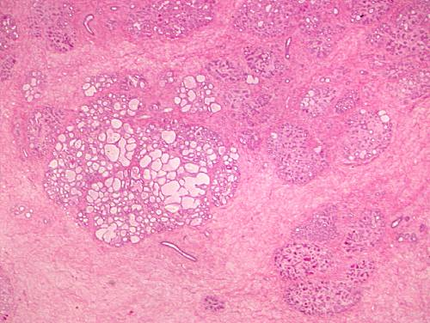
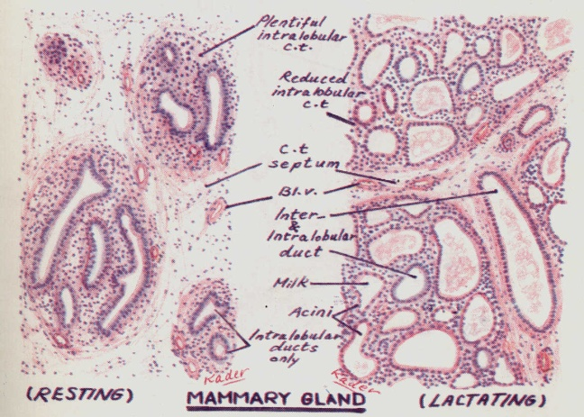
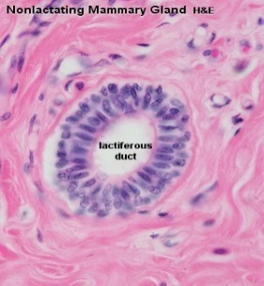
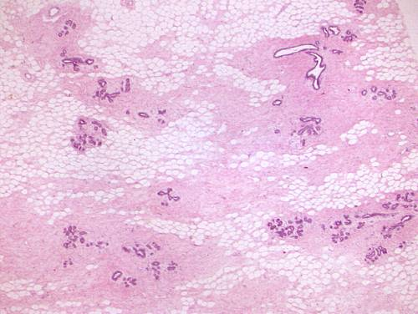
MAMMARY GLAND
At puberty they enlarge by accumulation of fat, but contain only a duct system.
Secretory units appear only during pregnancy and are functioning only during lactation
Lactating Mammary Gland: | Resting Mammary Gland:
Interlobular and intralobular C.T. become reduced. Lobules are made of ducts and alveoli. Alveoli are distended with milk and lined by cuboidal or flat cells surrounded by myoepithelial cells. Milk appears acidophilic with vacuoles of dissolved fat. Less adipose, more milk with carbs and proteins. | It is divided into lobes and lobules. The interlobular C.T. is dense and contains numerous fat cells. The intralobular C.T. is loose and contains no fat cells. Within the lobules, there are widely separated ducts lined by simple cuboidal epithelium. Ducts collect to form lactiferous ducts lined by stratified columnar epithelium and open at the top of the nipple. Landmark: adipose tissue
Milk accumulates distally so it can be excreted by myoepithelial cells, controlled by oxytocin.

Slide 16
MCQs
1\The Primary sex organs are:
A-2 Fallopian tubes.
B-2 ovaries.
C-2 mammary glands.
4\the main Function of corpus luteum:
A-secrete estrogen.
B-secrete progesterone.
c-phagocytosis.
2\The only follicles present before puberty:
A-Primordial follicles.
B-Primary follicles.
C-Mature graafian follicles.
5\Non-Ciliated cells of fallopian tube:
A-called peg cells.
B-Secretory cells.
C-both a&b.
3\They develop from the primordial follicles, at puberty under the effect of FSH:
A-Primary follicles.
B-Primordial follicles.
C-Mature graafian follicles.
6\the epithelium cells of uterus are:
A-stratified squamous cells.
B-simple columnar partially ciliated.
C-simple columnar completely ciliated.
1-b
2-a
3-a
4-b
5-c
6-b

Slide 17
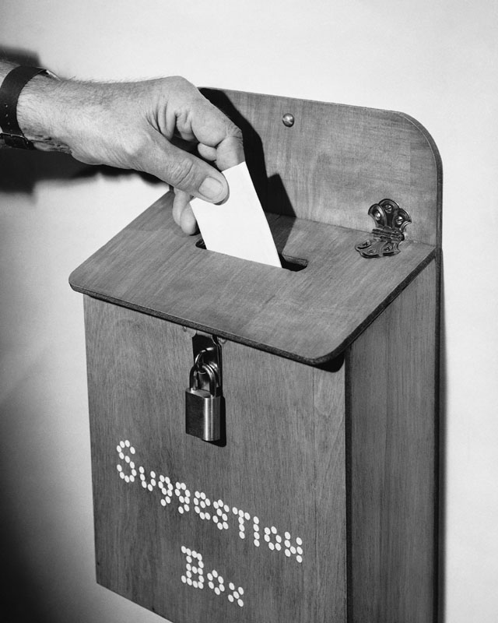
Thank you & good luck
- Histology team
Done by:
Amal AlGarni
Do’aa Walid
We’am Babaier
Heba AlNasser
Special thanks to Yara AlDuaijy
Team leaders:
Rana Barasain
Faisal Alrabaii
References:
Females’ and Males’ slides.
Doctors’ notes

