Slide 1
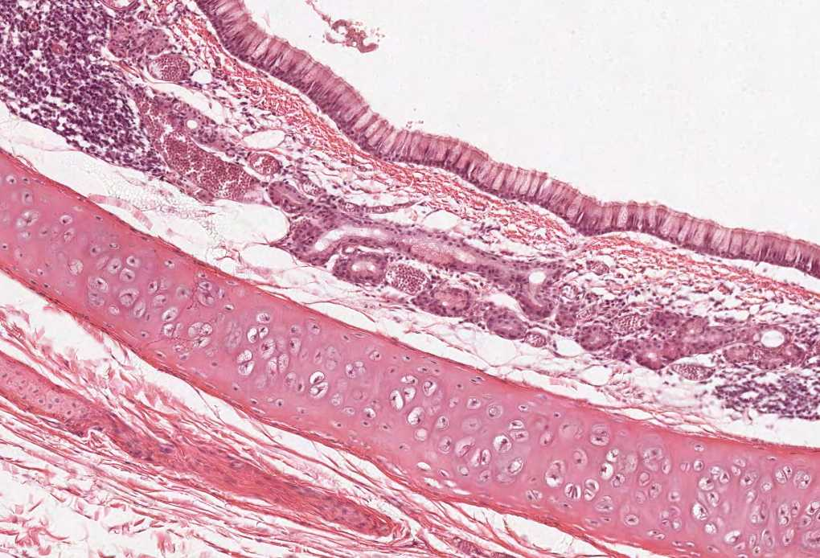
MALE REPRODUCTIVE SYSTEM
By the end of the lecture the student should be able to:
Describe the microscopic structure of :
1. Testis and epididymis.
2. Vas deferens.
3. Seminal vesicles.
4. Prostate.
Color index:
Slides.. Important ..Notes ..Extra..

Slide 2
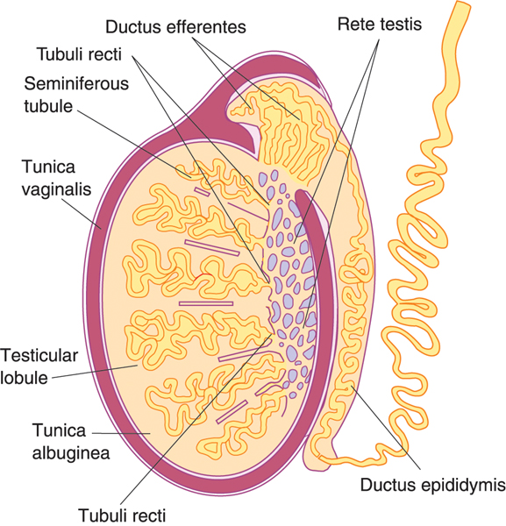
TESTIS
Stroma:
Tunica vaginalis
Septa.
Parenchyma:
Seminiferous tubules.
Exocrine part
Interstitial cells of Leydig.
Endocrine part
Tunica albuginea
Tunica vasculosa.
Interstitial tissue.

Slide 3
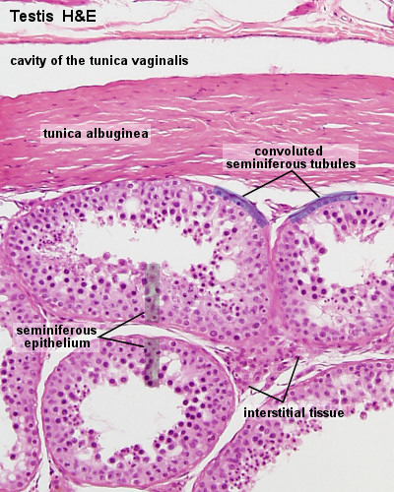
Stroma of the testis:
Septa of the Testis:
1. Tunica vaginalis
It is formed of mesothelial epithelial cells. Peritoneum covering of the testes
2. Tunica albuginea
Dense irregular collagenous C.T
3. Tunica vasculosa
It is formed of loose highly vascular C.T. lining tunica albuginea & speta from inside.
Dense irregular collagenous C.T.
Divide the testis into about 250 intercommunicating compartments or lobules , each lobule contains 1-3 seminiferous tubules
(testicular lobules = lobuli testis).
Interstitial Tissue:
Loose areolar vascular C.T. in between the seminiferous tubules of parenchyma.
Contents:
1- Loose vascular C.T.
2- Interstitial cells of Leydig.

Slide 4
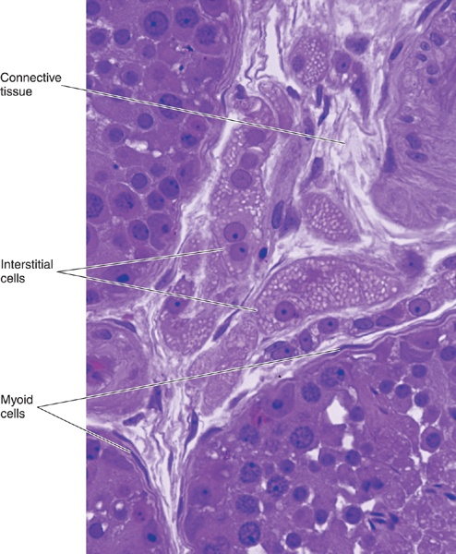
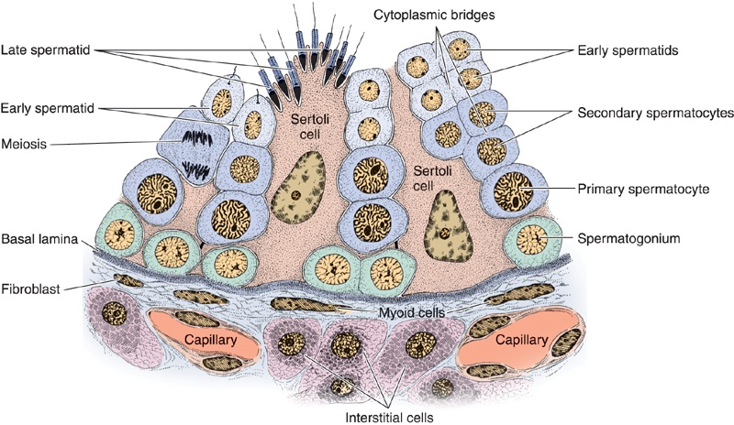
PARENCHYMA OF THE TESTIS
Are rounded or polygonal cells with central rounded nucleus. Located in the interstitium
Cytoplasm: acidophilic & vacuolated.
Function: Secrete testosterone.
Interstitial Cells of Leydig
Endocrine part:
interstitial cells of Leydig which produce testosterone.
It secrets steroid hormone ,so it has:
Lipids droplets , acidophilic Cytoplasm , abundant SER + mitochondria with with tubular cristae.
Each tubule is surrounded by a basement membrane.
Each tubule is lined with a stratified epithelium called seminiferous epithelium which is formed of 2 types of cells:
1- Spermatogenic cells.
2- Sertoli cells.
Exocrine part:
The seminiferous tubules which produce spermatozoa.
Seminiferous Tubules

Slide 5
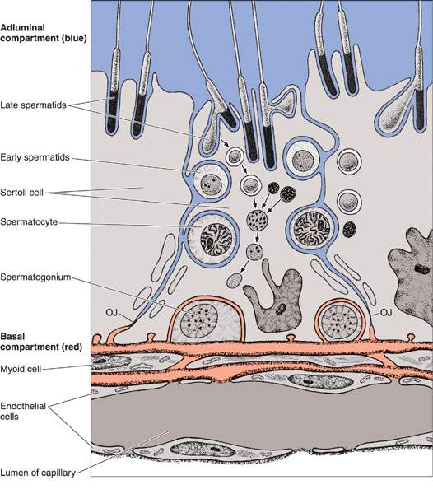
Sertoli Cell
Blood-Testis Barrier
Are columnar or pyramidal cells (cytoplasm is pale basophilic)
Nucleus | Basal, vesicular, irregular with prominent nucleolus.
Functions | 1- Support & Nutrition of spermatogenic cells.
 | 2- Phagocytosis of cytoplasmic remnants of spermatogenesis.
 | 3- Secretion: -Testicular fluid(nutritive medium for transport of immotile spermatozoa). -Androgen Binding Protein (ABP)(combines with testosterone and concentrate it inside the seminiferous tubules). -Inhibin hormone(inhibits FSH and LH thus controlling rate of spermatogenesis).
 | 4- Formation of blood-testis barrier.
It is formed by the tight junctions between the basal parts of the lateral borders of adjacent Sertoli cells
It divides the seminiferous tubule into 2 compartments:
1-Basal compartment: contains spermatogonia |  | 2-Adluminal compartment: contains the other spermatogenic cells.
Functions | 1- It protects developing spermatogenic cells from drugs and toxic materials.
 | 2- It prevents autoimmune infertility.
The barrier separates the tissue fluid outside the tubule from the spermatogenic cells inside the seminiferous tubule.
Isolation and protection of the sensitive developing spermatogenic cells from any harmful substance in the blood stream.
Prevention of autoimmune reaction: prevents the passage of autoantibodies against the developing gametes into the tubule.
It isolates the adluminal compartment from connective tissue influences, thereby protecting the developing gametes from the immune system. Because spermatogenesis begins after puberty, the newly differentiating germ cells would be considered "foreign cells" by the immune system.
Spermatogenic Cells
A series of cells lining the seminiferous tubules extending from the BM to the lumen
Include | 1-Spermatogonia. (It is oval or rounded, has only one layer, and 3 types: dark type A, pale type A, type B) 2-1ry spermatocytes. (It has 2 or 3 layers) 3-2ry spermatocytes. (it is hardly to detect) 4-Spermatids. (has 23 Single chromosomes) 5-Spermatozoa.

Slide 6
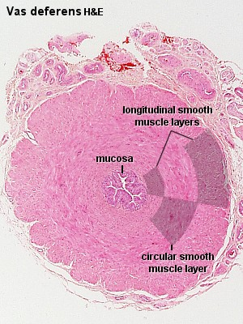
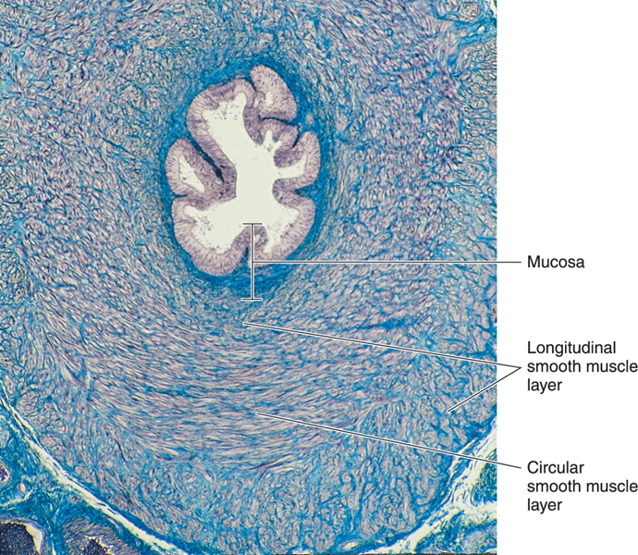
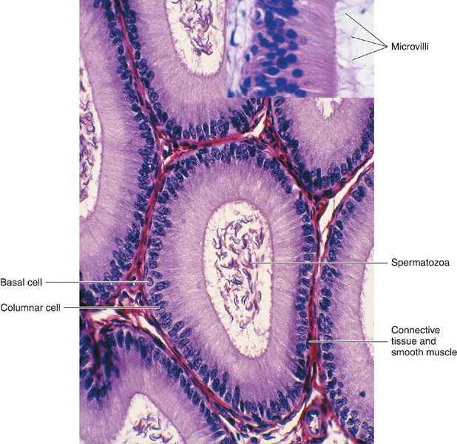
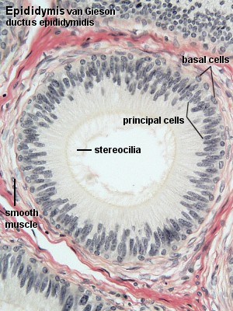
EPIDIDYMIS (DUCTUS EPIDIDYMIS)
DUCTUS DEFERENS (VAS DEFERENS)
Structure | 1-Epithelium: pseudostratified columnar epithelium with stereocilia. (stereocilia is elongated microvilli and it doesn’t has any microtubules) 2-Basal lamina. 3-Loose C.T. 4-Layer of circularly-arranged smooth muscle cells.
Functions | a. Storage & maturation of spermatozoa. b. Propelling spermatozoa to the vas deferens.
It is a muscular narrow tube with irregular lumen.
Structure | 1- Mucosa: Ps. Str. Col. E. with stereocilia (immotile cilia) on a corium of loose C.T.
 | 2- Musculosa (thick 3 layers) :Inner longitudinal muscle layer, Middle circular, and Outer longitudinal . (smooth muscles)
 | 4- Adventitia: loose C.T.
Functions | Propelling of spermatozoa by strong peristalsis.
A single tubule; 4-6 m in length.
Highly convoluted to form a compact organ 7.5 cm long.
Divided into head, body & tail.
Its tail gives rise to the vas deferens.
starting at the tail of the epididymis, enters the abdomen through the inguinal canal to join the duct of the seminal vesicle to form the ejaculatory duct.
Length is about 30 m.

Slide 7
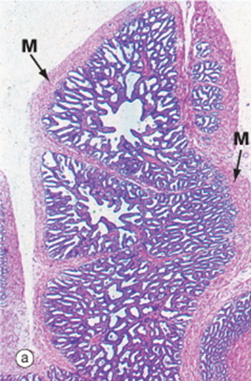
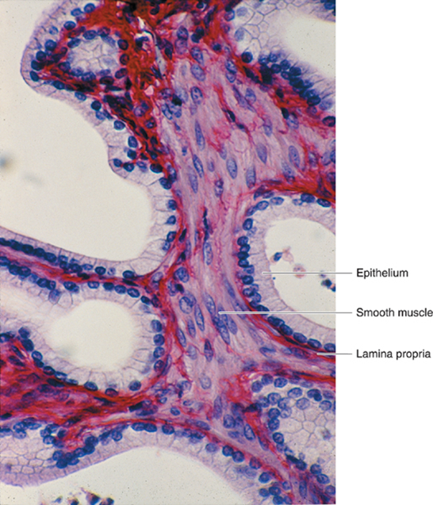
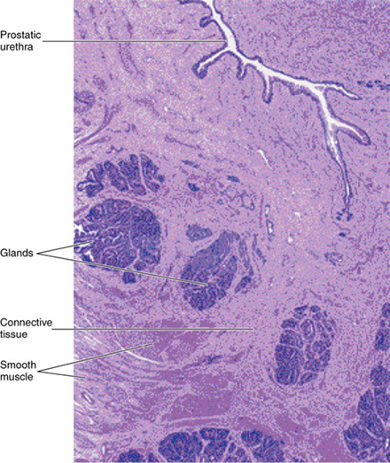
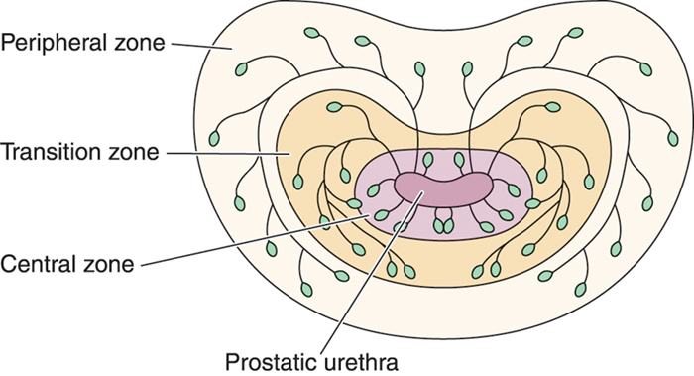
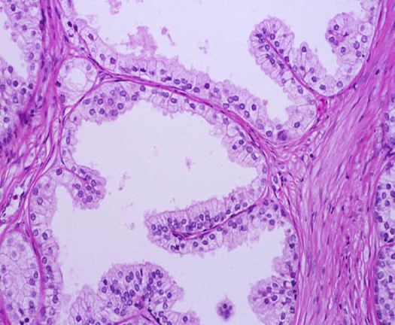
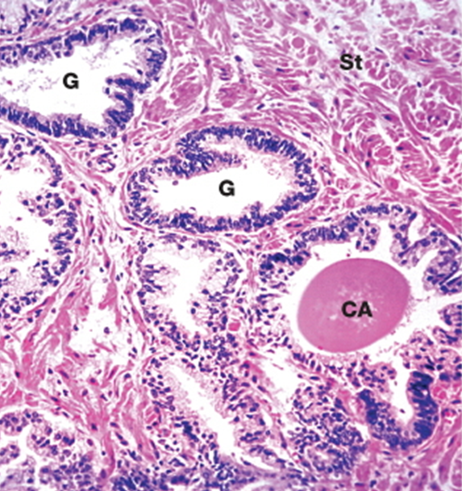
SEMINAL VESICLES:
PROSTATE:
Mucosa: | Musculosa: | Adventitia:
Is highly folded. Epithelium: Ps. Str. Col. E. (Pseudostratified columnar epithelium) Lamina propria of C.T | Inner circular layer. Outer longitudinal layer. | Connective tissue (C.T.).
Function: Secretion of most of seminal fluid, rich in fructose & vit. C. which are the main nutrients for spermatozoa.
Stroma: | Parenchyma: | Acini and ducts: | Prostatic concretions (corpora amylacea):
fibromuscular capsule & trabeculae. | 30-50 glands in 3 concentric groups around the prostatic urethra: Mucosal group: small. Submucosal group: medium-sized. Main group: Large, 70% of all glands. | are lined with simple Col. or Ps. Str. Col. E. according to activity of the glands. | Round or oval masses of glycoprotein in the lumen of some glands. Increase with advancement of age & become calcified.
Function: participates in the secretion of the seminal fluid. Its secretion is rich in acid phosphatase & proteolytic enzymes.

Slide 8
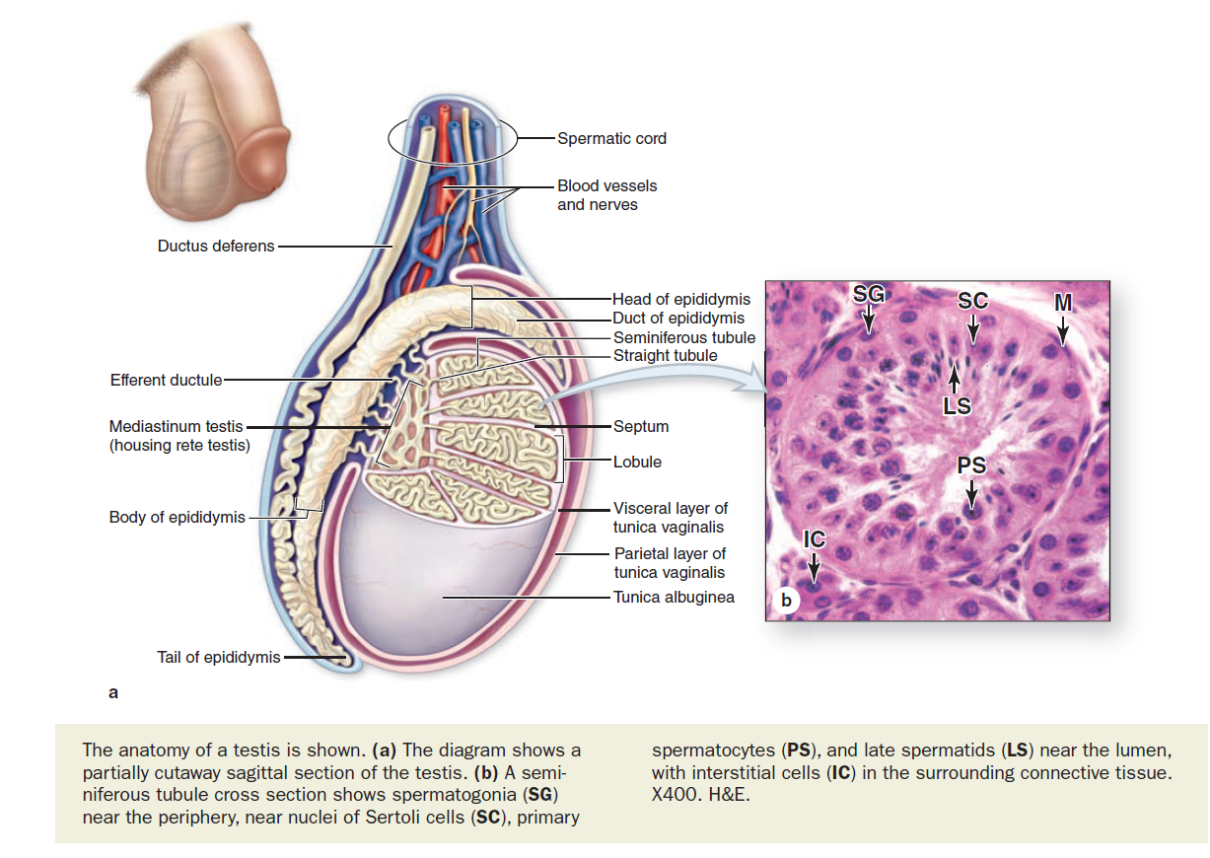
EXTRA
* زي ما تشوفون هنا " سيرتولي سيلز" تكون في الطرف لانها هي اللي تكون" بلود تيست بارير"
وهنا خلايا الليدنق تكون بين التوبيولز في الانترستيشم

Slide 9
MCQs
1)Mesothelial cell forms ?
A-Tunica vaginalis B-Tunica albuginea
C-Tunica vasculosa D-Septa
2)Which cell forms the blood testis barrier?
A-interstitial cells of leyding
B-spermatogenic cell
C-Sertoli cells
D-B cells
3)The basal compartment contains?
A-1ry spermatocytes B-2ry spermatocytes
C-Spermatids D-Spermatogonia
4) A part of male genital duct that has a strong peristaltic movement due to thick muscular layer?
A- Seminiferous tubules B- Ductus deferens
C-Epididymis D-Sertoli cells
5) Site of maturation of spermatozoa?
A- Seminiferous tubules B- Ductus deferens C-Epididymis D-Sertoli cells
1-A
2-C
3-D
4-B
5-C

Slide 10
* الحمدُلله الذي بنعمتِه تتم الصالحات.
تمّ الانتهاء من آخر مُحاضرة هيستولوجي للسنوات الاساسية.
فمَا هذا إلّا جهد مُقل ولاندعي فيه الكَمال ولكن عذرنا انّا بذلنا فِيه قصارى جُهدنا فإن اصبنا فذاك مُرادنا وان أخطئنا فلنا شرف المُحاولة والتعلّم.
ولأنه .. " لا يَشْكُرُ اللَّهَ مَنْ لا يَشْكُرُ النَّاسَ " / حديث حسن .. فإننا نشكُر الله أولا أن وفقَنَا و أعاننا جميعاً ، ونسأل الله الاخْلاص والقبول للجميع .. ونشكُر جميع من ساهَم في العمل خِلال هاتين السنتين راجِين من المولَى عز وجل أن يجعلَه فِي ميزان حسناتِنا.
- Histology team
Team members:
Amal AlQarni
Allulu Alsulayhim
Do’aa Walid
Heba AlNasser
Shahad AlAnzan
We’am Babaier
Ahmed Badahdah
Mutasem Alhasani
Omar Turkistani
Nawaf Aldarweesh
Mohammed Khojah
Team leaders:
Rana Barasain
Faisal Alrabaii
References:
Females’ and Males’ slides.
Doctors’ notes

