Slide 1
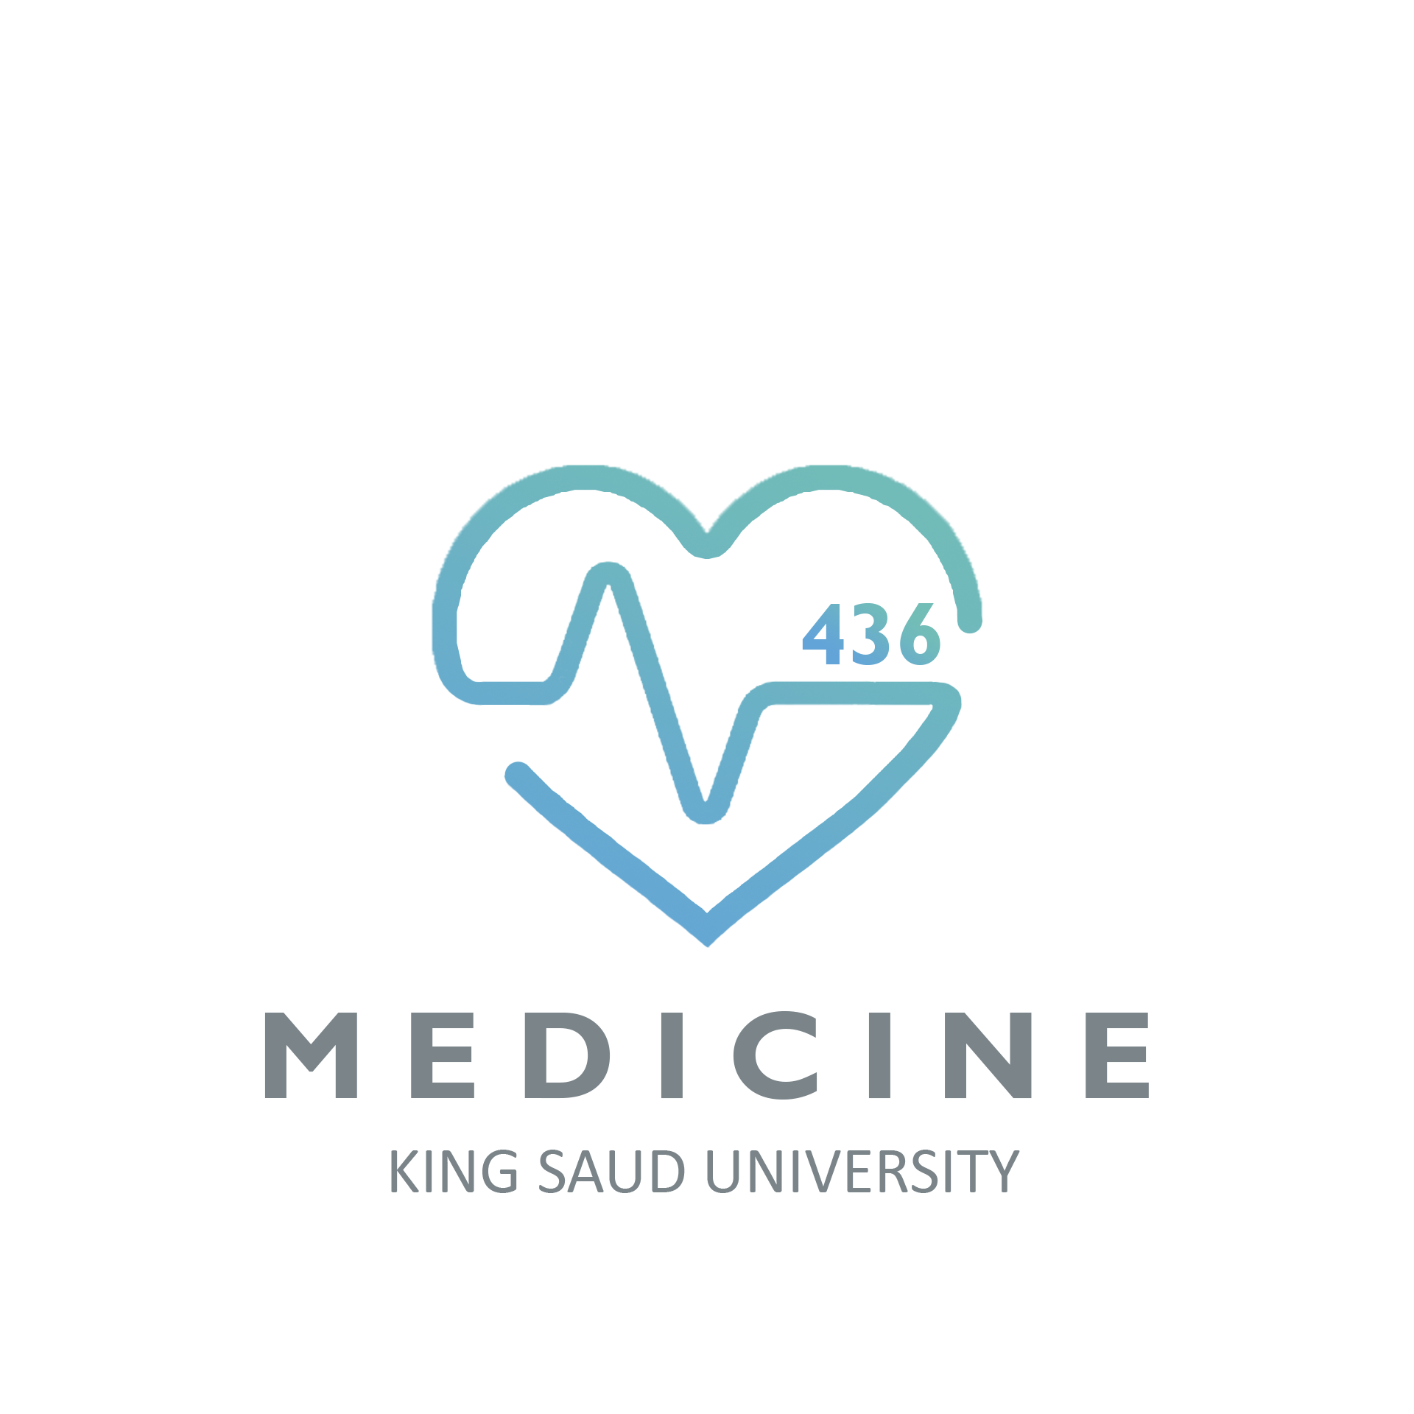
Reproduction Block
Lecture One
AIDS
Objectives:
To know the modes of transmission of HIV
To understand HIV interactions with CD4 positive helper lymphocytes
To understand the mechanisms involved in immunodeficiency associated with HIV
To know the course of immunological events from the time of infection with HIV until the development of AIDS
Important.
Extra notes.
Doctors’ notes

Slide 2
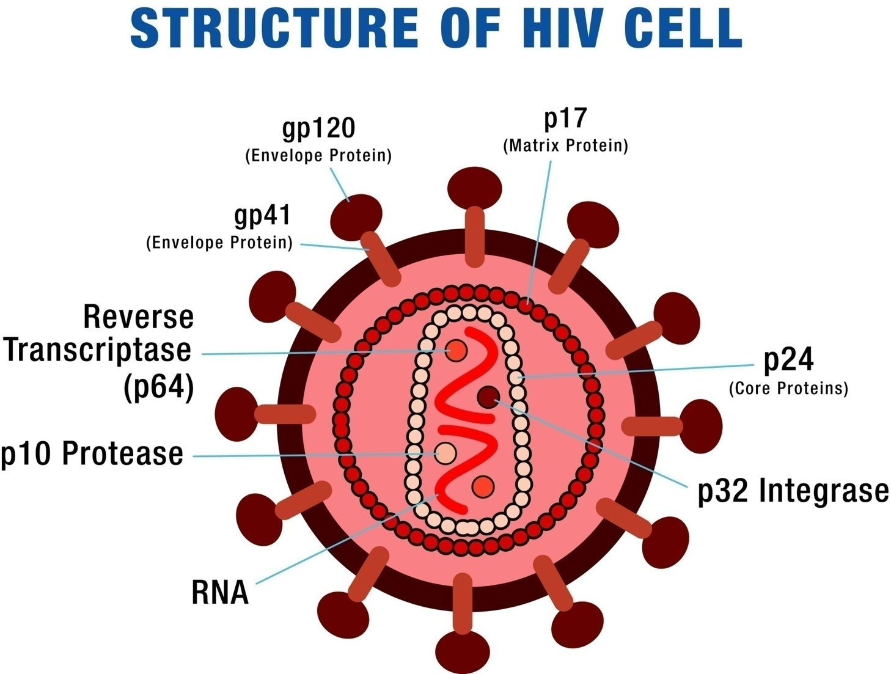
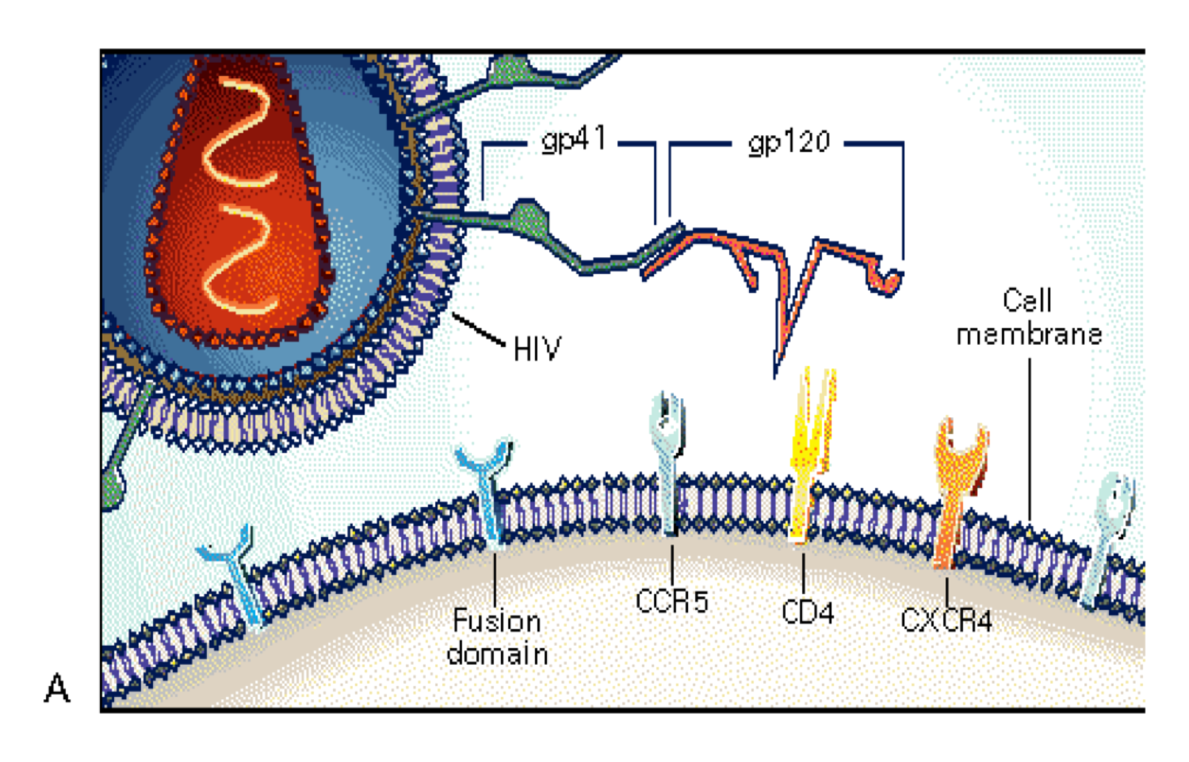
Structure of HIV cell:
Retrovirus (RNA).
Host derived envelope.
Glycoproteins on the surface.
Transmission
Modes of infection:
Sexual transmission at genital or colonic mucosa. the most common and most important way. common in homosexuals because the anal canal is highly vascularized and easily ruptured.
Blood transfusion. IV drug users (the virus can stay in the needle for up to 40 days).
Mother to infant. Breastfeeding can transmit it as well.
Accidental occupational exposure.
How HIV Enters Cell
Any cell that expresses CD4 can get HIV.
gp120 envelope protein binds to CD4 molecule
-CD4 found on T-cells macrophages, and
microglial cells.
-Binding to CD4 is not sufficient for entry.
gp120 envelope protein binds to co-receptor
-Chemokine receptors: CCR5 and CXCR4 receptors.
CXCR4 are mainly found on T cells while CCR5 are found
on T cells, Macrophages and dendritic cells.
Binding of virus to cell surface results in fusion
of viral envelope with cell membrane.
Viral core is released into cell cytoplasm
gp120 binds to CD4 but it needs chemokine
CCR5 or CXCR4 to gain access into the cell.
Some people have mutation in CCR5 gene these individuals cannot develop HIV.

Slide 3
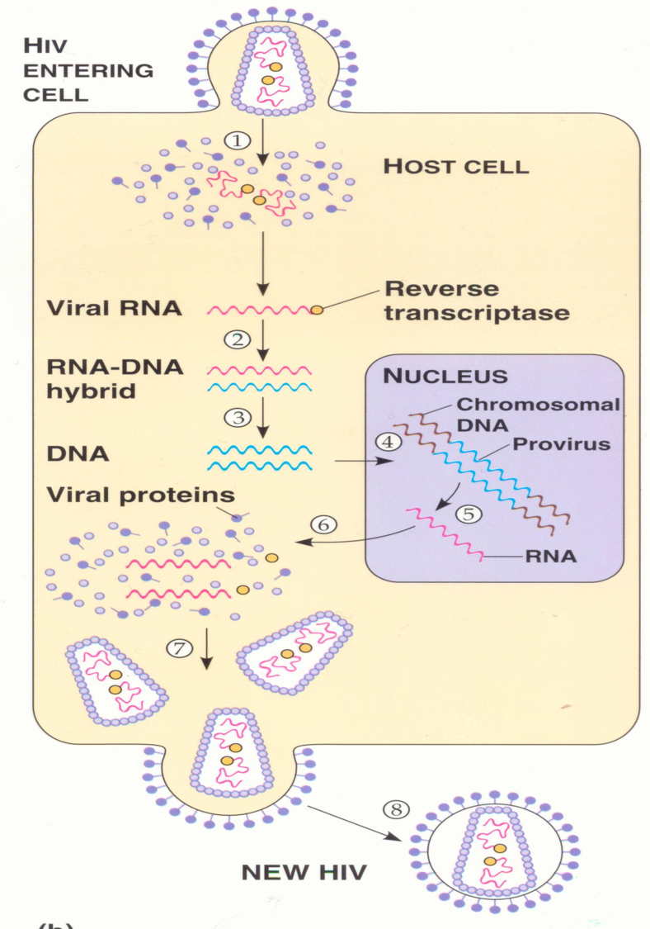
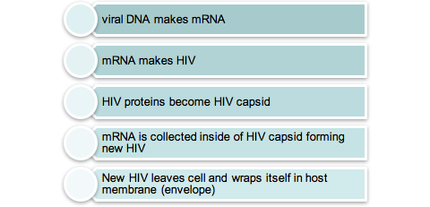
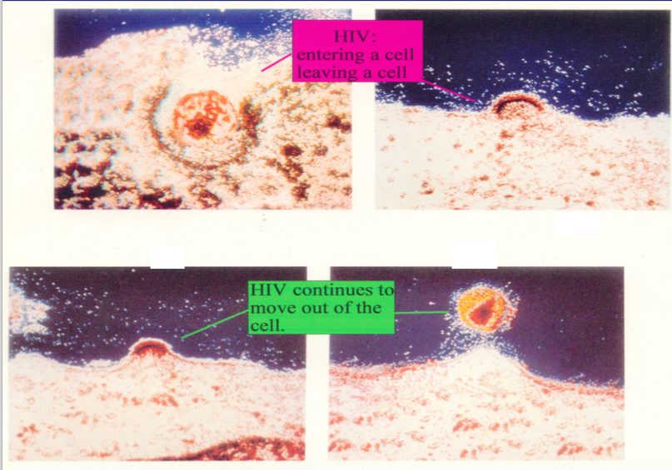
Viral-host Dynamics
About 10¹⁰ (10 billion) virions are produced daily
Average life-span of an HIV virion in plasma is ~6 hours
Average life-span of an HIV-infected CD4 lymphocytes is ~1.6 days
HIV can lie dormant within a cell for many years, especially in resting (memory) CD4 cells, unlike other retroviruses
1-Retrovirus enters cell.
2- Reverse Transcriptase makes DNA copy of RNA.
3-Viral DNA forms provirus with host DNA:
1
proteins
2
3
HIV entering and leaving a human cell

Slide 4
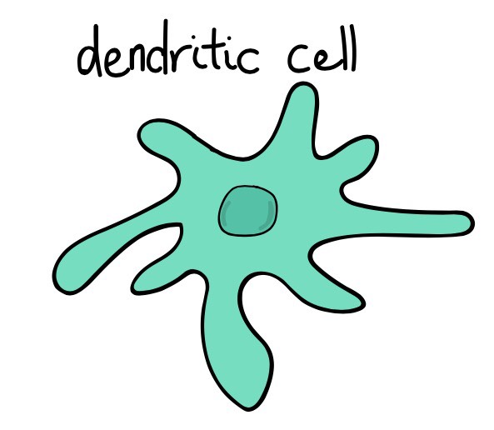
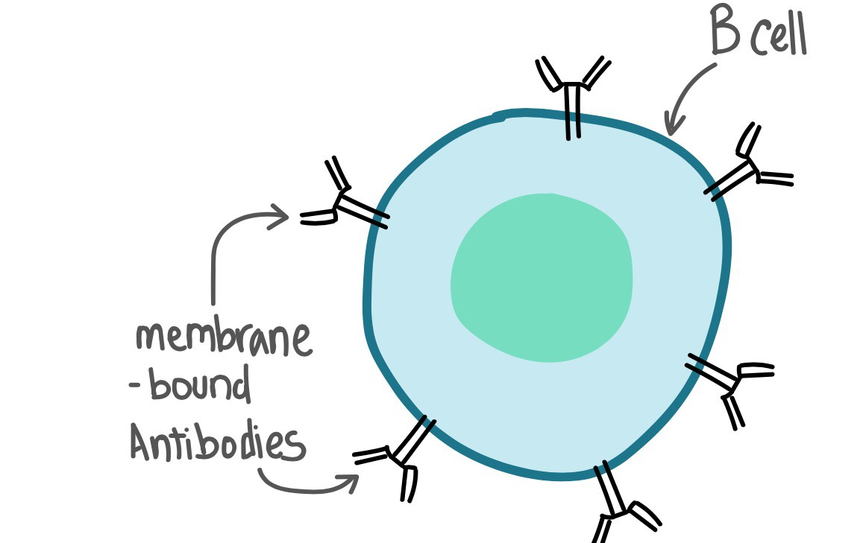
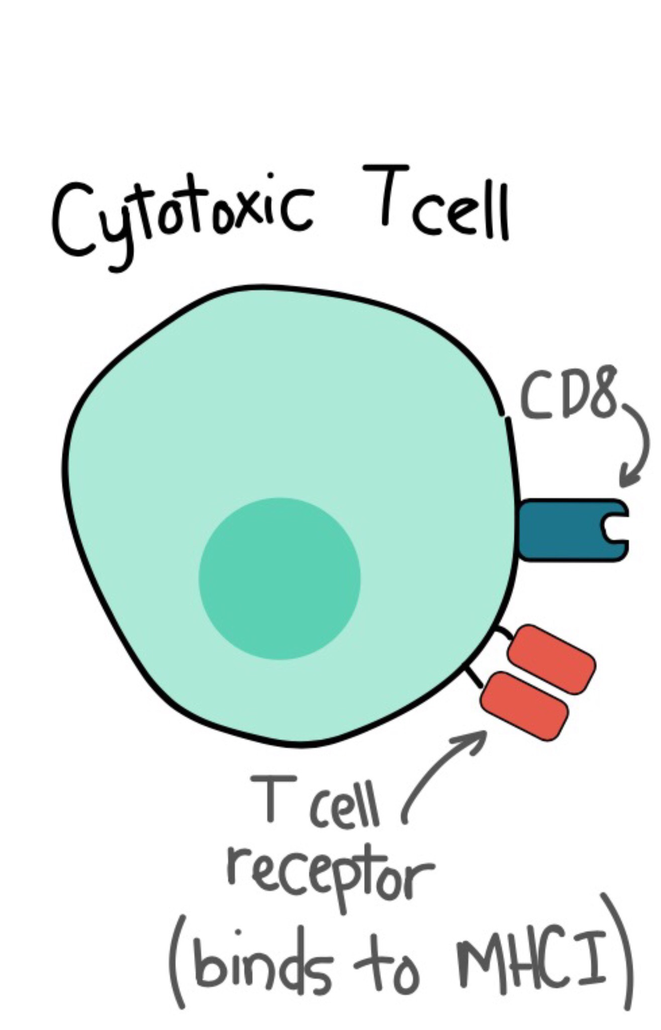
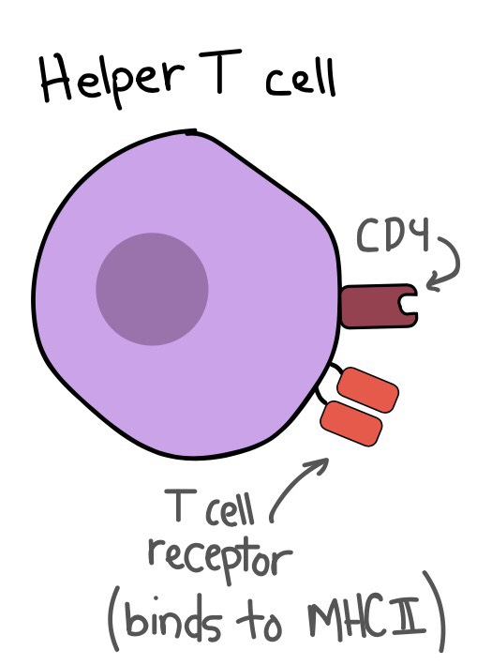
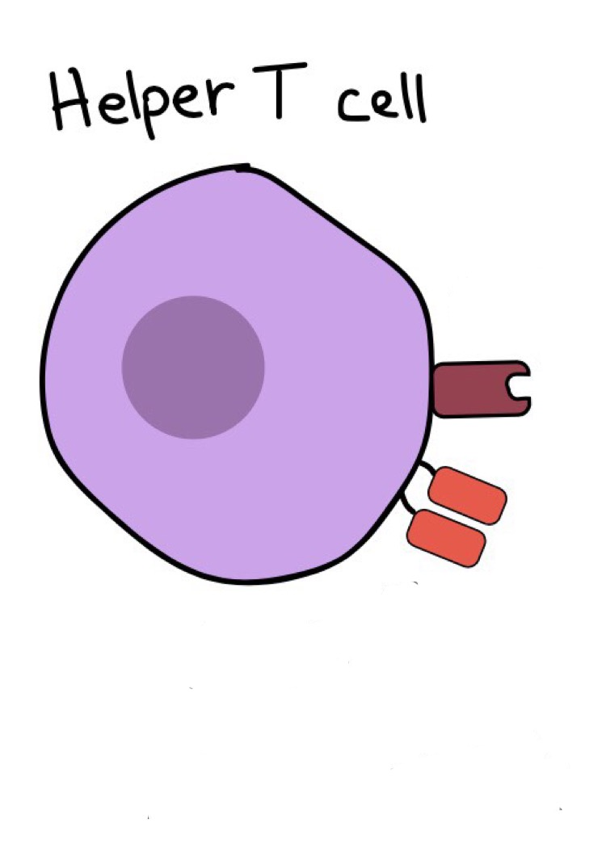
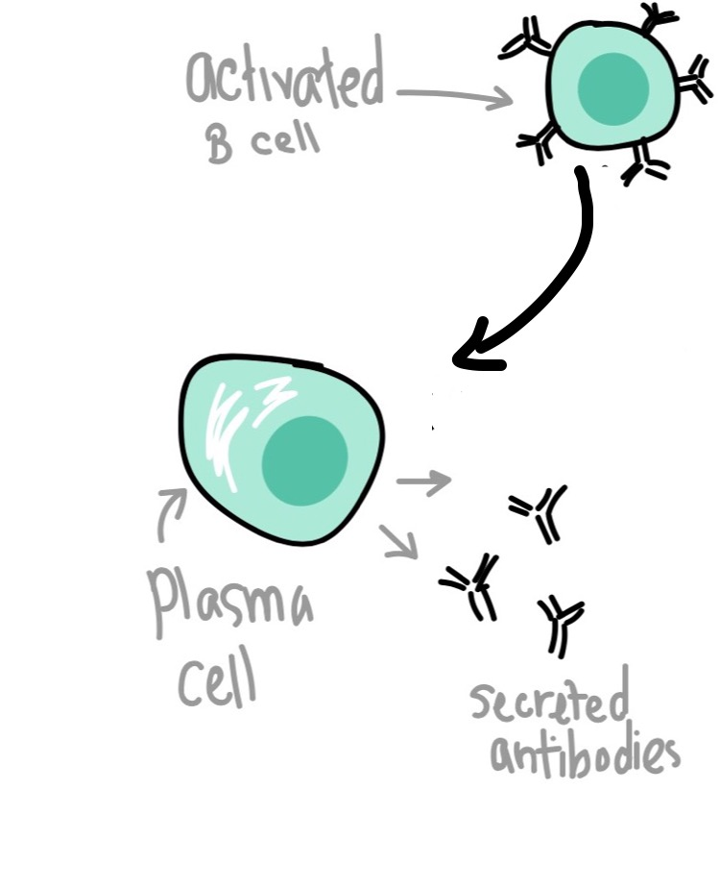
Overview of Adaptive Immune Response
Extracellular infection
APC or any cell
(intracellular infection)
Free antigens
MHC I presentation of endogenous antigen
Only APC
MHC II presentation of exogenous antigen
differentiates
differentiates
Th1
Th2
augments
augments
Cell mediated
(cytotoxic t lymphocytes)

Slide 5
General Principles of Viral-host Interactions
Host: mounts HIV specific immune responses .
-Cellular (cell mediated) most important. Cytotoxic cells.
-Humoral (antibody mediated).
Virus: subverts the immune system
-Infects CD4 cells that control normal immune responses
-Integrates into host DNA
-High rate of mutation
-Hides in tissue not readily accessible to immune system
Immune Responses to HIV
Cellular Immune Responses to HIV
CD8 Cytotoxic T lymphocyte (CTL)
(protective during HIV)
-Derived from naive T8 cells, which recognize viral antigens in context of MHC class I presentation
-Directly destroy infected cell
-Activity augmented by Th1 response
CD4 Helper T Lymphocyte (Th)
-Plays an important role in cell-mediated
response
Recognizes viral antigens by an antigen
presenting cell (APC):
-Utilizes major histocompatibility complex (MHC)
class II
Differentiated according to the type of “help”
-Th1) activate Tc (CD8) lymphocytes, promoting
cell-mediated immunity
-Th2) activate B lymphocytes, promoting antibody
mediated immunity
Humoral Immune Response to HIV
Neutralization
Antibodies bind to surface of virus to prevent attachment to target cell
Antibody-dependent cell-mediated cytotoxicity (ADCC)
Fc portion of antibody binds to NK cell
Stimulates NK cell to destroy infected cell
Less effective in controlling HIV infection compared to cellular immunity.
The Th1 response is mediated by IL-2, (IFN- gamma), and (TNF-beta)

Slide 6
Cells Infected by HIV
Numerous organ systems are infected by HIV:
Brain: macrophages and glial cells
Lymph nodes and thymus: lymphocytes and dendritic cells
Blood, semen, vaginal fluids: macrophages
Bone marrow: lymphocytes
Skin: Langerhans cells
Colon, duodenum, rectum: chromaffin cells
Lung: alveolar macrophages
General Principles of Immune Dysfunction in HIV
All elements of immune system are affected
Advanced stages of HIV are associated with substantial disruption of lymphoid tissue
Impaired ability to mount immune response to new antigen (1ry response)
Impaired ability to maintain memory responses (2ry response)
Susceptibility to opportunistic infections (in immunocompromised patients)
Decline in immune status parallels the decline in CD4 number and function. Loss of these cells results in failure of normal Th1 response and cell-mediated immunity that is necessary for controlling intracellular infections.
Mechanisms of CD4 Depletion and Dysfunction
Direct
Indirect
• Elimination of HIV- infected cells by virus- specific immune responses
• Loss of plasma membrane integrity because of viral budding
Syncytium formation
- Observed in HIV infection, most commonly in the brain
-Uninfected cells may then bind to infected cells due to viral gp120 (bind to CD4 of uninfected cells)
-This results in fusion of the cell membranes and subsequent syncytium formation.
- These syncytia are highly unstable and die quickly
Apoptosis
Autoimmunity

Slide 7
Role of Cellular Activation in Pathogenesis of HIV
HIV induces immune activation: HIV induce (infection) -> increase HIV replication and worsen it
Which may seem paradoxical because HIV ultimately results in severe immunosuppression
Activated T-cells support HIV replication: Intercurrent infections are associated with transient increases in viremia
Accounts for why TB worsens underlying HIV disease
Not only does the virus destroy and disrupt the immune system, it can manipulate the immune system to its own replicative advantage. This is achieved by immune activation. Clinically, this is demonstrated by the observation that viral load transiently increases in the presence of intercurrent illnesses, such as TB.
Role of Cytokine Dysregulation in Pathogenesis of HIV
HIV is associated with increased expression of pro-inflammatory cytokines:
TNF-alpha, IL-1,IL-6, IL-10, IFN-gamma
Associated with up-regulation of HIV replication
HIV results in disruption and loss of immunoregulatory cytokines
IL-2, IL-12
Necessary for modulating effective cell- mediated immune responses (CTLs and NK cells)

Slide 8
Seroconversion “seroconversion is the time period during which a specific antibody develops and becomes detectable in the blood.”
Median 8 weeks after infection
Level of viral load post seroconversion correlates with risk of progression of disease.
Asymptomatic Phase
Remain well with no evidence of HIV disease except for generalized lymphadenopathy
Fall of CD4 count by about 50-150 cells per year.
CD4 T-cell Count and Progression to AIDS
Gradual reduction in number of circulating CD4 cells is inversely correlated with the viral load
Any depletion in numbers of CD4 cells renders the body susceptible to opportunistic infections
in short, the less the CD4 T cell count the stronger the progression to AIDS
Primary infection:
70-80% symptomatic, 3-12 weeks after exposure
Fever, rash, cervical lymphadenopathy, aseptic meningitis, encephalitis, myelitis, polyneuritis
Surge in viral RNA copies to >1 million
Fall in CD4 count to 300-400\
Recovery in 7-14 days. Because of CD8 activation.
window period:
is the time between first infection and when the test can reliably detect the antibodies
can last up to 8 weeks.
a high viral load and a negative HIV
antibody test.
what is the test that will detect the early evidence of the disease? PCR,

Slide 9
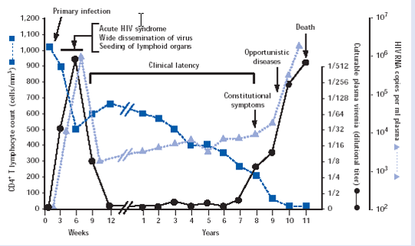
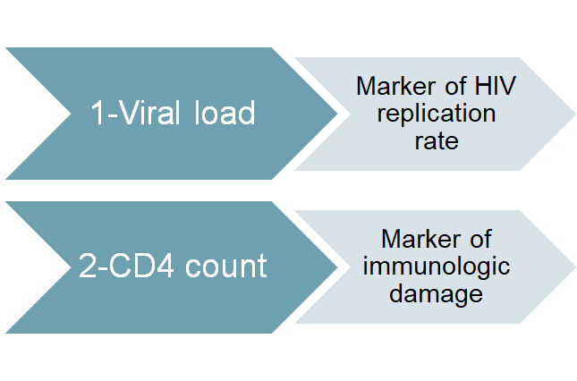
Natural History of HIV
Laboratory Markers of HIV Infection
Diagnosis:
Antibody test, ELISA, this is done first “routine test”
Western blot, for confirmation
HIV RNA viral load (done by PCR, the PCR looks directly for HIV.
The test is called HIV RNA viral load, but when asked how is it done, by PCR)
Management
Treatment recommended when symptomatic or CD4 count below 200.
Earlier if high viral load, rapidly falling CD4 count, hepatitis C co-infection.
Antiviral therapy
1-Reverse transcriptase inhibitors
2-Protease inhibitors
3-Fusion inhibitors
The antiviral therapy does not kill HIV or cure AIDS, it slows the replication of HIV so that the immune system can recover and confront other infections

Slide 10
Take home message
Infection with HIV usually occurs by sexual transmission, blood transfusion, mother to infant or accidental exposure
HIV targets the immune system and primarily infects CD4 positive lymphocytes
Immunodeficiency associated with HIV infections is mainly due to reduction in CD4 positive helper lymphocyte numbers
Increased viral load, significant reduction in CD4 lymphocytes and opportunistic infections are the hallmarks of progression to AIDS.
MCQs
1- HIV infected person called AIDS when the CD4 count is less than:
a) 400 b) 100 c) 200 d) 50
2-Which one of these cells infected by HIV in the colon?
a) macrophage b)lymphocytes c) langerhans d) chromaffin cells
3- the live span of an HIV version in the plasma is :
a)24 h b) 12h c) 6h d) 2h
4- the most sensitive test for HIV is:
a) ELISA b)PCR c) western blot d)antibody test
5- all elements of immune system are affected.
a)true b) false
6-apoptosis is a direct mechanism of CD4 Dysfunction.
a)true b) false
1-c
2-d
3-c
4-b
5-a
6-b

Slide 11
Contact us
Email: Immunology436@gmail.com
Twitter: Immunology436
Team Leaders
Ghada Alhadlaq Basel almeflh
Team members
Aroob Alhuthail
Dorah Alhamdi
Ghada Alskait
Hanin Bashaikh
Rawan Alwadee

