Slide 1
LECTURE: Candida infection Tricpmonas vaginalis Bacterial vaginosis
Editing File
Important
Doctor’s notes
Extra explanation
Only F or only M
"لا حول ولا قوة إلا بالله العلي العظيم" وتقال هذه الجملة إذا داهم الإنسان أمر عظيم لا يستطيعه ، أو يصعب عليه القيام به .

Slide 2
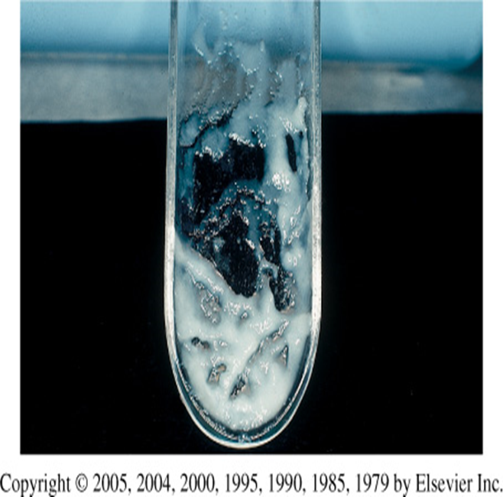
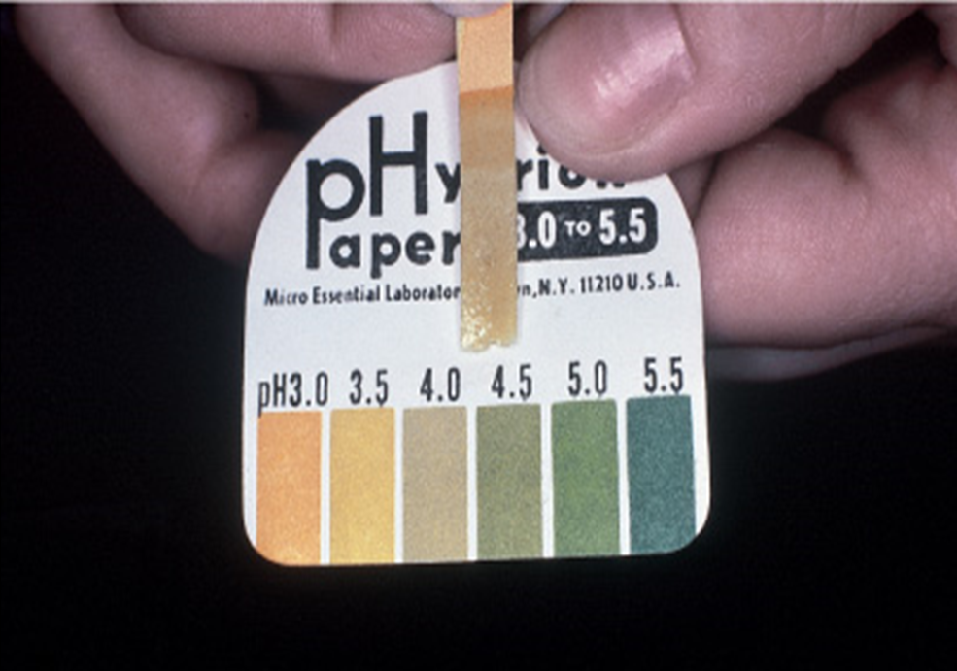
The human vagina:
Lined with 25 layers of epithelium cells.
Separation of microbial pathogens from the normal genital microbiota.
only in male’s slides
Lactobacilli (normal flora) Corynebacterium spp. Gardnerella vaginalis coagulase-negative: (staphylococci - Staphylococcus aureus) Streptococcus agalactiae (group B) Enterococcus spp. Escherichia coli Anaerobes Yeasts
Characteristics of the Vagina and Cervix | Vagina | Cervix
pH | <4.5 | 7.0
Epithelial cells | Squamous | Columnar
Pathogens/ Syndrome | Bacterial vaginosis Candida species Trichomonas vaginalis | Neisseria gonorrhoeae \ Chlamydia trachomatis
Abnormal vaginal secretion:
Characteristic of normal vaginal secretion:
Normal physiological vaginal secretion
Vaginal infection in order of prevalence :
Bacterial vaginnosis
Vulvovaginitis candiasis
trichimoniasis
Desquamative inflammatory vaginitis
Cervicitis: Infectious or Noninfectious
Estrogen deficiency
Desquamated vaginal epithelial cell
Lactobacilli (normal flora) dominate
PH 3.5 to 4.6 ( lactobacilli changes ph levels)
Oderless
No itching or irritation
Deonot soil underclothing
المحاضرة بتتكلم عن هذه الأنواع الثلاث
Vaginal PH examination

Slide 3
Types of infection:
Females | Males | Pregnant females | Children and postmenopausal women
Cervicitis usually STD Vulvovaginitis Urethritis Bacterial vaginosis (BV) Salpingitis (pelvic inflammatory disease [PID]) Endometritis Genital ulcers | Urethritis Epididymitis Prostatitis Genital ulcers | Disease in the neonate.
VAGINOSIS /VAGINITIS: Most common reason for patient visit to OB/GYN.
History & symptoms of vulvovaginitis:
History | symptoms
General gynecological history: (age Neonatal, pregnancy, prepubescent, atrophic post menopause) Onset, Esterogen depletion: (Menstrual history, Pregnancy, Sexual Hx, Contraception, Sexual relationship, Prior infection) General medical history: (Allergies, DM, Malignancies, Immunodeficiency) Candida is related to immunity Medication OCP< steroids, duches. | Discharge (quality scanty)physiological OCP Oder (BV,FB,EV fistula) Valvular discomfort (HSV) Dyspareunia (pain during intercourse) Abdominal pain (when it goes to the fallopian tube “complication”) (tricho) PID itching

Slide 4
Examination:
Causes of vulvovaginitis only in male’s slides
Breast Exam patient: breast also to detect early breast cancer
Adequate illumination
Magnification if possible
Give a patient mirror
Inspect external genetalia: (Lesions – Erythema)
Vaginal mucosa: (Erythema – Lesion - Secretion)
Examination of cervix: (Ectropion – Lesions – Erythema - Endocervical secretion)
Collect cervical and vaginal specimen
Bimanual examination
Bacterial : Bacterial vaginosis (40%)
Fungal : Candida vulvovaginitis (25%)
Parasitic : trichomonal vulvovaginitis (25%)
Low estrogen levels (called "atrophic vaginitis")
Allergic or irritation or injury response from spermicidal products, condoms, soaps, and bubble bath called “contact vulvovaginitis”.
Doctor notes:
Patient with STD we should check for the rest of STDs infection like HIV
Child have vulvovaginitis :Is indicator for child abuse
Ulcers are sexually transmitted : Like genital herps, papilloma virus and syphilis
Using bathroom after person affected is not at risk
Vaginal infection physiological changes : cervicitis can be infectious or non infectious , estrogen is involved that’s why pregnant or premenopausal and post menopausal is more susceptible
vaginal discharge: Thick white →candida - yellow → trichomonas
Itching and rash and ulcer → candida
STDs make cilia destructed and scar and ectopic pregnancy happen

Slide 5
Classification of vulvovaginitis:
Complicated | Uncomplicated
-Underlying illness: (HIV – DM) -Recurrent infection 4 or more per year -Non albican candida -Pregnancy -Sever infection Culture confirmation mandatory Antifungal suscep. Testing Treat for 10-14 days with vaginal or oral agent Other topical: ( Boric acid - 5 fluorocytocine ) Consider treatment of the partners Long term suppressive treatment for frequently recurrent diseases | -Sporadic -No underlying disease -By Candida albican -Not pregnanat -Mild to moderate severity Any available topical agent Fluconazole 150mg as a single oral dose

Slide 6
1- Candida infections (yeast infection moniliasis)
Candida is most common infection
Candidiasis or thrush is a fungal infection (mycosis) of any of the Candida species (yeasts) of which Candida albicans is the most common
Common superficial infections of skin and mucosal membranes by Candida causing local inflammation and discomfort
Budding yeast and no pseudohyphae in patients with C.glabrata..
Candidal vulvovaginitis (vaginal thrush):
Similar to :Urinary infection
Infection of the vagina’s mucous membranes by Candida albicans.
75% of adult women – between 20-30 years
candida albicans Found naturally in the vagina
Types of candidal vulvovaginitis:
Complicated thrush | Uncomplicated thrush
-four or more episodes in a year. -severe symptoms. -Pregnancy -poorly controlled diabetes/immune deficiency. -not caused by the Candida albicans | -single episode/less than four episodes in a year. -mild or moderate symptoms -caused by the Candida albicans
Odorless with itching: candida thin watery cheesy which there is hash itching

Slide 7
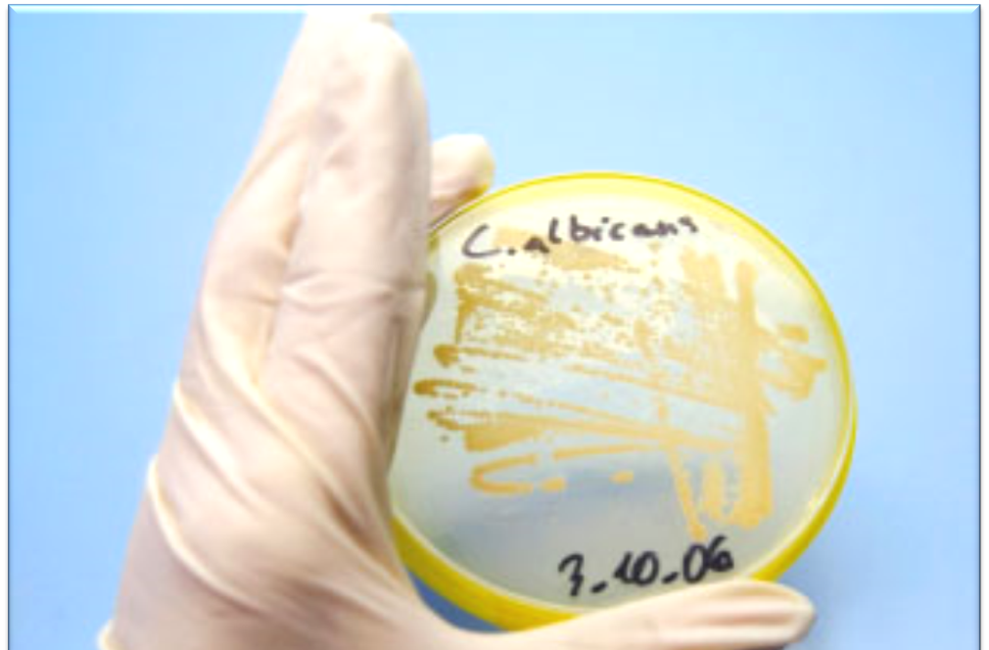
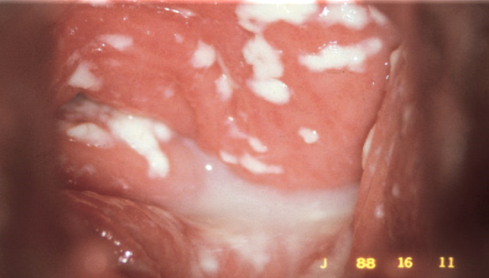
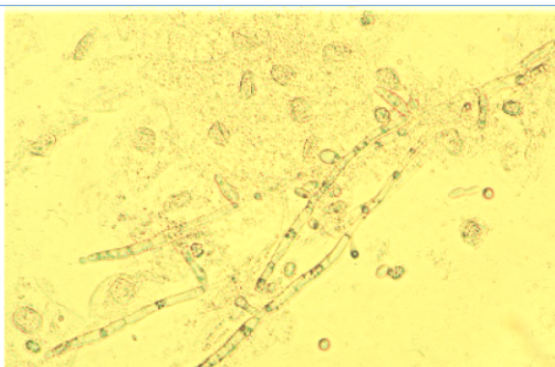
1- Candida infections:
Risk factors | Symptoms | Diagnosis
-Broad-spectrum Antibiotics -Pregnancy because of hormones which make them more susceptible to infection -Diabetes (poorly controlled) -Immunodeficiency -Contraceptives -Sexual behavior -Tight-fitting clothing -Female hygiene -Hormonal changes -Change in vaginal acidity. -Use of corticosteroid medications | Vulval itching Vulval soreness and irritation Superficial dyspareunia. Pruritus, soreness Dysuria Odourless vaginal discharge: (thin and watery or thick and white cheese-like) Erythema (redness) Fissuring satellite lesions. | History & symptoms physical and pelvic exam Wet prep to see clumps of pseudohyphae. KOH prep helpful but not always necessary. Candidiasis can be similar to other diseases: -Sexually transmitted diseases -Chlamydia -Trichomoniasis -Bcterial vaginosis -Gonorrhea
Treatment:
Butoconazole cream Clotrimazole: ( 1% cream or vaginal tablet) Miconazole: (2% cream or vagina suppository) Nystatin: vaginal tablet Oral Agent: Fluconazole - oral one tablet in single dose | Short-course topical formulations: single dose and regimens of 1–3 days effectively treat uncomplicated candidal vulvovaginitis Topical azole drugs are more effective than nystatin Azole drugs relief of symptoms in 80%–90% of cases.
Treatment failure: In up to 20% of cases (If the symptoms do not clear within 7–14 days)

Slide 8
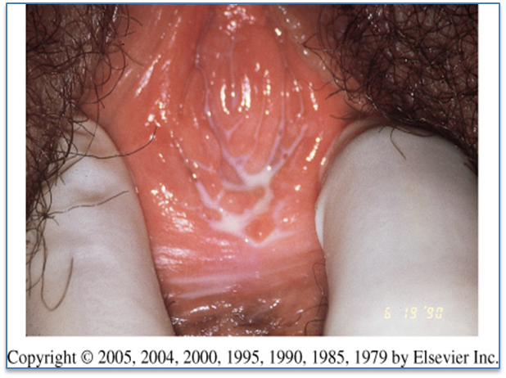
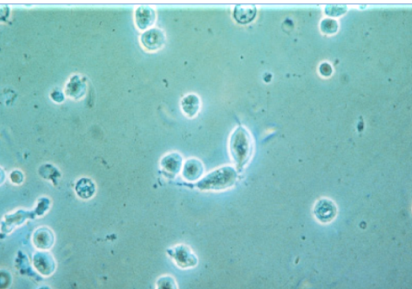
2- Trichomoniasis: (sexually-transmitted infection)
Parasite flagellated
Trichomonas is the most prevalent non-viral sexually transmitted disease (STD) agent
The wet mount's fast results
Symptoms: | Purulent vaginal discharge Yellow- greenish to grey in color Sometimes frothy | Dyspareunia Abnormal vaginal odor, |  |  | Vulvar irritation (strawberry) Dysurea, pruritus
Diagnosis: | Culture is considered the gold standard for the diagnosis of trichomoniasis. Its disadvantages include cost and prolonged time before diagnosis لذلك لا تستعمل Other Methods of Diagnosis: EISA :Sensitivity 91.6% - Specificity 97.7% \ DNA Probe
Management: | 1- Confirm the diagnosis: Wet preparation (miss 30%) \ Culture \ Gram Stain 2-Confirm all current sexual partners treated |  | 3-Oral metronidazole: 500 mg bid for 7 days 2 g daily for 3-5 days 4- If Rx failure : Consultation with experts Susceptibility testing Higher dose of metronidazole Alternative Tinidazole
Complications | Trichomonas associated with: Premature rupture of membranes Preterm labor and birth |  |  | Low birth weight Increased transmission of other STDs including HIV
Males usually asymptomatic, but can cause Non-gonococcal urethritis
نعرف الدايقنوز لمن نشوف الباراسايت تحت المايكرسكوب فمانحتاج نسوي كلتشر

Slide 9
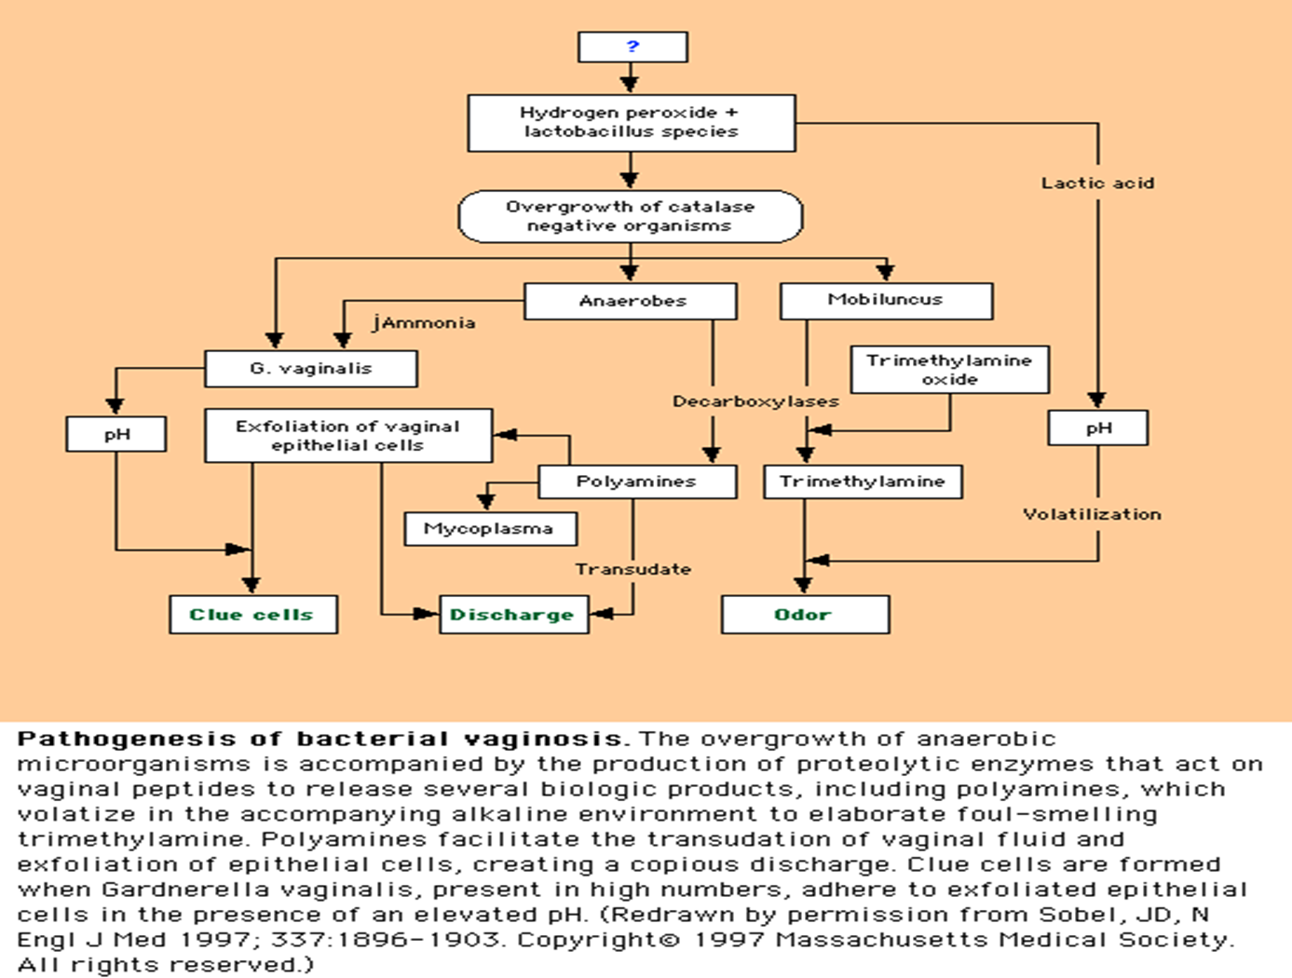
3- Bacterial Vaginosis: Floral imbalance
تحصل لمن تقل اللاكتوباسيلاي وتزيد القرادنيريلا
Lactobacillus acidophilus: anaerobic bacteria
-Compete with other microorganisms for adherence to epithelial cells
-Produce antimicrobial compounds such as organic acids (which lower the vaginal pH) hydrogen peroxide, and bacteriocin-like substances make acidety by fermintation and acidety is protecting
Gardnerella vaginalis normally in low quantity
Mycoplasma hominis
Mobiluncus species
Anaerobes:
-Bacteroides (Porphyromonas)
-Peptostreptococcus
-Fusobacterium
-Prevotella
Pathogenesis
Marked reduction in lactobacillus
-Decreased hydrogen peroxide production
Polymicrobial superficial infection: overgrowth of G. vaginalis and anaerobic bacteria
-Lactobacilli predominate after metronidazole treatment
Lactobacilli adjust your ph 3.4-4.6

Slide 10
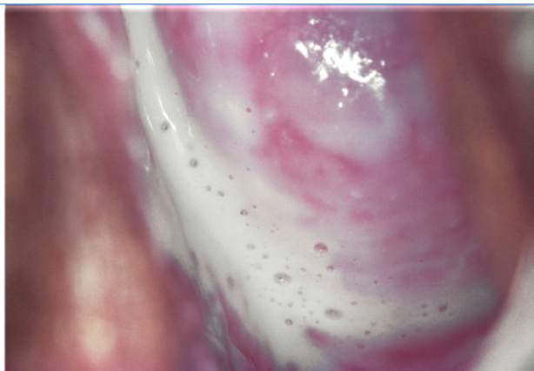
3- Bacterial Vaginosis:
Epidemiology | The most common vaginal infection in women of childbearing age-29%
Risk factors | Multiple or new sexual partners -(sexual activity alteration of vaginal pH) -Early age of first sexual intercourse -Douching -Cigarette smoking -Use of IUD -Although sexual activity is a risk factor for the infection, bacterial vaginosis can occur in women who have never had vaginal intercourse
Clinical Features | Most cases (50-75%) Homogenous grey vaginal discharge with less itching Dysuria and dyspareunia rare Pruritus and inflammation are absent Fishy vaginal discharge: During menstruation, After intercourse Minimal itching or irritation Burning Thin milky white or grey vaginal discharge Absence of inflammation is the basis of the term "vaginosis" rather than vaginitis

Slide 11
only in male’s slides
Bacterial Vaginosis complications
GYN complications | OB complications
Pelvic inflammatory disease (PID) Postaportal pelvic inflammatory disease Post hysterectomy infections Mucopurulent cervicitis Endometritis Increased risk of HIV , STD | Preterm delivery Premature rupture of membranes Amniotic fluid infection Chorioamnionitis Postpartum endometritis Premature labor Low birth weight

Slide 12
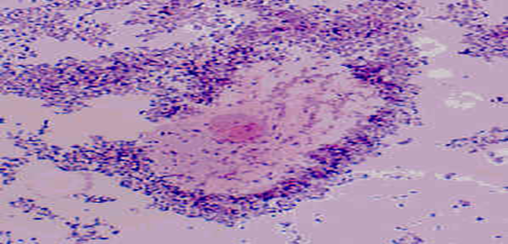
3- Bacterial Vaginosis:
Diagnostic Methods:
Clinical :
Related symptoms and sexual history.
Examination of introitus may reveal erythema of the vulva and edema of the labia.
Speculum examination.
A sample of the vaginal swab
microscopic Criteria
Gram Stain (“Gold Standard”): mixed small gram-positive and gram-negative rods ± curved rods = BV.
Clue cells on saline wet mount of vaginal discharge (on >20% cells) Bacteria adhered to epithelial cells; most reliable single indicator
Vaginal pH > 4.5 , whiff amine test
Elevated pH and increased amine : Sensitivity 87%; Specificity 92%
Culture: poor predictive value for G. vaginalis as prevalent in healthy asymptomatic women
DNA probes- expensive, poor predictive value alone
Clinical diagnose 3 out of 4 :
1-ph greater than 4.5
2-positive whiff test
3-any clue cells
4- homogenous discharge
only in male’s slides
Office Diagnostics for Vaginitis: | Empiric diagnoses often inaccurate and lead to incorrect treatment and management. Need for rapid, accurate and inexpensive diagnostic tests.
OFFICE-BASED TESTS FOR VAGINITIS ARE UNDERUTLIZED: | Simple, inexpensive, office-based tests were underutilized:
 | Microscopy | PH measurement | Whiff amine test

Slide 13
3- Bacterial Vaginosis:
Treatment Recommendations:
Oral treatment | Oral metronidazole 500 mg bid x 7 days ($5) Act only on anaerobes (not candida) | 84-96% cure rate Single dose therapy (2g) may be less effective
 | Oral Clindamycin 300 mg bid x 7 days ($28) | Less effective
Topical treatments (higher recurrence rates) | Metronidazole gel (0.75%) 5 g PV qhs x 5 days ($30) | 70-80% cure rate
 | --Clindamycin cream (2%) 5 g PV qhs x 7 days ($31) | Less effective May lead to Clindamycin resistant anaerobic bacteria
only in male’s slides: الدكتور قال مب مهمة
PH TEST | KOH "WHIFF" TEST | WET MOUNT PREPARATION
PH indicator strips: pH 3.5 - 7.0 Place sample of vaginal secretion on test strip: read while still moist. PH>4.5 indicates abnormality (i.e. BV-Trichomonas- or menstrual blood). Be careful not to sample the cervix; cervical secretions and blood have a PH 7.0 | Sample of vaginal secretions are placed in a test tube with 10% KOH. KOH alkalizes amines produced by anaerobic bacteria-results in a sharp "fishy odor" | Vaginal secretion sample from the anterior fornix and lateral wall Place swab in test tube with small amount of normal saline and place sample on glass slide with cover slip Visualize at both low and high power Clue cells, yeast, Trichomonas, WBC, bacteria.

Slide 14
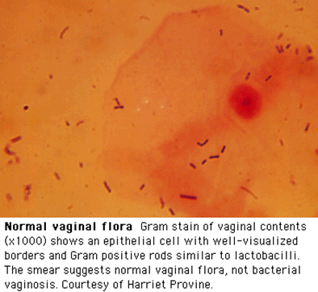
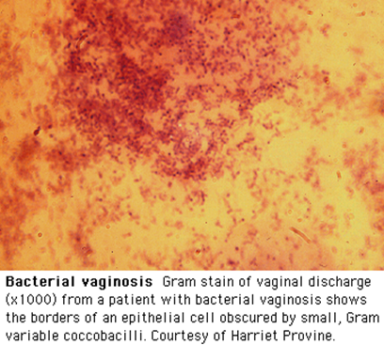
Diagnosis by Gram Stain

Slide 15
Specimen Obtained during gynecological examination
Vaginal secretion
PH - Saline wet preparation - KOH wet preparation*
Cervical cultural and non cultural
GC - C.trachomatis
Cervical cytological examination if not documented within previous 12 months
Vaginal culture
- Candida: Vaginal Yeast Culture: - Trichomonas vaginalis**
دكتورة فوزية قالت هذا زيادة من عندي
Probably not routinely indicated - many women are colonized with Candida
If obtained must correlate with patient signs and symptoms
For recurrent infections culture and susceptibility testing may be helpful
Routine bacterial cultures /not helpful
Routine NOT helpful
Wet mount- 60% sensitive (Trichomoniasis ,BV )
Abnormal or foul odor using a (KOH) "whiff test,"
The Gram stain is useful to diagnose BV : Using the Nugent scoring system
A wet mount+ a yeast culture and Trichomonas culture: Recommended tests to diagnose vaginitis.
Performing only a wet mount, without yeast or Trichomonas culture: 50% of either of these agents of vaginitis will be missed
A sensitive DNA probe assay is available: Combines the detection of yeasts, Trichomonas, and G. vaginalis as a marker for BV
*يستخدم لتشخيص الباراسيتك انفكشنز ** مانستخدم كلتشر نستخدم الوت مونت عشان نشوف الترافوزويت أو القرام ستين

Slide 16
موجودة في سلايدات الدكتور فقط , اعتبروها زي الملخص
Clinical syndrome | Etiology | Treatment
Bacterial vaginosis Malodorous vaginal discharge, pH >4.5 | Etiology unclear: associated with Gardenella vaginalis mobiluncus, Prevotella sp., | Metronidazole Tinidazole
Trichomoniasis Copious foamy discharge, pH >4.5 Treat sexual partners | Trichomonas vaginalis | Metronidazole Tinidazole
Candidiasis Pruritus, thick cheesy discharge, pH <4.5 | Candida albicans 80-90%. C. Glabrata C. tropicalis | Oral azole: Fluconazole Itraconazole

Slide 17
SUMMARY:
vulvovaginitis
complicated
pregnant
candida that isn't albicans
uncomplicated
mild
4 or more infections
HIV or diabetes
severe symptoms
not pregnant
candida albicans

Slide 18
SUMMARY:
infection | Risk factors | Symptoms | Diagnosis | treatment
Candidal vulvovaginitis “vaginal thrush” | Antibiotics Pregnancy DM OCP Sexual behavior | Vulval itching (soreness and irritation) Dysuria and dyspareunia Odorless vaginal discharge (cheese like or thin and watery) Erythema Fissures Satellite lesions | History and pelvic exam | Butoconazole Clotrimazole Miconazole Nystatin Oral agent: fluconazole
Trichomoniasis (STD) | -- | Purulent vaginal discharge (yellow-green) Vulvar irritation (strawberry) Dysuria and dyspareunia Abnormal vaginal odor | Culture is gold standard | Oral metronidazole Check all current sexual partners
Bacterial vaginosis | Multiple sex partners Antibiotics Douching IUD | Grey/white discharge Dysuria and dyspuerenia Fishy vaginal odor Minimal itching or irritation (no inflammation) | Gram stain is gold standard Clue cells on went mount | Metronidazole Clindamycin Oral or topical

Slide 19
QUIZ:
What is the gold standard test for Trichomoniasis?
a. Culture
b. Gram stain
c. Wet mount
2. 25 year old female comes in complaining of vulvar irritation and itching. She says she also has discharge that has a fishy odor. What’s the most likely causative organism?
a. Candida albicans
b. Gardenella Vaginalis
c. Trichomoniasis
3. Patient comes in with a case of vulvovaginitis due to C.Albicans. This is the 5th time she has suffered from the same infection within the last 11 months. What type of vulvovaginitis ?
a. complicated
b. uncomplicated
c. non of the above
4. Female diabetic patient comes in complaining of cheese like discharge and irritation. What is used for treatment?
a. Gentamycin
b. Butoconazole
c. clindamycin
Answers: 1. a 2. b 3. a 4. b

Slide 20
THANK YOU FOR CHECKING OUR WORK, BEST OF LUCK!
Hamad Alkhudiry
Shrooq Alsomali
Safa Al-osaimi
Jawaher Alkhayyal
Najd Altheeb
Doctors slides

