Slide 1


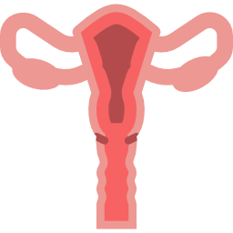

LECTURE: Transplacental Infection
Editing File
Important
Doctor’s notes
Extra explanation
Only F or only M
"لا حول ولا قوة إلا بالله العلي العظيم" وتقال هذه الجملة إذا داهم الإنسان أمر عظيم لا يستطيعه ، أو يصعب عليه القيام به .

Slide 2
OBJECTIVES:
Upon completion of this lecture, the students should be able to
To recognize the different types of infant infections.
To know major transplacentaly transmitted pathogens causing congenital infections .
(Toxoplasma , TP ,ParvoV , VZV, Rubella V & CMV.)
To describe their structures.
To know their major epidemiology features.
To describe clinical manifestations of their congenital infections
To illustrate different laboratory diagnosis of maternal and congenital infections.
To know their treatment and preventive measures.

Slide 3
Infant infection
Classification | Timing of events | Mechanisms
Congenital DURING PREGNANCY | In utero | Transplacental
Perinatal | During labour and delivery | Exposure to genital secretions & blood
Neonatal | After birth | ● Direct contact with the mother ● breast feeding or nosocomial exposure
Introduction
Etiology | Mostly by viruses , previously known as ( T O R C H ) infections: T = Toxoplasmosis ( Toxoplasma gondii) the main pathogen cause TPI. it is a protozoan parasite O = Others: Treponema pallidum (causes syphilis) , Parvovirus & Varicella Zoster Virus (VZV) . R = Rubella Virus C = C MV H=Herpes mainly type 2, Hepatitis & H IV
Risk of Intrauterine infection & fetal damage | Type of organism (Teratogenicity) Type of maternal infection (primary) more damage to the fetus Time during pregnancy ( 1 st “most severe” , 2nd, 3rd Trimesters) Primary Maternal infection in the first half of pregnancy poses the greatest risk to the fetus*
TORC → transplacental
H → perinatal
* because in recurrent infection , There is antibodies that get transferred to the fetus . That is why its less risky

Slide 4
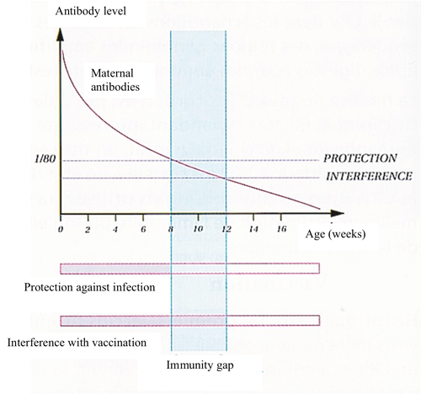
Cont. Introduction
Common Findings of congenital infection | Majority of congenital infections are “ asymptomatic ” at birth Babies with normal physical appearance may develop hearing loss or mental retardation Intrauterine growth retardation (IUGR) = small fetus " low birth weight" Hepatosplenomegaly (HSM) with jaundice Thrombocytopenia resulting in rash Microcephaly or hydrocephalus Risk of developing neurological or eyes abnormalities later in their life
Neonatal serological Dx | Detection of specific IgM antibodies (BUT the Absence of fetal IgM at birth does not exclude infection Persistence of specific Ig G antibody more than 12 months. Babies who are less than 12 ms old cannot develop IgM لان جهازهم المناعي مابعد اكتمل IgM= acute , IgG= chronic
Management | Preventative and therapeutic measures are possible for some of the agents
Highest in the 3rd trimester
Highst in 1st trimester

Slide 5
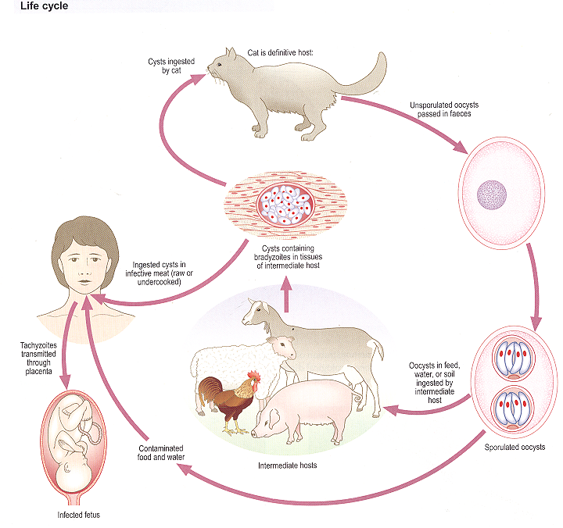
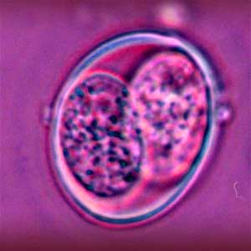
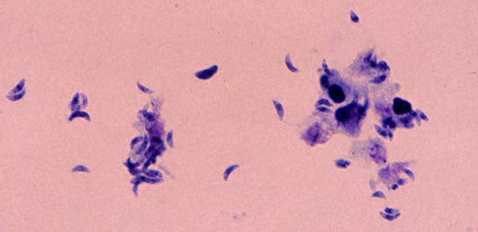
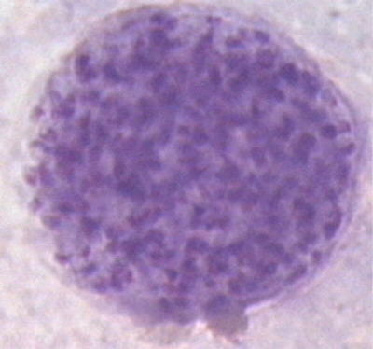
Toxoplasma Gondii
Morphology | ● Obligate intracellular parasite (protozoa) that has three forms: Oocysts: Shed in cat feces Tachyzoites: (tachy = rapid) rapidly dividing forms , seen in body fluids (acute phase) . Bradyzoites: (brady=slow) slowly dividing forms (chronic phase)
Transmission | Ingestion of oocyst ( through fecal oral route ): fingers, soil, water contaminated with cat feces Intermediate host -> Ingestion of cyst (containing bradyzoites) in undercooked meat . Blood transfusion and organ transplant. Transplacental route (by tachyzoites)
Oocysts;
Tachyzoites:
Bradyzoites:
Immunity +
→
←
Shed in cat feces
rapidly dividing forms
ACUTE PHASE
Immunity -
slowly dividing forms
CHRONIC PHASE
-Infective stage
-produced by sexual cycle in definitive host (cat)
وجود المناعة يبطئ نموه وعدم وجودها او ضعفها يسرع النمو

Slide 6
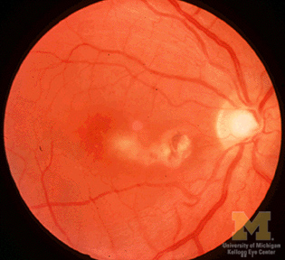
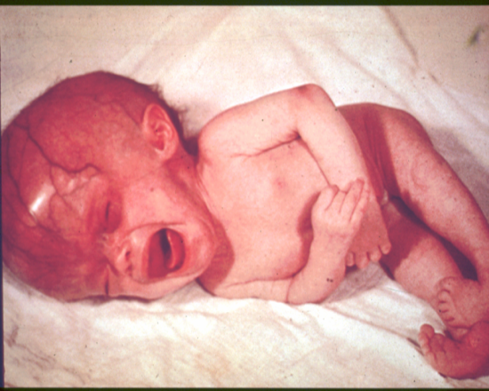
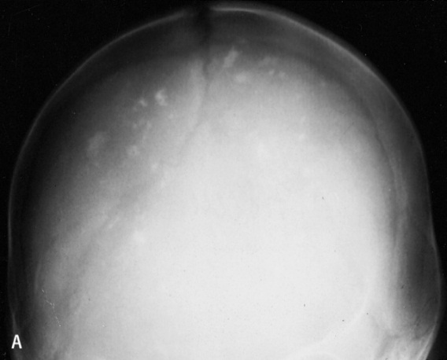
Toxoplasma Gondii
Manifestation | Most cases of congenital toxoplasmosis are due to primary maternal infection . Rarely caused by reactivation of a latent infection (bradyzoites transform into tachyzoites in the immunocompromised patient e.g. pregnancy, HIV, cancer) The highest transmission rate is in the third trimester. The most severe symptoms are if transmission occurred during the first trimester. i.e. If the mother gets the infection in the third trimester, there is a high possibility that it will be transmitted to the fetus, but baby’s symptoms are going to be the less severe “thanks god”. Most (70-90%) are asymptomatic at birth but are still at high risk of developing abnormalities later, especially of the eye (chorioretinitis) and neurologic disease (Mental retardation) . The classic triad of symptoms: Chorioretinitis, Hydrocephalus & Intracranial calcifications . Other signs include: rash, Hepatosplenomegaly, jaundice, lymphadenopathy, microcephaly, seizures, thrombocytopenia, deafness. Abortion & intrauterine death higher with infection in 1st trimester.
  Chorioretinitis
Hydrocephalus
  Intracranial calcifications

Slide 7
Diagnosis | Pregnant mother | ● Serology:IgM, IgG, IgG avidity, and IgG seroconversion compared to booking blood Low avidity = primary High avidity = recurrent
 | Infant | ● Pre natal Dx : PCR (detection of the Toxoplasma genome from amniotic fluid) , Culture or Serial Ultrasound (to detect anomalies) ● Post natal Dx: ○ Serology by detecting IgM (again, negative results doesn’t exclude infection) , or persistent IgG more than 12 months ○ PCR ○ Culture (isolation of Toxoplasma) ○ Evaluation of infant (ex, neuroimaging)
Prevention | Avoid exposure to cat feces ; Wash: hands with soap and water, wash fruits & vegetables, wash surfaces that touch fruits, vegetables & raw meat. Cook all meats thoroughly .
Treatment | Spiramycin Used for mothers to lower transmession rate Pyrimethamine combined with sulfadiazine. Used for neonates

Slide 8
Doctor notes:

Slide 9
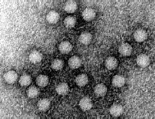
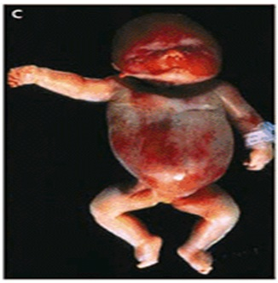
Parvovirus B19 (parvo = small)
Morphology | Family: Parvoviridae. parvo=small. (the smallest of the DNA viruses) Structure: nonenveloped , Icosahedral capsid & ssDNA genome.
Epidimiology | Worldwide distribution Humans are known hosts. the only reservoir, so it's not zoonotic like the Toxoplasma. Transmission: 1. Respiratoryroute 2. Transplacentalroute 3. Bloodtransfusion
Clinical presentation | Acquired infection | Immunocompetent host: Erythema infectiosum Maculopapular rash in cheecks Immunocompromised pts
 | Congenital infection | Risk of congenital infection is greatest when infection occur in 1s t 20 wks.. Infection in the 1s t trimester → IUD (Intrauterine death) 2-6 % nfection in the 2n d trimester → HF ( Hydrops fetalis )* 2ndary heart failure cuase ascitis and massive edema Infection in the 3r d trimester → Lowest risk * Parvovirus is known to cause fetal loss (hydrops fetalis) through: severe anaemia (due to the destruction of the RBCs by B19) → congestive heart failure (myocarditis) → generalized oedema & fetal death.
non developed V.
Icosahedral capsid
& s.s DNA genome

Slide 10
Parvovirus B19
Diagnosis | Pregnant mother | Specific Ig M , Ig G seroconversion.
 | Infant | Ultrasound ( to detect hydrops “edema” ) Doesn’t grow in cell culture. PCR should be performed to detect the viral DNA definitive diagnosis
Prevention | Hygiene No vaccine available
Treatment | No specific treatment: Intrauterine blood transfusion provides blood to fetus when fetal RBCs are being destroyed. We can treat symptoms e.g. digoxin for CHF

Slide 11
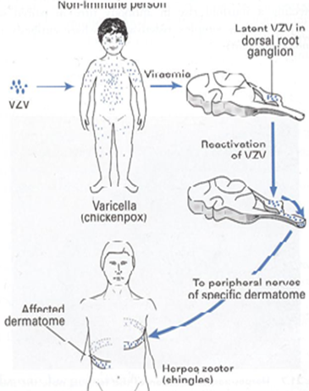
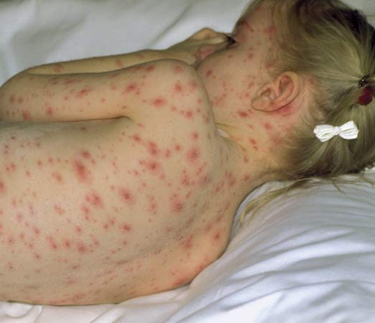
Varicella Zoster Virus ( VZV )
Morphology : | Family: Herpes viridae - Structure: dsDNA, Enveloped, Icosahedral Virus
Transmission: | Respiratory & Transplacental routes
Clinical presentation: | Acquired infection: 1- Varicella (chickenpox): (Primary illness) follows initial exposure to the virus with Generalized vesicular Rash. - Primary infection in a pregnant lady carries a greater risk of severe disease, in particular: pneumonia 2- Zoster (shingle): (Recurrent infection) causing localised vesicular painful Rash. Intrauterine infections: Congenital infection: Congenital varicella syndrome (CVS) incidence is ~1- 2% Occur when mother acquires the infection during 1s t 20 weeks of Pregnancy Characterised by: -Scarring of skin -Hypoplasia of limbs -CNS defects - eye defects Neonatal varicella: Less than 5 days before delivery: the neonate is more likely to have severe infection. More than 5 days before delivery: the neonate is more likely to have mild disease mother Had time to produce AB that cross the placenta and protect from disease

Slide 12
Diagnosis: | Pregnant mother | Direct Examination: Vesicular fluid (VF) for virus isolation Vesicular fluid (VF) for virus isolation → Immuno Fluorescent test (Ag) PCR to detect DNA-VZV Serological test : IgM Ab. Cell culture *takes time* 0r virus antigen *more rapid* OR virus DNA on PCR *more rapid and sensitive*
 | Infant | Prenatal Dx: Ultrasound . VZV DNA in fetal blood or amniotic fluid or placental villi. PCR VZV IgM in fetal blood. Postnatal Dx: after birth VZV IgM virus isolation skin leison VZV DNA in vesicular fluid or CSF (in case of CNS infection ).
Prevention: | Pre exposure: varicella vaccine: live-attenuated vaccines . Post exposure : VZIG If the mother isnt immune , she should be givin IgG Susceptible pregnant women who have been exposed to VZV. Infants whose mothers get infected by VZV < 5 to 2 days after delivery.
Treatment: | Acyclovir pregnant and neonate

Slide 13
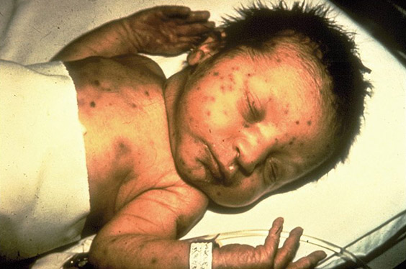
Rubella Virus
Morphology : | Family: Toga viridae - Structure: ss RNA, Icosahedral capsid, Enveloped Virus
Epidemiology & Pathogenesis: | Humans Transmission: Respiratory route / transplacental route A world wide distribution, but now decreased due to vaccination.
Manifestations : | Acquired infection: Maculopapular rash (Rubella=German measles) and fever Congenital infection: Risk of acquiring congenital rubella infection varies and depends on gestational age of the fetus at the time of maternal infection, Ranging from normal to congenital rubella syndrome (CRS) to intrauterine death (IUD). Congenital Rubella Syndrome: Triad of abnormalities Affecting & heart: ● Ears : Sensorineural hearing loss. ● Eyes: Cataracts, glaucoma. ● Heart: Cardiac malformations (patent ductus arteriosus) ● Others: Neurologic defects (Microcephalus) , growth retardation, bone disease, hepatosplenomegaly, thrombocytopenia (“blueberry muffin” lesions)
gestational age risk to fetus
0-12 wks 70%
13-16 wks 20%
>16 wks Infrequent

Slide 14
Diagnosis: | Pregnant mother | Serological diagnosis: Rubella specific IgM or IgG seroconversion
 | Infant | Prenatal Dx: Ultrasound Culture PCR virus RNA Postnatal Dx: Serology: - IgM - Persistent IgG in the infant's serum beyond 9-12 ms of age Culture PCR
Prevention: | Routine antenatal screening: Rubella specific IgG . vaccination : (LAV) - Non immunized women should take the vaccine - women who got vaccine should avoid pregnancy for 3 months.

Slide 15
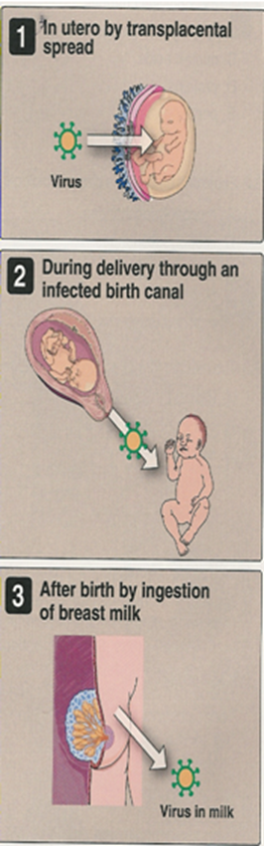
Cytomegalovirus ( CMV )
Morphology : | Family: Herpes viridae Structure: dsDNA, Enveloped, Icosahedral Virus After the initial exposure to the virus → the virus Establishes in latent form → When there is diminished immunity, the virus may reactivate and cause recurrent infection .
Epidemiology : | Humans are the reservoir, worldwide distribution.
Transmission: | Horizontal transmission | Vertical transmission
 | Young children: saliva. Later in life: sexual contact, Blood transfusion & organ transplant. | Vertical transmission is the transmission from mother to baby, can be: 1) transplacentally (in utero). 2) during delivery. 3) by breastfeeding: 40% transmission in primary CMV infection. Only 1% transmission in Recurrent CMV infection
Manifestations: | The majority of cases are asymptomatic at birth , BUT 15% of cases may develop Hearing defect and mental retardation , 4% Cytomegalic inclusion disease & 1% may die . Cytomegalic Inclusion Disease is characterised by: ● CNS abnormalities: microcephaly, Ventriculomegaly, and periventricular calcification (like toxoplasma, however CMV causes specifically periventricular calcification ). ● Eye: chorioretinitis ● Ear: sensorineural deafness ● Liver: Hepatosplenomegaly (HSM) and jaundice. ● Lung : pneumonitis ● Heart: myocarditis ● Thrombocytopenic purpura (“blueberry muffin” spots)

Slide 16
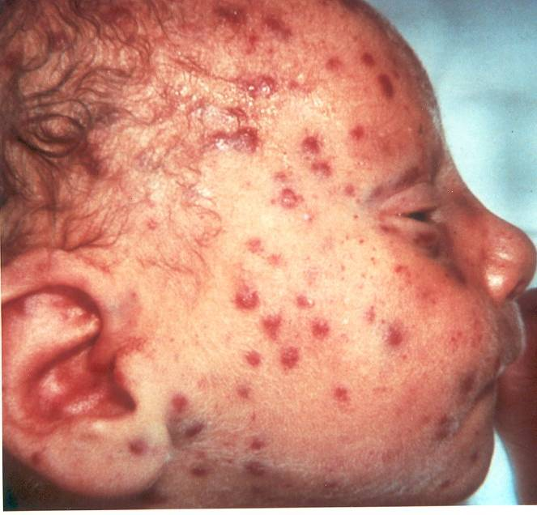
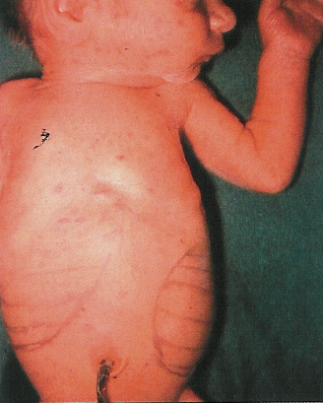
Congenital Infections:
Clinically normal
Blueberry muffin” spots
Majority asymptomatic
15% Hearing defect mental retardation
4% Cytomegalic inclusion disease
Microcephaly
Thrombocytopenia
Hepato_spleenomagaly
1% death

Slide 17
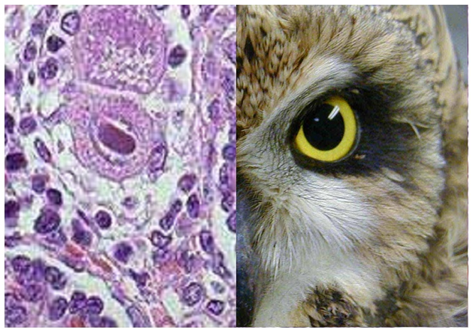
Cytomegalovirus ( CMV )
Diagnosis: | Pregnant mother | Maternal serology: CMV IgM, IgG, IgG avidity .
 | Infant | Prenatal Dx: PCR culture CMV specific IgM Ultrasound Postnatal Dx: Isolation of CMV or detection of its genome: in first 3 weeks of life From Body fluids: urine, saliva, blood. To differentiate congenital from perinatal - By using: Standard tube culture method, Shell vial assay or PCR Histology: Detection of Cytomegalic intranuclear Inclusion Bodies in affected tissue ( owl’s eye ) Serology: CMV IgM
Prevention: | Education about CMV & how to prevent it through hygiene and handwashing Vaccine is not available (TRIAL)
Treatment: | Symptomatic infants: Ganciclovir. Asymptomatic infants: not recommended.

Slide 18
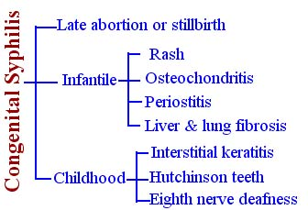
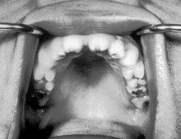

Only in male’s slides
Syphilis
 | Treponema pallidum (spirochete) Transmitted via sexual contact Mother with primary or secondary syphilis Typically occurs during second half of pregnancy
Clinical features | Intrauterine death in 25% 3 major classifications
Diagnosis | RPR/VDRL: non-treponemal test | MHA-TP/FTA-ABS: specific treponemal test | Confirmed if T. pallidum identified in skin lesions, placenta, umbilical cord, or at autopsy
Prevention | RPR/VDRL screen in ALL pregnant women early in pregnancy and at time of birth
Treatment | Penicillin G
and Funisitis (umbilical cord vasculitis)
Frontal bossing, Short maxilla, High palatal arch, Saddle nose , Perioral fissures

Slide 19
Only in male’s slides
herpes simplex
 | H=herpes simplex (HSV) HSV1 or HSV2
Epidemiology | Primarily transmitted through infected maternal genital tract Primary infection with greater transmission risk than reactivation Rationale for C-section delivery prior to membrane rupture
Clinical presentation | Most are asymptomatic at birth 3 patterns of equal frequency with symptoms between birth and 4wks:Skin, eyes, mouth , CNS disease, Disseminated disease (present earliest) Initial manifestations very nonspecific with skin lesions NOT necessarily present
Diagnosis | Culture of maternal lesions if present at delivery Cultures in infant CSF PCR Serologies is useless
Treatment | High dose of acyclovir

Slide 20
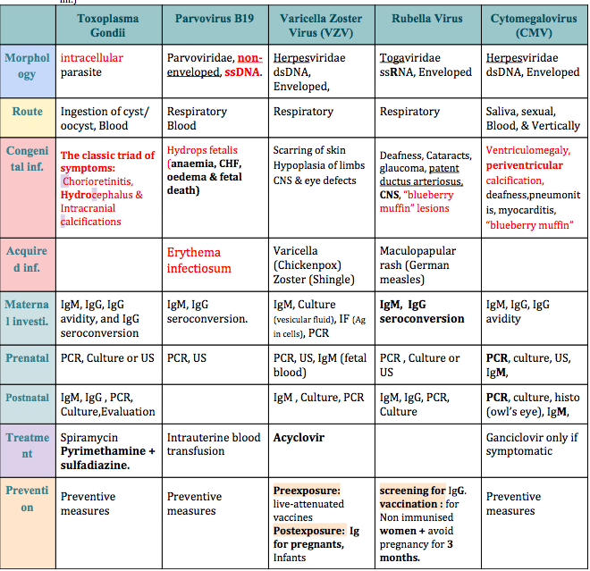
SUMMARY:
Special thanks to team 435

Slide 21
Quiz:
Q1) which of the following antiviral drug is recommended in treatment of varicella zoster virus ?
A-oseltamivir
B-Acyclovir
C-zanamivir
D-peramivir
Q3) Chorioretinitis, Hydrocephalus & Intracranial calcifications is a classic triad symptoms for :
A- toxoplasma gondii
B- cmv
C- hepres
D- hiv
Q2) Which of the following is the structure of rubella virus ?
A-dsDNA, Enveloped, Icosahedral Virus
B- ssDNA genome virus
C- ss RNA, Icosahedral capsid, Enveloped Virus
D- dsDNA , non enveloped virus
Ans:
1- b
2- c
3-a

Slide 22






THANK YOU FOR CHECKING OUR WORK, BEST OF LUCK!
Hamad Alkhudhayri
Talal alhoqail
Shrooq Alsomali
Lama Al musallam
Norah Alshabib
Jumana Alghtani
Doctors slides

