Slide 1
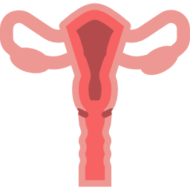
LECTURE: herpes simplex and genital warts
Editing File
Important
Doctor’s notes
Extra explanation
Only F or only M
"لا حول ولا قوة إلا بالله العلي العظيم" وتقال هذه الجملة إذا داهم الإنسان أمر عظيم لا يستطيعه ، أو يصعب عليه القيام به .

Slide 2
Introduction
Genital Herpes and genital Warts are recognized as the main sexual transmitted viral infections that might be acquired by any types of sexual contact. Either normal (vaginal) , homosexual or oral sex.
Risk groups:
1- Adults who have multiple sexual partners.
2- Immune compromised individuals.
3- Infants who have infected mothers. Transmitted by the mother to the child either during pregnancy or during delivery or after birth through direct contact.
4- Sexual child abuse.
Genital Herpes
Etiology:
There are two species of herpes virus capable of causing genial herpes:
Herpes simplex virus type 2 (HSV-2) (affects the lower part of the body, it is the main cause of genital herpes)
Herpes simplex virus type 1 (HSV-1) (affects the upper part of the body).
90% of genital herpes cases are due to HSV-2 infection, whereas 10% are due to HSV-1
Both (HSV-1 & HSV-2) are structurally very similar and share about 70% sequence homology.

Slide 3
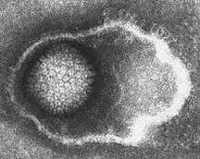
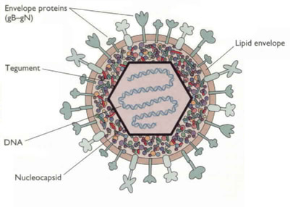
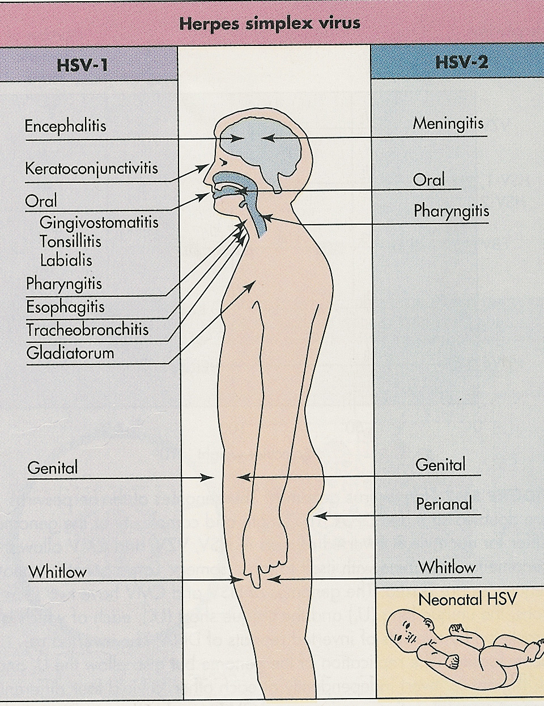
Characteristics Of Herpes Virus :
Family of herpesviridae.
Virion consist of:
Glycoprotein envelope
Icosahedral capsid.
Liner ds-DNA.
The Herpes viruses has the ability to induce latent infection (they stay inside the person until he dies)
HSV (1&2) → NERVE CELLS.
HSV-1 → Trigeminal ganglia أول ما تصيب المريض تتخبى بالمنطقة الي فوق
HSV-2 → Sacral ganglia
Transmission of Genital HSV infection
1- Sexual transmission:
The number of different sexual partners correlates directly with acquisition of HSV-2 in both male & female.
Homosexual men are more susceptible to HSV-2 infection. Because the anus is very vascularized so the infection could spread rapidly through blood.
Genital infection can be acquired by auto-inoculation from lesions elsewhere on the body by touching vesicular fluids from any herpetic lesions (HSV-1&2). .
HSV-1 can cause genital herpes infection after oral sex, also can be seen in cases of child abuse.
rare
rare
mainly

Slide 4
Transmission of Genital HSV infection
2- Perinatal transmission (during delivery):
The majority of maternal infection (85%) occurs during delivery, due to direct contact between the baby and infected maternal birth canal.
The risk of perinatal transmission is usually occurred in about 50% of mothers have primary (if she gets it while she is pregnant) genital herpes, while the risk is 8% if mother have recurrent (if she has it before pregnancy) infection.
This infection can lead to either massive herpetic skin lesions or generalized infection affecting skin and internal organs e.g; lungs , liver or brain .
To avoid perinatal infection we do Caesarean section. So if a pregnant woman has a primary HSV they do C-section for her to prevent transmission to the baby, and this is the only disease which can be prevented by C-section.
3-Intrauterine(vertical) transmission (10%):
Maternal primary genital HSV-2 infection of the mother during first trimester can leads to spontaneous abortion.
Maternal primary genital HSV-2 infection which develops after 20 weeks of gestations may induce malformation as
Microcephally
Jaundice
Hepatosplenomegally
Chorioretinitis
Herpetic vesicles on the skin.

Slide 5
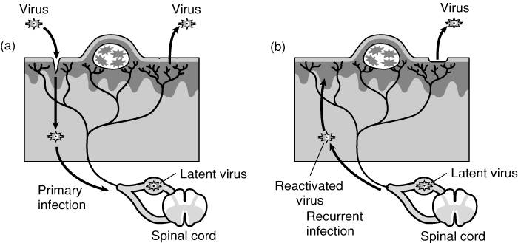
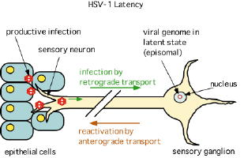
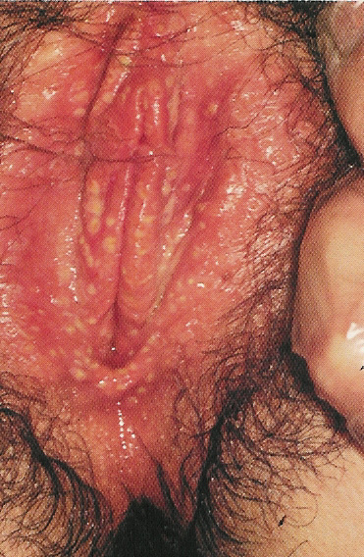
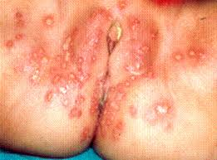
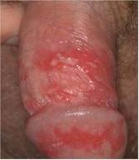
Pathogenesis of HSV-2
Genital herpes infection :
Primary infection occurs when HSV-2 infects epithelial cells covering the mucosa.
The virus then migrates to the nearest ganglion (sacral ganglia) via neurons where it replicates and establish latency for life.
Once its reactivated, it travels back through neurons to the site of the primary infection and causes recurrent infection.
Once the virus enters the human body it remains for life (latency) .
يعني لما يصير أول انفكشن ويخلص يتخبى الهيربس باثوجين في القانقليا وبعدين إذا ضعفت المناعة يرجع لمكان الإصابة الأساسي ويسبب المرض
Primary genital infection:
Vary from asymptomatic (but most cases have symptoms) to mild or sever painful episode.
If symptoms are present(I.P 2-12 days) they may include;
fever , malaise, dysuria,
Inguinal lymphadenopathy
Vesicular herpetic lesion or ulcer localized to the cervix, vagina, vulva or perineum of the female or the shaft of the penis in the male ,Herpetic proctitis (in the anal area) can be seen in homosexuals.
Aseptic meningitis have been observed in about 10% of cases as extra genital presentation.

Slide 6
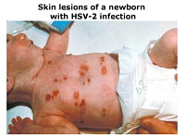
Neonatal herpes infection
Is not a common condition, but the mortality is >70% when it happens.
It occurs during labor and delivery through the vaginal canal when a mother is having a primary active herpetic lesion and shedding the virus, also in small % as vertical transmission during pregnancy.
It may spread to other organs such as lungs, liver, brain.
It has three forms:
Localized skin infection
limited to massive skin vesicular lesions .
Mild infection.
limited to CNS invasion causing encephalitis.
Generalized neonatal herpes infection.
Severe massive infection of the skin accompanied with internal organs infection as lungs (pneumonia), liver (hepatosplenomegally), and brain (encephalitis) with massive skin herpetic lesions. Usually fatal
Localized brain infection.
mortality is high

Slide 7
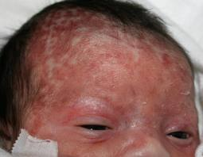
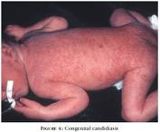
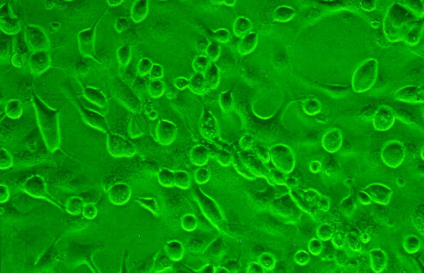
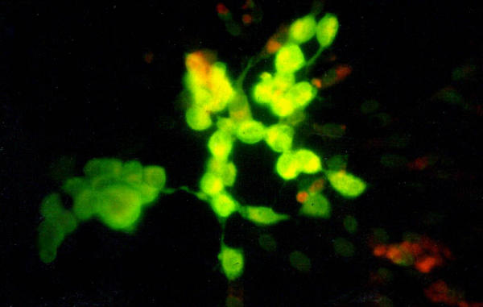
Clinical picture of recurrent genital herpes.
Occurs after reactivation by environmental or physiological factors such as stress, exposure to U.V. light, menstruation, pregnancy or any condition decreased the immunity.
This can be as frequent as six or more episode a year ,the attacks are milder and shorter than primary episode.
Accompanied with the appearance of herpetic vesicles on the external genitalia.
Symptoms may include pain and itching.
Lab diagnosis
ELISA: serum sample is analyzed for detection the IgM Ab. (golden routine standard) VERY IMP!
Immunofluorescence (IF):lesion scraping or vesicle fluid sample is analyzed for detection the Ag.
Polymerase chain reaction (PCR):CSF sample in case of neonatal herpes.
Tissue culture: (old method)
vesicle fluid sample is cultured in cell line (Vero or Hep-2 cells) and then identified by the following:
Observe the viral CPE
Direct immunofluorescence (IF)

Slide 8
Management
No vaccine is available to prevent HSV-2 infection, and thus the best way to control the HSV infection is by:
Avoid sexual contact with infected individuals.
Abstain from making prohibited relations.
Note: Condoms are not 100% protective against genital herpes infection.
Treatment (reduces the attack but doesn’t eradicate the virus)
1-Acyclovir:
The 1st choice therapy.
Suitable for pregnant women.
2-Famciclovir
3-Valacyclovir.

Slide 9
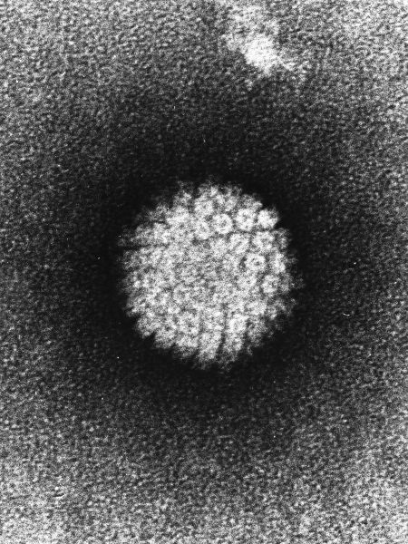
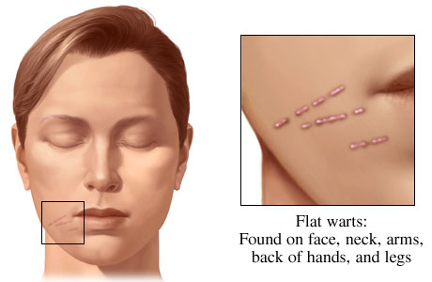
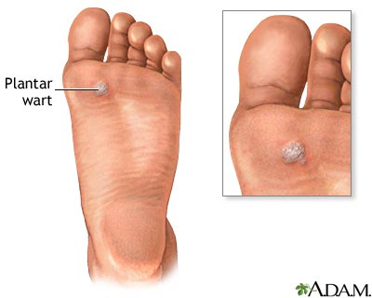
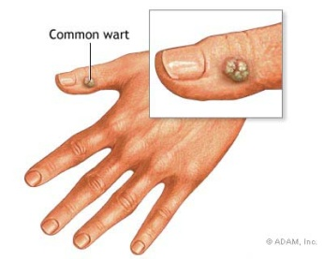
Human Papillomavirus
Family of Papillomaviridae. They don’t invade the blood.
Virion is small non-enveloped, and consist of:
Icosahedral capsid.
Circular ds-DNA.
They cause disease only in skin and mucous membrane.
Does not grow in tissue culture.
Resists detergent, and heat and can remain infectious in the environment for long time
Types of warts and HPV genotype
1- Cutaneous warts:
The virus is transmitted from infected skin ,either by direct contact or through fomites and enter its new host through abrasions.
Swimming pools and changing rooms are fertile sources of infection ,skin warts are most liable to affect young children.
Common Warts(HPV 2,4),
Plantar Warts (HPV1,2,4),
Flat Warts (HPV 3,10)

Slide 10
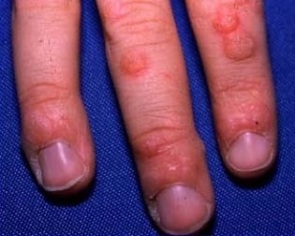
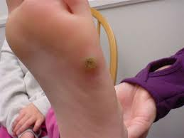
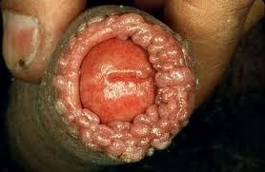
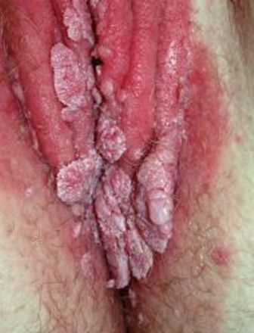
2- Genital Warts
Genital ,Anogenital or mucosal Warts:
These Warts are acquired by sexual contact ,they are in fact one of the most common sexually transmitted diseases, and often occur in association with other sexual diseases as gonorrhea or chlamydial infection.
There is strong association between increasing numbers of sexual partners and prevalence of genital HPV infections.
Vertical transmission: from mother to infant or prenatal transmission lesions appear within the first 6 weeks of life have been demonstrated. يعني الأعراض ماتبان الا بعد ٦ اسابيع.
Ano-genital or mucosal: VERY IMPORTANT! MEMORIZE NUMBERS!
Condyloma acuminata (benign HPV 6,11)
Cervical carcinoma (HPV 16,18, 31,45)
Penile and anal carcinoma in men (HPV 16,18)
Laryngeal Warts (benign HPV 6,11)
They may be transmitted to baby
Common warts and planter warts
Male
Female

Slide 11
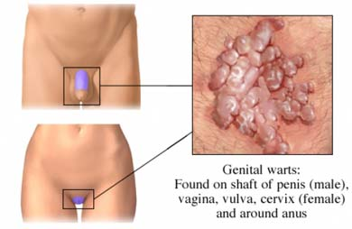
Clinical symptoms of genital warts
Appear after 3-4 months after infection(I.P – incubation period - long).
Warts size vary from small round to large complex mass.
Found in the anogenital tract (inside or outside the genital and the anal areas of both males and females).
Localized pain
Discomfort
Abnormal vaginal bleeding and discharge.
Link between HPV and cervical cancer
HPV type 6 and 11(Condylomata acuminata) is unusual to become malignant ,but they occasionally progress to squamous cell carcinoma ,while HPV 16 and 18 are more commonly associated with lesions of great dysplasia which involves all layers of stratified epithelium , and has high chance of progression to metastasizing carcinoma & invasive cancer.
Persistent HPV infection is considered the main cause of cervical cancer, HPV DNA can be detected in most grades of premalignant lesions of the female and male genital tract.
> 90% of positive Pap-smear is due to HPV infection.
Pap-smear: is a screening test for detection abnormal epithelial cells of the cervix.

Slide 12
Diagnosis
External genital warts can be easily diagnosed by medical examination.
Internal genital warts can be visualized by colposcopy.
Lab diagnosis:
Polymerase chain reaction (PCR) is used to detect HPV DNA. (golden standard) VERY IMP!
Pap-smear test is used to identify abnormal epithelial cells of the cervix (cervical dysplasia).
In-situ DNA hybridization is used for HPV genotyping. Same as PCR.
HPV prevention
There are two vaccines available Gardasil and Cervarix and both are:
Recombinant viral-like particles with no DNA.
Given in 3 doses at 0, 2, 6 months.
Recommended for young individuals ages 9-26 yrs old.
Not given to pregnant women.
Gardasil, a quadrivalent vaccine, provides protection against HPV genotypes 6,11,16,18 which causes genital warts and cervical cancer . (prevents both benign and malignant infections)
Cervarix, a divalent vaccine, provides protection against HPV genotypes 16, and 18 which causes cervical cancer. (only prevents malignant)

Slide 13
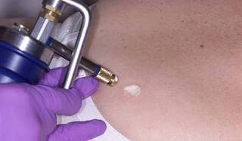
HPV treatment not important , just read it.
Cryotherapy:
freezing warts by liquid nitrogen
suitable for small external warts
Elctrocautery treatment:
destroying warts by an electric current
suitable for small warts
Laser therapy:
destroying warts by a focused light beam
suitable for small and large warts
Surgical excision:
removing warts by surgical tools
suitable for all warts
Topical treatment:
Applied directly on external warts.
Used for several weeks.
Examples: Imiquimod, Podofilox.
Podophyllin is applied by a doctor and contraindicated in pregnancy.
Trichloroacitic acid (T.C.A) safe in pregnancy.
Injection:
Interferon alpha, 5-flurouracil epinephrine gel.
Could be taken for several weeks (8-12).

Slide 14
SUMMARY:
 | Genital Herpes |  | Genital Warts
 | Herpes Simplex Virus (HSV) |  | Human Papilloma Virus (HPV)
Characteristic | ds-DNA with envelope |  | ds-DNA without envelope
Species | HSV-1 | HSV-2 | HPV 6 & 11 | HPV 16 & 18
 | Trigeminal ganglion | Sacral ganglion | Condyloma acuminate (benign) | Cervical carcinoma
Transmission | 1- Sexual (mainly HSV-2) 2- Perinataly (during delivery) To avoid we do caesarean section 3- Intrauterine (vertical): Primary infection during pregnancy: 1st trimester → spontaneous abortion After 20 weeks → malformation During delivery → neonatal herpes syndrome |  | 1- Sexual contact (one of the most common STDs) 2- Vertical transmission / prenatal transmission
Diagnosis | ELISA (IgM of HSV-1 & 2) IF PCR Tissue culture |  | PCR → HPV DNA (gold standard) Pap-smear (for cervical dysplasia) In-situ DNA hybridization (for genotyping)
Treat | Acyclovir (1st + used in pregnancy), famiciclovir, valacyclovir. |  | Many therapies (drugs and surgical) are available.
Prevent | NO vaccine. |  | 2 vaccines available: (1) Gardasil & (2) Cervarix

Slide 15
QUIZ:
Q1: Which of the following is the main cause of genital herpes?
HSV-1 B. HSV-2
C. Varicella D. Cytomegalovirus
ANS: B
Q5: Which of the following is the treatment of HSV?
Gentamycin
Metronidazole
Penicillin
Acyclovir
ANS: D
Q2: Where does HSV-1 hide during latency?
Trigeminal ganglion
Sacral ganglion
Facial ganglion
Optic ganglion
ANS: A
Q6: A patient was diagnosed with condyloma acuminata, which virus is he most likely infected with?
HPV-1 B. HPV-6
C. HPV-16 D. HPV-18
ANS: B
Q3: Which of the following infections can be resolved from transmitting to baby by doing caesarean section?
HIV B. Mumps
C. HSV D. HPV
ANS: C
Q7: A patient is infected with HPV-16. Which of the following conditions will he most likely get?
Benign gential wart
Cevical carcinoma
Laryngeal wart
Skin carcinoma
ANS: B
Q4: If a pregnant woman gets a primary infection of HSV-2 during the first trimester. What is most likely to happen to the baby?
Nothing, the baby will be healthy
Spontaneous abortion
Neonatal herpes infection
Pneumoniae
ANS: B
Q8: Which of the following the gold standard to diagnose HPV?
ELISA B. Culture
C. IF D. PCR
ANS: D

Slide 16
THANK YOU FOR CHECKING OUR WORK, BEST OF LUCK!
Hamad Alkhudiry
Shrooq Alsomali
Reem Alshathri
Heba Alnasser
Jawaher Abanumy
Doctors slides

