Slide 1
LECTURE: HIV & AIDS
Editing File
Important
Doctor’s notes
Extra explanation
Only F or only M
"لا حول ولا قوة إلا بالله العلي العظيم" وتقال هذه الجملة إذا داهم الإنسان أمر عظيم لا يستطيعه ، أو يصعب عليه القيام به .

Slide 2
اخر محاضرة مايكروبايولوجي
الحمدلله على التمام وشكرا لكل من اعتمد علينا وإن شاء الله كنّا عند حسن ظنكم
نشكر القادة الأكادميين الحاليين والسابقين على شغلهم المخلص والمتقن : شوق الأحمري – عبدالعزيز العنقري – طراد الوكيل جزيتم خيرا
والشكر كل الشكر للأعضاء اللي لولاهم بعد الله ماوصل التيم لهذا المستوى
Hanin Bashaikh
Jawaher Alkhayyal
Reem Alshathri
Rawan Alqahtani
Ohoud Abdullah
Ghadah Almazrou
Lama Al-musallm
Wateen Alhamoud
Ruba Barnawi
Shooq Albugami
Rema Albarrak
Shatha Alghaihab
Rana Barasain
Alaa Alaqeel
Rehab Alanazi
Najd Altheeb
Wejdan Alzaid
Ghada Alskait
Heba Alnasser
Safa Alosaimi
Jumana alghtani
Leen Altamimi
Norah Alshabib
Weam Babaier
Ebtisam Almutairi
Jawaher Abanumy
Aseel Nasser
Hayfaa Alshaalan
Razan Alotaibi
Aseel Badukhon
Reema Alshayie
Sara Alshamrani
Ghaida Alsaeed
Shoag Alahmari
lama Altamimi
Dorah Alhamdi
Leena Alwakeel
Amal Alshaibi
Nouf Aloqaili
Ibraheem Aldeeri
Abdulaziz almohammed
Abdulmalik alghannam
Omar albabtain
turki maddi
Talal Alhuqayl
Yousef Aljebrin
Basel Almeflh
Majed Alzain
Nawaf alkhudhairy
Saud alshenaifi
Hassan AlShammari
Mohammed Nasr
Waleed Aljamal
Ibrahim Fetyanu
Meshal Alhusainan
Hussam Alkhathlan
Faisal Alqumaizi
Abdulaziz Alangari
Khalid Alshehri
Nasir Aldosarie
Mohammad Al-Kahil
Khalid Alhusainan
Meshal Eiaidi
لا تنسونا من دعائكم

Slide 3
OBJECTIVES:
Outline:
Introduction to HIV & AIDS
HIV main structural components & life cycle
Mode of transmission
HIV pathogenesis
Stages of HIV infection
Persistent generalized lymphadenopathy (PGL)
AIDS related complex (ARC)
Serological profile
Diagnosis
Management & treatment
HIV main structural components
Mode of transmission
Stages of HIV infection
Main clinical features of each stage of HIV infection
Serological profile during the stages of HIV infection
Diagnosis
Management & treatment

Slide 4
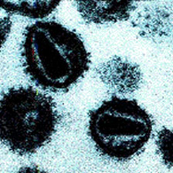
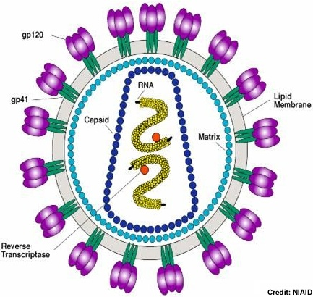
HIV and AIDS
فيديو مفيد جدا + شرحت عليه الدكتورة بداية المحاضرة
Human immunodeficiency virus (HIV)
Is a retrovirus that causes human AIDS, and was initially identified in 1983.
HIV infects mainly CD4+ T cells )T-helper cells), macrophages, monocyte and dendritic cells (target cell) which express the surface receptor CD4 (CD4 receptor is very important for this virus without the virus can not bind and cause a disease ) .
Destroying CD4+ T cells leads to severe immunologic impairment and eventually death.
Acquired immunodeficiency syndrome (AIDS)
Is the end stage of the disease that is associated with:
1- CD4+ T cell depletion
2-multiple or recurrent opportunistic infections
3-and unusual cancer (Kaposi sarcoma).
مو كل أحد بوسيتف للفايروس يعني مريض ايدز !مانطلق كلمة ايدز إلا في المراحل الأخيرة من المرض
HIV
Characteristics of HIV | Family of Retroviridae. Virion consist of: Glycoprotein envelope (gp120, gp41). Matrix layer (p17). Capsid (p24). Two copies of ss-RNA. | 3) Enzymes: مهمة Reverse transcriptase: converts viral RNA into DNA. Integrase: integrates viral DNA with host DNA (provirus), persisting infection. يشبك الدي ان أي حق الفايروس مع الدي ان أي حق الإنسان Protease: viral protein maturation.

Slide 5
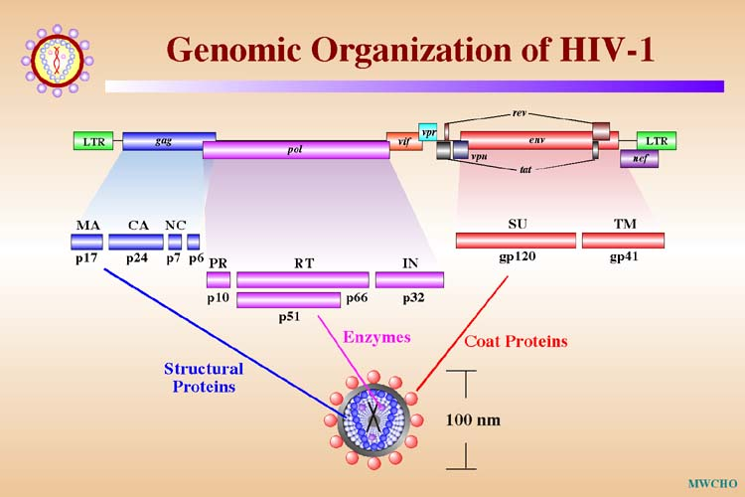
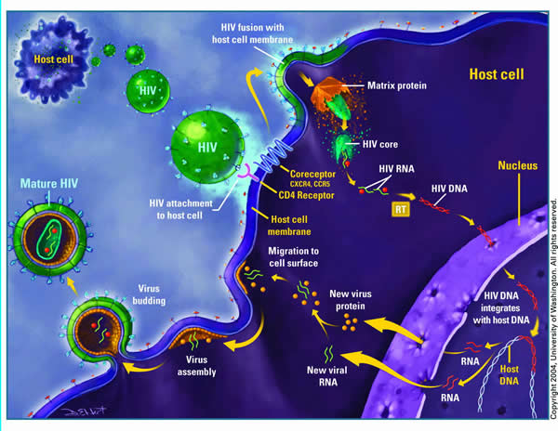
Cont…
HIV Genome | HIV Life Cycle | HIV Species
There are two HIV species known to cause AIDS in humans HIV-1 and HIV-2, and the overall sequence homology between HIV-1 & HIV-2 is less than 50%.
HIV-1:
Causes HIV infection worldwide.
Highly virulent.
Highly susceptible to mutations.
HIV-2:
Causes the infection in specific regions e.g. West Africa.
Relatively less virulent.
Relatively less susceptible to mutations.
The genome consists of 9 genes:
3 structural genes (gag, pol, env)
6 non-structural genes (tat, nef, rev, vif, vpr, vpu)
HIV needs CD4 receptors to enter the cell, it will leave the envelope outside and enter as ssRNA, after entering the cell, reverse transcriptase will convert the viral RNA into DNA. So, if we do anti-reverse transcriptase in the treatment we will prevent this step. Then the pro DNA (viral DNA) enter the nucleus to integrate with the host DNA by the integrase enzyme which will make them dsDNA, after that it will multiply inside the cell making the cell produce large amount of the provirus (millions) which will use the protease enzyme to convert it back to RNA then it will release and infect other cells

Slide 6
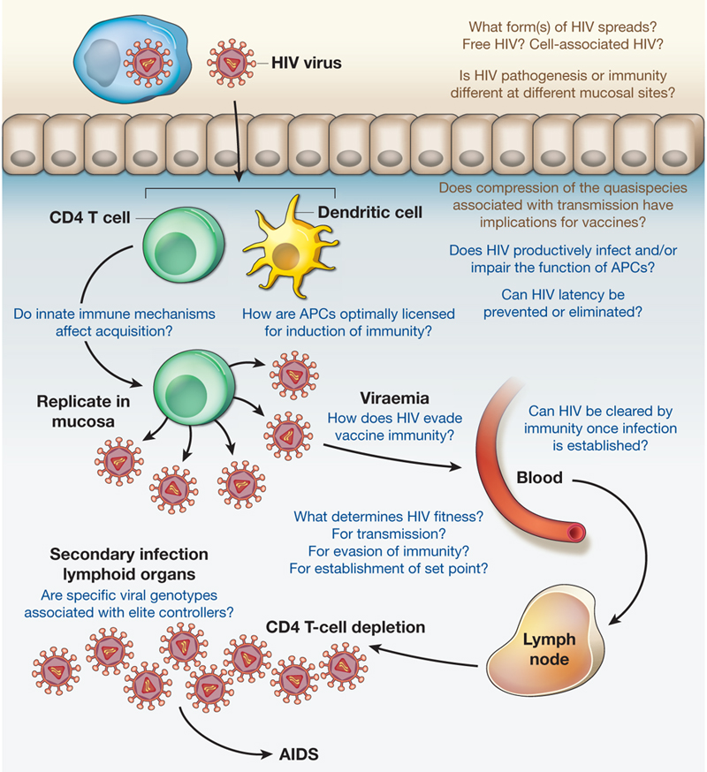
Cont…
The pathogenesis of HIV
Transmission of HIV
1- Sexually (unprotected sex): most common
The virus is present in blood, semen and vaginal secretions.
2- Parenteraly:
هذي الأشیاء لما تنشف بعد فترة یكون الخطر أقل
Direct exposure to infected blood or body fluids (e.g. receiving blood from infected donor).
Using contaminated or not adequately sterilized tools in surgical or cosmetic practice (dental, tattooing, body piercing), syringes (drug abuser)
Sharing contaminated needles, razors, or tooth brushes, nail cutter.
3- Perinatally (from mother to baby):
ممكن ینتقل للبیبي فترة الحمل بس الاكثر أثناء عملیة الولادة
Infected mothers can transmit HIV to their babies transplacentally (25%), but Treatment of the mothers with the reverse transcriptase inhibitor (Zidovudine) *during pregnancy can reduce transmission in most cases.
Virus spread to child perinatally mainly (50%) during delivery, but given the reverse transcriptase inhibitor (Nevirapine)* as single dose during delivery can reduce the transmission.
Breastfeeding is also an important way of perinatal transmission (25%).
Antiretroviral treatment of the mother and infant after birth can also significantly decrease the risk of HIV infection in the newborn.
Virus Inactivation
HIV is easily inactivated by treatment for 10 min at 37oC with any of the following:
10% House hold bleach, Sodium hypochlorite
50% Ethanol
35% Isopropanol
0.5% Paraformaldehyde
0.3% Hydrogen peroxide
*مهم جدا أننا نعرف أن الأدوية اللي فوق الميكانيزم حقها أنها Anti-reverse transcriptase

Slide 7
Stages of HIV infection
The course of HIV infection is divided into 3 stages based on CD4+ T cell count and presence of opportunistic infections:
 | The Acute phase(1) | The Chronic phase(2) (PGL & ARC) | AIDS(end stage)
Duration | Incubation period 2 weeks and lasts for about 12 weeks.(4 month) | Lasts for about 10 yrs in adults 5 yrs in children. | The end stage of the disease.
Symptoms | Mostly asymptomatic, but in about 25-65% of the cases, patients may develop symptoms resemble infectious mononucleosis or Flu like (fever, headache, anorexia, fatigue, lymphadenopathy, skin rash) which resolved in 2 weeks. Some of patients may develop aseptic meningitis. Image | Totally asymptomatic but the patients is still contagious(يعني ممكن ينقل العدوى). At the end of this stage patients start to develop: ● PGL ● ARC. | Defects in cellular immunity. Persistent or frequent multiple opportunistic infections ( pneumonia, toxoplasmosis , extra pulmonary myco-bacterial disease . Unusual cancer (Kaposi sarcoma). Image
Diagnosis | The 1st choice marker for detection HIV in the acute phase is HIV RNA. ( the main marker in this phase)

Slide 8
Stages of HIV infection: Continue…
 | The Acute phase | The Chronic phase (PGL & ARC) | AIDS(end stage)
Viral load | Rapid viral replication (high viral load RNA in the serum >10⁶ copies/mL). | low viral load(<10⁴copies/mL). but at the end of this phase (PGL and ARC): high load of viral RNA and core Ag. p24 (indicate active viral replication) | Continuous viral replication (high viral load).
CD4 cell count (it is also blood marker) | Gradual decrease in CD4+ T (Normal to slightly decreased in serology) | > 500 cells/mm³,further decreased in PGL and ARC but still more than 200(دام احنا فوق 200 احنا في السليم ماوصلنا للإيدز ) | Marked decrease in CD4+ T cell count < 200 cells/mm^{3**}
Blood markers | Appearance of the viral RNA*, and then the core antigen (p24 antigen) which indicate active viral replication. Appearance of two antibodies, Anti-envelop (Anti-gp120. gp41) & Anti-core (Anti-p24). | Viral load (HIV RNA) increases gradually, but HIV core antigen (p24) may not appear in blood. Anti-envelop (Anti-gp120. gp41) & Anti-core (Anti-p24) are positive. | High viral load (HIV RNA), and HIV core antigen (p24) Detection of both HIV RNA & the antigen p24 indicative of active viral replication. Anti-envelop (Anti-gp120) & Anti-core (Anti-p24) are positive.
* THE FIRST MARKER appear in the serum ** مهم جداً حفظ هالرقم

Slide 9
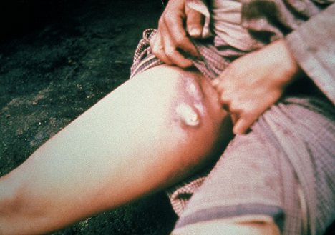
Chronic Phase مهم :
Persistent generalized lymphadenopathy (PGL)* | AIDS-related complex(ARC) باقي ماصار مريض ايدز هذي مرحلة قبله
Is defined as enlargement of lymph nodes for at least 1 cm in diameter in the absence of any illnesses or medications that known to cause PGL. Clinical features: In two or more lymph nodes out of the extra inguinal area (like cervical , axillary ). Persists for at least 3 months. | Is a group of clinical symptoms that come before AIDS and may include the following: Fever of unknown origin that persists > 1 month. Chronic diarrhea, persisting > 1 month. Weight loss > 10% of the original weight (slim disease). Fatigue, night sweating, and malaise. Neurological disease as myelopathy and peripheral neuropathy.
Slim disease
* The key words in red are very important

Slide 10
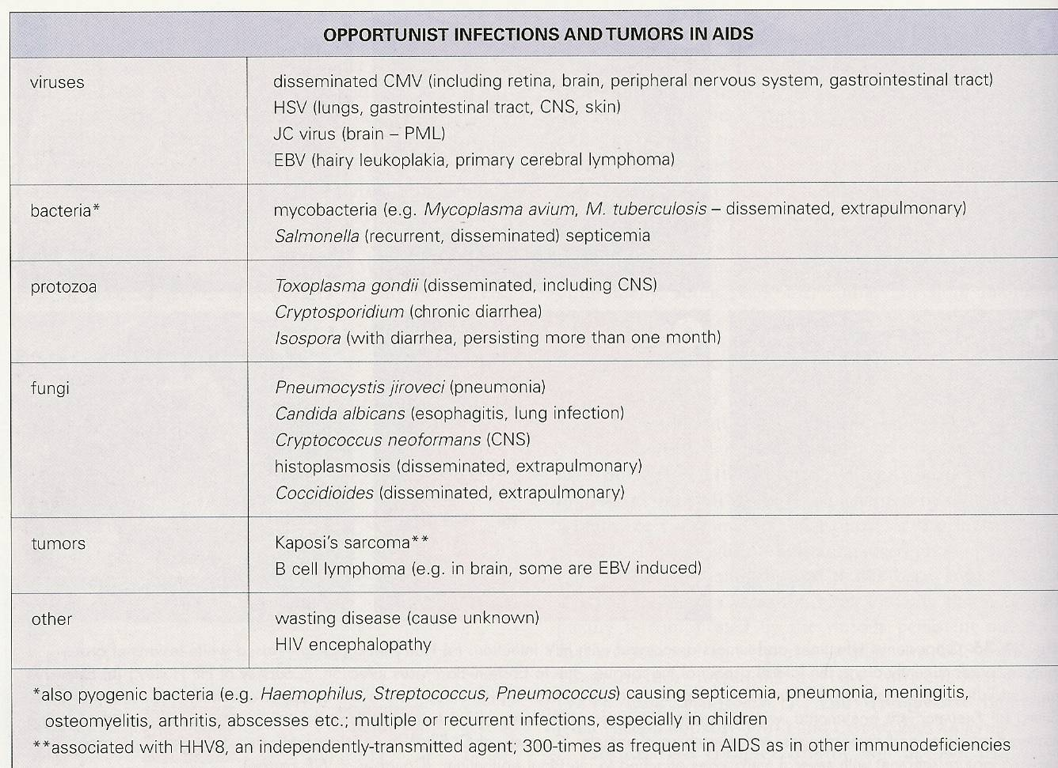
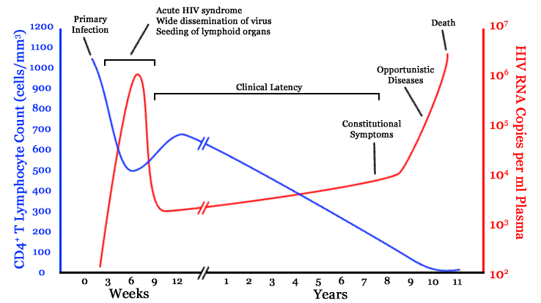
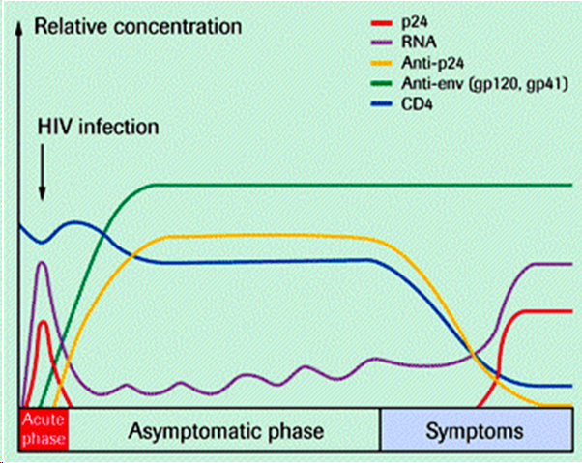
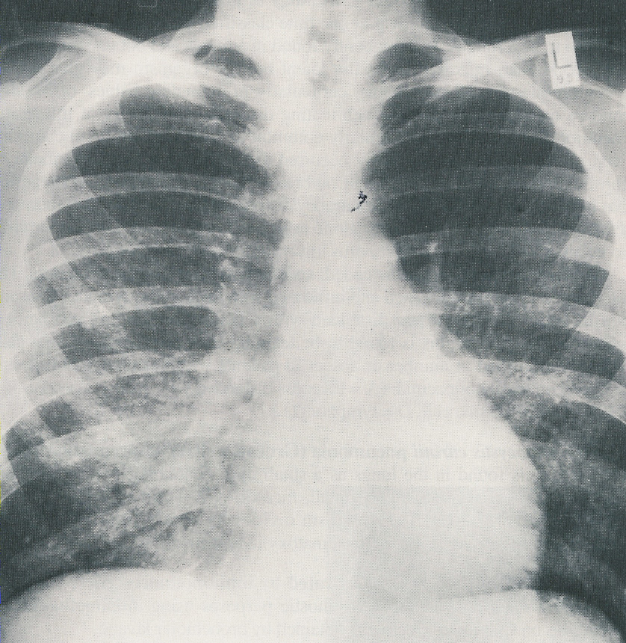
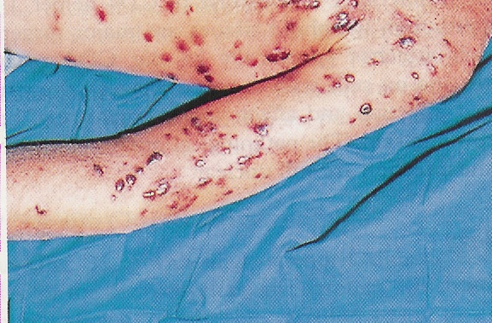
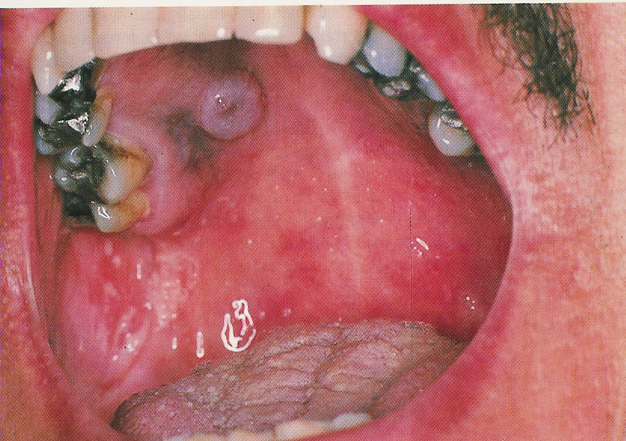
Continue..
HIV RNA copies VS CD4+ T cell counts
Serological profile of HIV infection
Kaposi sarcoma in ADIS patient not HIV patient صرنا كبار وفاهمين ☺ / Candida infection
Pneumocystis pneumonia

Slide 11
Diagnosis
First screening then confirmation 1. Patient’s history with or without clinical symptoms may give hints for a physician whether the patient has ever exposed to HIV or not 2. Screening: Elisa, HIV Ab, HIV Ag (p24) ELISA: ​for screening patient’s serum for both (HIV Ag(p24) & HIV Ab). ➔ if the result is +ve we repeat the specimen twice in duplicate​ ➔ if still giving +ve result will do confirmatory tests 3. Confirmatory: W.B., Riba & PCR ​In confirmatory tests Western Blot: To confirm the presence of Anti–HIV to the structural proteins of the virus by ELECTROPHORESIS Western blot indeterminate result, means that the test specimen not positive nor negative. The individual must be retested after 8-12 weeks. If the result is negative, report negative If the result is positive, report positive If the individual still indeterminate then the patient must be referred to medical evaluation and PCR are recommended to look for HIV-RNA genome. PCR: ​For detection of HIV RNA in the blood (viral load). This test is important for: 1- Diagnosis of Acute HIV infection 2- Diagnosis of HIV in infant of infected mother 3- To monitor the antiviral treatment
4- As confirmatory test.
5- monitor HIV replication

Slide 12
Continue..
Treatment | Goals of HIV treatment | Prevention & Control
High Active Antiretroviral Therapy (HAART) is a combined therapy composed of two ​reverse transcriptase inhibitors​ & one ​protease inhibitor​. NOTE: HAART does not clear the virus​, and should be taken all life. Treated patients are still contagious ​even if their blood viral load below detection (< 50 copies/μL) Reverse Transcriptase Inhibitors: AZT Zidovudine - ddC Zalcitabine - ddI Didanosine - d4T Stavudine - 3TC Lamivudine Protease inhibitors: Saquinavir - Indiniavir - Ritonavir - Nelfinavir | To inhibit viral replication. To control chronic immune activation and keep the immune system as close as possible to the normal state. To prevent the development of opportunistic infections. To minimize the chance of viral transmission especially from mother to neonate. Treatment will never eradicate the HIV virus.* | There is no vaccine available yet for HIV Practice safer sex . Do not share razors, tooth brushes, etc Do not share needles and syringes Avoid direct exposure to body fluids Educate the public about HIV-infection.
* This concept is very important , our goal not to clear the virus

Slide 13
Quiz:
Q1) which of the following antiretroviral Anti- reverse transcriptase is given to a pregnant women with HIV infection to reduce the risk of transmission to the fetus ?
A- Saquinavir
B- Indiniavir
C- Ritonavir
D- Zidovudine
Q3) HIV confirmatory test ?
A- ELISA B- PCR C- electrophoresis
D- b & c
Q4) During the acute phase there is marked decrease in CD4 cells<200 ?
A- true
B- false
Q2) CD4 cell count in ADIS ?
A- less than 200 cell B- > 500/ml C- more than 200 cells/mm3
D- normal
Q5) which of the following is used for
screening of HIV
A- ELISA
B- Western Blot
C- Riba
D- PCR
Ans:
1- d
2- a
3-d
4-b
5-a

Slide 14
THANK YOU FOR CHECKING OUR WORK, BEST OF LUCK!
Hamad Alkhudhayri
Majed AlZain
Hassan AlShammari
Mohammed Nasr
Shrooq Alsomali
Rema Albarrak
Ohoud Abdullah
Bye bye basic years
Doctors slides

