Slide 1
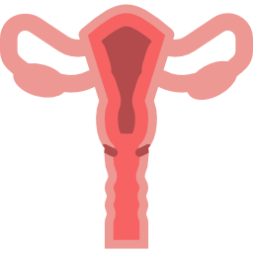
LECTURE: human papilloma virus vaccine
Editing File
Important
Doctor’s notes
Extra explanation
Only F or only M
"لا حول ولا قوة إلا بالله العلي العظيم" وتقال هذه الجملة إذا داهم الإنسان أمر عظيم لا يستطيعه ، أو يصعب عليه القيام به .

Slide 2
Objective:
WHAT IS HPV
HPV RELATED INFECTIONS
PREVELANCE IN U.S AND SAUDI ARABIA
TYPES OF VACCINES AVILABLE
TIME OF VACCINATION
DOSES AND ADMINISTRATIONS
DURATION OF PROTECTION
SAFETY OF THE VACCINE

Slide 3
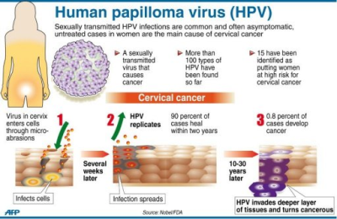
Human papillomavirus
DNA virus from the papillomavirus family
over 150 types are known
More than 40 types are transmitted through sexual contact and infect the anus and genitals.
spread by sustained direct skin-to-skin contact with vaginal, oral and anal sex
It does not spread via common items like toilet seats
cannot be cultured without living tissue
Important pic
Notes are Important
*
*All cervical cancer now a days relate to HPV and once there is a virus in the cervical area it’s going to spread to all adjacent structures.
** HPV is the only causative organism for genital warts ,and genital warts are not malignant lesions but they are very annoying , because it keeps coming and is very hard to treat, the medical failure is very high so we need to do a surgery and sometimes it’s extensive.
**

Slide 4
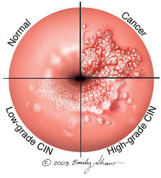
Notes are Important
DISEASE ASSOCIATIONS:
In females – in females and males – in males
HPV-related disease in females
cervical cancer and precursor lesions: is the third most common female cancer worldwide especially in developing countries |  | Vulvar and vaginal cancer and precursor lesions: Relatively rare cancers globally
in U.S | in Saudi Arabia | IN U.S
the estimated annual incidence of CIN among female who undergo cervical cancer screening is 0.4 % for CIN 1 and 0.5% for CIN 2/3 (CIN1 and CIN2 are low grade , where as CIN3 and some of the CIN2 are high grade ) HPV type 16 and 18 cause approximately 70% of cervical cancer and 50 % of precancerous cervical lesions HPV types 31, 33, 45, 52, and 58 are estimated to cause an additional 19 % (20 -25 %) of invasive cervical cancers | In Saudi Arabia which has a population of 8 million women over the age of 15 years, approximately 152 new cases of CC are diagnosed every year (the no.is much higher then that double or triple ) 55 women die from the disease annually ranking number 12 between all cancers in females Accounts for 2.4% of all new cases, despite the lack of national screening programs | estimated incidence of 27,000 vulvar cancers and 13,000 vaginal cancers in 2008 the attributable fraction due to HPV infection has been estimated to be 43 % for vulvar and 70 % for vaginal cancer **
*
CIN :cervical intraepithelial neoplasia
*And this cycle take from 5 to 15 years ,so it doesn’t happen instantly it takes a long time. thus seeing a gynecologist and getting examined every year is important to catch the patient before the cancer develops, but if she comes by the last stage (cancerous) it will depend on the cancer stage she’s at .
**Meaning half of the vulvar cancer cases are HPV positive and 70% of vaginal cancers are HPV positive.

Slide 5
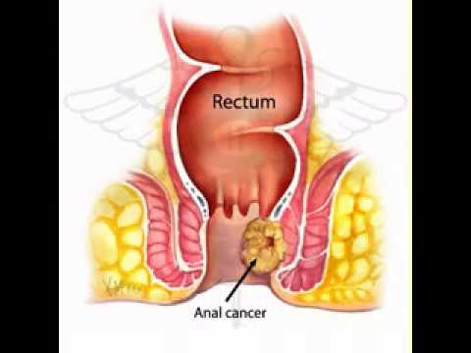
DISEASE ASSOCIATIONS:
In females – in females and males – in males
HPV-related disease in females and males
1-Anal cancer and precursor lesions: | 2-Genital warts:* | 3-Oro-pharyngeal cancer:
Relatively rare cancer globally HPV types 16 and 18 cause around 70 to 85 % of anal cancers and precancerous lesions (ie, anal AIN grade 2 and grade 3 | HPV types 6 and 11 cause 90 percent of genital warts. IT is associated with physical and psychological morbidity and have a high rate of treatment failure AND treatment of recurrent episodes is costly | HPV infection may also play a role in the pathogenesis of squamous cell carcinomas of the head and neck. primarily found in the oropharynx and base of the tongue , tonsil AND larynx And the way of transmit ion is by oral sex
HPV-related disease in males
Penile cancer and precursor lesions:
It is rare globally HPV 16 and HPV 18 cause approximately 35 to 40 % of penile cancers and 70-80 % of HPV-positive penile cancers ( very important )

Slide 6
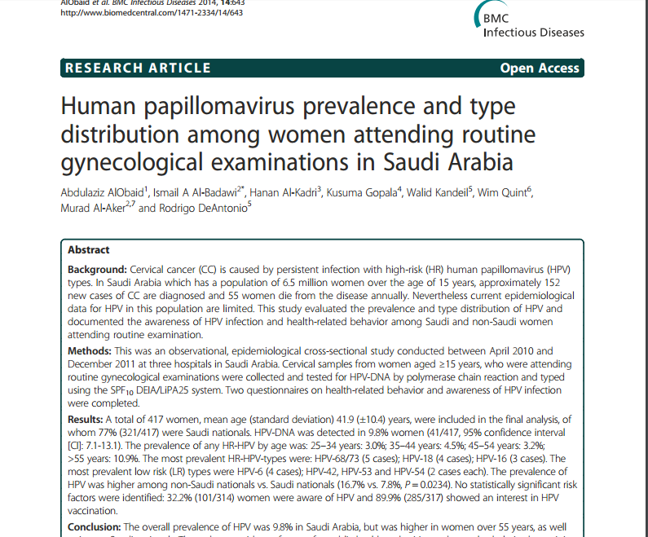
STUDIES:
This was an observational, epidemiological cross-sectional study conducted between April 2010 and December 2011 at three hospitals in Saudi Arabia
Result : The overall prevalence of HPV was 9.8% *in Saudi Arabia, but was higher in women over 55 years, as well as in non-Saudi nationals. The most prevalent High Risk HPV types were: HPV-68/73 (5 cases) - HPV-18 (4 cases) - HPV-16 (3 cases) 3. The most prevalent low risk types were** HPV-6***-- (4 cases) - HPV-42, HPV-53 and HPV-54 (2 cases each).
*Meaning around 10% were positive for the virus, meaning it is not a rare infection.
** very rare *** HPV 6 causes warts

Slide 7
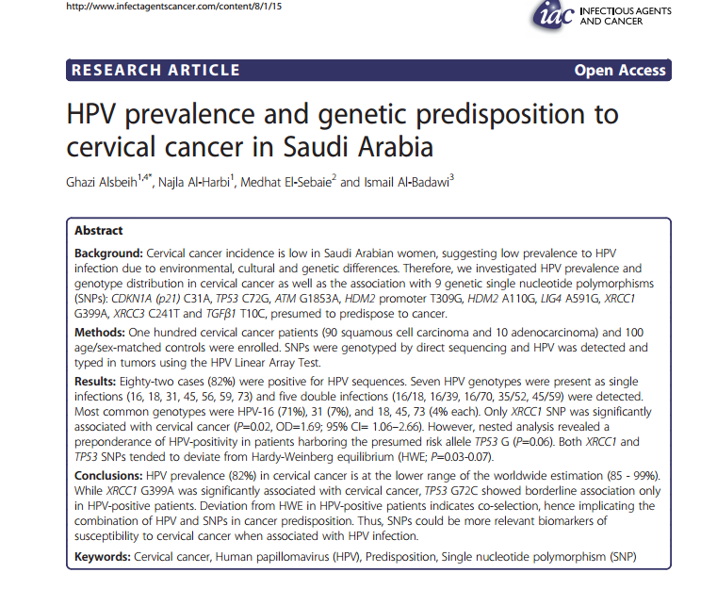
STUDIES:
100 patients with histo pathologically proven, locally advanced, cervical cancer were enrolled in this study out of 218 patients followed at KFSHRC from 2009 to 2012. There was no restriction on patients’ age or histological type of cervix cancer
Conclusions The prevalence of HPV infection in invasive cervical cancer in Saudi Arabia (82%) is at the lower range of that observed in the world (85%-99%) the most common HPV genotype was HPV-16 (71%), followed by HPV-31 (7%), HPV-18, 45, and 73 (4% each) double infections were present in 8.5% of HPV-positive patients.
The Departments of Obstetrics and Gynecology, and Histopathology at KKUH conducted A retrospective study.
reviewed all cervical pap smears obtained from Saudi women between the years of 2004 and 2014.
found that the frequency of epithelial cell abnormalities in the cervix among Saudi women is relatively low.
The mean age of cervical carcinoma was 61 years , which is higher than the one reported in western countries.*
relatively high incidence of invasive Cancer, which is found in older Saudi women, suggest that the starting age of cervical screening in our society should be from 25 years with continuation of the screening till after 65 years of age
*and this is due to the early sexual exposer and this doesn’t happen here (in Canada by the age of 15 50% of the girls have had some kind of sexual exposure )(the early you get the infection the early you get the disease) and we said there is a window of 5 to 15 for the infection years so if they get the virus at the age of 15 by the age of 30 they are already have the cancer

Slide 8
HPV VACCINE?
U.S FDA Approved ?
1989
Ian Hector Frazer
born 6 January 1953
is a Scottish-born Australian scientist
He met with virologist Jian Zhou the two considered the problem of developing a vaccine for HPV
2006
Saudi Food and Drug Administration approved prophylactic HPV vaccine in 2010
When?
American Cancer Society (ACS) guidelines
should be routinely offered to
1.females aged 11 to 12 years; immunization may begin at 9 years of age .
2.catch-up vaccination* for females aged 13 to 18 who have not been previously vaccinated or completed their vaccine series.
3.The ACS notes that there is insufficient evidence to recommend for or against vaccination of females aged 19 to 26 years.
The World Health Organization (WHO)
1.suggests that girls within the age range of 9 through 13 years should be the primary target population for HPV immunization.
2.local public health programs should recommend vaccination of older females only if it is affordable and cost effective and does not divert resources from vaccinating the primary target population or screening for cervical cancer.
* The catch-up vaccination :Is when the women miss the first plan

Slide 9
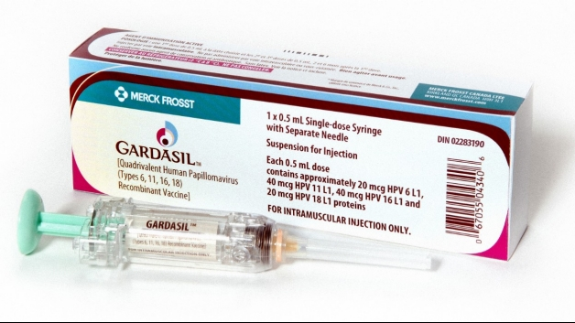
Three different vaccines have been developed against HPV :
Notes are Important
1- Gardasil:
FDA licensed Gardasil in June 8, 2006.
a quadri-valent HPV vaccine, targets HPV types 6, 11, 16, and 18
It is approved for the prevention of cervical cancer and cervical and vulvar intra epithelial neoplasia in young women
approved for both men and women from the ages of 9 to 26 *for the prevention of genital warts, anal cancers, and anal intraepithelial neoplasias.
Two large, randomized, double-blind, placebo-controlled trials have evaluated the efficacy of this vaccine in more than 17,000 adolescents and young females :
Among HPV-naïve populations, the efficacy for preventing CIN2 or more severe disease due to HPV types included in the vaccine, was 97 to 100 %
In the overall population of study participants (with or without prior HPV infection), the efficacy of the vaccine for preventing CIN2, or more severe disease due to HPV types included in the vaccine was significantly lower at approximately 44 % after a mean follow-up period of 3 years.
This reduction in efficacy reflects the fact that the vast majority of enrollees in this trial were already sexually active and many had been previously infected with vaccine HPV types
And this is because they want to target women before they get exposed to the virus, because the monument you are exposed and positive for the virus -it is not a contraindication to get vaccinated –but the efficiency and benefit is less .(because the strain (ex. HPV 16 )your are positive for will remain with you for life and you will not benefit from the vaccine for that specific strain ) meaning the vaccine will protect you form the other strains (HPV 6 ,11 18 ) but not HPV16 because you are already infected and this why it’s important to get it at an early age .

Slide 10
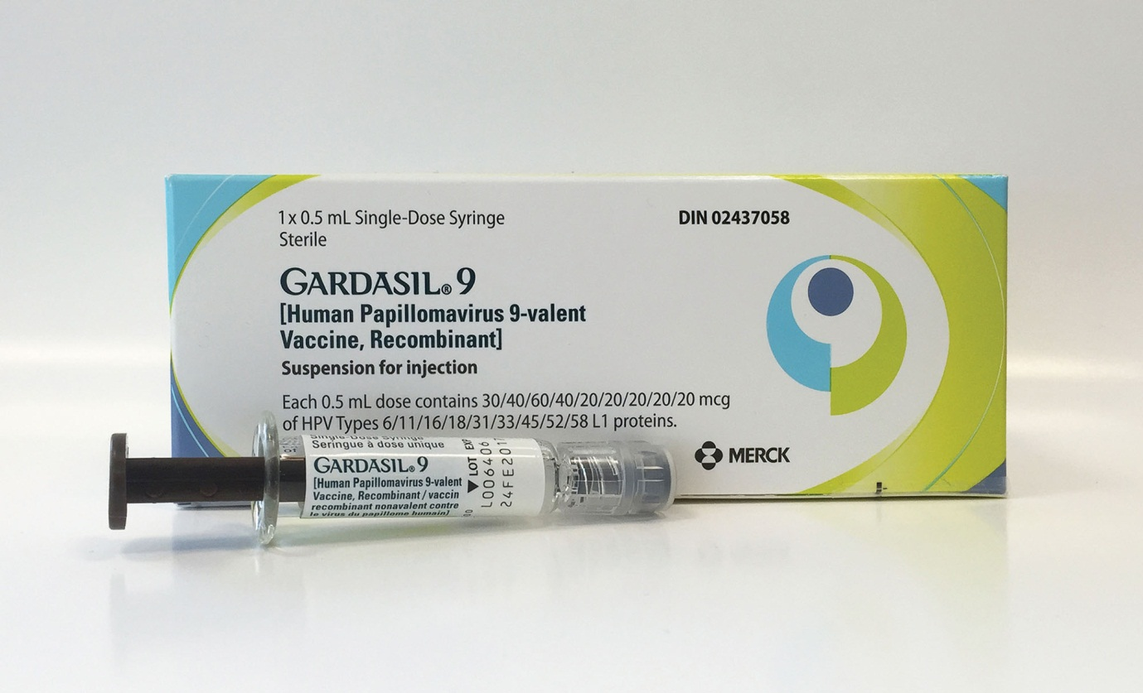
Three different vaccines have been developed against HPV :
2- Gardasil 9
is approved In December 2014, the United States' Food and Drug Administration (FDA) for women and girls aged 9 to 26 and men and boys aged 9 to 15.
a 9-valent vaccine, targets the same HPV types as the quadri-valent vaccine (6, 11, 16, and 18) as well as types 31,33, 45, 52, and 58 .
An international trial reported the efficacy of this vaccine in approximately 14,000 females aged 16 to 26 years who were randomly assigned to receive the vaccine :
Among HPV-naïve populations, the efficacy of 9-valent vaccine for preventing CIN2 or more severe disease, VIN2 or 3, and VaIN2 or 3 associated with HPV types 31, 33, 45, 52, and 58 was 97 %
In the overall population of study participants (with and without prior HPV infection), the rates of high-grade cervical, vaginal, and vulvar disease were the same among women who received the 9-valent vaccine and those who received the quadri-valent vaccine (14 cases/1000 person years in both groups).

Slide 11
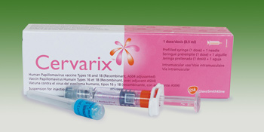
Notes are Important
Three different vaccines have been developed against HPV :
3- cervarix*
a bivalent vaccine, targets HPV types 16 and 18
is approved for girls and women aged 9 to 25 for the prevention of cervical cancer and CIN
One large randomized clinical trial in more than 18,000 young females aged 15 to 25 years demonstrated the efficacy of bivalent HPV vaccine .
Among HPV-naïve patients, the efficacy of the vaccine for preventing CIN2 or more severe disease due to HPV types included in the vaccine was 93 %
In the overall population of study participants (with and without prior HPV infection), vaccine efficacy for preventing CIN2 or more severe disease due to HPV types included in the vaccine was significantly lower at 53 % after a mean follow-up period of approximately 3 years.
*Cervarix doesn't protect from the warts( doesn’t cover HPV6 and 11 Only covers 16 and 18)

Slide 12
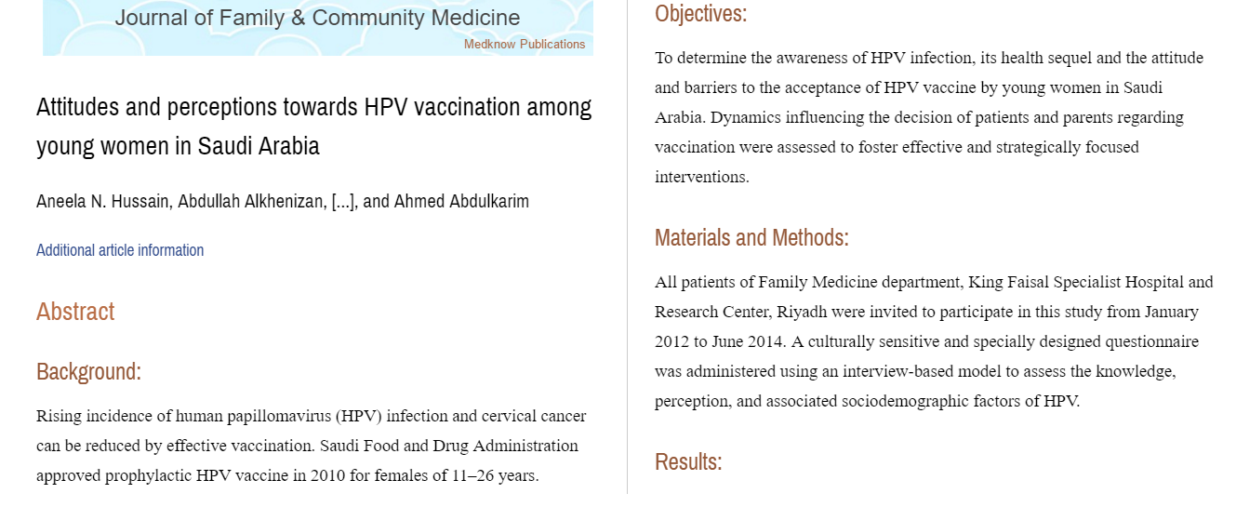
STUDIES:
Conclusion:
Knowledge and perception of HPV infection as an STDS and its vaccine was significantly low in this cohort of patients. Higher age and educational levels directly correlated with increased knowledge of HPV infection and its complications. It is recommended that awareness should be raised, and access to HPV vaccination increased to help reduce the health care burden of HPV sequelae in the Kingdom.

Slide 13
immunization in special patient populations:
1- pregnant females:
According to CDC RECOMMENDATIONS: not recommended (contraindicated )
given that safety in this setting has not been thoroughly evaluated .
If a woman is found to be pregnant after initiating the vaccination series, the remainder of the three-dose regimen should be delayed until after completion of the pregnancy
In quadri valent HPV vaccine trials, the composite rate of adverse pregnancy outcome (spontaneous abortion, late fetal death, congenital anomaly) was similar for the 3819 females who became pregnant and controls who did not receive the vaccine (22.6 versus 23.1 percent)
Similarly reassuring findings have been reported for the bivalent HPV vaccine and for the 9-valent HPV vaccine , although data are more limited
Safe in lactating females as it dose not affect the infant breast feeding

Slide 14
immunization in special patient populations:
2-Immunization in females with pre-existing cervical abnormalities or genital warts :
A history of genital warts, abnormal cytology, or +VE HPV DNA test result is not evidence of prior infection with any or all of the vaccine HPV types
vaccination can still provide protection against infection with HPV vaccine types not already acquired.
assessment with Pap testing or screening for existing HPV infection is NOT indicated as part of the determination for HPV vaccine candidacy.
these patients should be advised that vaccination will have no therapeutic effect on pre-existing HPV infection or CIN , and the potential benefit of HPV vaccination is not as great as if they were vaccinated before they started having sex.
3- Transplant recipients and HIV-infected patients:
According to CDC RECOMMENDATIONS:
Studies of the HPV quadrivalent vaccine in HIV-infected adult men and women aged 16 to 23 years , boys and girls aged 7 to 12 years suggest that it is both immunogenic and safe in these populations.
efficacy data are not yet available.
For solid organ transplant recipient It is safe to be given 3 to 6 months following transplantation

Slide 15
PREVACCINATION ASSESSMENT:
The Advisory Committee on Immunization Practices(ACIP) does not recommend serologic or HPV DNA testing prior to immunization in females or males
VACCINE DOSE AND ADMINISTRATION:
According To CDC GUIDELINES ON DEC 2016 :
Immunization schedule — In the United States, as of 2016, the recommended dosing schedule depends on the age of the patient
Individuals younger than 15 years should receive two doses of HPV vaccine at least six months apart.
Individuals 15 years or older should receive three doses of HPV vaccine over a minimum of 24 weeks.
The minimum interval between the first two doses is 4 weeks and the minimum interval between the second and third doses is 12 weeks.
The Gardasil and Gardasil 9 are typically administered in three doses at time zero, and at two and six months of follow-up.
Cervarix follow a similar three-dose schedule for those older than 15 years, the bivalent vaccine is typically administered in three doses at time zero, and at one and six months of follow-up.

Slide 16
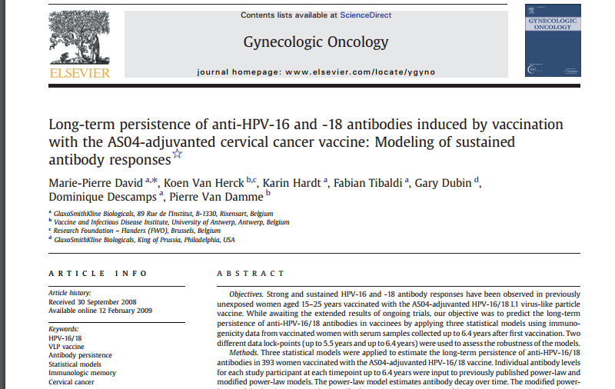
Interrupted schedules
if the vaccination series is interrupted for any length of time, it can be resumed without restarting the series.
For how long ? Duration of protection ?
IN ALL CLINICAL TRIALS Persistent antibody levels and protection against HPV infection have been reported up to 10 years following vaccination
Of note, the precise level of antibody needed for protection against infection is unknown.
Further data will become available in the future as female and male participants in vaccine studies are followed over time.
Results:
HPV-16 and -18 antibodies peaked at Month 7 and gradually plateaued at Months 18–24 and
remained stable through 6.4 years
Mean antibody levels at the last time point were several fold higher than those associated with natural infection.
The study predict that HPV-16 and -18 mean antibody levels will remain well above those associated with natural infection for at least 20 years

Slide 17
Vaccine safety
All vaccines use virus-like particles (VLPs) which mimic the viral capsid.
VLPs do not contain genetic material and are produced in biologic systems, which have well-established safety records
The majority of side affects are just mild injection site reaction :pain , redness etc. and rarely it could resemble the side effects of influenza virus vaccine
1- Quadrivalent vaccine (Gardasil) | Prelicensure trial data | The safety profile of the quadri valent vaccine was evaluated in diverse populations of females from resource-rich and resource-limited settings . Mild injection site reactions were the most commonly observed adverse events The safety profile of quadrivalent vaccine in males was reported to be similar to that of studies in females
 | Postlicensure data | In the U.S, adverse events following immunization are collected and analyzed within the Vaccine Adverse Event Reporting System (VAERS) Adverse events following HPV vaccine are compared with background rates following other immunizations. Between June 2006 and March 2013, approximately 57 million doses of quadrivalent HPV vaccines were distributed Reports of adverse events to VAERS have been consistent with the pre-licensure data: CONTINUO IN THE NEXT PAGE →

Slide 18
Vaccine safety
1- Quadrivalent vaccine (Gardasil) | Prelicensure trial data | ← LAST PAGE
 | Postlicensure data | From 2006 to 2013, VAERS received 21,194 reports of adverse events following HPV immunization among females The vast majority (92 %) were considered mild. The proportion of events reported as serious peaked in 2008 Among serious events, headache, nausea, vomiting, fatigue, dizziness, syncope, and generalized weakness were the most frequently reported. There is no increased risk of Guillain-Barré Syndrome compared with other vaccines in similar age groups Through 2011, 72 post-vaccination deaths had been reported, of which 34 were confirmed. There was no unusual pattern or clustering to the deaths that would suggest that they were caused by the vaccine VTE rates reported to the VAERS were higher for quadrivalent vaccine than other vaccines, of the 31 patients with thromboembolism reported through 2008, 90 % had a known risk factor (ie, estrogen-containing birth control pills or a family history of clotting disorder Anaphylaxis had also been reported following administration of the quadrivalent vaccine

Slide 19
Vaccine safety
2- 9-valent vaccine (Gardasil 9) | In an analysis of seven trials in which over 15,000 individuals received at least one dose of the 9-valent vaccine, the most common adverse effects were: mild or moderate injection site reactions (pain, erythema, and swelling) more frequently than with the quadrivalent vaccine. systemic adverse effects (eg, headache, fever, nausea, dizziness) were similar with the 9-valent and quadrivalent vaccines. Serious adverse effects occurred in <0.1 percent.
3-Bivalent vaccine (Cervarix) | In a phase III, multinational prospective, double-blind, placebo-controlled trial of more than 18,000 females aged 15 to 25 years, the vaccine was well tolerated and there were no differences in serious adverse events between vaccine and placebo recipients. Because of low uptake of the bivalent vaccine in the U.S only sparse post-licensure data are available. As of September 2011, there have been 52 VAERS reports of adverse events following administration of bivalent vaccine and the majority (98%) were considered non serious.

Slide 20
COST EFFECTIVENESS
Mathematical models have examined the cost effectiveness of HPV vaccination
One study suggested that vaccination of the entire United States population of 12-year-old girls would annually prevent
>200,000 HPV infections
100,000 abnormal cervical cytology examinations
3300 cases of cervical cancer if cervical cancer screening continued as currently recommended
A small massage to take is:
-HPV vaccination appears to be safe and effective in preventing subsequent infection in older women, but the overall benefit is less than that in younger females
-the need to vaccinate individuals before the onset of sexual activity to gain the greatest benefit and maximize cost effectiveness.
-None of the three vaccines treats or accelerates the clearance of pre-existing vaccine-type HPV infections or related disease.

Slide 21
SUMMARY:
اضغطوا هنا وبتلاقون ملخص شامل لكل المحاضرة
أو انسخوا الرابط
https://docs.google.com/file/d/1-3XDTKxI2m2GGfSLmemBsFDPc5ylsC80/edit?usp=docslist_api&filetype=mspresentation

Slide 22
QUIZ:
1. Number of HPV types that are sexually transmitted is:
a. 35
b. 40
c. 45
d. 50
2. The most common types of HPV that cause genital warts are:
a. 11 & 16
b. 16 & 18
c. 11 & 12
d. 6 & 11
3. Quadri-valent HPV vaccine targets all EXCEPT:
a. 11
b. 16
c. 8
d. 18
4. Persistent antibody levels and protection against HPV infection have been
reported up to:
a. 3 years
b. 10 years
c. 11 years
d. 15 years
5. Girls within the age range of 9 through 13 years should be the primary
target population for HPV immunization that was a suggestion by:
a. WHO
b. ASC
c. CDC
6. Which one of them is not correct about HPV vaccination:
a. Safe in lactating females as it dose not affect the infant breast
feeding
b. safe and effective in preventing subsequent infection in older
women
c. virus-like particles (VLPs)
d. vaccines accelerates the clearance of pre-existing vaccine-type
HPV infections
Answers: 1. B 2. d 3.c 4. b 5. a 6. d

Slide 23
THANK YOU FOR CHECKING OUR WORK, BEST OF LUCK!
Hamad Alkhudhayri
Shrooq Alsomali
Wejdan Alzaid
Ghaida Alsaeed
Doctors slides

