Slide 1
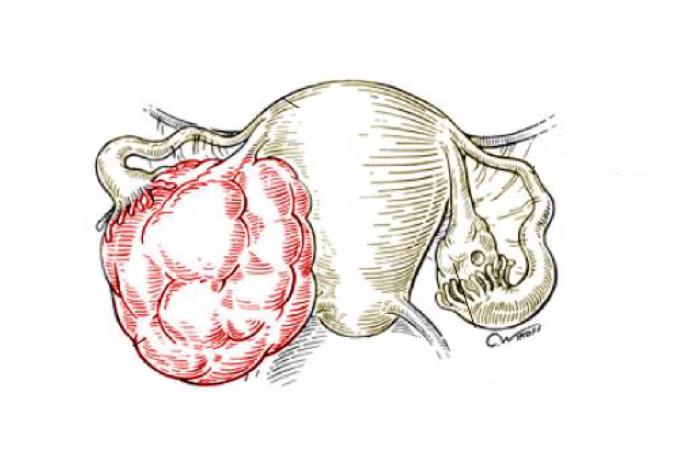
Ovarian Cyst and Tumors
Objectives:
The pathology of the major types of ovarian cysts (follicular and luteal) .
The classification and pathology of common ovarian tumors including surface epithelial , germ cell , stromal and metastatic neoplasm .
• Black: Doctors’ slides. • Red: Important! • Light Green: Doctors’ notes • Grey: Extra. • Italic black: New terminology.

Slide 2
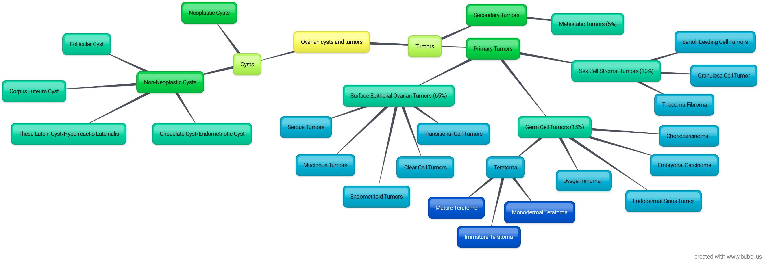
Over view of the lecture :

Slide 3
Non neoplastic cysts are common but they are not serious problems.
Inflammation of the ovaries is rare. It is usually associated with salpingitis¹ of fallopian tubes (salpingo-oophoritis). (Is rare, seen in TB)
Frequently, the ovaries are affected by endometriosis² . (Most common)
The most important medical problems in ovaries are the neoplasms.
Death from ovarian cancers is more common than that of cervix and uterus together because ovarian tumors grow silently and are usually diagnosed late, which make them so dangerous.
Non-Neoplastic Cysts of ovary
Non Neoplastic Cyst are more common than the neoplastic ones. They usually cause no problems. (We worry about the big ovarian tumors not the simple cysts)
Rarely a non neoplastic cyst can rupture and cause acute pain and intr-abdominal hemorrhage. Because: 1)They are always ignored 2)We may all have non-neoplastic cysts in our ovary and never found out about it 3) Asymptomatic)
The pathology of the major types of ovarian cysts (follicular and luteal)
Ovarian Cysts and Tumors (General points)
Common non-neoplastic cysts are as follow:
Arise from the ovarian follicles and are due to distension of un-ruptured Graafian follicle. | 1- Follicullar cyst
Results from hemorrhage into a persistent mature corpus luteum. | 2- Corpus luteum cyst
Are thin walled cysts lined by luteinized theca cells. They are associated with high levels of circulating gonadotropins (e.g. pregnancy, hydatidiform mole, etc). | 3- Theca lutein cyst/ hyperreactio luteinalis
The ovary is the most frequent site of endometriosis. And chocolate cyst is a blood filled cyst of the ovary. It is due to endometriosis in the ovary with hemorrhage. | 4- Chocolate cyst /Endometriotic cyst
1:infection and inflammation of fallopian tube
2:Endometriosis: a condition resulting from the appearance of ectopic endometrial tissue outside the uterus causing pelvic pain, especially with menstruation.

Slide 4
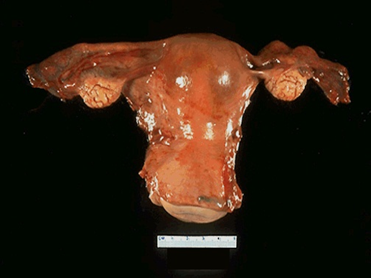
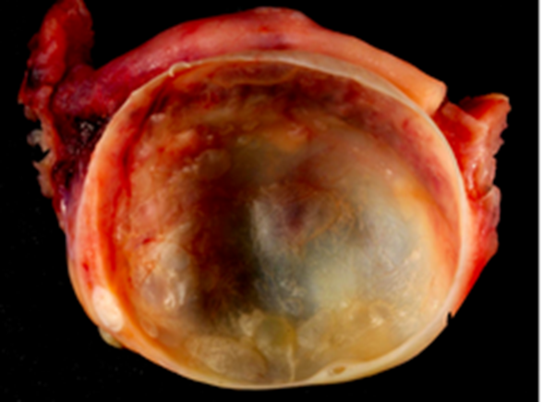
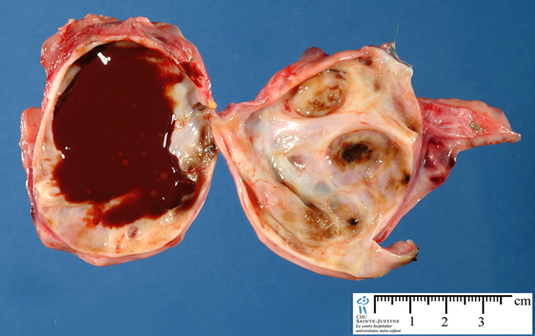
Ovarian cysts
Endometriotic cyst
Ovarian tumors (One feature is heaviness in the abdomen)
One of the leading cause of cancer death in women.
Ovarian cancers grow silently and go undetected in the early stage when it is still curable.
Most of the patients already have metastasis at the time of diagnosis. (late diagnosis= metastasis). (Usually diagnosed in late stages, asymptomatic in early stages/silent)
The WHO Histological Classification for ovarian tumors divides ovarian neoplasms into primary and metastatic (secondary).
Ovarian Tumors classification
Primary tumors (A tumor from the ovary itself): There are three main primary types of ovarian tumors based on the origin of the tumor cell:
Surface epithelial ovarian tumors (65%​) , derived from the cells on the surface of the ovary . This is the most common form of primary ovarian cancer and occurs in adults .
Germ cell tumors (15%​) , derived from the egg producing cells of the ovary , i.e.: from the ovarian follicles . This occurs mainly in children , teens and young women (we expect this type on tumors in young adults since it includes the mature follicles, so a post-menopausal women is unlikely to have germ cell tumors).They are less common as compared to epithelial ovarian tumors.
Sex cord stromal tumors (10%​) , derived from the ovarian stroma . They’re uncommon and often produce steroid hormones.
These 3 main types are further divided into many subtypes (see next slide).
Secondary/metastatic (Arising from other origins) (​5%​): Cancers from other organs can also spread to the ovaries.

Slide 5
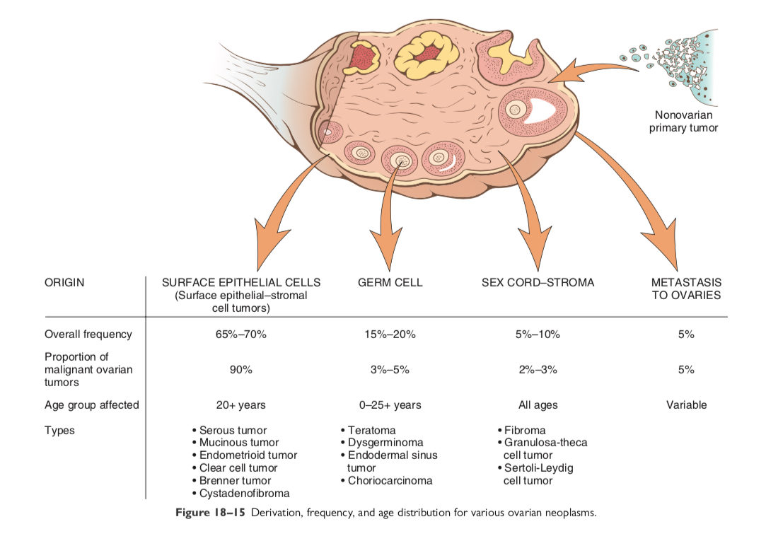
The tumor arising from the surface epithelium are the most common (1 being the most common, 4 being the least common):
Surface epithelial cells: Depend on which cell is overgrowing
Germ cell: Depends on which type of graafian cell is included
Sex cord-stroma: Arising from the stroma
Metastasis to ovaries
Now in the ovaries we have the lining epithelium that lines the whole ovary and we have the germ cells which are the oocytes and the stroma which is the connective tissue , and tumors are classified upon where they grow in each of those previously mentioned structures .

Slide 6
1.Surface Epithelial Ovarian Tumors
The classification and pathology of common ovarian tumors including surface epithelial , germ cell , stromal and metastatic neoplasm
Neoplasms of surface epithelium account for majority of all primary ovarian tumors. (Derived from cells on the surface of the ovary)
Are 65 – 70 % of overall tumors
They account for 90 % of malignant tumors in the ovary
Age 20+
Must watch!
The subtypes of the surface epithelial tumors are(The type of cells that grow and cause neoplasm in the surface epithelium )
Serous Tumors
Mucinous Tumors
Endometrioid Tumors
Clear cell Tumors
Transitional/Brenner cell Tumors
Others
All surface epithelial tumors are further divided into:
Benign | Malignant | Borderline/ intermediate/ tumors of low malignant potential
They do not spread and invade other tissues. | Are carcinomas and have potential to metastasize beyond the ovary. | This is a gray zone. They are ‘semi-malignant’. These appear to be low grade cancers with limited invasive potential. They have better prognosis than malignant. These tumors may seed or implant into the peritoneum.
Harmless, take it out and send the patient home
Has the potential to go everywhere and harm the patient (takes her life)
They have tendency to come back but have better prognosis than malignant tumors

Slide 7
They are derived from the cells on the surface of the ovary. This is the most common form of primary ovarian cancer and occurs in adults.
Malignant | Borderline | Benign | Surface Epithelial Tumors
Serous Adeno- carcinoma | Serous Borderline Tumor | Cystadenoma | 1)Serous Tumors
Mucinous Adeno- carcinoma | Mucinous Borderline Tumor | Cystadenoma | 2)Mucinous Tumors –Endocervical-like and intestinal type
Endometrioid Adeno- carcinoma | Endometrioid Borderline Tumor | Cystadenoma | 3)Endometriod Tumors
Clear Cell Adeno-carcinoma | Borderline Tumors | Benign | 4) Clear Cell Tumors
Malignant Brenner Tumor Transitional Cell Carcinoma (Non-brenner Type) | Brenner Tumor Of Borderline Malignancy | Brenner Tumor | 5)Transitional Cell Tumors
- | - | - | 6)Others

Slide 8
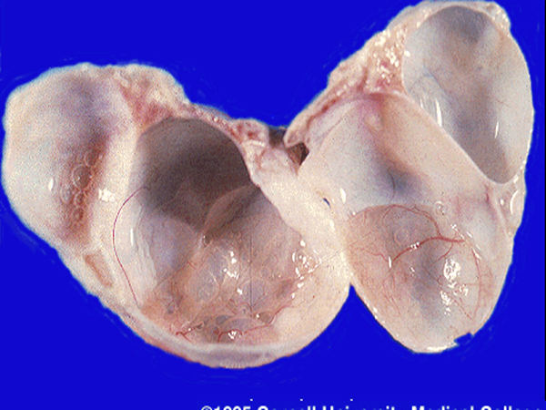
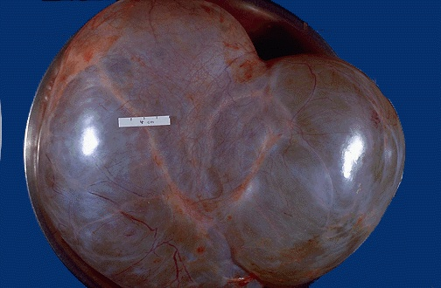
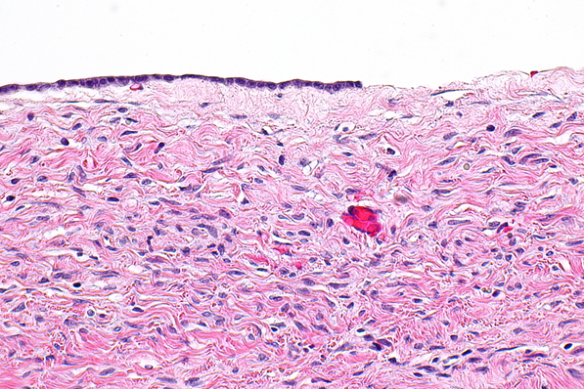
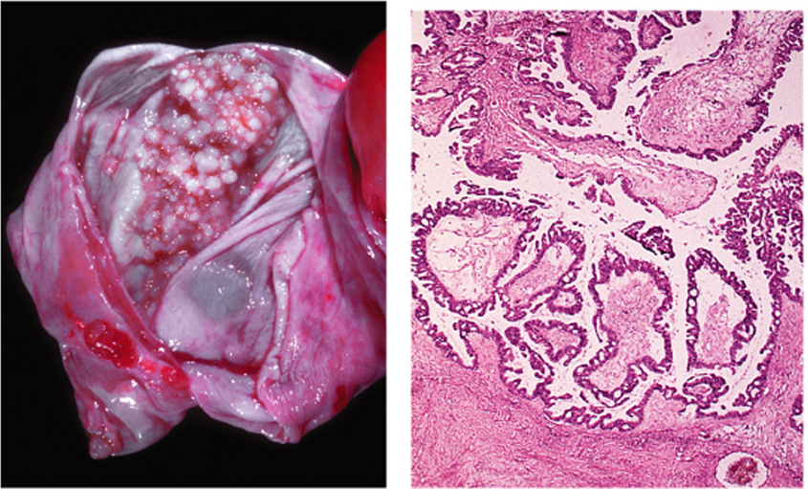
Serous Tumors
Serous ovarian tumors are the most common type ovarian tumors. They are also the most common group of epithelial tumors. The tumor cells are of serous nature.
Age is 30 -40
Usually cystic filled with clear serous fluid
Serous tumors are often bilateral.(serous= serious, so they are bilateral)
Psammoma bodies are commonly seen *focus on keywords*
The tumors are subdivided into benign (60%), borderline (15%) and malignant (25%).
Benign serous tumors (serous cystadenomas):
Are commonly large cystic and thin-walled, and unilocular³. (Cysts with fluid)
They are lined by serous cells and contain thin, clear yellow fluid.
Borderline serous tumors :
Cystic with thin wall and smooth surface, but often have multiple papillary excresences (grape-like clusters)
Protruding into the lumen in places. (Doesn’t harm the patient but she will keep coming back after 5 years with the same tumor hence the name borderline (relapse and remission) )
usually don’t metastasize but the patient may come back with abdominal heaviness where the tumor keeps growing into the abdomen
3:A small cavity or compartment within an organ or part of an organism

Slide 9
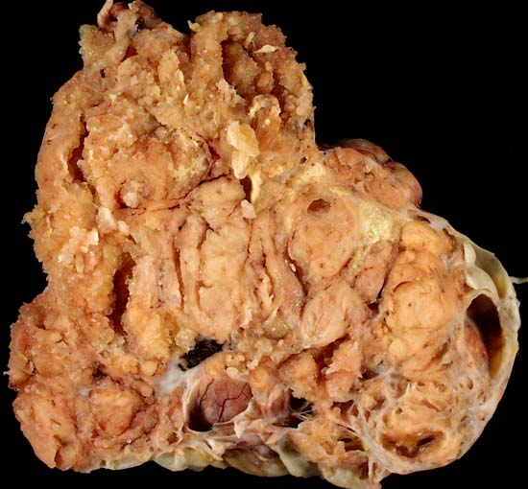
Malignant serous tumors (serous cystadenocarcinoma)
is the commonest malignant ovarian tumor, forming about a third of all cancers of the ovary.
The tumors are partly cystic and partly solid with prominent excrescences¹.
Often with necrosis and hemorrhage.
These tumors usually present with ascites due to abdominal metastases.
Treatment: surgery, chemotherapy and radiotherapy.
Prognosis: poor.
Under the microscope, malignant adenocarcinoma cells are seen
It can metastasize from the blood to the bone and take the life of the patient
1: الزوائد

Slide 10
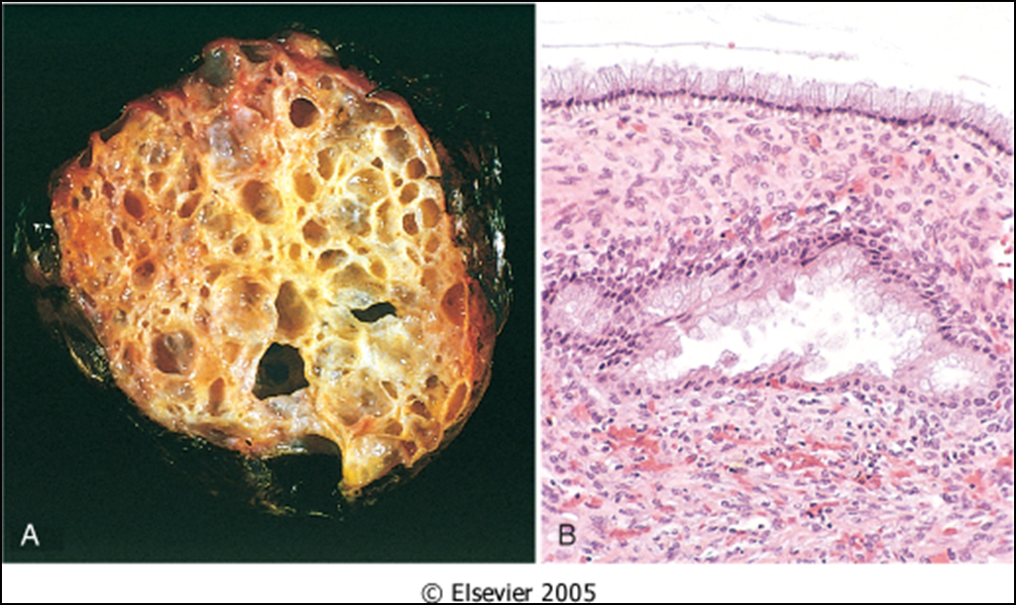
B.Mucinous Tumors
Mucinous tumors form about 25% of all ovarian neoplasms. The tumor cells are mucin-producing cells (which are either endocervical type or intestinal type cells).
Less likely to be malignant
80% are benign
10% are borderline
10% malignant
Bilaterality is uncommon.
Mucinous tumors can be very large.
They are typically cystic and multilocular and filled with thick sticky, viscous mucoid fluid.
Mucinous cystadenoma with multicystic cut section and glistening mucoid material; in it.
the cyst is lined by columnar epithelium (mucin producing)
C. Other surface epithelial tumors:
ENDOMETRIOID TUMORS They have tubular gland that resemble the endometrium so the name endometrioid (endometrium-like) . (Endometrial glandular cells) Endometrioid tumors form 10 to 20% of all ovarian tumors. Most of the endometrioid tumors are malignant (carcinomas). Some endometrioid tumors are accompanied by an endometrial carcinoma in the uterus and / or endometriosis in the ovaries (When you find an endometrial tumor in the ovaries, there is a good chance that endometrial tumor is in the uterus or endometriosis is found elsewhere) | TRANSITIONAL CELL/ BRENNER TUMOR Tumor cell are transitional cell type Most are benign
Doctor said just read this table

Slide 11
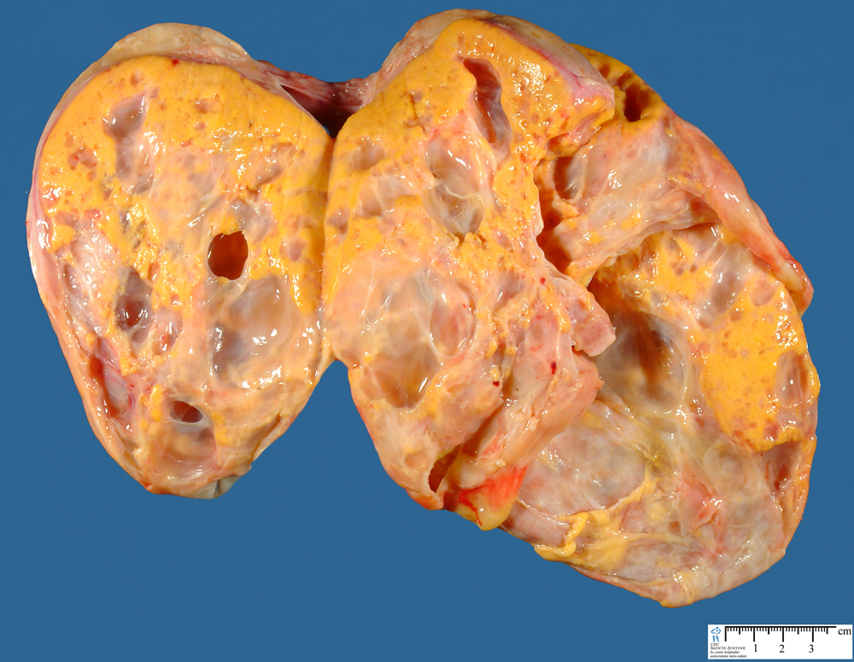
2.Sex Cord-Stromal tumor
Contents in ovarian stroma: theca cells, fibrotic tissue and granulosa cells
Almost always Benign
Thecoma
Fibroma and Fibrothecoma
With Malignant Potential
Granulosa Cell tumor
Sertoli-Leydig cell tumor
Must watch!
Thecoma-Fibroma (Arising from theca cells, fibrotic tissue or a combination of both)
Any age
Unilateral
Almost always benign. Very rarely malignant.
They can be either pure thecomas, pure fibromas or fibrothecomas (mixture of both).
Pure theca cell tumors produce estrogen (Appear in yellow color)
Fibromas do not produce estrogen except when mixed with thecomas.
They are solid tumors, vary in color from white to yellow. Fibromas are whiter, harder with whorled cut surface. (when ever you hear whorled it’s a FIBROMA)
About 40% cases are associated with ascites and hydrothorax and this combination is called as Meig’s Syndrome.

Slide 12
B. Granulosa Cell Tumor (Arising from granulosa cells)
Unilateral, solid and cystic
Produce estrogen
2 forms: adult and juvenile.
Adult form is more common in postmenopausal women.
The juvenile form is seen the first three decades, can present with isosexual precocity (Precautious puberty, she will develop all the symptoms of puberty in an early stage)
can present with abnormal vaginal bleeding
can be associated with endometrial hyperplasia and carcinoma (because of the production of estrogen)
About 5 to 25% show malignant behavior.
Has malignant potential so if the patient has a tumor, it is resected and must be followed-up for 5 years to make sure the tumor is not metastasizing.
Sertoli – Leydig cell tumor (Arising mainly from testes but it can also arise from stem cells in ovaries)
The tumor has the same cells as the steroli-leiding cell in the testis that’s why it produces testesterone.
Rare tumors of low malignant potential
All ages
Unilateral yellowish solid tumor.
Produces androgens and present with virilization in 1/3rd of cases (oligomenorrhea, amenorrhea, loss of female secondary sex characteristics with hirsutism, clitoromegaly, deepening of voice)

Slide 13
Classification of Ovarian Germ Cell Tumors (GCT):
3.Germ Cell Tumors:
Must watch!
Teratoma
Immature
Mature (benign):
Solid
Cystic (dermoid cyst)
Monodermal (e.g., struma ovarii, carcinoid)
Dysgerminoma
Yolk sac tumor (endodermal sinus tumor)
GERM CELL TUMORS
Choriocarcinoma
Embryonal carcinoma
mixture of germ cell tumors occurring together in one tumor mass (More tricky and difficult to treat (complicated) )
Mixed germ cell tumors:
NOTE: all ovarian GCTs are considered malignant except mature teratoma.
A. Teratoma
Are 15-20 % of ovarian tumors. Majority occur in the first 2 decades
The tumors are subdivided into mature, immature and monodermal.
Mature cystic teratoma are the most common. They are benign.
Immature teratomas are malignant and rare.
The younger the patient, the greater the likelihood of malignant behavior
Mature cystic teratoma:
Is the most common ovarian germ cell tumor and the most common type of ovarian teratoma (The most common ovarian tumor: surface epithelial cell tumors and the most common ovarian germ cell tumor: mature cystic teratoma)
It is a benign neoplasm that typically occurs during reproductive years composed of mature elements of the ectoderm, endoderm and mesoderm
It is a cystic tumor, filled with sebaceous material and hair and occasionally teeth.
Histology: skin, hair, sebaceous glands, and mature neural tissue predominate; cartilage, bone, respiratory and intestinal epithelium are common. (Because they are of mature elements of ectoderm, endoderm and mesoderm they can grow and differentiate to these structures.)
Complications include torsion)twisting), rupture, infection etc.

Slide 14
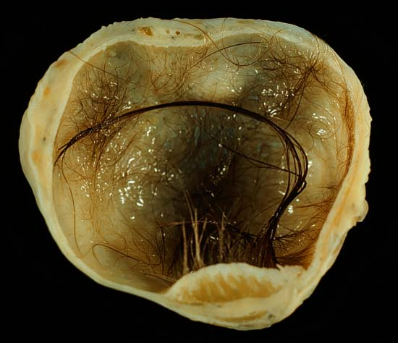
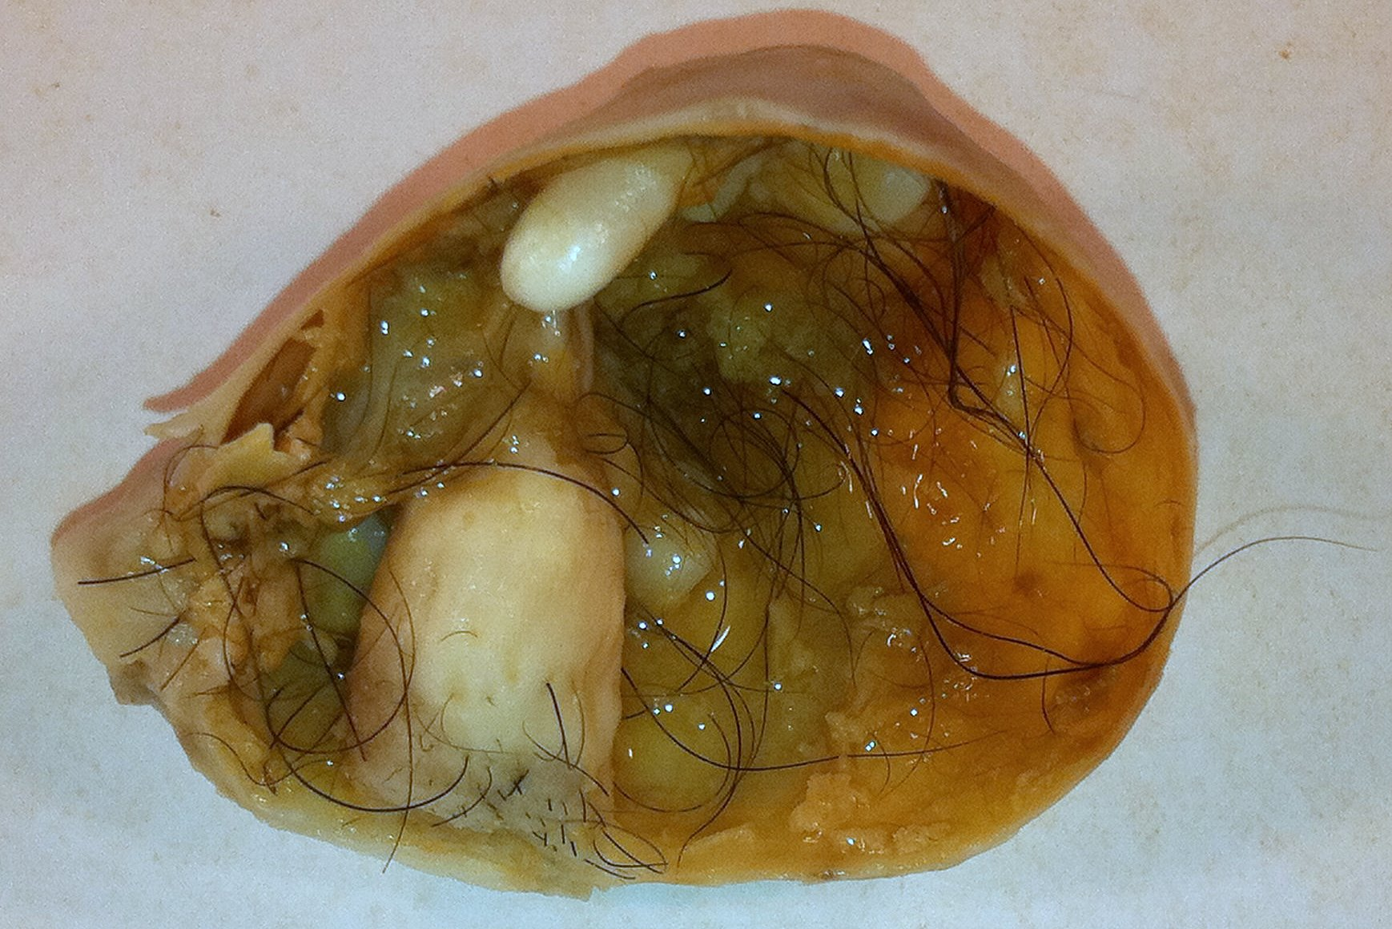
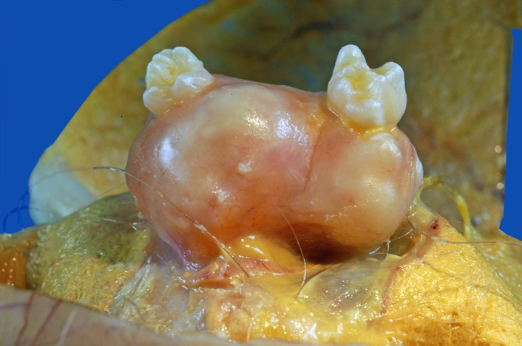
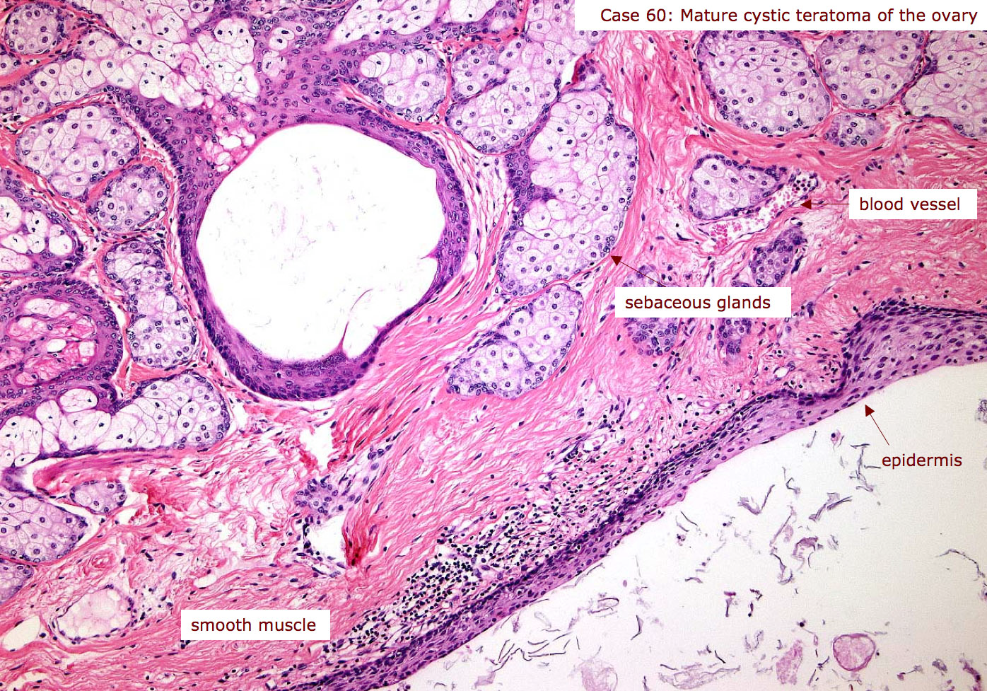
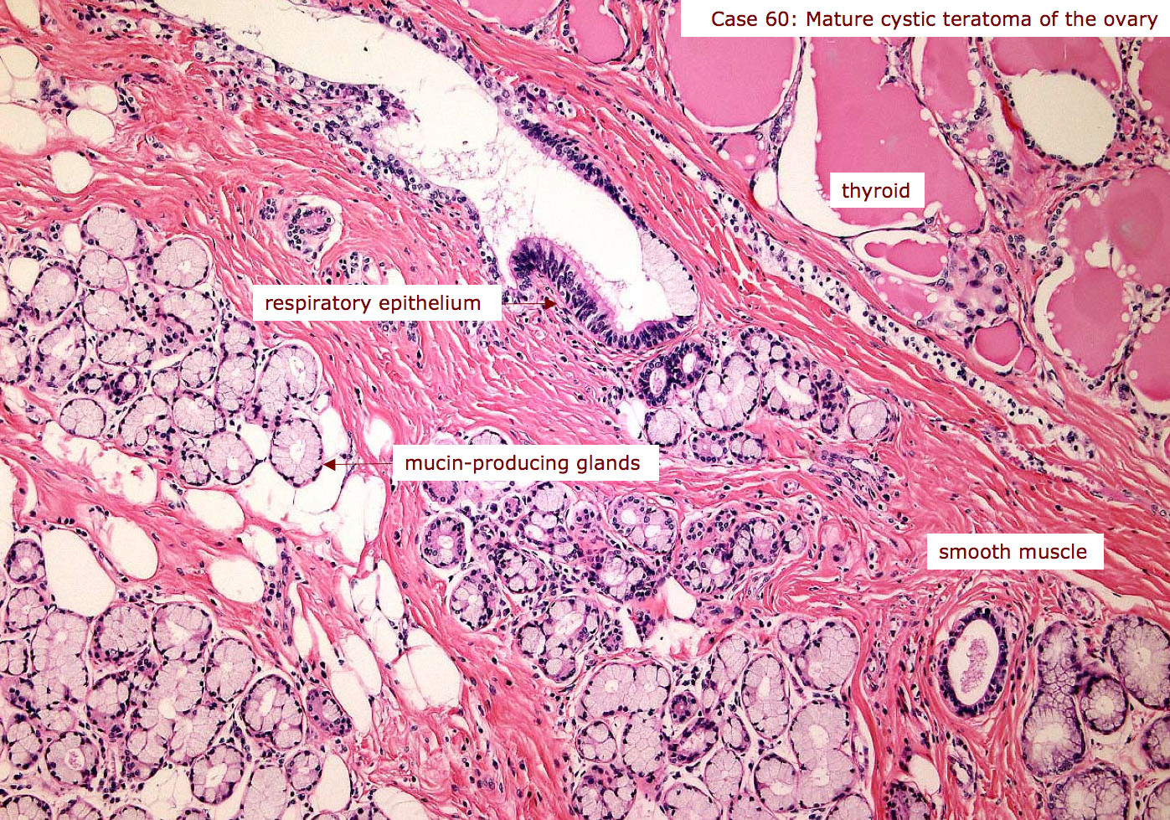
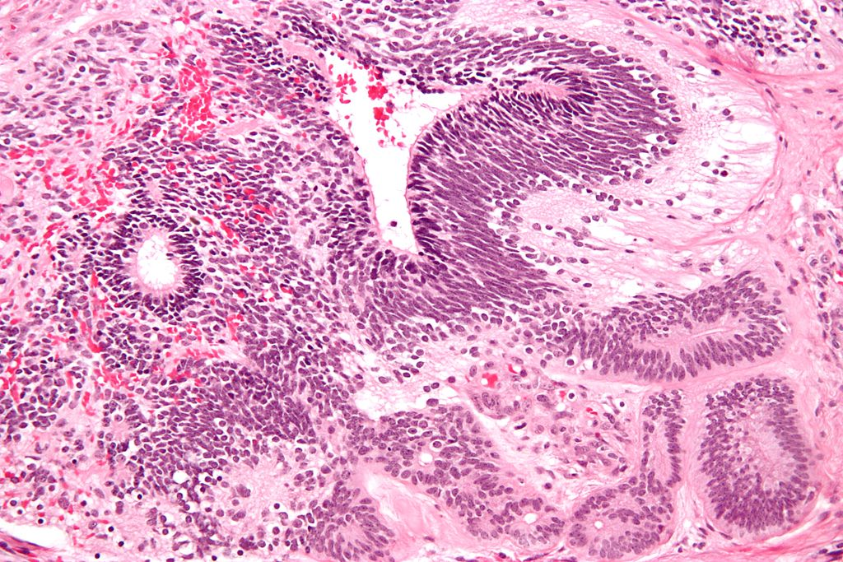
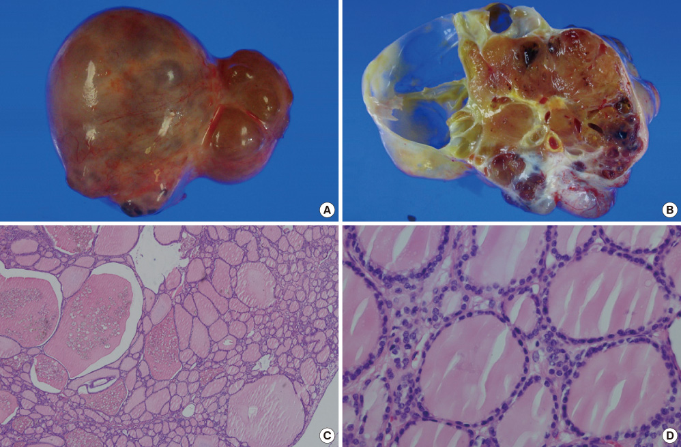
Gross
Histological
Opened mature cystic teratoma (dermoid cyst) of the ovary. Hair ball is present.
Immature teratoma :
It is malignant, occurs in children and young adults
Usually unilateral and solid
Similar to mature teratoma but in addition they contain immature or embryonal tissues especially immature neuroepithelial cells. (Immature tissue: the cells that are present in the fetus in the time of embryogenesis)
They are graded based on the amount of immature tissue
Monodermal teratoma:
A teratoma composed of one tissue element
The most common type of monodermal teratoma is called "struma ovarii", which is made up of mature thyroid tissue.
The thyroid tissue can sometimes become malignant. (Can develop carcinoma of the thyroid (like papillary carcinoma of the thyroid) But T3 and T4 levels will be normal because their negative feedback is still working)
Sometimes a carcinoid tumor can arise from it.

Slide 15
B. DYSGERMINOMA
C. ENDODERMAL SINUS TUMOR:
Uncommon
Between 10 to 30yrs of age
Unilateral and solid mass
Microscopically look exactly like its counterpart in testis (Seminoma) and brain (germinoma)
Malignant
PLAP positive (Dysgerminoma, Seminoma)
Highly sensitive to radiation therapy
“Also known as yolk sac tumor”
Under 30 years of age (In women who are menstruating)
Can be pure or a component of a mixed germ cell tumor
Is radioresistant but responds well to chemotherapy
The tumor is associated with elevated serum αlpha-fetoprotein and αlpha-1-antitrypsin.
Its characteristic histologic feature : Schiller-Duval bodies
Positive for immunostain for αlpha-fetoprotein
D. CHORIOCARCINOMA – Placental calls
E. EMBRYONAL CARCINOMA:
Rare, aggressive, highly malignant, metastasizes widely through the bloodstream to the lungs, liver, bone etc ( Fast metastasis)
Radioresistant AND chemoresistant
Similar to that seen in testis, usually occurs in combination with other GCTs (mixed GCT)
Elevated serum hCG levels (Human chorionic gonadotrophin-produced by placenta)
Unilateral, solid, hemorrhagic tumor, composed of malignant cytotrophoblast and syncytiotrophoblast
HCG immunostain positive
Rare, aggressive, highly malignant, radioresistant but responds to chemotherapy. (Prognosis: aggressive (we need to worry about it))
Similar to that seen in testis, usually occurs in combination with other GCTs (mixed GCT)
2nd and 3rd decade (children and young adults)
Unilateral, solid, hemorrhagic and necrotic
CD 30 immunostain positive.
If the percentage of this tumor is greater than 5%, the oncologist is worried
If it is less than 5%, he will over locate and follow up
If a tumor is considered as germ cell tumor (a mixture of tumors), the oncologist needs to know the percentages.
For example: 50% teratoma, 20% dysgeminoma, 10% endodermal sinus tumor. The most likely diagnoses would be teratoma. Stating the percentages will definitely help in management

Slide 16
Metastatic carcinoma in ovary:
Accounts for approximately 5% of ovarian tumors
Older ages, mostly Bilateral and sometimes very large (Bilateral because of metastasis)
Primary tumors can be from Gastro-intestinal tract (most common), Breast and lungs.
One of the most classic forms of metastatic carcinoma involving the ovaries is the Krukenberg tumor. This tumor is a metastatic carcinoma composed of signet ring cells in a fibrous background. The most common sites of origin is the GIT (stomach, colon and appendix).

Slide 17
Summary
Ovarian Cysts are divided to Neoplastic and non-neoplastic and the good news is that the non-neoplastic is more common.
Non-neoplastic cysts are four types 1)Follicular cysts 2)Corpus luteum cysts 3)Theca lutein cyst 4)Chocolate Cyst
Ovarian tumors are divides into primary and secondary .
Primary tumors are three types 1)surface epethelial ovarian cells 2)Germ cells tumors 3)Sex cord Tumors .
Surface epethelial ovarian cells tumor is the most common among all ovarian cancers .
Serous tumors of epithelial surface ovarian cells is the most common tumor among all .
Fibromas are white , hard and have WHORLED cut surface .
All ovarian Germ cell tumors are considered malignant except mature teratoma which is the most common type of GCTs.
Immature teratomas mostly contain immature Neuroepithelial cells .
Monodermal teratoma composed of one tissue element such as thyroid tissue ”Stroma ovarii” .

Slide 18
Questions
Q1) WHO classifies ovarian tumors based on:
serum markers
WHO criteria of ovarian neoplasms clinical features
primary or metastic
Ans:C
Q2) 38 old female diagnosed with an ovarian tumor, the oncologist explaining the management said: we’ll just take it surgically then you can go home. What is the type of the tumor?
serous borderline tumor
cystadenoma
immature teratoma
Ans:B
Q3)42 year old female was diagnosed with cystic and multilocular and filled with thick sticky viscous mucoid fluid tumer, which type of tumors is that?
A- Granulosa Cell Tumor.
B- Sertoli – Leydig cell tumor
C- mucinous tumor
Ans:C
Q4)Which tumor is more common in postmenopausal women:
A-Thecoma-Fibroma
B- juvenile form of Granulosa Cell Tumor
C- adult form of Granulosa Cell Tumor
Ans:C

Slide 19
Q5) A 25 year old patient with severe abdominal pain had some lab investigations which revealed HCG immunostatin positive and alpha-fetoproein positive , what is her diagnosis ?
Yolk sac tumor
Choriocarcinoma
Mixed tumor
Ans:C (Mixed germ cell tumors: Choriocarcinoma and Endodermal sinus tumor/yolk sac tumor)
Q6) What is the most classic form present in metastic carcinoma ?
Krukenberg tumor
Red man tumor
Pets berg tumor
Ans:A
Q7) Meig’s syndrome is thecoma-fibroma associated with ?
Hepatitis and ascites
Ascites and hydrothorax
Ascites and GI cancer
Ans:B
Q8) Which of the following tumors is PLAP positive?
Dysgerminoma/seminoma
Embryonal carcinoma
Choriocarcinoma
Ans:A
Q9) A 25 year old female was discovered to have a tumor with high levels of alpha-fetoprotein in the serum. What is most likely the diagnosis?
Dysgerminoma/seminoma
Embryonal carcinoma
Endodermal sinus tumor
Ans:C (yolk sac tumor)

Slide 20
حسبي الله لا إله إلَّا هو عليه توكلت وهو رب العرش العظيم.
الأعضاء
نوف العماري
ابتسام المطيري
فاطمة الطاسان
جواهر الخيال
أمل القرني
أميرة نيازي
دعاء وليد
رنيم الغامدي
لمى التميمي
ريما الشايع
القادة
حنين السبكي
هبة الناصر
عبدالله أبو عمارة
Editing File
Email: pathology436@gmail.com Twitter: @pathology436
References: Doctor’s slides + notes, Robbins basic pathology 10th edition.

