Slide 1
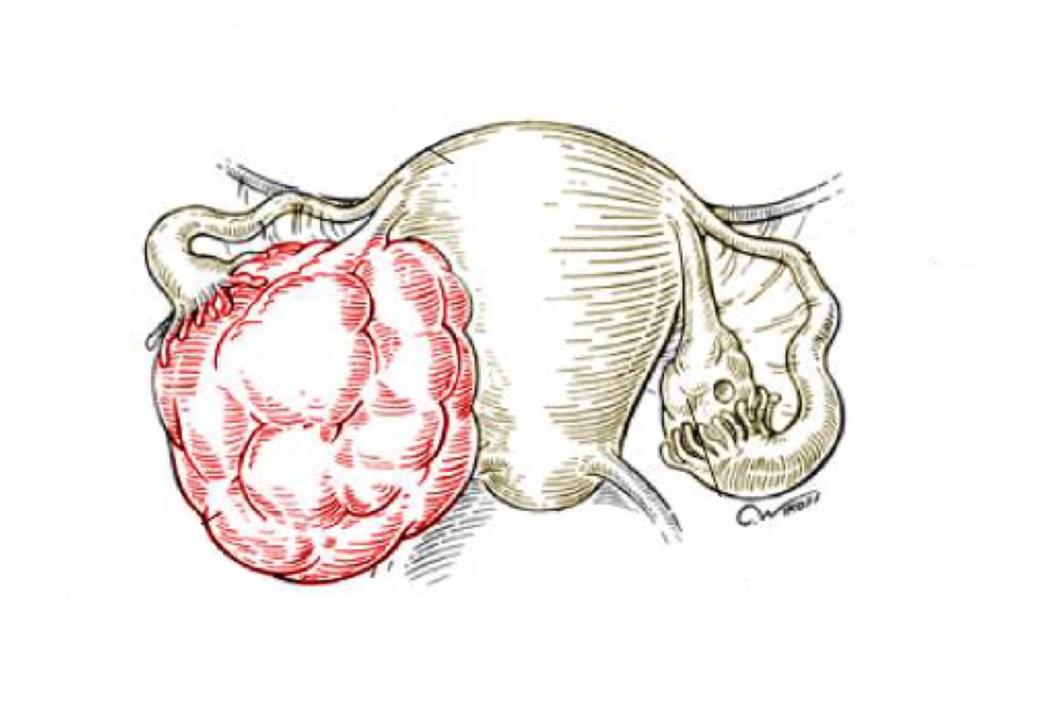
The Uterine Corpus
Objectives:
At the end of this lecture, the student should know:
Lesions of endometrium of uterus: know the risk factors, clinical presentation, macroscopic and histological features of:
Endometrial hyperplasia
Endometrial carcinoma
Lesions of myometrium of uterus:
Leiomyoma : understand the pathology and clinical features of uterine leiomyomas and is aware that leiomyoma (fibroid) is the commonest neoplasm arising in the female genital tract.
Leiomyosarcoma
• Black: Doctors’ slides. • Red: Important! • Light Green: Doctors’ notes • Grey: Extra. • Italic black: New terminology.

Slide 2
Lecture outline :

Slide 3
Lesions of Endometrium: Endometrial Hyperplasia
Endometrial Hyperplasia:
Endometrial hyperplasia is a process in which there is a proliferation of endometrial glands resulting in an increase in the gland/stroma ratio of the endometium when compared to normal. The glands are proliferating faster than stroma.
It is induced by persistent, prolonged stimulation of the endometrium by high levels of estrogen.
Remember: In menstruation: 1- Proliferative phase “Estrogen dependent”. 2- Secretory phase “progesterone”. So endometrial hyperplasia could happen in the proliferative phase.
The endometrial hyperplasia may progress to endometrial carcinoma.
The risk of developing carcinoma depends on the level and duration of the estrogen excess, the severity of the endometrial hyperplasia and associated cellular atypia.
Causes of Endometrial Hyperplasia:
Any condition in which there is high estrogen level can lead to endometrial hyperplasia e.g.:
Anovulatory menstrual cycles (failure of ovulation). Because of various hormonal problems.
Excessive endogenous production of estrogen (by the body) e.g. in:
Polycystic ovary syndrome (Stein - Leventhal syndrome),
Granulosa cell tumors of the ovary
Cortical stromal hyperplasia (excessive ovarian cortical function)
Exogenous administration or intake of estrogenic steroids without counter balancing progestins over a long period of time, like chemotherapy for the treatment of cancer.

Slide 4
Clinical features of Endometrial Hyperplasia: (mild, moderate and severe)
Mild type of hyperplasia tends to occur in younger patients. Most of the mild hyperplasia cases regress¹, either spontaneously or after treatment. Not very dangerous.
The more severe type of hyperplasia occur mainly in perimenopausal or postmenopausal² women. This form has a significant premalignant potential. Scary kind.
Patients with endometrial hyperplasia usually present with abnormal/dysfunctional uterine bleeding, like when a 45 years female complains that her period comes 2 times a month or with a longer bleeding days.
Classification of Endometrial Hyperplasia:
In endometrial hyperplasia, there is proliferation of both glands and stroma, but the proliferation of the glands is much more leading to over crowding of the glands.
Endometrial hyperplasia is classified based on:
The architecture of the endometrial glands, i.e. depending on the degree of grandular complexity and crowding.
It can be:
Presence or absence of atypia of the cells lining the endometrial glands.
Simple
Complex
Without atypia
With atypia
1:Regress: The action of returning to a former or less developed state
2:Perimenopause is the point when the ovaries stop releasing eggs. In the last 1 to 2 years of perimenopause, this drop in estrogen speeds up. Which lasts up until menopause. After this stage there’s postmenopause.

Slide 5
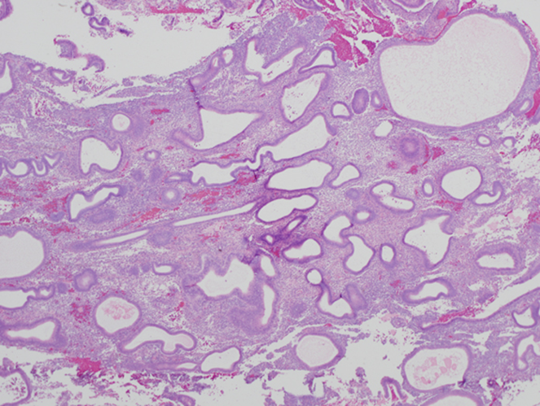
Classification of endometrial hyperplasia Cont.:
Simple hyperplasia: with or without atypia
Complex hyperplasia: with or without atypia
Note: atypia/pleomorphism = loss of polarity, vesicular nuclei, prominent nucleoli and rounded cells.
 | Simple hyperplasia (cystic hyperplasia): glands are variably shaped and sized and cystically dilated with abundant cellular stroma and give a "Swiss Cheese" appearance. Bubble/holes seen in ultrasound. There is a mild increase in the gland-to-stroma ratio These lesions rarely progress to adenocarcinoma Simple hyperplasia may progress to cystic atrophy | 1- Simple hyperplasia without atypia
 | Uncommon. It has the Architecture of simple hyperplasia, but there is cytologic atypia within the grandular epithelial cells. 10% of such lesions progress to carcinoma Normal glands appearance “circular” but there’s an increase in number | 2- Simple hyperplasia with atypia You should immediately think “not good” when you see atypia

Slide 6
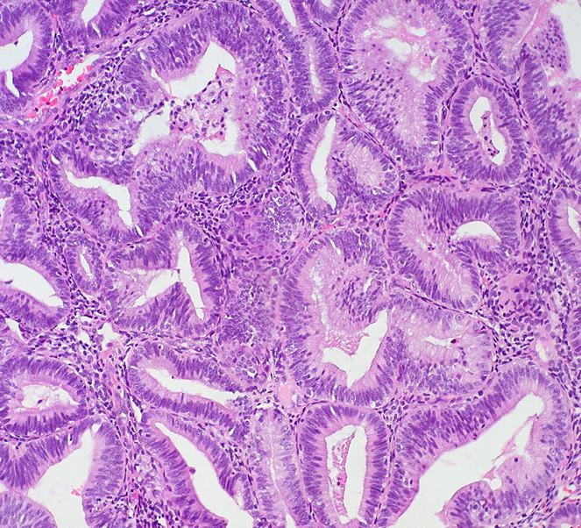
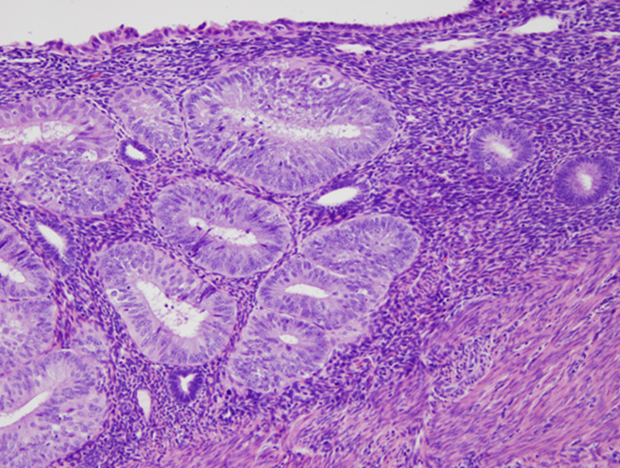
 | Proliferation of endometrial glands resulting in complex crowded glands with papillary infoldings and irregular shapes. The crowded glands are back-to-back with every little intervening stroma. The epithelial cells remain cytologically normal. 3% progression to carcinoma. | 3- Complex hyperplasia without atypia
 | Complex proliferation of endometrial glands (back-to-back irregular glands) with atypia. The nuclei show loss of polarity and are enlarged and rounded and may have irregular nuclear membranes. Commonly about 30% of women with this diagnosis have carcinoma somewhere in the uterus when a hysterectomy is performed butt not necessarily. About 30% progress to carcinoma | 4- Complex hyperplasia with atypia you always have to do hysterectomy in this type because it may not show in the section and you would lose the patient.
Endometrial Hyperplasia: Clinical behavior and premalignant potential:
Some endometrial hyperplasia revert to normal spontaneously or with medical treatment, others persist as hyperplasia, and a few progresses to endometrial adenocarcinoma.
The risks for developing adenocarcinoma in each are as follows:
Simple hyperplasia without atypia — 1%
Complex hyperplasia without atypia — 3%
Simple hyperplasia with atypia (simple atypical hyperplasia) — 10%
Complex hyperplasia with atypia (complex atypical hyperplasia) — 30%
Atypical hyperplasia in postmenopausal women appears to have a higher rate of progression to adenocarcinoma.

Slide 7
Risk Factors of Endometrial Hyperplasia: anything that increases estrogen
Obesity causes imbalance in hormones and alters Estrogen/progesterone ratio .
Western diet (junk food)
Nulliparity (No pregnancy) due to high estrogen exposure. In pregnancy progesterone takes over for 9 months.
Diabetes Mellitus
Hypertension
Hyperestrinism high estrogen , estrin is the precursor of estrogen .
Endometrial Hyperplasia is the platform on which cancer will grow. So endometrial adenocarcinoma will grow from Endometrial Hyperplasia specially from complex Hyperplasia with atypia.

Slide 8
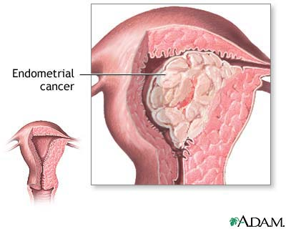
Lesions of Endometrium: Endometrial Carcinoma
Endometrial adenocarcinoma:
This is a common neoplasm in women. Overall it is the fifth commonest cancer in women.
Endometrial cancers arise mainly in pre and postmenopausal women
They cause postmenopausal bleeding
Early detection and cures are possible, we only do hysterectomy and send the patient home, not like other cancers in recurrence.
These tumors are classified into two broad categories:
Type I carcinomas (also known as endometrioid carcinoma): accounts for 80% of endometrial cancers. It is the most common type. e.g.→ endometrioid adenocarcinoma and its variants. This type is related to endometrial hyperplasia and increase in estrogen .
Type II carcinomas: 20% of population and estrogen independent. they are papillary serous carcinoma and clear cell carcinoma. Papillary serous is the more common form of type II carcinoma. Nothing to do with estrogen or hyperplasia.

Slide 9
Type I endometrial carcinoma (endometrioid) carcinoma:
Endometrioid carcinoma is associated with estrogen excess and endometrial hyperplasia. The majority of the carcinomas are well differentiated.
Endometrial hyperplasia is a precursor to endometrioid carcinoma
Risk factors for type I are the same as that of endometrial hyperplasia and include:
Obesity
Western diet
Nulliparity
Diabetes Mellitus
Hypertension
Hyperestrinism
Estrogen therapy
chronic anovulation
Late menopause
Tamoxifen therapy
High socioeconomic status.
The disease may follow atypical hyperplasia but may occur independently of it especially in older patients.
Usual sequence of events in Type I endometrioid carcinoma:
Sometimes you jump to final stage without going throw these sequences events.

Slide 10
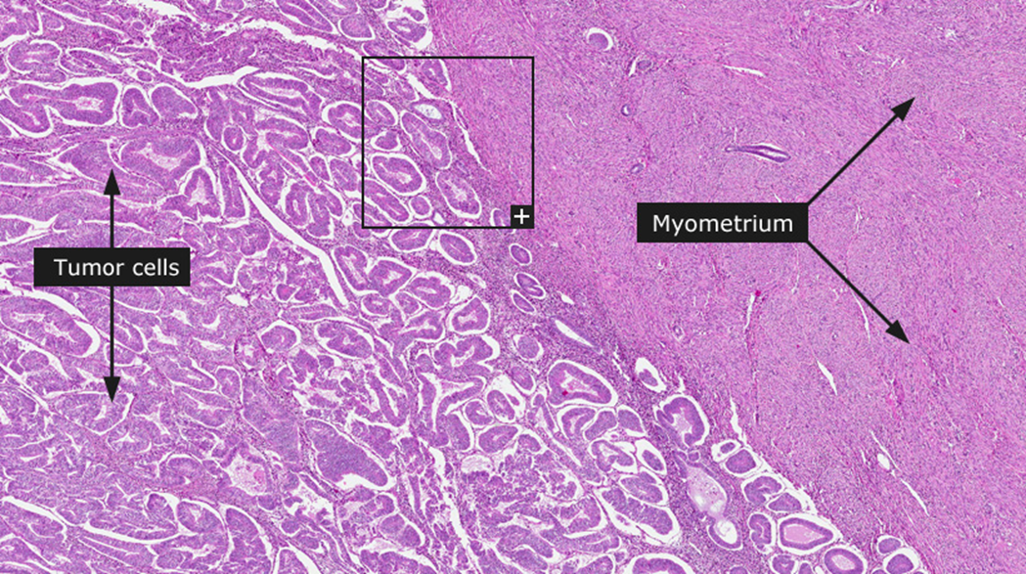
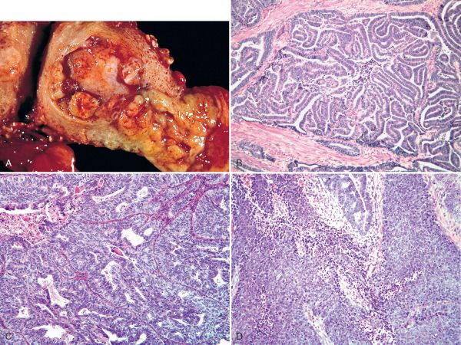
Type I endometrioid carcinoma: genetics:
Majority of endometrioid carcinomas have PTEN gene mutations.
Also there maybe inactivation of DNA mismatch repair genes
p53 mutations is seen in half of the poorly differentiated endometrioid carcinomas.
Endometrial carcinoma:

Slide 11
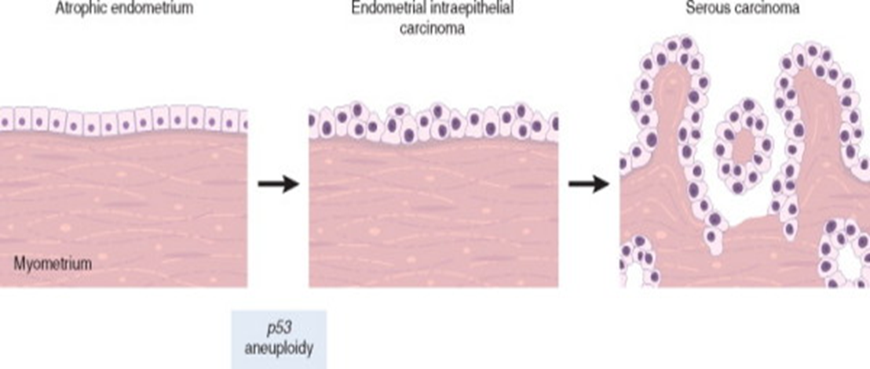
Type II endometrial carcinomas: Serous carcinoma common.
Serous carcinoma arises in older women (60+, which is the opposite of type 1), with endometrial atrophy (small atrophic uterus). In contrary type 1 because of hyperplasia and estrogen.
They occur in late in life, about one decade later than type I carcinoma
There is no association with hyperestrinism (↑ estrogen) or preexisting hyperplasia
They represent 15% of cases of all endometrial carcinoma
Mutations in p53 are present in at least 90% of serous endometrial carcinoma. More in serous than type 1. لو جاء بالإختبار أي نوع يكون فيه ميوتيشن بهذا الجين نختار السيرس لأنه أكثر شيوعًا فيه من اللي قبله.
The precursor of serous carcinoma –if present- is endometrial intraepithelial carcinoma (it’s like carcinoma in situ)it is the stage before serous carcinoma
These tumors are large bulky poorly differentiated tumors which invade early into the myometrium and have a poor prognosis. Extrauterine extension is common.
CHARACTERISTICS OF TYPE I AND TYPE II ENDOMETRIAL CARCINOMAS (differences)
FEATURES | TYPE I | TYPE II
HISTOLOGIC TYPE | Endometriod adenocarcinoma | Serous or clear cell carcinoma
AGE | Premenopausal and perimenopausal (50-60 yrs) | Post menopausal (~ 70 yrs)
UNOPPOSED ESTROGEN | Present | Absent
PRECURSOR LESION | Hyperplasia with atypia | Endometrial intraepithelial carcinoma
GROWTH | Slow growing | Rapidly progressing
GRADE | Low | High
MYOMETRIAL INVASION | Usually superficial | Usually deep
PROGNOSIS | Favorable | Poor
GENETIC ALTERATIONS NOTED | PTEN, microsatellite instability | P53 mutations

Slide 12
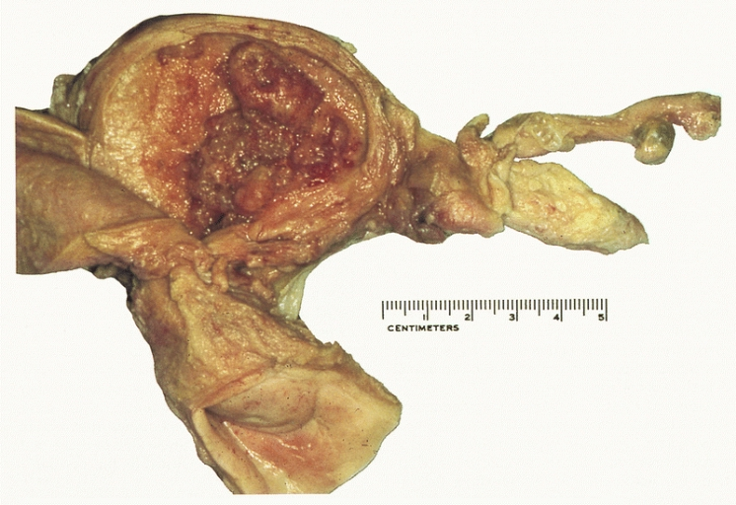
Clinical features of Endometrial Adenocarcinoma:
Most patients are between 50 and 60 years.
Many of the patients tend to be nulliparous and obese.
Patients have abnormal vaginal bleeding and excessive leucorrhea¹. (whitish or yellowish discharge of mucus from the vagina).
Elderly women present with postmenopausal bleeding.
The diagnosis of endometrial cancer must be confirmed by biopsy or curettage² and histologic examination of the tissue.
Basic morphology of Endometrial Carcinoma:
Grossly:
May look close to normal or exophytic or infiltrative
Microscopy:
Both type I and II are adenocarcinomas.
In both cases tumors originate in the endometrium and can eventually infiltrate the underlying myometrium, enter vascular spaces and metastasize to lymph nodes.
Serous carcinoma has much greater cytologic atypia and are more poorly differentiated and is therefore more aggressive
Tumor spreads by:
Direct myometrial invasion with extension to the periuterine structures. Like the Cervix, Vagina, Bladder & Rectum.
Through lymphatics to lymph nodes
In the late stages, metastasize to the lungs, liver, bones, others
1:Leucorrhea: excessive leukocytes in the vaginal discharge
2:to scrape the uterus for a sample .

Slide 13
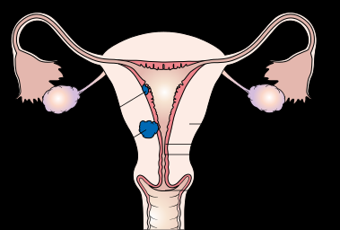
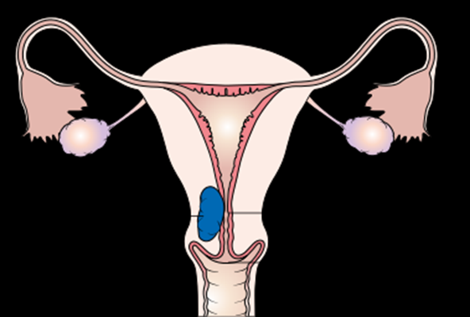
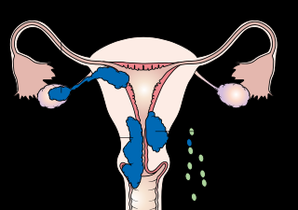
Prognosis of Endometrial Adenocarcinoma:
Clinical behavior of endometrial adenocarcinoma depends on the histologic type, the grade (degree of differentiation) and the stage (extent of spread).
Endometrioid carcinoma (type I) has a better prognosis than the other histologic types.
Serous carcinomas (type II) have poorer prognosis
Stage (how far does it go? Like lungs or bones) is the major determinant of survival.The rate of extension
How endometrial carcinoma can spread : (stages 1, 2 and 3 of endometrial carcinoma)
Stage 1
Stage 2
Stage 3
Stage 1 > (uterine) hysterectomy
Stage 2 > (uterine + lymph nodes) hysterectomy + chemotherapy
Stage 3 > Imaging >
(if only uterine + lungs + liver) still a chance with chemotherapy
(if reached bones) dead end
والشفاء بيد الله

Slide 14
Lesions of Myometrium: Leiomyoma
1- LEIOMYOMA (fibroid) of uterus:
Leiomyoma is a benign tumor of smooth muscle origin.
It is the most common neoplasm of the female genital tract and probably the most common neoplasm in women.
The tumor is estrogen responsive. Estrogen stimulates their growth. Leiomyomas often increases in size during pregnancy and decrease in size after menopause (because Estrogen levels ↓).
About 40% of leiomyomas have an associated chromosomal abnormality
They are benign tumors with no appreciable malignant potential (incidence of malignant transformation to sarcoma is 0.1-0.5%) so we only treat the patient if she has bad symptoms.
Clinical features:
It can be single or multiple (mostly multiple).
Irregular abnormal bleeding and sometimes pelvic pain.
It may cause anemia from heavy bleeding.
Can have urinary frequency if the fibroid is compressing the urinary bladder (mainly if the tumor was in the cervix).
It may interfere with implantation and therefore cause infertility.
In pregnant women it may cause abortion, obstructed labor, post partum hemorrhage etc.
Alternatively it maybe entirely asymptomatic

Slide 15
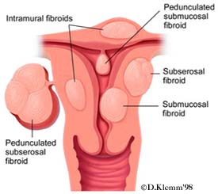
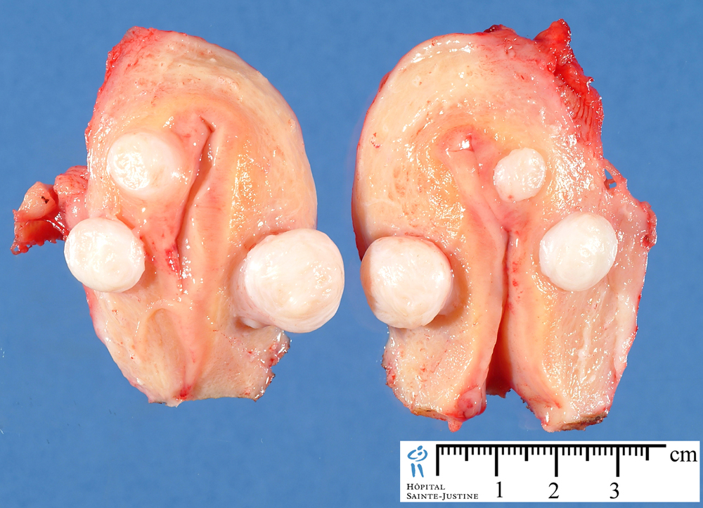
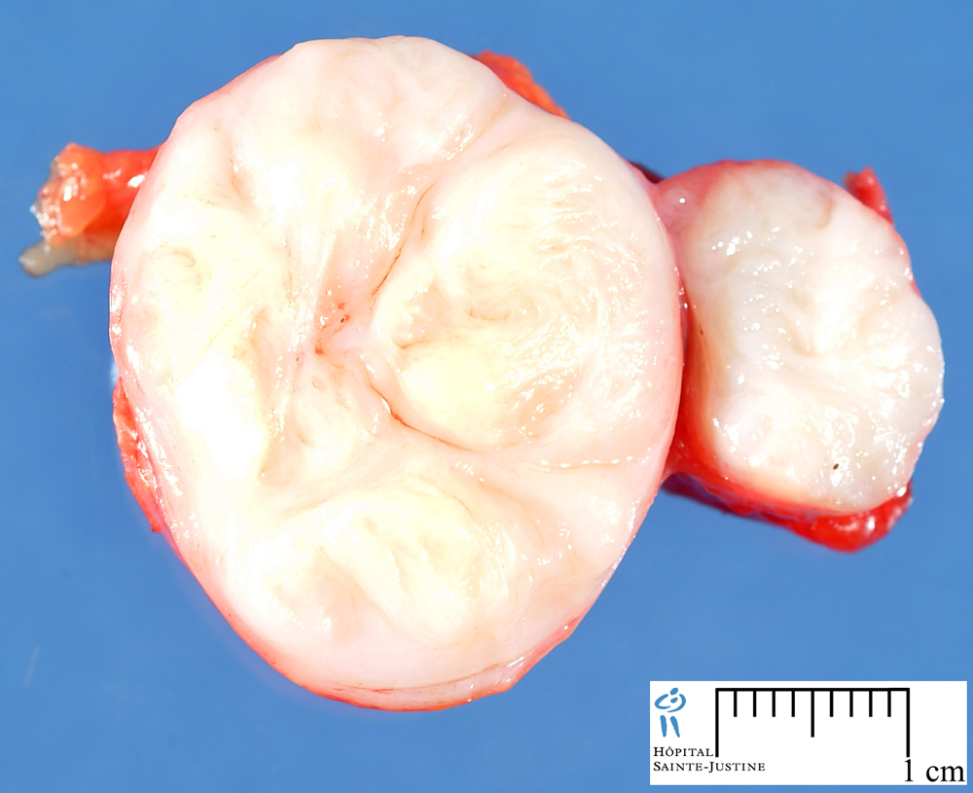
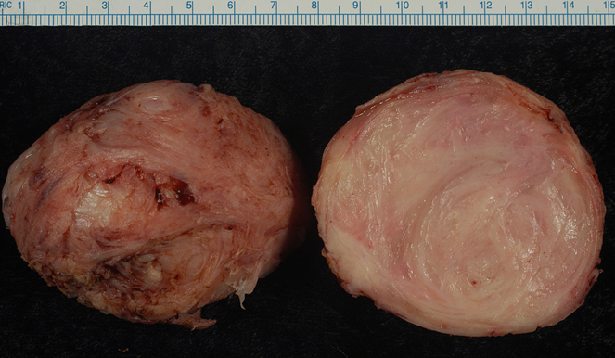
Uterine Leiomyoma:
Leiomyoma may be located anywhere in the myometrium:
Submucosal tumors are present immediately below the endometrium. (present with heavy bleeding because it irritate the endometrium).
Intramural tumors, the most common, lie within the myometrium. (No symptoms. Discovers by accidental findings)
Subserosal fibroids lie beneath the serosal surface of the uterus or are pedunculated and attached to the serosa.
Pedunculated ones may loose their connection to the uterus forming a "parasitic leiomyoma” (it's benign proliferation of smooth muscle cells found floating in the pelvic cavity).
Gross features of Leiomyoma:
Well circumscribed, spherical, dense and firm-to-hard masses.
Cut section shows whorled, tan-white cut surfaces.reminds you of fibroma huh?
FOCUS ON KEYWORDS HERE! Specially whorled.

Slide 16
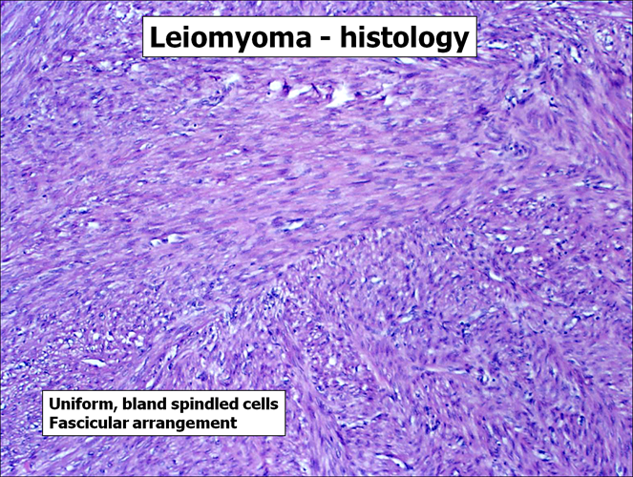
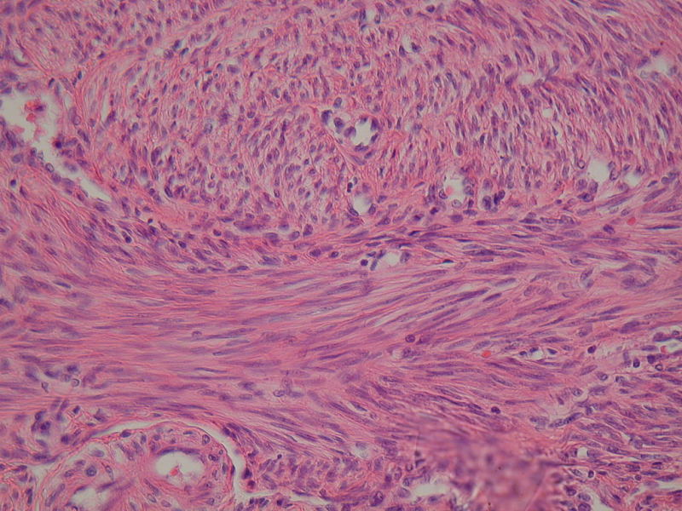
Leiomyoma:
Microscopically, there are interlacing (crossing) bundles of smooth muscle cells with collagenous stroma between bundles.
The individual muscle cells are uniform in size and shape.
They have the characteristic oval to elongated nucleus.
Mitotic figures are scarce.
No necrosis, No atypia, No mitosis. If there is, then it’s leiomyosarcoma.
Lesions of Myometrium: Leiomyosarcoma
2- Leiomyosarcoma:
It is the malignant tumor of the smooth muscle.
It is rare.
Sites include the uterus and soft tissue
Poor prognosis because it spreads very fast.

Slide 17
Extra: Notes from Robins basic pathology
In endometrial hyperplasia the risk of developing carcinoma is related to the presence of cellular atypia
In endometrial hyperplasia , Acquisition of PTEN mutations is believed to be one of several key steps in the transformation of hyperplasia to endometrial carcinoma.
Mutations in mismatch repair genes and the tumor suppressor gene PTEN are early events in the stepwise development of endometrioid carcinoma.
Women with germline mutations in PTEN (cowden syndrome) are at high risk for endometrial carcinoma.
Endometroid carcinomas include a range of histological types , including those showing mucinous , tubal (ciliated) , and squamous (occasionally adneosquamous) differentiation.
Serous carcinomas , form small tufts and papillae , rather than the glands seen in endometerioid carcinoma, and exhibit much greater cytological atypia.
Leiomyomas are monocolonal tumors associated with different chromosomal abnormalities including rearrangement of chromosomes 6 and 12.
Leiomyosarcomas are almost always solitary and most often occur in postmenopausal women.
Leiomyosarcomas are soft , hemorahgic , necrotic mases.
The diagnosic features of overt leiomyosarcoma include tumor necrosis , cytological atypia and mitotic activity.

Slide 18
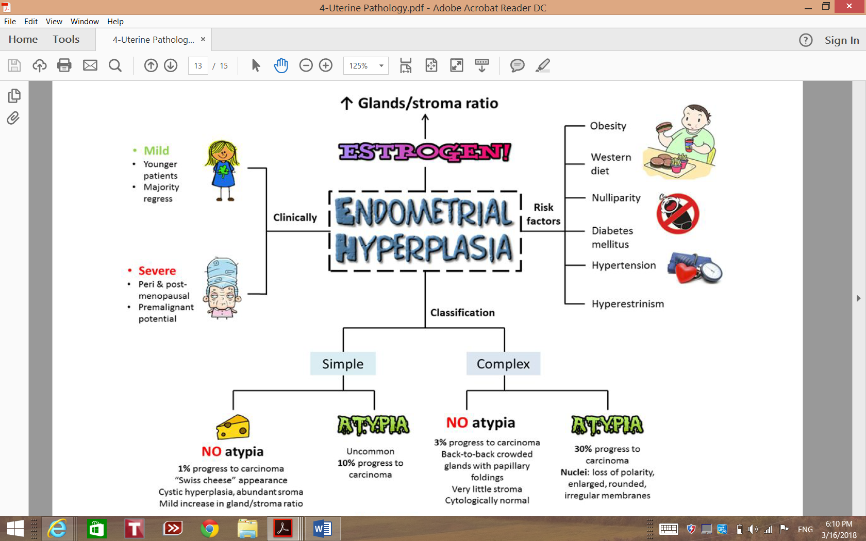
Summary

Slide 19
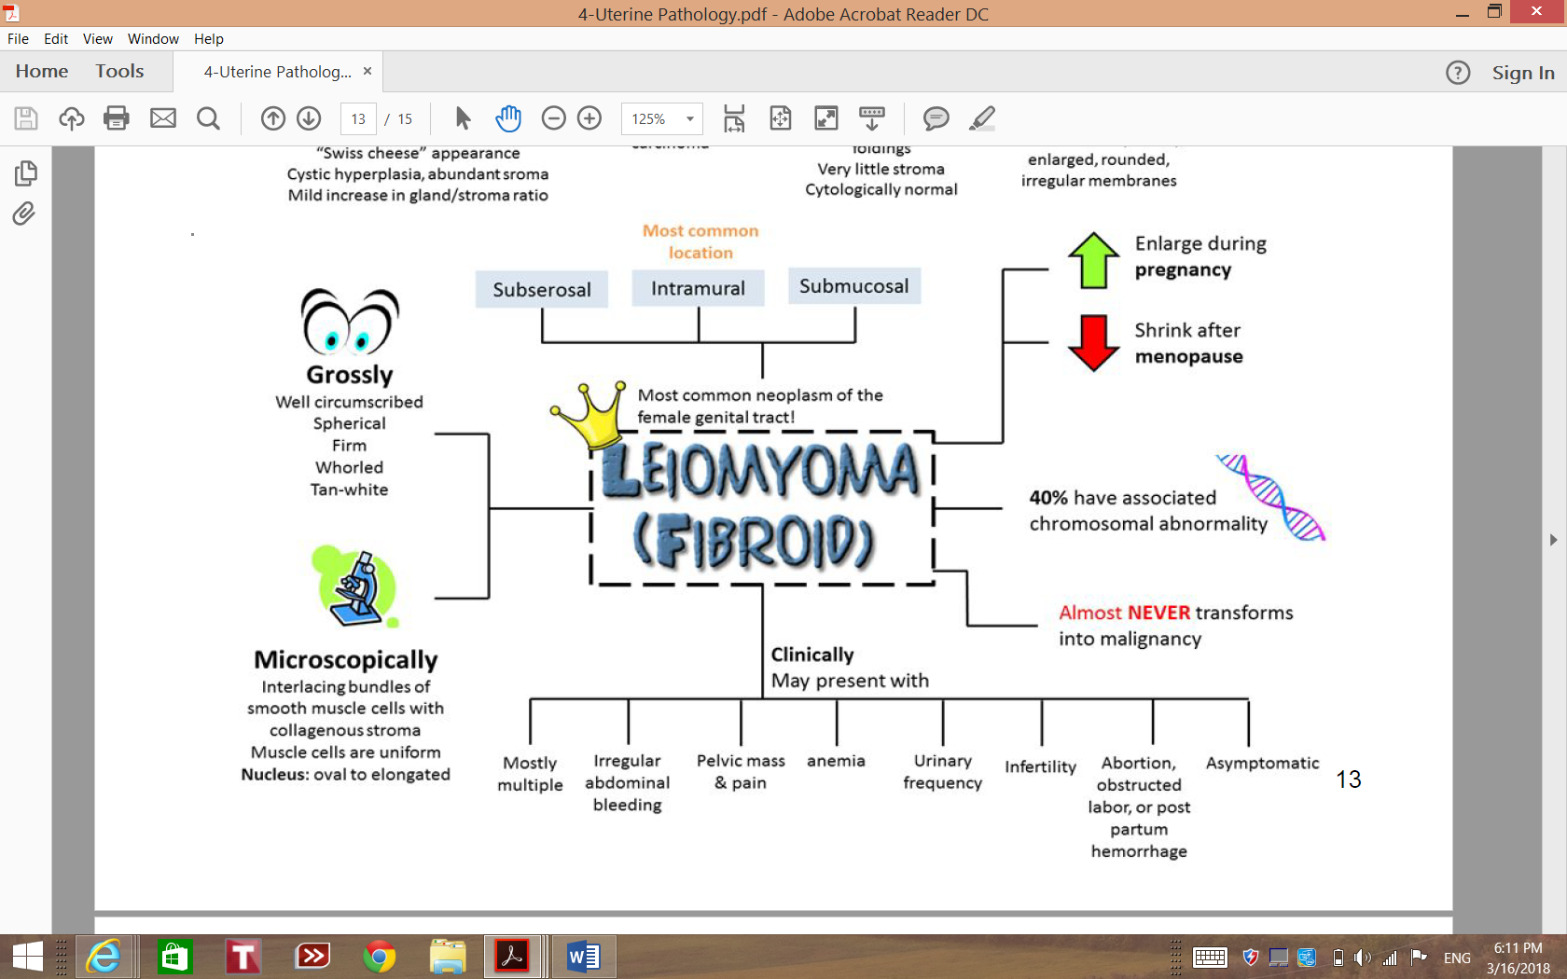
Summary

Slide 20
Questions
1- Severity of Endometrial hyperplasia is classified according to which of the following?
A- Mitotic figures.
B- Anaplasia.
C- Microvascular proliferation.
D- Cytologic Atypia.
ANS: D
2- A lady present with dysfunctional uterine bleeding, a mass was found in the muscle. Cut surface showed gray-white whorled areas. What is most probably the diagnosis of this case?
A- Endometrial hyperplasia
B- Endometrial carcinoma
C- Leiomyoma
D- Leiomyosarcoma
ANS: C
3- Which of the following is the most common benign tumor in females?
A- Leiomyoma.
B- Lipoma.
C- Thecoma.
D- Brenner tumor.
ANS: A
4- Obesity, Hypertension and diabetes are risk factors for Endometrioid carcinomas. Why is that?
A- They are part of Metabolic syndrome.
B- They increase estrogen levels.
C- They decrease mortality.
D- A&C.
ANS: B

Slide 21
Questions
5- A 65-year-old female presented to the hospital with intermittent post-menopausal vaginal bleeding. Ultra-sound showed a mass in the uterus, Biopsy and histopathological examination showed small tufts and papillae. Genetic studies revealed high levels of P53 mutation. What is the most likely diagnosis ?
A- Leiomyosarcoma.
B- Endometrioid.
C- Serous carcinoma of the endometrium.
D- Leiomyoma.
ANS: C
6- A 62-year-old obese, nulliparous woman has an episode of vaginal bleeding, which produces only 5 mL of blood. A Pap smear shows cells consistent with adenocarcinoma. Which of the following preexisting conditions is most likely to have contributed to the development
of this malignancy?
A- Leiomyoma.
B- Endometrial hyperplasia.
C- Chronic Endometritis.
D- Adenomyosis.
ANS: B
7- A well differentiated Leiomyosarcoma can be told apart from leiomyoma by?
A- Capsular invasion.
B- Immunohistochemistry.
C- Necrosis.
D- Vascular invasion.
ANS: C

Slide 22
حسبي الله لا إله إلَّا هو عليه توكلت وهو رب العرش العظيم.
الأعضاء
عبدالمجيد العمار
ابراهيم الفتياني
محمد الكحيل
فهد الزهراني
خالد العيدان
محمد اليوسف
عمر المغير
نورة السهلي
القادة
حنين السبكي
هبة الناصر
عبدالله أبو عمارة
Editing File
Email: pathology436@gmail.com Twitter: @pathology436
References: Doctor’s slides + notes, Robbins basic pathology 10th edition.

