Slide 1
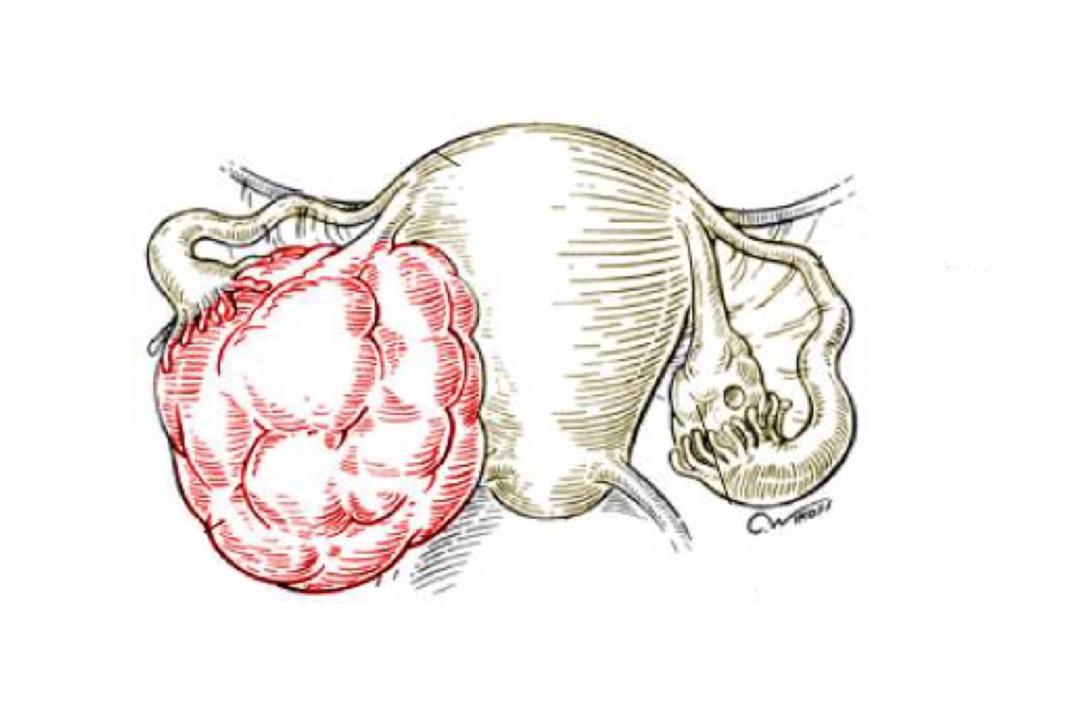
Prostate pathology
Objectives:
At the end of this lecture, the student should be able to:
Understand the basic anatomical relations and zones of the prostatic gland.
Know the epidemiology, pathogenesis and histopathologic features of:
Benign prostatic hyperplasia
Carcinoma of the prostate
• Black: Doctors’ slides. • Red: Important! • Light Green: Doctors’ notes • Grey: Extra. • Italic black: New terminology.

Slide 2
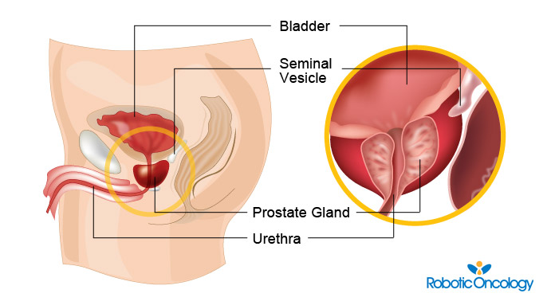
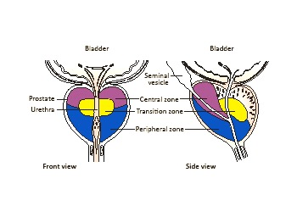
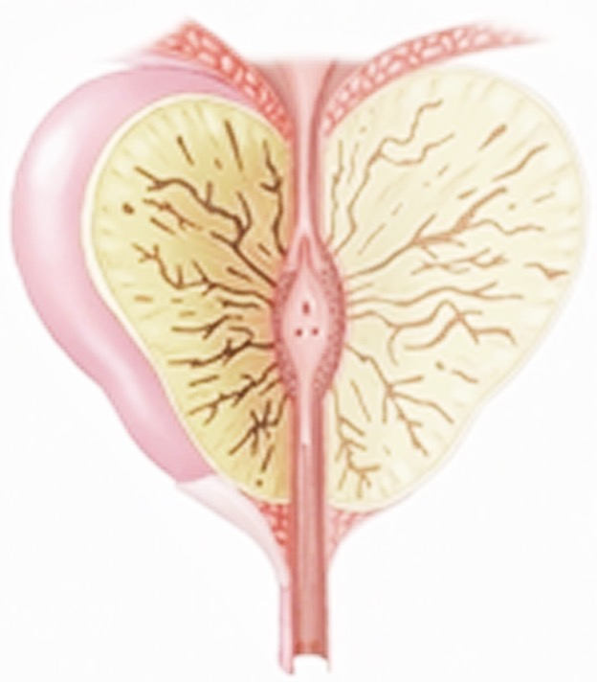
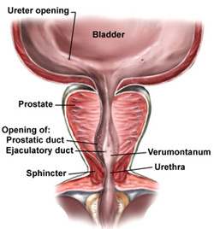
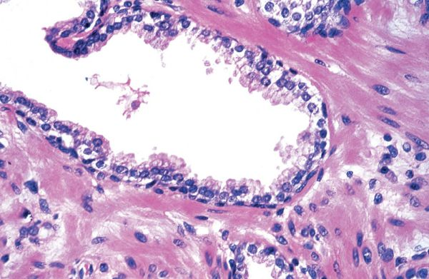
Understand the basic anatomical relations and zones of prostatic gland
Prostate Anatomy:
Prostate weighs 20 grams in a normal adult.
It is a retroperitoneal organ, encircling the neck of the bladder and urethra.
Devoid (doesn’t have) a distinct capsule.
The prostate is divided into different zones. They are central, peripheral and transitional zones. The transitional zone is the middle area of the prostate, between the peripheral and central zones. It surrounds the urethra as it passes through the prostate.
Majority of prostate cancers (Adenocarcinomas) are found in the peripheral zone and benign nodular hyperplasia in the transitional zone.
Microscopically: The prostate is a tubulo-alveolar organ.
The prostate glands are lined by two layers of cells, basal cells or myoepithelial cells and simple epithelial columnar secretory cells, may become simple squamous when it’s irritated.
In malignancy, myoepithelial cells disappears.
Normal prostate histology:
The prostate is located inferior to the bladder and surrounds its neck, and prostatic urethra pass through it. Posteriorly the rectum is present.
Bi-layerd:
1- Epithelial cells.
2- Myoepithelial cells.

Slide 3
IMPORTANT POINTS YOU NEED TO KNOW
All the pictures here are extra*
The normal prostate contains several distinct regions, including a central zone (CZ), a peripheral zone (PZ), a transitional zone (TZ), and a periurethral zone.
Compression of the urethra would happen more in nodular hyperplasia in the transitional or the central zones than in carcinoma in the peripheral zone, but it could happen in carcinoma of the peripheral zone if the tumor progresses later on.
Veins of prostate gland drain into internal iliac veins which is continuous posteriorly with the internal vertebral venous plexus, that’s why the most common areas of hematogenous metastasis are the brain and vertebral column.
We have 2 methods for taking prostatic needle biopsy:
1)Per-rectal biopsy: in this method we go through the rectum and insert a needle to the prostate and take the biopsy. This method can only be used to take a biopsy from the peripheral zone.
2)Transurethral biopsy: in this method we go through the urethra and insert a needle to the prostate and take the biopsy from the transitional and central zones. This can also be done in prostatic resection of transitional and central zones.

Slide 4
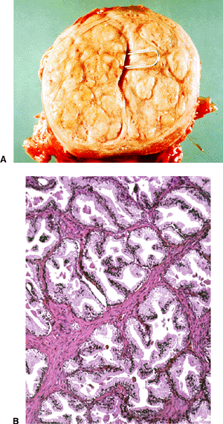
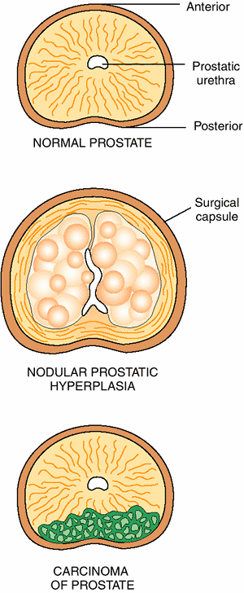
Know the epidemiology, pathogenesis and histopathologic features of benign prostatic hyperplasia
Benign Prostatic Hyperplasia (BPH):
Also known as benign nodular hyperplasia.
Epidemiology:
Extremely common lesion in men over the age of 50.
About 20% men have BPH by the age of 40.
About 70% men have BPH by the age of 60.
About 90% men have BPH by the age of 80.
Hyperplasia of glands and stroma results in nodular enlargement in the periurethral (central) region¹ of the prostate.
Once the nodules become large, they compress the prostatic urethra causing either partial, or complete obstruction of the urethra. Symptoms: urinary retention, incomplete emptying, constant feeling of wanting to go to the bathroom, frequent urination.
Nodular hyperplasia is not a premalignant lesion (it doesn’t progress and become malignant).
Pathogenesis:
The essential cause of BPH is unknown.
The pathogenesis is related to the action of androgens:
Dihydrotestosterone (DHT) (The active form of testosterone) is the ultimate mediator for the prostatic growth. It increases the proliferation of stromal cells and inhibits epithelial cell death. Therefore, DHT is implicated in the pathogenesis of both benign prostatic hyperplasia (BPH) and prostate cancer.
Testosterone is converted to dihydrotestosterone (DHT) by 5-alpha reductase enzyme.
Therefore, drugs that act as inhibitors of 5-alpha reductase have an important role in the prevention and treatment of BPH and prostate cancer.
Prepubertal castration² prevents BPH (no testosterone).
Narrow prostatic urethra
1:Where the transitional zone of prostate is located.
2:The removal of the testicles of a male animal or man.

Slide 5
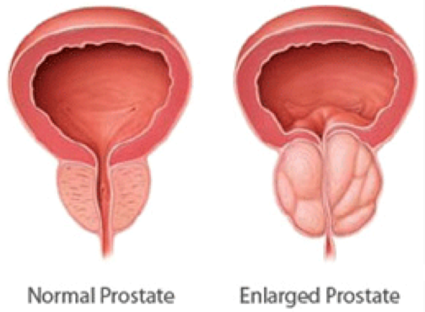
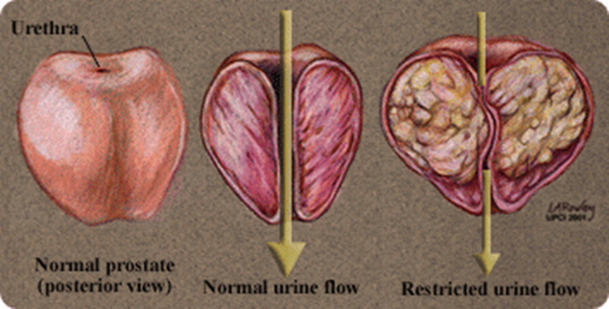
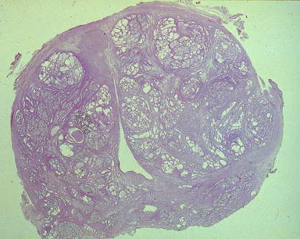
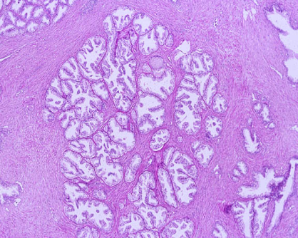
Benign Prostatic Hyperplasia
Gross Morphology | Microscopy
1. The prostate weighs between 60 and 100 grams | 1. Microscopically, the main feature of BPH is nodularity
2. The hallmark of BPH is nodularity due to glandular and fibro-muscular proliferation. | 2. The nodules can be:
 | purely stromal nodules composed mainly of fibromuscular element | Fibroepithelial with both glandular and fibromuscular component. There is aggregation of small to large to cystically dilated glands, lined by two layers of epithelium surrounded by fibromuscular stroma. (that’s how we know it isn’t malignancy because it is double layered).
3. Nodular hyperplasia begins in the inner aspect of the prostate gland, the transition zone
4. It compress the wall of the urethra resulting in a slit-like orifice.
5. Cut-section shows nodules which vary in size, color and consistency depending on which element is proliferating more (glandular or fibro-muscular). | 3. Needle biopsy doesn’t sample the transitional zone where BPH begins and occurs, therefore the diagnosis of BPH cannot be made on needle biopsy (needle biopsy is done for carcinoma).
Nodular hyperplasia

Slide 6
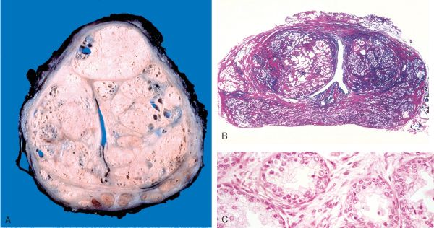
Clinical Features:
The nodule compress the prostatic urethra → urethral obstruction → leads to retention of urine in the bladder → bladder dilatation & hypertrophy.
The inability to empty the bladder completely leads to increase volume of residual urine → therefore infection.
Increased urinary frequency.
Nocturia (go to bathroom every 40 mins).
Difficulty in starting and stopping the stream of urine.
Dysuria.
Some patients present with acute urinary retention. Acute urinary retention: severe pain in the pubic area and once the catheter is inserted the patient is relieved.
Treatment:
Mild cases of BPH may be treated with α-blockers and
5-α-reductase inhibitors.
Moderate to severe cases require transurethral resection of the prostate (TURP).
Going through the transurethral approach and remove prostatic tissue, so the compression is relieved.
- Whole gland with dilated cysts.
- Bilayerd epithelium (epithelial and myoepithelial): Benign.

Slide 7
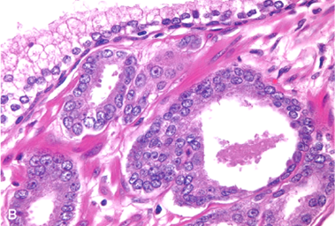
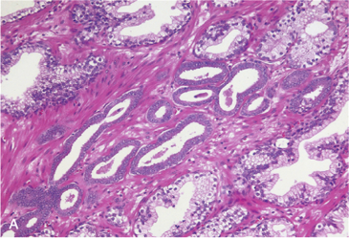
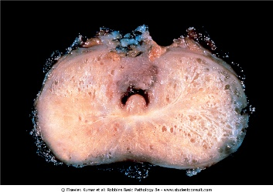
Know the epidemiology, pathogenesis and histopathologic features of carcinoma of the prostate
Prostatic Adenocarcinoma:
A common form of cancer in men.
Disease of men over the age of 50.
More prevalent among African American, but also common here in Saudi Arabia.
These tumors show a wide range of clinical behaviors.
Etiology: Several risk factors including:
Age.
Race.
Family history.
Hormone level (androgens)
Environmental factors.
Androgens are believed to play a major role in the pathogenesis
Morphology | Microscopy
70% arise in the peripheral zone in the posterior part of the gland. Which is the closest to the rectum. Tumor is firm, gritty and is palpable on rectal exam. Normally: the prostate has a smooth surface and it’s not very solid. Spreads by direct local invasion and through blood stream and lymphatics. Local extension most commonly involves the periprostatic tissue, seminal vesicles and the base of the urinary bladder (leading to ureteral obstruction. | Histologically, most lesions are adenocarcinomas that produce well-defined gland patterns. The malignant glands are lined by a single layer of cuboidal or low columnar epithelium with large nuclei and one or more large nucleoli. Nuclear pleomorphism is not marked. The outer basal cell layer typical of normal gland is absent. Commonly there is perineural invasion.
- Here the myoepithlial layer disapeared.

Slide 8
Prostatic Adenocarcinoma:
Metastasis first spread via lymphatics: initially to the obturator nodes and eventually to the para-aortic nodes.
Hematogenous extension occurs chiefly to the bones. Especially vertebrae
The bony metastasis are typically osteoblastic

Slide 9
Grading Prostatic Adenocarcinoma:
Gleason Grading & Scoring:
Gleason system is a histological grading and scoring system for prostatic adenocarcinoma done on the microscopic level.
There are five grades (1 to 5) depending on the degree and pattern of differentiation as seen microscopically (in which they range from, grade 1=well-differentiated to grade 5=very poorly differentiated).
Prostate carcinomas usually have more than one type of grade in the tumor mass. The two most common types of grades seen in the biopsy for each cancer patient are added and the final sum is called the Gleason score.
Gleason Grading and Scoring in prostate cancer is very useful in predicting the prognosis of a patient.
Staging Prostatic Adenocarcinoma:
Staging in prostate cancer depends on the TNM system. It is the most important indicator of prognosis. Actually the prostatic cancer have very good prognosis in good medical care
Staging depends on the extent (metastasis) of the tumor.
Highly recommended!
Explanation:
How do pathologists measure Gleason Score?
In routine check-up we screen the patient for prostatic specific antigen (PSA) level in the serum, if it is high and we suspect malignancy, we send the patient for prostate biopsy
First they take at least 6 biopsies from different sites of the tumor and grade each one of them from 1-5 depending on the pattern of cells differentiation under the microscope, then they sum up the most common 2 grades together which represent the final Gleason Score which could be from 2-10, the higher the number the more bad the tumor is.
For example:
Biopsies from a prostatic tumor represent the following:
Biopsy 1: grade 2
Biopsy 2: grade 2
Biopsy 3: grade 2
Biopsy 4: grade 4
Biopsy 5: grade 3
Biopsy 6: grade 3
Then the final Gleason Scoring would be (placing the predominant grade first): 2 + 3 = 5.
And if all the biopsies have the same grade (for example 3) then Gleason score would be 3 + 3 = 6.

Slide 10
Clinical features of Prostatic Adenocarcinoma:
Microscopic (or very small size) cancers are asymptomatic and are discovered incidentally.
Most arise in the peripheral zone, away from the urethra and therefore the urinary symptoms occur late.
Occasionally, patients present with back pain caused by vertebral metastasis.
Careful digital rectal examination may detect some early cancers.
PSA (Prostate specific antigen) levels are important in the diagnosis and management of prostate cancer. However, a minority and early stages of prostate cancers may have low PSA.
PSA is organ specific but not cancer specific because it could be increased in BPH and prostatitis.
A transrectal needle biopsy is required to confirm the diagnosis.
Treatment:
Surgery, radiotherapy and hormonal therapy.
90% of treated patients are expected to live for 15 years.
Currently, the most acceptable treatment for clinically localized cancer is radical surgery.
Locally advanced cancers can be treated by radiotherapy and hormonal therapy. Hormonal therapy (Anti-androgen therapy) can induce remission.
Advanced, metastatic carcinoma is treated by androgen removal treatment, either by orchiectomy or by hormonal anti-androgen therapy.
The prognosis depends on the Gleason score and stage of tumor.
Sometimes after the removal of the prostate the patient come after 2 years with high PSA levels, it means it is coming from the metastatic lesion.
Sometimes you can’t locate the metastatic cells, so you treat by anti-androgen therapy.
Prostatic intraepithelial neoplasia (PIN):
PIN is the precursor lesion for invasive carcinoma(you only need to know this). It can be low grade PIN or high grade PIN.
High grade PIN is like carcinoma in situ.
PIN like prostatic carcinoma occurs in the peripheral zone.

Slide 11
Summary
Benign Prostatic Hyperplasia
Also known as benign nodular hyperplasia Extremely common lesion in men over age 50.
Pathogenesis | The pathogenesis is related to the action of androgens Testosterone is converted to dihydrotestosterone (DHT) by 5-alpha reductase enzymes.
Gross morphology | The hallmark of BPH is nodularity due to glandular and fibro-muscular proliferation
Microscopy | Stromal nodules: fibro-epithelial with both glandular and fibromuscular component
Diagnosis | Dihydrotestosterone (DHT) is the ultimate mediator for prostatic growth.
Clinical features | Nocturia Dysuria Urgency Some patients present with acute urinary retention
Treatment | Mild cases: α-blockers and 5-α-reductase inhibitors Moderate to severe cases: require transurethral resection of the prostate (TURP)
Prostatic Adenocarcinoma
The a common form of cancer in men Disease of men over age 50 More prevalent among African Americans
Gross morphology | Tumor is firm and gritty and is palpable on rectal exam Spread by direct local invasion and through blood stream and lymphatics
Microscopy | Malignant glands are lined by a single layer of cuboidal or low columnar epithelium with large nuclei and one or more large nucleoli. Basal cell layer typical of benign glands is absent Peri-neural invasion
Diagnosis | PSA (Prostate Specific Antigen) levels are important in the diagnosis and management of prostate cancer. A trans-rectal needle biopsy is also required
Clinical features | Asymptomatic and are discovered incidentally Urinary symptoms occur late Back pain caused by vertebral metastases
Risk factors | Age Race Family history Hormone level (androgens) and environmental influences
Treatment | Surgery Radiotherapy Hormonal therapy

Slide 12
Questions
Q1) How to confirm the diagnosis of prostatic adenocarcinoma?
Transurethral resection of the prostate.
Per-rectal examination
Transrectal needle biopsy
ANS: C
Q2) A 67 year old man is found to have a single, hard, irregular nodule within his prostate on rectal examination. A biopsy of this lesion reveals the presence of small glands lined by a single layer of cells with enlarged, prominent nucleoli. From what portion of the prostate did this lesion most likely originate?
Transitional zone
Periphral zone
Periurethral zone
Central zone
ANS: B
Q3) The essential cause of Benign Prostatic Hyperplasia is:
Environment
Genetics
Unknown
Infection
ANS: C
Q4) In BPH, which of the following would lead to urethral obstruction?
Bladder hypertrophy
Kidney failure
Pyelonephritis
Nephrotic syndrome
ANS: A
Q5) Mild cases of BPH may be treated with:
Alpha-blockers
5-alpha-reductae inhibitors
5-alpha-reductase agonists
Both A+B
ANS: D

Slide 13
Questions
Q6) The diagnosis of BPH can be made with a per-rectal needle biopsy.
True
False
ANS: B
Confirmatory diagnosis of prostatic adenocarcinoma is made by per-rectal needle biopsy.
Q7) What is the most common location of benign prostatic hyperplasia?
Peripheral zone
Transitional zone
None of the above
ANS: B
Q8) What is the most common location of prostatic adenocarcinoma?
Peripheral zone
Transitional zone
None of the above
ANS: A
Q9) Microscopic examination of a prostatic adenocarcinoma shows glands that have two layers.
True
False
ANS: B
Q10) 60 years old man comes to the clinic complaining of back pain. His scan shows metastasis to the vertebrae. What is the most likely site of primary tumor?
Kidney
Liver
Bladder
Prostate gland
ANS: D

Slide 14
Questions
Q11) Which of the following is the most important mediator of BPH?
A- Estrogen.
B- DHT.
C- Testosterone.
D- DHET.
ANS: B
Q12) 50-year-old male came to the hospital for a routine check up. He was found to have a prostatic cancer. What was the most likely way of diagnosing it?
A- Digital rectal examination.
B- Elevated PSA level.
C- Elevated DHT levels.
D- Low sperm count.
ANS: B
Q13) Which of the following is a limitation of the test used in the previous question?
A- Non-organ specific.
B- Non-cancer specific.
C- Causes infertility.
D- Inadequate for follow up.
ANS: B

Slide 15
حسبي الله لا إله إلَّا هو عليه توكلت وهو رب العرش العظيم.
الأعضاء
العنود أبوحيمد
لمى التميمي
أمل القرني
ريما الشايع
حنين باشيخ
عبدالمجيد العمار
القادة
حنين السبكي
هبة الناصر
عبدالله أبو عمارة
Editing File
Email: pathology436@gmail.com Twitter: @pathology436
References: Doctor’s slides + notes, Robbins basic pathology 10th edition.

