Slide 1


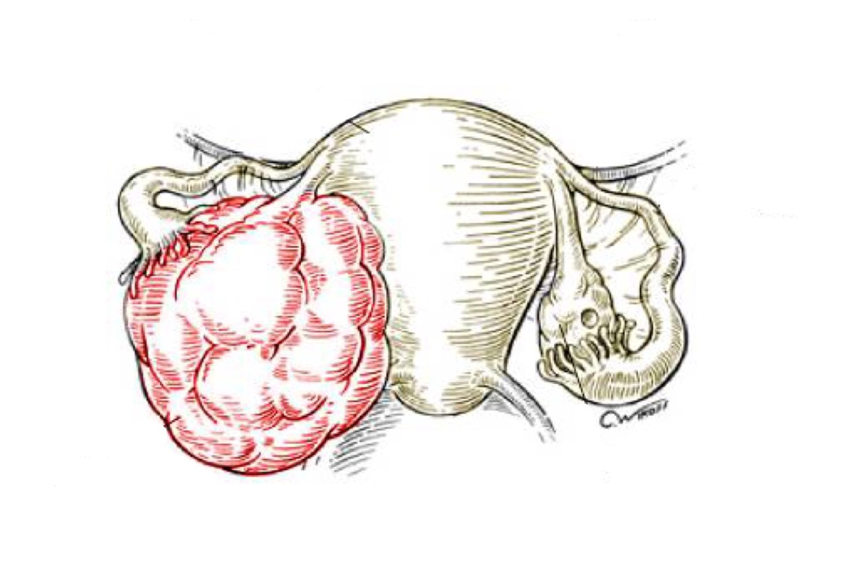
Testicular Pathology
Objectives:
Have a working knowledge of the normal histology of the testis and epididymis.
Know the predisposing factors and pathology of epididymitis.
Epididymitis and orchitis: Non specific Epididymitis and orchitis, Granulomatous/Autoimmune Orchitis, Gonorrhea, Tuberculosis.
Testicular tumors: Seminoma, yolk sac tumor, embryonal carcinoma, Teratoma, choriocarcinoma.
• Black: Doctors’ slides. • Red: Important! • Light Green: Doctors’ notes • Grey: Extra. • Italic black: New terminology.

Slide 2
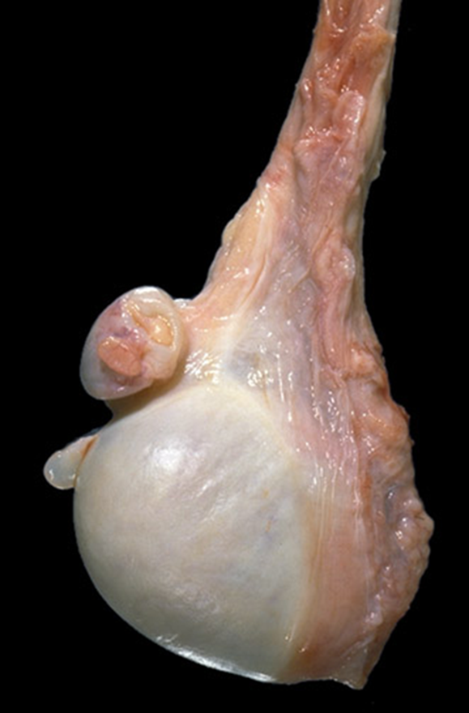
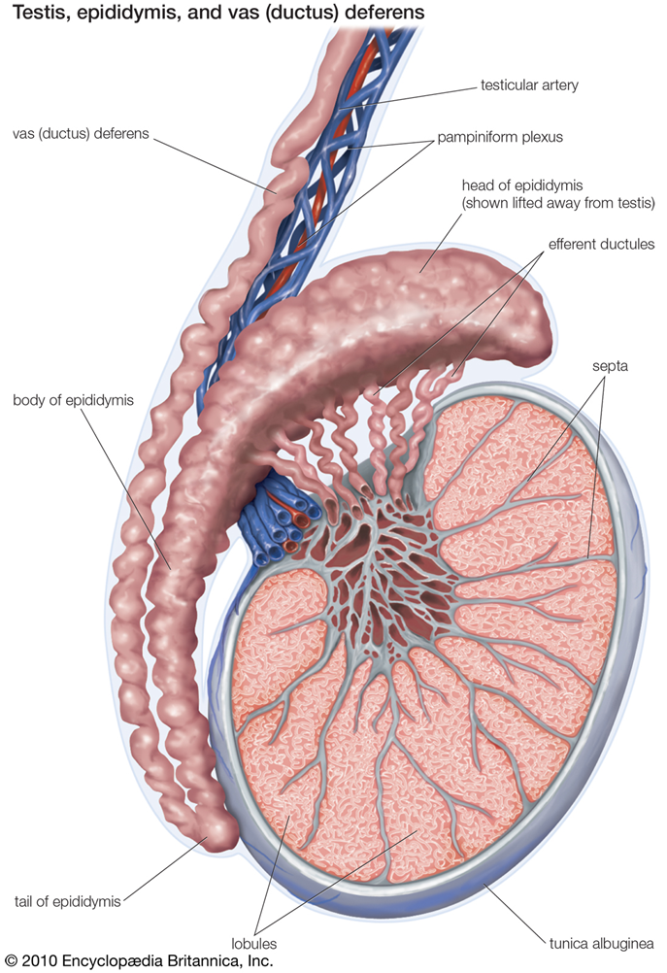
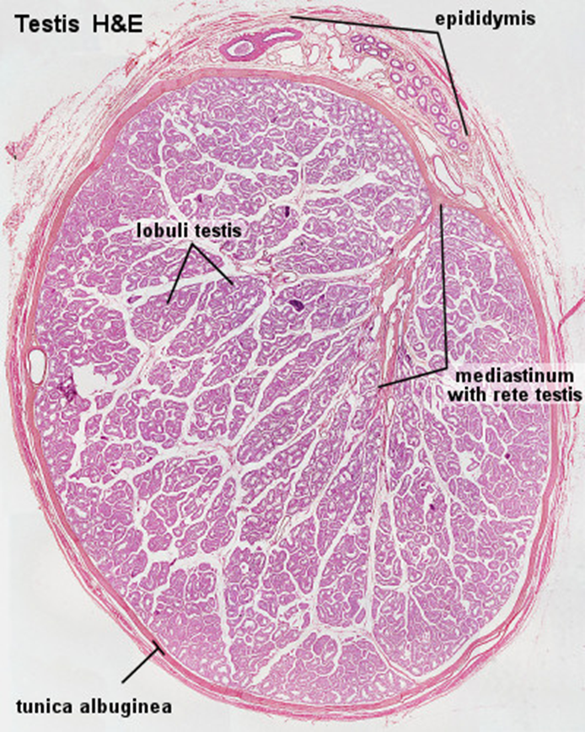
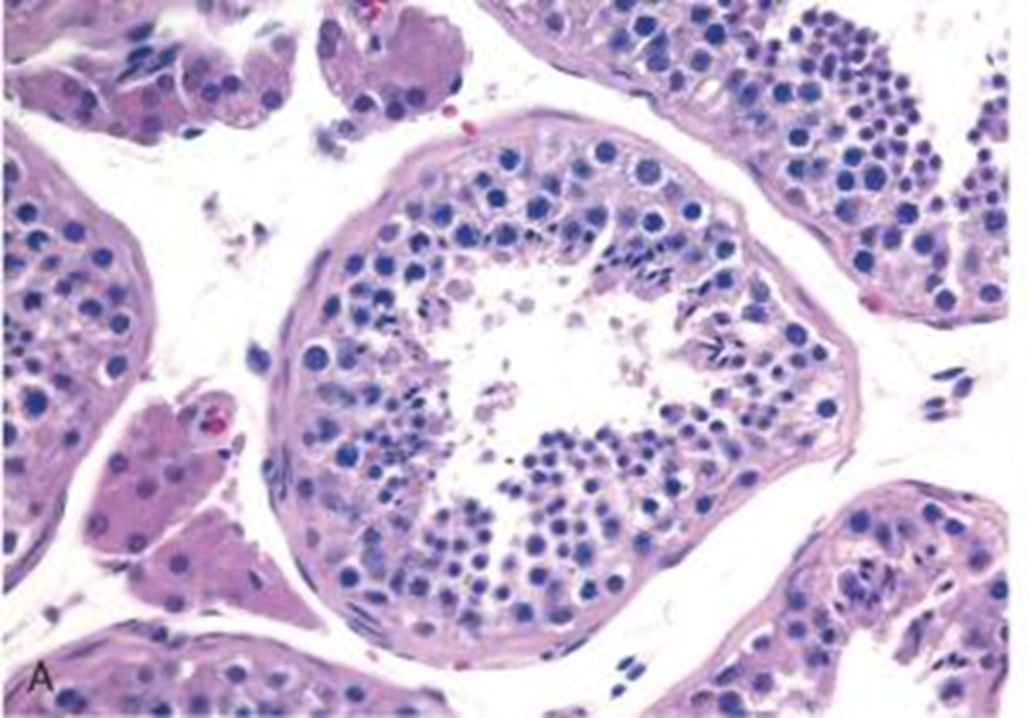
Normal testis and epididymis
Normal testis & epididymis
Section of normal testis
Section of Seminiferous tubule
Testicular disease: Epididymitis and orchitic:
we will ask you about tumors more than inflammation so focus on that.
Epididymitis: inflammation of epididymis
Orchitis: inflammation of testis
Inflammatory conditions are generally more common in the epididymis than in the testis.
However, some infections, notably syphilis, may begin in the testis with secondary involvement of the epididymis
Orchitis is mainly seen in TB or syphilis.
1) Granulomatous (autoimmune) epididymitis and orchitis:
middle–aged men present with unilateral testicular mass.
mimic testicular tumor. (we don’t know how it occurred it could be due to the following)
autoimmune basis is suspected.
May be in response to: | disintegrated sperm (broken down into smaller parts and lodged into spaces). post-infectious, due to trauma Sarcoidosis (inflammatory disease that affects multiple organs).
microscopy: | granulomatous inflammation with plasma cells and lymphocytes

Slide 3
2) Non specific epididymitis and orchitis:
Are commonly related to: | infections in the urinary tract (cystitis, urethritis and genitoprostatitis (inflammation of the prostate)).
Infections reach the epididymis/testis through: | the vas deference or the lymphatics of the spermatic cord.
Causative organisms vary with age: | Children: it is uncommon. Usually associated with a congenital genitourinary abnormality and infection with Gram –ve rods. In men younger than age 35 years: Chlamydia trachomatis and Neisseria are common causative organisms.(STDs) In men older than 35 years: E.coli and Pseudomonas.
Microscopic findings: | congestion, edema and infiltration by neutrophils, macrophages and lymphocytes. initially involves the interstitium but later involves seminiferous tubules may progress to frank abscess. Heals by fibrous scarring. Leydig cells are not usually destroyed. (Interestingly leydig cells are not destroyed so the testosterone level is not affected)
Basically everything in the urogenital region
With necrosis
3) Gonorrhea: (Sexually transmitted disease)
Gonococcal infection can spread from urethra to prostate, seminal vesicles and then to epididymis and testis leading to → suppurative* orchitis and even abscess. (*pus producing)
It is a sexually transmitted infection.
4) Tuberculosis:
Begins in the epididymis and spreads to the testis.
There is associated tuberculous prostatitis and seminal vesiculitis (inflammation of the seminal vesicle).
Microscopy: | Caseating Granulomas.

Slide 4
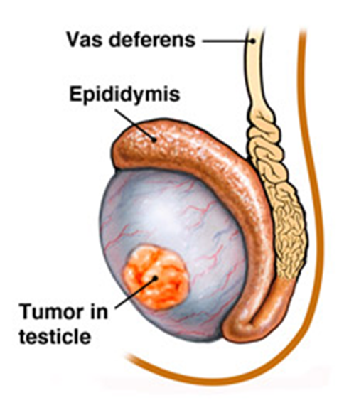
Testicular tumors:
Testicular tumors are the most important cause of firm, painless enlargement of the testis. (if there is a mass in the testis, most likely it will be a tumor)
Peak incidence between the ages of 20 and 34 years.
Tumors are important
Classification of testicular tumors:
(Classification is like ovarian tumors but there is NO surface epithelium tumors).
Testicular tumors are a heterogeneous group of tumors divided into germ cell tumors and sex cord stromal tumors:
In adults, 95% of testicular tumors are germ cell tumors, and all are malignant.
Sertoli or Leydig cells (sex cord/stromal tumors) are uncommon and are usually benign.
classification | 1) Germ cell tumors (95% of testicular tumors): | a) Tumors with One Histologic Pattern (pure form): | Seminomatous germ cell tumors | Seminoma (Seminoma is the classical type of seminomatous germ cell tumors) Spermatocytic seminoma(very good prognosis hardly metastasize)
 |  |  | Non-seminomatous germ cell tumors | Embryonal carcinoma Yolk sac (endodermal Sinus) tumor Choriocarcinoma Teratoma: they can be mature, immature or with malignant transformation
 |  | b) Tumors with more than one Histologic Pattern: mixed germ cell tumor (mixed form)
 | 2) Sex cord stromal tumors: | 1) Leydig cell tumor
 |  | 2) Sertoli cell tumor
(Seminomatous germ cell tumors are radio-sensitive)
Respond well to radio therapy
They are radio-resistant but chemosensitive.
Could be in a pure of mixed form
Stroma of the interstitium
Stroma of the seminephrous tubules
Germ cell tumors could have everything under the microscope we call it mixed or just the specific histological feature we call it pure form also good response to therapy.

Slide 5
GERM CELL TUMORS (GCT)
Between 15-30 years of age | Age group
these are the most common tumor in men. it is important to know that mixed tumors are more common than single tumors in germ cell tumors | Prevalence
Most of gem cell tumors are highly aggressive cancers, capable of extensive Dissemination. The Good news is that with current therapy most of them can be cured. Germ cell tumors may have: a single tumor type component or as 60% of cases a mixture of tumor types e.g. mixtures of seminomatous and non-seminomatous components Most GCTs originate from precursor lesions called intratubular germ cell neoplasia (it is like carcinoma-in-situ) | general information
Cryptorchidism¹ is associated with a 3 to 5 fold increase in the risk of cancer in the undescended testis and in the contralateral descended testis. Testicular dysgenesis (genetic disorientation) genetic factors Strong family predisposition. Brothers, fathers and sons of testicular cancer patients are at risk too. There is a high risk of developing cancer in one testis if the contralateral testis has cancer. Testicular tumors are more common in whites than in blacks. | Predisposing factors: factor that might lead to GCT
As in they metastasize quickly
The undescended and descended are at equal risk of developing germ cell tumor.

Slide 6
Seminoma
Peak incidence in the 30ies Almost never occur in infants (if she give a history in the exam remember age groups) | Age group
It is the most common type of testicular tumors. It is also the most common type of testicular GCT (50%) | Prevalence
An identical tumor occurs in the ovary (dysgerminoma). classic seminoma is highly sensitive to radiation therapy, and the overall 5-year survival is 90% to 95% | General information
Bulky masses, sometimes very large homogenous ,gray-white, lobulated cut surface No necrosis or hemorrhage (it is the clue for seminoma) | Gross morphology
sheets of uniform cells divided into lobules by delicate fibrous septa containing lymphocytes. cells are large and round with large nucleus and prominent nucleoli. Cytoplasm of tumor cell has glycogen. | Microscopic morphology
Positive for PLAP, OCT4 stain and c-kit (CD117). | teste
Spermatocytic Seminoma (slowly growing never metastasize and good prognosis)
Uncommon 1-2 % of testicular GCTs Over age 65 | Age group and Prevalence
Slow growing tumor, doesn’t metastasize prognosis is excellent | General information

Slide 7
Embryonal Carcinoma
20 to 30 year age group | Age group
Less common It accounts for about 15 to 35% of testicular GCTs | Prevalence
It is More aggressive than seminomas It metastasizes early via both lymphatic and hematogenous routes Can be seen combined with other GCTs (in mixed GCTs) Radiation is not as effective as with seminoma, but newer chemotherapeutic agents are very effective with greatly improved prognosis. | General information
smaller than seminoma poorly demarcated Variegated with foci of necrosis and hemorrhage | Gross morphology
Tumor cells are positive for cytokeratin (CK) and CD30 stain it is the clue teste | Teste

Slide 8
Yolk Sac Tumor(YST) also called endodermal sinus tumor
It is the most common tumor in infant and children up to 3 years of age and it has a very good prognosis in infants and children | Prevalence
Testicular yolk sac tumors occur in two forms: 1. as a pure form in young children (pure YST of the adult testis is rare) 2. as in combination with other NSGCT (mainly embryonal carcinoma, in adults) Patients have elevated serum alpha fetoprotein (AFP) it is the clue for YST. AFP may be used as a marker of disease. progression in the patient's serum and also aid in diagnosis. The biologic behavior of YST is similar to that of embryonal carcinoma | General information
Non encapsulated homogenous yellow white mucinous | Gross morphology
Tumor shows structure resembling endodermal sinuses called Schiller-Duval bodies (characteristic for yolk sac tumor) hyaline–pink globules tumor cell are positive for alpha fetoprotein (AFP) and alpha-1-antitrypsin stain. | Microscopic morphology
If the tumor contained both AFP and PLAP then it’s a mix between yolk-sac and seminoma
On histology these bodies will appear like a flower with a circle in the center.

Slide 9
It occurs due to the pluripotent cells found in the tissue
Choriocarcinoma (from placental tissue)
Highly malignant tumor choriocarcinoma is the worst type due to its aggressiveness.
Patients have elevated serum human chorionic gonadotropin (HCG) (also seen in pregnancy, trophoblastic tumors and ovarian tumors which have a component of chorionic carcinoma)
Small sized lesions
Prominent hemorrhage and necrosis
Made up of malignant trophoblastic (placental) tissue (cyto-trophoblastic and syncytio-troblastic cells)
Tumor cells positive for human chorionic gonadotropin (HCG) stain
Pure choriocarcinoma of the testis is extremely rare, and the tumor is much more common as a component of mixed GCT.
Teratoma Teratoma is always in OSPE (imp)
It is a tumor composed of various different types of cells or organ components
Any age, infancy to adult life
In its pure form it is common in infants and children second to yolk sac tumor (in this age group)
In adult the pure form is rare. It occurs as part of mixed GTC
Usually large 5 -10 cm
Heterogenous appearance with solid and cystic areas. Can show bone, cartilage and teeth grossly.
Composed of bizzarely distributed collection of different type of cells or organ structures (heterogenous)
Any of the following cell types of various organs can be present: neural/brain, cartilage, bone, squamous epithelium, hair, glandular cells, smooth muscle, thyroid tissue, bronchial epithelium of lung, pancreatic tissue etc.
If the cells/tissue is mature looking it is called as mature teratoma.
If some of the cells/tissue component is immature it is called as immature teratoma.
If any of the cells/tissue undergoes non germ cell type of malignant tranformation it is called as teratoma with malignant transformation (rare) e.g squamous cells develop squamous cell carcinoma or the glandular cells develop adenocarcinoma. (Even if it is mature and in adult we consider it malignant e.g, squamous cell carcinoma in the teratoma.)
Once you’ve found it, try to look for other components since its very unlikely for it to occur by itself.

Slide 10
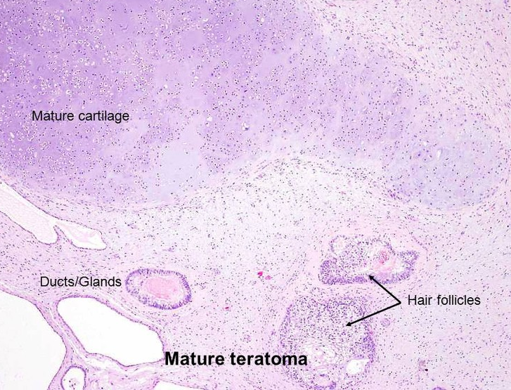
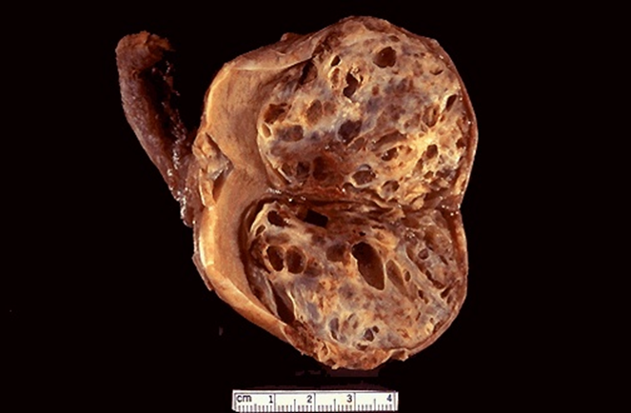
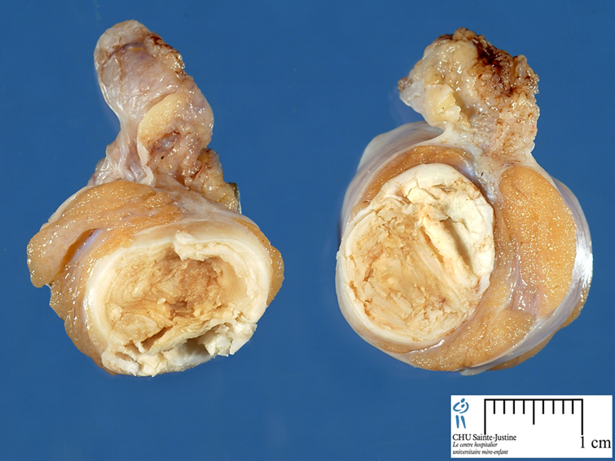
Mixed Germ Cell Tumors
Teratoma cont…
Behavior of teratomas:
  In infants and children, mature teratomas are benign and immature teratoma is considered malignant.
  In post pubertal male, all teratomas are regarded as malignant (since they’re most likely mixed), and capable of metastasis, regardless of whether the elements are mature or not.
In females mature teratomas are benign
Mixed Germ Cell Tumors are quite common. common in adults
About half of testicular tumors are composed of a mixture of GCTs.
The common combinations/mixtures are:
  Teratoma + embryonal carcinoma +/- yolk sac tumor
  Seminoma + embyronal carcinoma
Clinical features of GCTs Remember the combination & the stain for each tumor
Present as a painless enlarging mass in the testis. Generally any solid testicular mass should be considered neoplastic.
Germ cell tumors secrete hormones and enzymes that can be detected in blood (HCG, AFP, and lactate dehydrogenase)
Biopsy of a testicular tumor is associated with a risk of tumor spillage therefore it is not recommended. never do biopsy for testicular tumors because of (tumor spillage). This spillage doesn’t happen in breast, liver or kidney.
The standard management of solid testicular tumors is radical orchiectomy
The female doctor emphasized here that u know the tests for each just to
revise it for u seminoma is PLAP (pos) embryonal carcinoma is CD30 (pos) Yolk sac tumor is Alpha feto protein (pos) choriocarcinoma has HCG (pos)

Slide 11
Prognosis
Clinical features of GCTs cont..
GCTs can spread by direct extension to the epididymis, spermatic cord, or scrotal sac
Lymphatic spread is common. Retroperitoneal and para-aortic nodes are first to be involved
Hematogenous spread to Lung, liver, Brain, and bones.
Seminomatous tumors are radiosensitive.
Non-seminomatous tumors are chemosensitive and respond very well to chemotherapy.
More than 95% of patients with seminoma can be cured
90% of patients with non-seminomatous tumors can achieve complete remission with aggressive chemotherapy, and most can be cured
The rare pure choriocarcinoma is the most aggressive non-seminomatous tumor. Pure choriocarcinoma has a poor prognosis
Even though choriocarcinoma is very hard to manage the good thing is in the testes it has very little components.
Summary Difference between seminoma and non-seminomatous GCTs
non-seminomatous GCTs | seminomas
Embryonal,yolk sac , Choriocarsinoma,teratoma | seminoma
Not radiosensitive | radiosensitive
Chemosensitive | Chemosensitive
Early metastases to retroperitoneal lymph nodes | Late metastasis
More addressive | Excellent prognosis

Slide 12
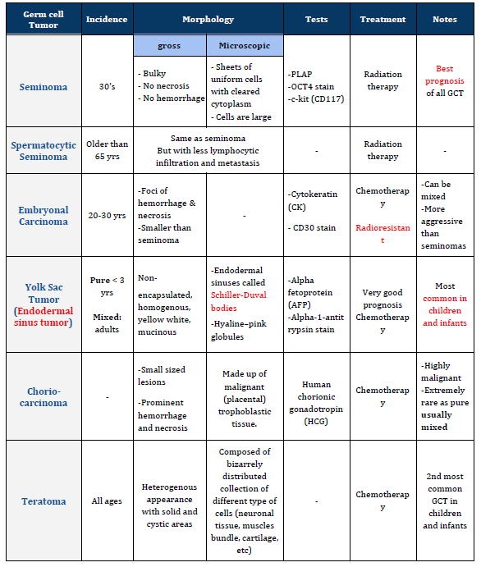
Summary

Slide 13
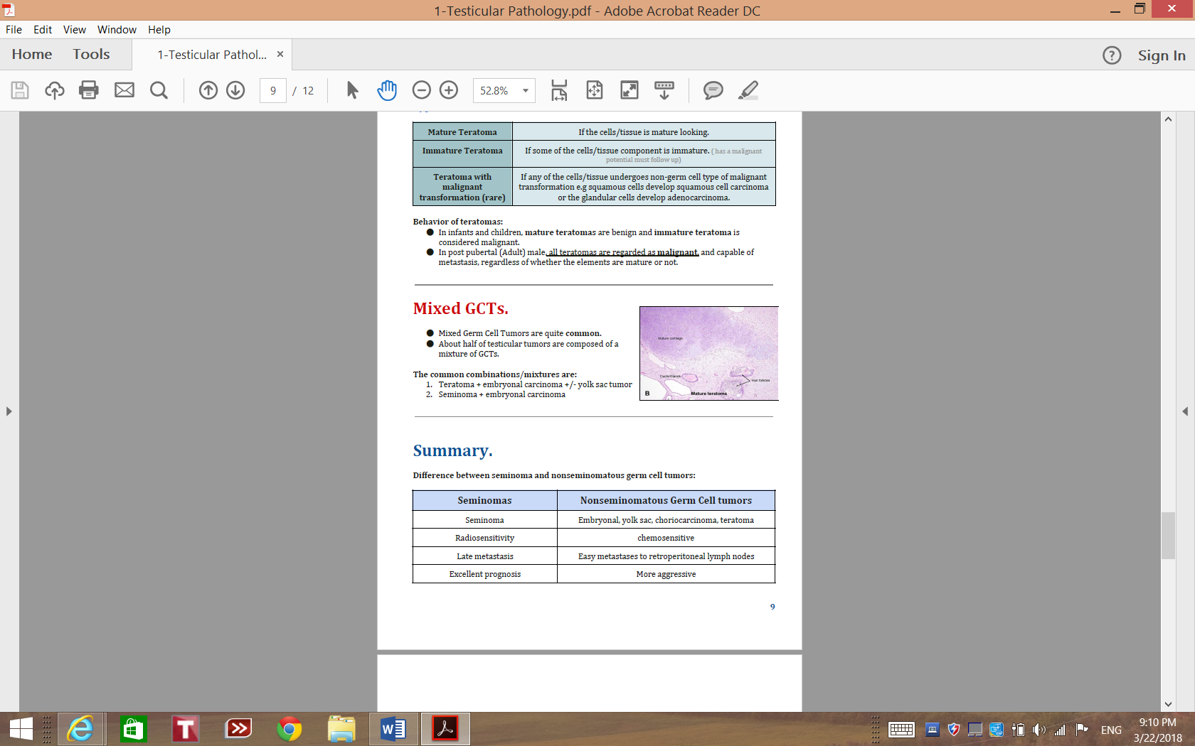

Slide 14
Questions
1- Which of the following is False regarding Inflammatory lesion of the testis and epididymis?
A- Epididymitis is more common than orchitis.
B- Commonly related to blood infections.
C- Orchitis rarely occurs in children.
D- Granulomatous inflammation of the testis is commonly caused by TB.
ANS: B, commonly related to urinary tract infection.
2- A-26-year old male came to the hospital with a right testicular mass and history of cryptorchidism. which of the following is most likely diagnosis?
A- Sex cord tumors.
B- Germ cell tumors.
C- Tuberculoma of the intrascrotal cord.
D- Vascular aneurysm.
ANS: B
3- A 26-year-old man has occasionally felt pain in the scrotum for the past 3 months. An ultrasound scan shows a 1.5-cm mass within the right testis. A right orchiectomy is performed, and gross examination shows the mass to be hemorrhagic and soft. A retroperitoneal lymph node dissection is done. Microscopic examination shows that areas of viable tumor are composed of cuboidal cells intermingled with large eosinophilic syncytial cells containing multiple dark, pleomorphic nuclei. Immunohistochemical staining of
syncytial cells is most likely to be positive for which of the
following?
A- α-Fetoprotein.
B- CD20.
C- Carcinoembryonic antigen.
D- Human chorionic gonadotropin.
ANS: D
4-A 32-year-old man has noticed an increased feeling of heaviness in his scrotum for the past 10 months. On physical examination, the left testis is three times the size of the right testis and is firm on palpation. An ultrasound scan shows a 6-cm solid mass within the body of the left testis. Laboratory studies include an elevated serum α-fetoprotein level. Which of the following cellular components is most likely to be present in this mass?
A- Cytotrophoblasts.
B- Embryonal carcinoma cells.

Slide 15
C- Seminoma cells.
D- Yolk sac cells.
ANS: D
5- A 33-year-old man has noted asymmetric enlargement of the scrotum over the past 4 months. On physical examination, the right testis is twice its normal size and has increased tenderness to palpation. The right testis is biopsied. The epididymis and the upper aspect of the right testis have extensive
granulomatous inflammation with epithelioid cells, Langhans giant cells, and caseous necrosis. Which of the following infections is the most likely cause of these findings?
A- Gonorrhea.
B- Mumps.
C- Syphilis.
D- Tuberculosis.
ANS: D
6- Which of the following is correct about testicular tumors?
A- They are more common in females.
B- Painful masses.
C- Seminomas metastasis are late.
D- Nonseminomatous tumor metastasis are late.
ANS: C
7-A 64-year-old man noted pain with burning on urination a week ago. He has had discomfort in his scrotum for the past 2 days. On examination, the right testis is swollen and tender. Which of the following organisms is the most likely cause?
A- E coli.
B- Mumps virus.
C- TB.
D- Human papillomavirus.
ANS: A, Time course suggests bacterial infection. And mumps is more likely to be bilateral and doesn’t cause UTI.

Slide 16

حسبي الله لا إله إلَّا هو عليه توكلت وهو رب العرش العظيم.
الأعضاء
طلال العنزي
عبدالملك الهدلق
عبدالمجيد العمار
عمر المغير
محمد اليوسف
خالد العيدان
عبدالكريم الحربي
إبراهيم الفتياني
القادة
حنين السبكي
هبة الناصر
عبدالله أبو عمارة
Editing File
Email: pathology436@gmail.com Twitter: @pathology436
References: Doctor’s slides + notes, Robbins basic pathology 10th edition.

