Slide 1
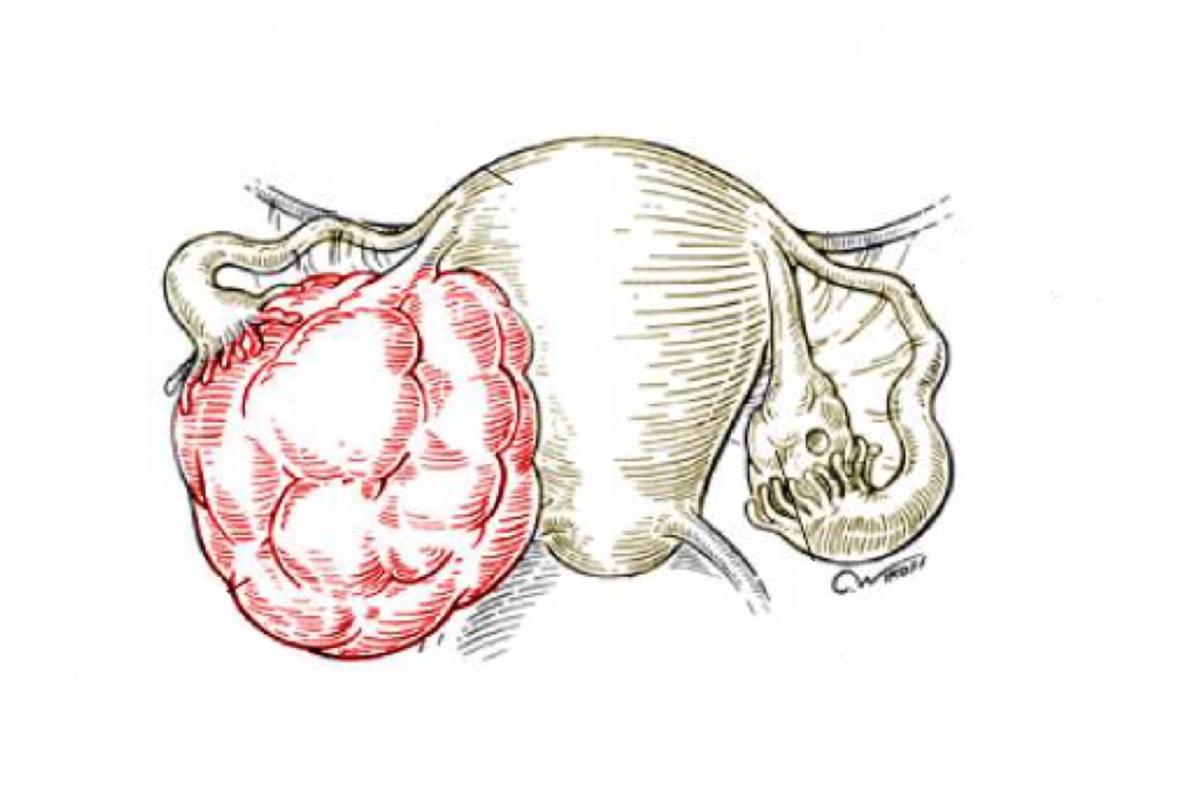
Polycystic ovarian disease and Endometriosis
Objectives:
At the end of this lecture, the student should be able to:
Know the clinicopathologic features of endometriosis with special emphasis on: definition, typical sites and theories behind its pathogenesis.
Understand the clinical manifestations and pathologic features of polycystic ovarian disease.
• Black: Doctors’ slides. • Red: Important! • Light Green: Doctors’ notes • Grey: Extra. • Italic black: New terminology.

Slide 2
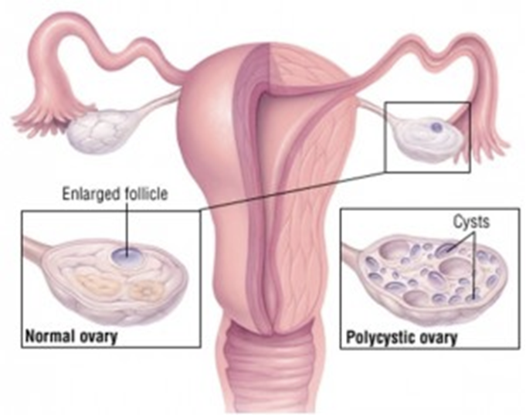
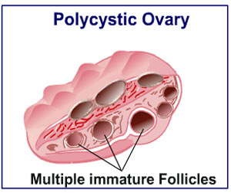
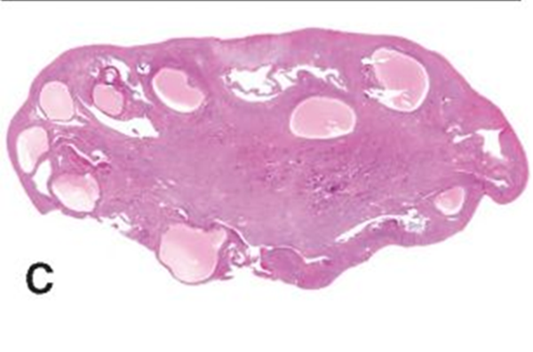
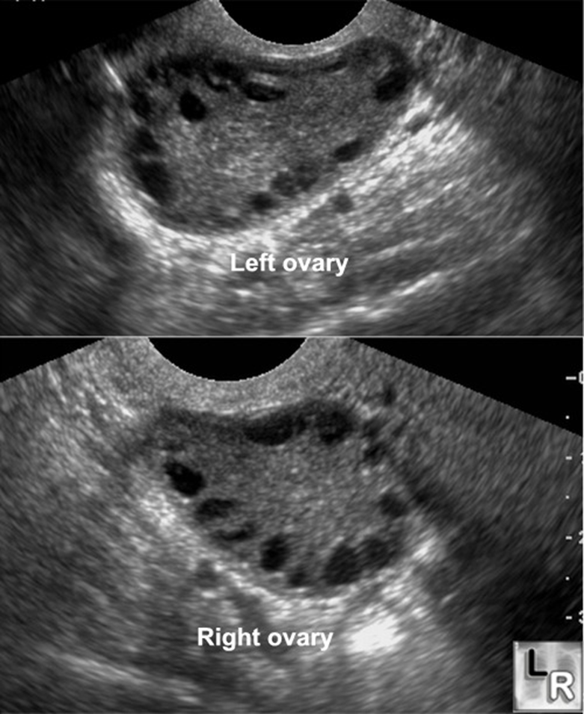
Understand the clinical manifestations and pathologic features of polycystic ovarian disease.
Polycystic Ovarian disease (PCOD):
Polycystic ovaries are characterized by:
Bilateral enlargement of ovaries by multiple small cysts.
Chronic anovulation. Ovulation happens due to the sudden release of LH(surge) from the hypothalamus, it causes a transition from the proliferative phase of menstrual cycle (high estrogen) to the secretory phase (high progesterone). So chronic anovulation is when ovulation is not taking place anymore , because there is constant LH secretion . the proliferative phase is not happening, there’s a constant high estrogen levels leading to signs and symptoms.
Clinical manifestations secondary to excessive production of estrogen and androgens (mainly androgens). Anovulation also triggers the production of high levels of androgens (testosterone).
The initial abnormality resulting in the syndrome is not known but is believed to be related to hypothalamic-pituitary dysfunction which leads to oversecretion of luteinizing hormone (LH). So there’s no LH surge, it’s constantly high.
LH in turn stimulates the ovaries to produce excess androgens. While the secretion of follicular stimulating hormone (FSH) is inhibited (the graafian follicle is not fully formed > supression of ovulation>grafian follicle becomes a cyst ), leads to suppression of ovulation and formation of cystic follicles in the ovaries.
Patients have:
High levels of LH. Which stimulates the production of estrogen and androgens.
Low FSH. The follicles are not maturing > they turn into cysts –instead of ovulation-.
High testosterone,
High estrogen.
Other names for this syndrome include polycystic ovarian syndrome and Stein-Leventhal syndrome. Every time she has a cycle she will have a cyst in the ovary
Clinical appearances:
Usually young women (between 15 and 30 years), present with:
Secondary amenorrhea with anovulation.
Oligomenorrhea or irregular menses.
Infertility.
Hirsutism.
Virilism due to increased androgenic (masculinizing) hormones – obesity.
Acne.
A: The ovarian surface reveals numerous nodular elevations of clear cysts.
B: Cut section shows several subcortical cystic follicles in the ovary.
C: Cystic follicles seen in low-power microphotograph.

Slide 3
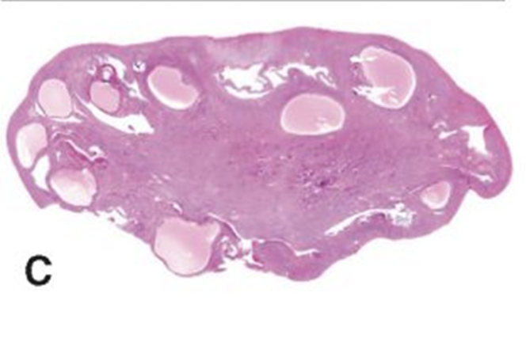
Polycystic Ovarian disease (PCOD):
Histology:
Ovaries:
Ovaries are 2 times the normal size with many subcortical cysts measuring 0.5 to 1.5 cm in diameter. If their size is >2cm you have to think of another pathology.
Microscopically: the outer portion of the cortex is thickened and fibrotic (cortical stromal fibrosis) with multiple cysts underneath. The follicular cysts usually have a prominent theca interna layer.
Corpora lutea are frequently absent (because there’s no ovulation, women with PCOD have anovulatory cycles).
Endometrium:
Chronic anovulation → Unopposed estrogen → Leads to a hyper estrogenic state → Endometrium may develop estrogen associated hyperplasia and show any of the following:
Simple with or without atypia.
Complex hyperplasia, with or without atypia.
Endometrial carcinoma.
Women with PCOD are at risk for the following:
Endometrial hyperplasia and endometrial cancer.
Insulin resistance/type 2 diabetes.
High blood pressure.
Depression/Anxiety.
Dyslipidemia.
Cardiovascular disease.
Strokes.
Weight gain.
Miscarriage.
Acanthosis nigricans (patches of darkened skin under the arms, in the groin area, on the back of the neck).
Autoimmune thyroiditis.
Treatment:
Treatment with drugs that either induce ovulation (clomiphene or hCG) or regulate the menstrual cycle and restores fertility.
Reduction of ovarian volume by wedge resection of the ovaries is also successful in initiating ovulation and restoring fertility.
The endometrial changes usually regress once ovulation is achieved.

Slide 4
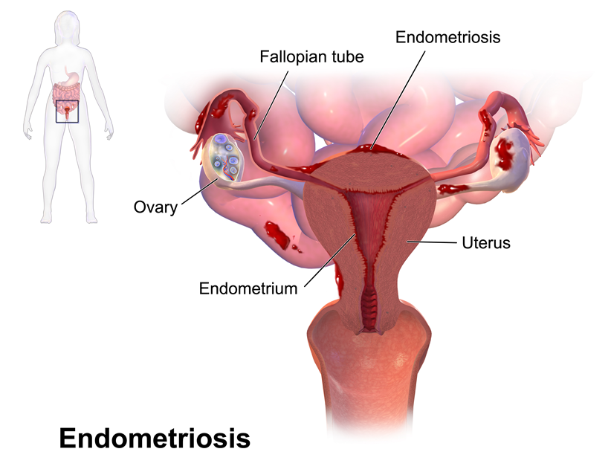
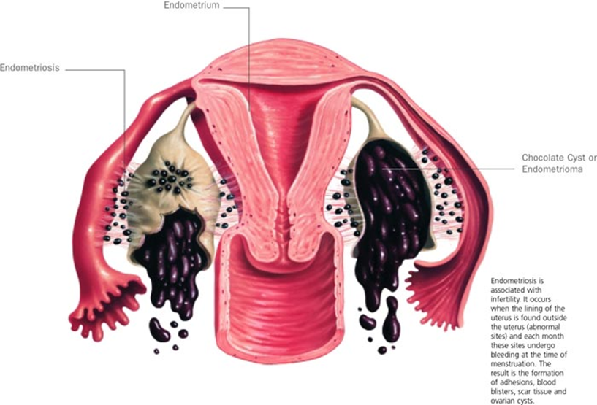
Know the clinicopathologic features of endometriosis with special emphasis on: definition, typical sites and theories behind its pathogenesis.
Endometriosis:
Normally, endometrial glands and endometrial stroma are found in the endometrium of the uterus.
Endometriosis is the presence of ectopic endometrial glands and stroma outside the uterus.
Endometriosis is usually found in the peritoneal surface of the reproductive organs and adjacent pelvic organs. The most frequent locations are:
Ovaries¹ (approximately 50%).
Followed by the pouch of Dougals (recto-uterine) and uterine ligamnets.
Occasionally: in cervix, vagina, perineum, bladder, large bowel and umbilicus.
Rarely: in small bowel, kidneys, lungs, nose and brain.
It has been reported in men: the sites involved have been the bladder, scortum and prostate. Because at the end we all come from the same pluripotent stem cell
It is non-neoplastic.
It behaves like the uterine endometrium, it is responsive to the hormonal variations of the menstrual cycle, and bleeds during menstruation.
Therefore, in endometriosis there is menstrual type bleeding at the site of ectopic endometrium. Resulting in blood filled areas (e.g. chocolate cysts). Most common place is the ovaries.
Clinical features:
Clinical features depend on the site of endometriosis.
Dysmenorrhea, cyclic abdominal pain and dyspareunia are common symptoms.
Usually there is severe menstrual-related pain. Due to accumulation of blood.
Often results in infertility.
Endometriosis usually appears as multiple red or brown (due to hemosiderin) 1 to 5mm nodules (some may from larger masses or cysts). Dense fibrous adhesions may surround the foci. Endometriosis causes inflammation which heals by scarring, so in the presence of scars everywhere, the patient would have difficulty conceiving because the eggs are stuck and can not go down or they can not get implanted and their growth is hard.
1:It under goes menestual cycle as in the uterus and bleed , but the difference is in the uterus blood can go out through the vagina whereas in the ovaries it collects causing severe pain

Slide 5
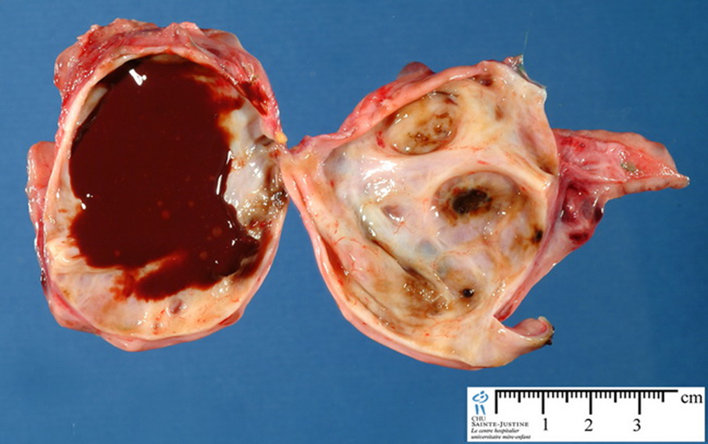
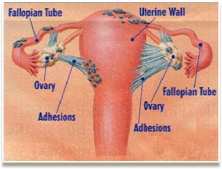
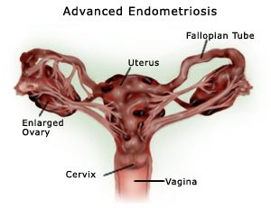
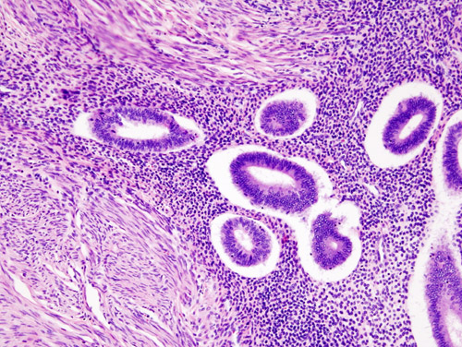
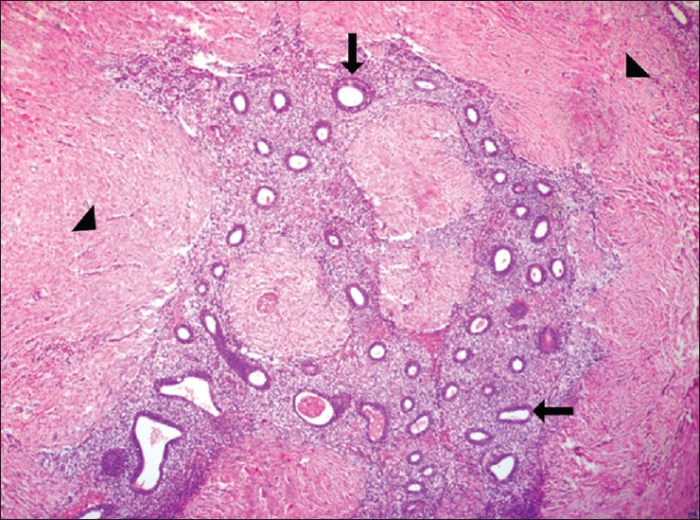
Endometriosis:
Repeated hemorrhage into the ovary with each menstrual cycle produces cysts filled with chocolate-brown material. These cysts are called “chocolate cysts”. With time, the ovaries become totally cystic and turn into large cystic masses filled with chocolate brown fluid.
Clinical behavior: Benign with no malignant potential. May recur after surgical excision but the risk is low.
Complications:
Infertility.
Adhesions.
Histology:
Ectopic endometrial glands and endometrial stroma are present.
Denatured blood from previous bleeding is present. RBCs denature and release pigment (hemosiderin) and it’s phagocytosed by macrophages.
Macrophages containing hemosiderin (siderophages) are present.
When endometriosis develops in a muscular organ, the smooth muscles around it are often hyperplastic. (when endometriosis occurs in the myometrium layer of the uterus it’s called adenomyosis)

Slide 6
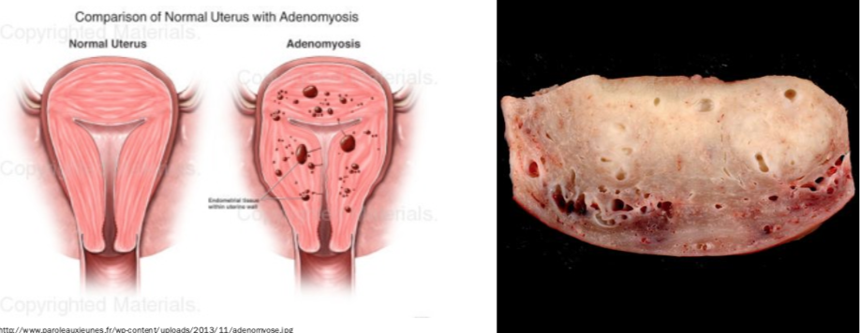
Adenomyosis:
This is defined as the presence of endometrial glands and endometrial stroma in the myometrium of the uterus.
It is more common in the posterior wall than the anterior wall (but it may affect both walls in the same uterus).
The disease is primarily a disorder of parous women and is uncommon in the nulliparous.
It is associated with menorrhagia and severe dysmenorrhea. In 1/3rd of the patients: there are no symptoms. They present with significant amount of abdominal pain.
When extensive, the lesions cause myometrial thickening with small yellow or brown cystic spaces containing fluid or blood.
Clinical behavior:
This is a benign condition with no known malignant potential, that regresses after the menopause.
Morphology:
Cross section through the wall of a hysterectomy specimen of a 30 year-old woman who reported chronic pelvic pain and abnormal uterine bleeding. The endometrial surface is at the top of the image, and the serosa is at the bottom.

Slide 7
Summary
Polycystic ovaries
aka: Stein-Leventhal syndrome.
Bilateral enlargement of ovaries by subcortical cysts.
Oversecretion of LH.
Hormones: ↑LH, ↓ FSH, ↑ Testosterone & ↑ estrogen.
C/F: young women (15-30 y), obesity, secondary amenorrhea / irregular menses, anovulation, infertility, hirsutism, acne, virilism.
Complications:
↑ estrogen → endometrial hyperplasia / cancer.
Insulin resistance/ type II DM
Hypertension
Dyslipidemia
Cardiovascular disease , Strokes
Depression/Anxiety
Weight gain
Miscarriage
Acanthosis nigricans (darkened skin)
Autoimmune thyroiditis
Endometriosis
Ectopic endometrial glands & stroma.
Non-neoplastic.
Responsive to menstrual cyclical changes.
Chocolate cyst in ovary = endometriosis in the ovary, its complications: adhesions and infertility.
Gross: Red or brown nodules or cysts , fibrous adhesions may surround the foci.
Siderophages, endometrial glands & stroma on histopathology.
Adenomyosis
Endometriosis in the myometrium .

Slide 8
Questions
Q1) A 35 year old lady presents with severe abdominal pain during menstruation, ovaries showed cysts with chocolate-brown material. What is the most likely diagnosis?
Endometrial hyperplsia.
Leiomyoma.
Endometriosis.
Ans: C
Q2) A 30 year old lady was diagnosed with endometriosis of the ovaries. What is most likely to be seen on histopathology?
Macrophages containing hemosiderin.
Hyperplasia.
Granulomas
Ans: A
Q3) A 28 year old female presents with infertility and irregular menstruation. On examination, the patient was shown to have hirsutism and acne which was diagnosed as Stein-Leventhal syndrome. Which one of the following is the leading cause of her symptoms?
High FSH.
Low estrogen.
Anovulation
Ans: C
Q4) Which of the following is the cause of cystic formation in the ovaries?
Maturation of ovarian follicles.
Immaturation of ovarian follicles.
High levels of progesterone.
Ans: B

Slide 9
حسبي الله لا إله إلَّا هو عليه توكلت وهو رب العرش العظيم.
الأعضاء
ريم الشثري
يارا الدعيجي
ليلى البريكان
فاطمة الطاسان
غادة المهنا
القادة
حنين السبكي
هبة الناصر
عبدالله أبو عمارة
Editing File
Email: pathology436@gmail.com Twitter: @pathology436
References: Doctor’s slides + notes, Robbins basic pathology 10th edition.

