Slide 1
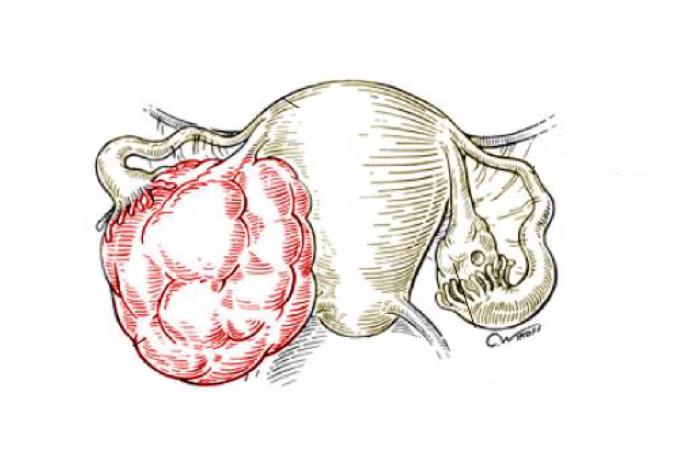
DISORDERS OF PREGNANCY AND PLACENTA
Objectives:
Understand the pathology and predisposing factors of ectopic pregnancy and spontaneous abortion.
Know the clinical presentation and pathology of hydatidiform mole and choriocarcinoma.
• Black: Doctors’ slides. • Red: Important! • Light Green: Doctors’ notes • Grey: Extra. • Italic black: New terminology.

Slide 2
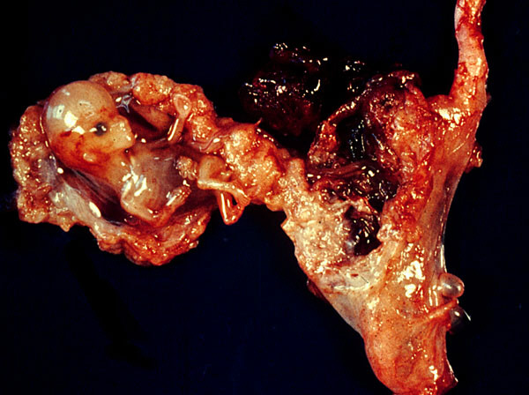
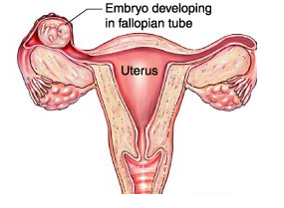
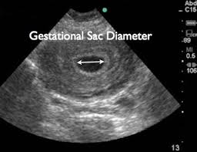
ECTOPIC PREGNANCY
Ectopic pregnancy is defined as implantation of a fertilized ovum in any site other than the endometrium of the uterine cavity. About 1% of all pregnancies are ectopic. | What is it?
90% most common of ectopic pregnancies occur in the fallopian tubes (tubal pregnancy). It could occur in ovaries , abdominal cavity and uterine cervix | Where dose it occur?
an ectopic tubal pregnancy patient may present with: pelvic pain or abnormal bleeding following a period of amenorrhea. Many present as an emergency with tubal rupture, severe acute abdominal pain and hemorrhagic shock. | What are its clinical features?
By two ways : Clinical: by doing pelvic/abdominal ultra sound Findings: gestational sac within fallopian tube or other location. Microscopic: by taking placental tissue or fetal parts. Findings: chorionic villi lined by cytotrophoblast and syncytiotrophoblast After the tube gets ruptured >they take them to histopathology lab to look for those findings . | How to diagnose ?
Fallopian tubes are the most common location for ectopic pregnancies Any factor that retards passage of the ovum through the tubes predisposes to tubal ectopic pregnancy. In about half of the cases, it is due to chronic inflammation and scarring in the oviduct | What are the risk factors?
It presents as normal pregnancy but as the ovum starts growing there is a problem. As it grows it may rupture the fallopian tube and cause acute abdominal pain.

Slide 3
The list of risk factors:
The risk factors are as follows:
Pelvic inflammatory disease/infections/salpingitis is the most common cause. ((The inflammation can damage ciliary activity, cause tubal obstruction, pelvic adhesions with scarring and distortion of the fallopian tubes)).
Women who have had pelvic infections have a five times greater risk of ectopic pregnancy. (infection is usually by Neisseriae gonorrhea & chlamydia).
Abdominal/pelvic surgery or tubal ligation surgery.may cause injury to tubes .
Intrauterine tumors and endometriosis.
Smoking can → decreased tubal motility by damaging ciliated cells or it may predisposing them to pelvic inflammatory disease (due to the impaired immunity in smokers).
Congenital anomaly of the tubes.
In-utero diethylstilbestrol (DES) exposure increases the risk of ectopic pregnancy due to abnormal tubal morphology.A type of estrogen tablets that were given to pregnant women to reduce misscarriage.
History of previous ectopic pregnancy
History of multiple sexual partners → increase chance of pelvic inflammatory disease and therefore are high risk for ectopic pregnancy.
Intrauterine device users are at higher risk of having an ectopic pregnancy.intra-uterine devices are supposed to inhibit the pregnancy ! But there are 1% risk that pregnancy can occur , and because the device takes the whole cavity of the uterus , so pregnancy will be located in the tubes .
History of infertility: there is higher risk of ectopic pregnancy in the infertile population. This may be due to the underlying infertility related issues or fertility drugs and treatments. In vitro fertilization has been associated with an increased risk of ectopic pregnancy including cervical pregnancies
NOTE: please note that in many tubal pregnancies, no anatomic cause is evident (unknown cause).
Ovarian pregnancies: probably result from rare instances in which the ovum is fertilized just as the follicle ruptures.
Gestation within the abdominal cavity: occurs when the fertilized egg drops out of the fimbriated end of the oviduct and implants on the peritoneum.

Slide 4
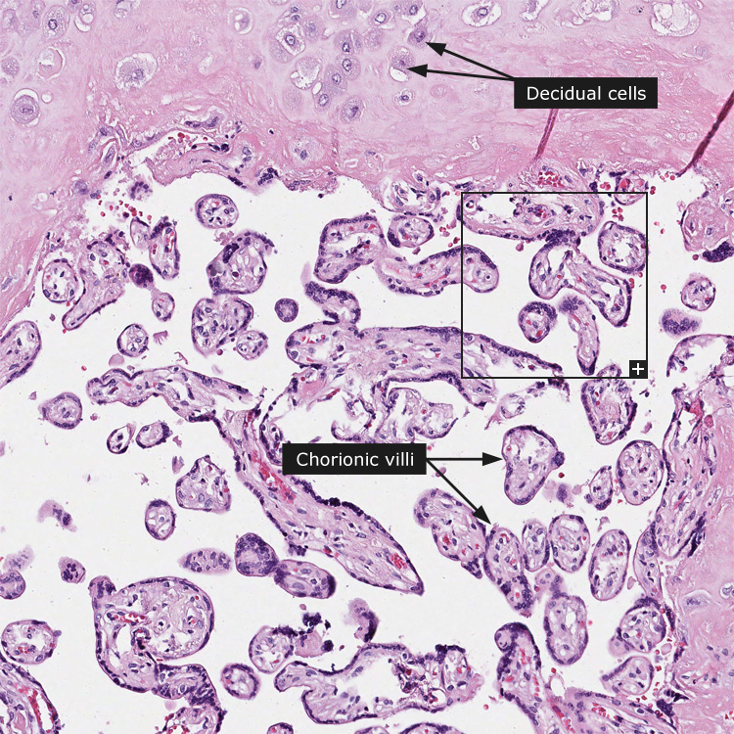
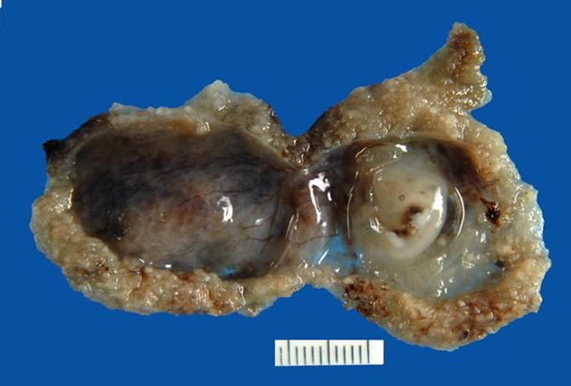
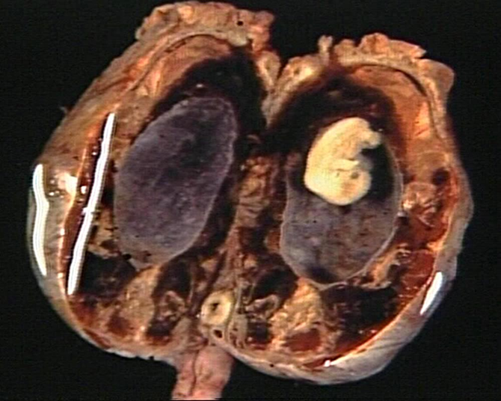
SPONTANEOUS ABORTION (Miscarriage)
It is the spontaneous end of a pregnancy at a stage where the embryo or fetus is incapable of surviving. (اجهاض) Miscarriages that occur : before the 6th week of gestation are called early pregnancy loss or chemical pregnancy. after the 6th week of gestation are called clinical spontaneous abortion. | What is it ?
About 10-25% of all pregnancies end in miscarriage. Most miscarriages occur during the first 13 weeks of pregnancy(first trimester) | Statistic
We will mention the causes in details in the next page. The cause of a miscarriage cannot always be determined. Miscarriages can occur for many reasons. Chromosomal abnormalities of the fetus are the most common cause of early miscarriages. | What are the causes of miscarriage?
The ways are: By ultrasound study (no fetal heart rate) By the examination of the passed tissue microscopically for the products of conception¹. The products of conception include chorionic villi, trophoblasts, fetal parts and changes in the endometrium (hyper-secretory). Genetic* tests may also be performed to look for chromosomal anomalies | How to diagnose ?
 | PRODUCTS OF CONCEPTION Products of conception will include the fetus sac embedded in the placental tissue.
¹A term often used after pregnancy loss, such as miscarriage, products of conception can identify fetal tissue, placenta tissue, or other material that comes from fertilization
* We do genetic testing if she has multiple miscarriages

Slide 5
The causes of miscarriage are as follows:
Chromosomal abnormalities: most common in early miscarriage
%50 of the 1st trimester miscarriages have abnormal chromosomes.
Chromosomal abnormalities also become more common with aging, and women over age 35 have a higher rate of miscarriage than younger women.
A pregnancy with a genetic problem has a 95% probability of ending in miscarriage.
Hormonal problems: there is an increased risk of miscarriage with:
Cushing’s Syndrome
Thyroid disease
Polycystic ovary syndrome (PCOS).
Diabetes: good control of blood sugars during pregnancy is important. If the diabetes is not well controlled, there is increase risk of miscarriages and also of the baby to have birth defects.
Inadequate function of the corpus luteum in the ovary (which produces progesterone necessary for maintenance of the very early stages of pregnancy) leads to progeterone deficiency which may lead to miscarriage.
Infections: (by Listeria monocytogenes, Toxoplasma gondii, parvovirus B19, rubella, herpes simplex, cytomegalovirus and lymphocytic choriomeningitis virus etc…) are associated with an increased risk of pregnancy loss.
Maternal health problems can predispose to miscarriages e.g. systemic lupus erythematosus and antiphospholipid antibody syndrome There will be thrombosis formation and no blood supply reaching the fetus .
Lifestyle: smoking, drug use, malnutrition and exposure to radiation or toxic substances
Maternal age: SABs(Miscarriage) increase after age 35 due to ovum abnormalities
Maternal trauma
Abnormal structural anatomy of the uterus can also cause miscarriages e.g. septate or bicornate uterus affect placental attachment and growth. Therefore, an embryo implanting on the septum would be at increased risk of miscarriage. Uncommonly uterine fibroids can interfere with the embryo implantation and blood supply, thereby causing miscarriage. The fetus has nowhere to grow.
Others: surgical procedures in the uterus during pregnancy e.g amniocentesis and chorionc villus sampling.

Slide 6
Background: Normal fertilization<< a single sperm of 23 chromosomes fertilizes a normal egg of 23 chromosomes = 46 chromosomes
GESTATIONAL TROPHOBLASTIC DISEASE (GTD) doctor said that the exam will come from this part (no guarantees)
Gestational trophoblastic disease is a group of related disorders in which there is abnormal proliferation of placental trophoblasts. | What is it?
Benign non-neoplastic trophoblastic lesions These lesions are diagnosed as an incidental finding on an endometrial curettage or hysterectomy specimen. They are: Exaggerated placental site Placental site nodule Hydatidiform mole They result from abnormalities in fertilization. They are essentially benign, but patients who have them carry an increased risk of subsequently developing choriocarcinoma. They are: Complete hydatidiform mole Partial hydatidiform mole Invasive mole/chorioadenoma destruens Gestational trophoblastic neoplasia (GTN) They are a group of tumors. They have potential for local invasion and metastases. They are: Choriocarcinoma Placental site trophoblastic tumor Epithelioid trophoblastic tumor | Types of GTD
The maternal age above 40 years has a 5 times more risk of trophoblastic disease compared to the mothers below 35 years. (↑ age ↑ risk) Most women who have had gestational trophoblastic disease can have normal pregnancies later. | Statistic
Most GTD produces the beta subunit of human chorionic gonadotropin (HCG). Serum HCG is also elevated in pregnancy (normal and ectopic) but in GTD it is markedly elevated, its very high and it keeps increasing to thousands. Also while in normal pregnancy the HCG levels drop after 14 weeks of gestation (2nd trimester), in GTD the serum HCG levels continue to rise even after 14th weeks. | Chemistry
Only know name

Slide 7
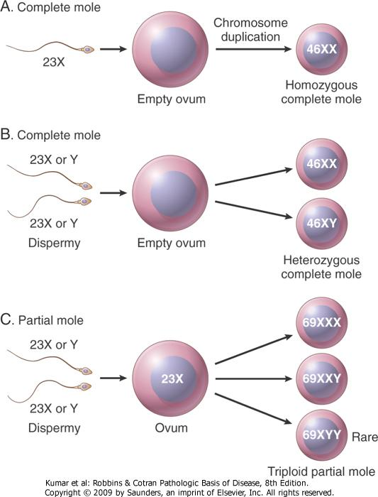
Hydatidiform Mole (we have 2 types: complete & partial)When u hear Mole pregnancy that always mean that you have excess genes from the father
It is an abnormal placenta due to excess of paternal (from father) genes. Normally half from each parents | What is it?
It is caused by abnormal gametogenesis and fertilization. It results in the formation of enlarged and edematous placental villi, which fill the lumen of the uterus. Passage of tissue fragments, which appear as small grapelike masses, is common. They become big and increase in number so they start going out of the vagina The serum HCG concentration is markedly elevated, and are rapidly increasing. | General information
It is the most common form of gestational trophoblastic disease; occurs in 1/1,000-2,000 pregnancies Maternal age: girls younger than 15 years of age and women over 40 are at higher risk. Ethnic background: incidence higher in Asian women Women with a prior hydatidiform mole have a 20-fold greater risk of a subsequent molar pregnancy than the general population | Risk factors
Normally during fertilization a sperm (which has 23 Y or X) enters the ovum (which has 23X) and this results in an embryo of 46 XX or XY which has genes both maternal (from mother) and paternal (from father). In a hydatiform mole the fertilization is NOT normal. Either all the gene are coming from the father (complete) or most of it from the father and only some from the mother (partial), this is abnormal . In the complete mole it is all paternal so there will be NO fetus. But if there is some maternal genes an embryo may be formed but will die early on.

Slide 8
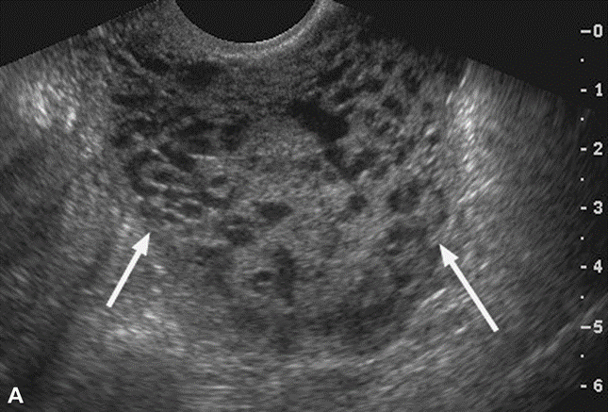
Complete hydatidiform mole
It is a genetically abnormal placenta with hyperplastic trophoblasts, without fetus or embryo Complete mole results from fertilization of an empty ovum that lacks maternal DNA <<as a result all chromosomal material is derived from the sperm. There is complete lack of maternal chromosomes All the chromosomes come from the male/paternal side i.e. it is an androgenetic pregnancy with no maternal DNA. | What is it?
fast rate of abdominal swelling (due to rapid increase in uterine size) that might thought as a normal pregnancy but the uterus is disproportionately large for that stage of pregnancy. For example at week 5 the baby should be a certain size, but here its going to be bigger. patient has some vaginal bleeding, severe nausea ,vomiting and also HCG levels are elevated. Uterus is distended and filled with swollen/large villi with prominent trophoblastic cell proliferation. No embryo, or fetal tissue is present. Grossly it looks like a bunch of grapes. | Symptoms
90% of complete moles are 46 XX (the genetic profile is important), arising from duplication of the chromosomes of a haploid sperm after fertilization of an empty ovum.(a single sperm of 23 chromosomes) 10% of cases are 46 XY as a result of fertilization of an empty ovum by 2 sperm (dispermy) . There will be no 46YY because the cell won’t be functioning | Fertilization of Complete mole
Ultrasound: will show a “cluster of grapes” appearance or a “snowstorm” appearance, signifying an abnormal placenta. | Imaging
Evacuation of uterus by curettage (completely clean the inside of the uterus) and sometimes chemotherapy. With appropriate therapy cure rate is very high. | Treatment
The most important complication is the development of choriocarcinoma, which occurs in about 2% of patients after the mole has been evacuated. uterine hemorrhage. uterine perforation. trophoblastic embolism. infection. Few patients develop an invasive mole. | Complications
There are 3 possible scenarios:
The ovum is empty and one sperm enters and gives its 23X which duplicates to (1) 46XX.
The ovum is empty and two sperms enter and give their genes = so it could be (2) 46XX or (3) 46XY.

Slide 9
Partial Mole (PM)
It is a genetically abnormal placenta with a resultant mixture of large and small villi with slight hyperplasia of the trophoblasts, filling the uterus. In contrast to a complete mole, embryo/fetal parts may be present. But the fetus associated with a partial mole usually dies after 10 weeks' gestation and the mole (~pregnancy) is aborted shortly thereafter. It almost never evolves into choriocarcinoma. Grossly the genetically abnormal placenta has a mixture of large chorionic villi and normal-appearing smaller villi. | What is it ?
It makes up 15–35% of all moles Uterine size usually small or appropriate for gestational age Serum HCG levels are high but not as high as complete mole. Chromosomal analysis of partial moles shows 69XXY in majority of cases (i.e. 3 haploid sets also called as triploids). | General information
Partial hydatidiform mole results from fertilization of a normal ovum (that has not lost its maternal chromosome) by 2 normal sperms. So we have both maternal and paternal. This results in a triploid cell having 69 chromosomes (triploidy gestation), of which one haploid set (23X) is maternal and two haploid (23+23=46) sets are paternal in origin. (the pregnancy has too much paternal DNA). 58% are 69XXY 40% are 69XXX 2% are 69XYY | Fertilization of Partial Mole
Evacuation of uterus by curettage and sometimes chemotherapy. | Treatment
Risk for development of choriocarcinoma very low. Follow-up is mandatory. | Prognosis
The features are similar to complete mole except a little less severe and with embryo present.
Here we have 2 sperms and 1 ovum. All of them have DNA. (the ovum is NOT empty). So three things can happen:
Embryo | X | X | X
Sperm 1 | X | X | Y
Sperm 2 | X | Y | Y
Result | XXX | XXY | XYY
There are 3 possibilities but in the end we only get 1 combination.

Slide 10
Invasive Mole extra for your information
Invasive mole is when the villi of a hydatidiform mole extends/infiltrates into the myometrium of the uterus. The mole sometime enter into the veins in the myometrium, and a times spread via the vascular channels to distant sites, mostly the lungs (note: death from such spread is unusual). It causes blockage of the veins not metastasis. It occurs in about 15% of complete moles and rarely in partial mole. Can cause hemorrhage and uterine perforation (entire thickness of wall). | General information
Choriocarcinoma
Malignant tumor of placental tissue, composed of a proliferation of malignant cytotrophoblast and syncytiotrophoblast, without villi formation. | What is it?
About half the choriocarcinoma are preceded by complete hydatidiform mole. Others can be preceded by partial mole (rare), abortion, ectopic pregnancy and occasionally normal term pregnancy. | Statistic
It is an aggressive malignant neoplasm. It is characterized by very high levels of serum HCG. Choriocarcinomas are aneuploidic. (each cell is different and may be terta/hepta/deca….) It spreads early via blood to the lungs and other organs. Responds to chemotherapy | General information

Slide 11
FEATURE | Complete hydatidiform mole | Partial Mole
Karyotype | Usually diploid 46XX | Usually triploidy 69XXY (most common)
Villi | All villi are hydropic; no normal villi seen | Normal villi may be present
Fetal tissue | Not present | Usually present
Trophoblasts | Marked proliferation | Mild proliferation
Serum HCG | Markedly elevated | Less elevated
Invasive mole | Occurs in about 15% of CMs | Very rare
Behavior | 2% progress to choriocarcinoma | Very rarely progress to choriocarcinoma

Slide 12
Questions
1- Which of the following is the most common site of ectopic pregnancy?
A- Abdominal cavity.
B- Ovaries.
C- Peritoneum.
D- Oviducts.
ANS: D
2- A 17-year-old girl missed a menstrual period, and her pregnancy test is positive. A month later, she notes suprapubic pain and passing blood clots from her vagina. She passes a small amount of tissue 3 days later. Pathologic examination of this tissue shows products of conception.
Which of the following is the most likely cause for her pregnancy loss?
A- Bifid uterus.
B- Strept infection.
C- Polycystic ovarian syndrome.
D- Fetal Trisomy 16.
ANS: D
3-A 22-year-old woman experiences sudden onset of severe lower abdominal pain. An abdominal ultrasound scan shows a 4-cm focal enlargement of the proximal right fallopian tube. A dilation and curettage procedure shows only decidua from the endometrial cavity. Which of the following laboratory
findings is most likely to be reported for this patient? A- Detection of human chorionic gonadotropin in serum.
B- 69,XXY karyotype on decidual tissue cells.
C- Culture positive for Neisseria gonorrhoeae.
D- None of the above.
ANS: A
4- Which of the following is more important in prognosis in trophoblastic diseases?
A- Pathologic subtyping.
B- Morphologic subtyping.
C- Hormone response levels to therapy.
D- Histologic differentiation.
ANS: C

Slide 13
Questions
5- Diploid 46,xx or 46,xy are found in which of the following?
A- Partial hydatidiform mole.
B- Complete hydatidiform mole.
C- Invasive mole.
D- A & C.
ANS:D
6- A mole’s genetic content was made out of two spermatozoa and an ovum What do you expect to see in the mole?
A- No fetal parts.
B- Poorly vascularized chorionic villi.
C- Fetal parts.
D- Anaplastic cuboidal cytotrophoblasts.
ANS: C
7- A 32-year-old female presented to the hospital with bloody brownish discharge. Laboratory tests revealed elevated Beta-hCG in blood and urine. Imaging showed multiple masses in the lung, vagina and liver. Biopsy was taken, what do you expect to see?
A- Anaplastic cuboidal cytotrophoblasts.
B- Villi with atypical epithelium.
C- loose myxomatous stroma.
D- Villi with irregular scalloped margins.
ANS: A
8- Which of the following is true about Choriocarcinomas?
A- Always arise form totipotent cells(germ cells).
B- Complete hydatidiform moles are the most common precursors.
C- Abortions decrease their risk.
D- Increased chance with normal conception.
ANS: B

Slide 14
حسبي الله لا إله إلَّا هو عليه توكلت وهو رب العرش العظيم.
الأعضاء
خالد العيدان
عبدالمجيد العمار
محمد اليوسف
طلال العنزي
صقر التميمي
القادة
حنين السبكي
هبة الناصر
عبدالله أبو عمارة
Editing File
Email: pathology436@gmail.com Twitter: @pathology436
References: Doctor’s slides + notes, Robbins basic pathology 10th edition.

