Slide 1
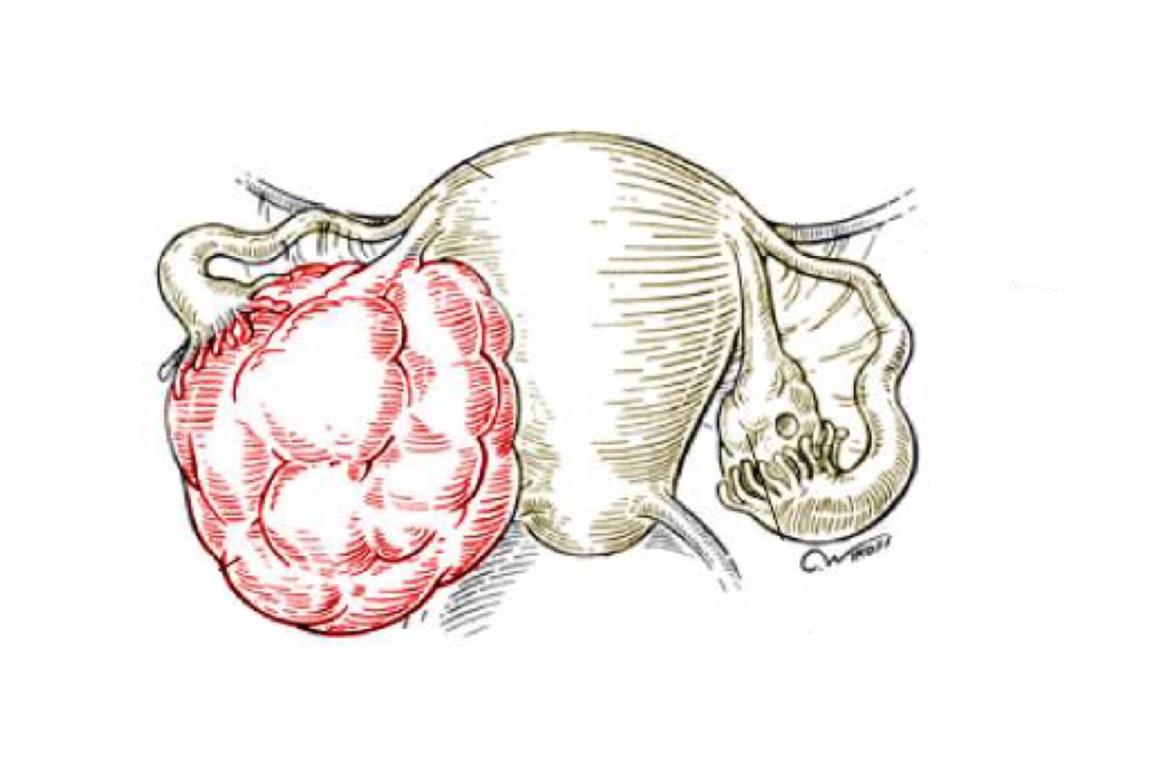
Uterine Cervix
Objectives:
Some common benign conditions and infections
Understand the concepts of dysplasia and intraepithelial neoplasia in the female genital tract and the role of a cervical screening programme.
Know the incidence, risk factors, clinical presentation, pathological features and prognosis of cervical squamous cell carcinoma.
• Black: Doctors’ slides. • Red: Important! • Light Green: Doctors’ notes • Grey: Extra. • Italic black: New terminology.

Slide 2
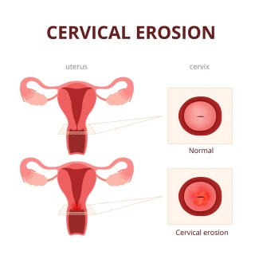
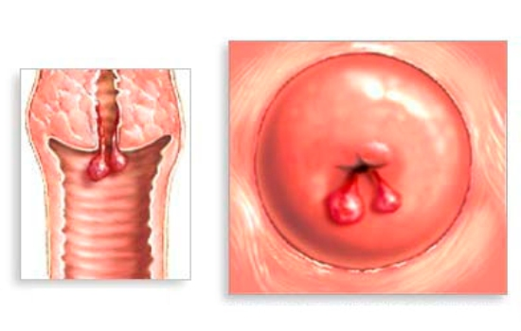
Common benign conditions and infections
Benign conditions of the cervix:
Erosion/ectropion of cervix: When squamous epithelium is replaced by columnar epithelium, grossly resulting in an erythematous area. It is a typical response to a variety of stimuli, such as chronic irritation and inflammation (chronic cervicitis), including hormones. It is benign and has no malignant potential. | Squamous metaplasia of cervix: Columnar cells are replaced by squamous cells. It is seen in cervix at the squamo-columnar junction. Squamous metaplastic epithelium is the area that is most affected by HPV infection and the area where dysplasia and malignant transformation starts. Note: squamous metaplastic epithelium is benign and by itself is not considered premalignant). Only when you have dysplasia it is considered premalignant.
Cervical polyp: This is a small, pedunculated mass. Most polyps originate from the endocervix (endocervical polyps) and few from the ectocervix (ectocervical polyps). They are not true neoplasms. This lesion is characterized by: Overgrowth of benign cervical stroma covered by cervical epithelium: the epithelium covering the polyp can be columnar or stratified squamous or sometimes partly both. *Remember: the normal epithelium lining the cervix is simple columnar in the cervical canal (endocervical), but it changes to stratified squamous epithelium (non-keratinized) at the external os (ectocervical). The stroma is made up of fibrous tissue with thick-walled blood vesselels and inflammatory cells. | Cervicitis: Inflammation of cervix. Can be: Non-infectious. Infectious.
Extra
Extra: Ectocervical polyp:

Slide 3
Cervicitis:
Noninfectious Cervicitis (Nonspecific)
It is an inflammation of the cervix caused by chemical (e.g. douche) or mechanical (e.g. tampon, diaphragm) irritation.
It can be acute or chronic.
Clinical appearances:
Often asymptomatic.
The cervix appears red and swollen
Histology:
The inflammatory cells are seen (neutrophils, plasma cells and lymphocytes).
Squamous metaplasia is common in chronic cervicitis. Any irritation will lead to squamous metaplasia.
Infectious Cervicitis
Can be caused by various organisims e.g. staphylococci, enterococci, Gardnerella vaginalis, Trichomonas vaginalis, Candida albicans and Chlamydia trachomatis and HPV.
Most often involves the endocervix.
May be asymptomatic
May manifest as vaginal discharge or itching
Infections of the cervix:
Trichomoniasis: It is caused by a unicellular flagellated protozoa called Trichomonas vaginalis. It is a sexually transmitted disease. It involves the vagina and the cervix. Clinical presentation: Vaginal discharge: Greenish-yellow frothy and foul smelling. Painful urination. Vulvovaginal itching or irritation. Dyspareunia (Difficult or painful sexual intercourse). Pap smear (cytology) shows: The organism can be identified in the Pap smear slides in a background of inflammatory cells. They can also be visualized by examination of a saline wet preparation in which the motile trophozites are seen. | Candidiasis (Moniliasis): Common. Caused by Candida albicans, a normal component of the vaginal flora. Involves the cervix and the vagina, Associated with diabetes mellitus, pregnancy, antibiotic therapy, oral contraceptive use and immunosupression. Characterized by white patchy mucosal lesions with thick curdy white discharge and vulvovaginal pruritis. Ulcers may develop. Cytology smears show: Fungal colonies in the form of spores and branching pseudo-hyphae on the cervical epithelium. Chronic inflammatory cells are present.

Slide 4
Explanation of the previous slide:
The difference between cytopathology and histopathology:
Candidiasis is associated with long standing antibiotics, remember when we said in endocrine that Candidiasis is almost always associated with immunosuppression? So keep in mind that any condition reducing the immunity could lead to Candidiasis.
Case scenario
A young girl in her twenties came to clinic and said “I had acne on my face and I took antibiotics but now I have a very bad vaginal itching”.
Why does this happen ?
Antibiotics change the vaginal PH which in turn affect the normal flora and therefore candida can multiply
Treatment: Stop the antibiotic treatment and the candida infection will resolve.
Cytopathology | Histopathology
The study of cells. | The study of the tissues.
Chlamydia trachomatis Cervicitis: Chlamydia trachomatis is an obligate, gram-negative intracellular pathogen. Chlamydia cervicitis is the most common sexually transmitted disease in the developed countries. It may coexist with Neiserria gonorrhoeae infection. It is a frequent cause of pelvic inflammatory disease. Chlamydial infection can also cause a condition known as lymphogranuloma venereum. Clinically: Is most often asymptomatic. In symptomatic cases: there is a mucopurulent cervical discharge with a reddened, congested and edematous cervix. It may be associated with urethritis. | Herpes simplex virus: HSV type 2 infection accounts for majority of genital herpes cases and is spread by sexual contact. It produces vesicles and ulcers that can involve the cervix, vagina, vulva, urethra and perianal skin. Pap smear: Show multinucleated cells with intracellular “Cowdry type” viral inclusions. Nuclei have ground glass appearance due to accumulation of viral particles.

Slide 5
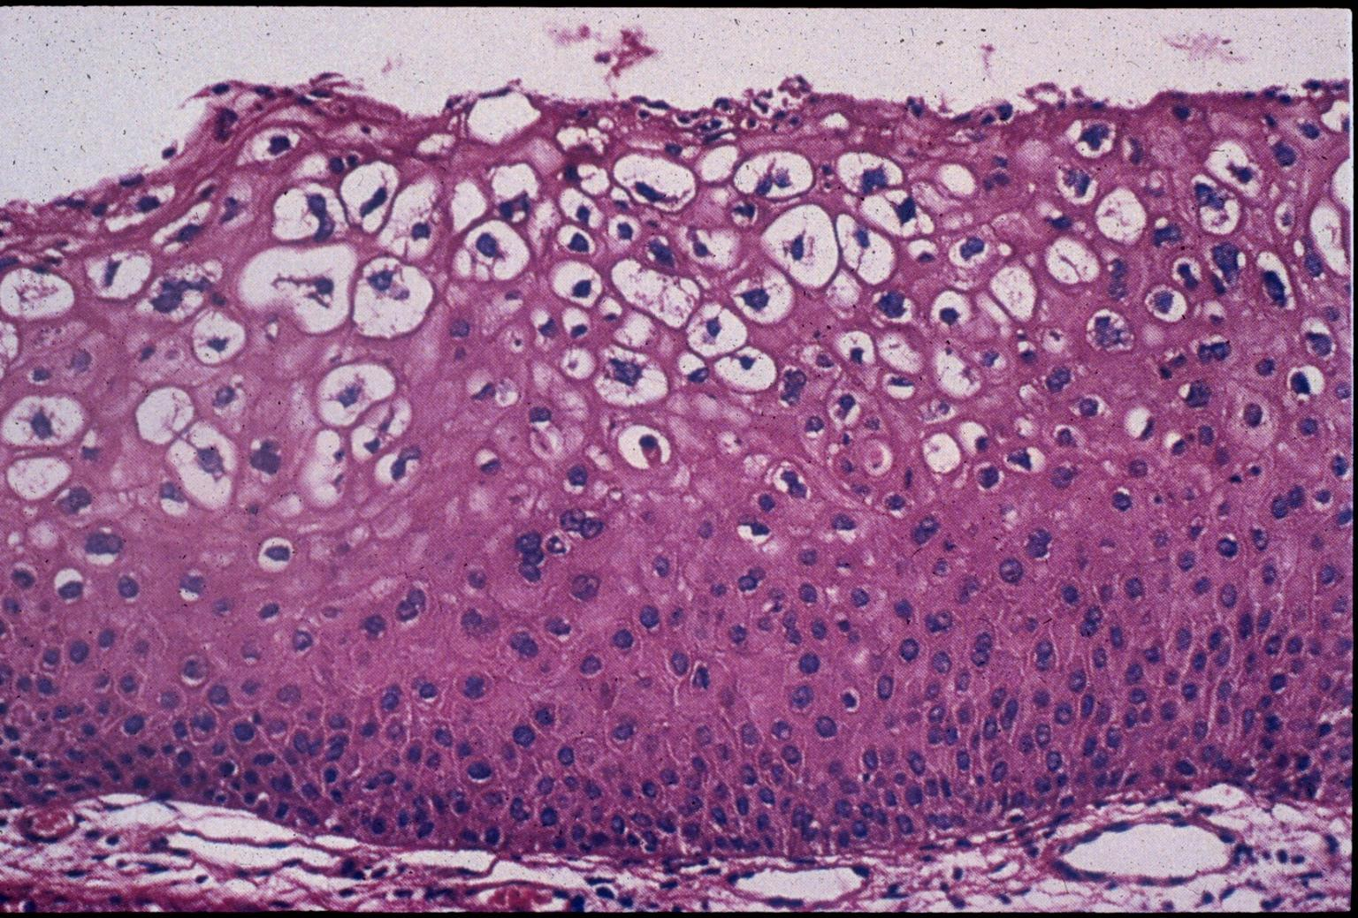
Human papilloma virus (HPV) infection:
HPV infection of the cervix is common.
Over 20 serotypes of HPV infect the female genital areas and cause a variety of different lesions depending on the serotypes.
Clinical behavior:
HPV infection causes koilocytic atypia in the cervical squamous epithelium
HPV infection is associated with increased risk of subsequent cervical cancer.
HPV infection may cause any of the following depending on serotype:
Condyloma: Usually caused by HPV serotypes 6 and 11.
It develops in the squamous epithelium of the ectocervix.
The lesions may be flat or exophytic (called exophytic condyloma acuminatum).
Mild dysplasia: is usually caused by "low risk" HPV serotypes, 6 and 11.
High- grade dysplasia: is caused by "high risk” HPV (types 16 and 18) and moderate risk HPV (types 31, 33 and 35).
Koilocytes:
Are squamous epithelial cells that have undergone structural changes due to infection of the cells by HPV.
They show koilocytosis or koilocytic atypia which is:
Nuclear enlargement
Irregular nuclear membrane
Nuclear hyper-chromasia
Perinuclear halo (clear area around the nucleus).

Slide 6
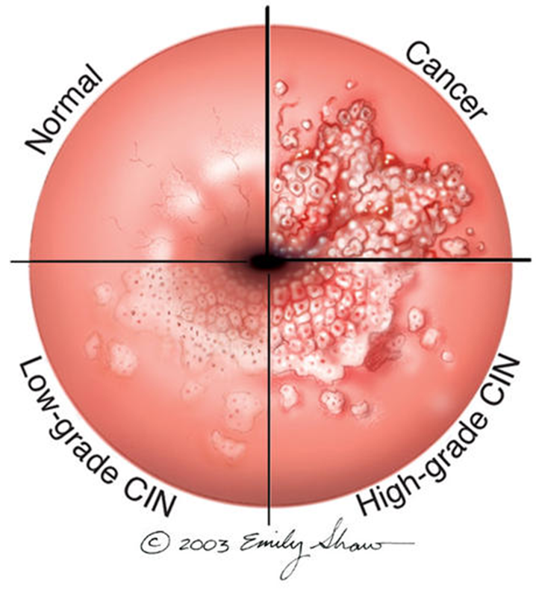
Understand the concepts of dysplasia and intraepithelial neoplasia in the female genital tract and the role of a cervical screening programme.
Cervical carcinoma:
The most common cervical cancer is squamous cell carcinoma. Other types are adenocarcinoma, neuroendocrine carcinoma, etc.
Cervical carcinoma used to be a major cause of cancer-related death in women. Nowadays there is dramatic improvement in management of this disease because now there is early diagnosis (and therefore early treatment). As a result deaths due to cervical cancer are decreasing.
The early diagnosis is due to the use of a screening method/program called PAP screening test.
The wide use of PAP screening program has lowered the incidence of invasive cancer and deaths by it.
Precancerous lesion of cervical carcinoma:
1. Cervical intraepithelial neoplasia (CIN)
2. Or Squamous intraepithelial lesions (SIL).
All invasive squamous cell carcinomas arise from non invasive pre-cancerous cervical squamous epithelium called cervical intraepithelial neoplasia (CIN) or squamous intraepithelial lesions (SIL).
Note: not all cases of CIN/SIL progress to invasive cancer and some cases of CIN/SIL may spontaneously regress.
Cases of high grade CIN/SIL have a higher risk of progression to cancer. High grade CIN/SIL are associated the high-risk HPV serotypes.
Timely detection and diagnosis of CIN/SIL is essential in preventing the development of invasive carcinoma.
When to use the right terms :
When we use histopathology the term we use is Cervical intraepethelial neoplasm , and if the sample is sent to the cytopathology we scrape the cell from the cervix and spread them on the slide and we will be using the term “Squamous intra-epethelial lesion”

Slide 7
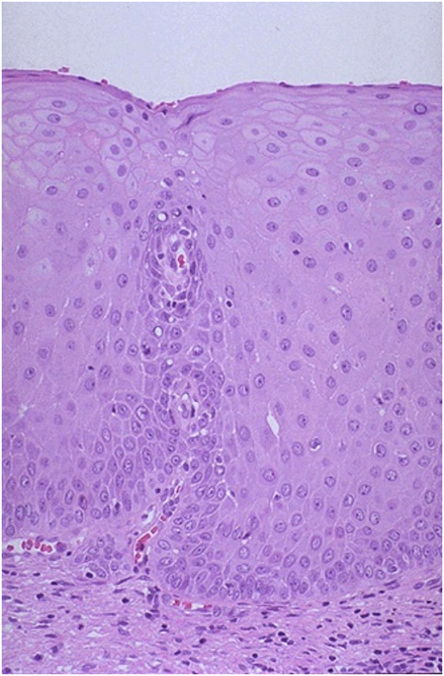
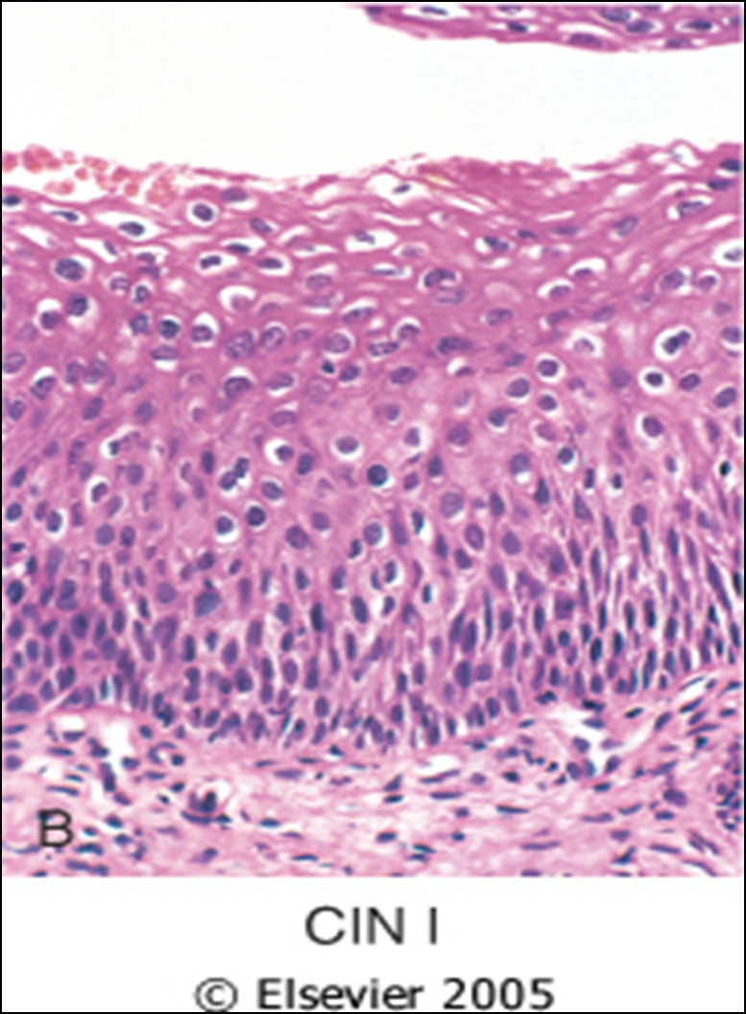
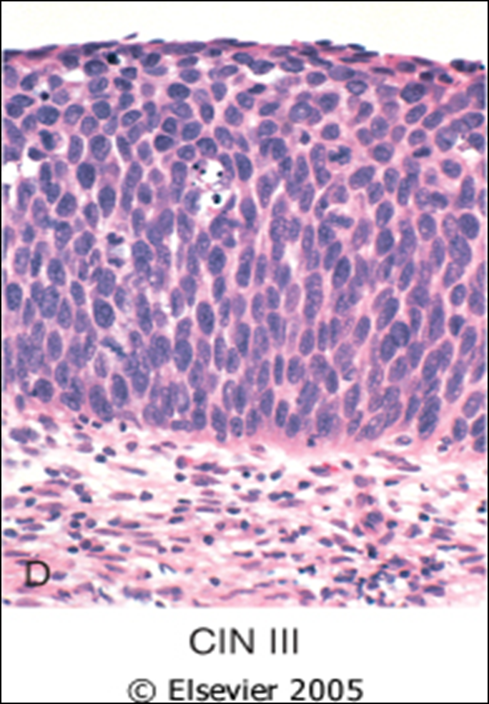
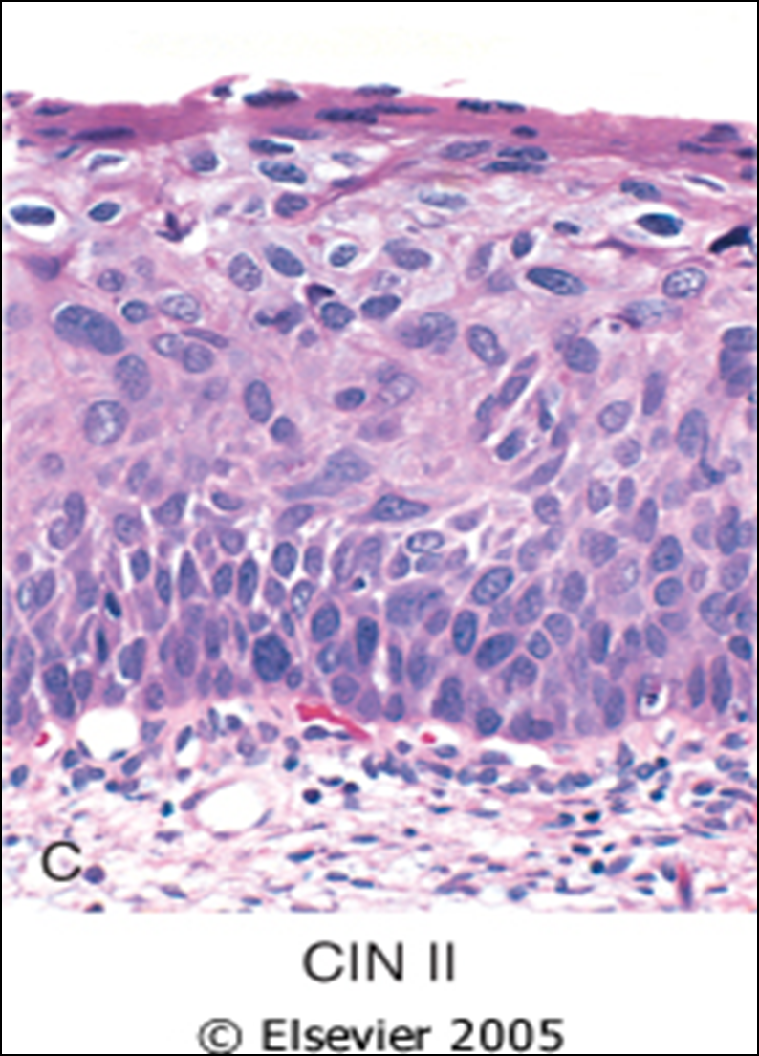
CIN are precancerous lesions of the cervix.
Pre-cancer changes can precede the development of invasive cancer by many years.
Cervical intraepithelial neoplasia (CIN) terminology is used for histological reporting
CIN lesions may begin as Low Grade CIN and progress to High Grade CIN, or they might start straight away as High Grade CIN.
On the basis of histology: pre-cancer lesions are graded as follows:
CIN I : Mild Dysplasia
CIN II : Moderate Dysplasia
CIN III : Severe Dysplasia and Carcinoma in situ (CIS).
Normal
CIN I = Mild dysplasia
with HPV associated koilocytotic atypia. Lower 1/3rd of the epithelium is replaced by pleomorphic cells.
CIN II = Moderate dysplasia
There is progressive atypia in the layers of the epithelium; lower 2/3rd of the epithelium is replaced by pleomorphic cells
CIN III (CIS) = Severe dysplasia
There is diffuse atypia and loss of maturation. All levels of the epithelium are replaced by pleomorphic cells (full thickness) until here, it is considered as PRECANCEROUS not cancerous! Since the basement membrane is still intact.

Slide 8
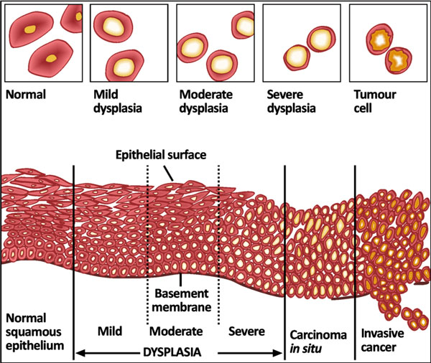
PAP SCREENING TEST: CYTOLOGY SCREENING FOR PRECANCEROUS LESIONS
Cytologic examination can detect precancerous squamous intraepithelial lesions long before any abnormality can be seen grossly, using the PAP screening test.
PAP test is the cytologic examination of the cells of cervix.
Cervix is examined and the cells lining the cervical wall at the sharp transformation zone (site of epithelial changing between columnar and squamous) sampled with a spatula and then transferred onto a slide, processed, stained (with Papanicolaou stain) and then examined under a light microscope to look for squamous intraepithelial lesions (SIL) and a diagnosis is made.
This screening for pre-cancer should be done on all women usually from age of 21 years and onwards.
The terminology used in Pap smears is squamous intraepithelial lesions (SIL).
About 1 to 5% of low Grade SIL become invasive squamous cell carcinomas
About 6 to 74% of high Grade SIL become invasive squamous cell carcinomas
PAP results
SIL
Low Grade
High Grade
Normal cells/ Negative
CIN1/mild dysplasia
CIN2 and CIN3/ moderate to severe dysplasia

Slide 9
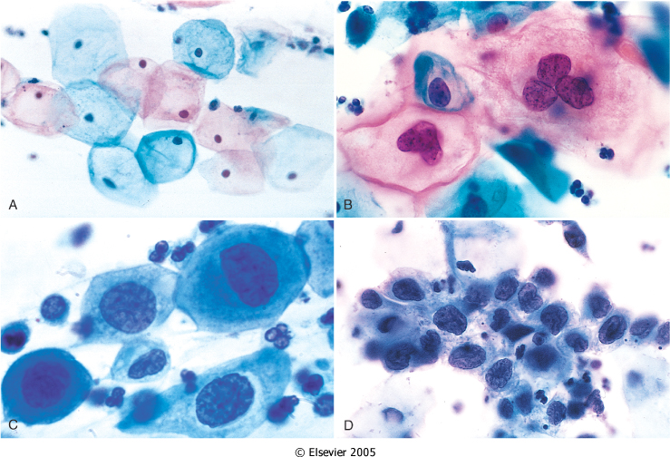
A: Normal exfoliated superficial squamous epithelial cells.
B: CIN I/ low grade SIL
C: CIN II/ high grade SIL.
D: CIN III/ high grade SIL.
Note the reduction in cytoplasm and the increase in the nucleus to cytoplasm ratio, which occurs as the grade of the lesion increases. This reflects the progressive loss of cellular differentiation on the surface of the lesions from which these cells are exfoliated.
Papanicolaou smear
Risk Factors and causes for CIN/ SIL and cervical carcinoma :
Risk Factors:
Early age at first intercourse.
Multiple sexual partners.
A male partner with multiple previous sexual partners.
Persistent infection by high risk papillomaviruses.
Other risk factors: low socioeconomic groups.
Rare among virgins and multiple pregnancies.
Cause :
The HPV virus. The HPV is the number one cause for abnormal cells of the cervix.
HPV is a skin virus, which results in warts, common warts ,flat warts, genital warts (condylomas), planter warts, and precancerous lesions.
HPV can be detected in 85 -90 % of pre-cancer lesions.
High risk types HPV : 16, 18, 31, 33, 35, 39, 45, 52, 56, 58, and 59.
Low risk types HPV :6, 11, 42, 44 . These types result in condylomas.
Treatment :
Laser or cone biopsy is the most effective method of managing patients with High grade SIL in cancer prevention

Slide 10
CIN/SIL & RULES OF PAP TEST :
Should start pap test by the age of 21.
For women between age 21 to 29: pap test should be done every 3 years
For women between age 30-64 : there are 2 possibilities
Either do only pap test once every 3 years
Or do two tests (co-testing) at the same time → the pap test + DNA in-situ hybridization HPV testing, every 5 years.
Note:
Women with SIL/CIN have no visible signs or symptoms and it is difficult to diagnose SIL/CIN without a Pap smear/exam.
Therefore regular pap exams should be done on women, to detect any SIL.
It is a common testing procedure for HPV infection. The Pap smear detects HPV infection early.
This HPV DNA in-situ hybridization (ISH) test, is called the Diegene Hybrid Capture test. It is done to identify the serotype of the HPV. This test will determine whether you carry high or low risk strains of the virus. HPV DNA screening test should not be used before age 30 if pap test is normal.
Invasive Cervical Carcinoma :
About 75-90% of invasive cancers are squamous cell carcinomas.
The remainder are Adenocarcinoma.
It is the 8th most common cause of cancer death in women in US now (was #1 in 1940's); still #1 in other countries
Reduction in the West is due to Papanicolaou smear test which detects premalignant lesions.
Morphology:
The tumors may be invisible or present as an exophytic mass. (tending to grow outward beyond the surface epithelium from which it originates) .
Cervical carcinomas are graded from 1 to 3 (i.e. well, moderately and poorly differentiated) based on cellular differentiation and staged from 1 to 4 depending on clinical spread.

Slide 11
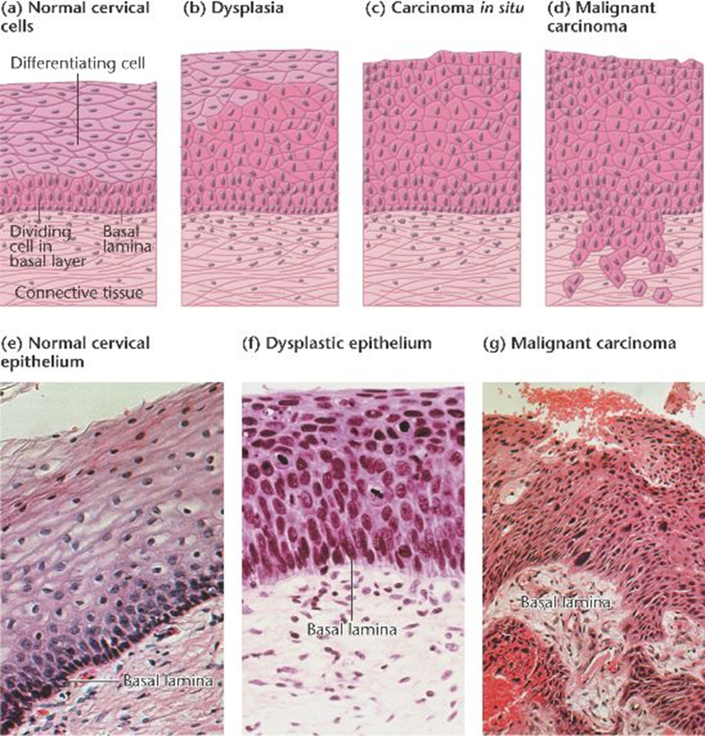
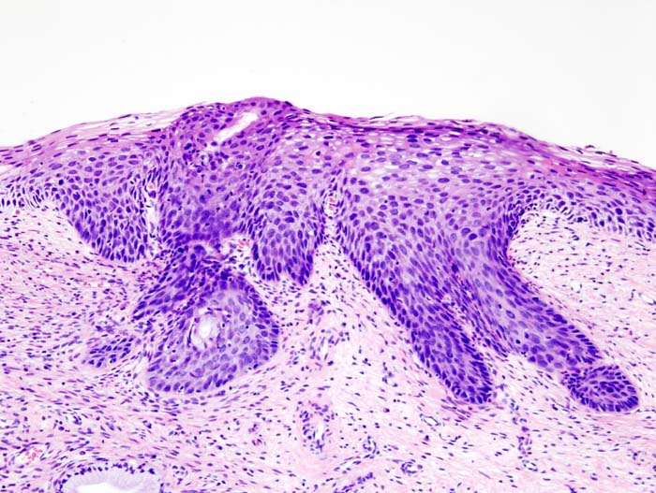
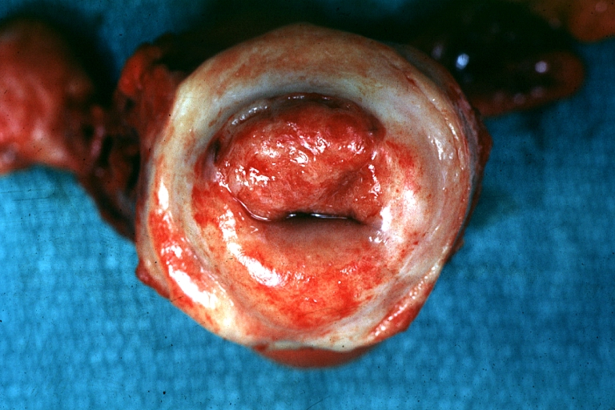
Figures
Cervical cancer

Slide 12
Know the incidence, risk factors, clinical presentation, pathological features and prognosis of cervical squamous cell carcinoma.
INVASIVE SQUAMOUS CELL CARCINOMA OF CERVIX:
Squamous cell carcinomas typically arise from pre-cancer CIN/SIL lesions at the transformation zone.
Mean age: 51 years, uncommon before age 30 years but most are ages 45 - 55 years.
Nowadays, due to the pap screening test, many of cervical cancers are diagnosed in early stages, and majority are diagnosed in the pre-invasive CIN/SIL phase.
Advanced cases of Squamous cell carcinoma are seen in women who either have never had a Pap smear or have waited many years since the last pap smear.
Clinical & pathological features :
The early stages of cervical cancer may be completely asymptomatic.
On colposcopy examination (invasive surgical examination used if PAP was positive) : cervix shows a mosaic vascular pattern and the lesions appear as white patches after application of acetic acid to cervix
Vaginal bleeding, contact bleeding, or cervical mass.
Dyspareunia.
In advanced disease, metastases may be present in the abdomen, lungs or elsewhere. anteriorly: urinary bladder (can make a hole into the bladder) posteriorly: rectum ( can make a hole into the rectum). Can be both anterior and posterior metastasis and causes interconnected holes which causes a complex case scenario ( patient will have loss of appetite , weight loss , pelvic pain, back pain, leg pain, swelling legs, heavy bleeding from vagaina , bone fractures and sometime leakage of urine and feaces from vagina (in advanced cases)).
Symptoms of advanced cervical cancer may include: loss of appetite, weight loss, fatigue, pelvic pain, back pain, leg pain, swollen legs, heavy bleeding from the vagina, bone fractures, and/or (rarely) leakage of urine or feaces from the vagina.

Slide 13
Cervical Carcinoma: Treatment:
Depending on the stage there are different treatment options:
If patient wants to be able to have children, the cancer is removed with a cone biopsy (cervical conization), and then followed up regularly.
Simple hysterectomy (removal of the whole uterus including part of the vagina).
Radical hysterectomy (removal of the whole uterus including part of the vagina along with the removal of lymph nodes in the pelvis.
Chemotherapy and radiotherapy maybe needed in advanced cases.
Cervical Carcinoma: Staging: (for your information only)
Zero: Carcinoma in Situ
1: Confined to the cervix
2: Extension beyond the cervix without extension to the lower third of Vagina or Pelvic Wall
3: Extension to the pelvic wall and/or lower third of the vagina
4: Extends to adjacent organs

Slide 15
Questions
1- A 32-year-old female during postpartum came to the hospital complaining of purulent vaginal discharge. Biopsy showed columnar epithelium and acute inflammation. Culture was requested, which of the following organisms is the most likely cause?
A- T. Vaginalis.
B- C. Trachomatis.
C- Neisseria gonorrhoeae.
D- Staphylococcus aureus.
ANS: D, This is acute cervicitis which is limited to women in the postpartum period and usually caused by staph or strept.
2- Which of the following is false about HPV?
A- The main cause of Cervix neoplasia.
B- Most are non-transient and chronic.
C- Acts on immature squamous cells.
D- Replicates its DNA in differentiated squamous.
ANS: B
3- HPV causes differentiated squamous cells which don’t normally replicate DNA to replicate HPV’s own DNA. How?
A- By immaturation.
B- Acting on CTKLA.
C- Inactivating P53 and Rb.
D- By division.
ANS: C, HPV has two important proteins, E6 and E7 which inhibit p53 and Rb respectively. Promoting growth and susceptibility to more mutatuions.
4- HPV alone is not sufficient to drive the neoplastic process. Which of the following also contribute to neoplasia of the cervix?
A- Co-Infections.
B- LKB1 Mutations.
C- Immunodeficiency.
D- All of the above.
ANS: D

Slide 16
Questions
5- A 37-year-old sexually active woman comes for a routine examination. She has been taking Oral contraceptives for 7 years. PAP smear revealed HSIL. Which of the following is the most likely pathogenesis?
A- Multiple sexual partners.
B- Estrogen stimulation.
C- Inheritance of Tumor suppressor gene mutation.
D- Viral inactivation of Rb1 gene.
ANS: D
6- A 34-year-old woman has a routine Pap smear for the first time. The results indicate that dysplastic cells are present, consistent with HSIL, also called cervical intraepithelial neoplasia III. Which of the following is likely to be done in her case?
A- Observe for 3 months.
B- Conization.
C- Aggressive chemotherapy.
D- Radiotherapy.
ANS: B
7- A 33-year-old woman comes to her nurse practitioner for a routine health maintenance examination. On physical examination, there are no abnormal findings. A Pap smear reveals Dysplasia extending to the middle third of epithelium with some pleomorphism and mitosis. In which stage is she?
A- CIN I
B- CIN II
C- CIN III
D- SCC.
ANS: B
8- A 39-year-old woman presented with leukorrhea and painful coitus. The physician performed a physical examination from which he identified a barrel cervix. Which of the following is true in her case?
A- HSIL in an early stage.
B- CIN I
C- Invasive carcinoma of the cervix.
D- Cervicitis.
ANS: C

Slide 17
حسبي الله لا إله إلَّا هو عليه توكلت وهو رب العرش العظيم.
الأعضاء
صقر التميمي
عبدالرحمن الراشد
ريان القرني
خالد العيدان
محمد اليوسف
عبدالمجيد العمار
دينا النويصر
القادة
حنين السبكي
هبة الناصر
عبدالله أبو عمارة
Editing File
Email: pathology436@gmail.com Twitter: @pathology436
References: Doctor’s slides + notes, Robbins basic pathology 10th edition.

