Slide 1


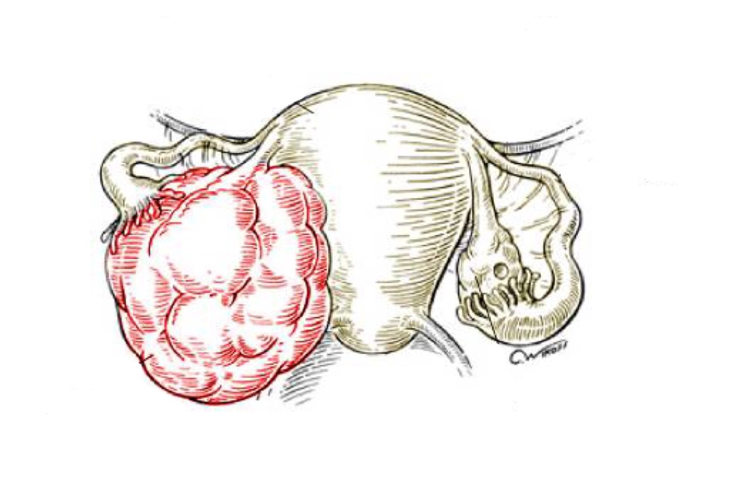

Breast Cancer
Objectives:
Know the risk factors for the development of breast cancer
Know the classification of breast cancer
Understand the behavior and spread of breast cancer
Know the prognostic indicators of breast carcinoma
• Black: Doctors’ slides. • Red: Important! • Light Green: Doctors’ notes • Grey: Extra. • Italic black: New terminology.

Slide 2
Know the risk factors for the development of breast cancer
Breast cancer
Carcinoma of the breast is one of the most common cancer in women. But now adays lung cancer had become the most common cancer in women .
Women who live to age 90 have a one in eight chance of developing breast cancer.يعني من كل ٨ نساء عاشوا لعمر ال٩٠ وحدة يجيها بريست كانسر
Mammographic screening has dramatically increased the detection of small invasive cancers.
DCIS Ductal carcinoma in situ –the precursor lesion for breast cancer by itself is almost exclusively detected by mammography, so the incidence of DCIS is increased with the use of mammography. Therefore a number of women with invasive/advanced cancer is markedly decreased. أعداد اللي تشخصوا بالدكتل كارسينوما ان سيتو زادت لأن صاروا يكتشفوها مبكر قبل ما يتحول لكانسر و يعالجونها و بالتالي قلت أعداد النساء المصابين بالكانسر
The mortality rate have started to decline. Currently only 20% of the women with breast cancer are expected to die of the disease.
Classification “depending on the etiology”
Hereditary Breast Cancer (family history or germ line mutation):
A family history of breast cancer in a first-degree relative.
About 25% of familial cancers (or around 3% of all breast cancers the rest 97% are sporadic ) can be attributed to two autosomal-dominant genes: BRCA1 and BRCA2.
Sporadic Breast Cancer: Any other cause other than Hereditary !
The major risk factors for sporadic breast cancer are related to hormone exposure, gender, age at menarche and menopause, reproductive history, breast-feeding, and exogenous estrogens.
The majority of these cancers occur in postmenopausal women and incase of overexpression of estrogen.
Etiology in most women is unknown but most likely is due to a combination of genetic, hormonal and environmental risk factors.
The major risk factors being hormonal and genetic (family history).

Slide 3
Risk factors:
Age | Increased incidence in older women Majority >50 years of age. Rare before 25 years except in familial forms.
Estrogen Exposure | Factors associated with exposure to increased levels of estrogen have been shown to increase a woman’s risk for breast cancer. These factors include: ● Early age at menarche: the younger the age at menarche, the higher her risk of breast cancer. Because she will be exposed to estrogen at an early stage . ● Late age at menopause ● Nulliparity (no break 9 months from estrogen)because women who gets pregnant, progesteron dominate and decrease estrogen so they are less exposed to estrogen , in contrary to Nulliparous women. ● Late age at first child-birth: e.g. A woman who has her first birth after 30 years has an increased risk. The earlier a woman has her first birth, the lower her lifetime risk for breast cancer. the earlier is better , because age is a risk factor too ! ● Also postmenopausal hormone replacement slightly increases the risk.
First Degree relative with Breast Cancer Personal history of breast cancer could also be a risk factor either on the contralateral breast or as a recurrence on the same breast | Women with history of cancer in a first degree relative ,Example: Mother, sister, aunt or daughter. ● The risk increases with the number of affected first degree relatives as well. ● At least two genes that predispose to breast cancer → BRCA 1 & 2 ● Majority of cancers occur in women without such history.As we said sporadic is the most common form
Race & Geographic influence | ● Low Incidence in African American women. ● Generally Caucasians have the highest rate of breast cancers ● Breast cancer is more common in Western industrialized countries than in developing countries.
Exercise | Lower risk
Breast feeding | The longer the women breastfeed, the lower the risk. Estrogen decreases during breastfeeding

Slide 4
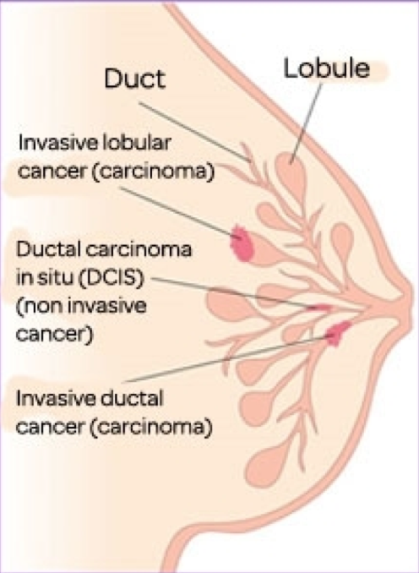
Radiation exposure | High rates of breast cancer
History of breast cancer | Women who have had a breast cancer or have cancer In one breast are at increased risk of devolping a second primary breast caner .
History of other cancers | Example: Ovarian or endometrial cancers are at high risk.
Certain breast disease | As noted previously women with certain types of benign breast diseases are at risk.
Obesity and Dietary factors | Example: high fat intake and excessive alcohol consumption.
Environmental toxins | Pesticides.
Tobacco | Not associated with breast cancer, but associated with the development of peri-ductal mastitis, or sub-areolar abscess. it could be a contributing factor to breast cancer , but it’s nota main reason
Know the classification of breast cancer
Almost all (majority) are adenocarcinomaArising from glands. There are 2 major types
Ductal.
Lobular.
Breast cancer is divided into
Carcinoma in situ (non-invasive).Ductal and lobular
Invasive carcinoma Ductal and lobular

Slide 5
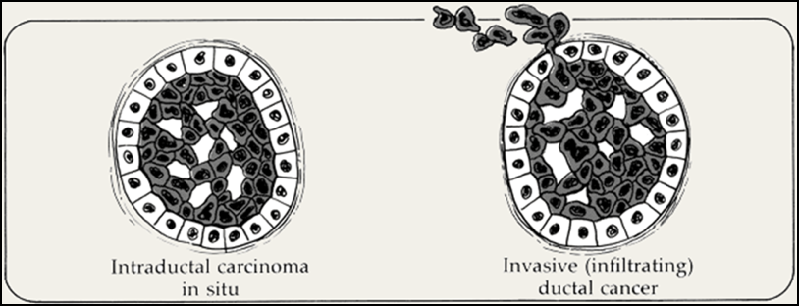
Understand the behavior and spread of breast cancer
Carcinoma in situ
This is epithelial proliferation that is still confined to the TDLU¹ (Terminal duct lobular Unit), has not invaded beyond the basement membrane and is therefore incapable of metastasis.
There are two subtypes:
Ductal carcinoma in situ (DCIS) or intraductal carcinoma (80%).
Lobular carcinoma in situ (20%).
Ductal carcinoma In Situ
DCIS is the non-invasive proliferation of malignant cells within the duct system without breaching the underlying basement membrane.
They have a very high risk of development of subsequent invasive carcinoma.
The tumor distends and distorts the ducts.
Age range: same age range of invasive breast carcinoma.
Often multifocal—malignant cells can spread widely through the ductal system without breaching the basement membrane.
Women with DCIS are at risk of recurrent DCIS following treatment.
On mammography DCIS frequently shows micro-calcifications. Mammography is a very sensitive diagnostic procedure for detecting DCIS since majority of DCIS are not palpable. Less frequently they can present as a mammographic density² if they are very largeor a vaguely palpable mass or nipple discharge.
Because of mammography there has been a marked increase the detection and diagnosis of DCIS in the last two decades.
1:The collecting duct has several branches , which ends in a terminal ductal-lobular unit . The basic functional and histopathalogical unit of the breast .
2:in the breast , region of fat appears darker on mammography , so when you have brighter regions these are called densities .

Slide 6
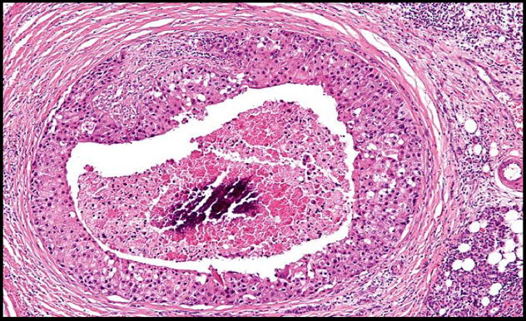
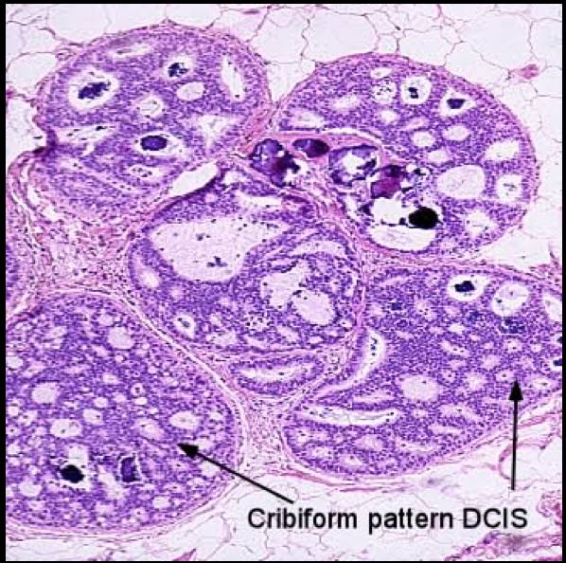
Different patterns/subtypes of DCIS can be seen e.g.
Comedo (central necrosis)
Cribiform (cells arranged around “punched-out” spaces); papillary,
Micropapillary
Solid (cells fill spaces)
DCIS can be of different grades i.e. low, intermediate and high grade.
Comedo-necrosis- DCIS: is characterized by large central zones of necrosis with calcified debris. This type of DCIS is most frequently detected as radiologic calcifications. Less commonly, the surrounding desmoplastic response results in an ill-defined palpable mass or a mammographic density.HOW TO DIFFERENTIATE between comedo DCIS and usual ductal hyperplasia. UDH > two cell types are proliferating while as DCIS just one cell type(clonal proliferation)
Calicifications
Cribriform DCIS : It comprises cells forming round, regular ("cookie cutter") spaces. The lumens are often filled with calcifying secretory material. The difference between this and Atypical DUCTAL hyperplasia , is tha ADH doesn’t involve the whole ducts !

Slide 7
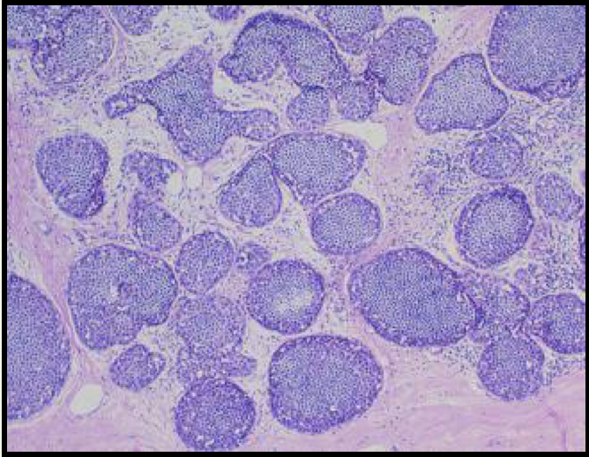
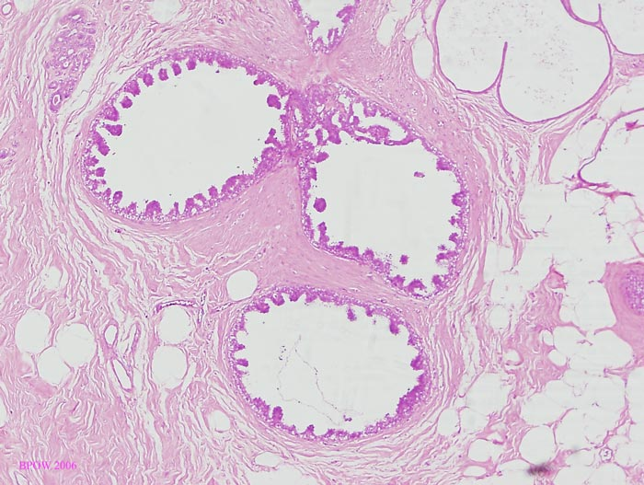
Solid pattern
Micropapillary pattern
Clinical behavior of different types of DCIS
May vary depending on the subtype and the grade
Comedo-carcinoma has essentially a 100% chance of becoming invasive if left untreated.
Pure cribriform/micro-papillary carries only a 30% chance of becoming invasive carcinoma.
Treatment
Wide local excision
Mastectomy
Paget’s Disease it’s a form of DCIS
Paget's disease of the breast is a rare type of breast cancer that is characterized by a red, scaly eczematous lesion on the nipple and surrounding areola.
Paget’s disease may be subtle or appear as an eroded and weeping erythematous eruption.Pruritus itchy is common and it might be mistaken for eczema.it’s almost always mistaken for allergic reaction
Malignant cells are called Paget cells and are found scattered in the epidermis.

Slide 8
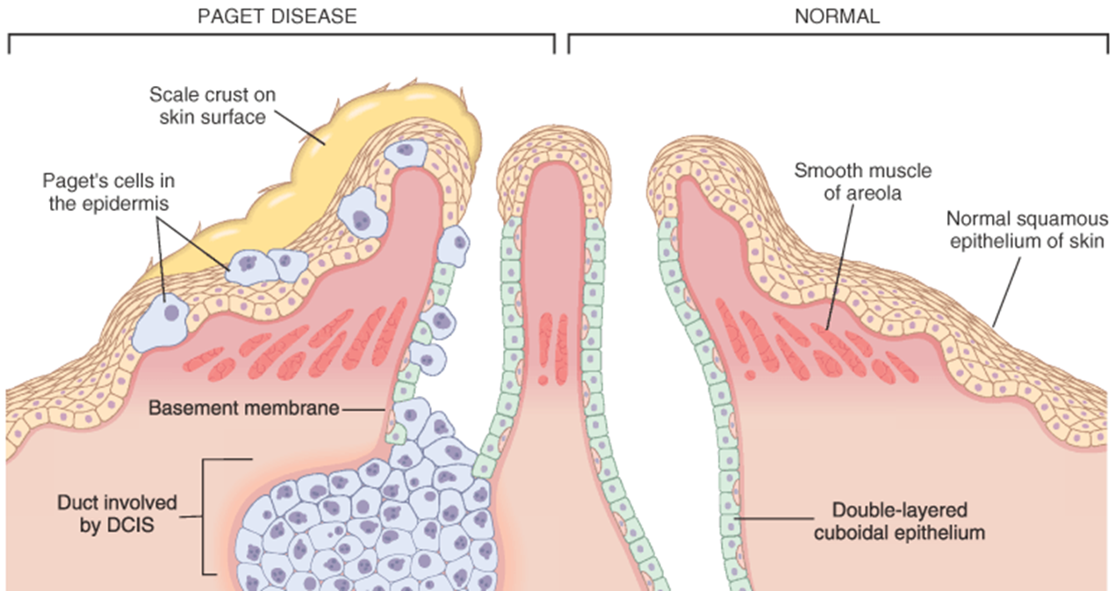
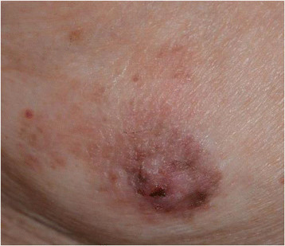
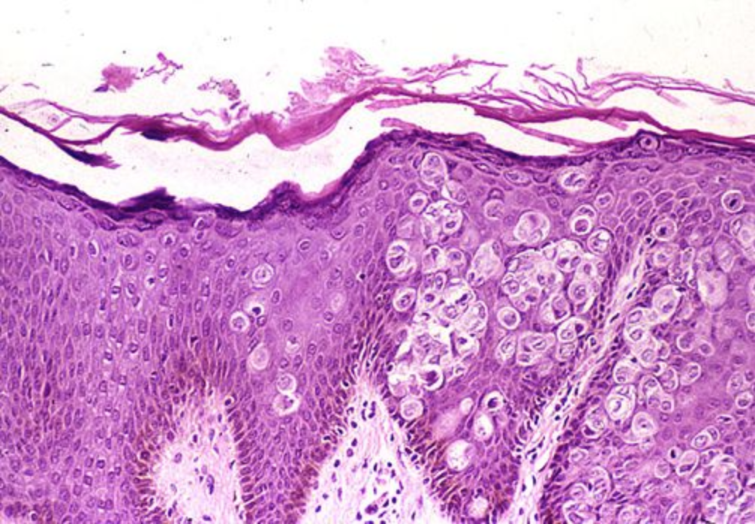
They travel along BM , Underlying the epidermis . NO INVASION !
The histologic hallmark of Paget’s disease of the nipple is the infiltration of the epidermis by large neoplastic ductal cells with abundant cytoplasm, pleomorphic nuclei and prominent nucleoli. The cells usually stain positively for mucin.
Paget cells extend from DCIS within the ductal system into nipple skin without crossing the basement membrane.
Palpable mass can be seen in 50% of women with Paget disease indicating an underlying invasive carcinoma near by. وجود الواحد لا يمنع وجود الآخر
Piaget’s cells
Epidermis

Slide 9
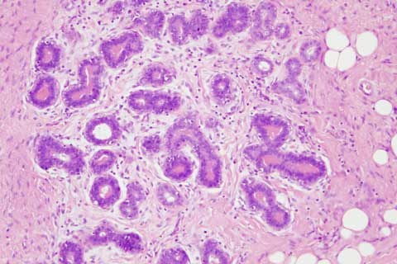
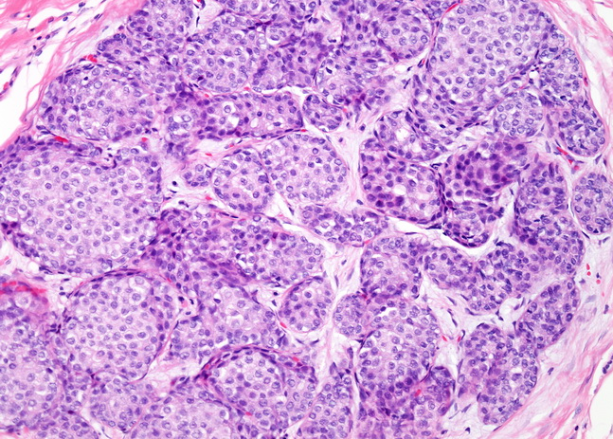
Lobular Carcinoma in situ its very SNEAKY !
LCIS alone is always an incidental finding in breast biopsies performed for another reason.
It does not form a palpable mass and cannot be detected clinically on palpation or on gross pathological examination
Microcalcifications in LCIS are infrequent and so mammography is not useful for detection.
It is uncommon.
It tends to be multicentricinvolving more than one quadrant of the breast. Where as multifocal means involving one quarter of the breast in more than one point. and bilateral and therefore subsequent carcinomas can occur both breasts.
Clinical behavior:
If LCIS is left untreated, about 30% of women develop an invasive cancer within 20 years of diagnosis. The invasive cancer that develops is usually lobular (but can be ductal too).Any combination of any lesions can happen together .
It is a marker of increased cancer risk in both breasts
Histology:
monomorphic population of small, rounded cells fills and expands the acini of lobules.The difference between this and Atypical lobular hyperplasia that ALH fills the lobules but doesn’t expand them and only affect few acini from the lobule .
The underlying lobular architecture can still be recognized.

Slide 10
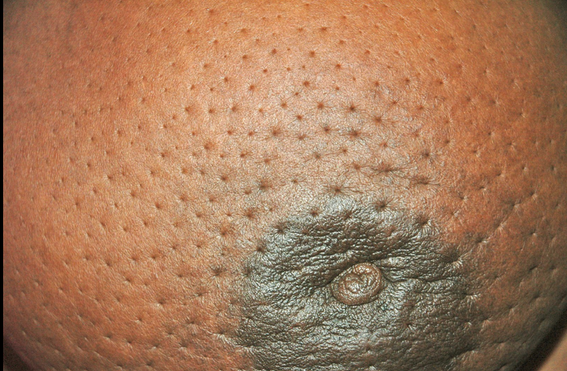
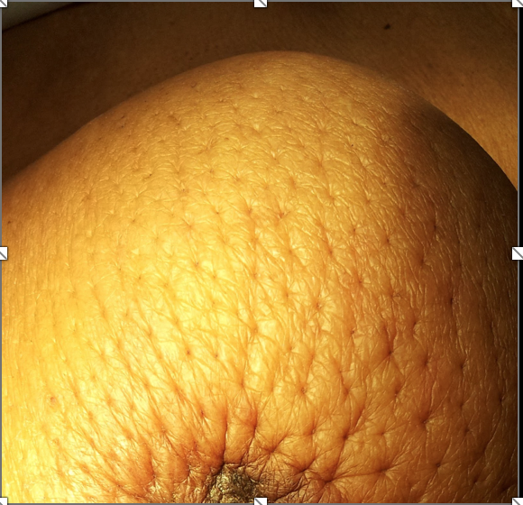
Invasive Breast Carcinoma
Invasive breast carcinoma is a tumor that has extended across the basement membrane.
This permits access to lymphatics and vessels and Therefore the potential to metastasize.
subdivided into:
NOS Ductal 80% (NOS= no otherwise specified)the classical type with NO special features .
Lobular 10%
Tubular 6%
Mucinous(Colloid) 2%
Medullary 2%
Papillary 1%
Metaplastic Carcinoma 1%
Clinical features
Palpable mass.
About half of the patients will have axillary lymph node metastases.
Larger carcinomas may be fixed to the chest wall or cause dimpling of the skin. In contrary to fibro-adenoma (breast mouse). IF u examine someone and u feel a mass that cant be moved , you should be worried!
Lymphatics may become involved , and the lymphatic drainage of that area and the overlying skin gets blocked causing lymphedema and thickening of the skin, a change referred to as peau d'orange.
When the tumor involves the central portion of the breast, retraction of the nipple may develop. But if the retraction is congenital and from long tima ago , then it’s normal .

Slide 11
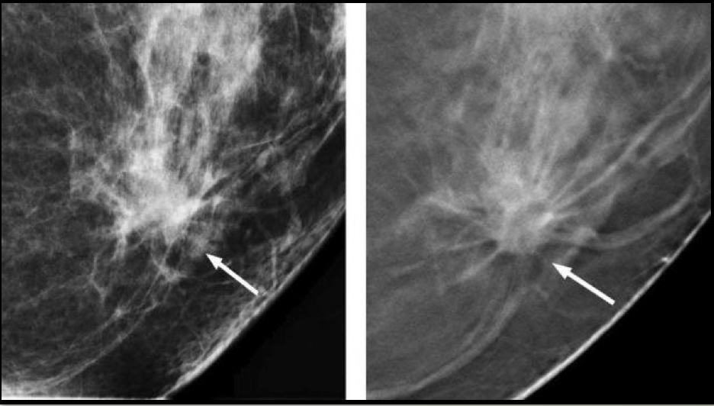
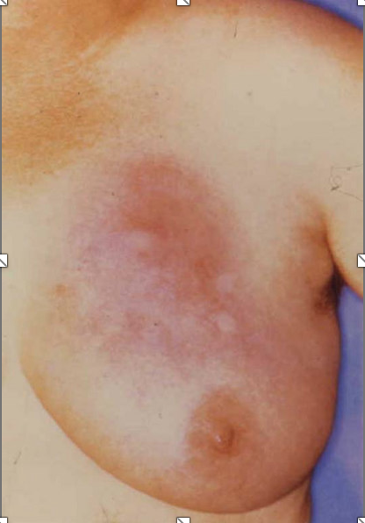
Continue clinical features of Invasive breast cancer
On mammography, invasive carcinomas commonly present as a density.
Invasive carcinomas presenting as mammographic calcifications without an associated density are usually very small in size.
The term "inflammatory carcinoma" refers to the clinical presentation of a carcinoma extensively involving dermal lymphatics, resulting in an enlarged erythematous breast. The diagnosis is made on clinical grounds and does not correlate with a specific histologic type of carcinoma .

Slide 12
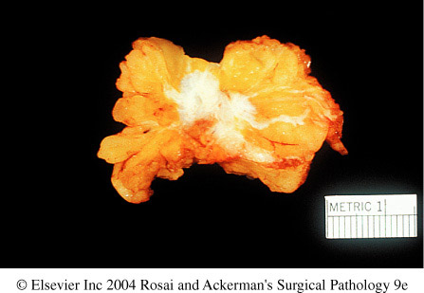
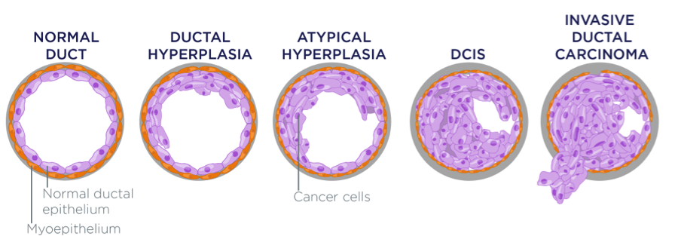
Invasive Ductal Carcinoma, NOS
Invasive Ductal Carcinoma, NOS is the most common type of breast cancer, forming up to 80% of these cancers.
Most of these tumors induce a marked fibroblastic (desmoplastic) stromal reaction to the invading tumor cells producing a palpable mass with hard consistency (scirrhous carcinoma =stone-hard). And therefore a palpable mass is the most common presentation.
The tumor shows an infiltrative attachment to the surrounding structures and may cause dimpling of the skin (due to traction on suspensory ligaments) or nipple retraction. The tumor invades the dermis and they lymphatics within the dermis so it blocks the lyph fluid > it accumulates causing edema and thickening of the breast skin, redness and inflammation . Becauuse breast has fibrous ligaments which cant expand with edema it will pull the breast backwars and orange like breast will appear.
Grossly
tumor is firm, hard, with an irregular border.
Cut surface: gritty Sandy cut surface and shows irregular margins with stellate infiltration (sometimes it can be soft and well demarcated) and in the center there are small foci of chalky white stroma and occasionally calcifications which have characteristic grating sound when cut or scraped .
IDC is usually accompanied by varying amounts of DCIS.
Histology
the tumor cells are large and pleomorphic usually within a dense stroma.
They are adenocarcinomas and so they show glandular formation but can also be arranged in cords or sheets of cells.
The tumors range from well differentiated to moderate or poorly differentiated.
Carcinomas associated with a large amount of DCIS require large excisions with wide margins to reduce local recurrences .
Tumor mass

Slide 13
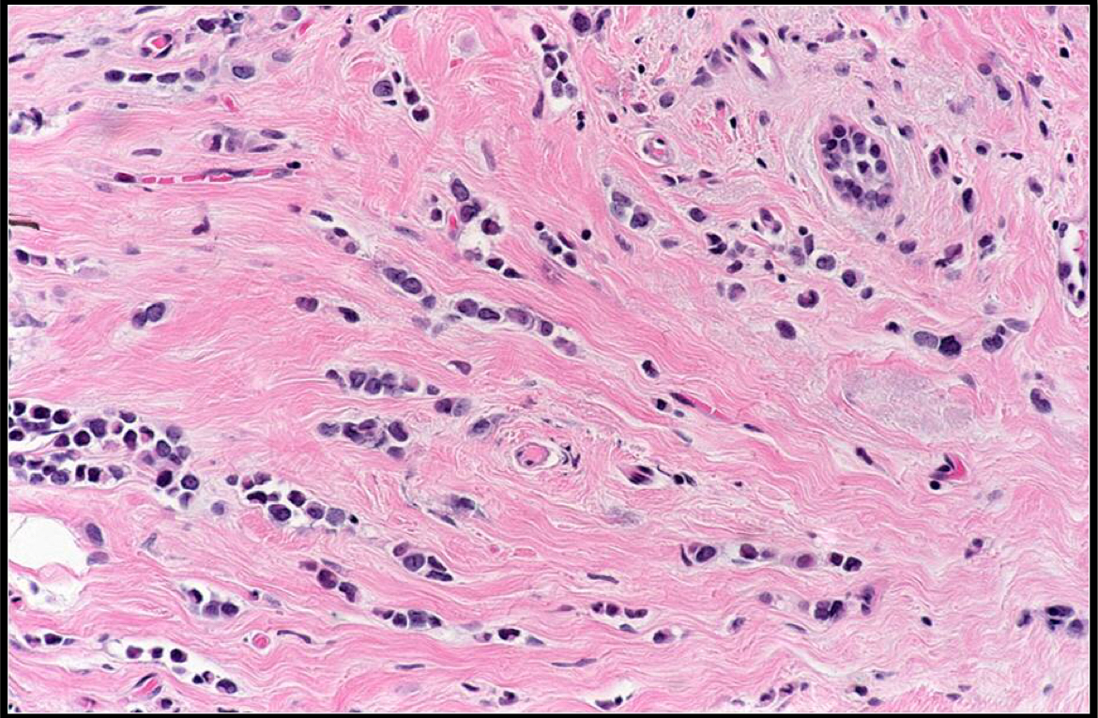
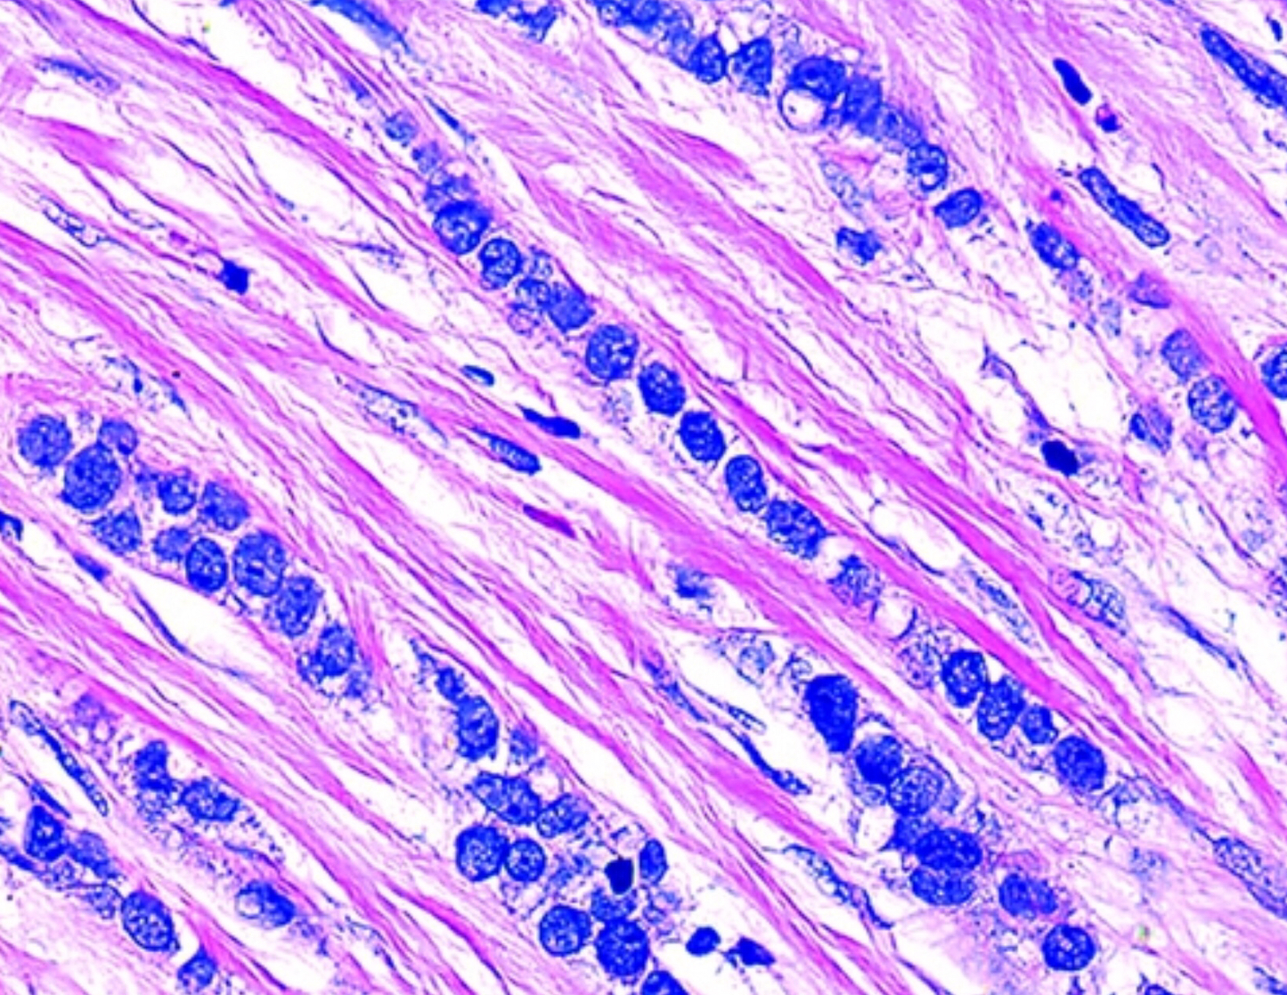
Invasive Lobular Carcinoma usually its bad news !
It is the second most common type of invasive breast cancer forming up to 10% of breast cancers.
The tumor may occur alone or in combination with ductal carcinoma.
It tends to be bilateral and multicentric. (same as LCIS)
The amount of stromal reaction to the tumor varies from marked fibroblastic (desmoplastic) response to little reaction and therefore the presentation varies from a discrete mass to a subtle, diffuse indurated area. Sneakier than LCIS
Most are firm to hard with irregular margins
Histology
single infiltrating malignant cells, forming a line often one cell width (called as indian file patternindians ling time ago used to walk in parallel rows).
No tubules or papillary formation.
Extra

Slide 14
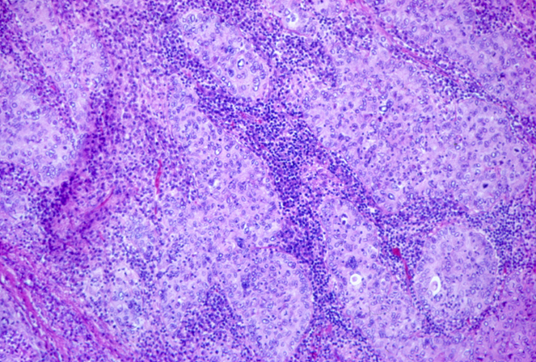
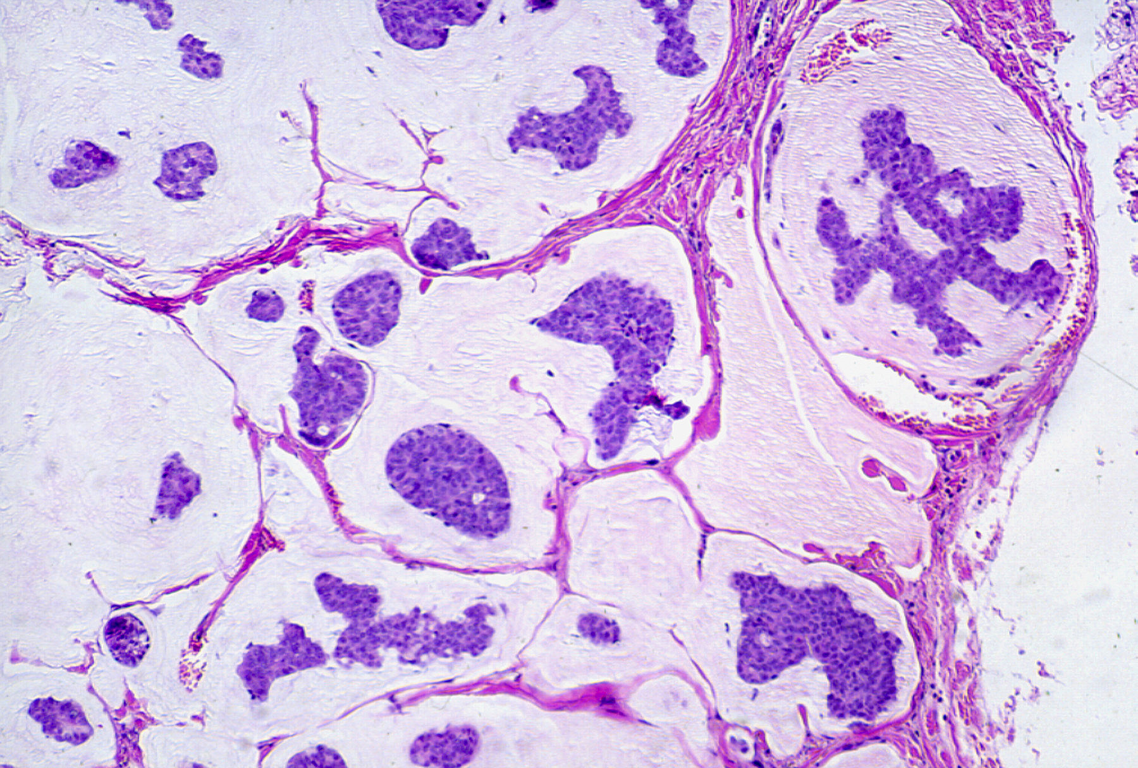
Medullary Carcinoma it comes under Ductal invasive carcinoma DIC
This subtype of breast cancer presents as a well circumscribed massthat doesn’t mean its not malignant .
May be mistaken clinically and radiologically for fibroadenoma
It does not produce any fibroblastic (desmoplastic) reaction and therefore is soft and fleshy.
Histology: the tumor is composed of solid sheets of malignant cells surrounded by many lymphocytes and plasma cells. There is scant fibrous stroma.
Colloid Carcinoma/ Mucinous carcinoma
Tends to occur in older women.
It is sharply circumscribed, lacks fibrous stroma and is slow growing.
Is soft and gelatinous and has a glistening cut surface.
It may be in pure mucinous or mixed with another type of invasive breast carcinoma.
The tumor is composed of small islands of tumors cells and single tumor cells floating in pools of extracellular mucin
Treatment Always surgery , but the extent if surgery depends
Wide local excision(lumpectomy).
Mastectomy:
Simple
Modified radical
radical

Slide 15
Know the prognostic indicators of breast carcinoma
Prognostic Factors Major This important and you have to know which is minor and which is major !
Invasive or In situ disease: Invasive carcinoma has poorer prognosis as it can metastasize. In-situ carcinoma is confined to the ductal/lobular system and cannot metastasize, so it has better prognosis.
Distant metastasis: Once distant metastases is present, cure is unlikely, although long-term remissions and palliation can be achieved. Favored sites for dissemination are the lungs, bones, liver, adrenals, brain, and meninges.
Lymph node metastasis: Axillary lymph node status is the most important prognostic factor for invasive carcinoma. The clinical assessment of nodal involvement is very inaccurate, therefore, biopsy is necessary for accurate assessment. The lymph nodes here are the ones located outside the breast so the tumor metastisized .
Tumor Size: The size of the carcinoma is the second most important prognostic factor. The risk of axillary lymph node metastases increases with the size of the carcinoma.
Note: all the above parameters are used to stage the tumor. Stage is a combination of size, lymph node status and distant metastasis. Tumor size less than 2 cm is associated with a favorable prognosis. The single most important prognostic indicator is the lymph node status. Negative lymph nodes have the best prognosis. Involvement of 1 to 3 lymph nodes has an intermediate prognosis and 4 or more positive nodes have the worse prognosis.
Locally advanced disease: Tumors invading into overlying skin or underlying skeletal muscle are frequently associated with concurrent or subsequent distant disease. With increased awareness of breast cancer detection, such cases have fortunately decreased in frequency and are now rare at initial presentation.
Inflammatory Carcinoma: Women presenting with the clinical appearance of breast swelling and skin thickening have a poor prognosis.
Stage has 3 arms :
1-T: The size of the tumor which is the 2nd most imp. Prognostic factor .
2-N: Lymph node involvement is the 1st most imp prognostic factor .
3-M:Metastesis Third most imp. Prognostic factor

Slide 16
Prognostic Factors Minor
Histologic Subtype: Infiltrating ductal and lobular carcinomas have the worst prognosis. Medullary and mucinous have intermediate prognosis. And tubular and cribriform have the most favorable prognosis (from three aspects 1)Tubules : if it increased that means it’s a good sign if its sheets and cords this is bad . 2)nuclear Polymorphisms means a bad sign 3)Mitosis is bad too.
Tumor Grade: it is calculated using a grading system called modified Scarff-Bloom-Richardson (SBR) grading system. There are three grades: 1, 2 and 3. Grade 1 has better prognosis and grade 3 has poorer prognosis. This SBR grading system is based on the estimation of the amount of well formed glands, the degree of nuclear pleomorphism, and the mitotic rate, on microscopic examination. It is calculated by the pathologist.
Tumor cells with estrogen and progesterone positive receptors: majority of breast carcinoma cells express estrogen and progesterone receptors. Such hormone positive cancers have better prognosis. They respond well to specific chemotherapy drugs e.g. Tamoxifen. Therefore it is mandatory to identify which tumors are ER/PR positive as they respond well to chemotherapy and have better prognosis when compared to ER/PR negative tumors.
HER2 (human epidermal growth factor receptor 2): is a glycoprotein overexpressed in about 30% of breast carcinomas. Many studies have shown that overexpression of HER2 is associated with a poor prognosis. In addition, ongoing studies have shown that HER2-overexpressing tumors respond very well to a chemotherapy drug named Trastuzumab (Herceptin). Therefore, it is mandatory to determine the HER2 status of the tumor when reporting breast cancer in order to help decide the chemotherapy plan.
Lymphovascular invasion: is strongly associated with the presence of lymph node metastases and is a poor prognostic factor. Here the lymonodes are those within the breast tissue , there is no metatesis to distant lymph nodes
Proliferative rates: ki67 index (the higher the ki67 proliferative index, the more aggressive the tumor is) its stains proliferating cells

Slide 17
Summary
Comedo characteristics are, large central zones of necrosis with calcified debris.
LCIS & DCIS are not palpable, while others are palpable.
LCIS characteristics are, MONOPHORIC, population of small, rounded cells, expands the acini of lobules, Microcalcifications & could happen in both breasts, MAMMOGRAPHY is not useful.
Paget’s disease characteristics are, eczematous lesion, pruritus, infiltration of the epidermis, usually stain positively for mucin, half of the patient could have palpable mass.
Invasive Ductal Carcinoma characteristics are, fibroblastic (desmoplastic), palpable mass with hard consistency (scirrhous carcinoma), may cause dimpling of the skin, or nipples retraction, show glandular formation, the mass has irregular border and small foci of chalky white stroma & occasionally calcifications.
Invasive Lobular Carcinoma characteristics are, most are firm to hard with irregular margins, varies from a discrete mass to a subtle, Single infiltrating malignant cells (indian file pattern) & no tubules or papillary formation.
Medullary Carcinoma characteristics are, well circumscribed mass, mistaken for Fibroadenoma, soft and fleshy, the tumour is composed of solid sheets of malignant cells and lymphocytes & plasma cells.
Fibroadenoma characteristics are, firm, mobile lump (“breast mouse”),may increase in size during pregnancy and degrees after menopause, solitary tumour and could be in both breasts, it’s colour is pearl-white, it’s shape is whirled. In histological finds It has fibrous c.t.
Phyllodes tumor characteristics are, large palpable masses, fibro-epithelial tumors arranged in leaf like pattern with cellular stroma.

Slide 18
Questions
Q1) 50 year old woman presented with a palpable right breast mass that is stony hard, excision and examination of the cut section showed a firm tumor with irregular margins & stellate infiltration with foci of chalky white stroma
The most likely diagnosis is:
A- invasive lobular carcinoma
B- invasive ductal carcinoma
C- complex sclerosing breast lesion
Answer: B
Q2) Histological examination of a breast tumor of a 53 years old woman showed malignant glands with an extensive fibroblastic desmoplasia . Diagnosis is:
A- cystic apocrine metaplasia
B- invasive ductal carcinoma
C- paget’s disease
Answer: B
Q3) 57 years old female doing mammographic screening for the first time, multiple masses were detected bilaterally. Histological examination showed lines of one-cell width. What is the diagnosis?
A-invasive ductal carcinoma
B- indian file pattern / Invasive lobular carcinoma
C-medullary carcinoma
Answer: B
Q4) majority of breast carcinoma cells express which receptors?
A- estrogen only.
B- progesterone only.
C- both A&B
Answer:C

Slide 19
Q5) A 52 year old female patient was diagnosed with breast cancer the mass was sharply circumscribed, lacks fibrous stroma and is slow growing, which type is that?
A- Invasive ductal carcinoma.
B- Medullary carcinoma.
C- Colloid Carcinoma.
Answer:C
Q6) A 40 year-old woman has noticed a red, scaly area of skin on her left breast that has grown slightly larger over the past 5 months. On physical examination, there is a 1-cm area of eczematous skin Adjacent to the areola, the skin biopsy specimen shows The cells stain positively for mucin. What is the most likely diagnosis:
A- Paget disease of the breast
B- invasive ductal carcinoma
C- Ductal carcinoma in situ
D- Lobular carcinoma in situ
Answer: A

Slide 20

حسبي الله لا إله إلَّا هو عليه توكلت وهو رب العرش العظيم.
الأعضاء
أميرة نيازي
أمل القرني
ريما الشايع
فاطمة الطاسان
نورة السهلي
ريم الشثري
ابتسام المطيري
منيرة الضفيان
القادة
حنين السبكي
هبة الناصر
عبدالله أبو عمارة
Editing File
Email: pathology436@gmail.com Twitter: @pathology436
References: Doctor’s slides + notes, Robbins basic pathology 10th edition.

