Slide 1
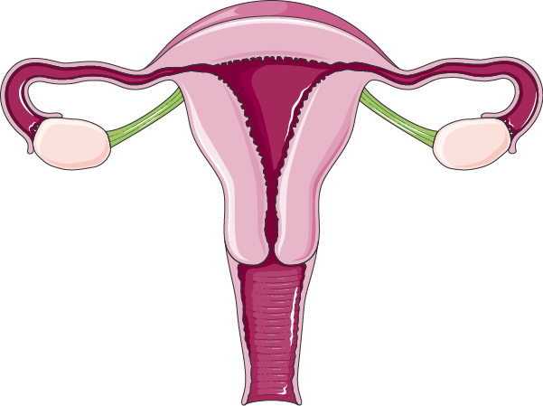
Review file
هذا العمل هو عمل طلابي بحت، يحتمل الصواب والخطأ
اعتمدنا في هذا العمل على ما نبه عليه أعضاء هيئة التدريس خلال المحاضرة
هذا العمل ليس للدراسة الأساسية إنما للمراجعة السريعة النهائية
إن أصبنا فمن الله وإن اخطأنا فمن انفسنا والشيطان
قام بهذا العمل:
اللولو الصليهم
جواهر ابانمي
جومانا القحطاني
روان القحطاني
ريم الشثري
شروق الصومالي
ليلى مذكور
منيال باوزير
وجدان الزيد
Good Luck ♥
Color index
Doctors’ notes
Drugs names
Important

Slide 2
Oral contraceptive
Estrogen : Ethinyl estradiol or mestranol (a prodrug converted to ethinyl estradiol) | Progestins : Has systemic androgenic effect: Norethindrone , Levonorgestrel, Medroxyprogesterone acetate Has no systemic androgenic effect: Norgestimate, Desogestre, Drospirenone
Combined pills (COC) Contains estrogen & progestin (100% effective) :
M.O.A | Inhibit Ovulation by Suppressing The Release Of Gonadotrophins (FSH & LH) Increase viscosity of the cervical mucus making it so viscous → no sperm pass Inhibit IMPLANTATION by causing abnormal contraction of the fallopian tubes & uterine musculature → ovum will be expelled rather than implanted.
Monthly Pills | For 21 days: starting on day 5, ending at day 26. This is followed by a 7 day pill free period To improve compliance: a formulation of 28 pills: The first 21 pills are of multiphasic formulation Followed by the last 7 pills are actually placebo
Seasonal Pills | Taken continuously for 84 days, break for 7 days, Cover 91 days schedule Has very low doses of both estrogens and progestins.
 | Benefit: It lessens menstrual periods to 4 times a year. Useful in those who have menstrual or menstrual disorders(prevent migrane), and in perimenopausal women with vasomotor symptoms(Painful & heavy periods=menorrhagia & dysmenorrhea). | Disadvantages: Higher incidence of breakthrough bleeding spotting during early use.
Adverse effects | Impaired glucose tolerane(hyperglycemia) Increase incidence of breast, vaginal & cervical cancer Cardiovascular (major concern): Thromboembolism , Hypertension | Weight gain Hirsutism Masculinization (Norethindrone) Menstrual irregularities
Interactions | Medications that cause contraceptive failure : Impairing absorption: (e.g. ampicillin) Microsomal Enzyme (CYT P450 ) Inducers (e.g. Phenytoin , Phenobarbitone, Rifampin,) Medications that increase combined oral contraceptive toxicity: Microsomal Enzyme Inhibitors: (e.g. Acetaminophen, Erythromycin). Medications altered in clearance of combined oral contraceptive which increase their toxicity: (e.g. Warfarin, Cyclosporine, Theophyline).

Slide 3
Oral contraceptive
MINI Pills, Progestin-Only Pills (POP)
Note | Contains only a progestin as norethindrone or desogestrel….
M.O.A | The main effect: increase cervical mucus, so no sperm penetration & therefore, no fertilization.
Uses | Are alternative when oestrogen is contraindicated (e.g.: during breast feeding, hypertension, cancer, smokers over the age of 35).
Post Coital Contraception (Emergency Contraception)
Contraception on instantaneous demand, 2^{ndry} to unprotected sexual intercourse They are used when desirability for avoiding pregnancy is obvious : Unsuccessful withdrawal before ejaculation Torn, leaking condom Missed pills Exposure to teratogen e.g. Live vaccine Rape
Composition | Method of Administration | Timing of 1st dose After Intercourse | Reported Efficacy
Ethinyl estadiol¹ + Levonorgestrel² | 2 tablets twice with 12 hrs in between* | 0 - 72hrs | 75%
High-dose only Ethinyl estadiol | Twice daily for 5 days | 0 - 72hrs | 75 - 85%
High dose only levonorgestrel | Twice daily for 5 days | 0 - 72hrs | 70 – 75%
Mifepristone ± Misoprostol | A single dose | 0- 120 hrs | 100% - 85
¹ Interferes only with ovulation does not cause abortion
² causes abortion because it interferes with ovulation and implantation

Slide 4
Ovulation Induction
Class | Antiestrogens SERMs |  |  | GnRH agonists | Gonado‐ Trophins |  | D₂ R Agonists
Drug | Clomiphene |  | Tamoxifen | Leuprolin & Goserelin | Menotropin (hMG) Extracted from Postmenopausal urine (contains LH & FSH). | Pregnyl (hCG) Extracted from pregnant women urine (contains mainly LH). | Bromocreptine (Not a hormone)
MOA | ↓ Negative feedback of endogenous estrogen on Hypothalamus and anterior pituitry → ↑ GnRH → ↑ FSH & LH → OVULATION! |  |  |  |  |  | D2 R agonists binds to dopamine receptors in the AP gland → inhibits prolactin secretion.
Indication | ‐Female infertility, due to anovulation or oligoovulation. | Women with PCOS and clomiphene‐resistant cases. Estrogen receptor‐ positive breast cancer. |  | Female infertility due to hypothalamic amenorrhea GnRH deficient). | Female infertility 2ry to Gonadotropin deficiency (pituitary insufficiency). |  | Female infertility 2ndary to hyperprolactinemia.
Administration | Given from 5th to 10th day of the cycle. Can not be repeated more than 3 cycles. |  |  | Given S.C. in a pulsatile drip to stimulate Gonadotropin (Start from day 2-3 of cycle up to day 10) Given continuously when gonadal suppression is desirable e.g.: Precocious puberty. Breast cancer in women. Prostatic cancer in men. | I.M. daily starting at day 2‐3 of cycle for 10 days. | Given on 10th ‐ 12th day for Ovum retrieval.
ADRs | High incidence of multiple birth. |  |  | Hypoestrogenism : Hot flashes, Osteoporosis | FSH :Fever, Ovarian enlargement, Multiple Pregnancy LH: Headache, Edema |  | GIT disturbances; nausea, vomiting Dry mouth & nasal congestion
Treating insulin resistance in PCOS by Metformin will highly increase the possibility of pregnancy.

Slide 5
Teratogens and Drugs of Abuse in Pregnancy
Drug | Teratogenic effect
Retinoids: Vitamin A, Isotretinoin
Sedative and Hypnotics (Thalidomide) | Phocomelia: shortened or absent long bones of the limbs and absence of external ears
Phenytoin | Fetal Hydantoin Syndrome Nail & Digital hypoplasia, Oral Clefts (cleft lip and palate), Cardiac Anomalies.
Valproic acid + Phynytoin³ | Neural tube defect (spina bifida) Impairs folate absorption.
Antibiotics (Tetracycline, Quinolones) | Altered growth of teeth and bones Permanent teeth staining Enamel hypoplasia
Anticoagulants (Warfarin) | Hypoplasia of nasal bridge CNS and CVS malformation
Corticosteroids | Cleft lip and Palate
Hormones: * Estrogens * Androgens * Diethylstilbestrol | Serious genital malformation: Testicular atrophy in male fetus, Fetal masculinization in female fetus Vaginal carcinoma of female offspring
Lithium | Ebstein's anomaly: Cardiovascular anomalies mainly valvular heart defect involving tricuspid valve
ACE inhibitor: * Captopril * Enalapril | ACE inhibitors disrupt the fetal renin-angiotensin system, which is essential for normal renal development They cause renal damage, Fetal & neonatal anuria, Fetal hypotension, Hypoperfusion, Growth retardation
Hypertension in Pregnancy
Safe α- methyl dopa, Labetalol |  | C.I: ACE inhibitors, Angiotensin II receptor blockers, Thiazide diuretics, Propranolol, Calcium channel blockers |  | Emergency: Hydralazine, Labetalol
Coagulation Disorders in Pregnancy
Safe: Heparin (The antidote, protamine sulphate is available) |  |  | C.I: Warfarin (Teratogenicity in 1st trimester, bleeding in 2nd and 3rd trimester)
Antithyroid Drugs in Pregnancy
SAFE: Propylthiouracil |  |  | C.I: Methylthiouracil (Methimazole), Carbimazol, Radioactive Iodine (I¹³¹) Risk of congenital goiter and hypothyroidism

Slide 6
Teratogens and Drugs of Abuse in Pregnancy
Antibiotics in Pregnancy
SAFE: Penicillin (ampicillin, amoxicillin), Cephalosporins, Macrolides (erythromycin and azithromycin): BUT erythromycin estolate should be avoided, bc of the risk of hepatic injury to the mother |  | C.I: Tetracyclines: teeth and bones deformity, Quinolones (ciprofloxacin): athropathy (bone and cartilage damage), Aminoglycosides: ototoxicity Sulfanamides: neonatal jaundice-kernicterus Chloramphenicol: gray baby syndrome
ADRs of Drugs During 2nd and 3rd Trimesters
Drug | Adverse effect
Tetracyclines | Impaired teeth & bone development yellow-brown discoloration
Aminoglycosides | Streptomycin, kanamycin Ototoxicity = 8th (Cranial nerve damage)
Cloramphenicol | Gray baby syndrome
Corticosteroids | Adrenal atrophy, growth retardation
Propranolol | Bradycardia, neonatal hypoglycemia…
Antithyroid drugs | Risk of neonatal hypothyroidism and goiter
NSAIDs | Constriction of ductus arteriosus (close prematurely), pulmonary hypertension in newborns Increase in gestation time prolong labor, neonatal bleeding Risk of postpartum hemorrhage
CNS depressants | Respiratory depression Chronic use (Diazepam): neonatal dependence and withdrawal symptom
ACEIs | Renal damage
Warfarin | Risk of bleeding
Sulfonamides | neonatal hyperbilirubinemia, Jaundice
Drug abuse
Alcohol | The use of alcohol is contraindicated during all trimesters of pregnancy The chronic maternal alcohol abuse during early weeks of the 1st trimester of pregnancy cause Fetal Alcohol Syndrome (FAS), which characterized by: Small head, Craniofacial abnormalities. (thin upper lips, small eye opening, smooth philtrum)
Cocaine | It decreases blood flow to uterus and fetal oxygenation (Hypoxia). Placental abruption (separation of placenta from uterus wall before delivery)
Tobacco | Fetal hypoxia, Low birth weight, Perinatal mortality

Slide 7
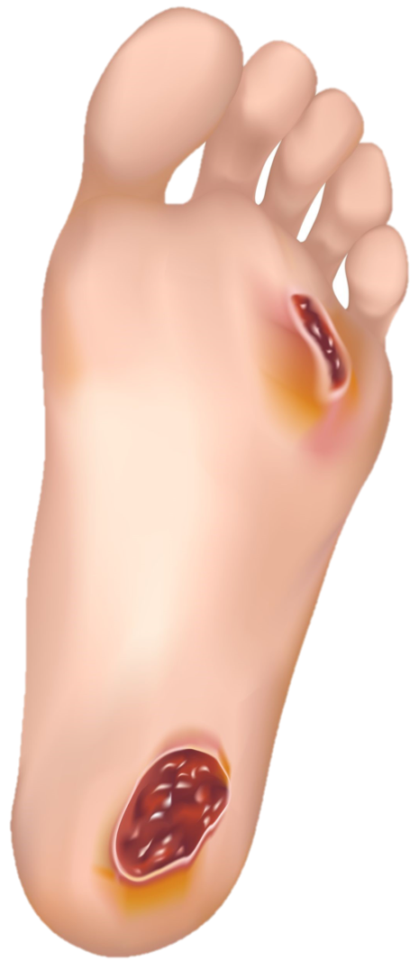
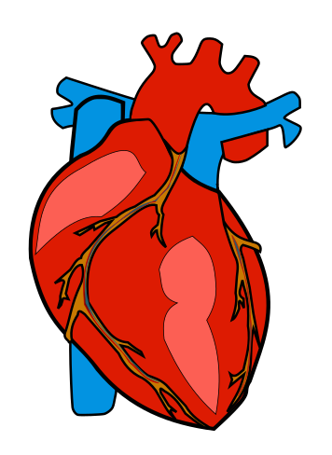
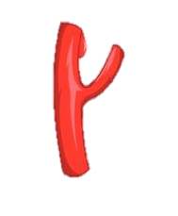
Oxytocin and Tocolytics
Oxytocin (Syntocinon)
M.O.A | Effect on uterus: Clinically oxytocin is given only when uterine cervix is soft and dilated Effect on Myoepithelial cells: Oxytocin contracts myoepithelial cells surrounding mammary alveoli in the breast & leads to milk ejection.
P.K | Administered I.V. (augment labor) then we monitor its effect on the uterus Also as nasal spray (impaired milk ejection)
Uses | Mild preeclampsia near term - Uterine inertia - Incomplete abortion - Post maturity - Maternal diabetes Post partum uterine hemorrhage Impaired milk ejection, the drug of choice to induce labor At term.
ADRs | Maternal death due to hypertension - Uterine rupture - Fetal death (ischemia) - Water intoxication
C.I | Hypersensitivity - Prematurity of the uterus - Abnormal fetal position - Evidence of fetal distress - Cephalopelvic disproportion - Incompletely dilated cervix
Ergot Alkaloids
Natural (Ergometrine) |  | Synthetics (Methyl ergometrine)
M.O.A | It causes contractions of uterus as a whole i.e. fundus and cervix (tend to compress rather than to expel the fetus)
Uses | Post partum hemorrhage (3rd stage of labor) When to give it? After birth, 3rd stage of labor
ADRs | Vasoconstriction of peripheral blood vessels ( toes & fingers) Gangrene Hypertension
C.I | Induction of labor: 1st and 2nd stage of labor vascular disease Severe hypertension

Slide 8
Oxytocin and Tocolytics
Prostaglandins
PGE2 (Dinoprostone) |  | PGF2α (Dinoprost) | synthetic PGE1 (Misoprostol)
Uses | Induction of abortion (pathological) Induction of labor (fetal death in utero) Postpartum hemorrhage
ADRs | Bronchospasm (PGF2α)=Dinoprost, C.I in asthmatic pregnant Flushing of the face and chest (PGE2) bc it causes vasodilatation
C.I. | Mechanical obstruction of delivery, Fetal distress
Preca. | Asthma, Multiple pregnancy, Glaucoma , Uterine rupture
Difference b/w Oxytocin , Ergometrine , and Prostaglandins
Character | Oxytocin | Ergometrine | Prostaglandins
Contractions | Only at term and it resembles normal physiological contractions | Tetanic contraction ; doesn't resemble normal physiological contractions | Contraction through out pregnancy
Cervix | Does not soften the cervix | - | soften the cervix
Uses | Induce and augment labor and postpartum hemorrhage | Only in postpartum hemorrhage | Induce abortion in 2nd trimester of pregnancy and used for induction of labor
Uterine Relaxants (tocolytic): Use to Relax the uterus and arrest threatened abortion or delay premature labor.
β₂-Adrenoceptor agonists: Ritodrine (1st choice) |  | Calcium Channel Blockers: Nifedipine (2nd choice) | Compete with oxytocin receptors: Atosiban
M.O.A | Selective β2 receptor agonist used specifically as a uterine relaxant. | Markedly inhibits the oxytocin-induced contractions | Compete with oxytocin at its receptors on the uterus.
ADRs | Hyperglycemia Hypokalemia | Ankle edema Flushing

Slide 9
Hormonal Replacement Therapy
Drug |  | M.O.A |  | Uses |  | ADRs |  | C.I
Hormonal | Estrogen | binds with its receptors ER α & ER β ER α : mediates female hormonal functions (located in Endometrium, breast, ovaries, hypothalamus,… ER β: mediates other hormonal functions. (located in brain, bone, heart, lungs, kidney, bladder, intestinal mucosa, endothelial cells,….) |  | In menopause: -Improves vaginal dryness - Protects CVS - Controls sleep disturbance & mood swings - Improves urethral , urinary symptoms, hot flushes , night sweats, insulin resistance & glycemic control in diabetics - Improves cognitive function - Delays parkinsonism Contraception Primary ovarian failure Amenorrhea & Hirsutism |  | Irregular vaginal bleeding Breast tenderness Nausea. Vaginal discharge. Fluid retention, Weight gain. Spotting or darkening of skin (on face) |  | Undiagnosed vaginal bleeding Severe liver disease Thromboembolic manifestations Cancer in: endometrial, breast ,ovarian
 |  | interactions | With :contraception |  | SERM ↑side effects for both drugs |  | Aromatase inhibitors: ↓ efficacy |  | Corticosteroids: ↑ side effects
 | Progestins | Progestins are synthetic progestogens that have effects similar to progesterone but are not degraded by GIT |  | In menopause: -Protects against estrogen induced endometrial cancer -protects against breast cancer development -Confers neuroprotection -Controls insomnia & depression -Counteract osteoporosis Contraception (Estradiol + Progestins) Dysmenorrhea Menopausal symptoms (Estradiol + Progestins given together) Lady with uterus (estrogen + Progestins), lady without uterus (estrogen) |  | Mood changes e.g. anxiety, irritability. Headache, dizziness, drowsiness Nausea, vomiting, abdominal pain or bloating (distention). Hirsutism, masculinization (Not with new preparations) |  | we add progestins with estrogen but not if there is hystrectomy

Slide 10
Hormonal Replacement Therapy
Drug |  | M.O.A | Uses | ADRs | C.I
Hormonal | Raloxifene | Antagonist in breast and uterus and agonist in bone , can be used in primary osteoporosis | preventing vertebral bone fracture be agonistic in brain, bone, cardiovascular system ,vagina & urinary system but antagonistic in breast & uterus
 | Tamoxifen | Antagonist in breast and partial agonist in bone and endometrium , Can be used in breast cancer with postive ER |  | Increase the risk of venous thrombosis tends to precipitate vaginal atrophy & hot flushes
 | Phytoestrogens | They mimic action of estrogen on estrogen receptor-β: They block actions mediated by estrogen receptor-α in some target tissues | alleviate symptoms related to hot flushes, mood swings, cognitive functions & possess CVS protective actions. lower risks of developing endometrial & breast cancer. |  | Avoid in esterogen dependent breast cancer
 | Androgen | N.B. Tibolone, is a synthetic steroid drug with estrogenic, progestogenic, and weak androgenic actions | sole therapy to menopausal women who lack sexual arousal.
None-Hormonal | Fluoxetine | Selective Serotonin Reuptake Inhibitor (SSRI) | reduces vasomotor symptoms
 | Clonidine | (centrally acting antihypertensive, alpha 2 agonist) | helps with vasomotor symptoms
 | Gabapentin | Anticonvulsant | reduces severity and frequency of hot flushes

Slide 11
Hormonal Replacement Therapy
Benefits and Risks of HRT
Benefits | Risks
Definite benefits: Osteoporosis (Definite increase in bone mineral density; probable decrease in risk of fractures) Uncertain benefits: Cognitive functions | Definite risks: Endometrial cancer (estrogen only) Venous thromboembolism (long term) Breast cancer (long term 5 yrs.)
Note: the risk of CVS problems and breast cancer with HRT is more than their benefits
Breast feeding
Factors Controlling Passage of Drugs into Breast Milk
Related to drug | Related to mother | Related to neonate
Molecular weight Lipid solubility Drug pH (Acidic drug is safe) Degree of ionization (Highest is safe) Protein binding Half life Oral bioavailability | Dose of the drug Route of administration Time of breast feeding Health status Maternal drug concentration | Neonatal hyperbilirubinemia : caused by oxidizing drugs: sulfonamides, trimethoprim , Primaquine Methemoglobin: oxidized form of hemoglobin cause hypoxia
Drugs that increase lactation (decrease dopamine) | Drugs that decrease lactation (decrease prolactin)
Levodopa Bromocriptine Estrogen Androgens Thiazide diuretics | Metoclopramide Domperidone Haloperidol Methyl dopa Theophylline
Drugs totally contraindicated during lactation (breast feeding should be avoided)
Anticancer drugs e.g. (Doxorubicin, cyclophosphamide, methotrexate ) Radiopharmaceuticals (radioactive iodine) CNS drugs (amphetamine, heroin, cocaine) Alcohol & Lithium Chloramphenicol CVS drugs (Atenolol & Sotalol) Potassium iodide Ergotamin Tobacco smoke

Slide 12
Breast feeding
Drugs & Breast Feeding
Class | Safe | Avoid
Antibiotics | Cephalosporins, Penicillin Macrolides (erythromycin) | Chloramphenicol (gray baby syndrome), Quinolones (arthropathy), sulphonamides (neonatal jaundice) tetracyclines
Antidiabetics | Insulin oral antidiabetics | Metformin
Anticoagulants | Heparin, Warfarin (with monitoring of PT)
Analgesics | Acetaminophen (paracetamol) Ibuprofen | Asprin (Reye's syndrome)
Antithyroid | Propylthiouracil | Potassium iodide Radioactive iodine (C.I)
Anticonvulsants | Carbamazepine, Phenytoin | Lamotrigine
Antidepressants | SSRI (Paroxetine)
Sedatives | Barbiturates (phenobarbitone) Benzodiazepines Diazepam Lorazepam | Avoid chronic use
Anti-asthmatic | Inhaled corticosteroids, prednisone
Antihistaminics | Loratidine (non-sedating) | Diphenhydramine (sedating)
Oral contraceptives | Minipills (Progestin only) | Estrogens Containing Pills

Slide 13
Treatment of STDs
Drugs for syphilis
Drug | M.O.A |  | Uses |  | ADRs | C.I
Penicillin | inhibit bacterial cell wall synthesis via inhibiting transpeptidase (Bactericidal) 1st line of treatment in syohilis |  | A) penicillin G : given i.v , short B) Procaine penicillin: i.m C) Benzathine penicillin: i.m , the best one given due to its long action ( given once every 3-4weeks) |  | convulsions , hypersensitivity , super infection | who have renal failure/disease
 | P.K | Acid unstable |  |  | beta lactamase sensitive
Tetracycline (Doxycycline) | inhibit protein synthesis 30 S ( bacteriostatic) |  | 2ND option in case of syphilis with Penicillin resistance | Given with food brown discoloration deformity/growth inhibition of bones in children = ( CI : children) hepatic toxicity |  | pregnancy, breastfeeding, children
Macrolides (Azithromycin) | inhibit protein synthesis 50 S ( bacteriostatic) |  | PK | allergic reactions ( urticaria , mild rashes)
 |  |  | Acid stable, doesn't penetrate CSF, No effenct on cytochrome p450
Cephalosporin (Ceftriaxone) | inbit cell wall synthesis ( Bactericidal) |  | PK | thrombophlebitis
 |  |  | it is Elemenated via biliary excretion given i.v
WHO Guideline instructions for syphilis
Pregnant |  | Benzathine penicillin Gor Procaine penicillin G Erythromycin or Ceftriaxone or Azithromycin
late stages |  | Benzathine penicillin G or Procaine penicillin G Doxycycline (If penicillin is not allowed due to allergy)
congenital syphilis (infant) |  | Aqueous benzyl penicillin i.v or procain penicillin i.m

Slide 14
Treatment of STDs
Drugs for UNCOMPLICATED gonorrhea
Drug | M.O.A | Uses |  | ADRs | C.I
Ceftriaxone or cefixime + azithromycin or doxycycline | 1st line of treatment | To cover both Chlamydia and gonorrhea, use a combination of: Ceftriaxone or cefixime (3rd generation Cephalosporin) + azithromycin or doxycycline
Fluoroquinolones (ciprofloxacin / ofloxacin) | It inhibit DNA Gyrase enzyme | 2ND option in case of UNCOMPLICATED gonorrhea |  | Arthropathy Phototoxicity | Pregnancy nursing mother children< 18
# if the pt. Cannot tolerate Cephalosporins or Quinolones we use = spectinomycin
Spectinomycin | Inhibit protein synthesis 30 S |  | pain at site of injection Fever Nephrotoxicity
treatment of ocular prophylaxis in newborn:
1- silver nitrate : germicidal effects ,used immediately after birth
2- Erythromycin : immediately after birth, used for treatment & prevention

