Slide 1
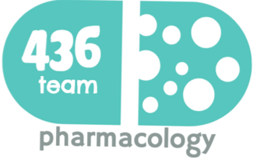
1: Drug Affecting Erectile Dysfunction
Objectives
Revise the haemodynamic changes inducing normal erection
Interpret its different molecular control mechanisms
Define erectile dysfunction [ED] and enumerate its varied risks
List drugs inducing ED and reflect on some underlying mechanisms
Correlate drugs used in treatment of ED to the etiopathogenesis
Classify oral 1st line therapy relevent to; Mechanism / Utility / ADRs
Compare the pharmacological difference of PDE₅ inhibitors
Study the transurethral, intracavernous or topical 2nd line therapies; Mechanism / Utility / ADRs
Enumerate lines of treatment of priapism
Color index
Doctors’ notes
Drugs names
Extra information and further explanation
Important
Mnemonics
Kindly check the editing file before studying this document

Slide 2
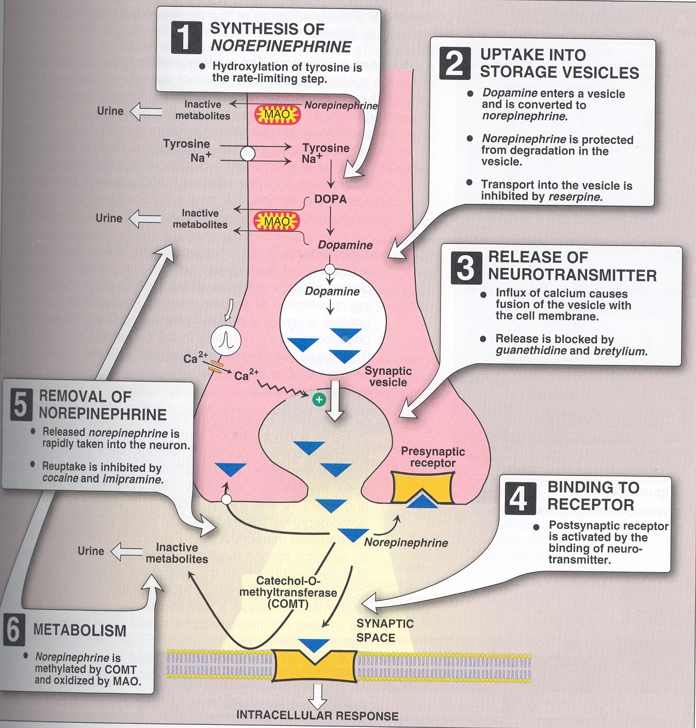
Recall
Adrenergic receptors
Receptor | Location | Effect
α₁ | Post synaptic | On blood vessels: vasoconstriction
α₂ | Presynaptic | Inhibition of transmitters release
β₂ | Post synaptic | On blood vessels: vasodilatation
هذي المحاضرة راح نتكلم كثير عن الأوعية الدموية وتأثير هذي المستقبلات عليها:
بالنسبة لمستقبلات α₁ هذي راح يسوون عندي انقباض للأوعية الدموية، فلما نستخدم أدوية تسكر هذي المستقبلات معناته راح يصير عندي أيش؟ بالضضضبط ارتخاء للأوعية الدموية
مستقبلات α₂ موجودة على الخلايا العصبية، هي راح تمنع إفراز الناقلات العصبية (زي نورابينيفرين والدوبامين) فبالتالي بتقلل عندي arousal، طيب لو جبنا أدوية تسكرها أيش راح يصير عندي؟ زيادة إفراز الناقلات العصبية بالتالي arousal
مستقبلات β₂ وهم موجودين على أعضاء كثير منها الأوعية الدموية، وظيفتهم يسوون ارتخاء للأوعية الدموية، إذا سكرنا هذي المستقبلات أيش راح يصير؟ انقباض للأوعية الدموية
Methyl-dopa
Mechanism of action:
Decrease dopamine release by forming methyl dopa
Acts centrally as α2 receptor agonist to inhibit NE release
في خلال تصنيع الدوبامين المفترض بعدين يتحول إلى نورابينيفرين، هذا الدوا يحول لي الدوبامين إلى ميثايل دوبا بالتالي يقل عندي الدوبامين و نورابينيفرين

Slide 3
Pathophysiology of Erection*
Stages
When does erection occur? it occurs when the amount of blood rushing to the penis is greater than the amount of blood flowing from it
2- ERECT State
A massive influx of blood accumulates in the sinusoidal spaces due to relaxation of smooth muscle & dilatation of arteries → corpora cavernosa to swell (tumescence)
(blood inflow > venous outflow) (explanation : there is a deep artery in the middle of each carpora cavernosa , when parasympathetic works, this artery gets dilated and the fill the whole carpora cavernosa sinuses with blood → erection of the penis → dilation of carpora cavernosum → compress the vein on top of it → decrease out flow )
Tumescence compresses the veins that normally drain the penis → reduces venous outflow & maintains penile rigidity
1- FLACCID State
(blood inflow = venous outflow)
A normal erection relies on the coordination:
Vascular (blood vessels)
Neurological
Hormonal
Psychological (self psychosis)
Stimulation
An erection can occur following direct*:
Genital stimulation
Auditory or visual stimulation
Aspects that contribute to the influx of blood to the penis
*خلونا نتفق أول إن erection يصير عن طريق تحفيز الدماغ ” arousal” عن طريق محفز سمعي أو نظري فيفرز الدوبامين ويتحفز الدماغ ويروح يرسل إشارات عن طريق parasympathetic للأعصاب اللي تغذي penis، هذي الإشارات راح تسبب زيادة تدفق الدم لpenis، ليش؟ لأن parasympathetic يسوي انبساط للشرايين، يعني عشان يصير erection نحتاج نسوي vasodilatation
بشكل عام نقدر نسوي vasodilatation عن طريق: ١- إغلاق مستقبلات الفا١ الموجودة في عضلات الشرايين الملساء أو ٢- عن طريق إغلاق باثواي راح نشرحه في السلايدات الجايه ☺

Slide 4
Erectile Dysfunction
Erectile dysfunction: Persistent or recurrent inability to attain (acquire) & maintain (sustain) an erection (rigidity) sufficient for satisfactory sexual performance
Impotent
Definition: is reserved for those men who experience erectile failure during attempted intercourse more than 75 % of the time.
Prevalence: Endothelial Dysfunction → Commonest Cause (cases of Endothelial Dysfunction)
Other causes: collected in monic IMPOTENTCE
اللي بالأحمر مهمة
Inflammatory | Prostatitis, urethritis
Mechanical | Peronei's disease, chordee
Psychological | Depression, performance anxiety, stress, relationship difficulties
Occlusive vascular | Arterial: hypertension, smoking, hyperlipidemia hyperlipidemia (lead to atherosclerosis ), DM, peripheral vascular disease (Oxidative stress →endothelium damage → lose the vasodilator ) Venous: venous occlusion due to anatomical or degenerative changes
Trauma | Pelvic fracture, SC injection, penile truma
Endocrine | Hypogonadism, hyperprolactinemia, hypothyroidism, hyperthyroidism
Neurologic | Parkinsons, multiple sclerosis, spina bifida, pelvic surgery, peripheral neuropathy
Chemical | Anti-HTN, anti-arrhythmics, antidepressant, anxiolytics, anti-androgens, anticonvulsants, alcohol, marijuana, anti-parkoson drugs, LHRH analogues
Extra factors | Prostatectomy (may damage the nerve), old age (hormonal embalance ) , CRF, cirrhosis

Slide 5
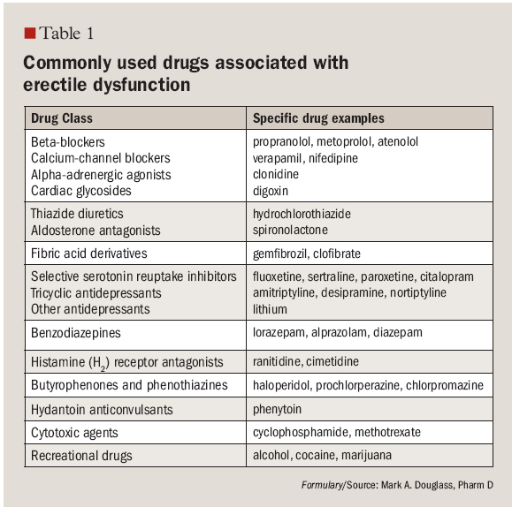
Drugs Adversely Causing ED
دي بس أقروها
Central acting drugs
Main action | Dopamine more than epinephrine promote arousal. 5HT (serotonin) action on 5HT₂ → decrease dopamine release → decrease arousal (there are some neurotransmitters affect the Arousal, one of them is Dopamine, so any agonist of Dopamine will increase Arousal & any antagonist of Dopamine will decrease it).
anti-Depressant Drugs | e.g. non-selectively as TCAs, selectively as SSRIs ADD (anti-Depressant Drugs) decrease 5HT uptake which lead to ↑ 5HT in synapse act on 5HT₂ → decrease dopamine release → decrease arousal Peripheral effect: antagonize NO actions / decrease genital sensation → Delay ejaculation (use for Treat of Premature Ejaculation)(SSRI)
Anti-psychotic drugs | DA (dopamine) antagonist + hyperprolactinemia
Anti-epileptic drug | e.g. phenytoin, they have GABA effect (inhibitory neurotransmitter) → antagonize excitatory Amino acid. → increase sedation → decrease arousal.
SSRI and other Anti-depressant drugs are the most common class of drugs which cause ED in male.

Slide 6
Anti-hypertensive
Anti-hypertensive
Central hypotensive | Methyl-dopa, Reserpine: they decrease DA by depleting dopamine → decrease arousal Clonidine (α₂ agonist): decrease arousal centrally, Vasoconstriction peripherally by anticholinergic action (blocking alpha receptors) → ED
Other hypotensive | β₂ blockers: -ve vasodilating β₂ + potentiate α₁ effect (vasoconstriction) Thiazide diuretics: decrease spinal reflex controlling erection + decrease arousal
Anti-androgen (Decrease the Desire)
Anti-androgen
Drug | Finasteride: (used in Benign prostatic hyperplasia , male androgenic alopecia (during first puberty they have a lot of testosterone lead to acne and hair loss → α reductase inhibitor (prevent production of active testosterone → irreversible erectile dysfunction
Drug | Cyproterone acetate: synthetic steroidal antiandrogen
Drug | Cimetidine* (H₂ blocker used in peptic ulcer), Ketoconazole, Spironolactone: (used in HF by working on angiotensin system) but it cause hyperprolactinemia + gynecomastia * Long acting
Drug | Estrogen-containing medications
وصلنا نهاية (Finasteride=Final=end)الطريق خلاص ما فيه رجعه منه (irreversible)
Habituating Agent
Habituating agent
Smoking | Cigarette smoking cause vasoconstriction + penile venous leakage (blood flow to penis will not be maintained due to vasoconstriction and wall damaged → coordination is disrupted blood in <or = out flow)
Alcohol | Small amount: increase desire + decrease anxiety + vasodilatation Big amount: increase sedation + decrease desire Chronic alcoholism: hypogonadism + polyneuropathy

Slide 7
Drugs Treat ED
Peripheral
Central
selective PDE₅ inhibitors
Oral
transurethral¹
Topical¹
Intracavernosa¹
Androgens
(Testosterone) ↑ desire
Sildenafil
Phentolamine
Alprostadil
Papaverine
Alprostadil
Apomorphine
(dopamine agonist)
( ↑ arousal)
Vardenafil
Yohimbine
Minoxidil
Papaverine
Tadalafil
Trazodone
Nitroglycerine
Phentolamine
Avanafil
Korean Ginseng
المقصود من الصورة إن عندنا مادتين يطلعون من الإندوثيليم حقت الشرايين وهم: (١) NO (٢) prostacyclin وهم يطلعون خلال sexual activity، بيروحون للعضلات الملساء ويحفزون أنزيمات وهم: (امشوا مع الصورة عشان يسهل عليكم الفهم)
أ- NO يحفز انزيم اسمه GC اللي بيعطيني cGMP هذا لحاله بسوي vasodilation بس يجي بعدين انزيم ثاني يكسره اسمه PDE₅ وبيحول cGMP إلى GMP
ب- prostacyclin راح يحفز انزيم اسمه AC “تونا دارسينه في الإندوكراين ياويلكم لو نسيتوه ☺ ” هذا الأنزيم يعطيني cAMP اللي بيسبب vasodilation بعدين انزيم ثاني يكسره اسمه PDE_{2,3,4} بيحول cAMP إلى AMP
بالمختصر: عشان أسوي ارتخاء للعضلة أحتاج cAMP or cGMP وهم بعدين بيتكسرون ويتحولون إلى GMP و AMP طیب المشكلة عندنا في ھذي المحاضرة إن العضلة منقبضة فما فيه دم يوصل لذلك نحتاج نسوي vasodilation ² عشان يوصل الدم بكمية كبيرة، لذلك أبغى أزود شغل الأنزيم (AC+ GC) اللي يعطيني المادة المسببة لارتخاء العضلة (cGMP + cAMP) أو بنمنع الأنزیمات اللي تكسر هذي المواد.
¹ These way are more favorable to decrease the affect of systemic affect ( e.g. lead to sever hypotension → angina )
² So vasodilatation mechanism is so important in sexual life and the way to maintain it by keep exercising to increase blood flow to all of your body even it help to improve memory

Slide 8
Selective PDE₅ Inhibitors
Nafil = Number five
 | Sildenafil | Vardenafil | Tadalafil | Avanafil
M.O.A | Inhibit PDE₅ → prevent breakdown of cGMP → pertain vasodilatation → erection. They do not affect the libido, so sexual stimulation is essential to a successful (this drug prevent PDE₅ from degenerate cGMP, but we need NO to produce cGMP, and NO excreted during sexual stimulation)
P.D | Pharmacodynamics action relevant to PDE₅ inhibition: Vascular smooth muscle cells (VSMCs) of Erectile Tissue of Penis Other vascular smooth muscle cells (VSMCs) (lung, brain….) / heart (so we use them in pulmonary hypertension) Other non-VSMCs (prostate, bladder, seminal vesicle, GIT….) Platelets (so we can use them to treat benign prostate hyperplasia) Other tissues; testis, sk. muscles, liver, kidney, pancreas, ….. All types have similar efficacy: Sildenafil: 74-84% , Vardenafil: 73-83% , Tadalafil: 72-81%
Uses | Erectile dysfunction; 1st line therapy. Pulmonary hypertension (they cause smooth muscle relaxation, BPH & premature ejaculation(SSRI as well) (rare)
Selectivity | 10-fold selective | 16-fold selective | >200-fold selective
 | Selectivity on PDE₅ is not absolute and vary with each drug: Can partially act on PDE targeting cGMP (6, 11, 9, 1) In higher doses it can act on PDE targeting cAMP (2,3,4, 10,…) PDE types and locations: PDE1: Heart, brain, lung, smooth muscle (main ADRs: IH3D / AMI) PDE2: Adrenal gland, heart, lung, liver, platelets (main ADRs: IH3D / AMI) PDE3: Heart, lung, liver, platelets, adipose tissue, inflammatory cells (main ADRs: IH3D / AMI) PDE4: Sertoli cells, kidney, brain, liver, lung, inflammatory cells ((main ADRs: IH3D / AMI) PDE5: Lung, platelets, vascular smooth muscle, heart. (Main ADRs: Headache/Flush nasal congestion) PDE6: Photoreceptor (main ADR: Altered VISION) PDE7: Skeletal muscle, heart, kidney, brain, pancreas, T lymphocytes PDE8: Testes, eye, liver, skeletal muscle, heart, kidney, ovary, brain, T lymphocyte PDE9: Kidney, liver, lung, brain, possibly heart PDE10: Testes, brain PDE11: Skeletal muscle, prostate, kidney, liver, pituitary gland and salivary glands, testes (main ADR: Back Pain) المقصود هنا إن الأودية هذي مب بس تأثر على انزيم PDE₅ إنما عندها تأثير على انزيمات ثانية، إذا أخذناها بالجرعة المعتادة راح تأثر على اللي لونهم سماوي (كونها بتأثر عليهم يعني بتعطي تأثير على الأعضاء الموجودة فيهم بالتالي بتعطيني آثار جانبية) أما إذا أخذناها بجرعة عالية راح تأثر على كل الأنزيمات اللي بالوردي والسماوي لا تحفظون شي من الأنزيمات غير اللي محدد بالعنابي

Slide 9
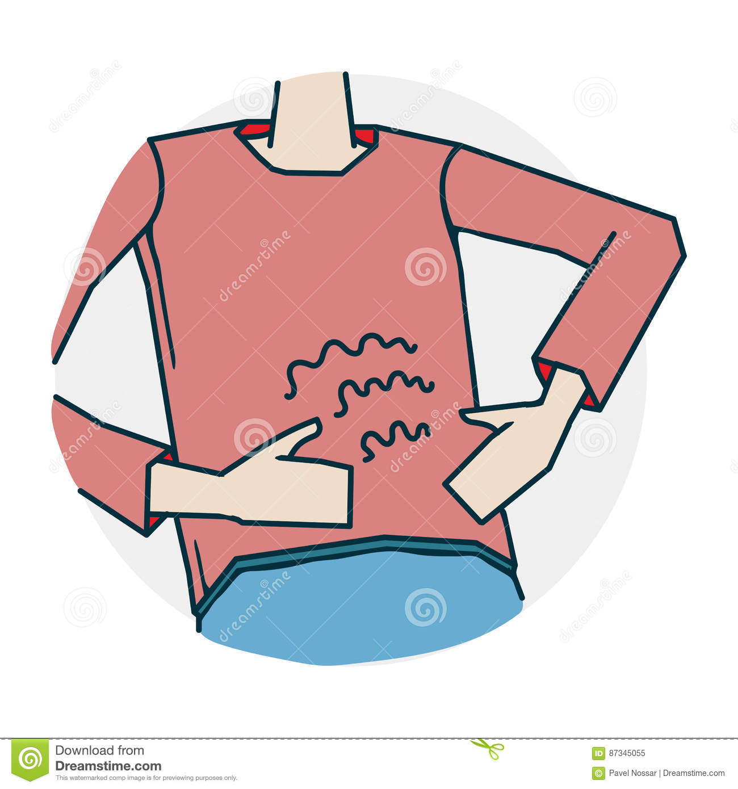
ADRs of PDE₅ Inhibitors
Major common ADRs:
Sildenafil
Vardenafil
Tadalafil
14
10
15
Headache
Most of them have these because they are all vasodilation
12
11
3
Flushing
Congestion
Rhinitis
Congestion
Nasal
7
3
15
Dyspepsia
4
Bc It acts on PDE₆: Photoreceptor.
< 2
Abnormal vision
السلايدز Sildenafil الزرقاء دايم تعمي العين
-
-
5
Myalgia & Back pain
Tadalafil تدل الطريق ؟ تكسر ظهري ورجلي وأنا أدور
-
-
Less than (?)
Sperm functions
Tadalafil; Adal is infertile
-
Increase
-
Q-T prolongation
Vardenafil يوم شفت الفأر وقف قلبي من الخوف
Major less common:
IHD & AMI: patients on big dose or on nirates
Hypotension: patients on α-blockers than other antihypertensives (as nitrate is contraindication)
Bleeding: epistaxsis (bleeding from nose # in blood disorder)…..etc.
Priapism: if erection lasts longer than 4 hours → emergency situation
Major rare ADRs:
Ischemic Optic Neuropathy: can cause sudden loss of vision or herring loss
Hearing loss
With high selective PDE₅ the adverse effects is less (ADRs depend on the selectivity)

Slide 10
Selective PDE₄ Inhibitors
 | Sildenafil | Vardenafil | Tadalafil | Avanafil
Absorption | Fatty food interferes with Sildenafil & Vardenafil absorption, so taken on empty stomach at least 2 hours after food |  | Tadalafil & Avanafil are not affected by food
Interactions | All by hepatic CYT3A4; Tadalafil > the rest, thus: Increase ADRs with enzyme inhibitors; erythromycin & clarithromycin, ketoconazole, cimetidine, tacrolimus, fluvoxamine, amiodarone…etc. Decrease efficacy with enzyme inducers; rifampicin, carbamazepine, phenytoin
Dose | 50 - 100 | 10 - 20 | 10 - 20
Time of admin. | 1 hour before intercourse | 1 hour before intercourse | 1-12 hours before intercourse Must be given every 72 hrs if used with enzyme inhibitors | Has the advantage of been given 30 min before intercourse
Onset | 30 - 60 min | 30 - 60 min | < 30 - 45 min
Duration | 4 (shortest) | 4 - 5 | 36
 |  |  | Usually if the drug with long duration, that’s mean used for pulmonary hypertension or BPH
C.I | Nitrates: total contraindication (the less selective PDE₅ may Induce hypotension so we need to know if the patient take antihypertensive drugs as nitrate because if the patient take the two medication he will develop sever hypotension and it's emergency station and enter ICU also may lead to the death of the patient). Hypersensitivity to drug Patients with history of AMI, stroke, fatal arrhythmias <6 month
Precautions | With α blockers (except tamsulosin), bc they cause orthostatic hypotension With hepato/renal insufficiency With bleeding tendencies (leukemia's, hemophilia, Vit K deficiency, antiphospholipid syndrome,…etc) With quinidine, procainamide, amiodarone (class I & III antiarrhythmic) especially with (Vardenafil) because it cause prolong QT interval Dose adjustment; when using drugs that have interaction on hepatic liver microsomal enzymes i.e. inhibitors or inducers. Retinitis pigmentosa

Slide 11
Oral Drugs to Treat ED
Testosterone (Androgens) | Given to those with hypogonadism or hyperprolactinemia. ( when prolactin increase in male will contribute with receptors in gonads and inhibit testosterone synthesis). Given for promotion of desireالرغبة .
Apomorphine Central acting → increase Arousal | A dopamine agonist on D₂ receptors. Activates arousal الإثارة centrally; Erectogenic + Little promotion of desire Given sublingual, so Acts quickly. Not FDA approved, Weaker than PDE₅ Is Given in mild-moderate cases, psychogenic, PDE₅ Is contraindication ADRs: nausea, headache, and dizziness but safe with nitrate
Oral Phentolamine | α₁ blocker / debatable efficacy
Yohimbine | Central and peripheral presynaptic α₂ agonist (vasoconstrictor) (Aphrodetic + Erectogenic) but low efficacy and many CV side effects, such as hypertension. (not used any more)
Trazodone | Antidepressant, a 5HT reuptake inhibitor which cause priapism. In beginning it was used to treat premature ejaculation but later was noticed that may lead to priapism
Korean Ginseng | Questionable / may be a NO donner.
أنا آدري إنك تبي(ترغب)
أبو المورفين مسوي فيها إثارة
Topical Drugs to Treat ED
Combination:
20% Papaverine (Direct smooth muscle relaxant): increase cAMP + cGMP
2% Minoxidil (antihypertensive): NO donner + K channel opener
2% Nitroglycerine: a drug absorption enhancers
Disadvantage:
Low efficacy / No FDA approval
Female Partner can develop hypotension, headache, due to vaginal absorption.

Slide 12
Transurethral Drugs to Treat ED
Alprostadil
M.O.A | PGE1 → increase cAMP (PGE1 increase AC activity → more cAMP → vasodilatation)
P.K | Synthetic + more stable Applied by a special applicator into penile urethra & acts on corpora cavernousa which lead to Erection Low - Intermediate Efficacy Minimal systemic effects / Rarity of drug interactions. (Advantages upon PDEI₅)
ADRs | Variable penile pain urethral bleeding, urethral tract infection Vasovagal reflex, Hypotension Priapism or Fibrosis (rare)
Intracavernosal Drugs to Treat ED
Alprostadil | Needs training: Erection → after 5-15 min Lasts according to dose injected May develop fear of self injury, so Discontinuation ADRs: Pain or bleeding at injection site, cavernosal fibrosis, Priapism
Papaverine | PGE1 → increase cAMP
Phentolamine | α₁ blocker
3 combined in severe cases
First line of treatment is PDE₅I , if there is no effect we can start multi-treatment such as transurethral Alprostadil. If it is sever we can give them the injection form.
Treatment of Priapism
Priapism: A medical emergency (if erection lasts longer than 4 hours)
Treatment:
Aspirate blood to decrease intracavernous pressure.
Intracavernous injection of Phenylephrine (local α₁ agonist) ⟶ Detumescence

Slide 13
Summary
Drugs adversly causing ED
Centrally Acting Drugs | Antidepressant drugs, SSRI (Treat premature ejaculation.), Anti-psychotic drugs and Anti-epileptic drugs (phenytoin).
antihypertensives | Centrally acting antihypertensives: Methyldopa, Reserpine, Clonidine Other antihypertensives: β2 blockers and Thiazide diuretics
Antiandrogens leads to ↓ desire | Finasteride: α reductase inhibitor (cause irreversible erectile dysfunction) Cyproterone acetate Cimetidine / Ketoconazole /Spironolactone: leads to hyperprolactinemia & gynecomastia .
Habituating Agents | e.g. Cigarette smoking and alcohol intake.
Drugs used in treatment of ED
Selective PDE5 Inhibitor.
Sildenafil, Vardenafil, Tadalafil, Avanafil
Inhibit PDE5 which prevent breakdown of cGMP.
They don’t affect libido (don’t produce NO)
It target multiple tissues in the body
Used as treatment in Erectile dysfunction, Pulmonary hypertension and BPH
ADRs:
Headache, flushing, nasal irritation
Abnormal vision, more with Sildenafil
Myalgia, back pain and decreased sperm function with Tadalafil
QT prolongation, prolonged with vardenafil
IHD and AMI, Bleeding; epistaxis, Priapism.
Ischemic Optic Neuropathy, hearing loss (both rare)
C.I:
Patient using nitrate
Hypersensitivity to drug.
Patients with history of AMI, stroke or fatal arrhythmias
Precautions:
With alpha blocker, hepato/renal insufficiency.
Retinitis pigmentosa.
With Quinidine, procainamide, amiodarone
Dose adjustment when using drugs that have interaction on hepatic liver microsomal enzymes
oral drugs
Testosterone: given to those with hypogonadism or hyperprolactinemia for promotion of desire.
Apomorphine: A dopamine agonist on D2 receptors, safe with nitrate. Given if PDE5 is contraindicated.
ADRs: Nausea, headache, and dizziness
Oral phentolamine: α1 blocker / debatable efficacy.
Trans-urethraloral (Alprostadil): Prostaglandin E1 analogue
ADRs: Variable penile pain Urethral bleeding, infection.
Vasovagal reflex, Hypotension and priapism.
Intra-cavernosal (Alprostadil, Papaverine, Phentolamine)
Topical (20% Papaverine, 2% Minoxidil, 2% Nitroglycerine) Female Partner can develop: Hypotension, headache because of vaginal absorption.
Treatment of Priapism:
Aspirate blood to decrease intracavernous pressure
Intracavernous injection of Phenylephrine (α₁ agonist)

Slide 14
MCQs
Q1: Which of the following statements is CORRECT regarding the mechanism of action of phosphodiesterase-5 (PDE-5) inhibitors?
PDE-5 inhibitors increase prostaglandin production.
PDE-5 inhibitors enhance the effect of nitric oxide.
PDE-5 inhibitors cause vasoconstriction of the erection chamber.
PDE-5 inhibitors antagonize cyclic GMP.
Q2: A patient who is taking a PDE-5 inhibitors for ED, is diagnosed with angina. Which of the following antianginal medications would be of particular concern in this patient?
A. Metoprolol. B. Diltiazem. C. Amlodipine. D. Nitroglycerin.
Q3: Which of the following BEST describes the mechanism of action of alprostadil?
Alprostadil blocks cGMP.
Alprostadil blocks nitric oxide.
Alprostadil increases PDE-5.
Alprostadil increases cAMP.
Q4: Alprostadil is administered locally. Which of the following is CORRECT regarding local administration of alprostadil? *
Local administration of alprostadil allows for low systemic absorption.
Local administration of alprostadil increases the chance of drug interactions.
Local administration of alprostadil is accomplished by way of a cream.
Local administration of alprostadil causes changes in color vision.
Q5:Which of the following is CORRECT regarding finasteride ?
α reductase inhibitor.
cause irreversible erectile dysfunction.
Decrease the desire.
All of them.
Q6: 39 years old male who has erectile dysfunction, his doctor prescribe to him Viagra. Which of the following is incorrect about Viagra (Sildenafil)** ?
They block the conversion of cGMP into GMP.
They inhibit PDE-5.
Pulmonary hypertension
They affect libido.
Q7: Which one of the following PDE-5 inhibitors may lead to prolonged QT intervals ?
Sildenafil. B. Vardenafil. C. Tadalafil. D. Avanafil.
* Local administration of alprostadil allows for minimal systemic absorption. This makes alprostadil associated with few drug interactions. Alprostadil is administered by injection or urethral suppository, not a cream. Because there is little systemic absorption, and alprostadil does not affect PDE-6, changes in color vision are not likely.
** PDE5 inhibitors are ineffective without sexual stimulation. So sexual stimulation is essential to be successful
B
D
D
A
D
D
B

Slide 15
MCQs
Q8: which one of the following drugs need sexual stimulation to be effective in treatment of erectile dysfunction ?
A. Korean Ginseng. B. Nitroglycerine. C. Vardenafil. D. Papaverine.
Q9: Which one of the following adverse effects/complications explain the highly contraindication to combine quinidine with Vardenafil ?
Anaphylactic reaction due to Hypersensitivity to these drugs.
fatal arrhythmias due to prolonged QT interval.
Sever hypotension due to potentiated effect.
Both A & B.
Q10: A patient who is taking a PDE-5 inhibitors for ED, later he is diagnosed with angina and be treated with Nitroglycerin. Which of the following medications would be the safest to be used in this patient to treat erectile dysfunction ?
A. Nitroglycerin . B. Vardenafil . C. Phentolamine. D. Apomorphine.
Q11: Which one of the following drugs can be safe to be used in combination with PDE-5 inhibitors ?
Prazosin. B. procainamide. C. Nitroglycerin. D. Tamsulosin.
Q12: Which one of the following PDE-5 inhibitors may lead to visual disturbance due to its action on PDE-6 in photoreceptors ?
Sildenafil. B. Vardenafil. C. Tadalafil. D. Avanafil.
Q13: Which one of the following adverse effects/complications explain the highly contraindication to combine nitrates with any drug from PDE₅ inhibitors class ?
Anaphylactic reaction due to Hypersensitivity to these drugs.
fatal arrhythmias due to prolonged QT interval.
Sever hypotension due to potentiated effect.
Both A & B.
Q14: 44 years old male came to ER with Priapism persist for 6 hours. Which one of the following drugs is highly recommended in his case ?
A. Trazodone. B. Phenylephrine . C. Phentolamine. D. Apomorphine.
Q15: Which one of the following can be used to Treat the Premature Ejaculation in male*** ?
A. Trazodone. B. fluoxetine. C. Phentolamine. D. Vardenafil.
C
B
D
D
A
C
B
B
*** SSRI and other Anti-depressant drugs are the most common class of drugs which cause ED in male. Also SSRI such as fluoxetine can be used in case of Premature Ejaculation in male

Slide 16
قادة فريق علم الأدوية :
اللولو الصليهم & فارس النفيسة
الشكر موصول لأعضاء الفريق المتميزين :
روان سعد القحطاني
شذا الغيهب
لينا الوكيل
References :
1- 436 doctor’s slides and notes
2- Lippincott Illustrated Reviews: Pharmacology 6th Edition
pharma436@outlook.com
@pharma436
Your feedback

