Slide 1
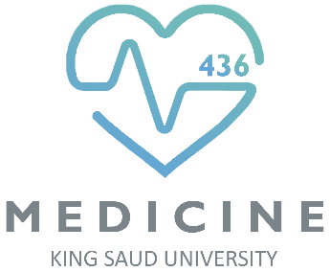
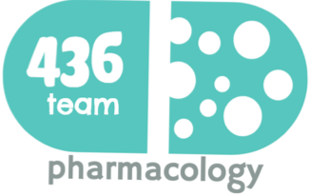
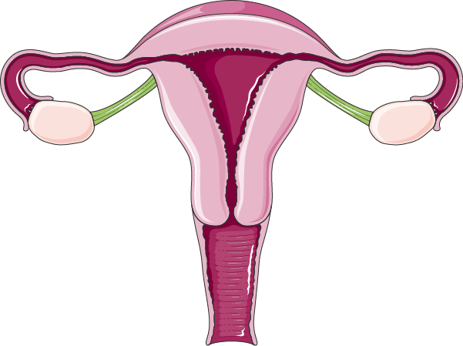


2: Drug Used in Male Infertility
Objectives
Define male infertility
Recognize regulations contributing to male fertility & dysregulations leading to infertility
Classify hormonal & non-hormonal therapies used in male infertility whether being empirical or specific.
Expand on the mechanism of action, indications, preparations, side effects, contraindications & interactions of most hormonal therapies
Highlight some potentialities of non-hormonal therapies
Color index
Doctors’ notes
Drugs names
Extra information and further explanation
Important
Mnemonics
Kindly check the editing file before studying this document

Slide 2
Introduction
Infertility
Definition: Inability of a male to achieve conception in a fertile woman after one year of frequent unprotected intercourse.
Prevalence: Infertility has traditionally been thought of as a woman's problem. However, about one out of every three cases of infertility is due to the man alone
Infertility Vs Impotence
Infertility: the male sexual behavior is fine but the problem in the sperms (low count, abnormal shape , abnormal motility).
Impotence: the male has problem in his sexual behavior (Erectile Dysfunction)
Actually this man has problems with erection and ejaculation, but his sperm count and shape are good.
Semen Analysis in Infertility
In male infertility, the semen analysis is abnormal:
Count is low (oligospermia)
Sperms are absent in the ejaculate (azoospermia)
Sperm motility is seriously affected (asthenospermia).
Sperms are totally immobile or dead (necrospermia)
Cause of Male Infertility
Idiopathic (causes unknown). Hormone, pituitary, Hypothalamus & testes all are intact.
Pre- testicular causes (poor hormonal support & poor general health) including: Hypogonadism, Drugs, alcohol, Tobacco, Strenuous riding (bicycle & horse riding & sauna) causes ↑ temperature on the testes, Medications (chemotherapy, anabolic steroids the mechanism is the exogenous androgens will be converted into estrogen causing suppression of testosterone secretion → gynecomastia and small testes).
Testicular causes (testes produce semen of low quantity and/or poor quality): Age, Malaria, Testicular cancer, Idiopathic (unexplained sperm deficiencies). no treatment
Post- testicular causes (conditions that affect male genital system after sperm production): Vas deferens obstruction, Infection (e.g. prostatitis, T.B), Ejaculatory duct obstruction, Impotence. Affect delivery of sperms

Slide 3
Infertility in Male
Pathophysiology
1- Pulsatile secretion of GnRH from hypothalamus will stimulate anterior pituitary to secrete gonadotropin (FSH , LH) that will lead → initiation & maintenance of spermatogenesis
2- FSH: will act on sertoli cell in seminiferous tubule lead to release inhibin → (negative feedback on anterior pituitary)
4- LH: will act on leyding cell lead to secrete testosterone → (negative feedback on anterior pituitary and hypothalamus)
3- Convert T in seminiferous tubule to (DHT) and Estradiol → ( +ve feedback on leyding C and –ve feedback estrogen has more potent negative feedback than testosterone on ant. pit., hypothalamus)
LH → Testosterone → Pulsatile
(chronic LH → makes testis refractory)
Treatment

Slide 4
Overview
Testosterone and synthetic androgens
Mester = Mr. = male = testosterone
Mesterolone
Phene/fen the SERMفين السيروم
Drugs Used in the Treatment of Male infertility
SERMs
Tamoxifen
Anti-estrogens
Clomiphene
Aromatase inhibitors
Anastrozole
Ana At room = Aromatase
GnRH
GnH together with hcG
Antioxidants
Kallikrein
Non- hormonal therapy
Folic acid
Zinc
L-carnitine

Slide 5
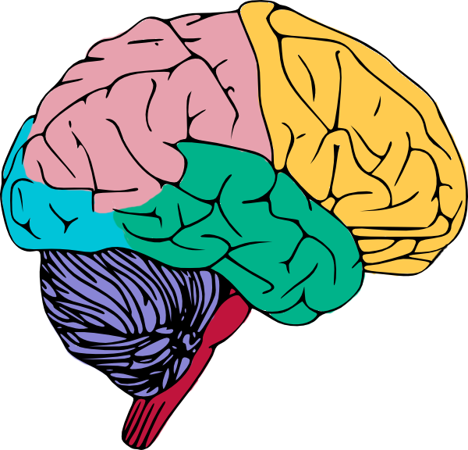
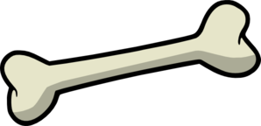
Testosterone
Testosterone and synthetic androgens
General info. | Principle male sex hormone produced in testis (> 95%), small amount in adrenals. It follows a circadian pattern→ increase in early morning & decrease in evening
M.O.A | Prostate, seminal vesicles convert testosterone by 5α-reductase to 5DHT → go to the cytoplasm of the target tissue → bind to DNA (androgen receptor element), → transcribed into mRNA → translated → androgenic effects. Testosterone is metabolized to estradiol by c-p450 aromatase. Bone: estradiol accelerates maturation of cartilage into bone leading to closure of the epiphysis & conclusion of growth (البنت اللي تجيها الدورة في وقت مبكر تكون قصيرة القامة) Brain: estradiol serves as the most important feedback signal to the hypothalamus (esp. affecting LH secretion) which lead to suppression of testosterone secretion. يعني testosterone في accessory glands يتحول إلى DHT وفي العظام يتحول إلى estradiol
Pharmacological actions | Virilizing effects: Gonadotropin regulation Spermatogenesis Sexual dysfunction هذا التأثير فقط يحصل لمن يكون الهرمون عالي عن الطبيعي (لذلك اللي يستخدم الهرمونات عشان يبني العضل ينتبهون) Sexual restoration and development Protein anabolic effects: (anabolic steroids, not used in infertility) Increase bone density Increase muscle mass Increase red blood cell mass

Slide 6
Testosterone
Testosterone and synthetic androgens
Pharmacokinetics | Natural Androgens Ineffective orally Bc of first pass metabolism (inactivated by 1st pass met.) I.M or S.C. Skin patch & gels are also available Binds to Sex Hormone Binding Globulin [SHBG] t_{½} = 10 –20 min لذلك هو غير مفيد لو ناخذ التيستييستيرون الطبيعي كدواء لأنه بيخلص الإفكت حقه بسرعه، فراحوا الصيادلة سووا نفس تركيب التيستييستيرون لكن يستمر لوقت أطول Inactivated in the liver. 90% of metabolites → excreted in urine. Disadvantages: Rapidly absorbed, rapidly metabolized (Short duration of action). | Synthetic Androgens (better) Less rapidly metabolized & more lipid soluble → increasing its duration of action. Derived from Testosterone Esters: proprionate, enanthate, cypionate → in oil for IM (every 2-3 weeks) Other derivatives as Fluoxymesterone, Methyltestosterone, Danazol: given Orally (daily) Derived from DHT as Mesterolone: given Orally (daily) ودا يا بنات أهم واحد bc it will not be converted into estradiol so we won’t have the effects of negative feedback.
Indications | As Testesterone Replacement Therapy(TRT): Therapy for androgen deficiency in adult male infertility. In delayed puberty with hypogonadism: give androgen slow & spaced for fear of premature fusion of epiphyses (short stature). لا يعطى لفترات طويله
Adverse effects* | Excess androgens (if taken > 6 wks) can cause impotence, decreased spermatogenesis & gynecomastia. الاستخدام الطويل راح يعطي نتائج عكسية Alteration in serum lipid profile: ↓ HDL & ↑ LDL, hence, ↑ risk of premature coronary heart disease. عشان كذا في الكارديو كنا نقول الرجال عندهم ريسك إنه يجيهم أمراض قلب أكثر من النساء Salt & water retention leading to edema. Hepatic dysfunction: ↑ AST levels, ↑ alkaline phosphatase, ↑ bilirubin & cholestatic jaundice. Hepatic carcinoma (long term use) Behavioral changes: physiologic dependence, ↑ aggressiveness, psychotic symptoms Polycythemia (increase number of RBC) → ↑ risk of clotting. Premature closing of epiphysis of the long bones. Reduction of testicular size * دا يا بنات كلو فزيولوجي وأنا مش حسألكم عن حاجات زي كده
I’m native
I’m hating ?
Dana have you tried Maestro Pizza ? (orally)

Slide 7
Testosterone
Testosterone and synthetic androgens
C.I | Male patients with cancer of breast or prostate Severe renal & cardiac disease → predispose to edema Psychiatric disorders Hypercoagulable states Polycythemia
Interactions | Corticosteroids, they both cause edema Warfarin: Testosterone ↓ Warfarin metabolism → ↑ bleeding Insulin or oral hypoglycemics + Testosterone cause hypoglycemia Propranolol : Testosterone ↑ Propranolol clearance → ↓ Propranolol efficacy Previous effects of testosterone are because it effects on the renal tubules not the liver.
Important notes | Mesterolone: More safely given in decrease testosterone or in 2ndry hypogonadism. Why? Not aromatized into estrogens → no –ve of GnHs → encourages natural testosterone production → spermatogenesis is enhanced Unlike other oral synthetic androgens it is not hepatotoxic.
Mesterolone = Mr. alone,
the only androgenic drug which does not cause negative feedback and no estrogenic effect.

Slide 8
Antiestrogens
 | SERMs e.g. Tamoxifen, Clomiphene | Aromatase Inhibitors e.g. Anastrozole
M.O.A |  | Blocks conversion of testosterone to estrogen within the hypothalamus
 | Because estrogens → negative feedback on hypothalamus → decrease GnRH pulse frequency & pituitary responsiveness to GnRH , so antiestrogens → increase GnRH & improve its pituitary response.
P.K |  | Given as daily dose over a period of 1 –6 months.
indication | All are used for inducing spermatogenesis in oligozoospermia ( count is low) Best to improve sperm count & motility with good pregnancy rates
ADRs | Both drugs (Tamoxifen, Clomiphene) can induce libido & bad temper in men

Slide 9
Treatment of Male Infertility
 | GnRH | GnHs
M.O.A | Exogenous excess of GnRH → down-regulation of pituitary GnRH receptors & decrease LH responsiveness. | Increase spermatogenesis
P.K | Given as Pulsatile GnRH therapy (4-8 ug subcut every 2 hours) using a portable pump. مش بسألكم في الدوزز | GnHs replacement must be combined; hCG² (IM. for 2 ms.) followed by hCG + hMG² (IM. for 6 -12 ms).
uses | Used in hypothalamic dysfunction bc they will cause androgenization & spermatogenesis¹ | Used in 2ndry hypogonadism i.e. problem in pituitary (FSH or both FSH or LH absent), bc it cause spermatogenesis
ADRs | Headache, depression, generalized weakness, pain , gynecomastia and osteoporosis | Headache, local swelling (injection site), nausea, flushing, depression, gynecomastia, precocious puberty
Non-hormonal Therapy³
Antioxidants | Protect sperm from oxidative damage (e.g. vit E,C) because ROS damages the membrane of the sperms.
Kallikrein | Has proteolytic activity, cleaving kininogen to kinins which is important for sperm motility. It enhances the sperm motility, so the doctor prescribe it if there is any abnormality in the sperm motility
Folic acid | Plays a role in RNA and DNA synthesis during spermatogenesis & has antioxidant properties.
Zinc | Plays an important role in testicular development, sperm production & sperm motility. موجودة بالسمك والشرم (اللي يتابعون الثرونز ما تذكرتوا سير دافوس ☺)
L-carnitine | Is important for sperm maturation. Taken as tablets
¹ If the hypothalamus is not working → the pituitary will not work → no FSH → no spermatogenesis
² we will study them in details in other lecture (drugs in ovulation) so don’t worry about them now
³ Sometimes is very promising, to improve sperm quality and quantity.

Slide 10
Summary
Testosterone and synthetic androgens
M.O.A | Prostate and seminal vesicles: converted to DHT by 5-alpha reductase giving androgenic effect Bones: metabolized to estradiol by C-P450 aromatase which accelerate maturation of cartilage to bones. Brain: converted to estradiol by C-P450 aromatase giving an important negative feedback signals to the hypothalamus.
Actions | Virilizing effects: Gonadotropin regulation. Spermatogenesis. Sexual restoration and development. | Protein anabolic effects: Increase bone density. Increase muscle mass. Increase RBCs mass.
Uses | In androgen deficiency in adult male infertility and delayed puberty in hypogonadism.
C.I | Male with breast or prostate cancers. Sever renal and cardiac diseases. | Psychiatric disorders. Hypercoagulable state and Polycythemia.
Inter- actions | Corticosteroids, both causes edema. Warfarin → Bleeding. | Insulin and oral hypoglycemic. Propranolol → ↓ efficacy
Import. | Mesterolone: More safely given in decrease testosterone or in 2ndry hypogonadism. Why? Not aromatized into estrogens → no –ve of GnHs → encourages natural testosterone production → spermatogenesis is enhanced Unlike other oral synthetic androgens it is not hepatotoxic.
GnRH | Used in hypothalamic dysfunction andcauses androgenization and spermatogenesis. Given as pulsatile GnRH therapy using portable pump. Excessive exogenous GnRH causes down regulation of Pituitary GnRH receptors and decreases LH receptors.
GnHs | Used In secondary hypogonadism to increase spermatogenesis.
 | SERMs e.g. Tamoxifen, Clomiphene | Aromatase Inhibitors e.g. Anastrozole
M.O.A |  | Blocks conversion of testosterone to estrogen within the hypothalamus
 | Because estrogens → negative feedback on hypothalamus → decrease GnRH pulse frequency & pituitary responsiveness to GnRH , so antiestrogens → increase GnRH & improve its pituitary response.
Uses | All are used for inducing spermatogenesis in oligozoospermia ( count is low) Best to improve sperm count & motility with good pregnancy rates

Slide 11
MCQs
Q1: 39 years old male who is infertile for 3 years, on physical examination we notice enlargement of his breast. The lab investigation shows high prolactin and low testosterone. Which one of the following drugs would be helpful to treat his infertility ?
A. metoclopramide. B. Bromocriptine. C. Anastrozole. D. Tamoxifen.
Q2: Which of the following is Derived from Dihydrotestosterone ?
A. Cypionate . B. Fluoxymesterone. C. Mesterolone. D. Danazol.
Q3: Which of the following BEST describes the mechanism of action of Anastrozole ?
Mimic the natural action of testosterone.
Antagonize the action of estrogen on its receptors in hypothalamus.
Inhibit Aromatase enzyme and prevent the conversion of testosterone into estradiol.
Increase spermatogenesis by preventing the negative feedback to pituitary gland .
Q4: Which one of the following is common ADRs effect of methyl-testosterone especially in children of teenagers ?
osteoporosis. B. Muscle atrophy. C. short stature & premature fusion of epiphyses. D. Anemia.
Q5: Which one of the following can be given Intramuscularly ?
A. Cypionate . B. Fluoxymesterone. C. Mesterolone. D. Danazol.
Q6: 15 years old teenager has delayed puberty. His doctor decide to prescribe Androgenic drugs. Which one of the following medications will not be of particular concern in this patient especially with his growth*?
A. cypionate . B. Fluoxymesterone. C. Mesterolone. D. Danazol.
Q7: Methyl-testosterone will increase the clearance which of the following ?
A. Corticosteroids. B. Warfarin. C. Propranolol. D. Metformin.
Q8:Which of the following is INCORRECT regarding Mesterolone ?
It is safely to be used in secondary hypogonadism to decrease Testosterone.
Exhibit negative feedback of GnHs in pituitary gland.
it is not hepatotoxic.
Not aromatized into estrogens
Q9: Which one of the following enhances spermatogenesis by encouraging the natural testosterone production from the tests ?
A. cypionate . B. Fluoxymesterone. C. Mesterolone. D. Danazol.
Q10: 37 years old male who is infertile due to hypothalamic dysfunction, Which one of the following drugs could be used to treat him ?
A. GnHs. B. GnRH. C. Anastrozole. D. Tamoxifen.
B
C
C
C
A
C
C
B
C
B
* Mesterolone will not cause Premature closing of epiphysis of the long bones, because it is Derived from DHT and will not be converted in estradiol.

Slide 12
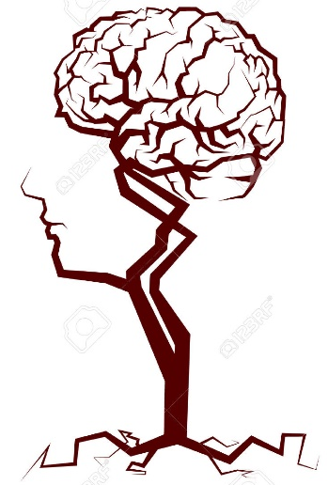
قادة فريق علم الأدوية :
اللولو الصليهم & فارس النفيسة
الشكر موصول لأعضاء الفريق المتميزين :
روان سعد القحطاني
حنين باشيخ
خالد العيسى
رحاب العنزي
عبدالرحمن ذكري
References :
1- 436 doctor’s slides and notes
2- 435 Pharmacology team
pharma436@outlook.com
@pharma436
Your feedback

