Slide 1


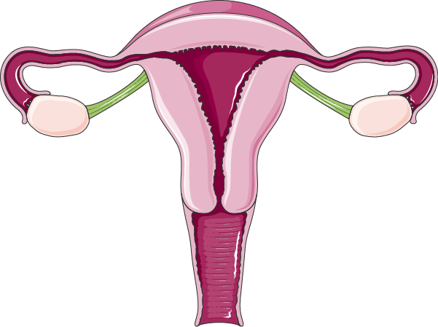


5: Pharmacology Of Contraception
Objectives
Perceive the different contraceptive utilities available
Classify them according to their site and mechanism of action
Justify the existing hormonal contraceptives present
Compare between the types of oral contraceptives pills with respect
to mechanism of action, formulations, indications, adverse effects,
contraindications and possible interactions
Hint on characteristics & efficacies of other hormonal modalities
Color index
Doctors’ notes
Drugs names
Extra information and further explanation
Important
Mnemonics
Kindly check the editing file before studying this document

Slide 2

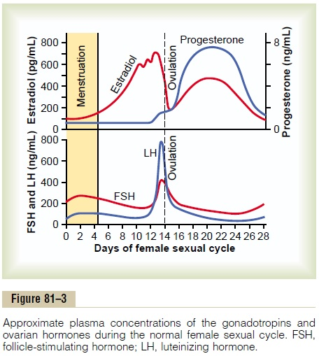
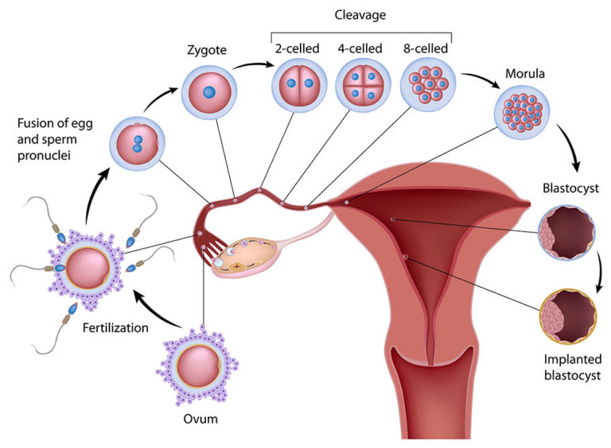
Introduction
Definitions
Conception: there is fusion of the sperm & ovum to produce a new organism.
Contraception: we are preventing this fusion to occur
Contraception
Inhibit the normal process of ovulation
Implantation
Hormone therapy:
Oral contraceptive pill (birth controlling pills)
Contraceptive Patches (causing slow hormone release ‘use for long time’)
Vaginal rings
Injectable
IntraUterine Device ‘IUD’ (with hormone) a device inserted in uterus and secrete hormones which make the uterus contracted ‘no good environment for implantation’
IntraUterine device ‘IUD’
(copper T)
the uterus see this loop as foreign body, so it will contract which expel the fertilized ovum (spermacidal)
Killing sperms (spermicidals):
Jells
Foams
Interruption by a barrier:
Condoms
Cervical caps
Diaphragm
Thin films
Preventing sperm from fertilizing the ovum
Physiology review
Progesterone
Hypothalamic pituitary gonadal axis
Plasma concentrations of the gonadotropins & ovarian hormones during the normal female sexual cycle
Early development of the fetus

Slide 3
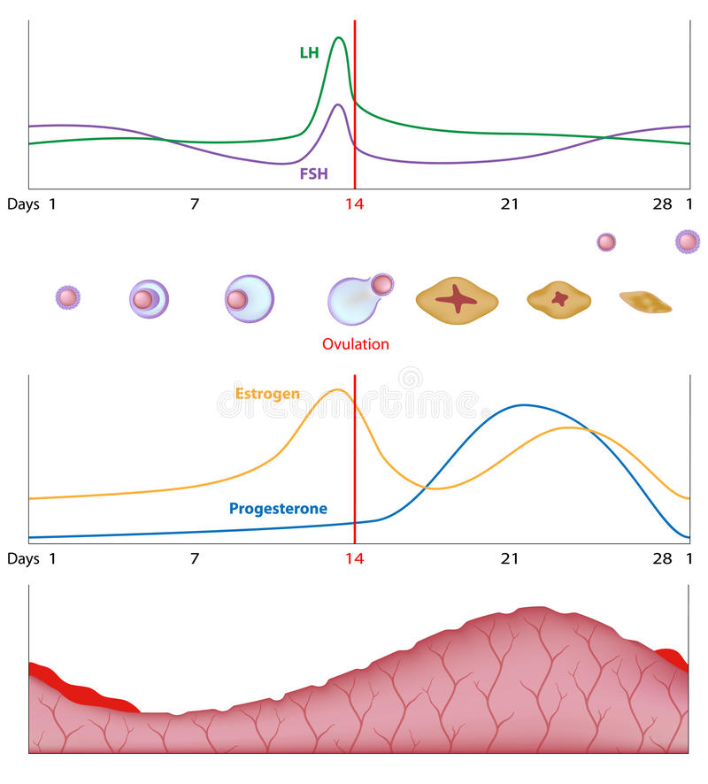
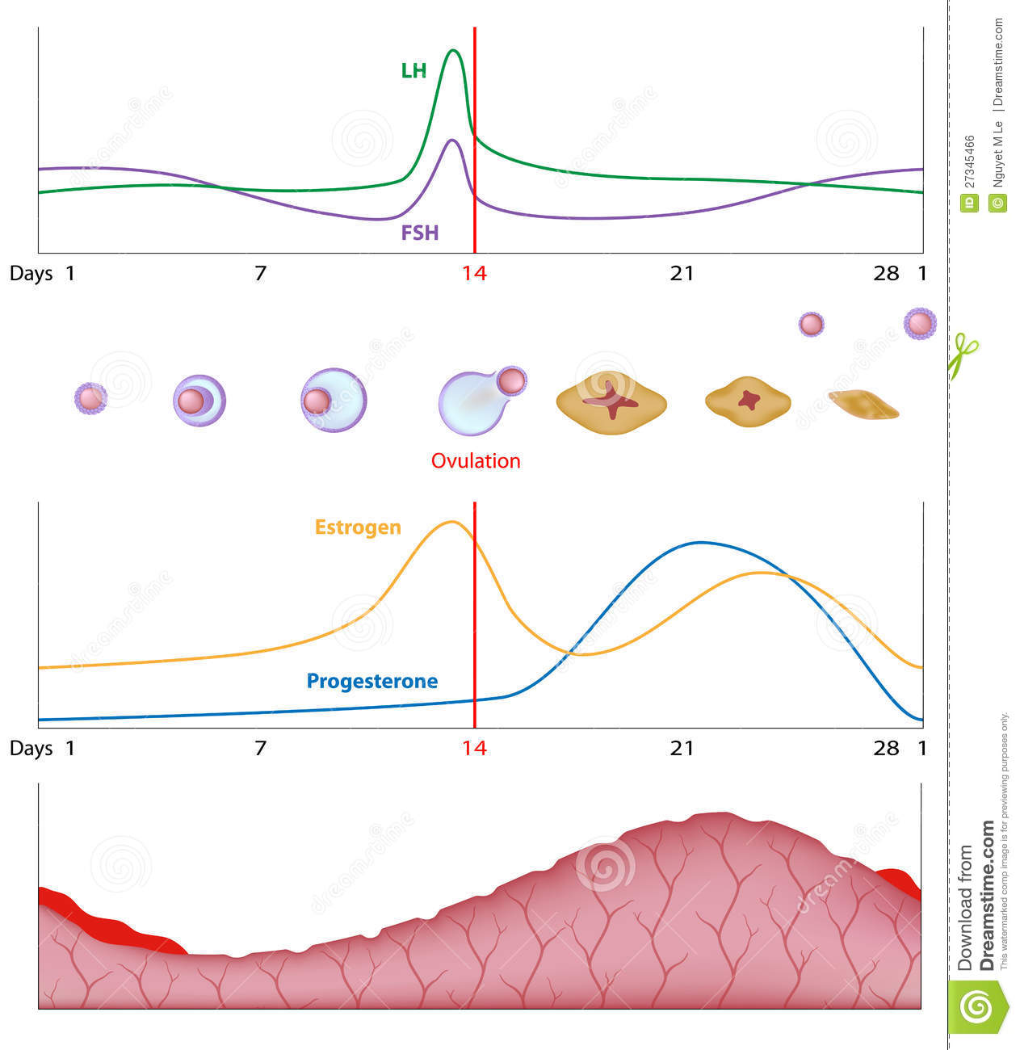
Physiology review*
2
1
3
4
1
2
3
4
At the beginning of the cycle the FSH increase, with a modest increase in LH ;and that is to prepare the follicle that will contain the oocyte ,at the same time we see an increase in estrogen that helps in producing the perfect environment for the embryo in the uterus by increasing the vascularity and thickness of the endometrium
2 days before the ovulation at 12th day : the LH surge then LH will drop ,as well as the Estrogen ,and this will lead to ovulation
After the ovulation the corpus luteum will secrets progesterone and high amount of estrogen to prevent the formation of a new ovum by causing a negative feedback to GnRH thus preventing the secretion of FSH and LH
If the ovum is fertilized in the fallopian tube it will implant in endometrium but if not at the 26th day the corpus luteum will loose it’s secretion (no estrogen and progesterone ) and become corpus albican.
This will cause the shedding of the endometrium +the cassation of the –ve feedback → repeated cycle
2
3
1
4
* الدكتور شرحهم باستفاضة، أنتوا دارسينها من أيام المد إذا ناسين شي أقروها تسوي ريفريش لذاكرتكم ☺

Slide 4
Overview
أنا أدري(Androgenic) إنك دكتور رقم واحد بتخصصك( in.dr.one )
Levonorgestrel (Progestins )²
أنا أدري (Androgenic)إنك تحب تلعب أونو (love UNO=lev.ono)
Medroxyprogesterone acetate (Progestins )²
أنا أدري (Androgenic) إنهم ما يدروا (Medro)
Desogestrel(current)³
Drospirenone (current)³
Ethinyl estradiol
Estrogen⁴
Mestranol⁵
Contain only a progestin (97%effective)
Mini Pills or Progesterone Only Pills (POP)
Ethinyl estadiol
(in high dose)
Levonorgestrel
(in high dose)
Mifepristone ± Misoprostol
¹ 100% effective
² Has systemic androgenic effect; acne, hirsutism, weight gain. جى في اختبار في سنة من السنوات
³ Has no systemic androgenic effect
⁴ Currently concentration used now is very low to minimize estrogen hazards
⁵ a “prodrug” converted to ethinyl estradiol

Slide 5
Combined Pills (COC)
المحاضرة شرحتها لنا بروف. يلدز، اللي ركزت عليه حطيناه لكم بالعنابي
 | Estrogen | Progestin
M.O.A | INHIBIT OVULATION by SUPPRESSING THE RELEASE OF GONADOTROPHINS (FSH & LH) → no action on the ovary → ovulation is prevented. Increase viscosity of the cervical mucus making it so viscous → no sperm pass Inhibit IMPLANTATION by causing abnormal contraction of the fallopian tubes & uterine musculature → ovum will be expelled rather than implanted. (no good environment for implantation) Abnormal transport time through the fallopian tubes (the uterus is contracting and full of mucus so the sperm will take time to reach to the ovum)
Monthly Pills | Pills are better taken same time of day For 21 days: starting on day 5, ending at day 26. This is followed by a 7 day pill free period سبع أيام ما تاخذ الحبوب To improve compliance: a formulation of 28 pills: The first 21 pills are of multiphasic formulation Followed by the last 7 pills are actually placebo Currently, their formulation is improved to mimic the natural on going changes in hormonal profile. الطريقة الأولى صارت تسبب لخبطة عند النساء من ناحية الحسبة وبعضهم صاروا ينسون يبدون يأخذون من جديد بعد السبع الأيام ، فراحوا سووا حبوب تأخذ المرأة حبة وحدة كل يوم لمدة ٢٨ يوم، ٢١ حبة تكون فيها الهرمونات لكن السبع الباقيات بلاسيبو مافيها هرمونات، بعض الدول بدل ما يعطون بلاسيبو فاضي يحطون فيتامينات أو حديد Accordingly we have now the phase formulations: Monophasic: a fixed amount of estrogen & progestin Biphasic (2 doses): a fixed amount of estrogen, while amount of progestin increases stepwise in the second half of the cycle Triphasic (3 doses): amount of estrogen; fixed or variable & amount of progestin increases stepwise in 3 phases.

Slide 6
Combined Pills (COC)
 | Estrogen | Progestin
Combination | دكتور الأولاد ما تكلم عنها لكن بروف يلدز قالت بس اعرفوا نفس ما كتبنا إن في mono الإستروجين والبروجيستيرون ثابتين أما في bi يكون الإستروجين فقط الثابت والبروجسترون يتغير على فترتين ، أما tri كلهم يتغيرون الإستروجين و خاصة البروجيستيرون يكون على ثلاث فترات إذا تلخبطتوا اسحبوا عليه عادي الدكتورة قالت ما راح نسألكم عنها
Seasonal Pills | Are known as Continuous, Extended cycle, Cover 91 days schedule Taken continuously for 84 days, break for 7 days, so she’s gonna have period every 3 months (during the 7 days break) Has very low doses of both estrogens and progestins Benefit: It lessens menstrual periods to 4 times a year. Useful in those who have menstrual pain or menstrual disorders such as endometriosis , and in perimenopausal women with vasomotor symptoms. Can prevent migraine during period. Disadvantages: Higher incidence of breakthrough bleeding & spotting during early use.

Slide 7
Combined Pills (COC)
 | Estrogen | Progestin
Adverse effects | Nausea and breast tenderness Headache ↑ Skin Pigmentation Impair glucose tolerance (hyperglycemia) Increase incidence of breast, vaginal & cervical cancer (because estrogen ↑ the proliferation of endothelium cells) ↑ frequency of gall bladder disease Cardiovascular (major concern): Thromboembolism , Hypertension cuz estrogen increase the platelets aggregation and lipid con. and cause water retention | Weight gain* Hirsutism* Masculinization* (Norethindrone) Menstrual irregularities Nausea, vomiting & headache Slightly higher failure rate Fatigue, depression of mood Ectopic pregnancy. * إذا تتذكروا في محاضرة البايو الأولى كان البروجيستيرون بيتحول بعدين إلى أندروجين، هذول الآثار كلهم يحصلون لمن يتحول البروجيستيرون إلى أندروجين
Contraindications | Lactating mothers use progestin-only pills (mini pills) bc estrogen inhibit prolactin secretion N.B. Obese Females, smokers, Females > 35 years better given progestin only pills (smoking cause atherosclerosis and vasoconstriction and estrogen its self cause cardio problem) Contraindications of Estrogen containing pills: Thrombophlebitis / thromboembolic disorders Chronic heart failure or other causes of edema Vaginal bleeding of undiagnosed etiology, because we suspect cancer Known or suspected pregnancy, may lead to abortion Known or suspected breast cancer, or estrogen-dependent neoplasms Impaired hepatic functions Dyslipidemia, diabetes, hypertension, migraine…..

Slide 8
Combined Pills (COC)
 | Estrogen | Progestin
Interactions | Medications that cause contraceptive failure : Impairing absorption: Antibiotics that interfere with normal GI flora → decrease absorption → decrease its bioavailability (e.g. ampicillin only male slide) Microsomal Enzyme (CYT P450 ) Inducers : Increase catabolism of oral contraceptive (e.g. Phenytoin , Phenobarbitone, Rifampin, barbiturate) Medications that increase combined oral contraceptive toxicity: Microsomal Enzyme Inhibitors: ↓ metabolism of oral contraceptive which will ↑ toxicity (e.g. Acetaminophen, Erythromycin). Medications altered in clearance of combined oral contraceptive which increase their toxicity⁶: (e.g. Warfarin, Cyclosporine, Theophyline). ناخذ فكرة عنها، خصوصًا الوارفارين
MINI Pills, Progestin-Only Pills (POP)
MINI Pills
Note | Contains only a progestin as norethindrone or desogestrel….
M.O.A | The main effect: increase cervical mucus, so no sperm penetration & therefore, no fertilization. make the endometrium thin → hard implantation
Uses | Are alternative when oestrogen is contraindicated (e.g.: during breast feeding, hypertension, cancer, smokers over the age of 35). Should be taken every day, the same time, all year round (it has higher failure rate, if she miss the pill, pregnancy could happen)
P.K | I.M injection e.g. medroxy progesterone acetate 150 mg every 3 months. (it remains in the body for a long period of time, so it has long effect + should not be given to women who want to conceive because its effect)
⁶ COC and these drugs excreted by the same enzyme, so there is competition which will decrease the excretion of these drugs (e.g. Warfarin) → Warfarin toxicity

Slide 9
Morning-After Pills
 | Post Coital Contraception (Emergency Contraception)
Indications | Contraception on instantaneous demand, 2^{ndry} to unprotected sexual intercourse When desirability for avoiding pregnancy is obvious : Unsuccessful withdrawal before ejaculation Torn, leaking condom Missed pills Exposure to teratogen e.g. Live vaccine ((لأنه هنا قد يحصل تشوه للجنين Rape
Methods of Use (ودا نركز عليه أوي يا بنات)
Composition | Method of Administration | Timing of 1st dose After Intercourse | Reported Efficacy
Ethinyl estadiol⁷ + Levonorgestrel⁸ | 2 tablets twice with 12 hrs in between* | 0** - 72hrs | 75%
High-dose only Ethinyl estadiol | Twice daily for 5 days | 0 - 72hrs | 75 - 85%
High dose only levonorgestrel | Twice daily for 5 days | 0 - 72hrs | 70 – 75%
Mifepristone⁹ ± Misoprostol¹⁰ | A single dose | 0- 120 hrs | 100% - 85 Very effective
⁷ Interferes only with ovulation does not cause abortion
⁸ causes abortion because it interferes with ovulation and implantation
* تاخد الست الحبة وبعد ١٢ ساعة بتأخذ الحبة مره تانية
** 0 means after the emergency situation immediately
⁹ synthetic steroidal antiprogestogen → no progesterone → no good environment for implantation
¹⁰ prostaglandin analog → contraction of the uterus → abortion

Slide 10
Summary
Estrogen : Ethinyl estradiol or mestranol (a prodrug converted to ethinyl estradiol) | Progestins : Has systemic androgenic effect: Levonorgestrel Has no systemic androgenic effect: Norgestimate
Combined pills (COC) Contains estrogen & progestin (100% effective) :
Mechanism of action | Inhibit Ovulation by Suppressing The Release Of Gonadotrophins (FSH & LH) (main action) Increase viscosity of the cervical mucus Inhibit IMPLANTATION by causing abnormal contraction of the fallopian tubes & uterine musculature
Monthly pills | Pills are better taken same time of day. For 21 days: starting on day 5 TO IMPROVE COMPLIANCE: The first 21 pills are of multiphasic formulation followed by the last 7 pills are actually placebo.
Seasonally pills | Cover 91 days schedule, Taken continuously for 84 days, break for 7 days Benefit: It lessens menstrual periods to 4 times a year. Useful in those who have menstrual or menstrual disorders, and in perimenopausal women with vasomotor symptoms. Disadvantages: Higher incidence of breakthrough bleeding & spotting during early use.
Interactions | Medications that cause contraceptive failure: Microsomal enzyme inducers phenytoin, phenobarbitone, rifampin, antibiotics. Medications that is altered in clearance by COC : Increase in their toxicity. Warfarin, cyclosporine, theophyline. Medications that increase COC toxicity: Microsomal enzyme inhibitors increase toxicity e.g.: acetaminophen, erythromycin
Mini pills (POP), contains only a progestin (97% effective)
Mechanism of action:
The main effect is increase cervical mucus, so no sperm penetration and therefore, no fertilization.
Contains only progestin as norethindrone or desogestrel
Indications :
Are alternative when estrogen is contraindicated (e.g.; during breast feeding, hypertension, cancer, smokers over the age of 35) بليز مره مهم تعرفون هالنقطة
P.K:
Should be taken every day, the same time, all year round. I.M injection e.g. medroxy progesterone acetate 150 mg every 3 months.
Morning-after Pills
Mechanism of action :
Emergency contraception Contraception of instantaneous demand, 2^{ry} to unprotected sexual intercourse
Important:
Ethinyl estadiol + Levonorgestrel: 2 tablets twice with 12 hrs in between*
High-dose only Ethinyl estadiol: Twice daily for 5 days
High dose only levonorgestrel: Twice daily for 5 days
Mifepristone ± Misoprostol: A single dose, Very effective

Slide 11
MCQs
Q1: Which of the following is the most appropriate oral contraceptive for a patient with moderate acne?
A. Ethinyl estradiol/levonorgestrel. B. Ethinyl estradiol/norethindrone. C. Ethinyl estradiol/norgestimate. D. Ethinyl estradiol/medroxyprogesterone acetate.
Q2: Which of the following progestin is not preferable to be used in COC due to its systemic androgenic effects?
A. Desogestrel. B. Norethindrone. C. Norgestimate. D. Drospirenone
Q3: 38 years old female who is obese and heavy smoker wants to control her birth. Which type of oral contraceptive would be suitable in her case ?
A. Triphasic combined pills. B. Seasonal combined Pills. C. progestin only pills.
Q4: 29 years old female who has menorrhagia&Dysmenorrhea, Which type of oral contraceptive would be helpful in her case?
A. Triphasic combined pills. B. Seasonal combined Pills. C. progestin only pills.
Q5: Which of the following best describes the main mechanism of mini pills as contraceptive ?
A. Inhibit ovulation by exhibiting negative feedback on pituitary.
B. Inhibit implantation by decreasing endometrial thickening.
C. Inhibit sperm penetration by increasing cervical mucus.
Q6: 19-year-old female was raped before four days came to ER, What can be used in her case to prevent her to get pregnant ?
A. High-dose of combined oral contraceptive. B. Mifepristone ± Misoprostol. C. High-dose of mini pills.
Q7: Which of the following best describes the main and most important mechanism of Combined oral contraceptive pills?
A. Inhibit ovulation by exhibiting negative feedback on anterior pituitary.
B. Inhibit implantation by decreasing endometrial thickening.
C. Inhibit sperm penetration by increasing cervical mucus.
Q8: 32 years old female who gave birth recently. She breastfeed her child now, and does not want to get pregnant. Which type of oral contraceptive would be suitable in her case and will not affect her milk’s volume ?
A. Triphasic combined pills. B. Seasonal combined Pills. C. progestin only pills.
Q9: A 26-year-old female is using combined oral contraceptive as a method of contraception. Which of the following is the most serious adverse effects is a concern if she wishes to use this therapy long-term?
A. Breast tenderness. B. Ectopic pregnancy. C. Impair glucose tolerance . D. Venous thrombosis.
Q10: 28 years old female who has family history of breast cancer. She is married and does not want to get pregnant. Which type of oral contraceptive would be suitable in her case ?
A. Triphasic combined pills. B. Seasonal combined Pills. C. progestin only pills.
Q11: 34 years old female who is on warfarin, she decide to control her birth by taking combined oral contraceptive. What will we expect to happen in her case ?
A. Contraceptive thereby failure & she get pregnant. B. potentate COC toxicity & she develop gall stone. C. Potentate Warfarin toxicity & she start bleeding.
Q12: 34 years old female who is on phenytoin, she decide to control her birth by taking combined oral contraceptive. What will we expect to happen in her case ?
A. Contraceptive thereby failure & she get pregnant. B. potentate COC toxicity & she develop gall stone. C. Potentate Phenytoin toxicity.
Q13: 27-year-old female was given live attenuated vaccine, What can be used in her case to prevent her to get pregnant ?
A. High-dose of combined oral contraceptive. B. Mifepristone ± Misoprostol. C. High-dose of mini pills.
1) C.
2) B.
3) C.
4) B.
5) C.
6) B.
7) A.
8) C.
9) D.
10)C.
11)C.
12)A.
13)B.

Slide 12

قادة فريق علم الأدوية :
اللولو الصليهم & فارس النفيسة
الشكر موصول لأعضاء الفريق المتميزين :
روان سعد القحطاني
وجدان الزيد
سعد الرشود
منيال باوزير
عبدالله هاشم
References :
1- 436 Doctors’ slides and notes
pharma436@outlook.com
@pharma436
Your feedback

