Slide 1


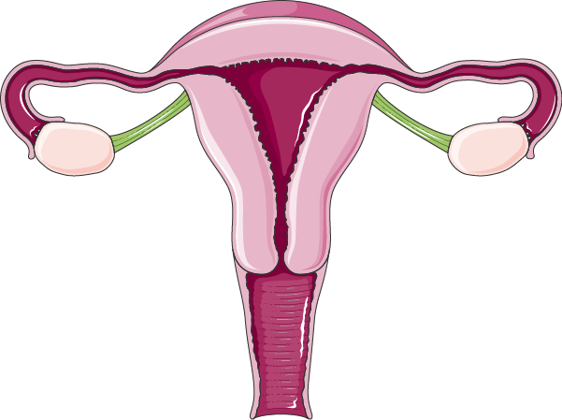


7: Hormonal Replacement Therapy
Objectives
Recognize menopausal symptoms & consequences
Classify drugs used to alleviate such symptoms that are used as Hormonal Replacement Therapy [HRT]
Expand on the mechanism of action, indications, preparations, side effects & contraindications of such agents.
Color index
Doctors’ notes
Drugs names
Extra information and further explanation
Important
Mnemonics
Kindly check the editing file before studying this document

Slide 2
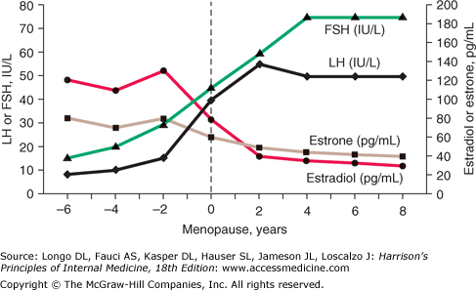
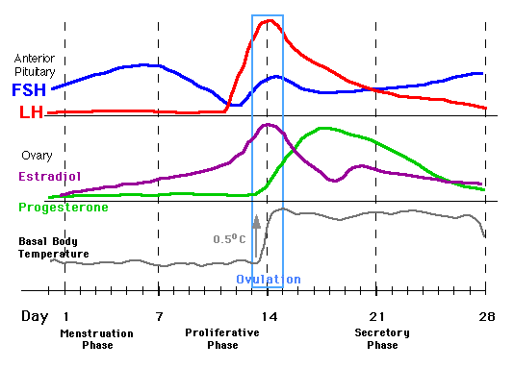
Menopause
Definition
Menopause: menos'( month) 'pausis'(cessation), so menopause means a complex physiological changes that occur at the time when the last period ends generally as women get older and lose fertility (age late 40s)
Characteristics of menopause: low estrogen and progesterone, low androgen, high FSH & LH, high insulin resistance (the aim of hormone replacement therapy is to boost these hormones)
Menopause
Normal menstruation
Symptoms & Consequences of Menopause
Immediate
Intermediate
Long term
Hot Flushes / Night Sweats (vasomotor symptoms)
Insomnia, Anxiety, Irritability
Mood Disturbances
Reduction In Sexuality & Libido
Poor Concentration / Memory Loss
Dyspareunia & vaginal dryness (caused by atrophic vaginitis due to thinning of the vaginal mucosa)
Urethral syndrome (dysuria, urgency & frequency) (also due to the thinning of vaginal mucosa)
Incontinence, difficulty in voiding (due to muscle weakness)
Increased bruising
Generalized aches and pains
Osteoporosis
CVS Risks; ↑ LDL/HDL ratio, coronary heart disease, stroke,..
CNS deficits; Alzheimer's, dementia
Symptoms Experienced Most During Menopause
20% no symptoms, 60% some symptoms, 20% severe symptoms

Slide 3
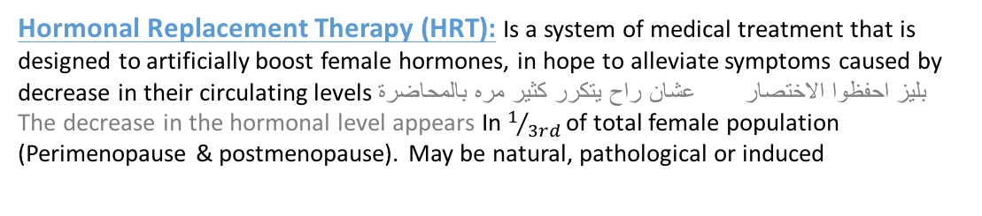
Hormonal Replacement Therapy
Definitions
Hormonal Replacement Therapy (HRT): Is a system of medical treatment that is designed to artificially boost female hormones, in hope to alleviate symptoms caused by decrease in their circulating levels بليز احفظوا الاختصار عشان راح يتكرر كثير مره بالمحاضرة
The decrease in the hormonal level appears In $1/{3rd }$of total female population (Perimenopause & postmenopause). May be natural, pathological or induced
HRT
Adminstration
Given for short term: never exceed 5 years to control menopausal symptoms without allowing ample time for malignant transition that might be induced by estrogen
Long-term administration: was only indicated in osteoporosis & CVS protection but now better drugs are available
Agents Used in Management of Menopausal Symptoms
Hormonal
Non-hormonal
Estrogen¹
اهم حاجة
Estradiol
Fluoxetine
Conjugated estrogens
Esterified estrogens
Clonidine
Progestins²
Phytoestrogens
Gabapentin
Androgen³
Tibolone
Physical activity
Selective Estrogen Replacement Modulators (SERM)
Tamoxifen
Raloxifene
¹ one of menopausal symptoms is low estrogen, so we use estrogen replacement to alleviate the symptoms. Estrogen has some undesirable side effects
² we add progestins with estrogen but not if there is hystrectomy
³ responsible for sexual arousal (given only if there is loss of libido & orgasm)

Slide 4
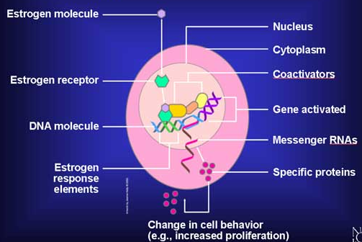
Estrogen
Estrogen
General information | In natural: As therapy: Estradiol: Oral bioavailability is low due to its rapid oxidation in the liver so used only in transdermal patch, subcutaneous implant, …. Conjugated estrogens: mixture of Na salts of sulfate esters of estrone & equilin (estrogen derived from horses). Esterified estrogens
Receptors | What dose estrogen do? It binds with its receptors Types of estrogen receptors (ER): ER α : mediates female hormonal functions. They are located in (Endometrium, breast, ovaries, hypothalamus,…) in female genitalia (to produce the sexual effect) ER β: mediates other hormonal functions. They are located in (brain, bone, heart, lungs, kidney, bladder, intestinal mucosa, endothelial cells,….) Estrogens bind to ER (α or β) that exist either: (only male slides) Cytoplasmic: mediates its genomic actions (hours to days time scale) and this kinds of receptors important for development, neuroendocrine, metabolism Membranous: G protein estrogen receptors → 2nd messenger → ↑ Ca or cAMP or ↑ mitogen activated protein (MAP) Kinase⁴ → mediates its non-genomic actions* → seconds to minutes time scale. E.g. receptors of: nitric oxide, neurotransmitters, endometrium, ….. * There will be no activation of DNA, instead where will be enzyme phosphorylation.
Aromatase
*Ovaries & adrenals in pre-menopausal
**Adrenals in menopause
Androstenedione
Estrone
Androstenedione
Dehydrogenase
Testosterone
Aromatase
Estradiol
Happens in the Ovaries of pre-menopause lady
Genomic effects: when the hormone enters the cell and binds with intracellular receptors → binds to hormone response element → gene activation → transcription → translation → protein → effects e.g. (increase cells proliferation)
⁴ activate transcription factors to promote mitogenesis

Slide 5
Estrogen
Estrogen
Administration* | Oral: Conjugated equine, Estradiol valerate , Estrial succinate Transdermal (estradiol): Patches (24 hour twice weekly) Gel (24 hours daily). Subcutaneous implant (estradiol): 6 monthly. Vaginal cream: as such or as rings pessaries
Indications | In menopause: Not given unless presence of symptoms; alone only after hysterectomy or with progestin as HRT (never exceed 5 years administration) to avoid cancer Improves vaginal dryness by ↑ epithelial thickness & vascularity, collagen content (topical ‘pessaries or rings’ and systemic estrogens preparation ‘oral, transdermal patches, or subcutaneous implant’ are effective) Increases bone density by ↑ calcitonin release from thyroid to ↓ osteoclastic activity. Progestins act synergistic by blocking corticosteroid induced bone resorption. (Decrease incidence of hip fracture) Protects CVS by enhance vasodilatation via ↑ neritic oxide production & ↑ HDL & ↓ LDL thus ↓ atherosclerosis & ischemic insults (HRT started at the beginning of menopause will prevent CVS problems, however HRT increases CVs problems in long term; since it may cause deep venous thrombosis → embolism to lung, brain etc.)يعني لو استخدمت الاستروجين لوقت قصير بيكون كويس للقلب والشرايين، لكن إذا استخدمته لوقت طويل بيسبب تجلطات Improves hot flushes & night sweats Controls sleep disturbance & mood swings by acting on norepinephrine, dopamine & serotonin at reticular formation Improves urethral & urinary symptoms by ↑ epithelial thickness & vascularity, collagen content at urethra & norepinephrine transmission that contract sphincters & relax detrusal muscles of the urinary bladder, and thus improves the urinary continence Improves insulin resistance & glycemic control in diabetics Improves cognitive function via ↑ expression of estrogen receptor in brain & by ↓ amyloid deposition thus preventing Alzheimer's. Delays parkinsonism by acting on dopamine system in midbrain
* نتفق يا بنات إن HRT ممكن نديها systemic أو local ليه نديها systemic؟ عشان تعالج المشاكل الكبيرة اللي تحدث في menopause، systemic يعني نعطيها على شكل orally, transdermal patches or as subcutaneous implants

Slide 6
Estrogen
Estrogen
Indication | Other uses: Contraception Primary ovarian failure Amenorrhea & Hirsutism caused by excess androgens
ADRs | Irregular vaginal bleeding (patients discontinue HRT⁵). Breast tenderness (patients discontinue HRT⁵).. Nausea. Vaginal discharge. Fluid retention, Weight gain. Spotting or darkening of skin (on face) (chloasma/ (وحمة
C.I | Absolute Undiagnosed vaginal bleeding because we suspect cancer Severe liver disease Thromboembolic manifestations Cancer in: endometrial, breast (hormone sensitive), ovarian
Interactions | With contraception With selective estrogen receptors modulators (SERM): additive side effects for both drugs With Aromatase inhibitors: ↓ efficacy With Corticosteroids: ↑ side effects
⁵ patients who stop HRT

Slide 7
Progestins
Progestins
General information | In nature: Produced by Adrenal glands, Gonads, Brain, Placenta The synthesis is induced by LH Are precursor to estrogens, androgens, and adrenocortical steroids. As therapy: Progesterone is degraded in GIT, so can be given only parentally Progestins are synthetic progestogens that have effects similar to progesterone (progestinic effects) but are not degraded by GIT, so we can give it orally Progestin preparations as in contraceptive pills
MOA | What does progesterone do? Binds to its receptors. There are two types of progesterone receptors [PR]: PR-A & PR-B. مش مهم They could exist cytoplasmic to mediating genomic long term effects مش مهم They could exist membranous to mediating non-genomic rapid effects مش مهم
Indications | In menopause: As HRT, usually given in combination with estrogen Some use it alone in risk of cancer but does not ↓ all menopausal symptoms Protects against possibility of estrogen induced endometrial cancer (Estrogen ↑ cell growth. If unopposed → endometrial cell lining can show atypical hyperplasia on the other hand, Progesterone beneficially matures endometrial cell lining ‘become differentiated’ & ↑ apoptosis of atypical cells). يعني باختصار الإستروجين يزيد نمو الخلايا بس بتكون غير ناضجة لكن البروجيستيرون بيخلي هذول الخلايا ناضجة فماراح تتحول لخلايا سرطانية Progesterone (natural) protects against breast cancer development by anti-inflammatory & apoptotic mechanisms, but this effect is not as clear with synthetic progestins. Mammography recommended every 6 months. To make sure if there is breast cancer or not Confers neuroprotection (mild effect) Controls insomnia & depression (little effect) Counteract osteoporosis bc it is directly +ve (stimulate) osteoblasts Other uses: Contraception (Estradiol + Progestins) Dysmenorrhea Menopausal symptoms (Estradiol + Progestins given together)
Cholesterol
Pregnenolone
Progesterone
معلومة مهمة: if we have menopause lady and here uterus is present we DON’T give estrogen alone, if there is no uterus we use estrogen ALONE حرفيًا بروف يلدز عادتها عشر مرات ☺

Slide 8
Progestins
Progestins
Administration | Oral: Micronized progesterone or progestins IntraUterine) IU(: as Levonorgestrel or Progestasert Vaginal: natural progesterone gel, pessary. Transdermal: sequential )replaced daily), continuous patch.
ADRs | Mood changes e.g. anxiety, irritability. Headache, dizziness, drowsiness Nausea, vomiting, abdominal pain or bloating (distention). Hirsutism, masculinization (Not with new preparations) only female slides
ركزوا على اسماء route of admenstration
Benefits and Risks of HRT
Benefits | Risks
Definite benefits: Alleviates symptoms of menopause (vasomotor, genitourinary) Osteoporosis (Definite increase in bone mineral density and probable decrease in risk of fractures) Uncertain benefits: Cognitive functions (Alzheimer's symptoms) | Definite risks: Endometrial cancer (estrogen only) Venous thromboembolism (long term) bc estrogen increase the coagulability Breast cancer (long term 5 yrs.)
Note: the risk of CVS problems and breast cancer with HRT is more than their benefits

Slide 9
Selective Estrogen Receptors Modulators
Selective Estrogen Receptors Modulators (SERM)
General information | An ideal SERM⁶ for use as HRT should be agonistic in brain, bone, cardiovascular system (not necessarily the liver), vagina & urinary system but antagonistic in breast & uterus, so it will not cause breast or uterine cancer like estrogen
 | Raloxifene⁷ | Tamoxifen⁷
 | Antagonist in breast and uterus and agonist in bone | Antagonist in breast and partial agonist in bone and endometrium (may lead to endometrium cancer).
Effects | Very effective preventing vertebral bone fracture Has no effect on hot flushes or increases hot flushes Cardiovascular problems less compared to Estrogen Increase the risk of venous thrombosis For osteoporosis use of bisphosphonate is better than SERMs⁶ | Increase the risk of venous thrombosis tends to precipitate vaginal atrophy & hot flushes
 | Brain | Uterus | Vagina | Breast | Bone | CVS
Estradiol | ++ | ++ | ++ | ++ | ++ | ++
Ideal SERM⁶ | ++ | — | ++ | — | ++ | ++
Tamoxifen | — | + | — | — | + | +
Raloxifene | — | — | — | — | ++ | +
Not ideal
Has a good effect on bone
⁶ Selective Estrogen Receptors Modulators
⁷ oral and non-hormonal

Slide 10
Hormonal Replacement Therapy
 | Phytoestrogens | Androgen
General info. | supplements from plants containing isoflavones (soya beans, flaxseeds) or lignans (whole grains). Avoid in esterogen dependent breast cancer | Testosterone is responsible for sexual arousal in females
M.O.A | They mimic action of estrogen on estrogen receptor-β: alleviate symptoms related to hot flushes, mood swings, cognitive functions & possess CVS protective actions. (data limited on their efficacy) They block actions mediated by estrogen receptor-α in some target tissues: lower risks of developing endometrial & breast cancer.
Indications |  | It is given as the sole therapy to menopausal women in whom their menopausal symptoms are focused on lack of sexual arousal. It is given as adjuvant to combined estrogen & progestin if all other menopausal symptom exist. N.B. Tibolone, is a synthetic steroid drug with estrogenic, progestogenic, and weak androgenic actions⁸, can be effective in some women bc it has some androgen agonistic properties⁹ (androgens use is not approved by FDA in women)
⁸ only female slides
⁹ only male slides

Slide 11
Non-hormonal agent
Fluoxetine | Selective Serotonin Reuptake Inhibitor (SSRI) reduces vasomotor symptoms
Clonidine | (centrally acting antihypertensive, alpha 2 agonist) helps with vasomotor symptoms. (female slides)
Gabapentin | Anticonvulsant reduces severity and frequency of hot flushes (only female slides)
Physical activity | exercise, smoking cessation and relaxation of mind will improve symptoms of menopause (e.g. hot flushes) and fall preventing strategies prevents chances of fracture.
The women’s health initiative and HRT
(The doctor skipped this slide)
Menopausal Hormone Therapy: For decades, hormone therapy widely used in menopausal symptoms. (only male slides)
Estrogen has been used alone in menopausal women who have had their uterus removed. (Male slides)
Progestin, the synthetic form of an estrogen-related hormone called progesterone, is combined with estrogen in menopausal women who still have their uterus. (only male slides)
The Women’s Health Initiative (WHI), a 15-year research program launched in 1991, addressed the most common causes of death, disability, and poor quality of life in postmenopausal women.
The research program examined the effectiveness of hormone replacement therapy in women. In 2002, findings from two WHI clinical trials examined:
  The use of estrogen plus progestin in women with a uterus
  The use of estrogen only in women without a uterus.
In both studies, women were randomly assigned to receive either the hormone medication or placebo.
In both studies, when compared with placebo, the hormone medication (whether estrogen plus progestin or estrogen only) resulted in an increased risk of stroke and blood clots. In addition, the estrogen plus progestin medication resulted in an increased risk of heart attack and breast cancer.
These concerns are one reason that many women are turning to mind and body practices and natural products to help with menopausal symptoms.

Slide 12
Summary
Estrogen
Admin. | Orally (Conjugated equine, Estradiol valerate and estrial succinate). Also available as: Transdermal patches (estradiol), Subcutaneous implant (estradiol) and Vaginal cream.
Indications | Improves vaginal dryness by ↑ epithelial thickness & vascularity, collagen content Increase bone density. Improves insulin resistance. | Protects CVS in short use, however HRT increases CVs problems in long term Improves hot flushes & night sweats Improves urethral & urinary symptoms |  | Contraception. Primary ovarian failure Amenorrhea and hirsutism. Improves cognitive function Controls sleep disturbance & mood swings
ADRs | Brest tenderness. Spotting and darkening of the skin. |  | Vaginal discharge. Spotting or darkening of skin
Inter.A | Other contraceptives. With SERMs. |  | With Aromatase inhibitors. With corticosteroids.
Progestin
Indications | Protect against estrogen induced endometrial and breast cancer. Confers neuroprotection. Controls insomnia and depression Dysmenorrhea. Menopausal symptoms
Admin. | Progesterone can be given only parentally Progestins are not degraded by GIT, so we can give it orally Oral: Micronized progesterone or progestins IntraUterine) IU(: as Levonorgestrel or Progestasert Vaginal: natural progesterone gel / pessary. Transdermal: sequential )replaced daily) / continuous patch.
SERM
General information | An ideal SERM for use as HRT should be agonistic in brain, bone, CV system (not necessarily the liver), vagina & urinary system but antagonistic in breast & uterus.
 | Raloxifene | Tamoxifen
 | Antagonist in breast and uterus and agonist in bone | Antagonist in breast and partial agonist in bone and endometrium.
Effects | very effective preventing vertebral bone fracture Has no effect on hot flushes or increases hot flushes CVs problems less compared to Estrogen for osteoporosis use of bisphosphonate is better than SERMs | Increase the risk of venous thrombosis & tends to precipitate vaginal atrophy & hot flushes

Slide 13
Summary
 | Phytoestrogens | Androgen
General info. | supplements from plants; containing isoflavones (soya beans, flaxseeds) or lignans (whole grains). Avoid in esterogen dependent breast cancer | Testosterone is responsible for sexual arousal in females.
Inter-action |  | N.B. Tibolone, is a synthetic steroid drug with estrogenic, progestogenic, and weak androgenic actions. (synthetic form of androgen, to given to menopausal women in whom their menopausal symptoms are focused on lack of sexual arousal)
Benefits and Risks of HRT
Benefits | Risks
Definite benefits: Osteoporosis (Definite increase in bone mineral density; probable decrease in risk of fractures) Uncertain benefits: Cognitive functions | Definite risks: Endometrial cancer (estrogen only) Venous thromboembolism (long term) Breast cancer (long term 5 yrs.)
Note: the risk of CVS problems and breast cancer with HRT is more than their benefits
Non-hormonal agents
Fluoxetine | (SSRI) reduces vasomotor symptoms
Clonidine | (centrally acting antihypertensive, alpha 2 agonist) helps with vasomotor symptoms.
Gabapentin | (anticonvulsant) reduces severity and frequency of hot flushes
Physical activity | exercise, smoking cessation and relaxation of mind

Slide 14
MCQs
Q1: Which of the following should be combined with estrogen in hormone replacement thereby to reduce the incidence of endometrium cancer ?
A. Phytoestrogens. B. Progestin. C. Tamoxifen. D. Raloxifene.
Q2: Which of the following has protective effect against breast cancer ?
A. Estrogen. B. Progestin. C. Tamoxifen. D. Raloxifene.
Q3: Which of the following has protective effect on bones and reduce the incidence and severity of primary osteoporosis ?
A. Phytoestrogens. B. Progestin. C. Tamoxifen. D. Raloxifene.
Q4: 49 years old female is diagnosed with pelvic inflammatory disease and she has high risk to develop uterine cancer, so her doctor decide to do hysterectomy. Which one of the following drugs can be safe in her case to treat postmenopausal osteoporosis ?
A. Estrogen. B. Progestin. C. Tamoxifen. D. Raloxifene.
Q5: A 65-year-old female who has been diagnosed with postmenopausal osteoporosis. She has no history of fractures and no other pertinent medical conditions such breast or ovary cancer. Which of the following would be most appropriate for management of her osteoporosis?
A. Clomiphene. B. Progestin. C. Tamoxifen. D. Raloxifene.
Q6: A 70-year-old woman is being treated with raloxifene for osteoporosis. Which of the following is a concern with this therapy ?*
A. Breast cancer. B. Endometrial cancer. C. Venous thrombosis. D. Hypercholesterolemia
Q7:Which of the following drugs could be safe to be used in case of cardiovascular disorders such as MI ?
A. Clomiphene. B. Estrogen. C. Tamoxifen. D. Raloxifene.
Q8: A 47 years old women who start to develop symptoms such as hot flushes, night sweats, mood Disturbances, vaginal dryness, difficulty in voiding and Loss of Sexual Arousal & Libido. Which of the following would be helpful in her case? **
A. Estradiol+progestrone+Raloxifene. B. Clomiphene+Estradiol+progestrone. C. Testosterone+Estradiol+progestrone. D. Estradiol+progestrone.
1) B.
2) C.
3) D.
4) A.
5) D.
6) C.
7) D.
8) C.
*Raloxifene can increase the risk of venous thromboembolism. Unlike estrogen and tamoxifen, raloxifene does not result in an increased incidence of endometrial cancer. Raloxifene lowers the risk of breast cancer in high-risk women, and it also lowers LDL cholesterol.
** Progesterone for → she has uterus, so we need to combine it with estrogen due to its protective effect.
Estrogen for → Hot flushes, night sweets and other symptoms.
Androgens & testosterone for → loss of libido and sexual arousal.
- Tibolone, is a synthetic steroid drug with estrogenic, progestogenic, and weak androgenic actions.

Slide 15

قادة فريق علم الأدوية :
اللولو الصليهم & فارس النفيسة
الشكر موصول لأعضاء الفريق المتميزين :
روان سعد القحطاني
انوار العجمي
عبدالله ابودجين
عبدالرحمن ذكري
لمى التميمي
ليلى مذكور
References :
1- 436 doctor’s slides and notes
2- 435 biochemistry teamwork
pharma436@outlook.com
@pharma436
Your feedback

