Slide 1
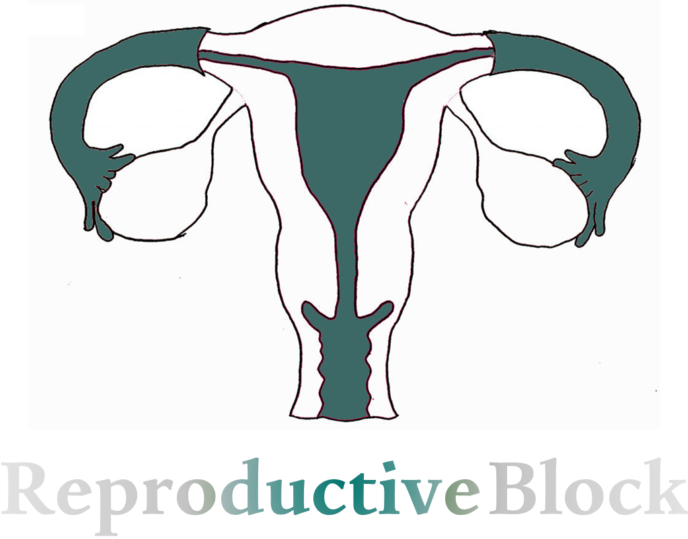
المحاضرة مو طويلة، أغلبها شرح اكسترا ☺
Text
Only in Females’ slide
Only in Males’ slides
Important
Numbers
Doctor notes
Extra Notes

Slide 2
Menstrual Cycle
(Ovarian & Uterine cycles)
By the end of this lecture, students should be able to describe:
Recognize the hypothalamic- pituitary-ovarian-axis.
Describe the physiological phases of ovarian cycles.
Describe the changes that occur in the ovaries leading to ovulation.
Describe the development and the fate of corpus luteum.
Describe the normal phases of menstrual cycle.
Discuss the structural changes that occur in the endometrium during the menstrual cycle and explain how these changes are hormonally controlled.
List the hormones of female reproduction and describe their physiological functions.
Describe the physiology of menopause and the disorders of menstruation.

Slide 3
Physiologic Anatomy of The Female Sexual Organs
The picture shows the principal organs of the human female reproductive tract, including the ovaries, fallopian tubes (also called uterine tubes), uterus, and vagina.
Reproduction begins with the development of ova in the ovaries. In the middle of each monthly sexual cycle, a single ovum is expelled from an ovarian follicle into the abdominal cavity near the open fimbriated ends of the two fallopian tubes.
This ovum then passes through one of the fallopian tubes into the uterus; if it has been fertilized by a sperm, it implants in the uterus, where it develops into a fetus, a placenta, and fetal membrane and eventually into a baby.
Since the vagina in the middle between the urethra and the rectum, During delivery they put a catheter to evacuate the urinary bladder for easier delivery + enema to o expel the rectum contents to facelift the delivery.

Slide 4
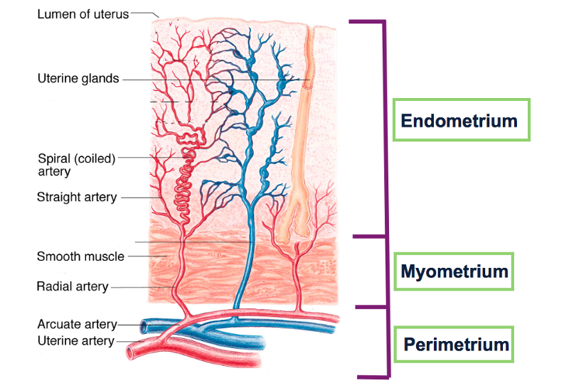
Layers of Uterine Wall
Uterine wall, which is made up of three different layers. There's the outer perimetrium, the middle (muscular) myometrium (that's the thickest layer), and the inner endometrium (thinner layer).
But only one of these layers undergoes the changes during the uterine cycle, and that's the endometrium.
The endometrial tissue itself is also made up of two layers:
Basilar zone, which attaches the endometrium to the underlying myometrium.
Functional zone, which is the part that changes throughout the uterine cycle.

Slide 5
Introduction of Female Reproductive Physiology
Monthly ovarian cycle:
In normal reproductive years of female there is a monthly rhythmical changes in the rates of secretion of female hormones & corresponding physical changes in the ovaries & other sexual organs (menstrual / sexual cycle).
Duration of the cycle:
Duration of the menstrual cycle averages 28 days (20 - 45 days).
(menstrual cycle = ovarian cycle + uterine cycle)
Results of the female sexual cycle: (important)
Single ovum (oocyte) البويضة البدائيةis released from the ovaries each month.
Uterine endometrium is prepared for implantation of the fertilized ovum (Under the effect of estrogen and secretory changes).

Slide 6
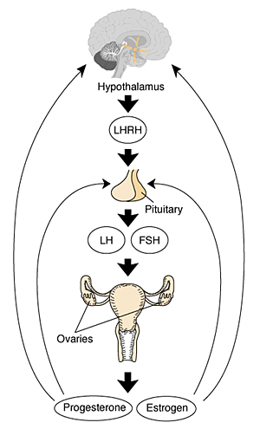
Gonadotropic Hormones & Their Effects on The Ovaries
The ovarian changes during the sexual cycle depend completely on FSH & LH secreted by anterior pituitary, controlled by negative feedback.
In the absence of these hormones, the ovaries remain inactive throughout childhood.
At puberty the anterior pituitary starts to secrete FSH & LH which lead to the beginning of monthly reproductive cycles.
First menstrual cycle is called menarche.
Both FSH and LH stimulate their ovarian target cells by combining with highly specific receptors leading to an increase:
Rates of secretion.
Growth & proliferation of the cells.
GnRH
GnRH released at puberty & stimulates the relapse of FSH and LH which are proteins (peptide hormones) & we cannot measure GnRH from blood because its secretion is pulsatile, not sustained.
in females it will affect ovaries only not endometrium or uterus and in males it will affect testis, then it will stimulate the release of progesterone and estrogen in female and testosterone in male and these are steroid hormones so, it can cross BBB.
Oral contraceptives contain estrogen and progesterone.
All hormones cause -ve feedback except oxytocin and estrogen can cause both -ve feedback & +ve feedback .

Slide 7
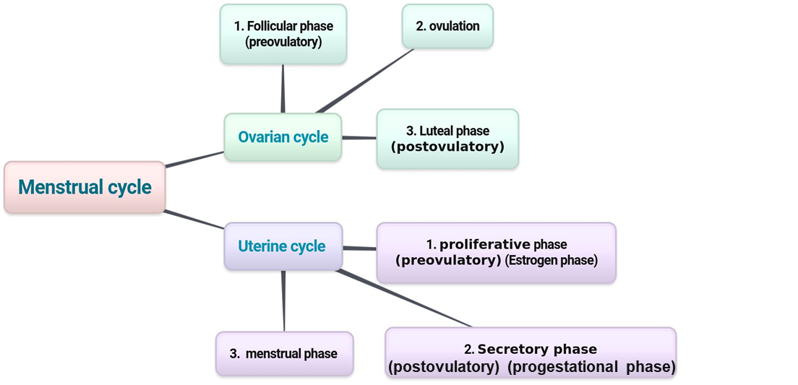
Overview of Menstrual Cycle
Mnemonic:
Progesterone → pro- means after or extra, so we correlate its function time being after ovulation.
To memorize the different phases of each cycle remember this sentence: ( FOoL Many Protective Sloths) → (Follicular, Ovulatory, Luteal, Menstrual, Proliferative, secretory)
From day 1 - 14
Day 14
From day 14 - 28
Usually luteal phase is fixed but the follicular may be disturbed and differs from month to another
= Follicular phase
= Luteal phase
When we start to count the days of the cycle? when the bleeding starts.
The menstrual cycle الدورة الشهرية composed of two cycles:
1. The Ovarian cycle which occurs in the ovaries.
تغيرات تحدث في المبايض
2. The Uterine cycle which occurs in the endometrium of the uterus.
تغيرات تحدث في الطبقة الداخلية للرحم endometrium
حطوا ببالكم أن التغيرات والـCycles متداخلة وليست جميعها متسلسلة.
مثل ماهو موضح بالصورة:
الـ(Follicular Phase + proliferative phase + menstrual phse) يحدثون بنفس الوقت مع اختلاف أوقات البداية والنهاية، وبعدهم يحدث الـOvulation .
وبعدها الـ(Luteal phase + secretory phase)

Slide 8
Effect of LH & FSH In Biosynthetic Pathway For Progesterone & 17β-estradiol In The Ovaries
What should I memorize from this diagram?
Luteinizing hormone (LH) stimulates cholesterol desmolase enzyme in theca cells. Cholesterol desmolase enzyme is the enzyme that converts cholesterol to pregnenolone which is the first step of steroids hormone synthesis.
Pregnenolone will be converted into progesterone by 3β-hydroxysteroid dehydrogenase.
Follicle-stimulating hormone (FSH) stimulates aromatase enzyme in granulosa cells. Aromatase enzyme is the enzyme that converts testosterone to the 7β-estradiol.

Slide 9
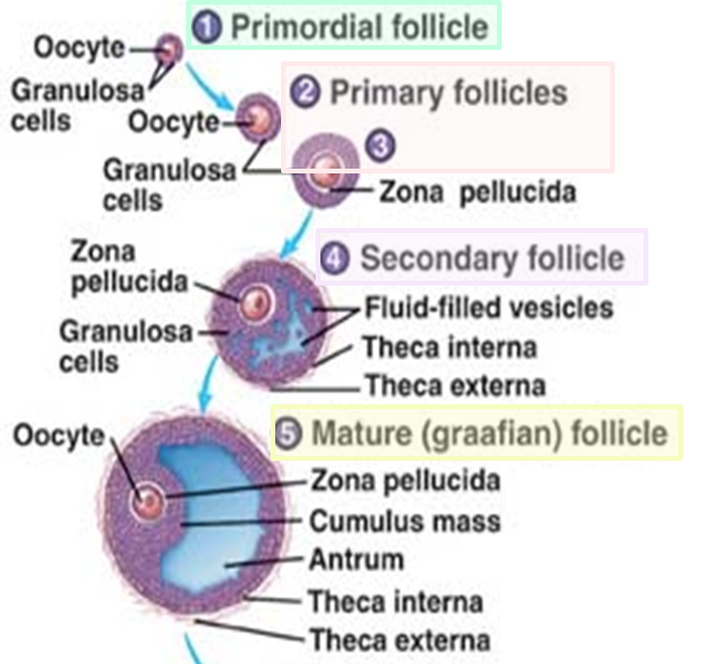
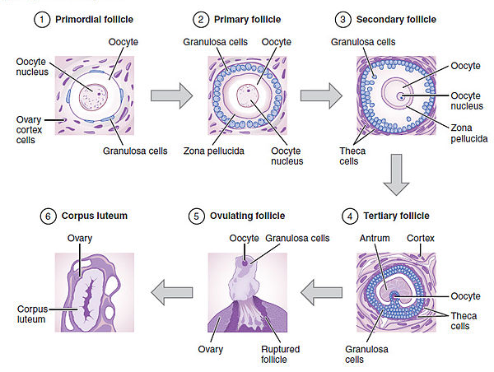
“Follicular” Phase of The Ovarian Cycle (Ovarian follicle growth)
Stage 1
primordial follicle
Stage 2 & 3
Primary Follicles
Stage 4
Secondary Follicles
Stage 5
Mature Graafian Follicles
When the follicular phase occur?
It occurs 1 - 14 days after the onset of menstruation in 28 days cycle.

Slide 10
Cont.
This slide is only in females but the males Dr talked about it
Stage 1: Primordial Follicle
In female child each ovum (oocyte) is surrounded by single granulosa cell sheath called primordial follicle.
Ovum (oocyte) =الصيغة البدائية للبويضة
Functions of granulosa cells during childhood: (Important)
Provide nourishmentالغذاء for the ovum.
Secrete oocyte maturation inhibiting factor which keeps the ovum in its primordial state.
Embryo female has 7.000.000 primordial follicle (the ova is lined by single layer of follicular cells and layer of granulosa cells).
Why is ova inside follicle? Ova has secretions to keep it from drying out.
After delivery (fetus female) has 2.000.000 follicle. While In puberty, female has 500.000 follicle.
شرح الكلام:
أول خطوة من الـFollicular phase هي تكوّن الـPrimordial Follicle during the childhood
الـ Primordial Follicle عبارة عن Ovum (الصيغة البدائية للبويضة) محاطة بـ granulosa cell زي ماهو موضّح بالصورة عاليمين، أثناء الطفولة يكون عندنا منها بالملايين ولكنها تكون خاملة وما تكبر ولا يصير لها شيء إلى سن البلوغ (الخطوة الجاية).
ليش البويضة تكون محاطة بالـ granulosa cell؟ وظيفة الـ granulosa cell بهذه المرحلة أنها توفر التغذية للـovum، وتفرز مثبط نمو للـovum حتى تحافظ عليها في حالتها البدائية وما تكمّل نموّها.

Slide 11
Cont.
This slide is only in females but the males Dr talked about it
Stage 2 & 3: Primary Follicles
After puberty, anterior pituitary secrete FSH and LH which:
Stimulate the ovaries and result in growth of some follicles. Growth of the follicle begins with increase in size of the ovum & growth of additional layers of granulosa cells of some follicles.
شرح الكلام:
ثاني وثالث خطوة من الـFollicular phase هي تكوّن الـ .Primary Follicle after the puberty
بعد البلوغ الـanterior pituitary راح تفرز هرمونين هم: FSH & LH.
في هذه المرحلة: راح تتحفز عندنا الـمبايض عشان يزيد حجم الـovum وتزيد لنا كمية الـ granulosa layers المتكونة من الخطوة السابقة، ونتيجة لذلك راح يزيد عندنا حجم بعض الfollicle.
هذه الخطوات تصير تحت تأثر هرمون الـFSH فقط، بينما الخطوة الجاية هرمون الـFSH ما يقدر لحاله يستوعب حجم النمو فيحتاج مساعدة هرمون الـLH

Slide 12
Cont.
This slide is only in females but the males Dr talked about it
Important
Stage 4: Secondary Follicles
During the first few days of the monthly female reproductive cycle there is increase in secretion of FSH and LH.
Increase in FSH is slightly more & earlier than LH which causes the acceleration of growth of many primary follicles each month.
There is proliferation of the granulosa cells to many layers. The ovary interstitium collect in several layers outside the granulosa cells to form a second mass of cells called theca.
This theca is divided into 2 layers: (Important)
Theca interna, the cells have epitheloid characteristics and similar to the granulosa cells and secrete sex hormones (estrogen and progesterone).
Theca externa, the outer layer, develops into a highly vascular connective tissue capsule of the developing follicle.
شرح الكلام:
رابع خطوة من الـFollicular phase هي تكوّن الـ .Secondary Follicle
يزيد عندنا إفراز هرموني الـFSH & LH أثناء الأيام الأولى من الدورة الشهرية، وزي ما قلنا بالسلايد السابق بداية النمو والتكون تكون تحت تاثير هرمون الـFSH، لكن في هذه المرحلة الهرمون لحاله ما يقدر يستوعب الحجم والنمو، فـ راح يحتاج مساعدة هرمون الLH وهذا راح يسرّع لي نمو كثير من الـ primary follicles .
الـ granulosa cellsتبدأ تكبر ويصير فيها عدة طبقات واحدة منها اسمها theca cells
الـtheca cells نفسها تتقسم لطبقتين:
Theca interna: الطبقة الداخلية وهي تشبه تشبه للـgranulosa cells وتفرز استروجين وبروجسترون.
Theca externa: الطبقة الخارجية، وتكون مليئة الأوعية الدموية (ما تفرز هرمونات فقط طبقة محيطة)

Slide 13
Cont.
Important
Stage 5: Mature Graafian Follicles (very large and ready for rupture)
Few days after proliferation & growth of the follicles, the granulosa cells secrete follicular fluids contain high concentration of estrogen. This fluid accumulate to form antrum within the mass of the granulosa cells.
The early growth of the follicle up to the antral is under FSH stimulation (The follicular cells (granulosa cells) have specific receptor for FSH) Then there is accelerated growth of the follicle to larger follicle called vesicular follicle caused by:
يعني هذه هي الثلاث خطوات اللي راح تُنتج لي Mature Graafian Follicles
1. Estrogen secreted into the follicle causes the granulosa cells to form increasing number of FSH receptors which causes positive feedback effect.
2. Both estrogen & FSH combine to promote LH receptors on the granulosa cells, allowing more increase follicular secretion.
3. The increasing estrogen from the follicle plus increasing LH from the anterior pituitary
causes proliferation of the follicular theca cells & increase their secretion.
الشرح بالسلايد الجاي

Slide 14
Cont.
The antral follicles begin to grow. The ovum enlarges & remain embedded at one pole of the granulosa cells of the follicle.
After a week or more of growth (but before ovulation occurs) one of the follicles begins to outgrow all the others, and the remaining 5 to 11 developing follicles involute (a process called atresia). (The cause of the atresia is unknown)
As a result: (only in females slides)
Rising estrogen levels: Positive feedback locally & Negative feedback centrally.
Rising inhibin levels: Further negative feedback.
Declining FSH levels:
Withdraw growth support.
Atresia in lesser follicles.
Mainly contains estrogen
Once the bleeding starts, FSH secretion start as well, to prepare for the next cycle but its not specific so, it will stimulate from 5-11 follicles only. Each women lose 5-11 ovum monthly
The fastest follicle to grow remain in the cycle, while others degenerate because of the low estrogen level.
Estrogen has –ve feedback on the FSH while it has two +ve feedback:
paracrine: estrogen and FSH increase LH stores in the follicles.
Endocrine: before the follicle rupture, it sends signals to AP, the signal is “I’m ready to rupture and I need LH”.
So, estrogen occur in blood and fluctuate (up & down) → LH surge (increase LH) → rupture.
What will happen if estrogen level is constant (not fluctuate) → no LH surge → no rupture.
باختصار:
الـgranulosa cells راح تنتج كمية كبيرة من الـfollicular fluid اللي يحتوي على كمية كبيرة من الاستروجين وهذا راح يتجمع ويسوي الـantrum تحت تأثير الهرمون FSH.
بعد أسبوع، بويضة واحدة من اصل ٥-١١ بويضة هي اللي بتكبر والباقي راح يتحللون.

Slide 15
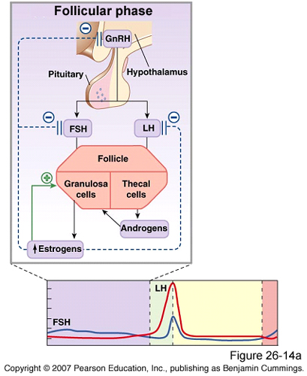
Summary of “Follicular” Phase of The Ovarian Cycle
Important
During the first few days of the monthly female sexual cycle there is an increase secretion of FSH, LH.
The early growth of the primary follicle up to the antral stage is under FSH stimulation only. Then there is accelerated growth of the follicle to larger follicle called vesicular follicle (Graffian) caused by:
Estrogen ↑ FSH receptors (positive feedback effect).
Estrogen & FSH combine to promote LH receptors on the original granulosa cells in addition to FSH stimulation. → Proliferation of the follicular theca cells & increase their secretion.
From the growth of follicles to the formation of antrum is mainly done by FSH.
Antrum is a sac filled with estrogen.
At puberty there will only be FSH secretion, since it has target receptors on the follicular cells.
During menstruation, FSH secretion is more than LH. LH is insignificant in this phase until the last 2 days (day1-14), because GnRH is not specific for FSH secretion, so when the AP is stimulated, both FSH & LH will be released.

Slide 16
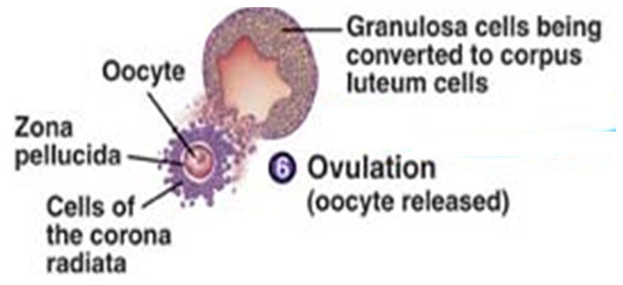
“Ovulation” Phase of The Ovarian Cycle
When the ovulation phase occur?
It occurs 14 days after the onset of menstruation in 28 days cycle.
What does that mean? It means it occurs in the half of the period time.
Ex: if the cycle is 28 days the ovulation will be in the 14th day.
If the cycle is 35 days the ovulation will be in the 21th day. (because if there is menstrual imbalance mostly the problem will be in the follicular phase)
Before ovulation:
2 Days before ovulation, the rate of LH secretion from the anterior pituitary increase markedly to 6-16 fold & peak about 16 hours before ovulation. FSH also increases to 2 to 3 folds & acts synergistically with LH to cause swelling of the follicle before ovulation.
LH surge is necessary for ovulation (without LH hormone, ovulation will not occur): LH has specific effect on the granulosa cells & theca cells converting them to progesterone secreting cells (these cells are important in maintaining and protecting the embryo from abortion) so the rate of estrogen secretion begins to fall about 1 day before ovulation while progesterone secretion begin to increase.
Ovulation can be detected by hormonal analysis & increase in body temperature due to the effect of progesterone.
شرح الكلام:
قبل التبويض بيومين نسبة الـLH & FSH بتزيد وتؤدي الى انتفاخ البويضة. لو ماكان عندنا LH كثير مارح يتم التبويض لانه هو الي يخلي الـgranulosa & theca cells تنتج بروجسترون.

Slide 17
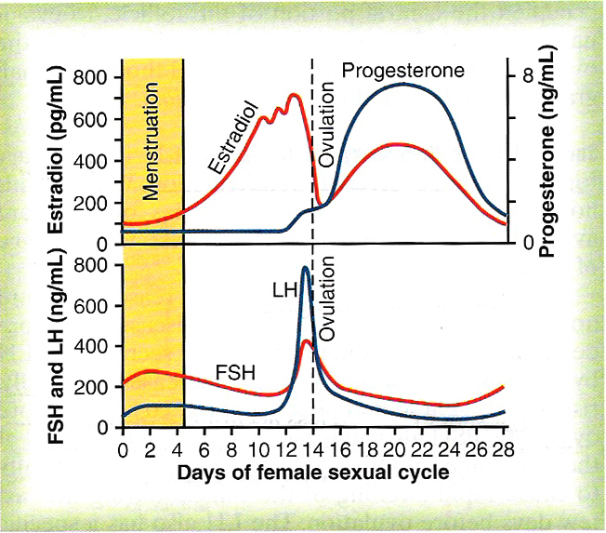
Cont.
Important
1
2
3
In day 13 or 14 the follicle is ready so, it will secrete the estrogen (which is stored in the antrum) as signals to the brain.
After multiple signals (3 times) the estrogen activate the anterior pituitary gland to secrete LH, then rupture happen

Slide 18
Cont.
Important
Starting of ovulation (initiating):
Large quantity of LH secreted by the anterior pituitary causes rapid secretion of progesterone from the follicle within a few hours.
2 events occur which are necessary for ovulation: (Important)
The theca externa begins to secrete proteolytic enzymes & causes weakening of the wall result in swelling of the follicle & degeneration of the stigma.
Rapid growth of new blood vessels into the follicle wall & prostaglandins are secreted into the follicular tissue.
Those two changes causes swelling of the follicle, plasma transudation into the follicle & degeneration of the stigma with discharge of the ovum.
شرح الكلام:
الـtheca externa تفرز انزيمات تضعف جدار الـfollicle وتؤدي الى انتفاخها. اوعية دموية تبدأ تنموا داخل الـfollicle وتفرز prostaglandins. كل هذي الاحداث تتسبب في التبويض.

Slide 19
Cont.
During Ovulation:
Small area in the center of the follicle called stigma protrude & fluids ooze from the follicle.
The stigma ruptures allowing more viscous fluid outward carrying with it the ovum surrounded by mass of granulosa cells called corona radiata (Corona radiata= granulosa cells).
In this stage, the ova has layer of follicular cells (corona radiata) and zona pellucida (protective layer that a sperm should penetrate).
شرح الكلام:
في منطقة بالـfollicle اسمها stigma تصير بارزة ويبدا السائل يتسرب منها ومع السائل تطلع البويضة وتكون حولينها corona radiata.

Slide 20
“Luteal” Phase of The Ovarian Cycle
Stage 1
Corpus Luteum
Stage 2
Corpus Albicans
When the luteal phase occur?
It occurs 14 – 28 days after the onset of menstruation in 28 days cycle.

Slide 21
Cont.
From ovulation until bleeding phase LH is the dominant hormone only.
Stage 1: Corpus luteum (الجسم الأصفر)
After expulsion of the ovum from the follicle, the remaining granulosa & theca interna cells change to lutein cells & become filled with lipid inclusions giving them yellowish appearance.
The granulosa cells with the theca cells called corpus luteum.
The functions granulosa cells: develop extensive intracellular endoplasmic reticula & form large amount of progesterone & few estrogen.
The theca functions cells: form mainly androgens which are converted by granulosa cells into female hormones (by aromatase; the adipose tissue contain this enzyme, so obese males will have high amounts of estrogen in the blood stream → female characteristics) and small amount can appear in plasma. Androgen are not diffused to blood from day 1–14 (follicular phase) because it diffuse from the theca cells to the follicular cells. While the estrogen is diffused to blood and stored in the antrum.
The corpus luteum grow to about 1.5 cm in diameter, at about 7 to 8 days after ovulation. Then begins to involute & losses its secretory function & its yellowish characteristic about 12 days after ovulation & becomes corpus albicans & replaced by connective tissue & absorbed.
شرح الكلام:
بعد خروج البويضة من الـfollicle، المتبقي من الـgranulosa & theca interna cells راح يتحولون الى lutein cells ويصيرون ممتلئين بالدهون وهذا اللي يعطي اللون الأصفر، ولهذا السبب نسمي الـcorpus luteum بالجسيم الأصفر.
الـcorpus luteum هي عبارة عن granulosa & theca cells وتبدأ تتكون بعد ٧-٨ أيام بعد التبويض
وظيفة الـgranulosa cells: نمو الـendoplasmic reticulum وكمية كبيرة من الاستروجين البروجسترون.
وظيفة الـtheca cells تكون لنا الهرمونات الذكورية (androgens) اللي جزء منها راح يتحول الى هرمونات أنثوية بواسطه انزيم الـaromatase
الـcorpus luteumتبدا تتحلل وتخسر خواصها بعد ١٢ يوم من التبويض وهنا تسمى corpus albican

Slide 22
Cont.
Luteinizing Function of LH:
A local hormone in the follicular fluid called luteinization – inhibiting factor hold the luteinization process until after ovulation.
After extrusion of the ovum from the follicle the following changes occur:
Conversion of granulosa and theca interna cells into lutein cells.
Maintains secretion of progesterone & estrogen from the corpus luteum.
Causes ovulation.
If pregnancy occurs:
The chorionic gonadotropin (hCG) (هرمون الحمل) from the placenta (Trophoblast) act on the corpus luteum to prolong its life for 2 to 4 months of pregnancy. (الدكتور قال بنرجع ناخذها بالتفصيل في محاضرة الحمل، بس اعرفوها بشكل سطحي الحين)
The ova inside primordial follicle moves to fallopian tube and fertilization occurs in ampulla → form zygote which is covered by a layer of trophoblast cells secreting hCG. If there is no pregnancy, corpus luteum convert to corpus albican → it will die.
(The hCG is almost biochemically identical to LH, it does it’s same functions primarily by maintaining the corpus luteum)
Very important : Lutein cells = found in corpus luteum, second half of female sexual cycle and secret progesterone.

Slide 23
Cont.
Q1) What are the dominant hormone in the follicular phase?
Estrogen
Q2) What are the dominant hormone in the luteal phase?
Progesterone
Important
Stage 2: Corpus albicans الجسم الأبيض (Involution of the corpus luteum and onset of the next ovarian cycle)
Lutein cells of the corpus luteum secrete both progesterone & estrogen & inhibin which all together will inhibit both FSH & LH by causing negative feedback on the anterior pituitary.
(The corpus luteum needs LH to survive, so by inhibiting it’s release from the AP its killing itself)
Low levels of both FSH & LH & causes the corpus luteum to degenerate completely, called involution of the corpus luteum.
Around 26th days of normal sexual cycle & after involution of corpus luteum (because there is no LH), sudden
cessation of estrogen, progesterone & inhibin removes the negative feedback inhibition of the anterior pituitary
& allowing ↑ secretion of FSH & LH again.
FSH & LH initiate the growth of new follicles, beginning a new ovarian cycle.
شرح الكلام:
الـlutein cells تفرز بروجسترون واستروجين وهم اللي راح يثبطون إفراز الـFSH & LH.
لما الـFSH & LH يكونون نازلين (مثبّطين) راح يؤدون الى تحلل الـcorpus luteum ويصير اسمه corpus albican.

Slide 24
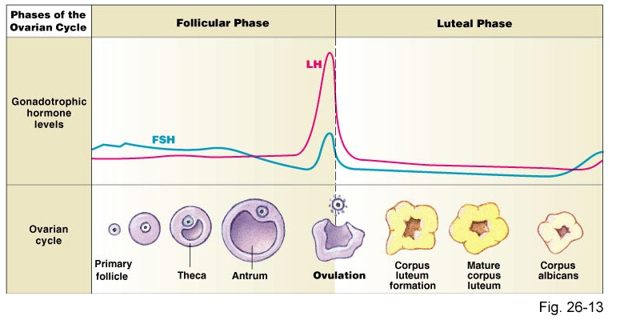
The End of The Ovarian Cycle
At the end of the cycle when the corpus luteum degenerates, there is no negative feedback on the anterior pituitary anymore, FSH & LH are released again to initiate the beginning of a new cycle.

Slide 25
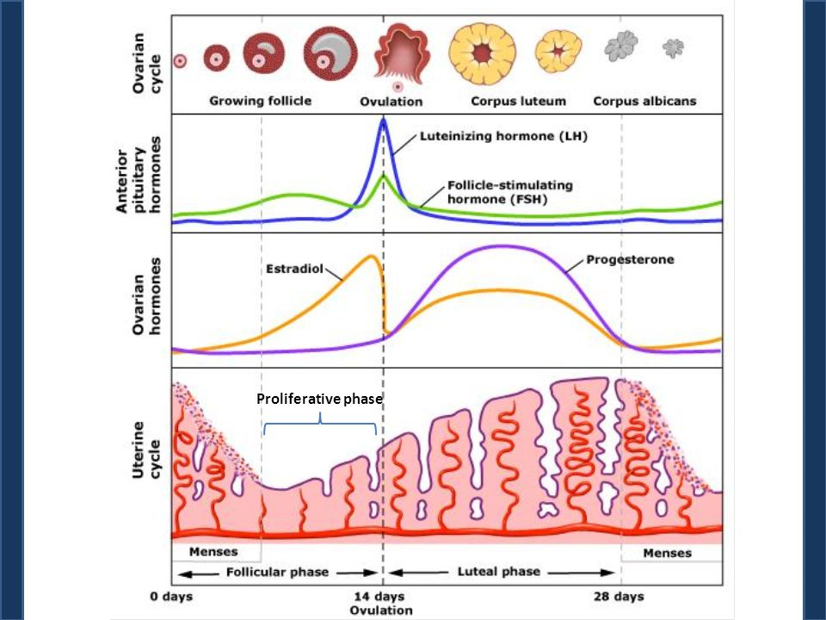
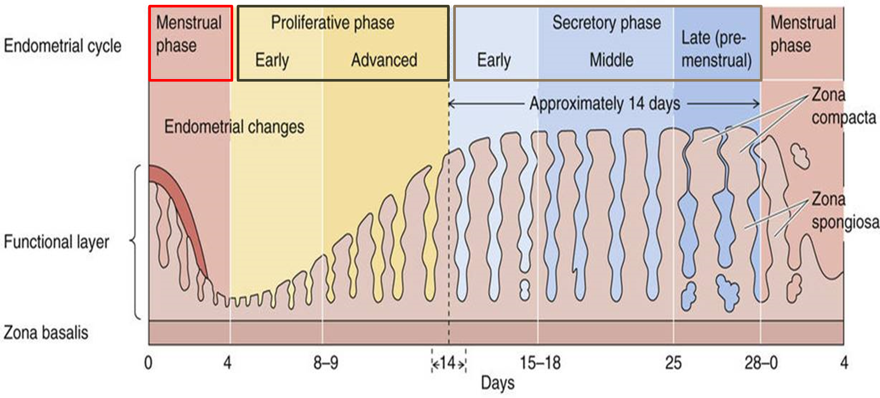
Uterine Cycle (Endometrial Cycle)
Monthly endometrial cycle and menstruation is associated with the monthly cyclical production of estrogens & progesterone by the ovaries in the lining of the uterus.
The Uterine cycle occurs in the endometrium of the uterus.
Phases:
LH and FSH affect the ovaries → so, they secrete estrogen and progesterone → affect the uterus endometrium.

Slide 26
Dr. Alotaibi’s Explanation For The Upcoming Slides
The functioning layer of the endometrium is the one which will be renewed monthly.
The Basel layer will remain from previous period at day 5, when menstruation stops under the influence of estrogen; the endometrium will proliferate and increase the cell and blood supply.
Estrogen has two effects: working on the endometrium and cervix.
At the end of day 14 or 15 the thickness is from 3-5 mm (it was in an exam two year ago).
Until now it's not ready yet for pregnancy!
The other action of estrogen before ovulation by 2 days the estrogen at the highest level, she will have secretion from the cervix, and under microscope there will be channels or holes, that direct the sperm into the fallopian tube.
The other half of the cycle is controlled by progesterone from day 15-28, it will make the secretion very thick so the sperm can't penetrate the cervix (because the brain think that pregnancy is happening, so it must protect the embryo from other sperms), the progesterone every month will prepare the endometrium for the pregnancy by increasing the secretion and implantation.
How the embryo live its first three months? by uterine milk.

Slide 27
Proliferative Phase (Estrogen Phase)
When the Proliferative Phase occur?
Occurring before ovulation & it lasts for 11 days.
Stages:
1. At the beginning of each cycle, most of the endometrium has been desquamated by menstruation. After menstruation only thin layer of the endometrial stroma remains & the deeper portions of the glands & crypts of the endometrium.
2. Under the influence of estrogens, secreted in large quantities by the ovaries, the stromal cells & epithelial cells proliferate rapidly.
3. The endometrial surface re-epitheliazed within 4-7 days after the beginning of menstruation. Before ovulation the endometrium thickness increases, due to increase numbers of stromal cells & progressive growth of the glands & new blood vessels.
4. At the time of ovulation, the endometrium is 3-5 mm thick. The endometrial glands, cervical region secrete a thin, stringy mucus (due to high estrogen level) which helps to guide sperm in the proper direction from the vagina into the uterus.
= follicular phase
Controlled by estrogen
شرح الكلام:
بعد الـ Menstruation تكون بطانة الرحم رقيقة.
بعد ماتفرز المبايض كميات كبيرة من الاستروجين ترجع البطانة تنمو وتصير سميكه، بهذه المرحله يفرز الرحم مادة مخاطية لتسهل دخول الـsperm لها.

Slide 28
Secretory Phase (Progestational Phase)
When the Secretory Phase occur?
Occurring after ovulation & it lasts for 12 days.
Stages:
1. After ovulation, estrogen & progesterone are secreted in the later part of the monthly cycle by the corpus luteum (large amounts of progesterone and small amount estrogen).
What are The effects of estrogen & progesterone?
Estrogen: cause slight proliferation in the endometrium.
Progesterone:
Marked swelling & secretory development of the endometrium.
The glands increase in tortuosity, excess secretory substances accumulate in the glands.
Increase the blood supply to the endometrium & the blood vessels become highly tortuous.
Increase lipids and glycogen deposits in stromal cells cytoplasm
= luteal phase
Controlled by progesterone
مهم نعرف الفرق بين دور البروجسترون والاستروجين في هذه المرحلة
The estrogens cause slight increase cellular proliferation in the endometrium during this phase of the cycle, while progesterone causes marked swelling and secretory development of the endometrium.

Slide 29
Cont.
2. 1 week after ovulation, endometrium thickness is 5-6 mm.
3. The secretory changes prepare the endometrium (stored nutrients) for implantation of the fertilized ovum .
3. Uterine secretions called “uterine milk” (هنا تبدأ تتكون البلاسينتا ويصير الامبلانتيشن)provide nutrition for the diving ovum.
4. The trophobastic cells on the surface of the implanted ovum begin to digest the endometrium & absorb endometrial stored substances.
No proliferation.
Secretions = endometrial glands + blood supply = these secretion NOURISH the zygote until the placenta develops.
No progesterone = zygote dies.
Progesterone relaxes the myometrium = no abortion.
في هذه المرحلة يتم إفراز هرمون الأستروجين وكميات كبيرة من هرمون البروجسترون الضروريين لزيادة كثافة الجدار الداخلي المبطن للرحم واستقبال البيضة الملقّحة.

Slide 30
Menstruation Phase
When the Menstruation Phase occur?
Occurring If the ovum is not fertilized, about 2 days before the end of the monthly cycle& it lasts in average 5 days.
Stages: How does the menstruation occur?
1. If the ovum is not fertilized, about 2 days before the end of the monthly cycle, the corpus luteum involutes & estrogens & progesterone decrease to low levels.
2. Due to decrease estrogen & progesterone there is decrease stimulation of the endometrium, followed by involution of the endometrium to about 65% of its previous thickness.
الـ endometrium دائما تحتاج تحفيز هرمون الاستروجين والبروجستيرون.
في هذه المرحلة عندنا نقص في هذه الهرومونين، بالتالي الـ endometrium راح تضعف و تتكسر ولما تتكسر راح تضعف وتتكسر الـarteries اللي داخلها بالتالي يحدث الـbleeding.
مشروحة أكثر بالسلايدات الجاية

Slide 31
Cont.
الشرح بالسلايد الجاي
3. During the 24 hours preceding the menstruation, there is vasospasm of the tortuous blood vessels due to release of vasoconstrictor (prostaglandins). There is:
Vasospasm.
Decrease nutrients to the endometrium.
Loss of hormonal stimulation.
What will happen during this phase?
Gradual necrosis of the outer layer of the endometrium leads to separation from the uterus at the site of the hemorrhages.
Within 48 hours, all the superficial layers of the endometrium desquamated in the uterine cavity.
The mass of desquamated tissue & blood plus the contractile effects of prostaglandins initiate contractions which expel the uterine contents.
All initiate necrosis in the endometrial blood vessels.
No estrogen + no progesterone = degeneration of lutein layer = necrosis
This blood is reach with prostaglandin A2 causes contractions and spasms when it reach the myometrium (has prostaglandin receptors).
In each spasm endometrium will rupture and blood supply will tear = pain.

Slide 32
Menstruation Phase
شرح الكلام:
لو مر يومين بدون لا يحصل تلقيح للبويضة، الجسم الأصفر يتحلل ومستوى الاستروجين والبروجستيرون ينزل، بالتالي يقل التحفيز لبطانة الرحم وتبدا سماكتها تقل بنسبة ٦٥٪ عن قبل، سبب قلة السماكة هو ان الـblood vessels يصيرلها vasoconstriction وبالتالي necrosis فتبدا الطبقة السطحية من البطانه بالتساقط على هيئة دم ويخرج من الجسم بسبب انقباضات الرحم.
What will happen during this phase?
In normal menstruation, about 40 ml of blood + 35 ml of serous fluid are lost.
The menstrual blood is normally non-clotting due to the presence of fibrinolysin.
Leukorrhea during menstruation: During menstruation, leukocytes are released
with the necrotic material & blood so the uterus is highly resistant to infection (protective mechanism).
Why do females’ feel pain during this phase?☹
As we said before, shedding of the endometrium is due to spasm of the blood vessels which lead to necrosis of the endometrium and thus casting it of.
The blood released from the raptured blood vessels contains high amounts of prostaglandin's, the prostaglandin's have binds to receptors in the myometrium (the middle muscular layer) & and this binding will lead to very strong contraction.
What will happen after this phase?
Within 4 to 7 days after menstruation, the loss of blood ceases & the endometrium become re-epithelialized.

Slide 33
Functions of Estrogens Vs Progesterone
Only in Males’ Slides
Functions of Estrogens Vs Progesterone
Estrogens | Progesterone
Estrogens increase the size of ovaries, fallopian tubes, uterus, and external genitalia. Estrogens cause marked proliferation of the endometrial stroma and greatly increased development of the endometrial glands. Estrogens cause: Development of the stromal tissues of the breasts. Growth of an extensive ductile system. Deposition of fat in the breasts. Estrogens stimulate bone growth and slightly increase protein deposition. Estrogens increase body metabolism and fat deposition. Estrogens cause sodium and water retention by the kidney tubules. | Progesterone promotes the secretory changes in the uterine endometrium. Progesterone promotes increased secretion by the mucosal lining of the fallopian tubes. Progesterone promotes development of the lobules and alveoli of the breasts, causing the alveolar cells to proliferate, enlarge, and become secretory. Progesterone decreases the frequency and intensity of uterine contractions.

Slide 34
Menopause سن اليأس
Definition of Menopause:
The period during which the cycle ceases & the female sex hormones diminish to almost none.
When the menopause phase occur?
It occurs at the age of 40 to 50 years.
When the menopause phase occur?
With advanced age the ovaries become unresponsive to gonadotropins (decline in the number of primordial follicles), and their function declines so that reproductive cycles disappear (menopause).
What happen during menopause?
When estrogens production falls below the critical value, estrogens no longer inhibit the production of gonadotropins (FSH & LH) so, there is no negative feedback effect → increased secretion of FSH and LH.
The ovaries no longer secrete estrogen and progesterone → The uterus and vagina atrophy.
Ovulation fails to occur & the cycle ceases.
What is the Physiological changes due to loss of estrogens?
The reproductive cycle becomes irregular.
“Hot flushes” characterized by extreme flushing of the skin.
Psychic sensations and dyspnea.
Irritability.
Fatigue.
Anxiety.
Occasionally various psychotic states.
Decreased strength and calcification of bones throughout the body.
Menopause women have:
No more follicles = no estrogen, no progesterone.
High blood levels of LH & FSH because no negative feed back by estradiol and progesterone.

Slide 35
Disorders of Menstruation
Disorders of Menstruation
Amenorrhea
Menorrhagia
Hypomenorrhea
Dysmenorrhea
Is absence of menstrual period
Refer to abnormally heavy or prolonged bleeding.
The most common cause is benign fibroid or can be familial
Refer to scanty flow.
Painful menstruation
Primary
Secondary
وحدة كانت تجيها الدورة عادي، وفجأة ما صارت تجيها ابدا
Secondary amenorrhea cessation of cycles in a woman with previously normal periods, caused by:
Pregnancy (the most common cause).
Emotional stimuli and changes in the environment.
Hypothalamic diseases ( $↓$GnRH pulses).
Pituitary disorders (Sheehan's syndrome, decreased functioning of the pituitary gland)
Primary ovarian disorders and various systemic disease.
Cramps due to accumulation of prostaglandins in the uterus and treatment with inhibitors of prostaglandin synthesis.
Primary amenorrhea in which menstrual bleeding has never occurred.
وحدة ما جاتها الدورة أبداً

Slide 36
SUMMARY of ovarian cycle
Location | Ovary during puberty
Hormones | FSH and LH (very essential to activate ovaries)
Main goal | Causing growth and maturation of Primordial follicles.
Events of ovarian cycle
Follicular Phase | Primordial Follicle [single granulosa cell layer] → Puberty [Release of FSH and LH]→ Primary Follicle [Increase in size of ovum + growth of additional layers of granulosa cells] →↑secretion of FSH and LH [FSH is higher]→ Acceleration of growth of many primary follicles also proliferation of granulosa cells to many layers → Ovary interstitium collect in several layers outside the granulosa cells →Theca [has two layers; Interna which produces ANDROGENS, Externa which is a vascular capsule][It surrounds the granulosa cell layers] →Granulosa cells starts to secrete follicular fluids [High cont. of Estrogen] → Accumulation of fluid → Antrum formation → High levels of Estrogen causes positive feedback on AP to release FSH and both will stimulate AP to secrete more LH. Estrogen from follicles and LH from AP will cause proliferation of the Theca cells along with their secretion → Vesicular Follicle [Graffian] →Antral follicles start to grow and ovum enlarges and remain in embedded at one pole of the granulosa cells → One week or more before Ovulation→ one follicle begins to outgrow and the rest will undergo Atresia.
Ovulation | Swelling of the follicle prior to ovulation by two days due to high secretion of LH and FSH [LH is higher]→ During ovulation the stigma will rupture and fluid ooze from follicle →Release of Ovum surrounded by mass of granulosa cells called Corona Rdiata.
Luteal Phase | Corpus Luteum formation [Lipid filled lutein cells originating from remaining granulosa and theca interna cells under influence of LH] →Fate of Corpus Luteum depends on pregnancy if it occurs or not.

Slide 37
Summary of Uterine Cycle

Slide 38
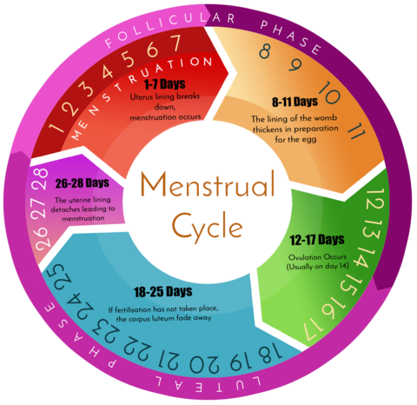
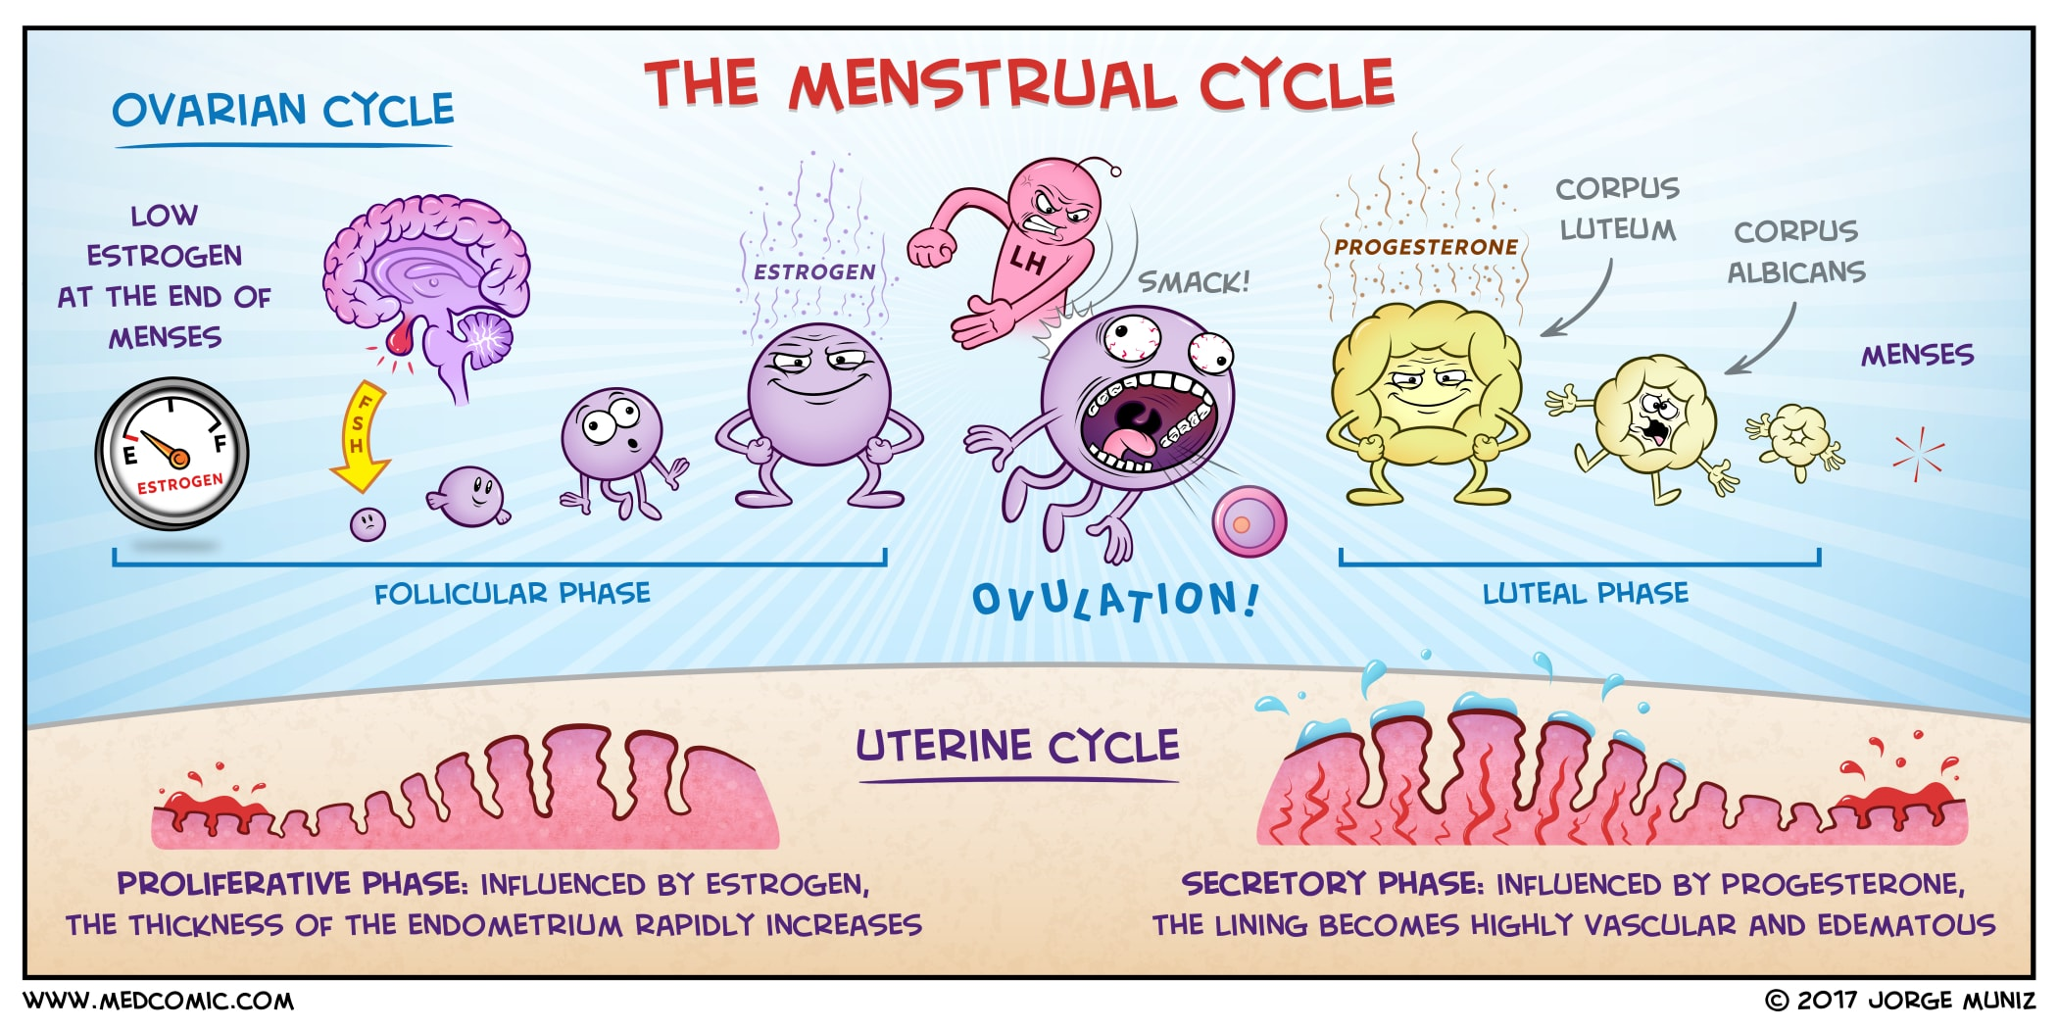
Summary Of Menstrual Cycle

Slide 39
MCQ’s
1. LH & FSH in female will stimulate which of the following organ:
Uterus.
Ovaries.
Fallopian tube.
Both A&B.
2. Ovulation occurs approximately at which day over the 28days of ovarian cycle?
7
20
14
10
3. The stimulation of the early growth of the primary follicle up to the antral stage is under which on of the following?
estrogen only
estrogen and progesterone
FSH only
FSH and LH
4. How man days after the onset of menstruation does the ovulation occur in a woman who has a normal 28-day female sexual cycle?
13
14
15
16
5. What is the predominant hormone in the luteal phase?
Estrogen.
progesterone.
testosterone.
chorionic gonadotropin.
6. Which of the following hormones are secreted to maintain the corpus luteum during pregnancy?
LH
FSH
hCG
estrogen
1=B 2=C 3=C 4=B 5=B 6=C

Slide 40
MCQ’s
1. Which of the following is correct about the uterine cycle?
The proliferative phase is know as the progestational phase
The secretory phase is known as the preovulatory
The secretory phase is known as postovulatory
The secretory phase is know as the estrogen phase
2. How thick is the endometrium AT the time of ovulation?
2-4mm thick
3-5mm thick
4-6mm thick
5-7mmthick
3. which of the following is a function of Estrogen?
increase body metabolism and fat deposition.
promotes increased secretion by the mucosal lining of the fallopian tubes.
decreases the frequency and intensity of uterine contractions.
promotes the secretory changes in the uterine endometrium.
4. progesterone is used to increase the frequency and intensity of uterine contractions in pregnant female.
TRUE
FALSE
1=C 2=B 3=A 4=B

Slide 41
Thank you for checking our work!
اعمل لترسم بسمة، اعمل لتمسح دمعة، اعمل و أنت تعلم أن الله لا يضيع أجر من أحسن عملا.
قادة الفريق:
ليــلـى مـذكور & مـحـمـد نـصـر
Please check our editing file to know if there are any additions, changes or corrections.
خالص الشكر لأعضاء الفريق الكِرام:
https://www.youtube.com/watch?v=vXrQ_FhZmos
ندى الدخيل
حمد الخضيري
خالد القحطاني
عبد الرحمن الراشد
فارس الجعفر
نواف الخضيري
لـمـى الـتـمـيـمـي
لين التميمي
دعاء ماهر
شذا الغيهب
شروق الصومالي
أسيل بادخن
2017-2018 Dr. Dr. Laila Al Dokhi’s Lecture & Notes.
2017-2018 Dr. Mohammed AlOtaibi’s Lecture & Notes.
Guyton & Hall of Medical Physiology 13th Edition.
Linda S. Costanzo 5th Edition.
First Aid For The USMLE Step One.
Study.com
Helpful physiology bocks.
Give us your feedback ☺
اللهم اني استودعتك ما حفظت وما قرأت وما فهمت، فرده لي وقت حاجتي إليه إنّك على كل شيءٍ قدير.

