Slide 1
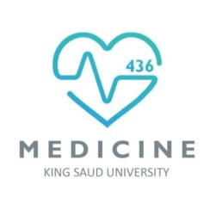
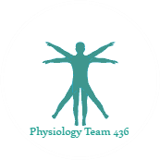
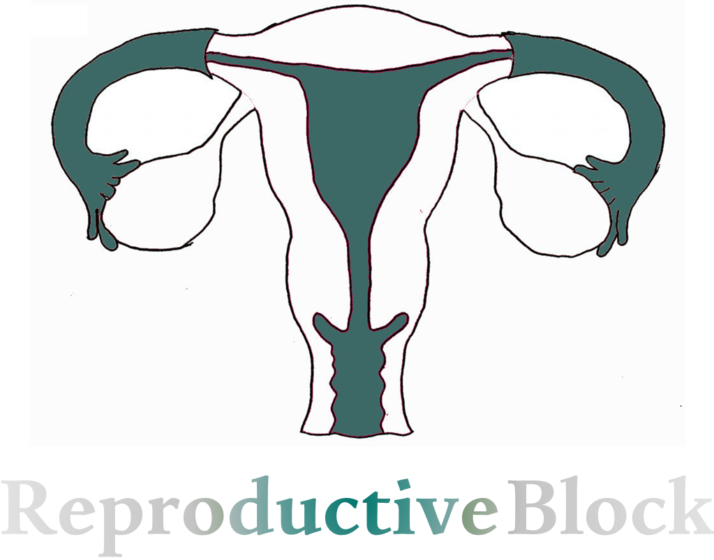


Text
Only in Females’ slide
Only in Males’ slides
Important
Numbers
Doctor notes
Extra Notes

Slide 2
Physiology of androgens and control of male sexual functions
By the end of this lecture, students should be able to describe:
Understand the functions of the male reproductive organs and glands.
Describe the synthesis, secretion, metabolism and effects of testosterone.
Explain how the hypothalamus and anterior pituitary gland regulate male reproductive function.
Describe the major testicular abnormalities.
Discuss the normal mechanism of the male sexual act.

Slide 3
Overview of The Lecture
During this lecture we will talk about male reproductive functions which can be divided into three major subdivisions:
Spermatogenesis: which means the formation of sperm.
Performance of the male sexual act.
Regulation of male reproductive functions by the various hormones.
Associated with these reproductive functions are the effects of the male sex hormones on the accessory sexual organs, cellular metabolism, growth, and other functions of the body.

Slide 4
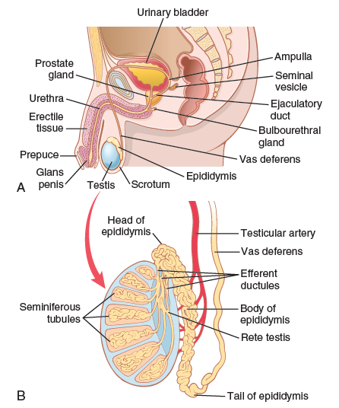
Physiologic Anatomy of The Males’ Sexual Organs
Please understand this to make the understanding of the steps easier.
The picture shows the various portions of the male reproductive system.
The testis is composed of up to 900 coiled seminiferous tubules, each averaging more than one-half meter long, in which the sperm are formed.
The sperm then empty into the epididymis, which is another coiled tube about 6 meters long. The epididymis leads into the vas deferens, which enlarges into the ampulla of the vas deferens immediately before the vas enters the body of the prostate gland.
Two seminal vesicles, one located on each side of the prostate, empty into the prostatic end of the ampulla, and the contents from both the ampulla and the seminal vesicles pass into an ejaculatory duct leading through the body of the prostate gland and then emptying into the internal urethra. Prostatic ducts also empty from the prostate gland into the ejaculatory duct and from there into the prostatic urethra.
Finally, the urethra is the last connecting link from the testis to the exterior. The urethra is supplied with mucus derived from a large number of minute urethral glands located along its entire extent and even more so from bilateral bulbourethral glands (Cowper glands) located near the origin of the urethra.

Slide 5

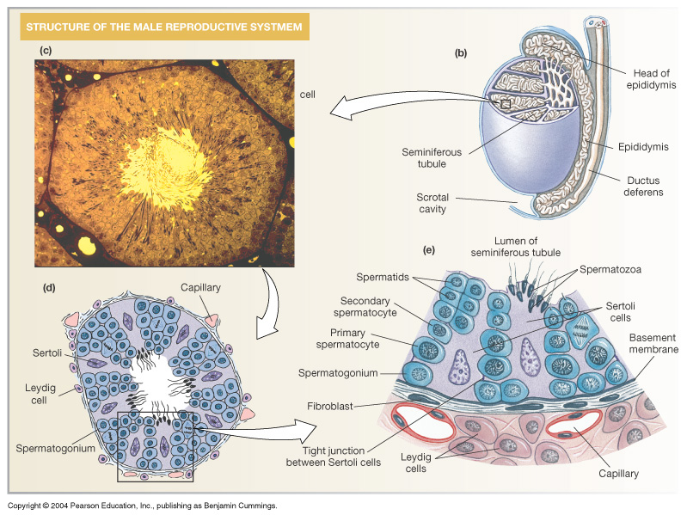
Spermatogenesis
Formation of sperm from spermatogonia which occur in the seminiferous tubules during active sexual life due to stimulation of hypothalamic pituitary gonadal axis (Anterior pituitary - GnHs).
Begin at an average age of 13 years & continue throughout life then decrease in old age.
There is no menopause for the males’.
Seminiferous tubules are anastomoses and form what called (rete testis) then we have the head of epididymis then into the tail which stored there for several months. They are suppressed and not moving, they are metabolically inactive which mean less active than normal.
Once they develop the capacitation their metabolism start to get rapidly and they leave only to two days. After ejaculation and capacitation they will be very active and their metabolism be high, therefore they die within 24 hours.
(We will discuss this later)

Slide 6
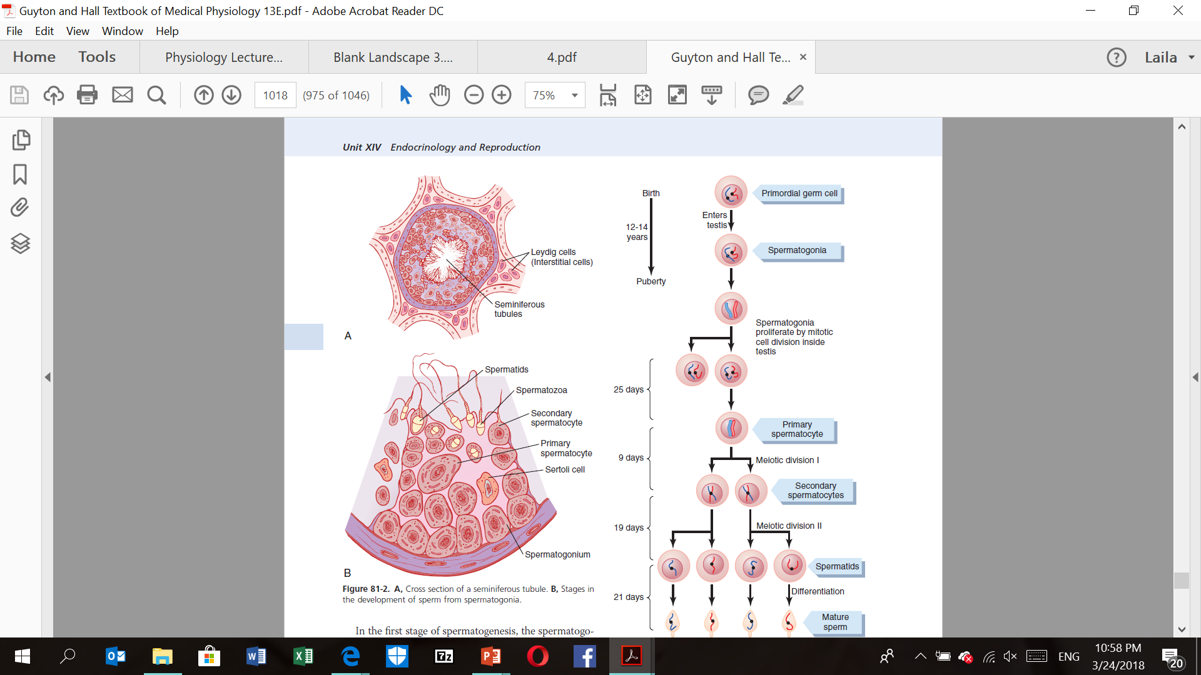
Sertoli & Leydig cells
Important
1. Sertoli cell: (Sustentacular cells or supporting cells)
Large with overflowing cytoplasmic envelopes that surround the developing spermatogonia around the central lumen of the seminiferous tubules.
2. Leydig cell:
Lie with interstitium between the seminiferous tubules.
Numerous كثيرةin the newborn male infants for the first few months of life. (It will disappear until puberty when it appears again)
They are not active during childhood when the testis secrete almost no testosterone. Then it become active at puberty & throughout adult life & secrete testosterone.
Sertoli = Supporting
Serotoli cells Have other name (Sustentacular cells or supporting cells), they support spermatogenesis, they form the blood tests barrier which don't allow anything to pass except with special permission like nutrients and hormones.
Leyding cells was named after the germinal anatomist (France Leyding) who discovers them in 1850.
Sertoli cells named after an Italian physiological gentleman in 1865 (he discovered them with light microscope).

Slide 7
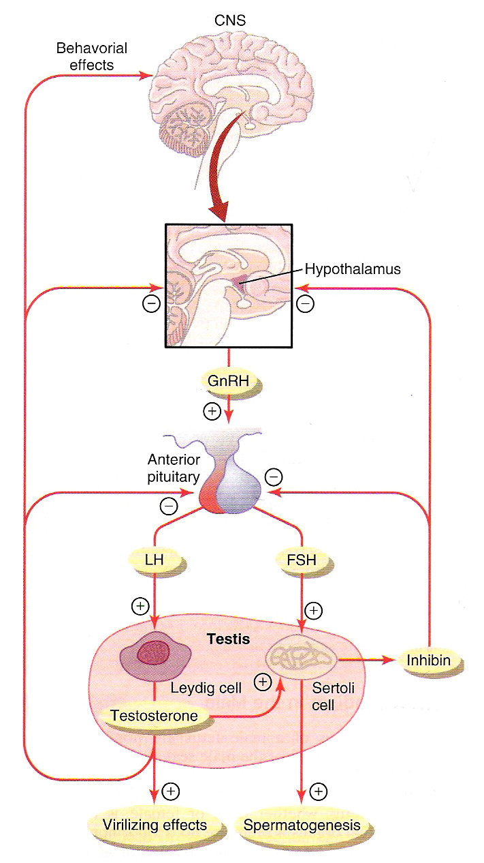
Hormonal Factors That Stimulate Spermatogenesis
Important
Hormonal Factors That Stimulate Spermatogenesis
Hormone | Secreted by | Functions
1. Testosterone | Leydig cells which located in the interstitium of the testis. | Essential for the growth and division of the testicular germinal cells.
2. Luteinizing hormone (LH) | Anterior pituitary gland (AP) | Stimulates the leydig cells to secrete testosterone.
3. Follicle stimulating hormone (FSH) | Anterior pituitary gland (AP) | Stimulates the sertoli cells. Stimulate the conversion of spermatids* to sperm (also important for spermatogenesis).
These three hormones are the most important hormones.
This picture was discussed in lecture 1
* The spermatid is the haploid male gametid that results from division of secondary spermatocytes. As a result of meiosis, each spermatid contains only half of the genetic material present in the original primary spermatocyte.

Slide 8
Cont.
Leyding cells secrets testosterone under the effect of LH.
testosterone like the adrenal hormones (glucocorticoids and aldosterone).
ACTH increase the cholesterol dismolase and increase the expression of STAR protein that will take cholesterol to the inner membrane of mitochondria which is the rate limiting step of cholesterol synthesis.
(كل هذي معلومات سابقة ماراح تنسألون عنها بالإختبار)
You just need to know that: ACTH and LH they like resemble each other in stimulating STAR protein expression and cholesterol dismolase, this will start the sires of synthesis of cholesterol.
STAR (Steroidogenic acute regulatory protein)
Hormonal Factors That Stimulate Spermatogenesis
Hormone | Secreted by | Functions
4. Estrogen | Formed from testosterone by the sertoli cell under FSH stimulation. | Essential for spermatogenesis. By aromatase we convert testosterone into estrogen. So, if we have mutation in this enzyme, we will have deficiency of spermatogenesis and infertility due low count of estrogen. Also these people are taller because estrogen is very important for closure of the epiphyses plate in the bones.
5. Growth hormone (GH) (Also other body hormones) | Anterior pituitary gland (AP) | Is necessary for controlling metabolic functions of the testis. GH promotes early division of spermatogonia, in the absence of GH (pituitary dwarfs), the spermatogenesis is severely deficient or absent → infertility.

Slide 9
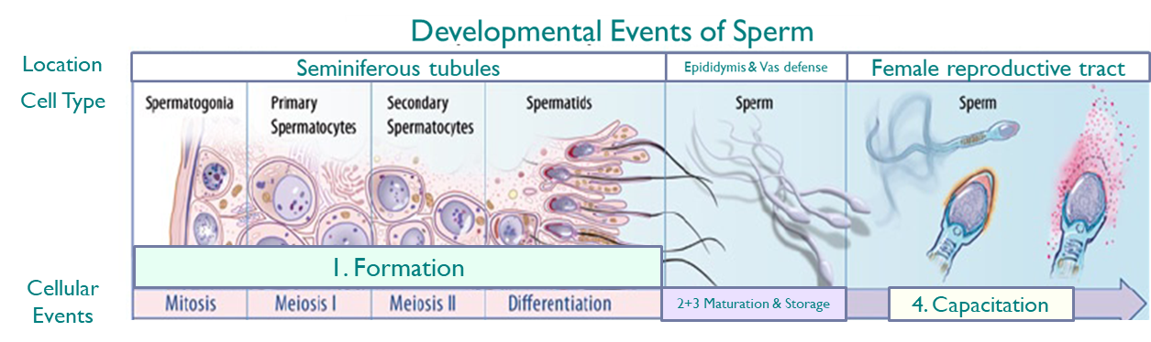
Developmental Events of Sperm
Stage 1
Formation
Stage 2
Maturation
Stage 3
Storage
Stage 5
Capacitation*
* The process by which the glycoprotein coat and the seminal proteins are removed from the surface of the sperm's acrosome by substances secreted by the uterus or fallopian tubes of the female genital tract, thereby permitting the acrosome reaction to occur.

Slide 10
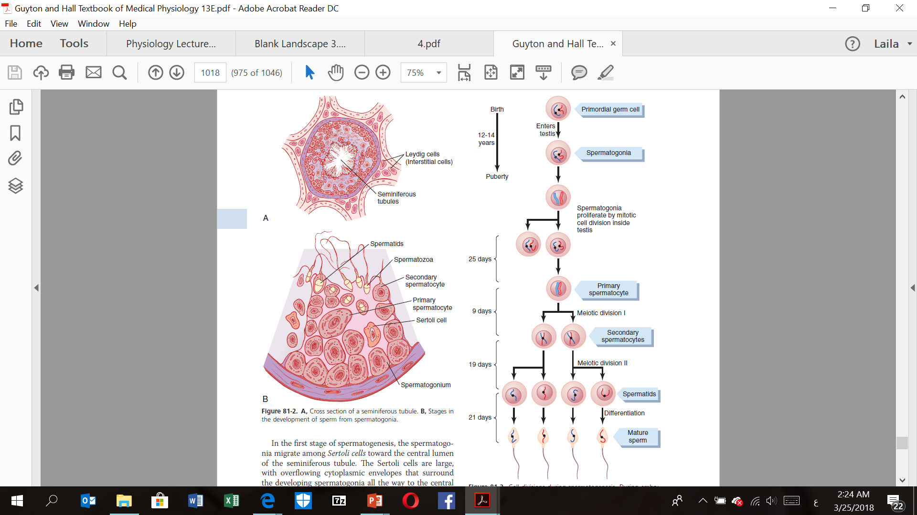
Cont.
Dr: don’t worry about this steps of this stage because its an Embryology
بس اعرفوا وين تحدث
Stage 1: Formation
Where the Formation stage occur?
In the seminiferous tubules. The 2 testis of adult human form up to 120 million sperm each day & could be several months.
During formation of the embryo, the primordial germ cells migrate into the testes and become immature germ cells called spermatogonia, which lie in two or three layers of the inner surfaces of the seminiferous tubules.
At puberty the spermatogonia begin to undergo mitotic division and continually proliferate and differentiate through definite stages of development to form sperm.
شرح الكلام: (اقروه وتبّعوا مع الصورة)
في هذه المرحلة الـ primordial germ cells تدخل للـ ـtestis، وبعد ما تدخل راح تتحول عندي إلى immature germ cells نسمّيها الـ spermatogonia. عند البلوغ الـ spermatogonia راح يصير لها mitotic division ، النتيجة من هذا الإنقسام الأول form two secondary spermatocytes، بعدين راح يصير عندنا mitotic division ثاني والناتج spermatids. أخيرا هذا الـ spermatids راح يتحول إلى Mature sperm.
The period of spermatogenesis, from spermatogonia to mature sperm takes about 74 days.

Slide 11
Cont.
Stage 2: Maturation
Where the Maturation stage occur?
In the Vas Defense.
Maturation of sperm in the epididymis: (Before ejaculation)
After formation of sperm in the seminiferous tubules, the sperm require several days to pass through the epididymis (still non-motile).
After the sperm have been in the epididymis for some 18 to 24 hours, they develop the capability of motility (But still capacitated (there is cholesterol covering the sperm) (some inhibitory proteins in the epididymal fluid prevent final motility until after ejaculation).
شرح الكلام:
بعد ما تكوّن عندي الحيوان المنوي في الـ seminiferous tubules، راح يحتاج أيام حتى يعبر الـ .epididymisوبعد وصوله إليه لو قعد فيه فترة تصل إلى يوم راح يكون motile. لكن بشكل عام الحيوان المنوي يكون غير قادر على الحركة داخل جسم الذكر وذلك بسبب وجود بروتينات مثبطة في الـ epididymis تمنع حركة الحيوان المنوي حتى يصير له ejaculation وبعدها يتحرك في الجهاز التناسلي للمرأة.
If you take sperms directly from epididymis like for IVF, Do these sperms have capability of fertilization? Yes they are, as long that you have 23 chromosomes you always have a way to inject them to the ovum although they lack the capability of motility.
Why are they not moving ? We have two processes: decapitation and capacitation. The decapitation in the epididymis and vas deferens, we have phospholipid & cholesterol which cover the flagella of sperm so, they prevent or decrease the permeability of Ca, which is very important step in any movement. After the ejaculation there is capacitation, those phospholipid & cholesterol will be washed away by vaginal and uterine fluids and the flagella will be more permeable to Ca and becomes motile.

Slide 12
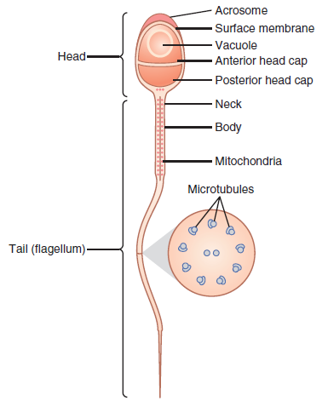
Cont.
Important
If there was no ejaculation the sperm will recycle (the protein will be lysed into amino acid, the lipids will be lysed into fatty acids and used for another formation).
Wet dream could be a source for get rid of the sperm but it is not significant, if the sperms stay for long time without ejaculation they will be lysis.
Stage 2: Maturation
Physiology of mature sperm: (After ejaculation)
After ejaculation, Mature sperm are motile & capable of fertilizing the ovum. (The sperm becomes much more active in the female genital system)
The Sertoli cells and epithelium of the epididymis secrete nutrient fluid which contains (testosterone & estrogens), enzymes & nutrients essential for sperm maturation.
Their activity is enhanced in a neutral & slightly alkaline medium & depressed in mildly acidic medium.
The life expectancy of ejaculated sperm in the female genital tract is only 1 to 2 days.
Strong acid can kill the sperms. Like in vagina the PH there is around 3.5-4.5 which will kill the sperms, but the prostate produce alkaline secretion to neutralize the semen itself and the acidity in vagina.
شرح الكلام:
إيش الفرق بين هذه السلايد واللي قبل؟
السلايد السابقة تتكلم عن الحيوان المنوي حتى مرحلة الـ ejaculation، وفيه هذه السلايد نتكلم عن الحيوان المنوي بعد ما صار له ejaculation، يعني إيش راح يصير فيه بعد ما يدخل الجهاز التناسلي للمرأة.
مهم جدا نعرف من هذه السلايد أن الحيوان المنوي يعيش أفضل في الـبيئة القلوية، بينما الـبيئة زائدة الحموضة تتسبب في قتل الحيوان المنوي. طيب بما أن الـVagina عالية الحموضة، كيف راح يقدر يعيش الحيوان المنوي؟
The prostate produce alkaline secretion to neutralize the semen itself and the acidity in vagina.

Slide 13
Cont.
Stage 3: Storage
Where the Storage stage occur?
In the epididymis and the vas deferens. (small amount in the vas deferens and the majority stored in the epididymis)
Maintaining their fertility for at least a month. The sperm are kept inactive state by multiple inhibitory substances in the secretion of the ducts.

Slide 14
Cont.
Stage 4: Capacitation of the spermatozoa
Where the Capacitation stage occur?
In the Females’ reproductive tract.
What’s Capacitation of the spermatozoa means?
Making it possible for them to penetrate the ovum. Sperm in the epididymis is kept inactive by multiple inhibitory factors secreted by the genital duct epithelia. They are activated in the female genital tract by a process called capacitation which requires 1-10 hours.
الهدف مرحلة الـ Capacitation هي لتجهيز الحيوان المنوي
To penetrate the ovum then the fertilization occur.
بالسلايد الجاي بنعرف إيش راح يصير بالضبط في هذه المرحلة لتجهيز الحيوان المنوي.

Slide 15
Cont.
شرح الكلام:
1- زي ما ذكرنا قبل، في الجهاز التناسلي الذكري تكون الحيوانات المنوية مثبطة، after penetration into female’s genital tract تتم إزالة المواد المثبطة عن طريق افرازات الرحم وقناة فالوب.
٢- قبل خروج الحيوان المنوي من الذكر، يكون رأسه مغلف بكولسترول فيصير اقوى وما تتسرب الانزيمات منه. لكن بعد الـejaculation الحيوان المنوي ينفك من الكوليسترول فيصير ضعيف.
٣- لما يضعف، يصير more permeable to Ca+2 فيصير يتحرك اسرع ويبدا يفرز الانزيمات الي تساعده انه يدخل الى البويضة.
Important
Stage 4: Capacitation of the spermatozoa
What will happen during this stage?
Uterine & fallopian fluids wash away the inhibitory factors which suppress the sperm activity in the male genital ducts.
While the spermatozoa remain in the fluid of the male genital ducts, they are exposed to many floating vesicles from the seminiferous tubules containing large amount of cholesterol. This cholesterol is added to the cellular membrane covering the acrosome making it more rough & prevent the release of its enzyme. After ejaculation the sperm swims away from the cholesterol vesicles & this makes the membrane of the sperm & head becomes weaker.
The sperm membrane becomes more permeable to Ca²⁺ ion which increase their movements & help to release the proteolytic enzymes from acrosome which aid in penetrating the ovum.
Acrosome enzymes, the “Acrosome Reaction” and penetration of the ovum:
The acrosome of the sperm stores large quantities of hyaluronidase and proteolytic enzymes.
Hyaluronidase depolarizes hyaluronic acid polymers in the intracellular cement that hold the ovarian granulosa cells together. Also the proteolytic enzymes digest the proteins.
خطوات تجهيز الحيوان المنوي

Slide 16
Seminal Vesicles
The function of the seminal vesicles is secrete mucoid material containing fructose, citric acid, nutrient substances & large quantities of prostaglandins & fibrinogen.
The prostaglandins help in fertilization in two ways:
By reacting with the female cervical mucus making it more receptive to sperm movement.
By causing backward reverse peristaltic contractions of the uterus & fallopian tubes to move the ejaculated sperm toward the ovaries. To help to reduce the spaces or the way to the ovum, That’s why sexual intercourse during late pregnancy might lead to induce the delivery because prostaglandins increase the contraction of uterus and vagina.
شرح الكلام:
وظيفة ال ـSeminal vesicels أنها تعمل على إفراز مادة مخاطية، هذه المادة المخاطية تحتوي على فركتوز، حمض الستريك، مواد مغذية و أهم شيء انها تحتوي على كميات كبيرة جدا من الـ
prostaglandins & fibrinogen
وظيفة الـ prostaglandins انها تساعد في عملية الـ fertilizationبطريقتين.
أنه يتحد مع female cervical mucus ويخلّيه اكثر قابليه لإستقبال الحيوان المنوي ولحركة الحيوان المنوي داخله.
أنه يساعد في حركة ووصول الحيوان المنوي إلى المبايض بسبب الـ contractions اللي راح يسويه في الرحم وقناة فالوب.

Slide 17
Prostate Gland
The function of the prostate gland secretes thin milky fluid contains Ca², citrate ion, phosphate ion, a clotting enzyme & profibrinolysin.
Alkaline prostate fluid functions: (important)
Important for successful fertilization of the ovum.
Helps to neutralize the slightly acidic fluid of the vas deferens (due to the presence of citric acid and metabolic product of the sperm which inhibits its fertility).
Helps to neutralize the acidic vaginal secretions (pH 3.5-4.0) to optimize it for better sperm motility (pH 6.0-6.5)
شرح الكلام:
زي ما قلنا قبل مهم نعرف أن الحيوان المنوي يعيش في البيئة القلوية، بينما يموت في البيئة اللي حامضيتها مرتفعة. كيف راح يقدر يتعايش في الرحم وهو حامضي؟
The prostate produce alkaline secretion to neutralize the semen itself and the acidity in vagina.
طيب كيف راح يتعايش في الـ Vas defense وهو حامضي؟
The prostate produce alkaline secretion to neutralize the slightly acidic fluid of the vas deferens (due to the presence of citric acid and metabolic product of the sperm which inhibits its fertility).

Slide 18
Semen*
During ejaculation the fluid coming from vas deference meets with the fluid coming from prostate and seminal vesicle by spontaneous contraction of smooth muscle of vas deference which will form the semen.
(كأنهم أودية السيمينال فزيكلز والبروستات يصبون في الفاس دفرينس)
Ejaculated semen during sexual act is composed of:
Fluid & sperm from the vas deferens
fluid from the prostate gland
fluid from the seminal vesicles
Small amounts from the mucous glands the bulbourethral glands.
(~10%)
(~30%)
(~60%)
Give the semen mucoid consistency.
Help to neutralize the mild acidity of other portions of the semen & gives the semen a milky appearance.
Give the semen mucoid consistency.
The semen is like an interstitial fluid with isotonic solution in equilibrium with the inside and outside, so you need physiological solution that containing some minerals and items like Ca even before ejaculation (in the epididymis).
Before ejaculation all the fluids are separated (not mixed) but after ejaculation all the fluids will be mixed.
The average pH of semen is about 7.5.
* Also known as seminal fluid, is an organic fluid that may contain spermatozoa.

Slide 19
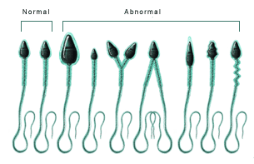
Effect of Sperm Count, Morphology And Motility on Fertility
العقم قد يكون بسبب قلة عدد الحيوانات المنوية، وقد يكون عددها طبيعي لكن شكلها غير طبيعي بالتالي يحدث العقم، وقد يكون الشكل والعدد طبيعي ولكن الحركة غير طبيعية بالتالي يصير يحدث العقم.
All of them are important to avoid infertility
Effect of Sperm Count, Morphology And Motility on Fertility
Effect of sperm count on fertility | Effect of sperm morphology on fertility | Effect of sperm motility on fertility
The quantity of ejaculated semen during coitus (intercourse) about 3 - 5 ml. Each milliter contains about 120 million sperm (normal sperm count vary between 35 million to 200 million sperm/ml). Sperm count below 20 million/ml leads to infertility. | Sometimes sperm count is normal but still infertile when about one half of the sperm having abnormal shape. | Sometimes the shape of the sperm is normal but they are either relatively non-motile or entirely non-motile which causes infertility.
Oxidative stress could happen during spermatogenesis which will damage the sperm, so in some infertile male if you give antioxidant (like Vit. E) it will prove their fertility.
إذا قل عدد الحيوانات المنوية أقل من 20 مليون راح يصير فيه عقم.
في هذه الحالة يكون عدد أو حركة الحيوانات المنوية طبيعية ولكن أشكالها غير طبيعية، ويحدث العقم لما يكون عدد معين أشكالهم غير طبيعية
في هذه الحالة يكون شكل أو عدد الحيوانات المنوية طبيعية ولكن حركتها غير طبيعية، بالتالي يحدث العقم.

Slide 20
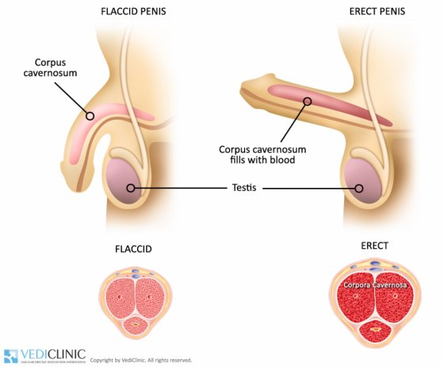
Male Sexual Act
Dr: you don’t need to worry about it, just read it
Male Sexual Act
Stage 1
Penile erection
Stage 2
Lubrication
Stage 3
Emission and ejaculation
Erection is caused by parasympathetic impulses that pass from the sacral portion of the spinal cord through the pelvic nerves to the penis.
Parasympathetic impulses cause the urethral glands & bulbourethral glands to secrete mucous.
Function of the sympathetic nerves. Emission begins by contraction of the vas deferens & ampulla to cause expulsion of the sperm in the internal urethra. Contraction of the prostate &seminal vesicles to expel their fluid in the urethra. All these fluid mix in the internal urethra with the mucous secreted by the bulbourethral glands to form the semen. This process at this point is called emission.
Filling of the internal urethra with semen causes sensory impulses through pudendal nerves to the sacral region of the cord. Fullness of the internal urethra causes rhythmical contractions of the internal genital organs which increases their pressure to ejaculate the semen to the outside called ejaculation.
Erection

Slide 21
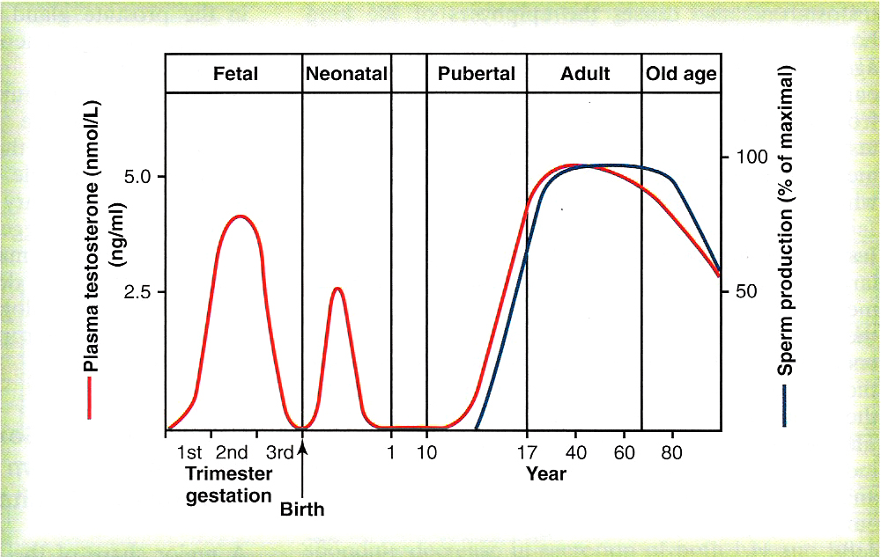
Testosterone And Other Male Sex Chromosomes
Secretion and chemistry of the male sex hormone:
Secretion of testosterone by the interstitial cell of leydig in the testis.
The testis secretes several male sex hormone called androgens including testosterone, dihydrotestosterone (DHT) and androstenedione.
Secretion of androgens in the body: from the adrenal glands & synthesized either from cholesterol or directly from acetate.
Testosterone is responsible for the characteristic masculine body.
During fetal life: the testis are stimulated by placenta chorionic gonodotropin to produce testosterone throughout fetal life & the 10 weeks after birth then no more testosterone production during childhood.
At puberty: under the anterior pituitary, gonadotropic hormones stimulation throughout life then decline beyond 80 years to 50%.
For your information, What are the causes of infertility in male ?
Mostly are hormonal.
And some cases we have Sertoli cells only syndrome (in seminiferous tubules contain only Sertoli cells there is no spermatogonia or germ cells).
some of them unknown (could be genetic or environmental).
Azoospermia (all ejaculated duct do not have any live sperms).

Slide 22
Cont.
Important
Metabolism of the male sex hormone:
Testosterone is more abundant form while dihydrotestosterone (DHT) is more active. Testosterone is converted into dihydrotestosterone (DHT) by 5-alpha reductase in the target cells.
The basic intracellular mechanism of action of testosterone:
It increases the rate of protein synthesis in target cells.
Testosterone converted by the intracellular enzyme 5 α reductase to dihydrotestosterone, then it binds with cytoplasmic “receptor protein”. This combination moves to the nucleus where it binds a nuclear protein and induces protein formation.
(Testosterone and DHT Bind to androgen receptor which present inside the cell, once they bind this receptors and form the complex which go and bind to androgen response elements on the DNA and initiating several gene expressions or the genes which involved in actions of androgen)

Slide 23
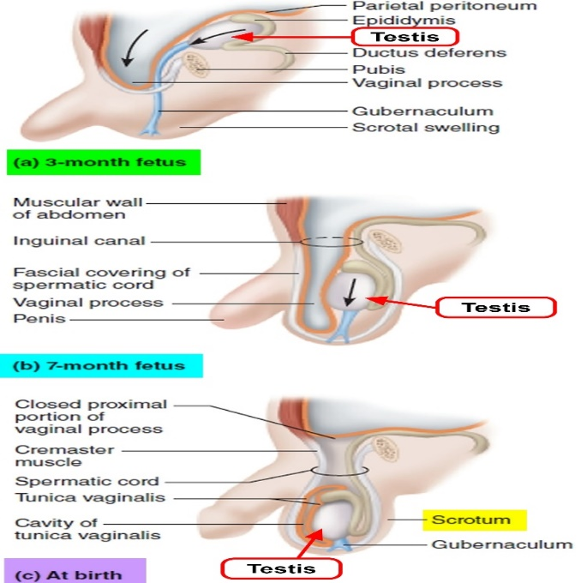
Function of Testosterone During Fetal Development
Testosterone secreted by the genital widges & later by the fetal testis is responsible for:
Development of the male body characteristics including the formation of penis & scrotum.
Development of prostate gland, seminal vesicles & male genital ducts.
Suppressing the formation of female genital organs.
Effect of testosterone to cause descent of the testis:
The testis descend into the scrotum during the last 2 to 3 months of gestation when the testis begin secreting reasonable quantities of testosterone.
Extra
From week 6 to week 10 is very important period for development of sexual organs . The absent of testosterone in that time even if fetus have XY his sex organs or external genitalia will not develop in proper way or will be ambiguous.
Also play a role in descending of tests before or after birth. If not descend he needs surgical intervention. The scrotum always down but the tests has to descend and be outside the body because spermatogenesis require two degrees lower than body temperature so the babies with failure of tests descending they have risk for infertility or reduce the fertility.

Slide 24
Effect of Testosterone on Development of Adult Primary And Secondary Sexual Characteristics
After puberty | Effect on the distribution of body hair | Baldnessالصلع
The increasing amounts of testosterone cause enlargement of the penis, scrotum & testis & secondary sexual characteristics. | Testosterone causes growth of hair over the pubis, upward along the linea alba of the abdomen to the umbilicus, on the face, on the chest, and less often on other regions such as the back. | Testosterone decreases the growth of hair on the top of the head by two factors: Genetic background. Large quantities of androgenic hormones.
Effect on voice | Effect on skin | Effect on muscle
It causes: Hypertrophy of the laryngeal mucosa. Enlargement of the larynx (typical adult masculine voiceالصوت الذكوري ). | Testosterone increases the thickness of skin over the body & subcutaneous tissues. Also it increases the secretion of the sebaceous glands الغدة الدهنية& sebaceous glands of the face causing acne حب الشباب . | Increase muscular development after puberty by 50% in muscle mass over that in female. Also increase in protein in non-muscle parts of the body. These effect due to the anabolic effect of testosterone.
24

Slide 25
Cont.
Effect on bone | Effect on metabolism | Effect on red blood cells
Bones grow thicker & deposit additional Ca²⁺ . Thus it increases the total quantity of bone matrix & causes Ca²⁺ retention (anabolic effect). Testosterone has specific effect on the pelvis: Narrow the pelvic outlet. Lengthen the pelvic outlet. Cause the funnel-like shapeشكل القمع instead of the broad ovoid shape of the female pelvis. It causes the epiphyses of the long bones to unite with the shafts of the bones & early closure of the epiphyses. | It increases the basal metabolic rate by about 15% (indirectly as a result of the anabolic effect). | It increases red blood cells/ml (due to increase metabolic rate).
 | Effect on electrolyte and water balance
 | It increase the reabsorption of Na+ in the distal tubules of the kidneys. (Just like adrenal cortex hormones, like Aldosterone and glucocorticoid)
You do not have to worry about it , focus on this and read the rest: We have two types of aromatase 1 and 2:
Type 1 is mainly in sebaceous gland within hair follicles which converts testosterone into dihydrotestosterone.
Type 2 is present in most of male reproductive organs (i.e. prostate and skin of penis and scrotum) That’s why “aromatase type 2 blockers” can be used in the treatment of prostate cancer. In the future, it may be possible to use “type 1 blockers” to reduce the incidence of inherited baldness and acnes.
25

Slide 26
Effect of Testosterone on Development of Adult Primary And Secondary Sexual Characteristics
Dr: you don’t need to worry about it, just read it
1. Hypogonadism in male |  | 2. Testicular tumors and hypergonadism in male
During fetal life when the testis are non-functional, none of the male sexual characteristics develop in the fetus. Instead female organs are formed. If the boy loses his testis before puberty, he become in a state of eunuchism (infantile sex organs & infantile sexual characteristics) & the height of an adult eunuch is slightly greater than normal because of slow union of the epiphyses. If a man is castrated after puberty, sexual organ regress in size and voice regress - loss of the thick masculine bones- loss of masculine hair production -loss of musculature of the virile male. |  | Interstitial leydig cell tumors (rare), over production of testosterone. In children, causes rapid growth of the musculature and bones and early uniting of the epiphyses and causes excessive development of male sexual organs. Tumor of the germinal epithelium (more common).
3. Adiposogenitial syndrome, Frohlich’s syndrome or hypothalamic eunuchism | 4. Cryptorchidism (The most common) | 5. Prostate gland and its abnormalities
Hypogonadism due to genetic inability of the hypothalamus to secrete normal amount of GnRH & abnormality of the feeding center of the hypothalamus result in obesity with eunuchism. | Failure of the testes to descend in the scrotum which normally occur during fetal life. 10% of newborn males, it falls to 2% at age 1 year, and 0.3% after puberty. They should be treated (by surgery) before puberty because of higher incidence of malignant tumors. | Increase muscular development after puberty by 50% in muscle mass over that in female. Also increase in protein in non-muscle parts of the body. These effect due to the anabolic effect of testosterone.
26

Slide 27
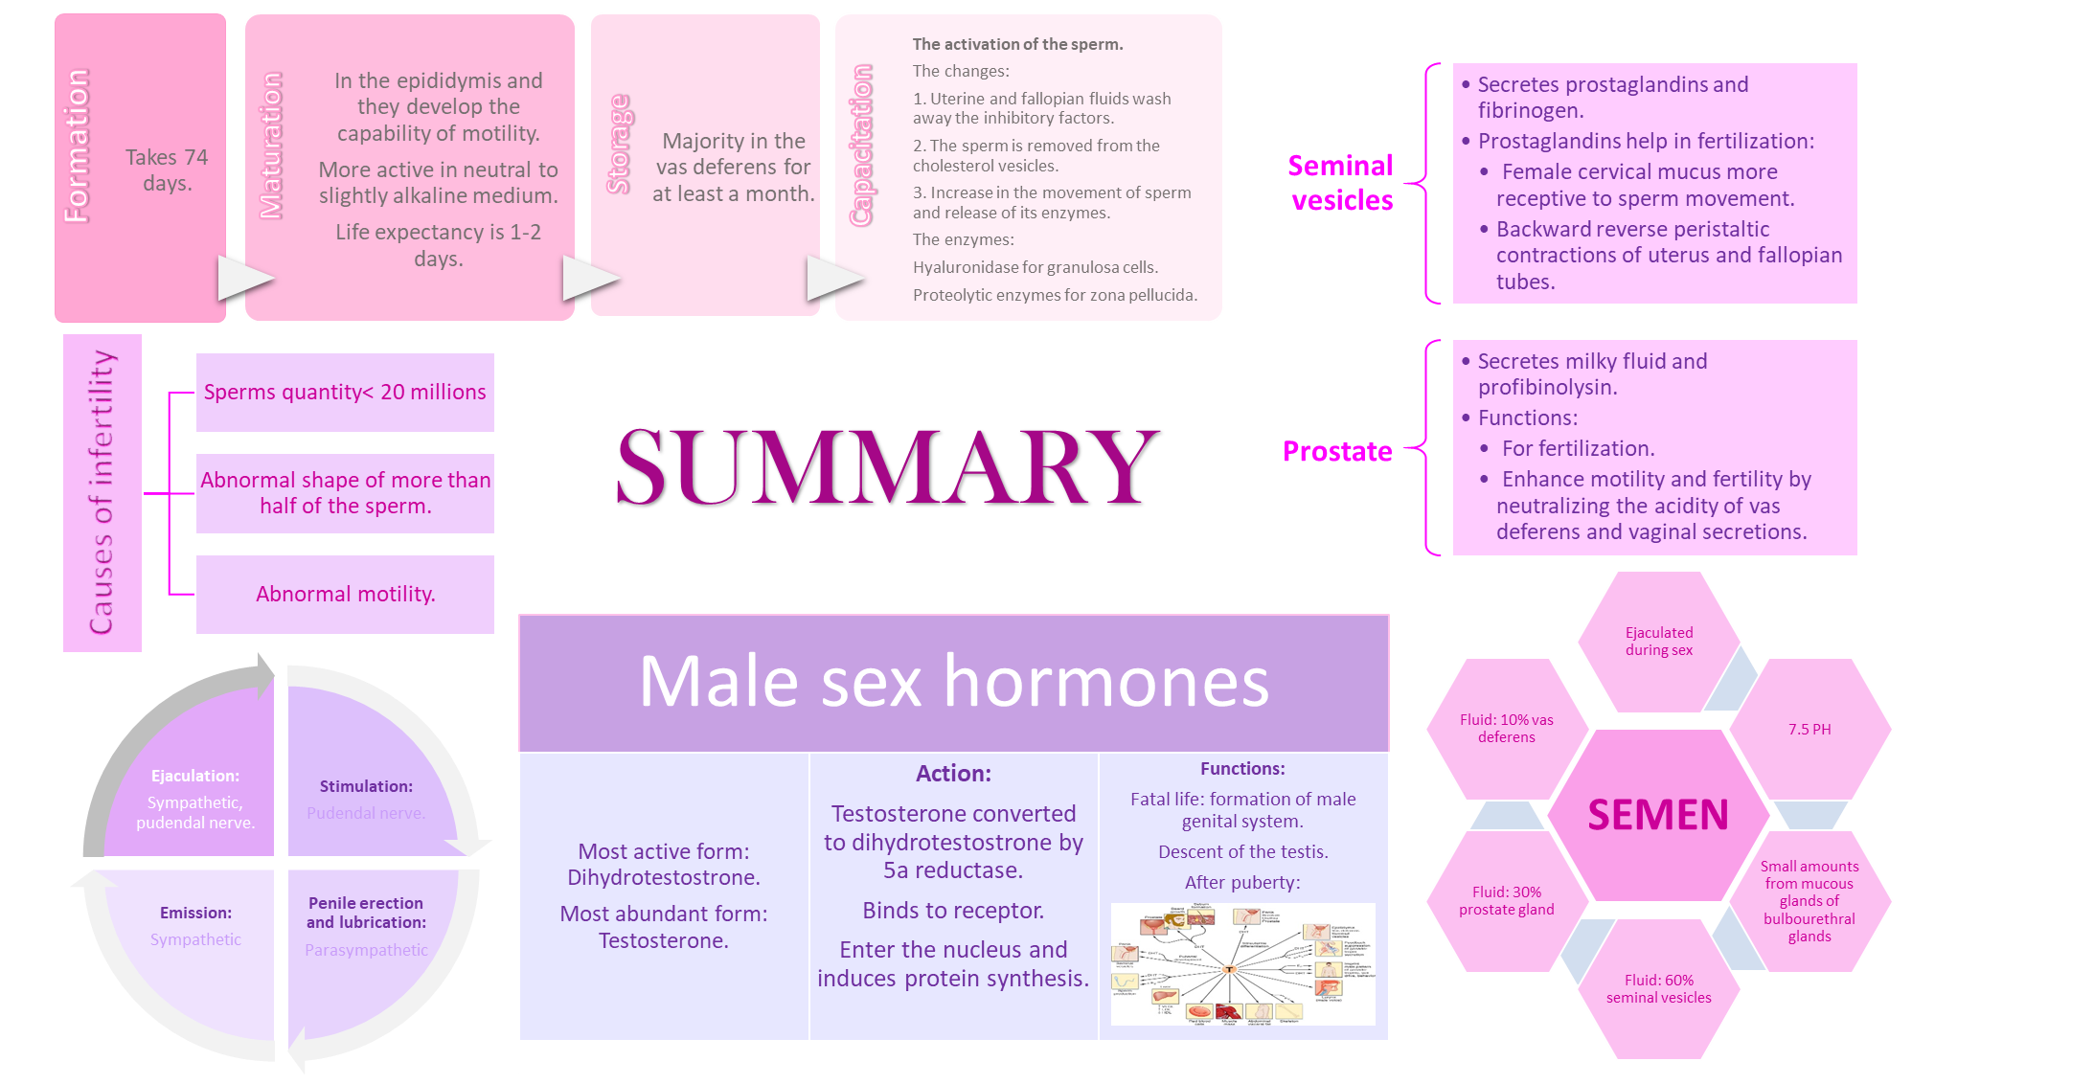
27

Slide 28
MCQ’s
1. Which of the following is the average pH of semen?
7.5
6.5
4.5
8.5
2. Which of the following doesn’t have an effect on fertility?
Sperm motility
Sperm morphology
Sperm count
Sperm length
3. Which of the following hormones play a role in spermatogenesis?
Testosterone.
GH
LH
All of them
4. Which of the following hormones Suppress the formation of female genital organs?
Testosterone.
Estradiol
LH
FSH
5. which of these condition is mainly associated with untreated or late treatment of cryptorchidism?
Malignant tumor.
Benign tumor.
Adenoma.
Non of them
6. Which of the following is the effect of testosterone on the skin?
Increases the growth of hair on the top of the head.
Enlargement of the larynx.
Decreases the secretion of the sebaceous glands.
Increases the thickness of skin.
1=A 2=D 3=D 4=A 5=A 6=D

Slide 29






Thank you for checking our work!
اعمل لترسم بسمة، اعمل لتمسح دمعة، اعمل و أنت تعلم أن الله لا يضيع أجر من أحسن عملا.
قادة الفريق:
ليــلـى مـذكور & مـحـمـد نـصـر
Please check our editing file to know if there are any additions, changes or corrections.
https://www.youtube.com/watch?v=3aubuA-Mdnw
خالص الشكر لأعضاء الفريق الكِرام:
باسل المفلح
حسان الشمري
فارس النفيسة
قيس المهيدب
لـمـى الـتـمـيـمـي
روان القحطاني
اللولو الصليهم
دانية الكلابي
زينة الكاف
نوف العماري
2017-2018 Dr. Dr. Laila Al Dokhi’s Lecture & Notes.
2017-2018 Dr. Khalid Al Regaiey’s Lecture& Notes.
Guyton & Hall of Medical Physiology 13th Edition.
Linda S. Costanzo 5th Edition.
Helpful physiology bocks.
Give us your feedback ☺
اللهم اني استودعتك ما حفظت وما قرأت وما فهمت، فرده لي وقت حاجتي إليه إنّك على كل شيءٍ قدير.

