Slide 1
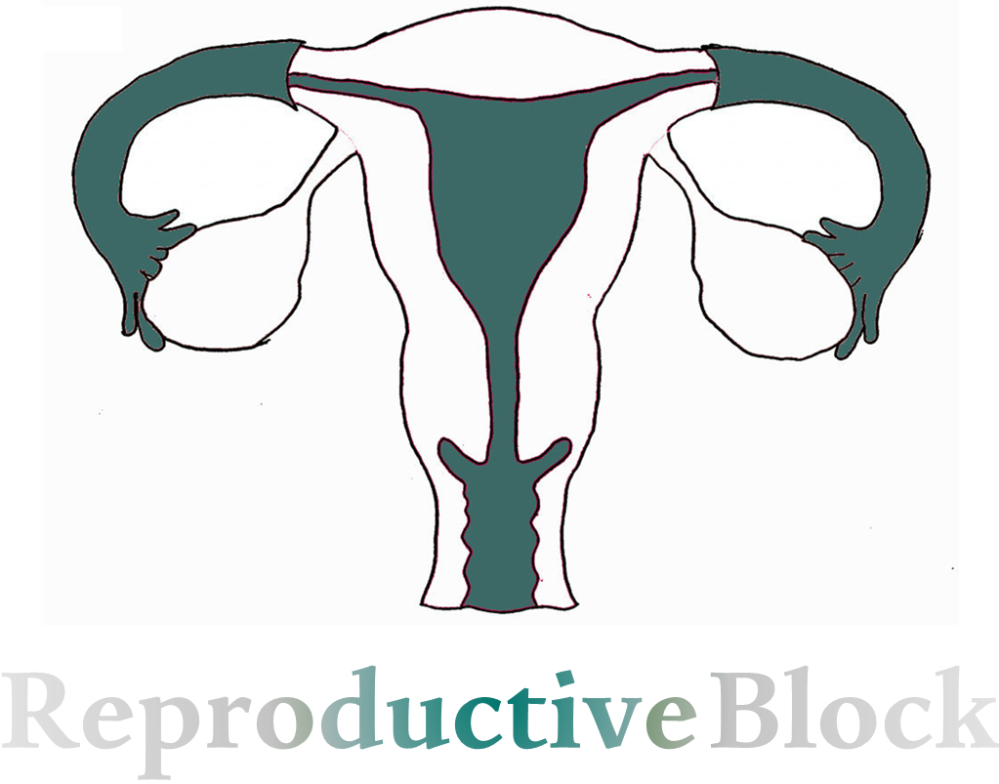
Text
Only in Females’ slide
Only in Males’ slides
Important
Numbers
Doctor notes
Extra Notes

Slide 2
Puberty In Males & Females
By the end of this lecture, students should be able to describe:
Definition of puberty.
Terms and events (thelarche, pubarche, menarche).
Hormonal changes (gonadaland extra gonadl).
Female hormonal changes and male hormonal changes and secondary sexual characters.
Staging of pubertal development (tanner) in boys and girls. 6. Pubertal disorders ( precocious puberty and delayed puberty).

Slide 3
Puberty
Definition:
Physiological transition from childhood to reproductive maturity.
A stage of human development when sexual maturation and growth are completed and result in ability to reproduce:
Accelerated somatic growth (Or physical growth).
Maturation of primary sexual characteristics (gonads and genitals).
Appearance of secondary sexual characteristics (pubic and axillary hair, female breast development, male voice changes).
Onset of puberty (menstruation & spermatogenesis):
Occurs between 8 and 14 years in girls. (Average is 11 years)
Occurs between 9 and 14 years in boys. (Average is 11.5 years)

Slide 4
Terms & Events of Puberty
Important
Arche is a Greek word means ‘beginning’.
Terms & Events
Thelarche
Puberache
Menarche
Adrenarche
Gonadarche
Development of breast.
Development of pubic & axillary hair.
The first menstrual period.
The onset of an increase in the secretion of androgens; responsible for the development of pubic/axillary hair, body odor and acne.
Maturation of gonadal function.

Slide 5
Changes Occur During Puberty
Changes Occur During Puberty
Hormonal changes
Physical changes
Hormonal changes precede physical changes.

Slide 6
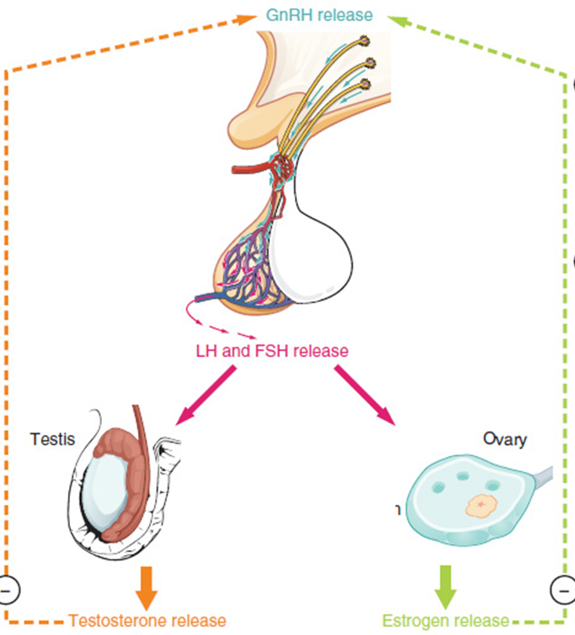
Hormonal Changes In Both Sexes
Increased stimulation of hypothalamic - pituitary Gonadal (HPG) axis
Gradual activation of the GnRH
(LHRH old name)
Increases frequency and amplitude of LH pulses.
Gonadotropins stimulate secretion of sex steroids (estrogens and androgens)
Nocturnal GnRH pulsatility (LH secretion) precedes phenotypic changes by several years. (It should be pulsatility not sustained, if it was sustained we will have what called sensitization and there will be no response from target tissues)
Extragonadal hormonal changes
(elevation of IGF-I, and adrenal steroids)

Slide 7
Hormonal Changes In Both Sexes
د: ماراح نسألكم عن (البنفسجي) لأنكم اختبرتوه بالإندوكراين
Hypothalamus
In young children, LH and FSH levels are insufficient to initiate gonadal function.
High levels of LH, FSH initiate gonadal development.
Between 9 -12 years, blood levels of LH, FSH increase.
Amplitude of pulses increases, especially during sleep.
GH secretion from anterior pituitary increases.
TSH (thyroid stimulating hormone) secretion from anterior pituitary increases in both sexes:
Increases metabolic rate.
Promotes tissue growth.
First phenotypic changes:
Breast development.
Testicular enlargement.
GnRH & GHRH
Anterior Pituitary
LH & FSH
Growth Hormone
Testis / ovary
Liver
Sex steroid synthesis
IGF-1
During childhood, Is there any FSH or LH in the plasma ?
Yes, there is but are insufficient or very low not zero.
Sexual maturation
Somatic growth

Slide 8
Cont.
Important
Pulsatile secretion of GnRH
What is the name of hormone which trigger the puberty in both girls and boys? LH
Increased sensitivity of the GnRH receptors in anterior pituitary
Affect LH more than FSH
Because we don’t need FSH for both ovulation and spermatogenesis in early puberty.
LH in male binds to leydig cells to secrete testosterone which is important in hair growth and secondary sexual characteristics.
Pulsatile secretion of LH and FSH
Appearance of large nocturnal pulses of LH during REM sleep.
LH in female cause stimulation cholesterol dismolase within theca cells which convert testosterone into androgens which essential for estrogen synthesis to show up secondary sexual characteristics.
Secretion of gonadal steroid hormones testosterone and estradiol
Appearance of the secondary sex characteristics at puberty

Slide 9
Early Pubertal In Males & Females
Important
In an early pubertal girl | LH secretion is minimal during waking hours. Pubertal LH pulsations promptly begin with sleep onset and wane with sleep offset, followed several hours later by increased ovarian estradiol secretion that peaks mid-day.
In an early pubertal boy | Daytime LH values are low, with minimal testosterone secretion. Pubertal LH pulsations begin promptly with sleep onset and cease with sleep offset; testosterone secretion occurs primarily during sleep, beginning about 2 hours after LH increases and waning on awakening.

Slide 10
Hormonal Changes In Males’ & Females’
Only in Females’ Slides
Important
Females’ |  | Males’
Surge of LH release initiates 1st ovarian cycle (usually not sufficient to cause ovulation). Brain and endocrine systems mature soon thereafter. Estrogen levels in blood increase, due to growing follicles. What is the functions of estrogen & androgen in females’ puberty? |  | LH and FSH release increases ~10 years of age. Spermatogenesis & Adrenals increases androgen secretion. Androgens causes retention of minerals in body to support bone and muscle growth & initiate growth of sex accessory structures (e.g. prostate), male secondary sex characteristics (facial hair, growth of larynx). Sertoli cells also secrete some estrogen. First signs of puberty often go unnoticed Prepubertal testis –2mls diameter →Puberty --4mls Penile and scrotal enlargement occur approx 1 yr after testicular enlargement. Pubic hair appears at same time . Begins of spermatogenesis; androgen secretion
Estrogens | Androgen
Estrogen induces secondary sex characteristics: Growth of pelvis. Deposit of subcutaneous fat. Growth of internal reproductive organs & external genitalia. | Androgen release by adrenal glands increases (not as much as in male) & will cause: Growth of pubic hair. Lowering of voice. Growth of bone. Increased secretion from sebaceous glands. (this gland secrete a lubricating oily matter (sebum) into the hair follicles to lubricate the skin and hair)

Slide 11
Physical Changes In Males’ & Females’
Important
Physical changes reflect progression in changes of the external genitalia and sexual hair.
Physical Changes In Males’ & Females’
Females’ | Males’
Breast enlargement usually first sign (Thelarche). So, Growth spurt peaks before menarche. (the first sign is Thelarche) Pupic hair depends on increased secretion of adrenal androgens (adrenarche) → pubic and axillary hair growth is sign of adrenal androgen secretion. (the second sign) Menarche usually 2 - 3 years after breast development. (The third sign and usually with no ovulation in first period because we don’t have FSH, so just we have uterine cycle due to estrogen). Starts at similar stage of apocrine gland sweat production and associated with adult body odour. | Puberty is associated with activation of the HPG axis. Leydig cell proliferation in the testes, and increased synthesis and secretion of testosterone. There is growth of the testes, largely because of an increased number of seminiferous tubules. (12 -13 years). There is growth of the sex accessory organs such as the prostate. There is a pronounced linear growth spurt. As plasma levels of testosterone increase, facial, pubic, and axillary hair appears and there is growth of the penis, lowering of the voice, and initiation of spermatogenesis (spermarche).
Secondary sexual characteristics:
Mean age 10.5 years in girls.
Mean age 11.5 – 12 years in boys.

Slide 12
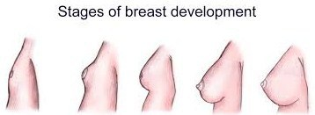
Staging of Pubertal Development (Tanner)
Dr said: will not ask you about this slide, its for your own information
Pubertal development is classified according to the Tanner standard (Tanner & Marshal Scale) to 5 different stages (P1 – P5) from childhood to full maturity.
 | Females’ Breast (B1-5) → Pubic hair (Pu1-5) → Axillary hair (A1-5) → Menarche. | Males’ Testicularvolume > 4 ml (Te) → Penis enlargement (G1-5) → Pubic hair (Pu1-5) → Axillary hair (A1-5) → Spermarche.
P1 | Prepubertal (قبل البلوغ) | Prepubertal, testicular volume < 1.5 ml ( 9 years and younger).
P2 | Early development of subareolar breast bud +/- small amounts of pubic and axillary hair. | Testicular volume between 1.6 - 6 ml; skin on scrotum thins. Few pubic hair ( 9 – 11 years).
P3 | Increase in size of palpable breast tissue and areolae. increased pubic / axillary hair. | Testicular volume between 6 - 12 ml, Lenghtening of penis. Further growth of testes and scrotum ( 11 – 12.5 years).
P4 | Breast tissue and areolae protrude above breast level. Further increased pubic/axillary hair growth. | Testicular volume between 12 - 20 ml; scrotum enlarges further and darkens. Incresed pubic / axillary hair ( 12.5 - 14 years).
P5 | Mature adult breast. Complete pubic/axillary hair growth. | Testicular volume greater than 20 ml. Genitalia adult in size and shape. Completed pubic/axillary hair growth ( +14 years).
Monitoring of the pubertal growth acceleration: (only in Females’ slides)
Growth velocity is 2 - 3 times greater than prepubertal.
Sexual dimorfism in pubertal growth.

Slide 13
Normal Pubertal Development
Only in Females’ Slides
Dr said: will not ask you about this slide, its for your own information
 | Females’ | Males’
Age of start (years) | 11.5 (9 – 13) | 12.5 (10 – 14)
First sign of puberty | B2 | G2 (testicular volume > 4 ml)
Growth velocity (cm/yr) | 9.0 (Tanner II-III) | 10.3 (Tanner III-IV)
Duration of puberty (years) | 2.4 ± 1.1 (menarche) | 3.2 ± 1.8 (adult size testis)
Sequence of normal puberty in girls’ & boys’
Budding is a fat tissue under the breast under control of estrogen not progesterone.

Slide 14
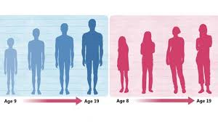
Timing of Puberty
Trend toward earlier puberty exists within Western Europe and USA.
Puberty usually completed within 3 - 4 years of onset.
Examination of lifestyle changes may give clues regarding mechanisms inducing onset.
One of the most contributing factors is nutrition.

Slide 15
Influencing Factors of Puberty Time
Exact cause isn't clear but there are some factors
Influencing Factors of Puberty Time
Genetic factors
Environmental factors
Nutritional factors
50-80% of variation in pubertal timing.
E.g. Extreme stress because it will affect HPG axis
(Extreme stress will secrete cortisol → decrease HPG by feedback inhibition→ decrease FSH and LH)
E.g. Leptin hormone regulates appetite and metabolism through hypothalmus. Permissive role in regulating the timing of puberty.

Slide 16
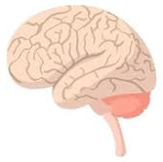
Cont.
Important
White Adipocyte
(fat cell)
Leptin accelerates the HPG axis.
The hypothalamus contains a peptide called (NPY) it’s main function is to increase food intake (by increasing appetite ). NPY has another function which is inhibiting Kisspeptin neurons in hypothalamus.
Leptin is a hormone released from white adipocyte (Fat cells) when fat storage is high.
Leptin hormone will inhibit NPY, and inhibition of NPY will decrease the food intake (by decreasing appetite). Also the inhibition of NPY will activate Kisspeptin neurons.
Activation of Kisspeptin neurons will stimulate the hypothalamus (by GPR54) to secrete GnRH and therefore stimulation of the Hypothalamus-Pituitary-Gonad Axis ( HPG Axis ).
Secrete
Leptin
Actions
In Hypothalamus
In Anterior pituitary
Under stimulation of Kisspeptin protein the Hypothalamus will:
Decrease NPY→
Increase GnRH
Increase LH & FSH
GPR54
Decrease the food intake
Increase the thermogenesis
Increse the reproduction
GPR54: G-protein coupled receptor 54

Slide 17
Cont.
Important
Another Explanation:
Leptin accelerates the HPG axis.
In normal people: leptin is secreted from white adipocytes (fat cells) in huge amount during eating and its signals travelled through the bloodstream to the hypothalamus.
When it reach the hypothalamus, Under stimulation of Kisspeptin protein the Hypothalamus will inhibit the NPY (a protein of hunger). thus, leptin eventually inhibits further eating.
In obese children (mainly girls): the amount of leptin secreted is very high resulting in insensitivity of NPY receptors and children would continue eating as this protein (NPY) can not be inhibited by leptin. As GnRH is located in hypothalamus, it would be stimulated continually by leptin (in obese children), resulting in premature activation of HPG axis and initiation of early puberty.
Insulin and glucocorticoids are linked to obesity in some cases and they are found to increase leptin secretion from the adipose tissues and further activation of GnRH and LH.
White Adipocyte
(fat cell)
Secret
Leptin
Actions
In Hypothalamus
In Anterior pituitary
Under stimulation of Kisspeptin protein the Hypothalamus will:
Decrease NPY→
Increase GnRH
Increase LH & FSH
GPR54
Decrease the food intake
Increase the thermogenesis
Increase the reproduction

Slide 18
Nutrition
Critical body weight must be attained before activation of the reproductive system.
Even though age of menarche is decreasing, the average body weight of menarche remains the same.
Earlier puberty due to improvement of nutrition, living conditions, healthcare.
(healthy people with good nutrition will undergo earlier puberty)
Evidence supporting hypothesis:
Obese girls go through early menarche. (because they have high level of Leptin which will stimulate HPG Axis earlier).
Malnutrition is associated with delayed menarche.
Primary amenorrhea is common in lean female athletes.
“Bodyfat” setpoint very noticeable in girls with fluctuating body weight due to anorexia nervosa.
(because underweight people will have low Leptin, therefore delayed stimulation of HPG Axis and delayed puberty)

Slide 19
Disorders of Puberty
Disorders of Puberty
Early or Precocious Puberty
Delayed Puberty
Precocious onset of puberty is defined as occurring younger than 2 years before the average age.
Girls < 8 years old
Boys < 9 years old
More common in females
Uncommon in males (usually pathological).
Maybe associated with a growth spurt.
Initial physical changes of puberty are not present.
By age 13 years in girls (or primary amenorrhea at 15.5-16 years)
By age 14 years in boys.
Pubertal development is inappropriate: - The interval between first signs of puberty and menarche in girls, completion of genital growth in boys is > 5 years.
1. Gonadotropin-dependent (true / central)
Gonadotropin- independent (peripheral)
Gonadal failure
Gonadal deficiency

Slide 20
Cont. Early or Precocious Puberty
Cuases of Gonadotropin-dependent (true / central)
(We mean depending on GnRH and FSH and LH)
Premature activation of the (HPG) axis.
Intra-cranial lesions:
Tumours (Tumors can lead to either activation or inhibitation of gland and secretion)
Hydrocephalus.
CNS malformations.
Gonadotropin secreting tumours in anterior pituitary gland (very rare).
Cuases of Gonadotropin-independent (peripheral)
(Two years ago, there was a case scenario about this)
Precocious pseudopuberty(another name):
No spermatogenesis or ovarian development. Why? Because there is a large amount of estrogen which give negative feedback to AP gland.
FSH & LH suppressed.
E.G:
Congenital adrenal hyperplasia (CAH).
Sex steroid secreting tumours: adrenal or ovarian

Slide 21
Cont. Delayed Puberty
Causes of Gonadal failure
(Hypergonadotropin-hypogonadism)
(You don’t have any problems in FSH or LH. But the gonads don’t respond or even absent)
Post-malignancy chemo / radiotherapy / surgery (Acquired).
Polyglandular autoimmune syndromes*.
Turner’s Syndrome (Congenital).
Causes of Gonadal deficiency
Congenital: hypogonadotropin-hypogonadism, Affect both , so you don’t have FSH or LH or estrogen or or progesterone or testosterone.
Hypothalamic / pituitary lesions (tumours, post-radiotherapy) (anosmia**)
Rare gene mutations inactivating FSH/LH or their receptors.
* Are a heterogeneous group of rare diseases characterized by autoimmune activity against more than one endocrine organ.
** Loss of the sense of smell.

Slide 22
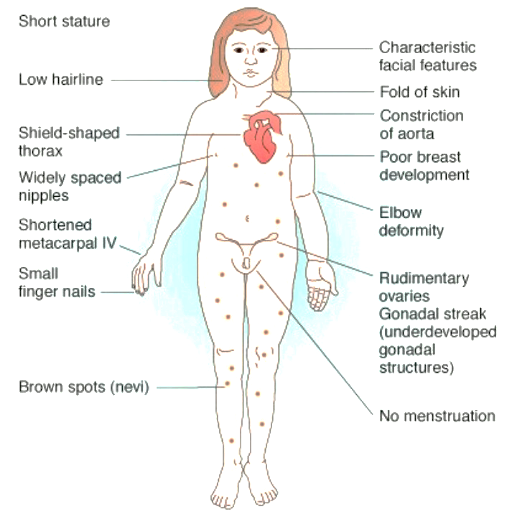
Turner Syndrome
Cause:
Karyotype 45,X (structural abnormalities of X chromosome).
Clinical manifestations:
Short stature (final height 144-146 cm).
Gonadal dysgenesis.
Skeletal abnormalities.
Cardiac and kidney malformation.
Dysmorphic face.
No mental defect.
Impairment of cognitive function.
Therapy:
Growth hormone, sex hormone substitution. (Will not be fertile but we give her to improve her appearance)

Slide 23
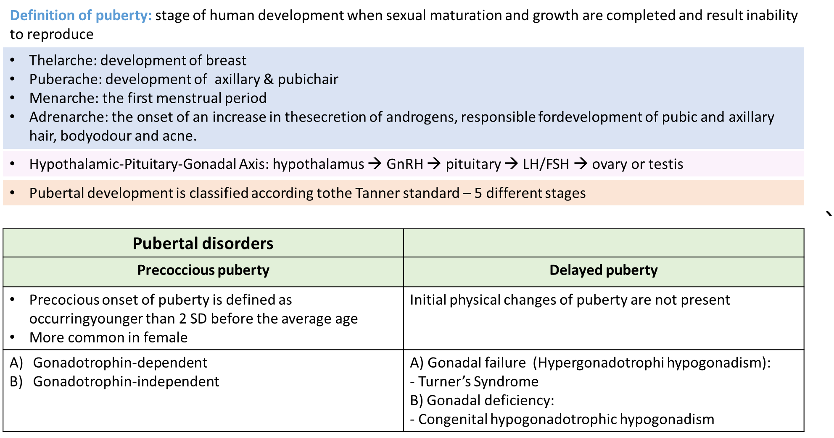
Summary

Slide 24
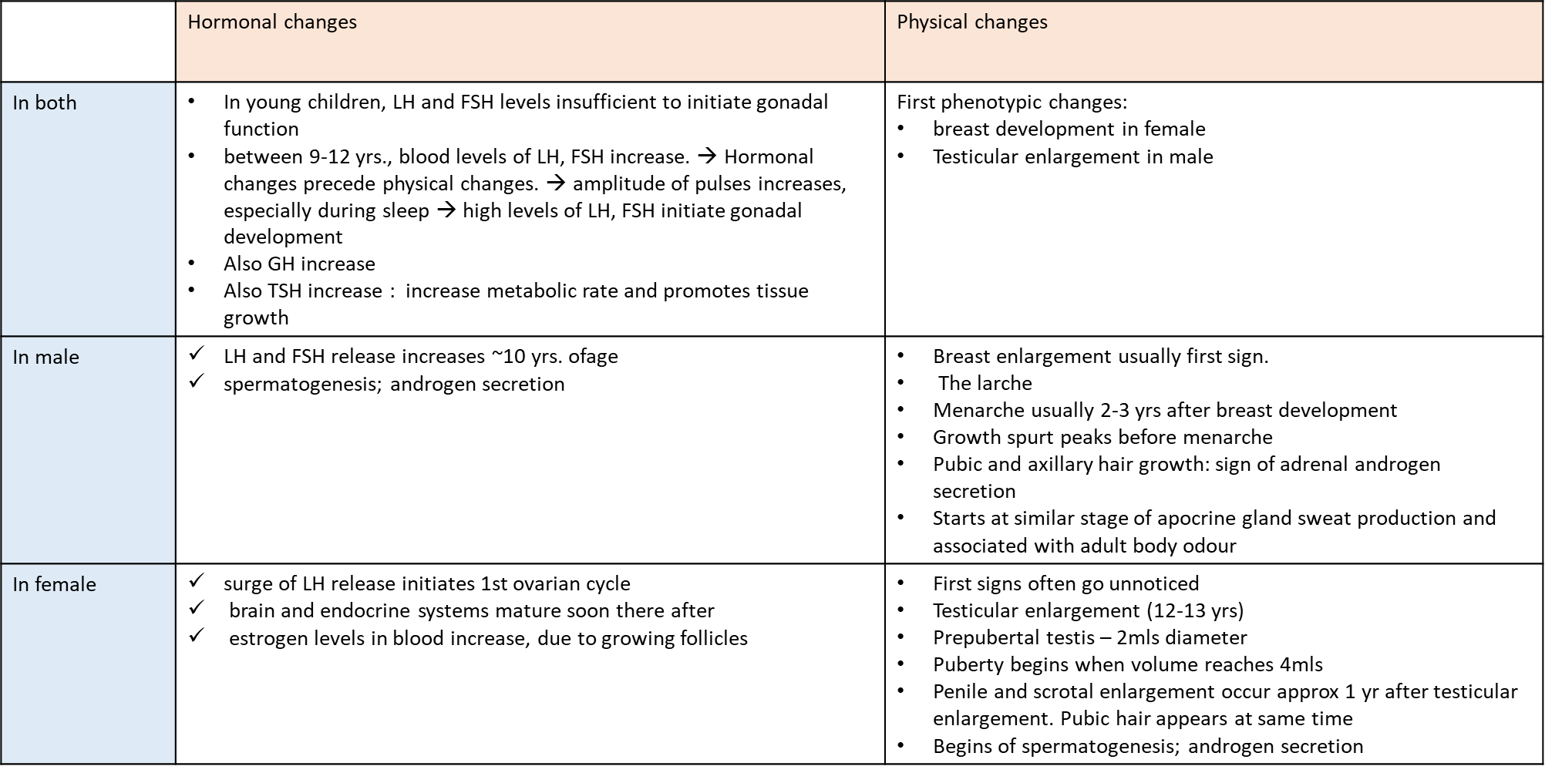
Summary

Slide 25
MCQ’s
1. Which one of the following is the onset of an increase in the secretion of androgens?
Adrenarche
Menarche
Thelarche
Gonadarche
2. Which one of the following stimulate the release of sex steroids?
GnRH
IGF-I
LH
Gonadotropins
3. Puberty usually completed within?
3-4 years of onset
1 year of onset
Immedietly
None.
4. Which of the following hormones has important role in puberty?
Leptin
Ghrelin
Thyroid hormone
Insulin
5. Which of the following causes Gonadal dysgenesis?
Hypothalamic/pituitary lesions
Rare gene mutations inactivating FSH/LH or their receptors
Turner’s Syndrome
1=A 2=D 3=A 4=A 5=C

Slide 26
Thank you for checking our work!
اعمل لترسم بسمة، اعمل لتمسح دمعة، اعمل و أنت تعلم أن الله لا يضيع أجر من أحسن عملا.
قادة الفريق:
ليــلـى مـذكور & مـحـمـد نـصـر
Please check our editing file to know if there are any additions, changes or corrections.
خالص الشكر لأعضاء الفريق الكِرام:
-
حسان الشمري
عبدالله السعيد
فهد الفايز
ماجد الزين
محمد المهوس
نواف الخضيري
لـمـى الـتـمـيـمـي
روان القحطاني
شروق الصومالي
2017-2018 Dr. Dr. Laila Al Dokhi’s Lecture & Notes.
2017-2018 Dr. Mohammed AlOtaibi’s Lecture & Notes.
Linda S. Costanzo 5th Edition.
First Aid For The USMLE Step One.
Helpful physiology bocks.
Give us your feedback ☺
اللهم اني استودعتك ما حفظت وما قرأت وما فهمت، فرده لي وقت حاجتي إليه إنّك على كل شيءٍ قدير.

