Slide 1
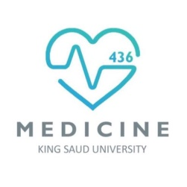
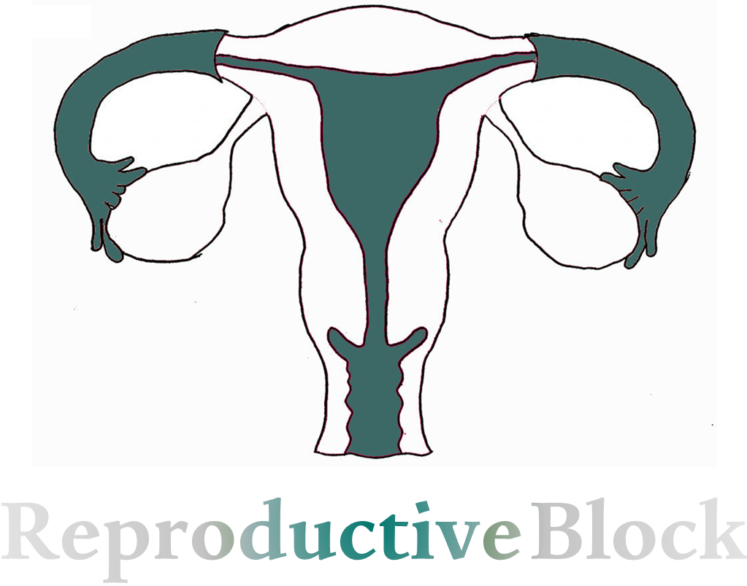
المحاضرة سهلة و 22 سلايد فقط، الباقي اكسترا
All numbers in this lecture are Important
Text
Only in Females’ slide
Only in Males’ slides
Important
Numbers
Doctor notes
Extra Notes

Slide 2
Physiology of Pregnancy
By the end of this lecture, students should be able to describe:
Describe Fertilization & implantation of the blastocyst into the endometrium.
Recognize the development and normal physiology of the placenta.
Describe the physiological functions of placental hormones during pregnancy.
Explain the physiological responses of mother’s body to pregnancy.
All numbers in this lecture are Important
المحاضرة سهلة و 22 سلايد فقط، الباقي اكسترا

Slide 3
Revision (Large Group Activity)
Only in Females’ Slides
1. How many sperms in the ejaculated semen?
Range of sperms depends on semen.
Average semen volume is 3-5 ml and the average of sperms is 100 million. So, if the semen was 5 ml X 100 million = half a billion of sperms.
2. In which stage the ova is after ovulation?
Metaphase of the 2nd meiotic division.
3. What is the parentage of ovulated ova that can reach fallopian tube?
95-98% of ova will reach the fallopian tube.
4. Can the ova released from the right ovary reaches the left fallopian tube?
The ova can enter the opposite fallopian tube
5. What are the factors that help the ovulated ova to reach the fallopian tube?
Fallopian tube contraction.
Fimbrial.
cilia with fluid
6. What are the factors that help the sperm to travel in the female genital tract?
Contractions of the uterus and fallopian tubes which stimulated by prostaglandins.

Slide 4
Maturation of The Ovum
While still in the ovary, the ovum is in the primary oocyte stage. Shortly before it is released from the ovarian follicle, its nucleus divides by meiosis and a first polar body is expelled from the nucleus of the oocyte.
The primary oocyte then becomes the secondary oocyte. In this process, each of the 23 pairs of chromosomes loses one of its partners, which becomes incorporated in a polar body that is expelled.
This leaves 23 unpaired chromosomes in the secondary oocyte. It is at this time the ovum, which is still in the secondary oocyte stage, is ovulated into the abdominal cavity. Then, almost immediately it enters the fimbriated end of one of the fallopian tubes → fertilization.

Slide 5
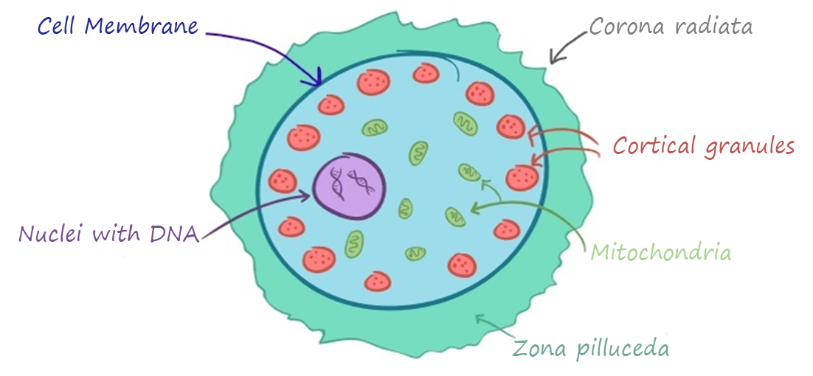
Layers of The Ovum
What are the layers that the sperms needs to reach the ovum? (from outer to inner)
Corona radiata. (Before ovulation it is called granulosa cells After ovulation it names becomes (corona radiate) We have ZP3 receptor on zona pellucida and corona radiata only).
Zona pilluceda.
Cell membrane.
Cortical granules.

Slide 6
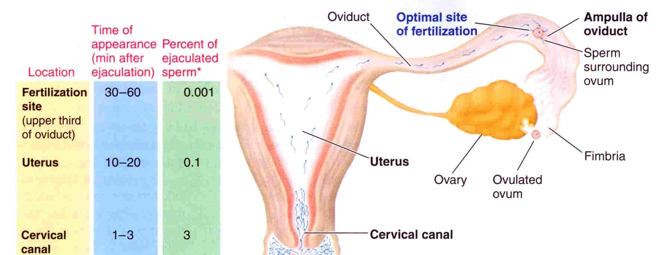
Fertilization
If the ovum becomes fertilized, a new sequence of events called gestation or pregnancy takes place, and the fertilized ovum eventually develops into a full-term fetus.
during intercourse, half billion sperms are made but only thousands will enter the female reproductive tract (that’s why we need a lot of sperms)

Slide 7
Process Fertilization
Important
Q: what leads to the block of polyspermy? Inhibition of ZP3 receptor by stimulation of Ca release stored in cortical granules.
Step 1: After the male ejaculate the semen into the vagina during intercourse, the sperm reach the ampulla of fallopian tube within 30 - 60 minutes (PG & OT actions)
Step 2: The fertilizing sperm penetrates the corona radiata via membrane-bound enzymes in the plasma membrane of its head and binds to ZP3 receptors on the zona pellucida.
Step 3: binding of sperm to these receptors triggers the acrosome reaction, in which hydrolytic enzymes in the acrosome are released onto the zona pellucida.
Step 6: The sperm stimulates release of Ca⁺² stored in cortical granules in the ovum, which in turn, inactivate ZP3 receptors, leading to the block to polyspermy.
Step 5: The sperm nucleus enters the ovum cytoplasm.
Step 4: The acrosomal enzymes digest the zona pellucida, creating a pathway to the plasma membrane of the ovum.
When the sperm reaches the ovum, the plasma membrane of the two cells fuse.
شرح الكلام بالسلايد الجاي ☺

Slide 8
Cont.
شرح الكلام: (افهموا الـlayers لتسهيل تذكّر الخطوات)
المرحلة الأولى: الحيوان المنوي بعد ما يخرج من الذكر يدخل لقناة فالوب، وبالتحديد في الـampulla في غضون ٣—٦٠ دقيقة.
المرحلة الثانية: الحيوان المنوي يتغلغل داخل الـzona pellucida (الطبقة الخارجية) بواسطة انزيمات داخل رأسه (تكلمنا عن إنزيمات الAcrosome في المحاضرة الرابعة) ثم يرتبط بـZP3 receptor الي يكون على الـzona pellucida.
المرحلة الثالثة: بعد الارتباط تفرز الـhydrolytic enzymes من رأس الحيوان المنوي (الـAcrosome).
المرحلة الرابعة: الانزيمات تهضم الـzona pellucida وتمهد الطريق عشان الحيوان المنوي يوصل للبويضة، اول مايوصل يلتحم الـcell membrane للبويضة مع الـcell membrane للحيوان المنوي ويصيرون مع بعض.
المرحلة الخامسة: نواة الحيوان المنوي تدخل لسايتوبلازم البويضة.
المرحلة السادسة: الحيوان المنوي يحفز اخراج الكالسيوم المخزن في الـcortical granules حقت البويضة وبالتالي يثبط الـZP3 receptor ويمنع دخول حيوان منوي آخر وبكذا نمنع الـpolyspermy ويكون عندنا حيوان منوي واحد فقط.

Slide 9
Results of Fertilization
Oocyte divides to form mature ovum (female pronucleus 23 unpaired chromosomes) + 2nd polar body.
Head of sperm swells (male pronucleus 23 unpaired chromosomes).
Fertilized ovum (zygote) contain 23 paired chromosomes.
The 23 chromosomes of the male and female pronuclei align themselves to re-form a complete complement of 46 chromosomes.
Male sperm either x or y arrive to fertilize the ovum; thus it’s the one determining the embryo’s sex.
. Theory: if a couple wants to have a boy they must do the intercourse in the day of the ovulation cause the y sperm is more faster and if they want a girl do the intercourse 2 days before the ovulation so the y sperm will die by then (sperm could stay in the female maximum 3 days ) and the x sperm could penetrate the ovum.
شرح الكلام:
قبل التلقيح: البويضة والحيوان المنوي يكون كل واحد منهم يحتوي على 23 unpaired chromosomes (ركزوا أنهم unpaired) (و 2nd polar body بالنسبة للبويضة).
بعد التلقيح: يتكون عندي الـzygote وهو عبارة عن ٢٣ زوج من الكروموسومات = ٤٦ كروموسوم.

Slide 10
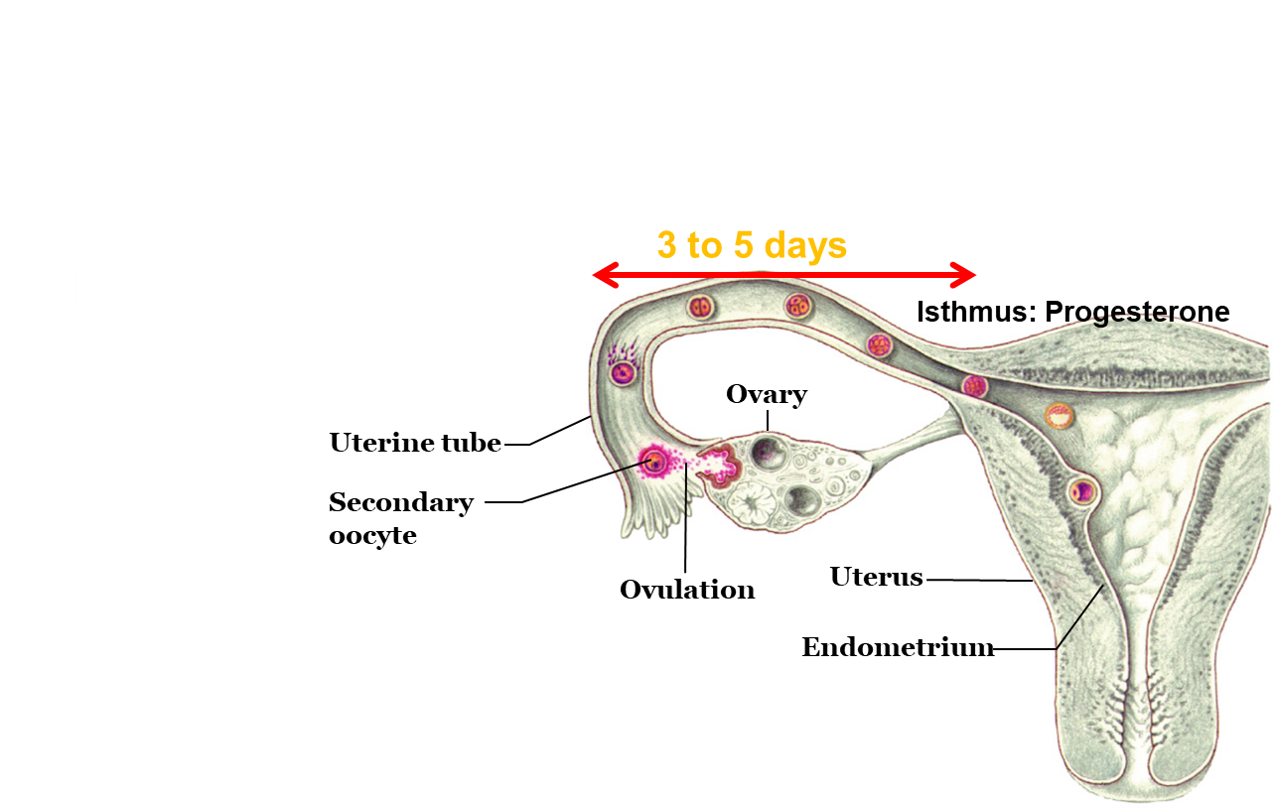
Transport of the Fertilized Ovum (Zygote)
Important
Definition: Zygote begins to divide as it travels through oviduct (fallopian tube).
Duration: After fertilization 3-5 days till zygote reach uterine cavity, delayed transport allows cell division to occur before the dividing ovum
Secretory cells in fallopian tube nourish the
blastocyst.
Transport is effected mainly by:
Fluid current.
Action of cilia.
Weak contractions of the fallopian tube (estrogen & progesterone).
Isthmus (last 2 cm of the oviduct) relaxes under effect of progesterone.
Blastocyst (100 cells) enters the uterus.
شرح الكلام:
بعد التلقيح الـzygote لازم ينتقل من قناة فالوب الى الرحم وتقريبا يأخذ من ٣-٥ أيام وفي هذه الاثناء الخلايا تنقسم.
العوامل المساعدة لنقل الـzygote هي: قوة اندفاع وتيار السوائل (زي النهر الغزير يجرّ كل شيء معاه) ، والـcilia الي تكون في قناة فالوب وانقباضاته الي تكون بسبب الاستروجين والبروجسترون.
طيب إيش هي العوائق؟
Isthmus of tube (narrow).
The Wall is not smooth (projections, rugae).
ليش ربي خلق هذي العوائق قدام الزيقوت قبل ما توصل الرحم؟ مافي شيء مخلوق عبث، فائدتها تعطي وقت للزيقوت عشان تنقسم قبل ما توصل هناك، ولو وصلت وهي ما انفسمت كفاية يحصل abortion.
طيب كيف نتغلب على هذي العوائق؟ بمعنى أنها تقدر توصل بس مو بسرعة عشان يمديها تنقسم.
الـ rugae ماراح نقدر نسوي لها شيء، أما نهاية قناة فالوب اللي هي الـ isthmus وهي بالحالة الطبيعية تعتبر اضيق مكان فالقناة، راح يحصل له ريلاكيشن وبالتالي يتوسّع عشان تمر البويضة الملقحة، وهذا يتم تحت تأثير البروجسترون.
If any of the transport mechanisms (very high progesterone, no fluid, no cilia and absent contractions) is absent, it will increase the risk of ectopic pregnancy.

Slide 11
Entry of The Ovum Into The Uterus
At day 19-20 of ovulatory cycle, transportation is done and the zygote entered the uterus.
When ovulation occurs, the ovum, along with a hundred or more attached granulosa cells that constitute the corona radiata, is expelled directly into the peritoneal cavity and must then enter one of the fallopian tubes (also called uterine tubes) to reach the cavity of the uterus.
The fimbriated ends of each fallopian tube fall naturally around the ovaries. The inner surfaces of the fimbriated tentacles are lined with ciliated epithelium, and the cilia are activated by estrogen from the ovaries, which causes the cilia to beat toward the opening or ostium of the involved fallopian tube. One can actually see a slow fluid current flowing toward the ostium. By this means, the ovum enters one of the fallopian tubes.
Although one might suspect that many ova fail to enter the fallopian tubes, conception studies suggest that up to 98 percent of ova succeed in this task. Indeed, in some recorded cases, women with one ovary removed and the opposite fallopian tube removed have had several children with relative ease of conception, thus demonstrating that ova can even enter the opposite fallopian tube.

Slide 12
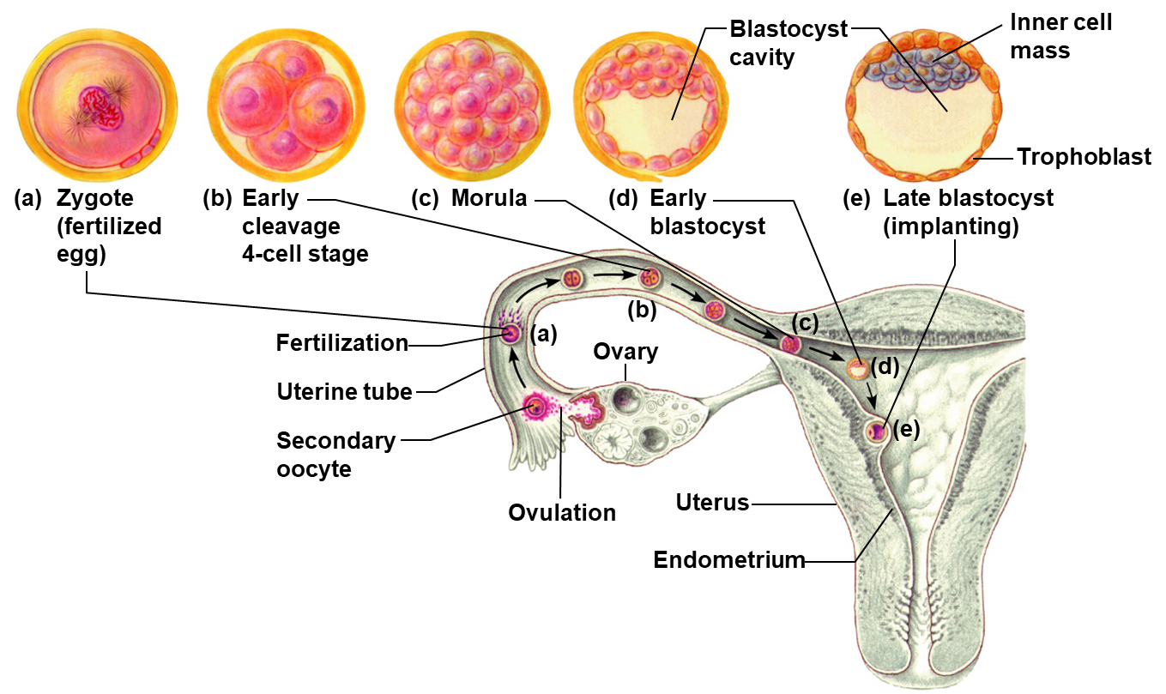
Cleavage
Doctor said: we wont ask about the name of the cells.
Remember it just in case..
Following fertilization (1st thing happening after fertilization) the zygote undergoes several mitotic divisions inside the zona pellucida (overall size does not change).
1st cleavage yields a 2 celled embryo, each cell is called a blastomere and is totipotent¹.
Divisions continue rapidly until the 32 cell stage AKA Morula.
Blastocyst (100 cells) enters the uterus.
(the zygote will not enter the uterus unless it become Blastocyst which mean 100 cells)
شرح الكلام:
بعد التلقيح تبدا عملية الانقسام المايتوزي داخل الـzona pellucida لكن الحجم ما يزيد في هذا الإنقسام.
اول انقسام يعطينا خليتين اسمهم blstomere وهذا النوع ممكن يعطينا أي نوع من الخلايا مستقبلا.
الانقسامات راح تكمل الين متى؟ الى ما يصير عندنا ٣٢ خلية.
الـzygote مايدخل الرحم الا لو وصل الـ١٠٠ خلية ويصير اسمه blastocyst (مهمه)
1: Totipotent embryo cells can differentiate into any cell type.

Slide 13
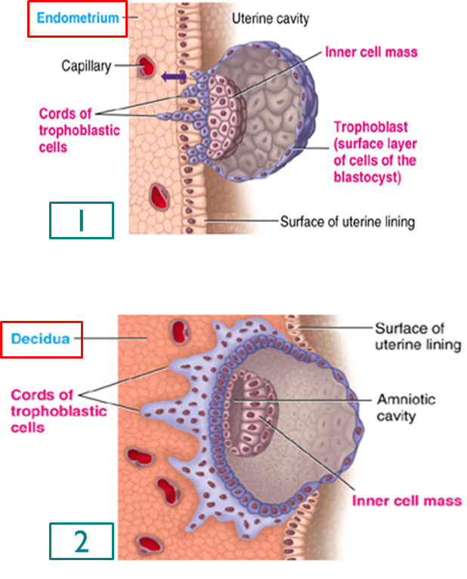
Implantation
Important
The blastocyst will plant itself by sending projections from chorionic cells into the endometrium (eating Decidua cells which are filled with glycogen & nutrient).
When the implantation occur?
Implantation occurs on 5-7 day after ovulation (day 21).
Steps of implantation:
Implantation results from the action of trophoblastic cords from the surface of blastocyst.
Digestion of endometrium.
Decidua cells¹ : (glycogen, proteins, lipids & minerals)
Both estrogen and progesterone are important at this stage:
Estrogen for proliferation of the endometrium.
Progesterone for the secretory phase (uterine milk) With increasing of the size of the endometrium due to estrogen and progesterone (secretions) it is called (Decidua; endometrium during pregnancy only).
شرح الكلام:
الطبقة الخارجية من الـblastocyst اللي دخلت الرحم اسمها trophoblast وهذي هي الي تساهم في عملية الـimplantation.
كيف تساهم ؟ بأنها تبدأ في غرس نفسها وفي نفس الوقت هضم طبقة الـendomerium و الـdecidua cells الي هي المشيمة التابعة للأم.
1: The decidua is the uterine lining (endometrium) during a pregnancy, which forms the maternal part of the placenta.

Slide 14
Embryological Development of Placenta
Blastocyst → Trophoblastic cords attaching to the uterus (Maternal blood sinuses develop around the trophoblastic cords) → blood capillaries grow into the cords from the vascular system of the newly forming embryo.
21 days after fertilization, blood starts to be pumped by fetal heart into the capillaries.
When implantation occur Blood sinuses appear supplied with blood from the mother develop around the outsides of the trophoblastic cords.
More and more trophoblast projections develop (placental villi).
شرح الكلام:
بعد الـimplantation، الاوعية الدموية تبدأ تتكون حولين الـtrophoblastic cord وكمان الاوعية الدموية للجنين تنمو من الجهة الأخرى.
بعد ٢١ يوم يبدأ قلب الجنين بضخ الدم داخل الأوعية.
نتوءات الـtrophoblasts (الي تمثل الـplacental villi) تزيد وبالتالي تزيد الـsurface area مما يساعد على تبادل الـnutrients من الأم الى الجنين.

Slide 15
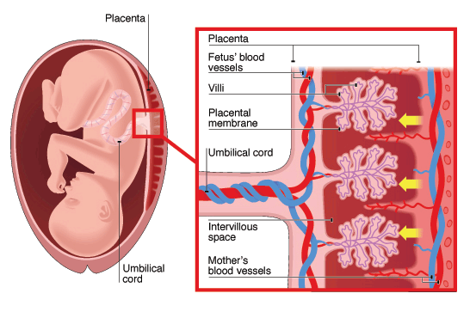
Physiologic Anatomy of The Placenta
The final structure of the placenta is shown in picture.
Note that the fetus’s blood flows through two umbilical arteries, then into the capillaries of the villi, and finally back through a single umbilical vein into the fetus. (the umbilical cord consists of two arteries and one vein).
At the same time, the mother’s blood flows from her uterine arteries into large maternal sinuses that surround the villi and then back into the uterine veins of the mother.
the picture also shows the relationship between the fetal blood of each fetal placental villus and the blood of the mother surrounding the outsides of the villus in the fully developed placenta.
The total surface area of all the villi of the mature placenta is only a few square meters - many times less than the area of the pulmonary membrane in the lungs.
Nevertheless, nutrients and other substances pass through this placental membrane mainly by diffusion in much the same manner that diffusion occurs through the alveolar membranes of the lungs and the capillary membranes elsewhere in the body.
The area with concentrated blood that’s why it is important to prevent this area for rupturing during labor

Slide 16
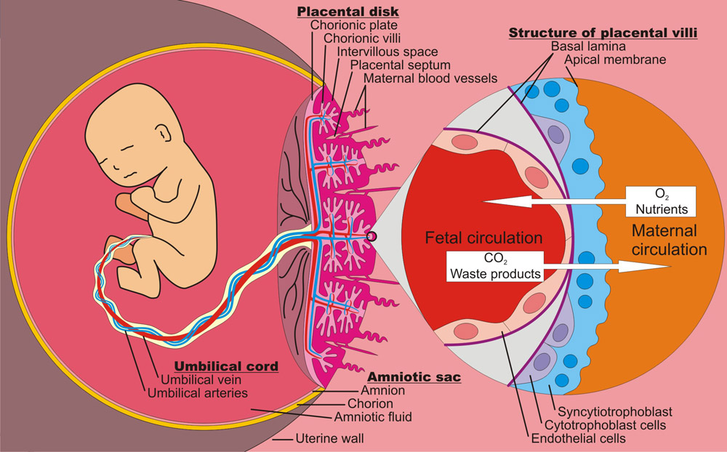
Functions of The Placenta
Functions of The Placenta
1. Respiration
2. Nutrition
3. Excretion
4. Endocrine
5.Protction
The first three functions are the major functions of the placenta.
We will discuss each one of these functions in next slides.

Slide 17
Respiration
Only in Males’ Slides
يقصد بها انتقال الأوكسجين من الأم للجنين
Placental permeability and membrane diffusion conductance
In the early months of pregnancy | In later pregnancy
In the early months of pregnancy, the placental membrane is still thick because it is not fully developed. The surface area is small because the placenta has not grown. So, how does the fetus get the nutrient ? Through the uterine milk (remember: in secretory phase progesterone secrete substances in the endometrium which is called UTERINE MILK) | In later pregnancy, The permeability increases because of thinning of the membrane diffusion layers and because the surface area expands many times over.
شرح الكلام:
في شهور الحمل الأولى الـplacenta تكون لسا ما اكتملت النمو تماما، بالتالي الـplacental membrane يكون سميك والـsurface area تكون صغيرة (تخيلوا أن شيء يكون طبقة سميكة بالتالي صعب اختراقها بينما لو كانت رقيقة بسهولة نخترقها) وهذا راح يعيق تبادل الأوكسجين بشكل كبير بين الأم والجنين.
بعد شهور الحمل الأولى، الـmembrane يصير thin والـsurface area توسع وتتمدد بالتالي عملية التبادل تكون أسهل وبكميات أكبر.

Slide 18
Cont.
Important
Diffusion of oxygen through the placental membrane:
The mean partial pressure of oxygen (PO2) of the mother’s blood in the placental sinuses is about 50 mm Hg, and the mean PO2 in the fetal blood after it becomes oxygenated in the placenta is about 30 mm Hg.
Dissolved O₂ in mother’s blood passes to fetal blood by simple diffusion.
PCO₂ 2-3 mm Hg higher in fetal than maternal blood.
Mean pressure gradient= 50 mm hg –30 mm hg =20 mm hg.
There are 3 reasons why this low PO₂ is sufficient to deliver O₂ to the fetal tissues:
Hemoglobin of the fetus.
Fetal hemoglobin concentration.
The Bohr effect.
شرح الكلام للسلايد هذي والجاية:
الـco₂ للجنين يكون عالي لأن ما عنده رئة تتخلص هذا الغاز، فما عند الجنين طريقة للتخلص من هذا الغاز إلا الأم.
كيف راح يتم التخلص منه عن طريق الأم؟
ارتفاع الـCo₂ راح يسوي concentration gradient فينتقل الغاز من العالي اللي هو الجنين إلى المنخفض اللي هي الأم ويتم التخلص منه (simple diffusion).
طيب الأوكسجين كيف؟
نفس الشيء فيه اختلاف في الPo₂ بين الأم والجنين، فيحصل diffusion من الأم للجنين بعكس الـCo₂ كان يروح من الجنين للأم.
يعني باختصار: الأم تعطي للجنين كل ماهو مفيد وتاخذ منه الضار.
Note that 20 mm Hg seems to be low and not enough for exchange sufficient oxygen to the fetal blood. BUT due to these 3 special reasons it is sufficient more than enough to deliver O₂ and nutrients to the fetus.
For each point we know that Hb F has more affinity to bind to oxygen than Hb A which is normal human Hb.

Slide 19
Cont.
Doctor said : There must be a question in the final exam each year about this topic
1,2: Hemoglobin of the fetus & Fetal hemoglobin concentration
What is the type of Hb of the fetus? Hemoglobin F (HbF).
The fetal hemoglobin concentration is about 50% greater than that of the mother. So, At the low PO2 levels in fetal blood (While the PCO2 in the fetus will be high), the fetal hemoglobin (HbF) can carry 20% to 50% more oxygen than maternal hemoglobin (HbA) (HbF has a higher oxygen carrying capacity than HbA).
Follow with the curves: In Maternal curve: when pressure of o₂ is 20 the Oxyhemoglobin become almost 38 and in the same time the oxyhemoglobin of the fetus if 46.
Imp: Conclusion ; whenever the curve is shifted to the right more o₂ will be carried (fetal). While whenever the curve is shifted to the left less o₂ will be carried (mother).
Oxygen-hemoglobin dissociation curves

Slide 20
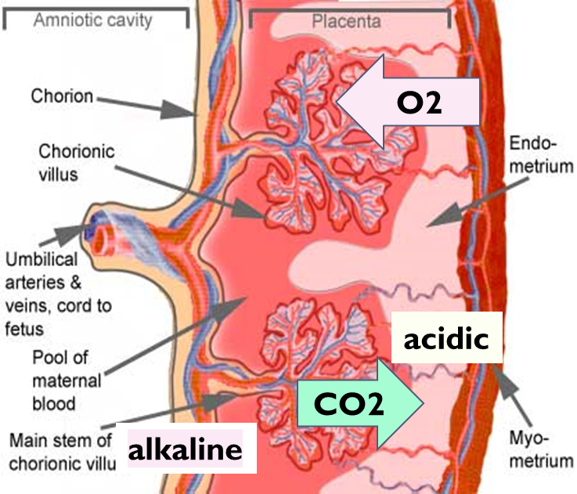
Cont.
Important
3: Bohr effect
Recall The Bohr Effect refers to the observation that increases in the carbon dioxide partial pressure of blood or decreases in blood pH result in a lower affinity of hemoglobin for oxygen.
 | Fetal blood | Maternal (mother) blood
PCO₂ | Lost CO₂ | Gains CO₂
PH | High pH (alkaline) | Low pH (acidic)
Shifts of the dissociation curves | Shifts to the left allowing additional oxygen uptake. | Shifts to the right releasing additional oxygen.
These changes cause the capacity of fetal blood to combine with O₂ to increase, and maternal blood to decrease, which forces more O₂ from the maternal blood while enhancing oxygen uptake by the fetal blood.
Normally before Exchange the fetal blood has high PCo₂ as a waste product due to his body activity, this will lead to make the PH in the fetal circulation to be more Acidic.
Shown in the diagram: As a result of the above the CO₂ will diffuse from fetal circulation to the mother passively, this diffusion of Co₂ from the fetal to the mother will change the PH in both sides , when the Co₂ leave the fetal circulation it turns to be Alkaline because it lost (CO₂) which is an acid.

Slide 21
Cont.
Important factors facilitate delivery of oxygen to the fetal tissues:
High maternal intervillous blood flow (almost double the fetal placental flow).
High fetal haemoglobin (16 - 17 g/dl).
High fetal cardiac output.
The fetal metabolic acidosis which shifts the curve to the right and thus aids delivery of oxygen to the tissues.

Slide 22
Nutrition
Important
يقصد بها انتقال الغذاء من الأم للجنين
Nutrition Diffusion of foodstuffs through the placental membrane
Glucose
Fatty acids
Amino acids
Electrolyte's
Fetus uses mainly glucose for nutrition so, the trophoblast cells in placental villi transport glucose by carrier molecules; GLUT (facilitated diffusion). That’s why pregnant woman desire something sweat and if it’s not controlled it could lead to gestational diabetes.
Fatty acids diffuses due to high solubility in cell membrane (more slowly than glucose).
The placenta actively transports all amino acids with fetal concentrations exceeding maternal levels.
K+, Na+ and Cl⁻ diffuses from maternal to fetal blood.

Slide 23
Excretion
يقصد بها الإخراج من الجنين للأم
Excretory products of the fetus diffuse through placental membrane to maternal blood to be excreted with waste products of the mother (Urea, uric acid and creatinine).
Higher concentration of excretory products in fetal blood insures continuous diffusion of these substances to the maternal blood.

Slide 24
Endocrine
In the trimester (first 3 months) | The placenta is not yet formed. High level of hCG secreted by the trophoblast of the embryo. Progesterone & estrogen are secreted from corpus luteum.
Second trimester (second 3 months) | The placenta is formed & the corpus luteum start to degenerate. The placenta will secrete most of hGC, progesterone & estrogen with slight increase of estrogen and progesterone. Estrogen and progesterone are also secreted from the corpus leutum
Third trimester (Third 3 months) | The corpus luteum is completely degenerated. High estrogen and progesterone with low hCG, estrogen & Progesterone are only secreted by placenta.

Slide 25
Cont. In Other Word (same of the previous slide)
A. Human chorionic gonadotropin (hCG) | Will increases until it reaches a maximum concentration near the end of the first trimester. Then it decrease to low level for the reminder of the pregnancy.
B. Progesterone | Progesterone continue to increase until it level off near the end of the pregnancy. Early in the pregnancy, progesterone is produced by the corpus luteum in thee ovary. By the second trimester, its production shifts to the placenta.
C. Estrogen | Estrogen levels increase slowly throughout the pregnancy, but they increase more quickly as the end of the pregnancy approaches. Early in the pregnancy estrogen is produced only in the ovary. by the second trimester, its production shifts to the placenta.

Slide 26
Cont.
hCG level (pregnancy test)
Increase the most in the 1st trimester then it will decrease, but still it is high comparing with normal women.
Blood hCG under 5 mIU/ml: Negative (Not pregnant)
Blood hCG between 5-25 mIU/ml: "Equivocal“, Maybe pregnant maybe not → Repeat test in a couple of days.
Blood hCG over 25 mIU/ml: You are pregnant!
One single hCG reading is not enough to make a clear diagnosis. Several hCG tests days apart give a more accurate assessment of the situation.
The blood hCG levels should not be used to date a pregnancy since these numbers can vary so widely

Slide 27
Cont.
Hormone | 1. Human Chorionic Gonadotropin (hCG) (only in females’ slides) | 2. Estrogen
Nature of the hormone | Glycoprotein | Steroid hormone
Secreted by | Syncytial trophoblast cells, then after the formation of the placenta, hCG will be secreted from the placenta. | Syncytial trophoblast cells towards end of pregnancy reaches 30×
Derived from | - | Weak androgen (DHEA) released from maternal & fetal adrenals.
Functions in the mother | Most important function is to maintain corpus luteum (↑estrogen & progesterone) till 13-17 weeks of gestation. Another function is that it act as LH hormone which in response, exerts interstitial (Leyding) cell-stimulating effect on testes of the male fetus (growth of male sex organs). | Enlargement of uterus, breast ducts & external genitalia. Relaxation of pelvic ligaments in preparation to labor. Activation of the uterus (gap junctions).

Slide 28
Cont.
Hormone | 3. Progsterone | 4. Human Chorionic Somatomamotropin or Human placental lactogen (hPL) | 5. Relaxin
Nature of the hormone | Steroid hormone | Protein hormone | Polypeptide
Secreted by | Syncytial trophoblast cells towards end of pregnancy reaches 10× | Placenta around 5th gestational week | Corpus luteum Placenta
Derived from | Cholesterol | - | -
Functions in the mother | Development of the breast lobules. Provides nutrition to developing embryo (uterine secretory phase. Development of decidual cells. Inhibit the contractility of the uterus. | Breast development (hPL). Weak growth hormone‘s action. Inhibit insulin sensitivity =↓ glucose utilization. Promote release of fatty acids. | Relaxation of symphysis pubic ligament (weak). Softens the cervix at delivery.

Slide 29
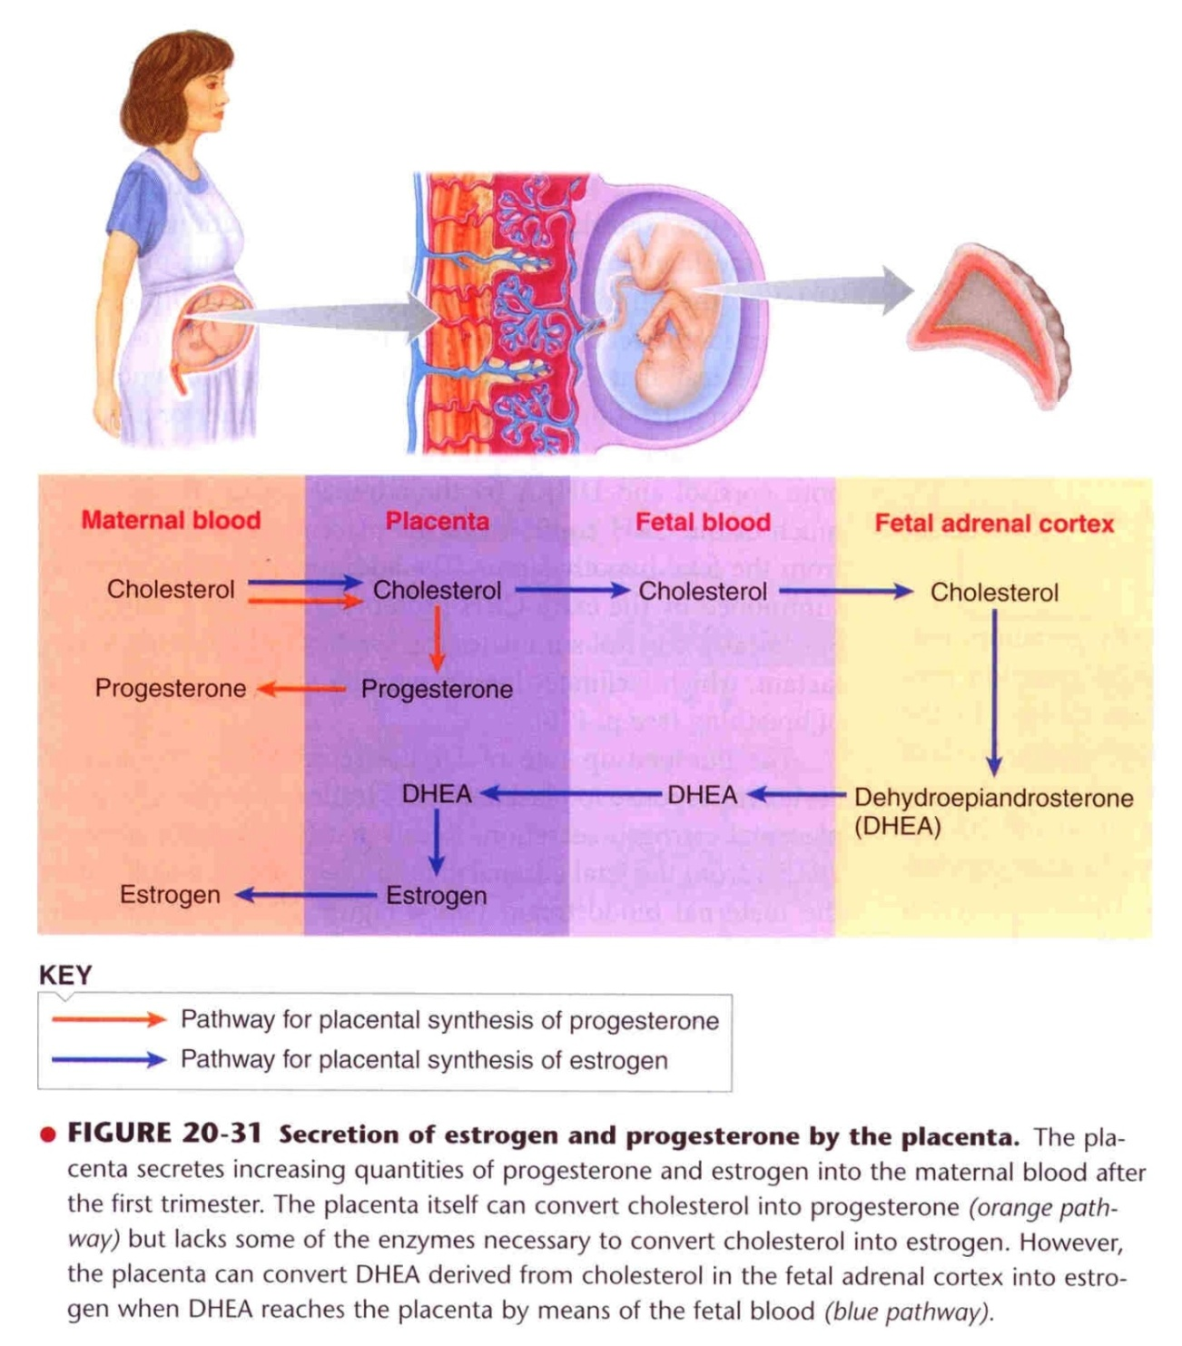
Sources of Placental Estrogen & Progesterone
Estrogen Production:
Cholesterol from maternal blood will diffuse through placenta to fetal blood then it will reach fetal adrenal cortex.
Fetal adrenal cortex will use the cholesterol to synthesis DHEA (Androgen).
DHEA will diffuse to the placenta and it will be converted to Estrogen.
Also maternal adrenal cortex will release DHEA which will be converted to Estrogen in placenta.
Finally, Estrogen will go back to maternal blood.
Progesterone Production:
Cholesterol from maternal blood will diffuse to placenta.
Placenta will use cholesterol to synthesis Progesterone.
Finally, Progesterone will diffuse back to maternal blood.

Slide 30
Physiological Adaptation To Pregnancy
Changes in maternal endocrine system (Almost everything n the body increases during pregnancy)
Anterior pituitary gland enlargement (50%) | Release of ACTH, TSH and PL increase. FSH and LH almost totally suppressed due to increase of progesterone & estrogen.
Adrenal gland | Increase glucocorticoids secretion (mobilize aa). Increase aldosterone (retain fluid).
Thyroid gland enlargement 50% | Increase thyroxine production (hCG) (Retain Na & water to increase maternal blood concentration even more blood cells will be produced from bone marrow. To prepare her for losing blood in labor)
Parathyroid gland enlargement | Increase PTH secretion (maintain normal Ca⁺²)

Slide 31
Cont.
Changes in Different Organs:
Increase in uterine size (50 gm to 1100 gm).
The breasts double in size.
The vagina enlarges to facilitate labor.
Development of edema and acne due to increase in androgen and water absorption.
Masculine or acromegalic features
Weight gain 10-12 kg (last 2 trimesters)
Increase appetite:
Removal of food by fetus.
Hormonal effect.
Changes in respiration:
Increase in O2 consumption 20%
Increase basal metabolic rate (BMR
Increase in body size
Growing uterus presses upwards (restriction)
Increase in RR (respiratory rate).
Increase in minute ventilation (TV* × RR) by 50%:
Progesterone ↑ sensitivity of RC to CO₂
* TV= Tidal volume

Slide 32
Cont.
Changes in circulatory system:
Increase in Cardiac output (30 - 40%) by 27 weeks.
Increase in blood flow through the placenta.
Increase in maternal blood volume 30% due to:
Increase aldosterone and estrogen (↑ ECF )
Increase activity of the bone marrow (↑ RBCs 40%)
Changes in metabolism:
Increase basal metabolic rate (BMR) 15%
Increase in daily requirements for:
Iron
Phosphates
Calcium & Vitamin D (Ca⁺² absorption)
Vitamins
The renal tubules’ reabsorptive capacity for Na, Cl, and water is increased as much as 50%.
The renal blood flow and GFR* increase up to 50%.
Normal pregnant woman accumulates only about 5 pounds (2.27Kg) of extra water and salt.
دائماً الحامل تحس أنها حرّانة.
* GFR= Glomerular filtration rate.

Slide 33
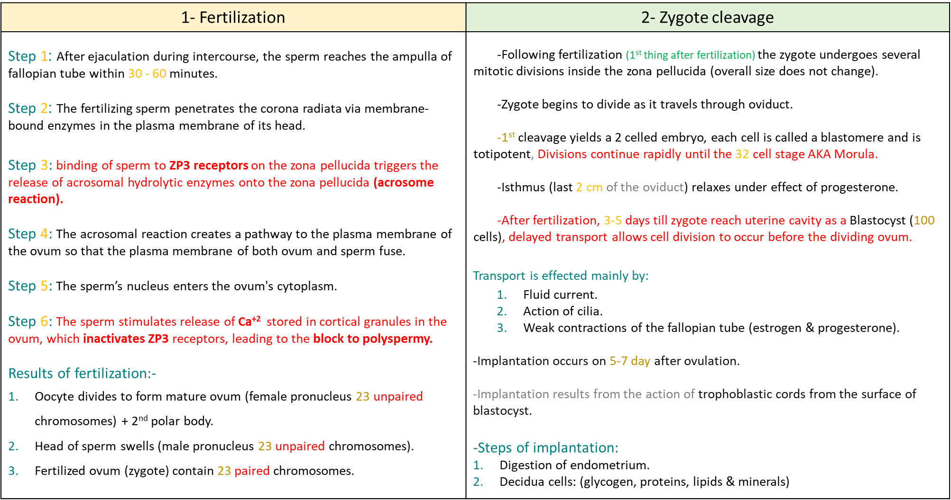
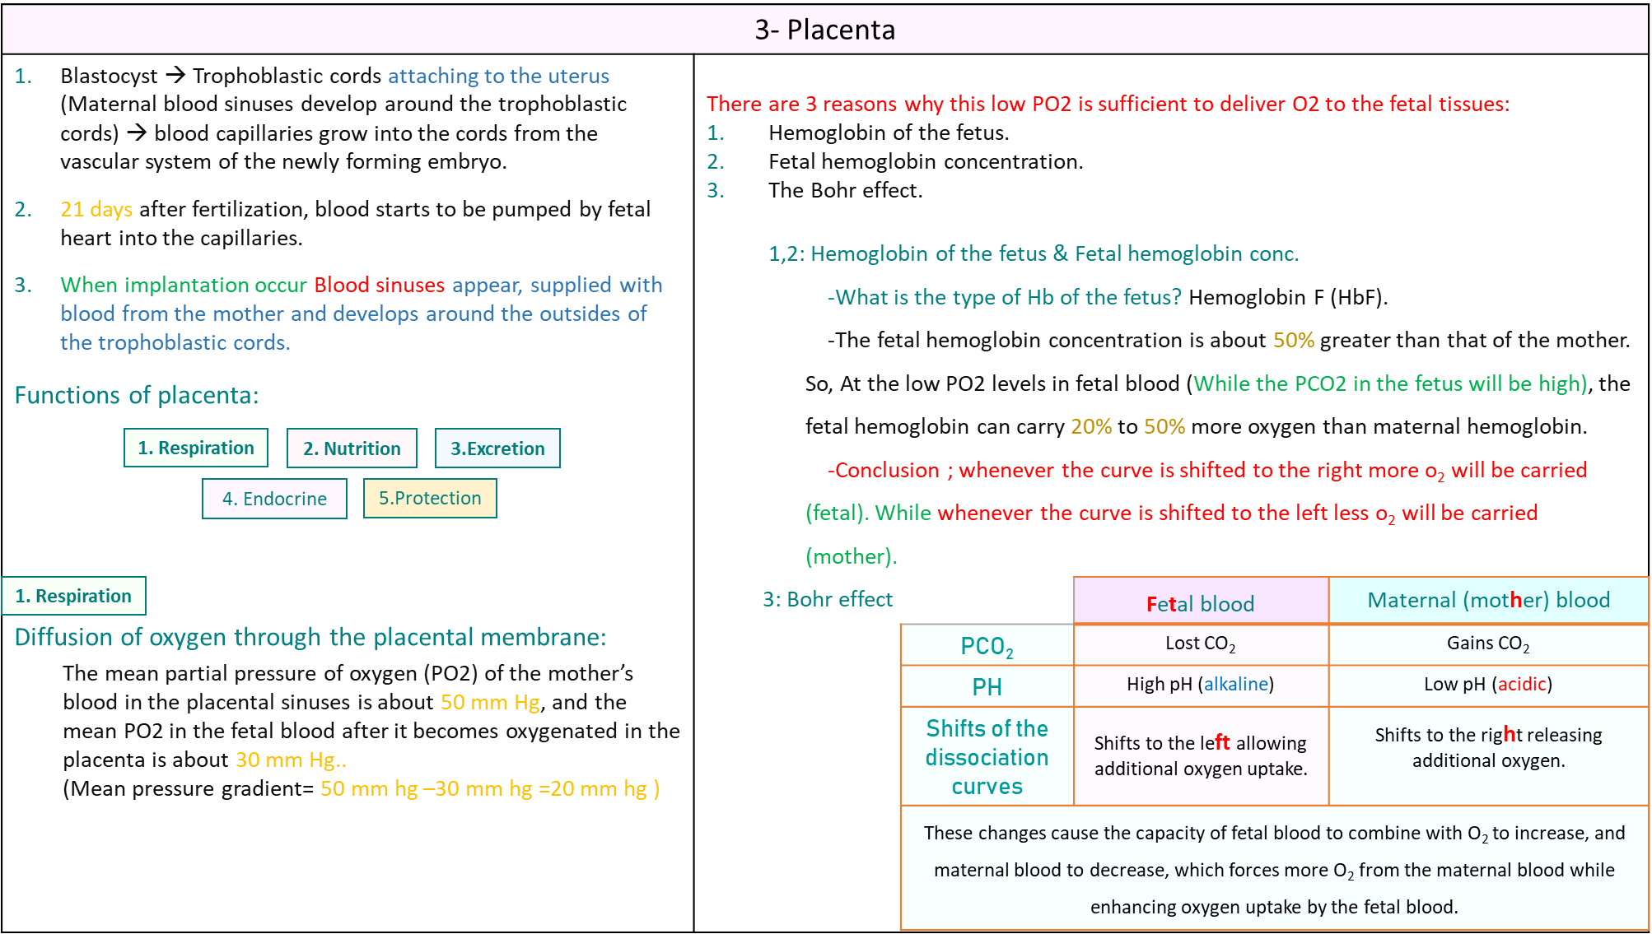
Summary
Here the summaries are clear

Slide 34
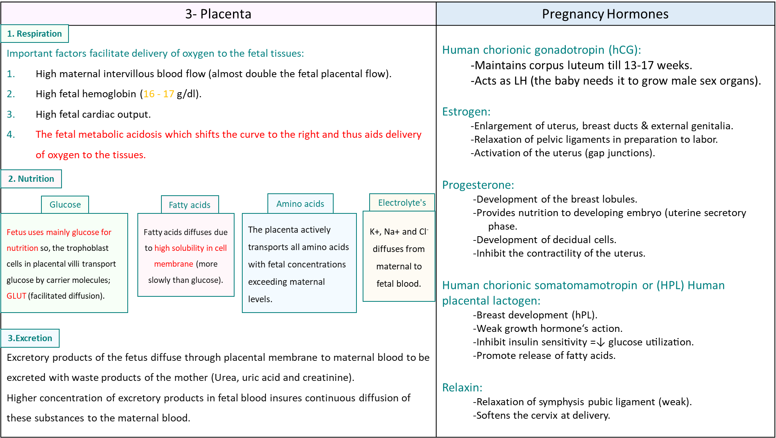
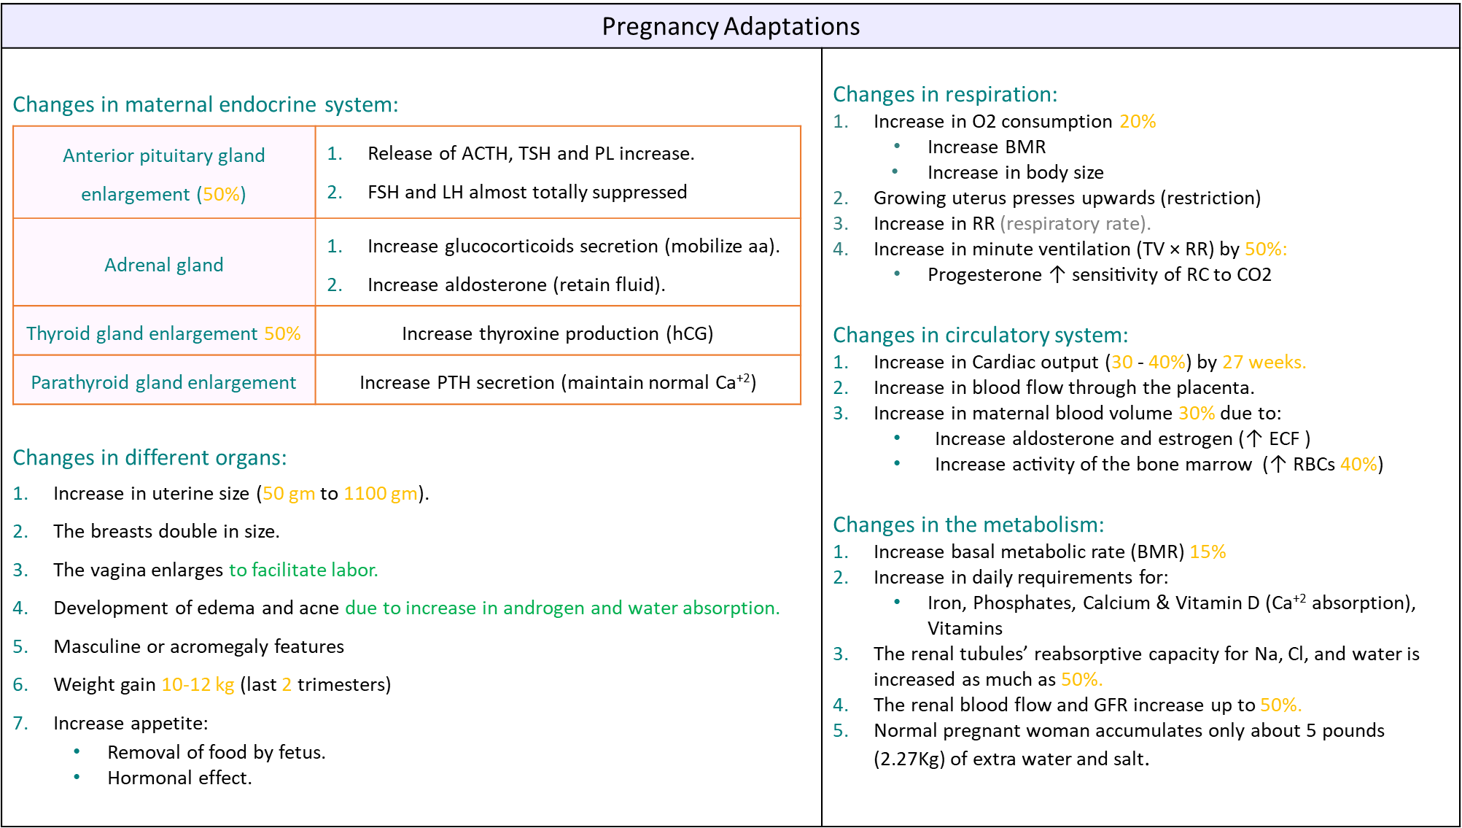
Summary
Here the summaries are clear

Slide 35
MCQ’s
1. Which of the following stages is the one that is implanted into the endometrium of the uterus?
Zygote
Morula
Early Blastocyst
Late Blastocyst
2. How many days does it take for the fertilized zygote to travel through the oviduct?
2-4
3-5
4-5
5-6
3. DHEA is converted to Estrogen in …?
Placenta.
Maternal blood.
Fetal blood .
Fetal adrenal cortex.
4. Which of the following will inhibit the contractility of uterus?
Estrogen.
Oxytocin.
Prolactin.
Progesterone
5. Which ONE of the following is a function of RELAXIN ?
Act upon uterine cervix
Developmental function
Promotes release of fatty acids
Decrease glucose sensitivity
6. Which ONE of the following is secreted by placenta around 5th gestational week ?
Human Chorionic Gonadotropin
Human Placental Lactogen
Relaxin
Gonadotropins
1=D 2=B 3=A 4=D 5=A 6=A

Slide 36
Thank you for checking our work!
اعمل لترسم بسمة، اعمل لتمسح دمعة، اعمل و أنت تعلم أن الله لا يضيع أجر من أحسن عملا.
قادة الفريق:
ليــلـى مـذكور & مـحـمـد نـصـر
Please check our editing file to know if there are any additions, changes or corrections.
خالص الشكر لأعضاء الفريق الكِرام:
-
حسان الشمري
عبدالرحمن الراشد
فؤاد بهجت
فهد الفايز
ماجد الزين
محمد المطلق
محمد المهوس
لـمـى الـتـمـيـمـي
ريما الشايع
لينا الوكيل
ندى الدخيل
آمال الشيبي
2017-2018 Dr. Hana Alzamil’s Lecture & Notes.
2017-2018 Dr. Mohammed AlOtaibi’s Lecture & Notes.
Guyton & Hall of Medical Physiology 13th Edition.
Linda S. Costanzo 5th Edition.
First Aid For The USMLE Step One.
Khan Academy.
Helpful physiology bocks.
Give us your feedback ☺
اللهم اني استودعتك ما حفظت وما قرأت وما فهمت، فرده لي وقت حاجتي إليه إنّك على كل شيءٍ قدير.

