Slide 1
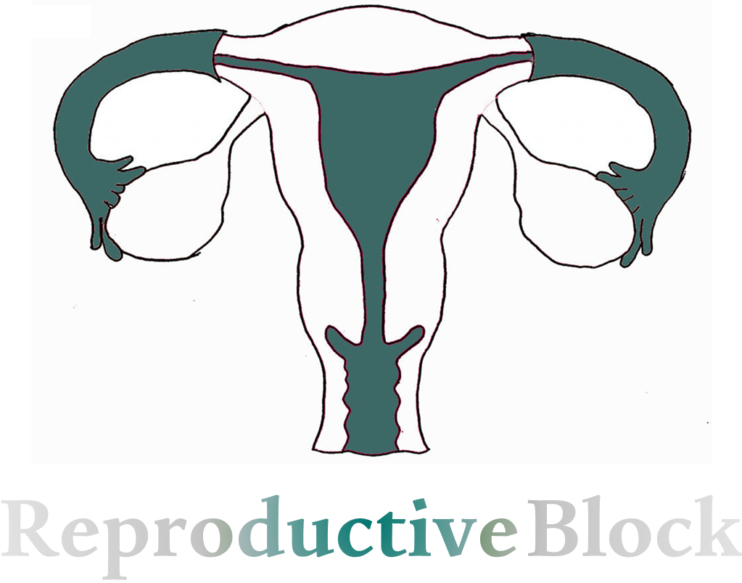
All the notes in this lecture are Important
Text
Only in Females’ slide
Only in Males’ slides
Important
Numbers
Doctor notes
Extra Notes

Slide 2
Physiology of Labor
By the end of this lecture, students should be able to describe:
Define labor/labour (parturition).
Recognize the factors triggering the onset of labor.
Describe the hormonal changes that occur before and during labor.
Describe the phases of uterine activity during pregnancy and labor.
Describe the clinical stages of human labor.
All the notes in this lecture are Important

Slide 3
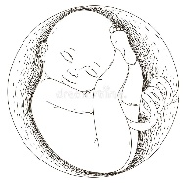
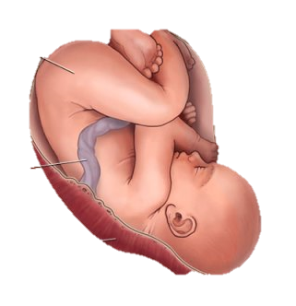
Definition of Parturition (Labor)
Uterine contractions that lead to expulsion إخراج of the fetus to extra uterine environment.
Towards the end of pregnancy the uterus become progressively more excitable and develops strong rhythmic contractions that lead to expulsion of the fetus.
Fetus
There is interactions between:
Placental membrane
Mother
Interactions between fetus, mother, and placental membranes will induce labor.

Slide 4
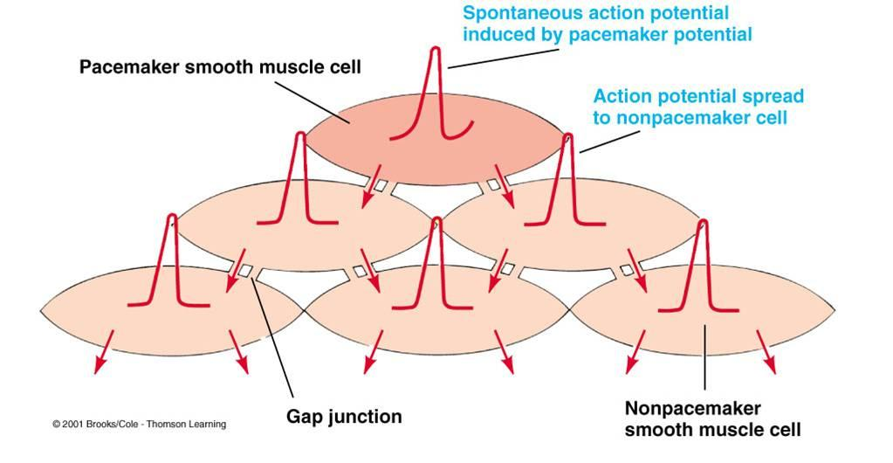
Normal Uterine Contraction
Important
Does non pregnant uterus contract?
Uterus is spontaneously active. (Other examples of spontaneously active organs: Ureter, stomach, intestine & blood vessels).
(The normal uterus always contracts, during or without pregnancy)
Spontaneous depolarization is produced by: pacemaker cells (Telocytes), causing spontaneous action potential (the cell can generate its own action potential independent on neurons) which is same of kajal cells that we talked about it during GNT block.
This depolarization will spread via Gap junctions (A protein called connexin 43)
(Gap junction not found during pregnancy (to prevent strong uterus contractions) but it will be overexpressed during labor)
During menstruation there is release of prostaglandins which will cause vasoconstriction and pain.
Uterus contracts as a whole unit. Unlike intestines, we can’t identify the location of the pacemaker cells of the uterus.
شرح الكلام: الرحم مثل القلب والجهاز الهضمي فيه خلايا دائما تنقبض.
تتذكروا ببلوك الجي أي لما قلنا أن الـkajal cell توفر الاكشن بوتنشل لنفسها وما تحتاج مساعدة عصب او أي مساعدة خارجية؟ الرحم نفس الشيء فيه Telocytes وهي نفس الـkajal cell تماما. انقباضات الرحم هذي قد ما نحس فيها وقد تكون مؤلمة مثل فترة الدورة الشهرية.
إذا كان الرحم الطبيعي دائما تحدث له انقباضات، فـ كيف الجنين يبقى في رحم الأم؟
The uterine contractions happens always but it is not strong enough to induce labor.

Slide 5
Factors That Trigger The Onset of Labor
Exact trigger is unknown, But there is effects may lead to increase the contraction responsible for parturition.
These effects lead to increase in the contractions responsible for parturition
Hormonal factor
(changes)
Mechanical factor
(changes)
Estrogen
Stretch of the uterine muscle
Progesterone
Stretch or Irritation of the Cervix
Oxytocin
Prostaglandins

Slide 6
Hormonal Changes
Increased ratio of estrogens to progesterone. (both are coming from the placenta)
Function of Estrogen | Function of Progesterone
Estrogen stimulate uterine contractility by: $↑$ GAP junctions with onset of labour. $↑$ Oxytocin receptors. (oxytocin is a very essential component of labor & without it the labor wont occur) $↑$ Prostaglandins. (it is not a hormone, synthesized inside the cells, and in the uterus synthesized inside the myometrium) | Progesterone inhibit uterine contractility by: $↓$GAP junctions. $↓$ Oxytocin receptor. $↓$ Prostaglandins. (cause contraction so, we lower it down) $↑$resting membrane Potential (-60mv).
عكس ما يسوي الأستروجين
From 7th month till term (birth):
Progesterone secretion remain constant or decreases slightly (gradually), because it decrease the contraction.
Estrogen secretion continuously increase because it increase the contraction.
The estrogen/progesterone ratio increases sufficiently toward the end of pregnancy to be at least partly responsible for the increased contractility of the uterus.

Slide 7
Cont.
Oxytocin (important) |  | Prostaglandin
Before labor | Dramatic increase of oxytocin receptors (200 folds) → will cause gradual transition from passive relaxed to active excitatory muscle (↑responsiveness). | Central role in initiation & progression of human labour. Locally produced (intrauterine). Oxytocin and cytokines stimulate its production. Prostaglandin stimulate uterine contractions by: Direct effect: Through their own receptors. Upregulation of myometrial gap junctions. Indirect effect: Upregulation of oxytocin receptors.
At labor | Increase in Oxytocin secretion at labor by posterior pituitary. Oxytocin increase uterine contractions by: Directly on its receptors. (positive feedback) Indirectly by stimulating prostaglandin production.

Slide 8
Mechanical Factors
Stretch of the uterine muscle | Stretch or Irritation of the Cervix
Stretch of the uterine muscle (smooth muscle) → Increases contractility (by stretch receptors which is controlled by the Ca+ ions in extracellular fluid). Examples of mechanical stretch eliciting uterine contractions: Fetal movements because it will stretch the uterus and lead to contractions. So, if a woman is pregnant with twins or more we give her progesterone to stably her pregnancy and prevent early contractions. Multiple pregnancy (if a woman is pregnant with twins she will usually deliver earlier). | Stretch of the cervix → Increases contractility (Positive feedback mechanism). Examples of mechanical changes stretching or irritating the uterine cervix: Membrane sweeping & rupture. physical stimulation of the cervix (introducing one finger in the cervix and separating the membrane will cause release of prostaglandin. Fetal head. (the head of the baby stretches the cervix more forcefully than usual or irritates it in other ways).
The mechanism by which cervical irritation excites the body of the uterus is not known. It has been suggested that stretching or irritation of nerves in the cervix initiates reflexes to the body of the uterus, but the effect could also result simply from myogenic transmission of signals from the cervix to the body of the uterus.

Slide 9
Onset of Labor
During most of the months of pregnancy, the uterus undergoes periodic episodes of weak and slow rhythmical uterine contractions called Braxton Hicks contractions (2nd trimester).
These contractions become progressively stronger toward the end of pregnancy; then they change suddenly, within hours, to become exceptionally strong contractions that leading to start cervix stretching and later force the baby through the birth canal, thereby causing parturition.
Suddenly uterine contractions become very strong leading to: Cervical effacement and dilatation.
A theory has been proposed to explain the onset of labor which is the positive feedback theory.
شرح الكلام: (راح تفهموا السلايد أكثر بعد دراسة جزيئة الـuterine activity بالسلايدات الجاية)
الرحم من بداية الحمل حتى انتهاء فترة النفاس يمر بتغيرات راح نعرفها بالسلايدات الجاية تسمى (Uterine Activity)، في مرحلة من المراحل تسمى (Activation) أو (phase one) لكن هذا ما يعني أنها أول مرحلة لأن أول مرحلة تسمى (phase 0). في هذه المرحلة (phase1) واللي تحدث بشهور الحمل الثانية أو الاخيرة يمر الرحم بإنقباضات بين فترة وفترة، هذه الإنقباضات ليست حقيقية مثل انقباضات الولادة، وليست قوية ولا مؤلمة، هدف هذه الانقباضات هو تهيئة الرحم للانقباضات الحقيقة في المرحلة اللي بعدها وتستمر حتى كم أسبوع قبل الولادة. مع قرب الولادة بكم أسبوع تبدأ (phase 2) وهي انقباضات متتالية ومؤلمة وقوية وتستمر حتى الولادة.

Slide 10
Cont. The positive feedback theory
Important
The positive feedback theory
A theory has been proposed to explain the onset of labor.
The positive feedback theory suggests that:
Stretching of the cervix by the fetus’s head finally becomes great enough to cause the contraction of the entire body of the uterus.
Stretching of the cervix will pushes the baby forward, which stretches the cervix more and initiates more positive feedback to the uterine body. Thus, causes the pituitary gland to secrete oxytocin.

Slide 11
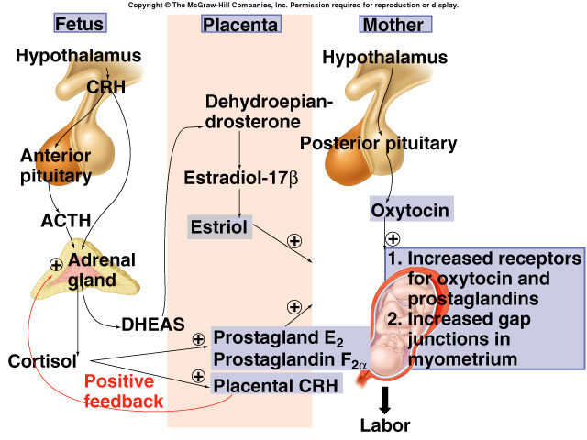
Cont.
There is a theory that says: the hypothalamus of the fetus releases CRH which will act on the anterior pituitary and secrete ACTH and stimulate the adrenal glands to secrete Cortisol. This fetal cortisol will go to the placenta and stimulate the release of prostaglandins (E2 and F2 alpha) and will potentiate the release of placental CRH which will again stimulate the fetal adrenal cortex to release more cortisol (positive feedback). at the same time in the mother there will be stimulation to the hypothalamus to act on posterior pituitary for the release of oxytocin which will cause its actions. The placenta will secrete Dehydroepiandrosterone which will be converted in the placenta to estrogen, estrogen together with oxytocin and prostaglandins will lead to increase contractions of the uterus.

Slide 12
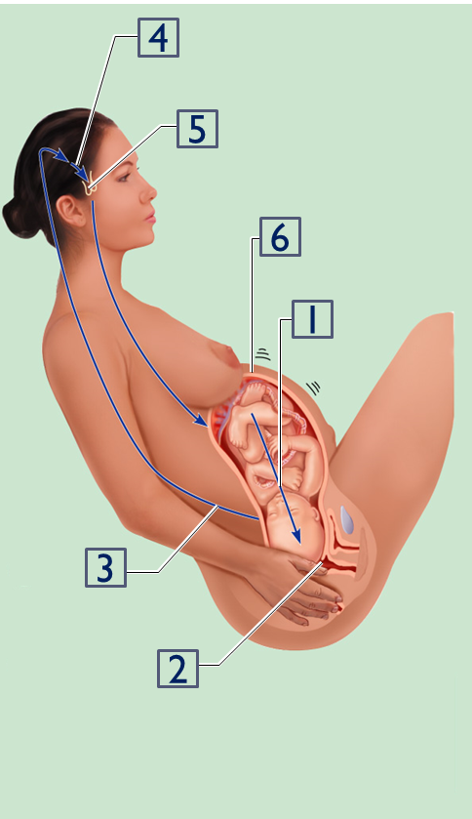
Cont.
Important
1. Baby moves deeper into mother’s birth canal
2. Pressoreceptors in cervix of uterus excited
3. Afferent impulses to hypothalamus
4. Hypothalamus sends efferent impulses to posterior pituitary, where oxytocin is stored
5. Posterior pituitary releases oxytocin to blood; oxytocin targets mother’s uterine muscle
6. Uterus responds by contracting more vigorously
7. Positive feedback mechanism continues to cycle until interrupted by birth of baby
شرح الكلام بالسلايد الجاي ☺

Slide 13
Cont.
شرح الكلام: (تبّعوا مع الصورة)
1: السيرفكس للحامل يكون مُغطّى بمادة مخاطية اسمها (mucus plug) راح تنشرح بالتفصيل لاحقا، بس اعرفوا أن هذه المادة تملأ منطقة السيرفكس بالتالي تسكّرها وتمنع رأس الجنين من الخروج، وعند قرب موعد الولادة تخرج هذه المادة بالتالي رأس الطفل راح يبدأ بالخروج الين يوصل للـbirth canal .
2: نزول رأس الطفل راح يسبب ضغط على الريسبتورز اللي في السيرفكس (Pressoreceptors).
3: هذه الريسبتورز راح ترسل رسائل حسية (afferent) للهايبوثلامس.
4 +5: الهايبوثلامس بالتالي راح يستجيب لهذه الإشارات ويرسل motor signals (efferent) إلى الـposterior pituitary عشان يزيد إفراز هرمون الـoxytocin اللي تكلمنا عنه بالإندوكراين بلوك والسلايدز الماضية وهو أهم هرمون بالولادة.
6: الرحم راح يستجيب للـoxytocin وبالتالي يبدأ ينقبض لدفع الطفل للخارج.
7: كيف يستمر الإنقباض حتى يخرج الطفل؟ عندنا positive feedback اللي تكلمنا عنه بالسلايدز الماضية. ايش وظيفته؟ يعيد لي المهمة، يعني يرجع يرسل رسائل للهايبوثلاميس عشان يطلع عندنا oxytocin زيادة، وكلما زاد الـoxytocin كلما زادت انقباضات الرحم وتستمر العملية حتى خروج الطفل🎉.

Slide 14
Cont.
Contractions start at the fundus and spread to the lower segment (Contractions starts from the fundus because it contains more oxytocin receptors).
The intensity of contractions is strong at the fundus but weak at the lower segment. (usually lower segment is more relaxed than upper)
In early stages: one contraction every 30 minutes. (شهور الحمل الأولى تكون الانقباضات غير مؤلمة ولا متتالية لتهيئة الرحم فقط)
As labor progresses: one contraction every 1 - 3 minutes. (شهور الحمل الأخيرة تكون الانقباضات مؤلمة و متتالية استعدادا للولادة)
Abdominal wall muscles contract (so they will ask the mother to PUSH when there is contraction and it will increases her intra-abdominal pressure which will help in moving the baby towards the vagina)
(Once uterine contractions become strong during labor, pain signals originate both from the uterus and from the birth canal. These signals, in addition to causing suffering, elicit neurogenic reflexes in the spinal cord to the abdominal muscles, causing intense contractions of these muscles. The abdominal contractions add greatly to the force that causes expulsion of the baby)
Rhythmical contractions allow blood flow (uterine artery branches reaches the placenta through the myometrium, so if there is continuous contractions, the blood will ceases and the baby will be blood-deprived).

Slide 15
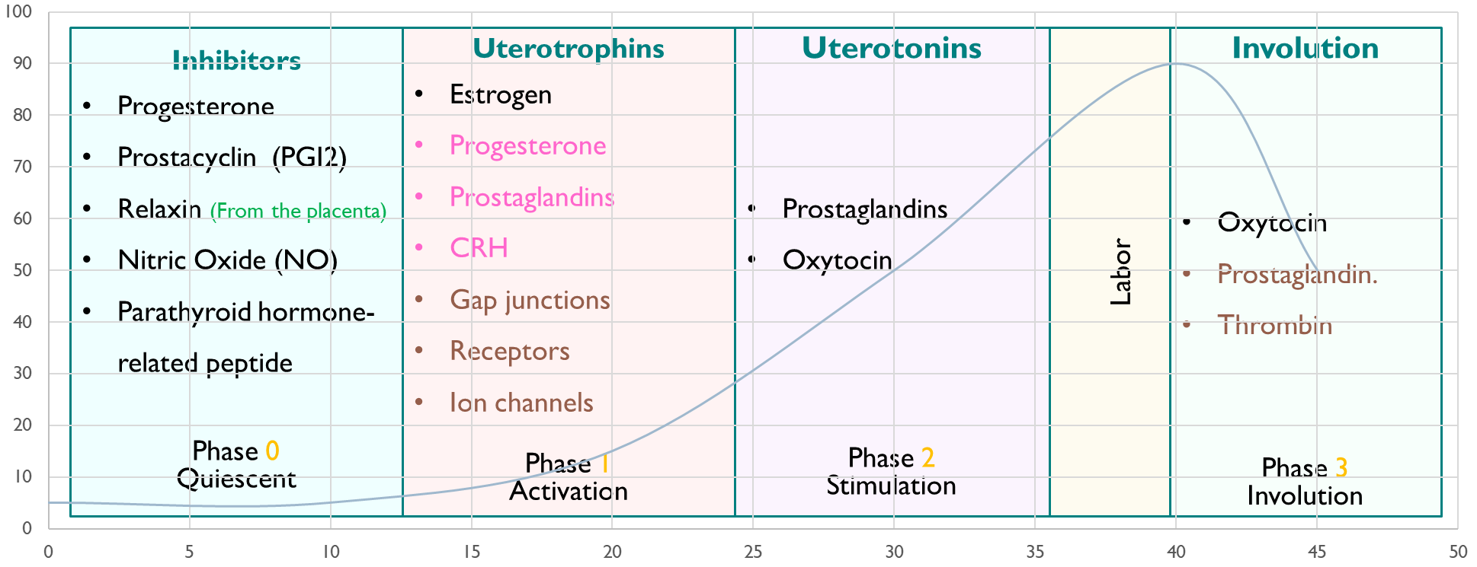
Phases of Parturition (Uterine Activity)
In the exam they will not write (phase 0 or one…) they will write quiescence, activation, stimulation and involution.
Phase 0
Quiescent
المقصود بهذه الـphases يعني إيش التغيرات اللي تحدث بالرحم من بداية حمل المرأة حتى إنتهاء فترة "النفاس"
لا تشيلوا هم هذه الصورة راح تنشرح بالسلايدات الجاية☺
Phase 1
Activation
Phase 2
Stimulation
Labor
Phase 3
Involution

Slide 16
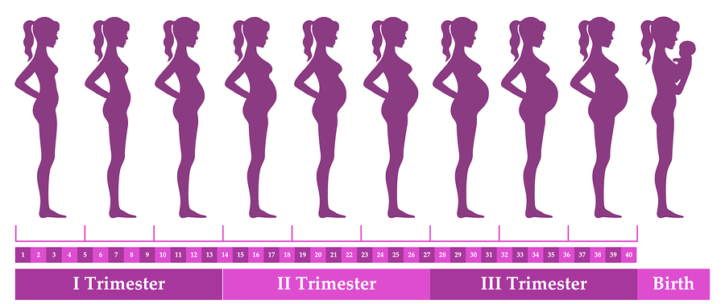
Cont.
Phase 0: Quiescent
When the Quiescent stage occur?
Occurs during early pregnancy.
What happen during this phase?
Uterus is relaxed (quiescent).
Increase in cAMP level to cause relaxations of the uterus.
Increase in production of:
Prostacyclin (PGI2) cause uterine relaxation
Nitric oxide (NO) cause uterine relaxation
Parathyroid hormone related peptide (PTHrP) inhibits uterine contraction.
شرح الكلام:
في هذه المرحلة وهي شهور الحمل الأولى، الرحم يكون مرتخي ومرتاح وما في انقباضات عشان الجنين يأخذ راحته وينمو بشكل جيد.
إيش اللي يساعد الرحم انه يكون مرتخي؟
زيادة افراز الcAMP.
زيادة افراز الـ Prostacyclin.
زيادة إفراز No.
إفراز PTHrP اللي يمنع الرحم من الإنقباض.

Slide 17
Cont.
Phase 1: Activation or Uterotrophins (This is the preparation phase)
When the Activation stage occur?
Occurs in third trimester. (4-6 months of pregnancy)
What happen during this phase?
Promote a switch from quiescent to active uterus.
Increase excitability & responsiveness to stimulators by:
Increase expression of gap junctions.
Increase G protein-coupled receptors & ion channels:
Oxytocin receptors.
Increase prostaglandin F (PGF) receptors
شرح الكلام:
في هذه المرحلة واللي تكون بشهور الحمل الأخيرة وحتى قبل الولادة بكم أسبوع، يبدأ الرحم ينقبض انقباضات خفيفة كل فترة، الانقباضات في هذه الفترة ما تكون متتالية ولا قوية ولا مؤلمة لأنها ليست انقباضات حقيقية مثل انقباضات الولادة، إنما انقباضات لتهيئة الرحم لأحداث الولادة.
No actual contractions during this phase, only preparation for the contractions.
There is increase proteins in the uterine tissue which are responsible for the receptors of the prostaglandins and oxytocin for preparation of contractions in the next phase. Also there is increase in Cyclooxygenase-2 (COX-2) which cause release of prostaglandins and there is a high level of calcium.

Slide 18
Cont.
Phase 2: Stimulation or Uterotonins
When the Stimulation stage occur?
Occurs in last 2 - 3 gestational weeks.
What happen during this phase?
Increase in synthesis of uterotonins: (uterotonins= anything that stimulates uterine contractions)
Prostaglandins
Oxytocin
Cytokines
Includes 2 stages:
Stage 1
Stage 2
شرح الكلام:
في هذه المرحلة اللي تبدأ قبل الولادة بكم أسبوع حتى الولادة، تكون الانقباضات متتالية وقوية ومؤلمة، وتزيد مع قرب موعد الولادة "الطلق"
هذه الزيادة هي بسبب زيادة افراز:
Cytokines
Prostaglandins
Oxytocin
The most important chemicals in labor
(37-38-39-40) are the normal delivery weeks.
Less than 37 pre-term.
37 to 40 full term and surfactant is present.
If a women come with preterm labor they will give her baby an injection for lung maturation)

Slide 19
Cont.
Phase 3: uterine involution
When the uterine involution stage occur?
Occurs in 4-5 weeks after delivery (After delivery & it lasts 40 days)
What happen during this phase?
Pulsatile release of oxytocin for ejection of milk and for intermittent contractions of the uterus to return back to its normal size.
Delivery of the placenta.
Involution of the uterus.
Lactation helps in complete involution. (because lactation stimulates oxytocin release)
شرح الكلام:
هذه المرحلة تبدأ بعد الولادة وحتى 40 يوم (فترة النفاس).
عند الولادة مباشرة يزيد افراز الـ oxytocin و الـprostaglandin وهذا يزيد انقباض الرحم حتى تخرج المشيمة وما يصير للأم نزيف قوي.
وحتى ما يكون النزيف قوي ومؤذي للأم يزيد إفراز الجسم للـthrombin هذه الفترة.
حتى انتهاء الـ40 يوم يرجع الرحم لطبيعته وكل التغيرات التابعة لأحداث الولادة تنتهي.
They give every single women oxytocin injection to prevent post-partum bleeding.

Slide 20
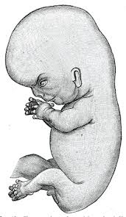
Clinical Stages of Labor
Stage 1
Dilation
Stage 2
Expulsion
Stage 3
Placental stage
New Baby ☺

Slide 21
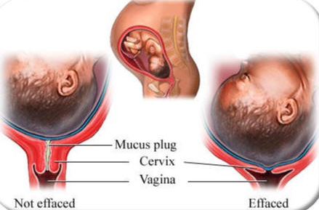
Cont.
Cervix during the pregnancy is very thick, a few days before delivery the cervix will start to become thinner
Effaced: loss of cervical length.
The mother may lose her mucus plug 3-4 days before labor.
How a mother knows she is going to deliver?
Before labor contraction she will see a plug getting out from her vagina, this is the mucus plug and then the labor will happen in a week or so..
شرح الكلام: لاحظوا الفرق بين الـEffaced والـnot effaced.
الـnot effaced فيها مادة مخاطية (mucus plug) في منطقة الـcervix، هذي المادة تملأ المنطقة بالتالي تسكّرها وتمنع رأس الجنين من الخروج.
بينما الـeffaced مافيها هذي المادة المخاطية والمنطقة تأخذ راحتها وتتوسع ورأس الطفل يبدأ بالخروج.
علامة مهمة تعطينا إياها هذي المادة، وهي قرب وقت الولادة. يعني الحامل إذا لاحظت خروج هذي المادة منها تعرف أنها بتولد هالفترة.

Slide 22
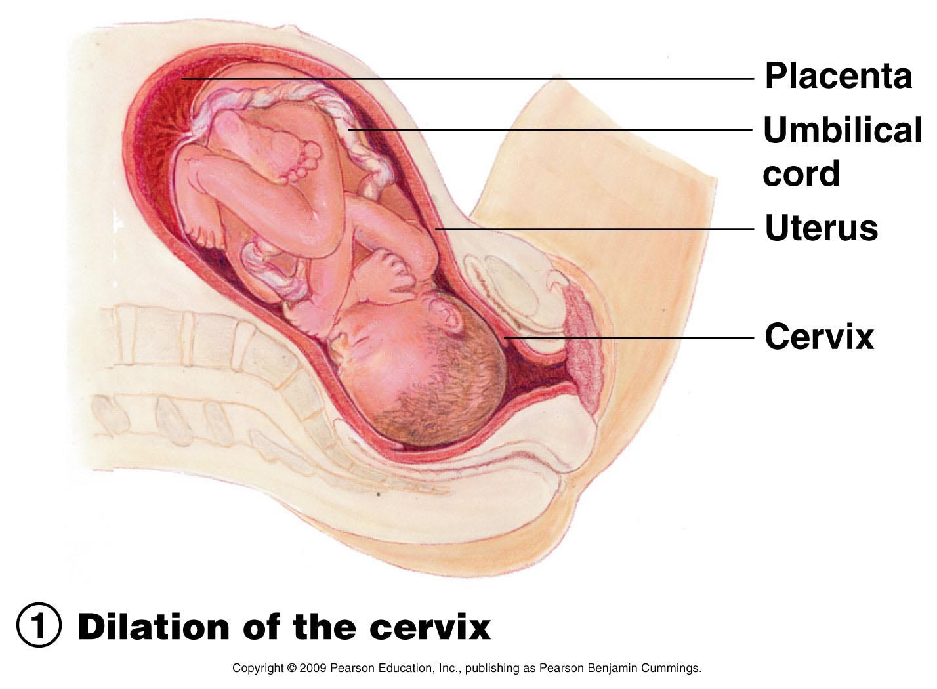
Cont.
Stage 1: Dilation
What will happen during this stage?
Cervix becomes dilated. (the most important event)
Full dilation is 10 cm.
Uterine contractions begin and increase.
Cervix softens and effaces (thins). softening is important to dilate.
The amnion ruptures “breaking the water”. so she must deliver within 24 hours even if there no contractions, doctor may have to break it himself, once it is ruptures it will induce strong contractions.
Longest stage at 6 - 12 hours.
شرح الكلام:
زي ما قلنا قبل، عند اقتراب موعد الولادة تخرج المادة المخاطية اللي تمنع رأس الطفل من النزول، بالتالي رأس الطفل راح يبدأ ينزل ويتوسّع السيرفكس، وكلما نزل رأس الطفل راح يزيد السيّالات العصبية للدماغ بالتالي يزيد الـoxytocin زي ما قلنا ببداية المحاضرة.

Slide 23
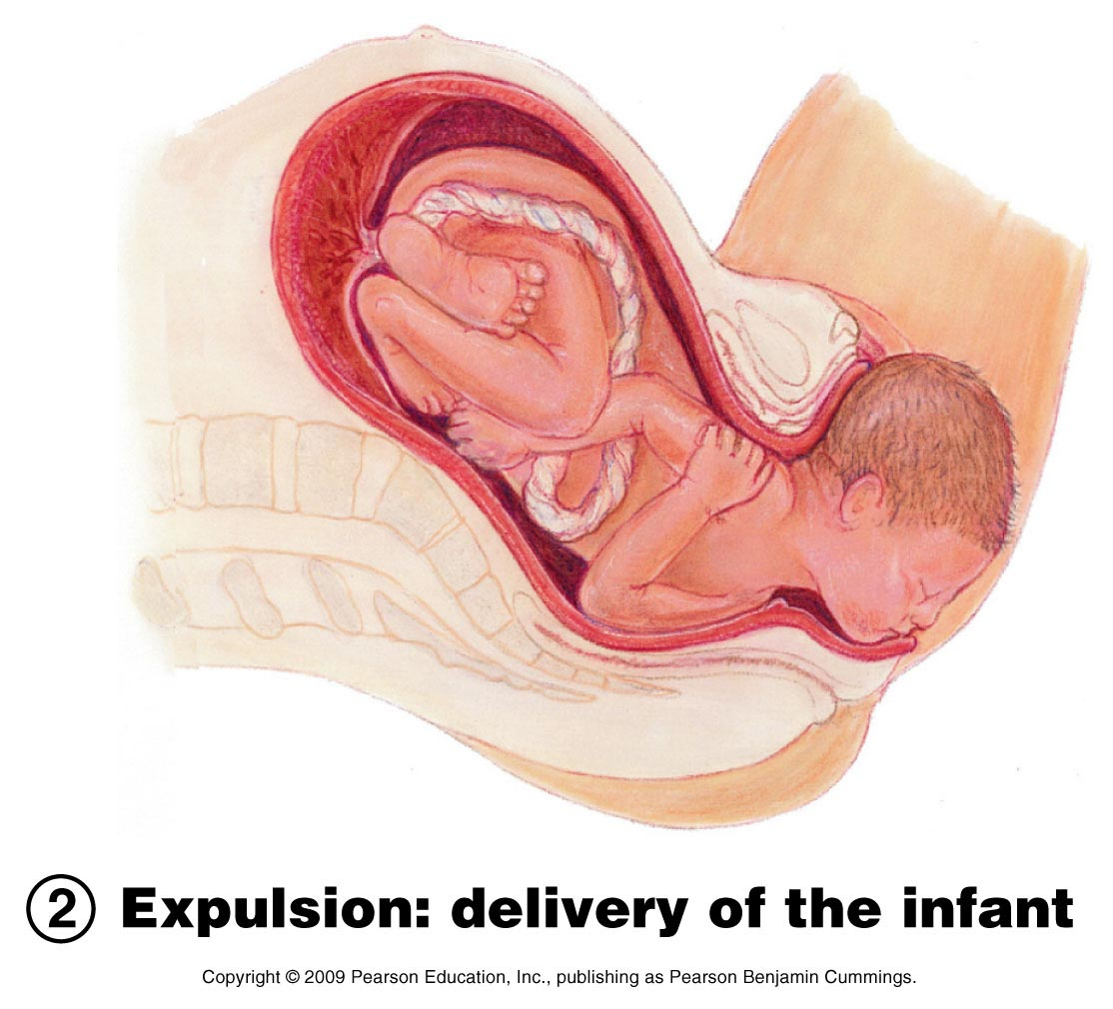
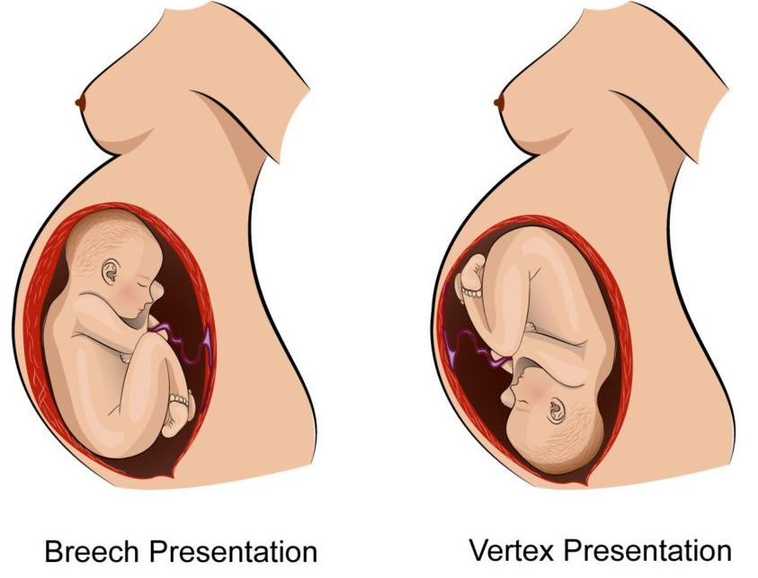
Cont.
Important
Stage 2: Expulsion (the hardest and most painful stage)
What will happen during this stage? (the most important stage)
Infant passes through the cervix and vagina because cervix is fully dilated.
Can last as long as 2 hours, but typically is 50 minutes in the first birth and 20 minutes in subsequent births.
Normal delivery is head first (vertex position).
Breech presentation is buttocks-first.
شرح الكلام:
في هذه المرحلة يخرج الجنين كاملا من الرحم.
الوضعية الطبيعية واللي تكون في أغلب الولادات هي خروج الرأس أولا، ولكن بعض الوضعيات قد يخرج الطفل بالمقلوب (الرجل أولا).

Slide 24
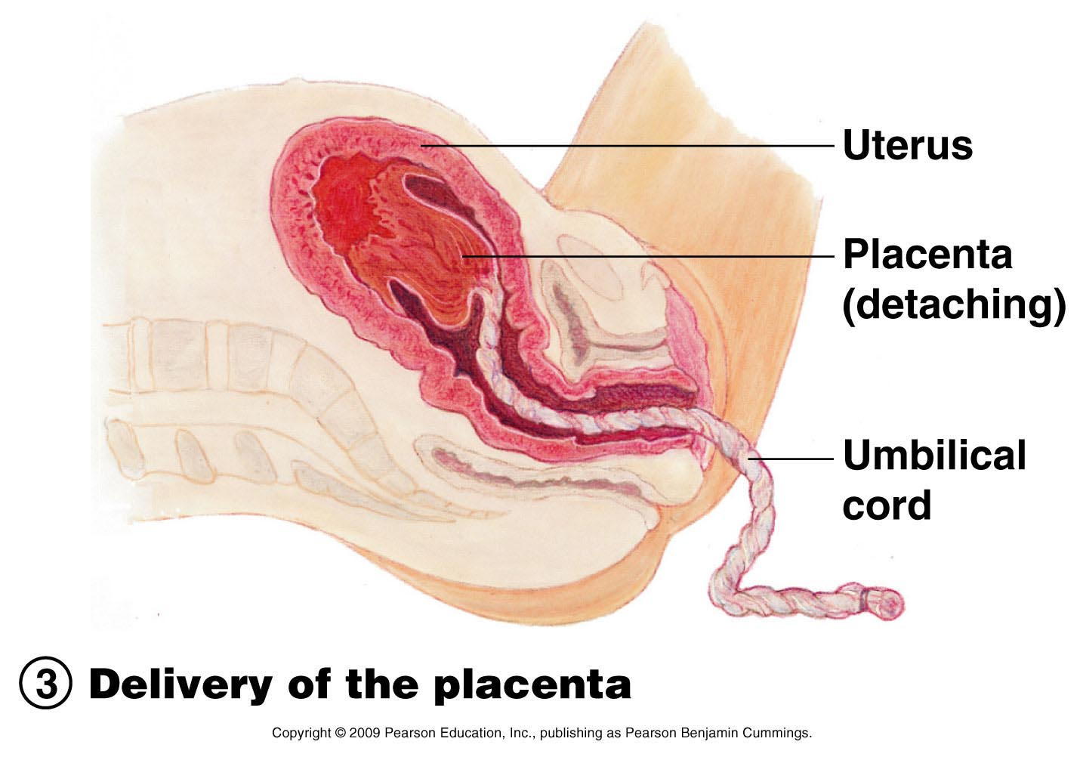
Cont.
Important
Stage 3: Placental stage
What will happen during this stage?
Delivery of the placenta.
Usually accomplished within 15 minutes after birth of infant.
After birth, placental attached fetal membranes.
All placental fragments should be removed to avoid postpartum bleeding if we don't give the mother oxytocin and prostaglandins to deliver the placenta.
When the baby is finally outside he/she will be still attaches to the placenta by the umbilical cord and breath through it, so once you cut the cord the baby will start breathing through the lungs.
شرح الكلام:
بعد خروج الطفل بـ15 دقيقة راح تخرج المشيمة، وضروري جدا أن الطبيب يتأكد أن كل المشيمة خرجت وما تبقّى منها شيء داخل الأم، لو بقى منها جزء ما خرج راح يسبب للأم نزيف، وعشان كذا يعطون الأم قبل الولادة oxytocin & prostaglandin عشان تخرج كل المشيمة بالتالي ما يصير عندها نزيف.

Slide 25
Normal Pregnancy vs Labor
 | Normal Pregnancy (start from fertilization to the 38th week) | Labor
Uterus | Uterine is relatively quiescence (there is a very weak contractions in these weeks) | Coordinated uterine activity
Cervix | Closed cervix | Progressive cervical dilation (Progressive = gradual not continue so, it takes time)
Fetus | Immature fetus | Maturation of the fetus

Slide 26
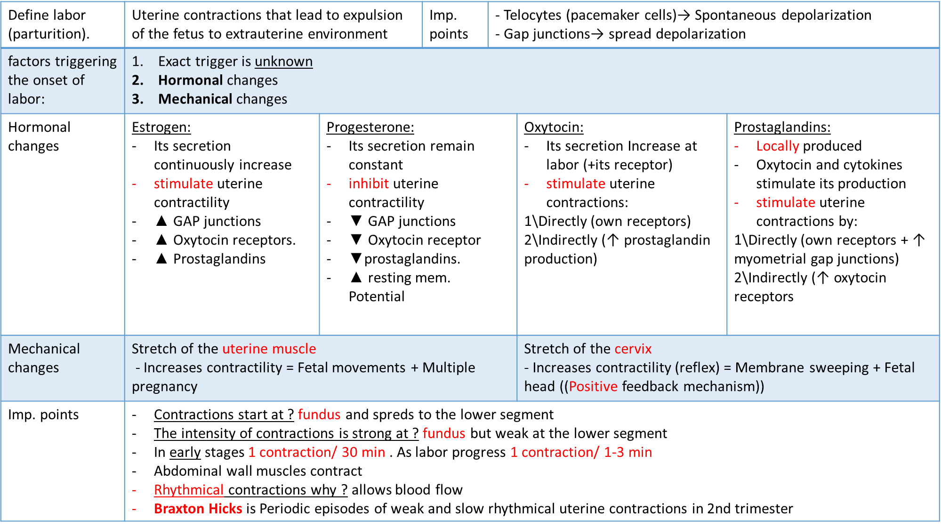
Summary

Slide 27
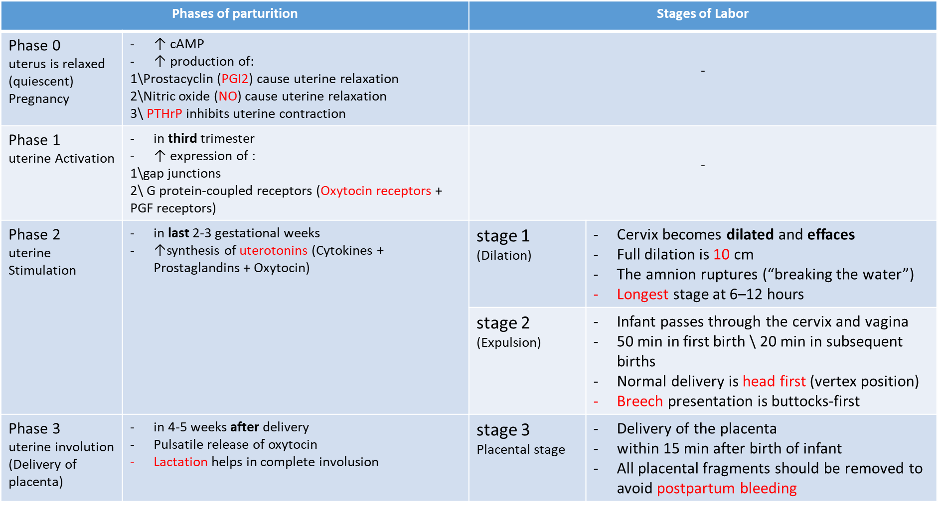
Summary

Slide 28
MCQ’s
1. During pregnancy, witch of the following is incorrect?
Closed cervix.
Immature fetus.
Maturation of the fetus.
Uterine is relatively quiescence.
2. Which of the following is responsible for the increased contractility of the uterus?
Cytokines.
Nitric oxide.
The increased ratio of progesterone/estrogen.
The increased ratio of estrogen/progesterone.
3. which one of the following is the action of progesterone during labor?
Increase resting membrane potential
Increase gap junction
Decrease prostaglandins
Increase oxytocin receptors
4. Which of the following will inhibit the contractility of uterus?
Through their own receptors
Upregulation of myometrial gap junction
Upregulation of oxytocin receptors
all of the above
5. Which of the following does NOT happen towards the end of pregnancy?
Braxton Hicks contractions
Strong uterine contractions
Cervical stretching
Release of Oxytocin
6. which one of the following phases occurs in the third trimester?
phase 0
phase 1
phase 2
phase 3
1=C 2=D 3=C 4=C 5=A 6=B

Slide 29
MCQ’s
7. which of the following is not considered an inhibitor?
prostaglandins
relaxin
nitric oxide
Estrogen
8. which of the following is the longest stage of labor?
Dilation
Expulsion
Placental
9. the amnion ruptures during expulsion stage
True
False
6=B 7=D 8=A 9=B

Slide 30
Thank you for checking our work!
اعمل لترسم بسمة، اعمل لتمسح دمعة، اعمل و أنت تعلم أن الله لا يضيع أجر من أحسن عملا.
قادة الفريق:
ليــلـى مـذكور & مـحـمـد نـصـر
Please check our editing file to know if there are any additions, changes or corrections.
خالص الشكر لأعضاء الفريق الكِرام:
-
حمد الخضيري
خالد القحطاني
فارس الجعفر
قيس المهيدب
نواف الخضيري
لـمـى الـتـمـيـمـي
غادة السكيت
حنين باشيخ
شذا الغيهب
غادة المزروع
2017-2018 Dr. Hana Alzamil’s Lecture & Notes.
2017-2018 Dr. Mohammed AlOtaibi’s Lecture & Notes.
Guyton & Hall of Medical Physiology 13th Edition.
Linda S. Costanzo 5th Edition.
First Aid For The USMLE Step One.
Khan Academy.
Helpful physiology bocks.
Give us your feedback ☺
اللهم اني استودعتك ما حفظت وما قرأت وما فهمت، فرده لي وقت حاجتي إليه إنّك على كل شيءٍ قدير.

