Slide 1
Improving Medication Safety
Prof. Hanan Hagar

Slide 2
Learning objectives
To provide an overview of Medication Safety
To encourage students to learn and practice ways to improve the safety of medication use

Slide 3
Knowledge requirements
Understand the scale of medication error
Understand the steps involved in a patient using medication
Identify factors that contribute to medication error
Learn how to make medication use safer
Understand the benefits of a multidisciplinary approach to medication safety

Slide 4
Medication Error
Medication use has become increasingly complex in recent times
Medication errors are a major cause of preventable patient harm
As future health-care workers, you will have an important role in making medication use safe.

Slide 5
Medication Errors
The drugs errors are the most common cause of medical errors in hospitals, affecting 3.7% of patients.

Slide 6
Definitions
Medication Error:
is any preventable event that may cause or led to inappropriate
medication use or patient harm.
Medication error may result in …
An adverse event if a patient is harmed
A near miss if a patient is nearly harmed.

Slide 7
Definitions
Side effect of a drug:
a known effect, other than that primarily intended, relating to the
pharmacological properties of a medication e.g. opiate analgesia often
causes nausea.
Adverse reaction of a drug:
unexpected harm arising from a justified action where the correct
Process was followed for the context in which the event occurred e.g.
An unexpected allergic reaction in a patient taking a medication for the
First time.

Slide 8
Definitions
Adverse drug event:
an incident in which a patient is harmed. It includes both errors & side effects of the medication.
Adverse drug event:
May be preventable (e.g. the result of an error) or
May not be preventable (e.g. the result of an adverse drug reaction or side-effect)

Slide 9
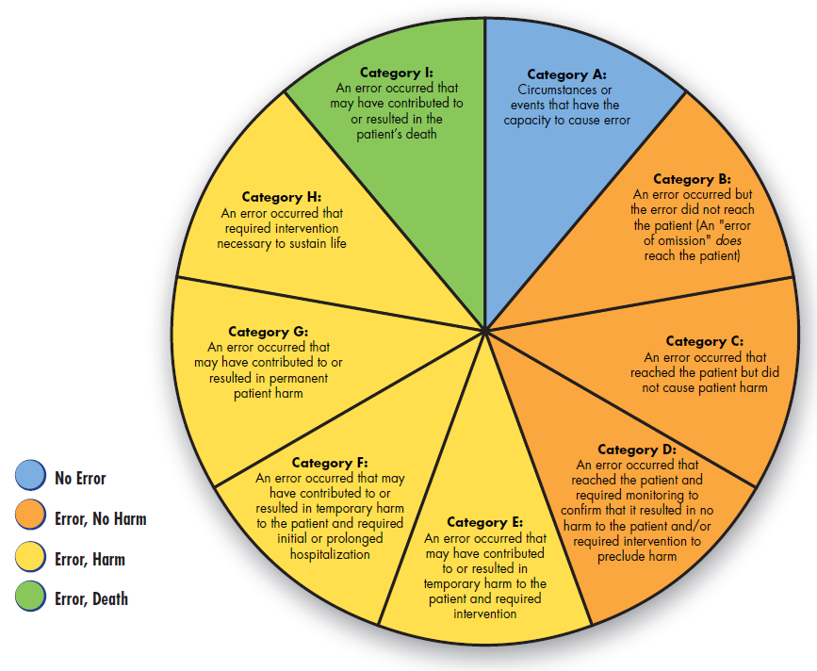
Categorizing Medication Errors
2001 National Coordinating Council for Medication Error Reporting and Prevention.

Slide 10
Steps in using medication
Prescribing
Preparation and Dispensing
Administration
Monitoring
Note: these steps may be carried out by healthcare workers or the
patient; e.g. self-prescribing over the counter medication and self
Administering medication at home.

Slide 11
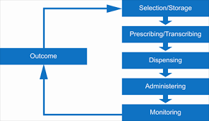
Medication Use Process in The Institutional Setting

Slide 12
Medication Prescription
Choosing an appropriate medication
for a given clinical situation, taking individual patient factors into account, such as allergies
Selecting the administration
route, dose, time and regimen
Documentation
Communicating details of the plan with:
Whoever will administer the medication (written-transcribing and/or verbal) and the patient

Slide 13
Sources of error in prescribing:
Inadequate knowledge about drug indications an contraindications
Not considering individual patient factors such as allergies,
pregnancy, co-morbidities, other medications
Wrong patient, wrong dose, wrong time, wrong drug, wrong route
Mathematical error when calculating dosage
Documentation: incomplete, ambiguous & dangerous abbreviation
Inadequate communication (written, verbal)
Incorrect data entry when using computerized prescribing e.g. duplication, omission, wrong number

Slide 14
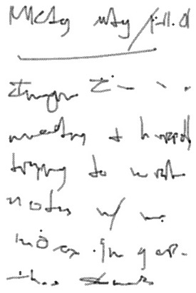
Example for prescribing error Illegible Handwriting

Slide 15
Strategies to Reduce Prescribing errors
Avoid illegible handwriting
Write complete Information
Look at Patient-Specific Information
Do Not Use Abbreviations
Decimals
Be alert to drug name, use generic name rather than trade names
Write the Medication reconciliation
Know the high alert medications
More attention to dosage calculations
Verbal orders

Slide 16
Strategies to Reduce Prescribing errors
Avoid illegible handwriting
Write/Print More Carefully
Use Computers
Verbal Communications
Write complete Information
Patient’s Name
Patient-Specific Data
Generic and Brand Name
Drug Strength
Dosage Form
Amount
Directions for Use
Purpose
Refills

Slide 17
Strategies to Reduce Prescribing errors
Look at Patient-Specific Information
Age
Weight
Renal and Hepatic Function
Laboratory Test Results
Concurrent Medications
Allergies
Medical/Surgical/Family History
Pregnancy/Lactation Status
Do Not Use Abbreviations
Drug names
“QD” or “OD” for the word daily
Letter “U” for unit
“µg” for microgram (use mcg)
“QOD” for every other day

Slide 18
Example for Error Prone Abbreviations

Slide 19
Example for Error Prone Abbreviations

Slide 20
Strategies to Reduce Prescribing errors
Decimals:
Avoid whenever possible
Use 500 mg for 0.5 g
Use 125 mcg for 0.125 mg
Never leave a decimal point “naked”
Haldol .5 mg → Haldol 0.5 mg
Never use a terminal zero
Colchicine 1 mg not 1.0 mg
Space between name and dose
Inderal40 mg → Inderal 40 mg
Be alert to Drug Name:
“Look-Alike” or “Sound-Alike” Drug Names
Celebrex (celecoxib, anti-inflammatory)
Cerebryx (fosphenytoin, anticonvulsant)
Celexa (Citalpram, antidepressant)

Slide 21
How can medication presentation contribute to medication errors?
Look-alike, sound-alike medications
Ambiguous labeling

Slide 22
Look-a-like and sound-a-like medications
Celebrex (an anti-inflammatory)
Cerebryx (an anticonvulsant)
Celexa (an antidepressant)

Slide 23
Ambiguous nomenclature
Tegretol 100mg
S/C
1.0 mg
.1 mg
Tegreto 1100 mg
S/L
10 mg
1 mg

Slide 24
Avoiding ambiguous nomenclature
avoid trailing zeros
e.g. write 1 not 1.0
use leading zeros
e.g. write 0.1 not .1
know accepted local terminology
write neatly, print if necessary

Slide 25
Strategies to Reduce Prescribing errors
Write the Medication reconciliation
Learn and practice thorough medication
history taking:
Include name, dose, route, frequency
duration of every drug the patient is taking;
Enquire about recently ceased medications;
Ask about over-the-counter
medications
dietary supplements and complimentary medicines;
More Attention to dosage calculations:
Use patient specific information
height
weight
age
body system function

Slide 26
Strategies to Reduce Prescribing errors
Verbal Orders:
Avoid when possible
Pronounce slowly and distinctly
State numbers like pilots
(i.e., “one-five mg” for 15 mg)
Spell out difficult drug names
Specify concentrations
Know the high alert medications
Need double check
Example :
Oral anticoagulants
Insulin
Chemotherapeutic agents
Neuromuscular blocking agents
Concentrated electrolytes
Emergency medications (potent and used in high pressure situations)

Slide 27
Strategies to Reduce Dispensing Errors
Standardized concentrations for all IV medication
Use commercially prepared solutions
Dispense a unit of use.

Slide 28
Administration
Obtaining the medication in a ready-to-use form; may involve counting, calculating, mixing, labeling or preparing in some way.
Checking for allergies
Giving the right medication to the right patient, in the right dose, via the right route, at the right time.
Documentation

Slide 29
How can drug administration go wrong?
Wrong patient
Wrong route
Wrong time
Wrong dose
Wrong drug
Omission, failure to administer
Inadequate documentation

Slide 30
The 5 Rs
Right Patient
Right Drug
Right Dose
Right Route
Right Time

Slide 31
Remember the 5 Rs when prescribing and administering
Right Patient (check the name in the order & the patient, use two identifier & ask the patient to identify himself/herself).
Right Medication (check the medication label & order).
Right Route (Confirm that the patient can take or receive the medication by the ordered route)
Right Time (Check the frequency of the ordered medication & Confirm when the last dose was given).
Right Dose (Confirm appropriateness of the dose using a current drug reference & correct calculation)

Slide 32
Strategies to Reduce Administration Errors
Be familiar with the institution policy
Preprinted & standardized infusion rate charts
Use programmable infusion device
Infusion tubing should be traced from the infusion bag to the point of delivery

Slide 33
Calculation errors
Can you answer the following question?
A patient needs 300 micrograms of a medication that comes
in a 1 ml ampoule containing 1 mg of the drug.
What volume do you draw up and inject?

Slide 34
Calculation errors
Can you answer the following question?
A 12 kg, 2-year-old boy requires 15 mg/kg of a medication
that comes as a syrup with a concentration of 120mg/5mls.
How many mls do you prescribe?

Slide 35
Medication monitoring
Monitoring involves …
Observing the patient to determine if the medication is
working, being used appropriately and not harming the
Patient.
Documentation

Slide 36
How can monitoring go wrong?
Lack of monitoring for side-effects
Drug not ceased if not working, or course completed
Drug ceased before course completed
Drug levels not measured, or measured but not checked or acted upon.
Communication failures:
this is a risk if the care provider changes, for example, if the patient moves from the hospital setting to the Community setting or vice versa

Slide 37
Do you know which drugs need blood tests to monitor levels?
?

Slide 38
Which patients are most at risk of medication errors ?
Patients on multiple medications
Patients with another condition e.g. renal impairment, pregnancy
Patients who cannot communicate well
Patients who have more than one doctor
Children and babies (dose calculations required?)

Slide 39
Factors for Medication Errors Staff Factors
Inexperience
Rushing
Doing two things at the same time
Interruptions
Fatigue, boredom, or stress
Lack of checking and double checking habits
Poor teamwork and/or communication between colleagues

Slide 40
How can workplace design contribute to medication errors?
Absence of a safety culture in the workplace
e.g. poor reporting systems and failure to learn from past near misses and adverse events
Inadequate staff numbers
Absence of memory aids for staff

Slide 41
Ways to make medication use safer
Use generic names where appropriate
Tailor prescribing for individual patients
Learn and practice collecting complete medication histories
Know the high-risk medications and take precautions
Be very familiar with the medications you prescribe
Use memory aids
Remember the 5 Rs when prescribing and administering
Communicate clearly
Develop checking habits
Encourage patients to be actively involved
Report and learn from errors

Slide 42
Case Study - 1

Slide 43
Recommended actions
Pharmacists/Technician should READ / CHECK carefully the label of each medication they prepare.
DOUBLE CHECKING is essential tool to avoid such mistakes
Look Alike medications should be stored separately with proper labeling to avoid such mistakes

Slide 44
Case Study - 2
A 38-year-old woman comes to the hospital with 20 minutes of itchy red rash and facial swelling; she has a history of serious allergic reactions
A nurse draws up 10 mls of 1:10,000 adrenaline (epinephrine) into a 10 ml syringe and leaves it at the bedside ready to use (1 mg in total) just in case the doctor requests it
Meanwhile the doctor inserts an intravenous cannula
The doctor sees the 10 ml syringe of clear fluid that the nurse has drawn up and assumes it is normal saline

Slide 45
Continue
There is no communication between the doctor and the nurse at this time
The doctor gives all 10 mls of adrenaline (epinephrine)through the intravenous cannula thinking he is using saline to flush the line.
The patient suddenly feels terrible, anxious, becomes tachycardia and then becomes unconscious with no pulse
She is discovered to be in ventricular tachycardia, is resuscitated and fortunately makes a good recovery
Recommended dose of adrenaline (epinephrine) in anaphylaxis is 0.3 - 0.5 mg IM, this patient received 1mg IV

Slide 46
Can you identify the contributing factors to this error?

Slide 47
Answer
Assumptions
Lack of communication
Inadequate labeling of syringe
Giving a substance without checking and double checking what it is
Lack of care with a potent medication

Slide 48
How could this error have been prevented?
Never give a medication unless you are sure you know what it is; be suspicious of unlabeled syringes
Never use an unlabeled syringe unless you have drawn the medication up yourself
Label all syringes
Communication - nurse and doctor to keep each other informed of what they are doing e.g. nurse: “I’m drawing up some adrenaline”
Develop checking habits before administering every medication … go through the 5 Rs e.g doctor: “What is in this syringe?”

Slide 49
Case Study - 3
A 74-year-old man sees a community doctor for treatment of new onset stable angina
The doctor has not met this patient before and takes a full past history and medication history
He discovers the patient has been healthy and only takes medication for headaches
The patient cannot recall the name of the headache medication
The doctor assumes it is an analgesic that the patient takes whenever he develops a headache

Slide 50
Continue
But the medication is actually a beta-blocker that he takes every day for migraine; this medication was prescribed by a different doctor
The doctor commences the patient on aspirin and another beta-blocker for the angina
After commencing the new medication, the patient develops bradycardia and postural hypotension
Unfortunately the patient has a fall three days later due to dizziness on standing; he fractures his hip in the fall

Slide 51
Can you identify the contributing factors to this error?
Two drugs of the same class prescribed unknowingly with potentiation of side-effects
Patient not well informed about his medications
Patient did not bring medication list with him when consulting the doctor
Doctor did not do a thorough enough medication history
Two doctors prescribing for one patient
Patient may not have been warned of potential side-effects and of what to do if side-effects occur

Slide 52
How could this error have been prevented?
Patient education regarding:
• Regular medication
• Potential side-effects
• The importance of being actively involved in their own care
e.g. having a medication list
More thorough medication history

Slide 53
Summary
Medications can greatly improve health when used wisely and correctly.
Yet, medication error is common and is causing preventable human suffering and financial cost.
Remember that using medications to help patients is not a risk-free activity.
Know your responsibilities and work hard to make medication use safe for your patients.

Slide 54
Recommendations
Acknowledge that medication safety is a topic and an understanding of the area will affect how you perform the following tasks:
Use generic names where appropriate
Tailor your prescribing for each patient
Learn and practice thorough medication history taking
Know which medications are high-risk and take precautions
Be very familiar with the medication you prescribe and/or dispense
Use memory aids
Remember the 5 Rs when prescribing and administering

Slide 55
Recommendations
Communicate clearly
Develop checking habits
Encourage patients to be actively involved in the process
Report and learn from medication errors.

Slide 56
THANK YOU

