Slide 1
Topic 2
Why applying human factors is
important for patient safety
Patient Safety Curriculum Guide
1

Slide 2
Learning objective
Understand human factors and its relationship to
patient safety
Patient Safety Curriculum Guide
2

Slide 3
Knowledge requirements
▪ Know the meaning of the term human factors
▪ Understand the relationship between human factors
and patient safety
Patient Safety Curriculum Guide
3

Slide 4
Performance requirement
Apply human factors thinking in the work environment
Patient Safety Curriculum Guide
4

Slide 5
Human factors and ergonomics
definitions
▪ The study of all the factors that make it easier to do the
work in the right way
▪ Apply wherever humans work
▪ Also sometimes known as ergonomics
Patient Safety Curriculum Guide
5

Slide 6
Human factors
Importance of human factors has been recognized for
a long time in:
▪ Aviation
▪ Manufacturing
▪ Military
Patient Safety Curriculum Guide
6

Slide 7
Human factors: importance
in health care
▪ Human factors only recently acknowledged as an
essential part of patient safety
▪ A major contributor to adverse events in health care
▪ All health-care workers need to have a basic
understanding of human factors principles
Patient Safety Curriculum Guide
7

Slide 8
Human factors experts
Design improvements in the workplace and the
▪
equipment to fit human capabilities and limitations
▪
Make it easier for the workers to get the work done
the right way
▪
Decrease the likelihood of errors occurring
Patient Safety Curriculum Guide
8

Slide 9
The range of workers
Good human factors design in health care accommodates
the entire range of workers
▪
▪
Not just the calm, rested experienced clinician
But also the inexperienced health-care workers who
might be stressed, fatigued and rushing
Patient Safety Curriculum Guide
9

Slide 10
Examples
Prescribing and dispensing
Hand-over/hand-off information
Move patients
Order medications electronically
Prepare medication
If all of these tasks become easier for the health-care provider, then
patient safety can improve
▪
▪
▪
▪
▪
Patient Safety Curriculum Guide
10

Slide 11
Examples of traps in health care?
▪ Look-alike and sound-alike medications
▪ Equipment design complexity
e.g. infusion pumps
Patient Safety Curriculum Guide
11

Slide 12
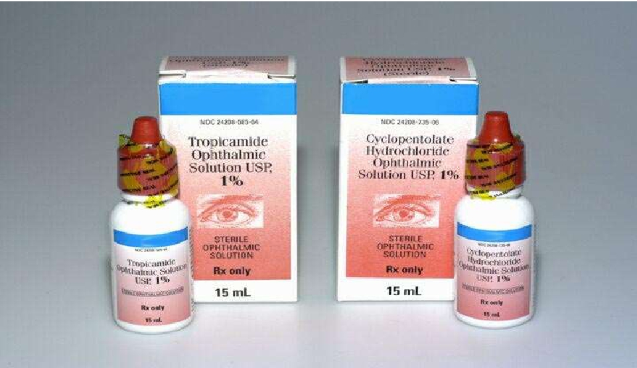
Avoidable confusion is everywhere…
12
Patient Safety Curriculum Guide

Slide 13
Health care is increasingly
complex
Patient Safety Curriculum Guide
Source: Gaba
13

Slide 14
Human factors
▪ Acknowledges:
- The universal nature of human fallibility
- The inevitability of error
▪ Assumes that errors will occur
▪ Designs things in the workplace to try to minimize the
likelihood of error or its consequences
Patient Safety Curriculum Guide
14

Slide 15
Human factors design principles
Psychomotor
- Hands
Senses
- Vision
- Hearing
Input Devices
- Buttons
Output
- Display
- Sound
I
N
T
E
R
F
A
C
E
US Department of Veteran affairs
Patient Safety Curriculum Guide
15

Slide 16
We cope quite well with complexity
Health-care workers are quite good at compensating
for some of the complex and unclear design of some
aspects of the workplace
▪
▪
Equipment
Physical layouts
Patient Safety Curriculum Guide
16

Slide 17
Because the human brain is ….
▪ very powerful
▪ very flexible
▪ good at finding shortcuts (fast)
▪ good at filtering information
▪ good at making sense of things
Patient Safety Curriculum Guide
17

Slide 18
Sometimes our brain
can play 'tricks' on us…
Patient Safety Curriculum Guide
18

Slide 19
Are the lines crooked or straight?
Optillusions.com
Patient Safety Curriculum Guide
19

Slide 20
Look at the chart
Say the colour of the word, not the word itself
Why is it hard?
Source: Optillusions.com
Patient Safety Curriculum Guide
20

Slide 21
Decisions and actions can be
flawed…
The fact that we can misperceive situations
despite the best of intentions is one of the main
reasons that our decisions and actions can
be flawed such that "silly" mistakes are made.
Patient Safety Curriculum Guide
21

Slide 22
Human beings make
“silly” mistakes
Regardless of their experience, intelligence, motivation or
vigilance, people make mistakes
Activity
Think about and then discuss with your colleagues any “silly” mistakes
you have made recently when you were not in your place of work or
study - and why you think they happened.
Patient Safety Curriculum Guide
22

Slide 23
The context of health care
When errors occur in the workplace the consequences
can be a problem for the patient
▪ A situation that is relatively unique to health care
Patient Safety Curriculum Guide
23

Slide 24
One definition of “human error” is
“human nature”
Error is the inevitable downside
of having a brain!
Patient Safety Curriculum Guide
24

Slide 25
What is an error?
▪ The failure of a planned action to achieve its intended
outcome
▪ A deviation between what was actually done and what
should have been done
James Reason
A definition that may be easier to remember is: 'Doing
the wrong thing when meaning to do the right thing.'
Patient Safety Curriculum Guide
25

Slide 26
Situations associated with an
increased risk of error
▪ unfamiliarity with the task*
▪ inexperience*
▪ shortage of time
▪ inadequate checking
▪ poor procedures
▪ poor human equipment interface
Charles Vincent
* Especially if combined with lack of supervision
Patient Safety Curriculum Guide
26

Slide 27
Individual factors that predispose to error
▪ Limited memory capacity
▪ Further reduced by:
• Fatigue
• Stress
• Hunger
• Illness
• Language or cultural factors
• Hazardous attitudes
Patient Safety Curriculum Guide
27

Slide 28
Fatigue
24 hours of sleep deprivation has performance effects
~
blood alcohol content of 0.1%
Source: D. Dawson, Nature, 1997
Patient Safety Curriculum Guide
28

Slide 29
Stress and performance
Performance level
Area of
“optimum”
stress
Low stress
Boredom
High stress
Anxiety, panic
Stress level
The relationship between stress and performance
Source: Yerkes, R. M., & Dodson, J. D. (1908) The relation of strength of stimulus to rapidity of habit-formation.
Journal of Comparative Neurology and Psychology, 18, 459-482
Patient Safety Curriculum Guide
29

Slide 30
Don’t forget ….
If you’re
▪ Hungry
▪ Angry
▪ Late
or
▪ Tired …..
H
A
L
T
Patient Safety Curriculum Guide
30

Slide 31
A performance-shaping factors
“checklist”
▪ I
▪ M
▪ S
▪ A
▪ F
▪ E
Illness
Medication: prescription, over-the-counter &
others
Stress
Alcohol
Fatigue
Emotion
Patient Safety Curriculum Guide
31

Slide 32
Putting knowledge of human factors
into practice
▪
▪
▪
▪
▪
▪
▪
Apply human factors thinking to your work
environment
Avoid reliance on memory
Make things visible
Review and simplify processes
Standardize common processes and procedures
Routinely use checklists
Decrease reliance on vigilance
Patient Safety Curriculum Guide
32

Slide 33
Summary: human factors
Errors are inevitable - even for experienced health
▪
professionals!
▪
There are situations that can increase the likelihood
of error
- Recognize them for your patient’s sake - and yours!
▪
Attention to human factors principles can lead to a
reduction in error or its consequences
Patient Safety Curriculum Guide
33

Slide 34
Summary
Human factors engineering is about designing the
workplace and the equipment in it to accommodate for
limitations of human performance.
Patient Safety Curriculum Guide
34

