Slide 1
Topic 5
Learning from errors to prevent harm

Slide 2
Learning objective
Understand the nature of error and how health- care providers can learn from errors to improve patient safety

Slide 3
Knowledge requirement
Explain the terms:
Error
Violation
Near miss
Hindsight bias

Slide 4
Performance requirements:
Know the ways to learn from errors
Participate in the analysis of an adverse
event
Practise strategies to reduce errors

Slide 5
Error
A simple definition is:
“Doing the wrong thing when meaning to do the right thing.”
Bill Runciman
A more formal definition is:
“Planned sequences of mental or physical activities that fail to achieve their intended outcomes, when these failures cannot be attributed to the intervention of some chance agency.”
James Reason

Slide 6
Note: violation
A deliberate deviation from an accepted protocol or standard of care

Slide 7
Errors and outcomes
Errors and outcomes are not inextricably linked:
Harm can befall a patient in the form of a complication of care without an error having occurred
Many errors occur that have no consequence for the patient as they are recognized before harm occurs

Slide 8
Human factors principles remind us that:
Error is the inevitable downside of having a brain!
One definition of “human error” is “human nature”

Slide 9
Human beings make mistakes
Regardless of their experience, intelligence, motivation or vigilance, people make mistakes
Activity:
Think about and then discuss with your colleagues any “silly mistakes” you have made recently when you were not in your place of work or study - and why you think they happened

Slide 10
The health-care context is problematic
When errors occur in the workplace the consequences
can be a problem for the patient…
…. a situation that is relatively unique to health care
In all other respects there is nothing unique about
“health-care” errors…
... they are no different from the human factors
problems that exist in settings outside health care
10

Slide 11
Summary of the principal error types
Attentional slips of action
Skill-based slips and lapses
Lapses of memory
Errors
Rule-based mistakes
Mistakes
…………
Knowledge- based mistakes
Source: J. Reason

Slide 12
Situations associated with an
increased risk of error
Inexperience*
Time pressures
Inadequate checking
Poor procedures
Inadequate information
* Especially if combined with lack of supervision

Slide 13
Individual factors that
predispose to error
Limited memory capacity
Further reduced by:
fatigue
stress
hunger
illness
language or cultural factors
hazardous attitudes

Slide 14
Don’t forget ….
If you’re
Hungry
Angry
Late
Tired …..
H
A L T
or

Slide 15
A performance-shaping factors “checklist”
I Illness
M Medication: prescription, over-the-counter and
others
S
A
F
E
Stress
Alcohol
Fatigue
Emotion
Am I safe to work today?

Slide 16
Incident reporting/monitoring
Involves collecting and analyzing information about any event that could have harmed or did harm anyone in the organization
A fundamental component of an organization’s ability
to learn from error

Slide 17
Removing error traps
A primary function of an incident reporting system is to identify recurring problem areas - known as “error traps” (J.Reason)
Identifying and removing these traps is one of the
main functions of error management

Slide 18
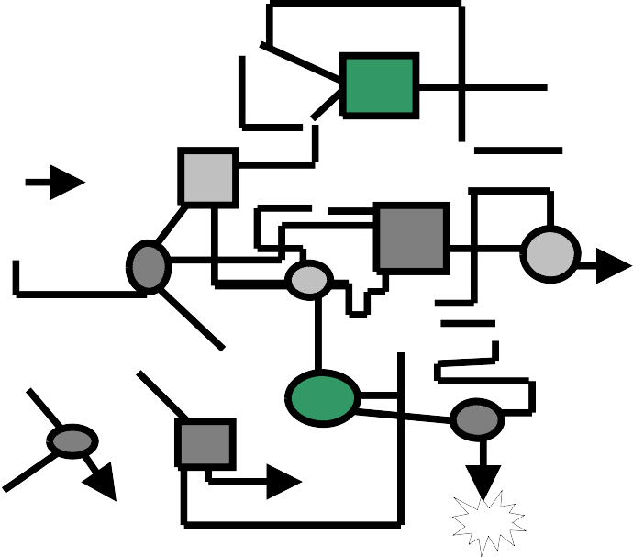
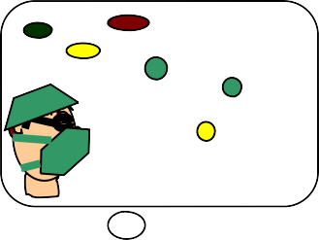
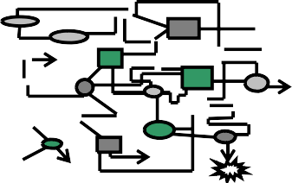
Hindsight Bias
Before the Incident
After the Incident
Modified from R. Cook, 2005, A Brief Look at the New Look in Complex System Failure, Error, Safety and Resilience

Slide 19
Culture: a workable definition
'Shared values (what is important) and beliefs (how things work) that interact with an organization’s structure and control systems to produce behavioural
norms (the way we do things around here)'
James Reason

Slide 20
Culture in the workplace
It is hard to “change the world” as a junior health-care professional
But …
…you can be on the look out for ways to improve the “system”
… you can contribute to the culture in your work
environment
20

Slide 21
Incident reporting and monitoring strategies
Successful strategies include:
anonymous reporting
timely feedback
open acknowledgement of successes resulting from
incident reporting
reporting of near misses
-“free" lessons can be learned
- system improvements can be instituted as a result of the
investigation but at no “cost” to a patient
Source: E.B. Larson

Slide 22
Root cause analysis (RCA)
A structured approch to incident analysis
Established by the National Center for Patient Safety of
the US Department of Veterans Affairs
http://www.va.gov/NCPS/curriculum/RCA/index.html

Slide 23
RCA model (1)
A rigorous, confidential approach to answering:
What happened?
Who was involved?
When did it happen?
Where did it happen?
How severe was the actual or potential harm?
What is the likelihood of recurrence?
What were the consequences?

Slide 24
RCA model (2)
Focuses on prevention, not blame or punishment
Focuses on system level vulnerabilities rather than individual performance
It examines multiple factors such as:
communication
training
fatigue/scheduling
- environment/equipment
rules/policies/procedures
barriers

Slide 25
Personal error reduction strategies
Know yourself: eat well, sleep well, look after yourself
Know your environment
Know your task(s)
Preparation and planning; “What if …?”
Build “checks” into your routine
Ask if you don’t know!

Slide 26
Mental preparedness
Assume that errors can and will occur
Identify those circumstances most likely to breed
error
Have contingencies in place to cope with problems, interruptions and distractions
Mentally rehearse complex procedures
James Reason

Slide 27
Summary
Health-care error is a complex issue, but error itself is an
inevitable part of the human condition
Learning from error is more productive if it is considered at an organizational level
Root cause analysis is a highly structured system
approach to incident analysis

