Slide 1
Introduction to Quality Improvement Methods

Slide 2
Learning objective
To describe the principles of quality improvement.
To introduce the basic methods and tools for improving the quality of health care.
To understand the benefits of using quality improvement methods.
To apply the principles and use the tools to undertake their own improvement project.

Slide 3
Outline
The science of improvement;
The quality improvement model;
Change concepts;
Examples of continuous improvement methods;
Clinical Practice Improvement(CPI)
Root Cause Analysis(RCA)

Slide 4
The purpose of Quality improvement methods
Identify a problem;
Measure the problem;
Develop a range of interventions designed to fix the problem;
Test whether the interventions worked

Slide 5
the science of improvement
The role of measurement in improvement
Measurement (collect and analyze data )is an essential component of quality Improvement.
There is strong evidence to show that when people use the appropriate measures to measure change, significant improvements can be made.
All quality improvement methods rely on measurement

Slide 6
the science of improvement
Three main types of measures
Outcomes Measures : Represent the ultimate goal of healthcare
Example: The 30-day mortality rate
Processes Measures: Represent the delivery of specific clinical services to patients, are often based upon clinical guidelines.
Example: The percentage of patients hospitalized for myocardial infarction who are treated with a beta blocker at the time of discharge
Structure Measures: Represent the characteristics of individual healthcare providers, organizations, and facilities.
Example: Nursing to patient ratio in the ICU

Slide 7
the science of improvement
Types of Measures
Avedis Donabedian Conceptual Framework

Slide 8
Change concepts
A general idea, with proven merit and sound scientific or logical foundation, that can stimulate specific ideas for changes that lead to improvement.
Asking what changes can be made to improve a particular situation
Example :improved study habits, tension with a family member, a teacher or difficulties at work

Slide 9
Change concepts
The following nine general categories:
Eliminate waste
Look for ways of eliminating any activity or resource in the hospital or clinic that does not add value to patient care.
Improve workflow
Improving the flow of work in processes is an important way to improve the quality of patient care delivered by those processes..

Slide 10
Change concepts
Change the work environment
Changing the work environment itself can be a high-leverage opportunity for making all other process changes more effective.
Enhance the health provider/patient relationship
To benefit from improvements in quality and safety of health care, the health-care professionals and patients must recognize and appreciate the improvements.

Slide 11
Change concepts
Manage time
An organization can get more achieved by reducing the time to deliver health care, develop new ways of delivering health care, reducing waiting times for services and cycle times for all services and functions in the organization.
Design systems to avoid mistakes
Organizations can reduce errors by redesigning the system to ensure that there is redundancy i.e. multiple checks and balances to combat human error.

Slide 12
continuous improvement methods
There are a number of examples of quality improvement methods in health care but the two most relevant to medical setting are:
Clinical practice improvement(CPI) methodology;
Root cause analysis(RCA).

Slide 13
continuous improvement methods Clinical practice improvement (CPI) methodology

Slide 14
improvement model- (Plan-do-study-act cycle)
The IHI model has two parts:
Three fundamental questions, which can be addressed in any order
The PDSA cycle to test and implement changes in real work settings—the PDSA cycle guides the test of a change to determine if the change is an improvement.

Slide 15
improvement model-(Plan-do-study-act cycle)
The questions are:
1. What are we trying to accomplish?
It is important that the team agrees that a problem exists and that it is worthwhile fixing.
2. How will we know whether a change is an improvement?
An improvement can only be confirmed when the measures show things were improved over time.
3. What changes can we make that will result in an improvement?
the team testing the different interventions used to make the improvements.

Slide 16
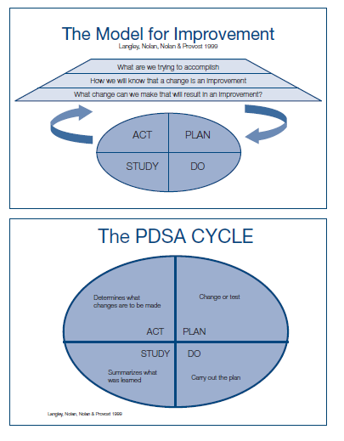
improvement model-(Plan-do-study-act cycle)

Slide 17
improvement model- Root cause analysis (RCA)
Is a defined process that seeks to explore all of the possible factors associated with an incident by asking what happened, why it occurred and what can be done to prevent it from happening again.

Slide 18
improvement model- Root cause analysis (RCA)
An effective root cause analysis requires the following components.
Multidisciplinary team
Root cause analysis effort is directed towards finding out what happened:
Documentation and review (medical records, incident forms, hospitals guidelines, literature review;
Site visit—to examine the equipment, the surroundings and observe the relationships of the relevant staff;

Slide 19
improvement model- Root cause analysis (RCA)
Event flowchart is a key part of the investigation as it:
Helps to form a common understanding of what happened;
Allows the team to develop problem statements
The team develops a problem statement

Slide 20
improvement model- Root cause analysis (RCA)
Establishing the contributing factors or root causes are accomplished through:
A brainstorming process of all possible factors:
Environmental factors: e.g. The work environment; medico-legal issues;
Organizational factors: e.g. Staffing levels; policies; workload and fatigue;
Team staff factors: e.g. Supervision of junior staff; availability of senior doctors;
Individual staff factors: e.g. Level of knowledge or experience;
Task factors: e.g. Existence of clear protocols and guidelines;
Patient factors: e.g. Distressed patients; communication and cultural barriers between patients and staff; multiple co-morbidities.

Slide 21
Quality improvement tools
Flowcharts
Cause and effect diagrams(ishikawa/fishbone)
Pareto charts
Run charts

Slide 22
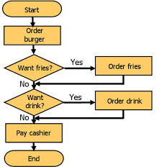
Quality improvement tools
Flowcharts
A flowchart is a pictorial method for showing all the steps or parts of a process that makes up the system.

Slide 23
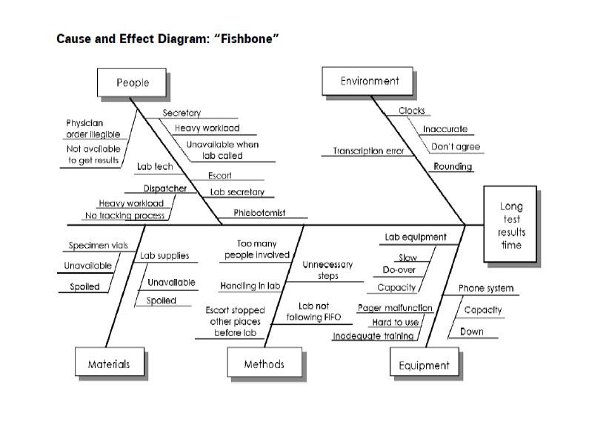
Quality improvement tools
Cause and effect diagrams(ishikawa/fishbone)
A tool for solving problems. The diagram is used to explore and display the possible causes of a certain effect

Slide 24
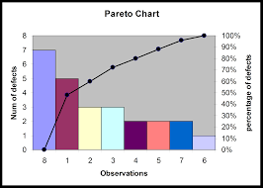
Quality improvement tools
Pareto charts
A bar chart in which the multiple factors that contribute to the overall effect are arranged in descending order according to the magnitude of their effect.
It helps the team concentrate its efforts on the factors that have the greatest impact

Slide 25
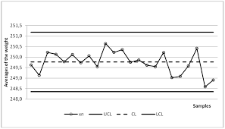
Quality improvement tools
Run charts
Run charts or time plots are graphs of data over time.
A run chart helps the team know if a change is an improvement over time or just a random fluctuation wrongly interpreted as significant improvement.

Slide 26
Summary
The patient care improves and errors are minimized when clinicians use quality improvement methods and tools.
You cannot manage what you cannot measure’.
Plan –Do – Check – Act’ cycle, plays a key role in quality and productivity improvement activities.
Flowcharts; fishbone; Pareto charts; and Run charts are effective tools for improvement

