Slide 1
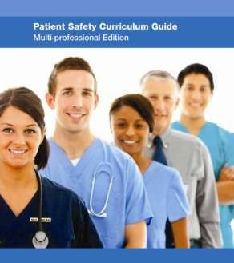
Topic 9
Infection prevention and control

Slide 2
Learning objectives
Demonstrate the devastating effects of inadequate infection prevention & control in health-care settings
Show students how they as individual members of the health-care team can help minimize the risks of contamination & infection to improve patient safety

Slide 3
Knowledge requirements
The extent of the problem
The main causes and types of HCAI
The modes of infection transmission in health-care
settings
The main principles and methods for HCAI prevention and control

Slide 4
Performance requirements (1)
Apply standard precautions
▪
Adhere to other infection prevention and control measures as
required
Apply principles of asepsis
▪
▪
Be immunized against hepatitis B
Use and dispose of protective clothing and equipment
appropriately
Know what to do if exposed to blood or other bodily fluids
▪
▪
Use and dispose of sharps properly
Act as a role model for other health-care staff

Slide 5
Performance requirements (2)
Educate community members as to how they can help to prevent infections
Encourage others to use standard precautions to prevent
and control HCAI
Understand the potential social, economic and emotional burden of HCAI on patients, and act accordingly
Be able to discuss HCAI with patients and relatives with sensitivity and clarity

Slide 6
What is the urgency?
Can no longer rely on antibiotics
Increased rates of nosocomial infections
Infected patients:
Stay longer in hospital
Die
Are treated with more toxic and less effective drugs
Are prone to surgical site infections

Slide 7
Global response: campaigns to decrease infection rates
WHO “SAVE LIVES: Clean Your Hands” campaign
Centers for Disease Control and Prevention campaign to prevent antimicrobial resistance in health-care settings
Institute for Healthcare Improvement “5 million lives” campaign

Slide 8
Main causes of infection
Person-to-person via hands of health-care providers, patients and visitors
Personal equipment (e.g. stethoscopes, personal
digital assistants) and clothing
Airborne transmission
Rare common-source outbreaks
Environmental contamination
Device contamination ( e.g. catheters)
Hospital staff carriers

Slide 9
Main types of infections
Urinary tract infections usually associated with catheters
Surgical infections
Blood stream infections associated with the use of an
intravascular device
Pneumonia associated with ventilators
Other sites

Slide 10
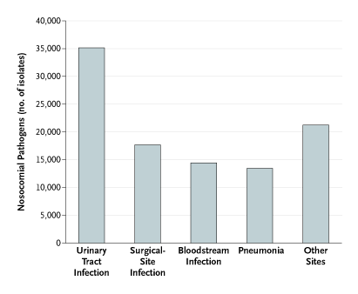
Main types of infections
Source: Burke J Infection control-a problem for patient safety New Eng Journal of Medicine
10

Slide 11
Environmental cleanliness
The environment:
Visibly clean
Increased cleaning during outbreaks
Use hypochlorite and detergents during outbreaks

Slide 12
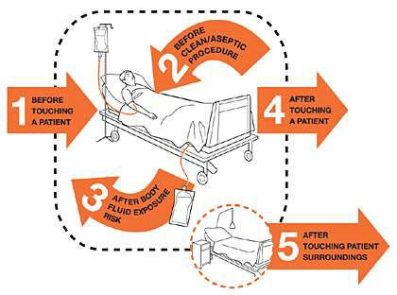
Hand hygiene to minimize spread of infection
WHO 's ' My 5 Moments for Hand Hygiene':
Before Touching a Patient
Before Clean/Aseptic Procedure
After Body Fluid Exposure Risk
After Touching a Patient
After Touching Patient Surroundings
Source:http://www.who.int/gpsc/5may/background/ 5moments/en/index.html

Slide 13
Personal protective equipment
Gloves
Gowns
Face masks

Slide 14
Safe disposal of sharps
Keep handling to a minimum
Do not recap, bend or break needles after use
Discard each needle into a sharps' container at the point of use
Do not overload a bin if it is full
Do not leave a sharps' bin in the reach of children

Slide 15
What students need to do
Apply standard precautions
Be immunized against Hepatitis B
Use personal protection methods
Know what to do if exposed
Encourage others to use standard precautions

Slide 16
Encourage others to participate in
infection control
Students may routinely observe staff who:
Fail to comply with hand hygiene practices
Fail to practice infection prevention and control
recommendations

Slide 17
Summary
Know the main guidelines in each of the clinical
environments in which you are working
Accept responsibility for minimizing opportunities for
infection transmission
Let staff know if supplies are inadequate or depleted
Educate patients and families/visitors about clean hands and
infection transmission
Ensure patients on precautions have same standard of care as others:
Frequency of entering the room
Monitoring vital signs

