Slide 1
Patient Safety Course

Slide 2
Course Description
World Health Organization has recommended Patient Safety as a core curriculum for all health profession education to help prevent the harm during patients care.
The course consists of eleven (11) topics covered in 10 sessions.
Was adapted from the WHO curriculum by inter-professional group of expert faculty
The course covers the relevant foundation knowledge and skills .
The educational issues relevant to clinical practice will be integrated in clinical courses.

Slide 3
Topics
Topic 1: What Is Patient Safety?
Topic 2: Why Applying Human Factors Is Important For Patient Safety
Topic 3: Understanding Systems And The Effect Of Complexity On Patient Care
Topic 4: Understanding And Managing Clinical Risk
Topic 5: Using Quality-improvement Methods To Improve Care
Topic 6: Being An Effective Team Player
Topic 7: Learning From Errors To Prevent Harm
Topic 8: Engaging With Patients And Cares
Topic 9: Infection Prevention And Control
Topic 10: Patient Safety And Invasive Procedures
Topic 11: Improving Medication Safety

Slide 4
General Objectives Course
At the end of the course, students will be able to:
Identify and value the importance of Patient Safety strategies in enhancing health care outcomes.
Recognize the key competencies relevant to mastering Patient Safety.
Explain the Patient Safety system and the effect of complexity on patient care.
Explain the process of learning from own errors and reporting them to prevent harm.
Identify and value his role as an effective team member in a health care system.
Identify quality strategies used to assure safe practice in the workplace.

Slide 5
Marks distribution of continuous assessment:
Ten marks for first students groups presentation on topics 2 and 3. Five marks for each of the other 2 students group presentations with a total of 20 marks.
Four marks for each of the three students group assignments with a total of 12 marks.
2 marks for quizzes/active participation at the end of the four topics which don’t have presentations or assignments (1, 4, 8, and 10). This is to enhance active participation.

Slide 6
What is Patients Safety?

Slide 7
Objectives of the topic
Define the basic concepts of patient safety.
Identify the application of patient safety in clinical practice.
Identify the consequences of unsafe practice in health-care.

Slide 8
Outline
Introduction and defining patient safety
The key dimensions of healthcare quality
Harm Versus error
Sources of System Error
Patient safety culture
Types of clinical incident
Seven levels of safety
Case scenario

Slide 9
Objectives
After completing this lecture you should:
  Recognize the magnitude and the importance of patient safety
  Define and describe the key elements of healthcare quality
  Summarize the differences between error and harm
  Recognizing characteristics of a just culture
  Differentiate between the different types of clinical incidence
  Describe several specific behaviors you can practice to foster a culture of safety in your workplace

Slide 10
Defining patient safety-Video
https://www.youtube.com/watch?v=BJP2rvBchnE

Slide 11
Defining patient safety
The reduction of risk of unnecessary harm associated with health care to an acceptable minimum. (WHO, World Alliance for Patient Safety 2009).

Slide 12
Introduction
Significant numbers of patients are harmed due to their health care, either resulting in permanent injury, increased length of stay (LOS) in health-care facilities, or even death.
44 – 98,000 deaths annually caused by medical error.
There are more deaths annually as a result of health care than from road accidents, breast cancer and AIDS combined.
Recent financial estimates suggest that adverse events cost the Uk £2 billion in 2000 in extra hospital days alone. Other costs, such as suffering of patients, their families and the health care workers involved, are incalculable.

Slide 13
Introduction –Video
https://www.youtube.com/watch?v=BJP2rvBchnE

Slide 14
Why is it a problem?
Hospital/Country | Years in which data was collected | Number of hospital admissions | Number of adverse event | Adverse event rate (%)
US(Harvard Medical Practice Study) | 1984 | 30195 | 1133 | 3.8
Australian (Quality in Australian healthcare study ) | 1992 | 14179 | 2353 | 16.6
UK | 1999-2000 | 1014 | 119 | 11.7
Denmark | 1998 | 1097 | 176 | 9
KKUH | 2014 | 47211 | 2950 | 6.2
Source: World Health Organization. Executive board 109th session, provisional agenda item3,4,5, 2001,EB 109/9

Slide 15
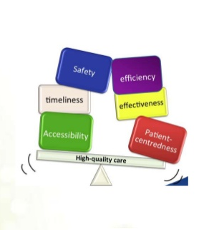
The 6 key dimensions of healthcare quality
Safe: Avoiding injuries to patients from the care that is intended to help them.
Effective: Providing services based on scientific knowledge to all who could benefit and refraining from providing services to those not likely to benefit (avoiding underuse and overuse). Doing the right thing for the right person at the right time.

Slide 16
The 6 key dimensions of healthcare quality
Timely: Reducing waits and sometimes unfavorable delays for both those who receive and those who give care.
Family-centered: Providing care that is respectful of and responsive to individual patient preferences, needs and values, and ensuring that patient values guide all clinical decisions.

Slide 17
The 6 key dimensions of healthcare quality
Efficient: Avoiding waste, in particular waste of equipment, supplies, ideas and energy.
Equal: Providing care that does not vary in quality because of personal characteristics such as gender, ethnicity, geographic location and socio-economic status

Slide 18
Harm VS Error
Harm
Error
  An error is a failure to carry out a planned action as intended. Errors may manifest by doing the wrong thing (commission) or by failing to do the right thing (omission).
  Example, a patient with shortness of breath is diagnosed with pneumonia and treated with an antibiotic. A few days later she is admitted as her condition worsens. Subsequent investigations reveal a pulmonary embolism as the true problem. This is treated with anticoagulation.
  Impairment of structure or function of the body and/or any deleterious effect arising from interaction with health care. Harm includes disease, injury, suffering, disability and death.
  Example : A patient with breast cancer undergoes chemotherapy. The treatment causes severe nausea and vomiting (a known complication) and she is admitted with clinical dehydration.

Slide 19
Sources of System Error
All errors can be divided into two main groups:
Active errors or human error are committed by frontline staff and tend to have direct patient consequences.
  Example, giving the wrong medication, treating the wrong patient or the wrong anatomical site, or not following the correct policies and procedures.
Latent or system errors are those errors that occur due to a set of external forces and indirect failures involving management, protocols/ processes, organizational culture, transfer of knowledge, and external factors
  Example : understaffed wards or inadequate equipment.

Slide 20
Error in medicine
Errors in health care can be caused by ‘‘active failures’’ or ‘‘latent conditions.’’
Most errors are not a result of personal error or negligence, but arise from system flaws or organizational failures

Slide 21
Definition of patient safety culture
  An integrated pattern of individual and organizational behavior, based on a system of shared beliefs and values, that continuously seeks to minimize patient harm that may result from the process of care delivery.

Slide 22
Patient safety culture
Previously, in many cases the traditional response to adverse incidents in health care has been to blame, shame and punish individuals.
The opposite of a ‘blame’ culture is a ‘blame-free’ culture, which is equally inappropriate. In some instances, the responsible individual should be held accountable.(in case of negligence or recklessness)
Recently , the a ‘just’ culture has been adapted which means : balancing the ‘blame’ and ‘no blame’ approaches

Slide 23
Patient safety culture
Example
If a patient is found to have received the wrong medication and suffered a subsequent allergic reaction,
Blame culture: we look for the individual student, pharmacist, nurse or doctor who ordered, dispensed or administered the wrong drug and blame that person for the patient’s condition care at the time of the incident and hold them accountable
Just Culture: we look for the system defect such as communication , protocols and processes for medication management , in addition to investigate the negligence or recklessness of the worker

Slide 24
Living a Just Culture Video
https://www.youtube.com/watch?v=yWhb4vLIegM

Slide 25
The concept of Clinical incident:
Definition:
Examples:
A clinical incident is an event or circumstance resulting from health care which could have, or did lead to unintended harm to a person, loss or damage, and/or a complaint. (deviation from standard of care and safety )
Medication errors (e.G. Wrong medication, omission, overdose);
Patient falls;
Intended self harm or suicidal behaviour;
Therapeutic equipment failure;
Contaminated food;
Problems with blood products;
Documentation errors;
Delayed diagnosis;
Surgical operation complications;
Hospital acquired infection;

Slide 26
Types of Clinical incident
Clinical Incidence
Adverse Event
Near Miss
Sentinel Event/Never Event
Adverse Drug reaction

Slide 27
Types of Clinical incident
Adverse Event:
An adverse event is an unintended injury or complication which results in disability, death or prolonged hospital stay, and is caused by health- care management
Example : Medication errors

Slide 28
Types of Clinical incident
Sentinel events:
A sentinel event is an unexpected occurrence involving death or serious physical or psychological injury, or the risk thereof. Serious injury specifically includes loss of limb or function.
Example:
  Hemolytic transfusion reaction involving administration of blood or blood products having major blood group incompatibilities

Slide 29
Types of Clinical incident
Never Events:
Events should never happen while in a hospital, and can be prevented in most cases.
Example:
    Infant discharged to the wrong person
    Wrong surgical procedure performed on a Patient
    Patient death or serious disability associated with a medication error

Slide 30
Types of Clinical incident
Near miss:
Is any situations that did not cause harm to patients (that did not reach the patient) , but could have done.

Slide 31
Types of Clinical incident
Adverse drug reaction:
A response to a drug which is noxious and unintended, and which occurs at doses normally used in man for the prophylaxis, diagnosis, or therapy of disease, or for the modifications of physiological function'.( WHO,1972)

Slide 32
Seven levels of safety
Patient factors: such as personality, language and psychological problems may also be important as they can influence communication with staff.
Task factors: The design of the task, the availability and utility of protocols ….
Individual factors: include the knowledge, skills and experience of each member of staff

Slide 33
Seven levels of safety
Team factors: The way an individual practices, and their impact on the patient, is influenced by other members of the team and the way they communicate and support each other.
Working conditions: These include the physical environment, availability of equipment and supplies and the light, heat, interruptions and distractions that staff endure.

Slide 34
Seven levels of safety
Organizational factors: The team is influenced in turn by management actions and by decisions made at a higher level in the organization. These include policies, continuing education, training and supervision and the availability of equipment and supplies.
External environment factors: The organization itself is affected by financial constraints, external regulatory bodies and the broader economic and political climate.

Slide 35
The physician’s role in patient safety
Adhere and follow the National Patient Safety Goals/ ROP(Required Organization Practice )
Adverse reporting
Client verification
Medication reconciliation
Dangerous abbreviations
Transfer of client information at transition points
Control of concentrated electrolytes
Infusion pumps training
High-alert medications
Hand hygiene
Antibiotic prophylaxis during surgery
Falls prevention strategy
Pressure ulcer prevention
Venous thromboembolism prophylaxis
Safe injection practices
Safe surgical practices
Preventive maintenance program

Slide 36
Video
https://www.youtube.com/watch?v=BFd54Yzg-vo

Slide 37
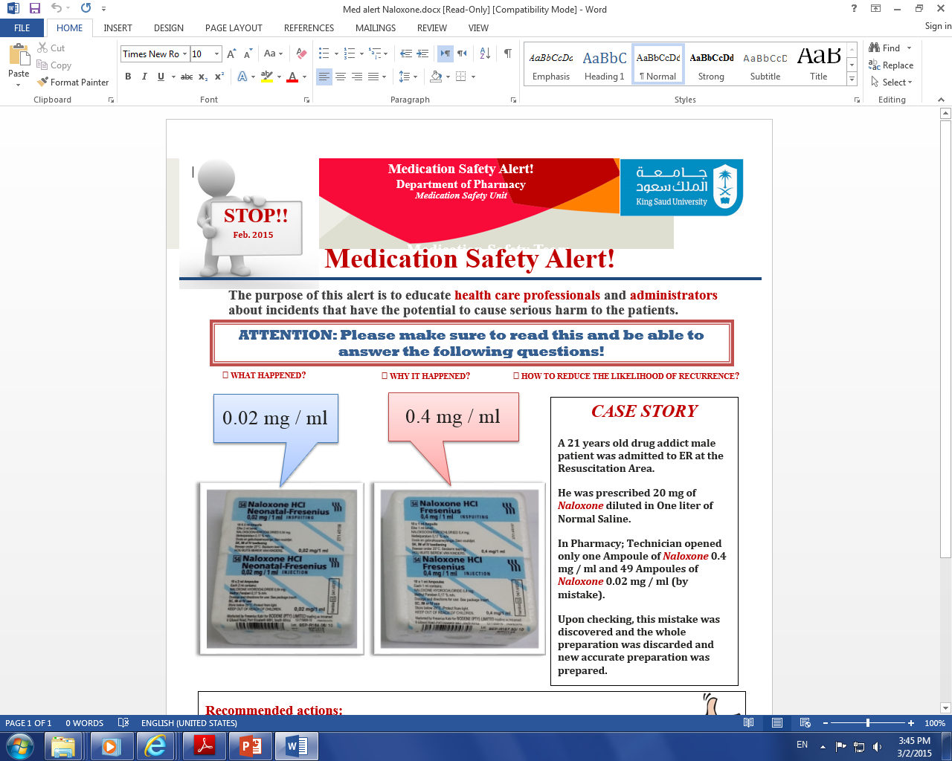
Case Study - 1

Slide 38
Case Study – 1
Recommended actions:
Pharmacists / Technician should READ / CHECK carefully the label of each medication they prepare.
DOUBLE CHECKING is essential tool to avoid such mistakes
Look Alike medications should be stored separately with proper labeling to avoid such mistakes
To change the brand the hospital purchases of either drugs if possible

Slide 39
Case Study - 2
A 38-year-old woman comes to the hospital with 20 minutes of itchy red rash and facial swelling; she has a history of serious allergic reactions
A nurse draws up 10 mls of 1:10,000 adrenaline (epinephrine) into a 10 ml syringe and leaves it at the bedside ready to use (1 mg in total) just in case the doctor requests it
Meanwhile the doctor inserts an intravenous cannula
The doctor sees the 10 ml syringe of clear fluid that the nurse has drawn up and assumes it is normal saline

Slide 40
Continue…. case study - 2
There is no communication between the doctor and the nurse at this time
The doctor gives all 10 mls of adrenaline (epinephrine)through the intravenous cannula thinking he is using saline to flush the line.
The patient suddenly feels terrible, anxious, becomes tachycardia and then becomes unconscious with no pulse
She is discovered to be in ventricular tachycardia, is resuscitated and fortunately makes a good recovery
Recommended dose of adrenaline (epinephrine) in anaphylaxis is 0.3 - 0.5 mg IM, this patient received 1mg IV

Slide 41
Can you identify the contributing factors for this error?

Slide 42
Can you identify the contributing factors to this error?
Lack of communication
Inadequate labeling of syringe
Giving a substance without checking and double checking what it is
Lack of care with a potent medication

Slide 43
How could this error have been prevented?

Slide 44
How could this error have been prevented?
Never give a medication unless you are sure you know what it is; be suspicious of unlabeled syringes
Never use an unlabeled syringe unless you have drawn the medication up yourself
Label all syringes
Communication - nurse and doctor to keep each other informed of what they are doing e.g. nurse: “I’m drawing up some adrenaline”
Develop checking habits before administering every medication … go through the 5 Rse.g doctor: “What is in this syringe?”

Slide 45
Conclusion
Patient safety is the avoidance, prevention and amelioration of harm from healthcare.
Two approaches to the problem of human fallibility exist:
  The person approach focuses on the errors of individuals, blaming them
  The system approach concentrates on the conditions under which individuals work
Some errors cause harm but many do not.
Blaming and then punishing individuals is not an effective approach for improving safety within the system
Adverse events often occur because of system breakdowns
Standardizing and simplifying clinical processes is a powerful way of improving patient safety

Slide 46
Bibliography
Maamoun J,An Introduction to Patient Safety. Journal of Medical Imaging and Radiation Sciences 40 (2009) 123-133
Reason J.Human error: models and management. BMJ. 2000 Mar 18;320(7237):768-70.
Sutker WL The physician's role in patient safety: What's in it for me?. Proc (Bayl Univ Med Cent).2008 Jan;21(1):9-14.
Sutker WL. The physician's role in patient safety: What's in it for me? Proc (Bayl Univ Med ‎Cent). 2008 Jan;21(1):9-14‎
Goode LD1, Clancy CM, Kimball HR, Meyer G, Eisenberg JM. When is "good enough"? The role and responsibility of physicians to improve patient safety. Acad Med. 2002 Oct;77(10):947-52.

Slide 47
Thank you

