Slide 1
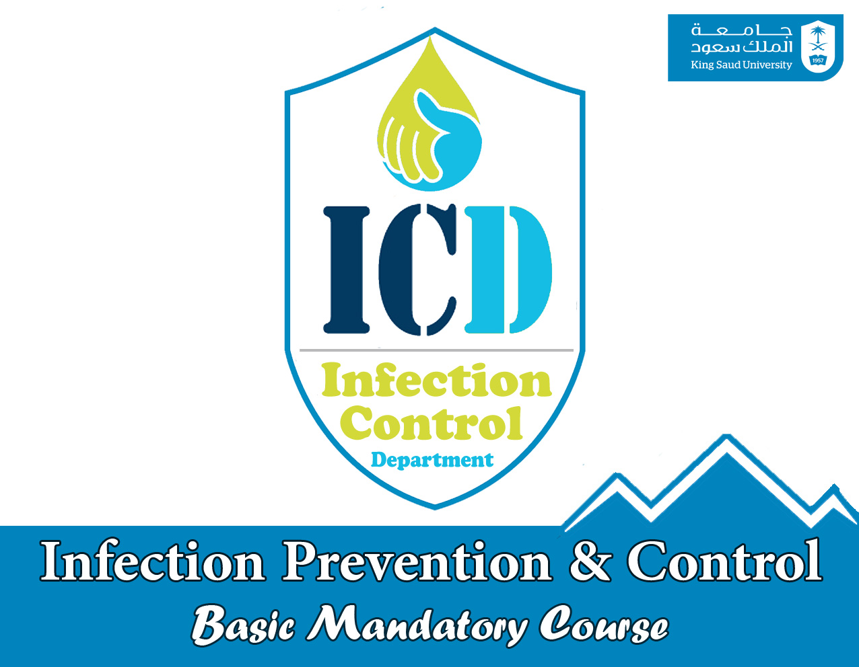

Slide 2

INTRODUCTION
    I. Infection Control Department
  II. Infection Control Committee

Slide 3
Responsibilities
Minimize Hospital Acquired Infection
Healthy Environment for Patients,Visitors,HCW
HCW- post-exposure prophylaxis
Education
Notification
HCW immunization

Slide 4

Surveillance
Outbreak Management
Waste Management
Antimicrobial Policy
Coordination to MOH
Product Evaluation

Slide 5

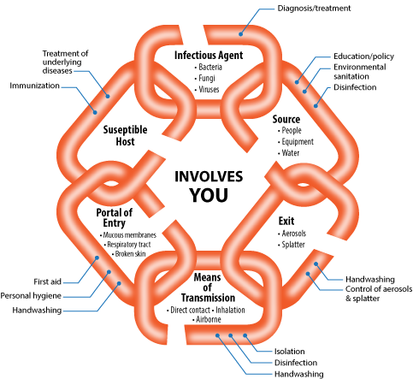
CHAIN OF INFECTION

Slide 6
Definition of Infection
Presented on Admission ( POA ) (Community Acquired)
Infection that presented or incubating at the time of admission to the hospital at the first 2 calendar days from admission and according to each disease case definition
Health Care - Associated (nosocomial)
It is presented after 2 calendar days of admission or within a defined period after hospital discharge according to the disease incubation period. We follow NHSN definition for HAI.

Slide 7
Categories of
Nosocomial Infection
1. Surgical Site Infection (SSI )
2. Pneumonia
3. Urinary Tract Infection (UTI )
4. Bacteremia
5. Device Related Infection (VAP-
CLABSI-CA UTI )
6. Gastro – intestinal Tract Infection

Slide 8
HAI burden
• Hundreds of millions of patients are affected by HAI worldwide each year, leading to significant mortality and financial losses for health systems.
• Of every 100 hospitalized patients , 7 in developed and 10 in developing countries will acquire at least one HAI .
• While UTI is the most frequent HAI in high-income countries, SSI is 1/3 in settings with limited resources,
(9 times higher than developed countries) .

Slide 9
HAI burden
HAI annually account for 37 000 attributable deaths in Europe
99 000 deaths in the USA.
Annual financial losses of,€7 billion in Europe, with 16 million extra days of hospital stay
US$ 6.5 billion in the USA.
Brazil, was estimated to be equal to US$ 18 million in 1992.
In Mexican ICUs, US$ 12 155/each HAI.

Slide 10
Patients at risk
immuno-compromised patients (oncology, dialysis, diabetic )
Prolonged hospital stay (Long stay patients )
use of invasive devices; (ICU )
Post procedures (Surgical )

Slide 11
Effective IC requirement

Slide 12
Effective IC requirement

Slide 13
Effective IC requirement

Slide 14
ICD And Manual
ICITY ( INTERNT CITY)
http://icity.ksu.edu.sa/Pages/default.aspx
DEPARTMENT
infection control
-refinance staff practice .
patient education .
IC Manual
ICITY ( INTERNT CITY)
http://icity.ksu.edu.sa/Pages/default.aspx
MAIN SERIVCE
IC Manual

Slide 15
Standard Precaution
a group of practices of infection prevention and control based on a principle that all blood, body fluids secretions, excretions (except sweat), non intact skin and mucous membranes may contain transmissible infectious agents regardless of their diagnosis.
Applied to all patients regardless of the patient diagnoses
MC-ICD-P/24

Slide 16
Elements Of Standard Precaution
1. Hand Hygiene
2. Gown 3. Mask 4. Face Protection 5. Gloves
6. Safe injection practices
7. Patient Care Equipment/ Devices
8. Environmental Control
9. Textile and laundry 10. Worker Safety
11. Patient Placement and Transport
12. Respiratory Hygiene / Cough Etiquette
13. Infection Control Practices for Lumbar Puncture

Slide 17



Slide 18
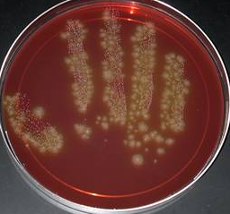
Hand Hygiene
Healthcare-associated pathogens are most often transmitted from patient to patient through the hands of healthcare workers.
Hand Hygiene is the single most important measure for preventing the spread of microorganisms in healthcare settings. MC-ICD-P/08

Slide 19


Hand Hygiene
What are our hands carrying?
Resident Flora:
Part of body’s natural defence mechanism
Deep seated.
Difficult to remove.
Associated with infection following surgery/invasive procedures.
Transient Flora:
Superficial.
Transferred with ease to and from hands.
Important cause of cross infection.
Easily removed with good hand hygiene.

Slide 20
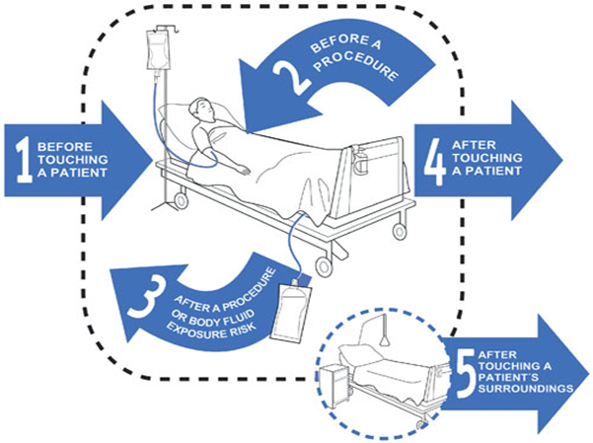
WHO “My five (KEY) moments for hand hygiene”
Hand Hygiene
Before touching a patient.
Before clean/aseptic procedure.
After body fluid exposure risk.
After touching a patient.
After touching patient surroundings.

Slide 21
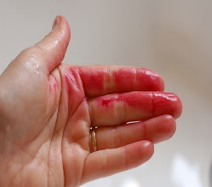
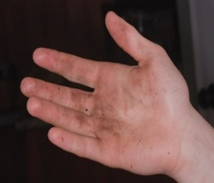
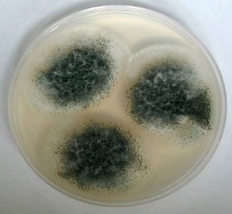

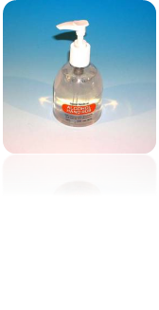

Hand Hygiene
What , When, How ?
What are types of Hand Hygiene?
Hand washing.
40-60 seconds
for visibly soiled hands & after using alcohol gel several times
when handling patients colonized/infected with spore-forming organisms
Use of alcohol rubs/gels.
20-30 seconds
for hands that are not visibly soiled.
Surgical hand ‘scrub.
brush and nail file
5 minutes (first wash of the day); 2-3 minutes (in between operations)

Slide 22
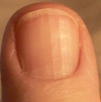


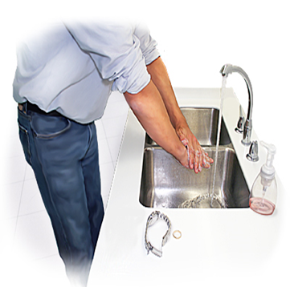
Tips for perfect clean hands
Hand Hygiene
Fingernails:
  Should be short, clean, and free from nail varnish as it harbour micro organisms that are not easily removed during hand hygiene.
  Jewellery:
  For proper hand hygiene REMOVE hand ring and watch

Slide 23
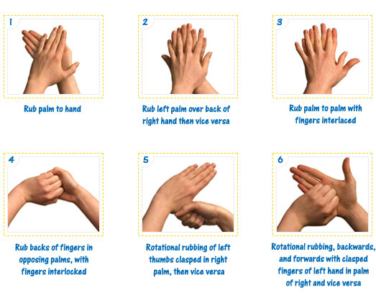
Hand Rub

Slide 24
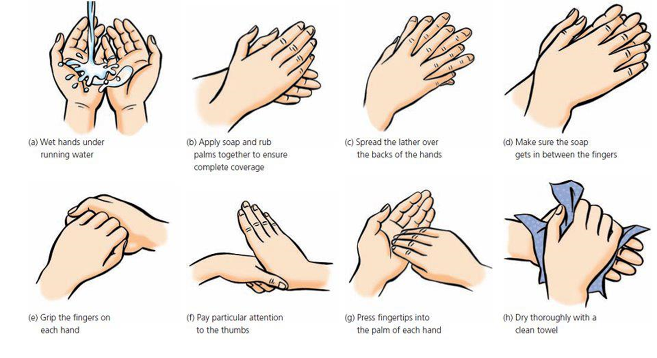
Hand Wash

Slide 25
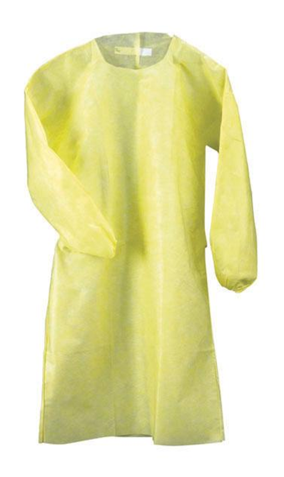
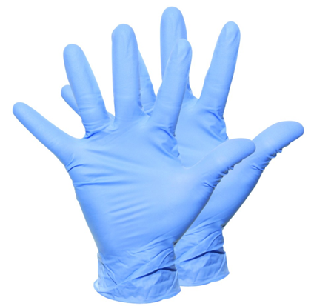
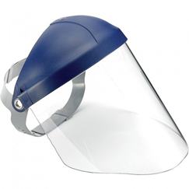
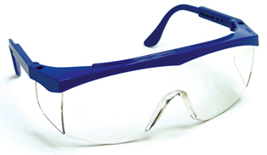
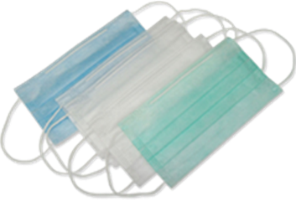
Personal Protective Equipment
A variety of barriers to protect both the patient and HCW’s from the potential risks of cross infection whenever blood/body fluid splashes are expected to come in contact with mucous membranes, airways, skin and clothing

Slide 26
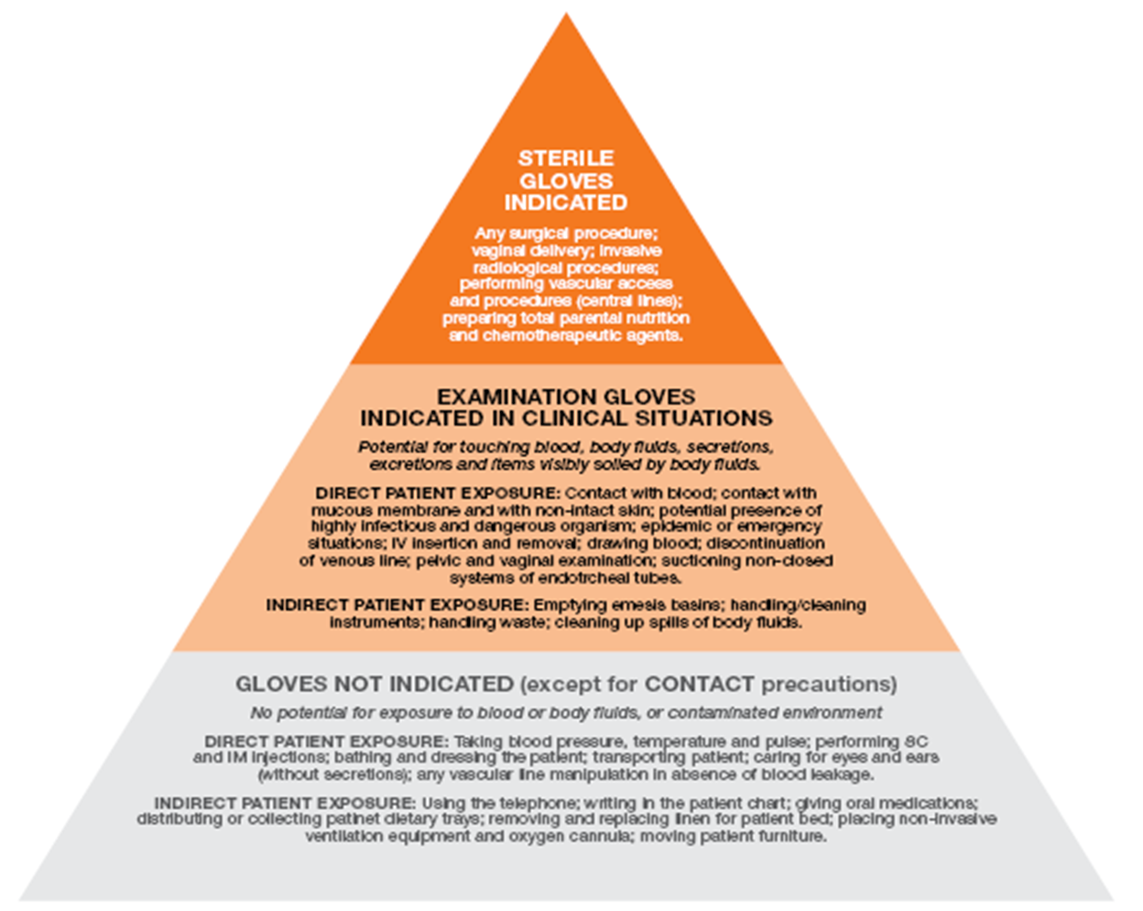
Glove Pyramid

Slide 27
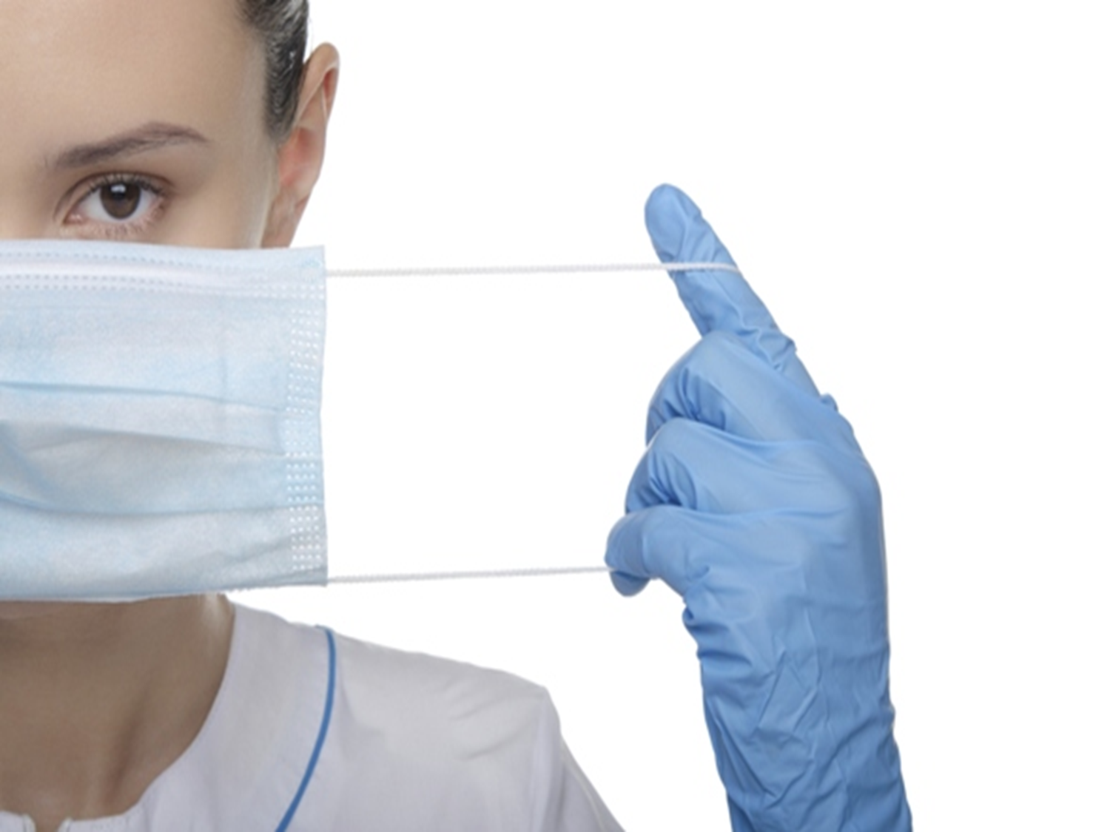
Masks
DON’T TOUCH
THE FRONT OF THE MASK

Slide 28
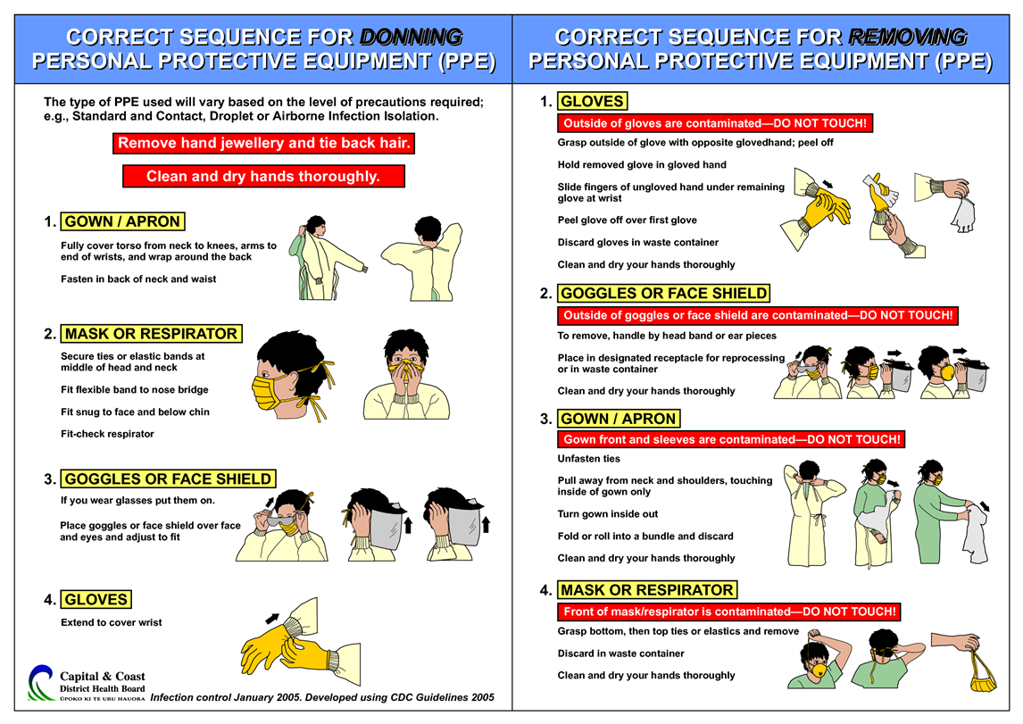
Donning & Doffing

Slide 29
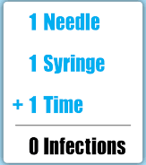
Safe Injection Practices
Do not recap, bend, break, or hand-manipulate used needles.
If recapping is required, use a one-handed scoop technique only.
Use safety features when available.
Place used sharps in puncture-resistant container.
Use Single Dose vials.

Slide 30
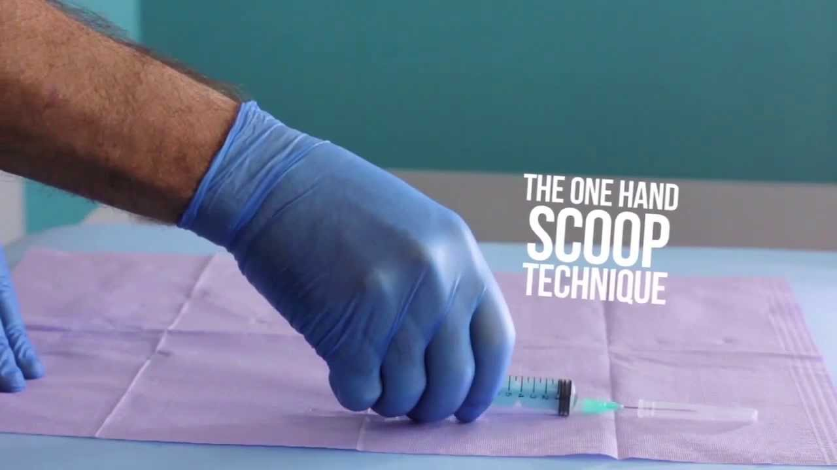
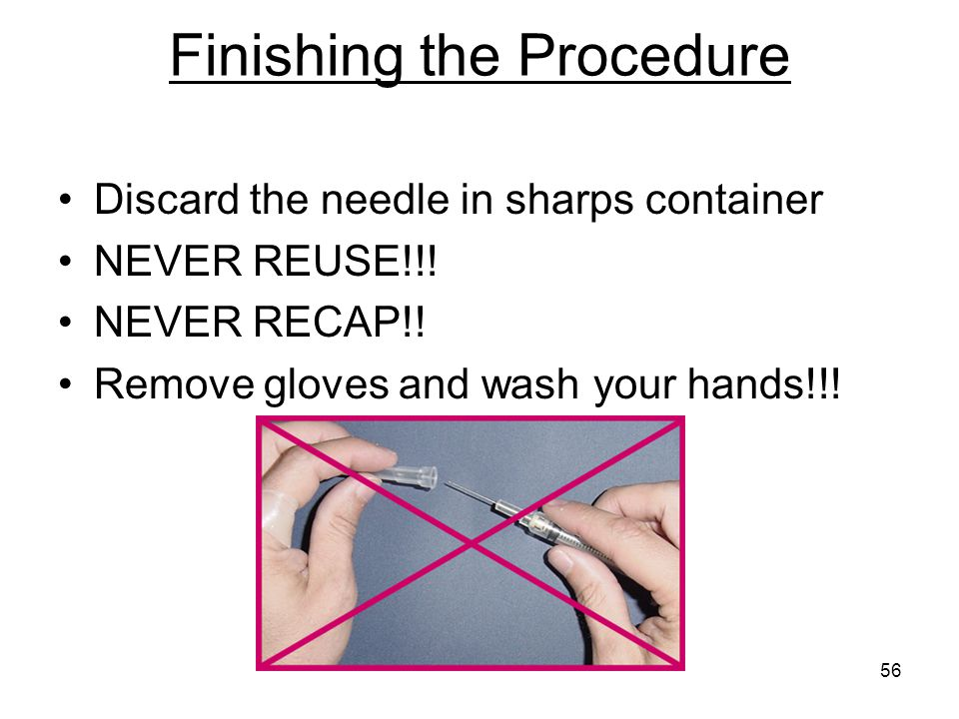

Slide 31
Patient Care Equipment
Handle used patient care equipment soiled with blood, body fluids in a manner that prevents transfer of microorganisms to one’s self, other patients and environments.
Single use, disposable items must be disposed properly.
Reusable items have to be been cleaned and reprocessed appropriately, prior to use on another patient based on the manufacture recommendation and the intended use (Spaulding criteria).

Slide 32
Definitions
Cleaning: Removal of adherent visible soil, blood, protein substances (tissue) and other debris from surfaces by mechanical or manual process.
Disinfection: Destruction of most viable pathogenic microorganisms to a specific level except spores (high, intermediate, and low).
Sterilization: The process by which all forms of microorganism, including bacteria, viruses, spores and fungi are destroyed.
MC-ICD-P/29,30 ,35 &41

Slide 33
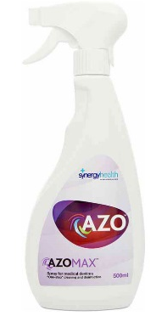
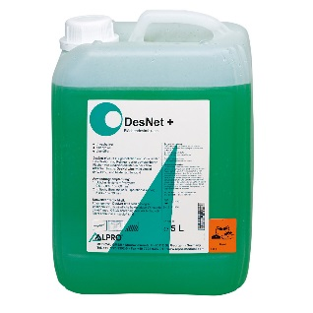
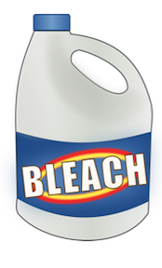
Environmental Control
Routine Cleaning: Hospital approved disinfectant , MC-ICD-P/14
AZO with Contact time 5 min.
DesNet plus with contact time 2 min.
Special Pathogen:
        MDRO/ MRSA: routine cleaning
        VRE: vigorous cleaning.
        Clostridium Defficille: Hypochlorite Releasing Products (contact time 2 min)

Slide 34
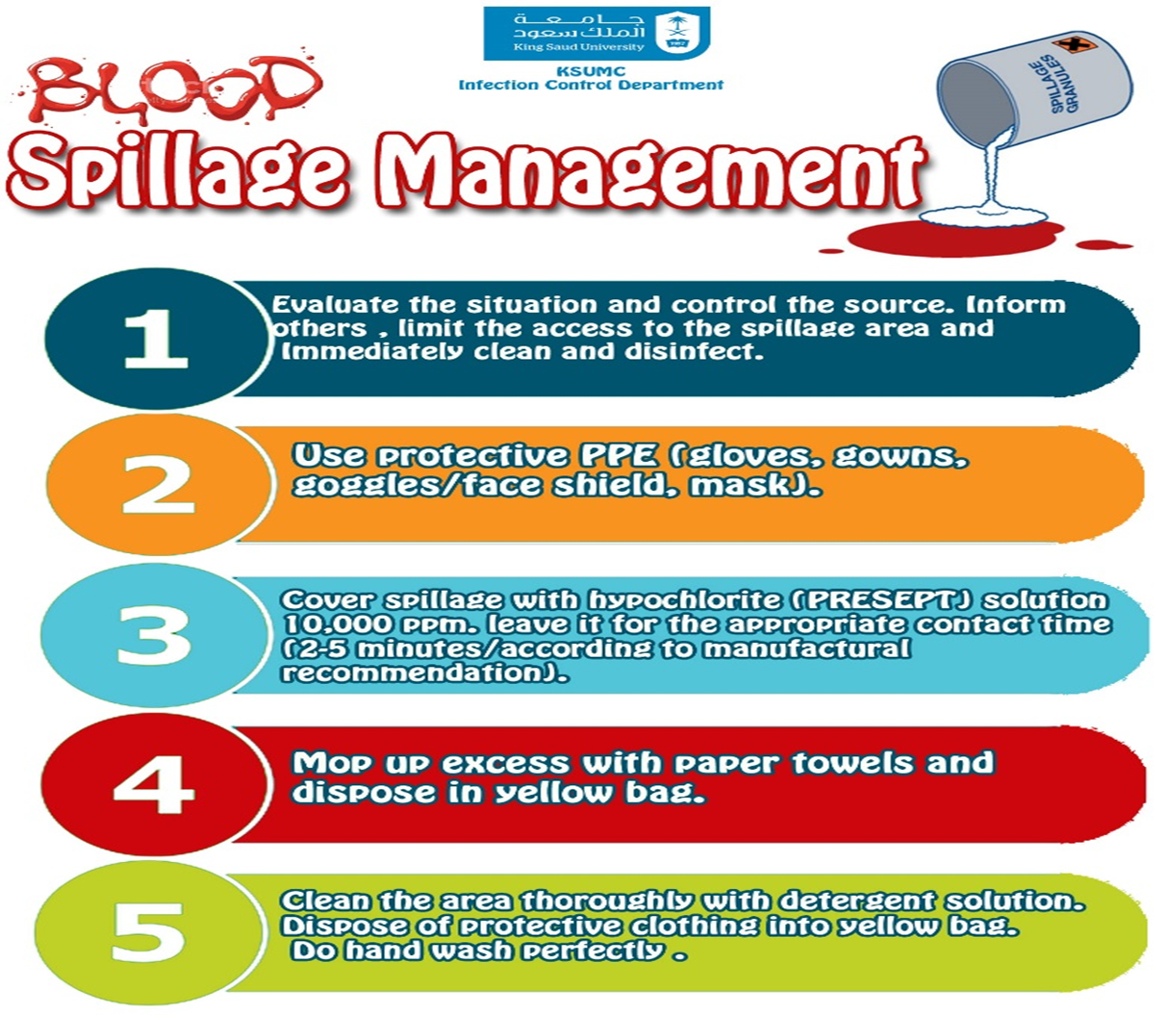
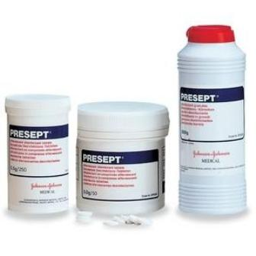

Slide 35

Blood spillage
        MC-ICD-P/01

Slide 36

Worker Safety
Prevention of sharps-related injuries.
Precautions during aerosol-generating procedures.
Prevention of mucous membrane contact.

Slide 37
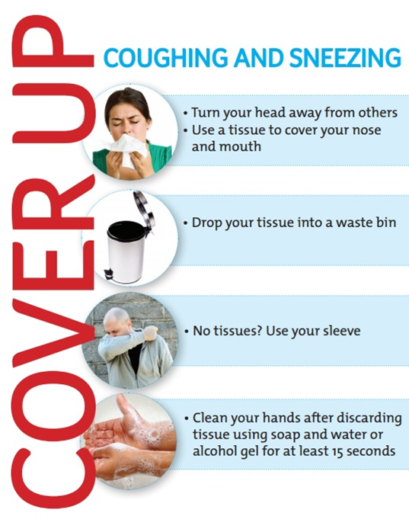
Cough Etiquette

Slide 38
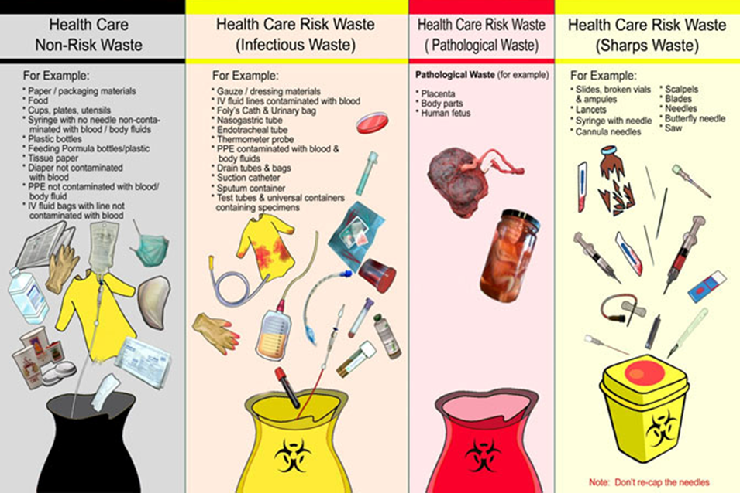
Waste Disposal

Slide 39
Transmission-Based Precautions
Airborne Precautions
Droplet Precautions
Contact Precautions

Slide 40
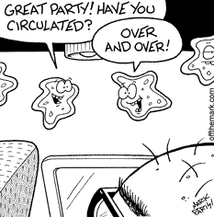
AIRBORNE PRECAUTIONS
Causative agents of diseases under airborne precaution are less than 5 μm, thus can be carried away by air currents

Slide 41
DISEASES UNDER AIRBORNE PRECAUTION
Measles
Tuberculosis (Pulmonary/Laryngeal)
Varicella

Slide 42
AIRBORNE PRECAUTIONS
Patient Placement
Single room with negative air pressure
12 air exchanges per hour(MOH)
Room door closed
MC-ICD-P/43

Slide 43
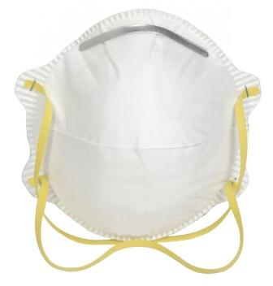
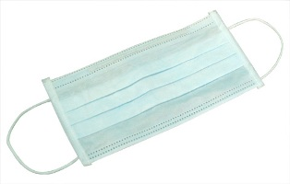
AIRBORNE PRECAUTIONS
Protection for HCW
Standard Precautions
N95 respirator
Patient Transport
Limit movement
Mask the patient
with surgical mask

Slide 44
AIRBORNE PRECAUTIONS
N95 mask is single use

Slide 45
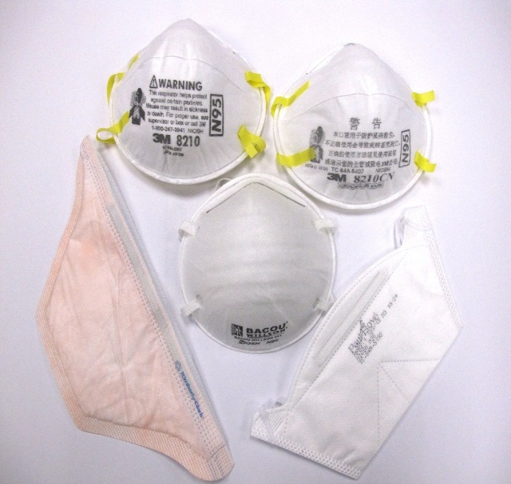
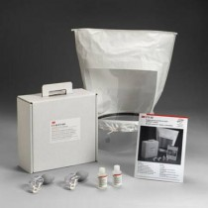
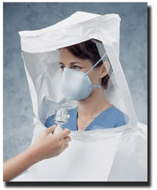
FIT TEST
MC-ICD-P/26

Slide 46
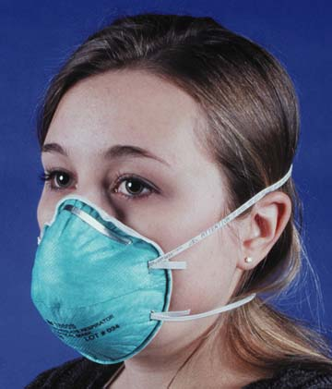
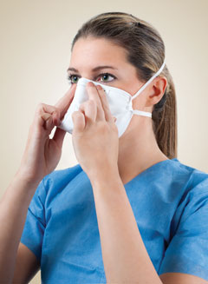
For Airborne Precautions
N95 respirator
Well sealed check
MC-ICD-P/05
Notes:
Proper fit testing is important to maximize the effectiveness of the mask
An N95 respirator will ONLY offer maximally effective protection if it has been tested to show that it fits well.
If the respirator has a bad fit, inhaled air can leak around the edges and be inhaled without going through the filter.
If the respirator has been fit tested, and the edges seal well to the face, inhaled air goes through the filter allowing the majority of the microorganisms and particulate matter to be filtered out of the air before it is inhaled

Slide 47
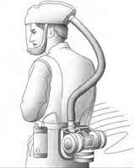
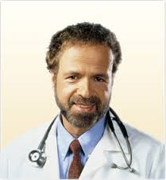
Powered Air purifying respirator
(PAPR)

Slide 48
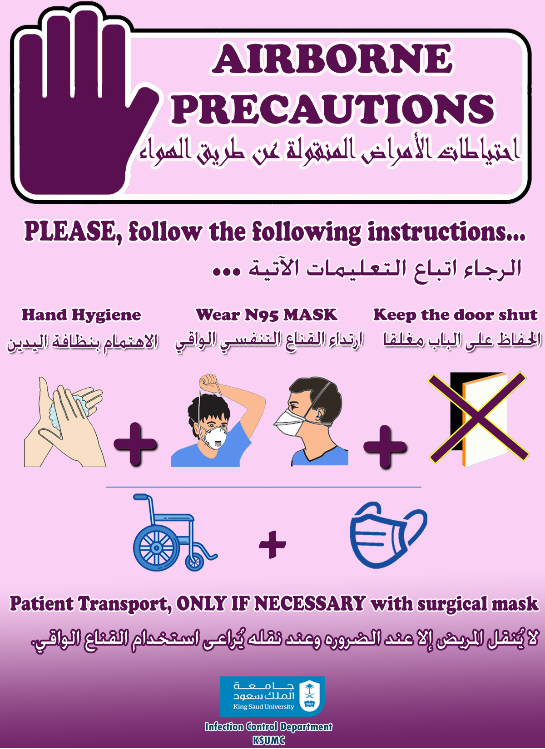

Slide 49
AIRBORNE PRECAUTIONS
Display sign outside the door. Remove sign after room is cleaned.
Common Conditions:
Pulmonary or Laryngeal Tuberculosis Chicken Pox Disseminated Herpes Zoster (Shingles) |  | Rubeola (Measles) Avian Influenza
Family and other visitors to follow precautions
Airborne Infection Isolation Room Use Airborne Isolation room. Nurse to notify Infection Control Preventionist and Facilities/Engineering of room number when starting and stopping precautions Dishes / Utensils: No special precautions. Kitchenware sanitized in dishwasher. Equipment / Supplies: Use dedicated or disposable equipment when available. Clean and disinfect reusable equipment including IV pumps, cell phone, or pagers (if used in room), other electronics, supplies and equipment prior to removing from patient’s room. Ensure blood pressure cuff and stethoscope are cleaned and disinfected between patients. Only essential supplies in room. Linen Management: Bag linen in the patient’s room. Patient Identification Procedure: Use patient’s label for validation of patient identity and destroy in room after use.
Personal Protective Equipment (PPE)
Put ON in order: Wash or sanitize hands Fitted N-95, 99, 100 respirator or PAPR required | Take OFF & dispose outside room, in order Fitted N-95, 99, 100 respirator or PAPR Wash or sanitize hands (even if gloves used)
Room Cleaning: After patient is discharged, keep door closed for one hour to allow complete room air exchange before routine cleaning procedures. Change cubicle curtain if visibly soiled.
Transport: Essential transport only and place surgical mask on patient. Clean and disinfect transport vehicle. Alert receiving department regarding patient’s isolation precaution status. Discontinue precautions as per hospital policy or Infection Preventionist Instructions.

Slide 50
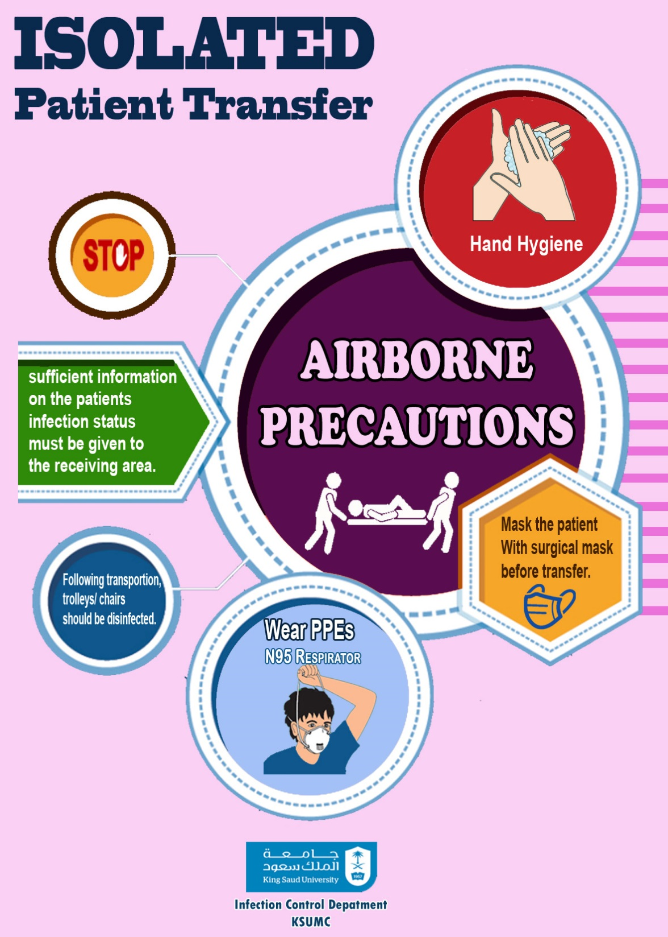

Slide 51

DROPLET PRECAUTIONS
Causative agents of diseases under droplet precaution are greater than 5 μm. They can travel up to 3 feet (1mtr)

Slide 52
DISEASES UNDER DROPLET PRECAUTION
Haemophilus influenzae type B disease, including meningitis, pneumonia, epiglottis and sepsis
Streptococcal (group A) pharyngitis, scarlet fever in infants and young children
Influenza, Mumps

Slide 53
DROPLET PRECAUTIONS
Patient placement
Private room
Cohort nursing

Slide 54
DROPLET PRECAUTIONS
Protection for HCW
Standard precautions
Surgical mask if working within 3 feet of the patient
Patient Transport
Limit movement
Mask the patient with
surgical mask

Slide 55
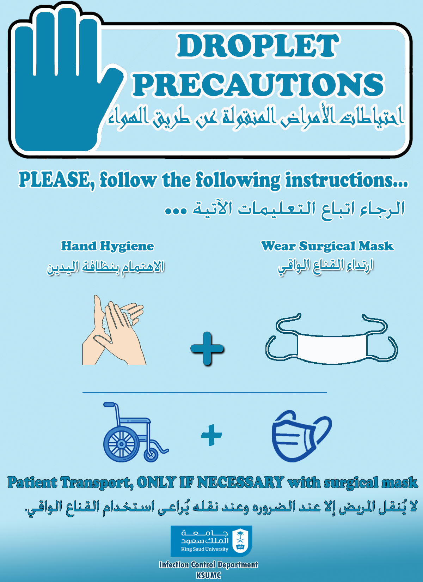

Slide 56
DROPLET PRECAUTIONS
Display sign outside the door. Remove sign after room is cleaned.
Common Conditions:
Seasonal Influenza Bacterial Meningitis (N. meningitides) |  | Pertussis (Whooping Cough) Mumps
Family and other visitors to follow precautions
Dishes / Utensils: No special precautions. Kitchenware sanitized in dishwasher. Equipment / Supplies: Use dedicated or disposable equipment when available. Clean and disinfect reusable equipment including IV pumps, cell phone, or pagers (if used in room), other electronics, supplies and equipment prior to removing from patient’s room. Ensure blood pressure cuff and stethoscope are cleaned and disinfected between patients. Only essential supplies in room. Linen Management: Bag linen in the patient’s room. Patient Identification Procedure: Use patient’s label for validation of patient identity and destroy in room after use.
Personal Protective Equipment (PPE)
Put ON in order: Wash or sanitize hands Gown (if needed) Mask Eye cover Gloves (if needed) | Take OFF & dispose outside room, in order Gloves (if used) Eye cover Gown (if used) Mask Wash or sanitize hands (even if gloves used)
Private Room: If not available, room with patient that has the same organism but no other infection.
Transport: Essential transport only and place surgical mask on patient. Clean and disinfect transport vehicle. Alert receiving department regarding patient’s isolation precaution status. Discontinue precautions as per hospital policy or Infection Preventionist Instructions.

Slide 57
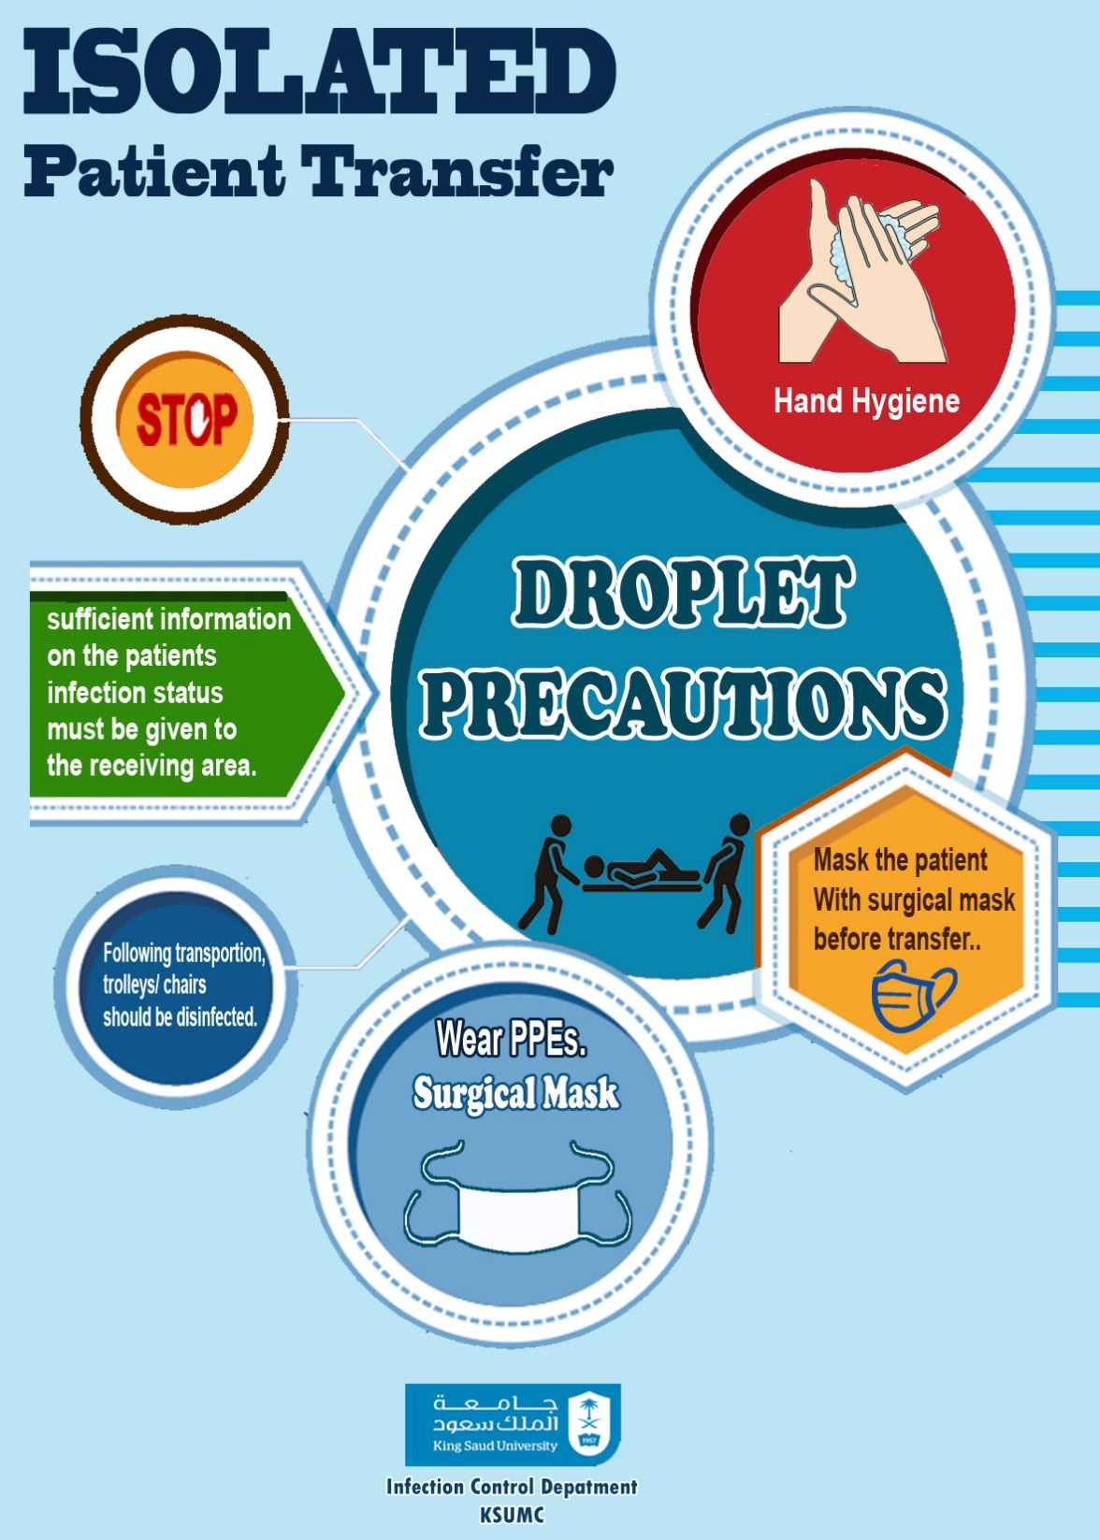

Slide 58
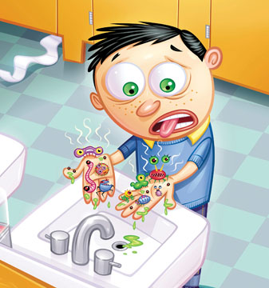
CONTACT PRECAUTIONS
Use In addition to standard precaution, for patients known or suspected to have serious illness transmitted through contact

Slide 59
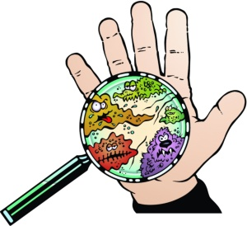
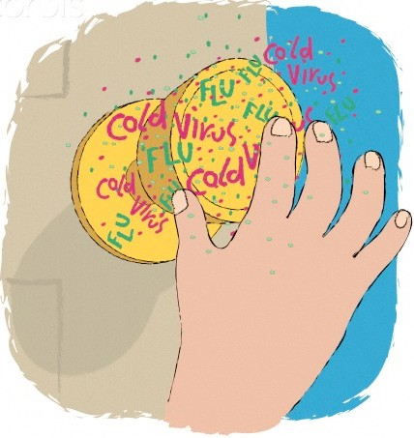
CONTACT PRECAUTIONS
Direct Contact Transmission
In-Direct Contact

Slide 60
DISEASES UNDER CONTACT PRECAUTION
Multi-drug resistant microorganisms (MDRO’s), VRE, MRSA, ESBL, B.cepacia
RSV infection in infants, young childrena nd immunocompromised patients
Clostridium defficile enterocolitis

Slide 61
CONTACT PRECAUTIONS
Patient placement
Private room
Cohort nursing

Slide 62
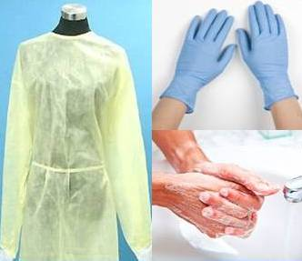
CONTACT PRECAUTIONS
Protection for HCW
Handwashing
Gloves
Gown
Patient Transport
Limit movement

Slide 63
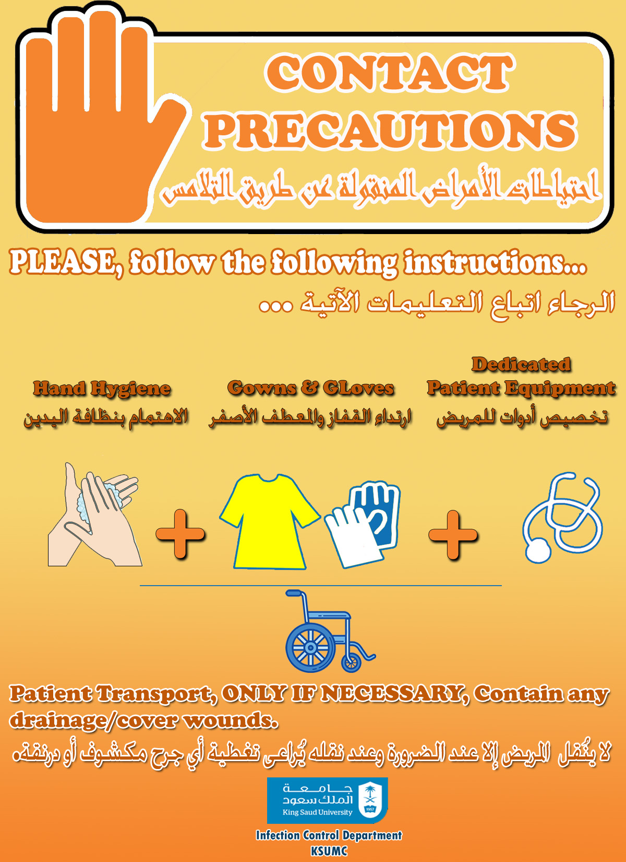

Slide 64
CONTACT PRECAUTIONS
Display sign outside the door. Remove sign after room is cleaned.
Common Conditions:
Multi-Drug Resistant Organism Methicilline Resistant Staphylococcus Aureus (MRSA Vancomycin Resistant Enterococcus (VRE) |  | Clostridium Difficile Infection (C. Diff) Scabies Wounds or abscesses with uncontained drainage
Family and other visitors to follow precautions
Dishes / Utensils: No special precautions. Kitchenware sanitized in dishwasher. Equipment / Supplies: Use dedicated or disposable equipment when available. Clean and disinfect reusable equipment including IV pumps, cell phone, or pagers (if used in room), other electronics, supplies and equipment prior to removing from patient’s room. Ensure blood pressure cuff and stethoscope are cleaned and disinfected between patients. Only essential supplies in room. Linen Management: Bag linen in the patient’s room. Patient Identification Procedure: Use patient’s label for validation of patient identity and destroy in room after use.
Personal Protective Equipment (PPE)
Put ON in order: Wash or sanitize hands Gown Mask (if needed) Eye cover (if needed) Gloves | Take OFF & dispose outside room, in order Gloves Eye cover (if used) Gown Mask (if used) Wash or sanitize hands (even if gloves used)
Private Room: If not available, room with patient that has the same organism but no other infection.
Transport: Essential transport only. Place patient in clean gown. Clean and disinfect transport vehicle. Alert receiving department regarding patient’s isolation precaution status. Discontinue precautions as per hospital policy or Infection Preventionist Instructions.

Slide 65
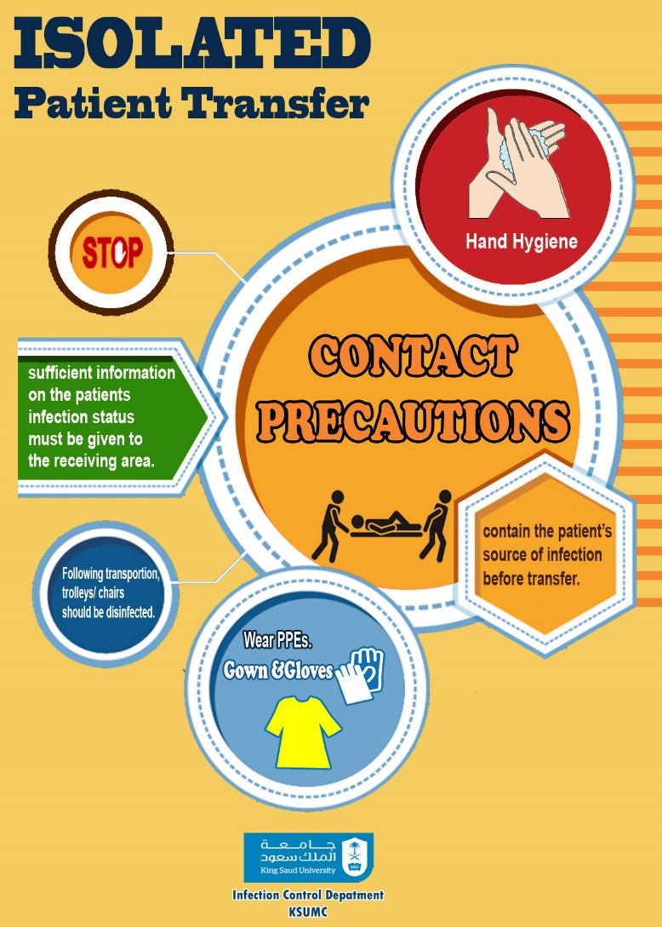

Slide 66

EMPIRIC ISOLATION PRECAUTIONS
The risk of infection transmission may be highest before a definitive diagnosis can be reached
Therefore, patients with certain clinical syndromes should be isolated empirically until we have a definitive diagnosis.

