Slide 2
Introduction

Slide 4
Infection Prevention and Control Program
Vision
To be a leading center expressing excellence in infection prevention and control in Saudi by striving consistently to reduce infection rate to the lowest possible level and promoting a safe environment for patients and Health Care Workers (HCWs).

Slide 5
Infection Prevention and Control Program
Mission
Implement the recommended infection control guidelines throughout continuous care on the basis of hospital surveillance, education and training of Health Care Workers (HCW), promoting research and continuous quality improvement.
Values
a- Islamic Ethic Code b. Excellence
c-Teamwork d. Honesty
e-Transparency & accountability f. Lifelong learning

Slide 6
INTRODUCTION
I. Infection Control Department
II. Infection Control Committee

Slide 7
Responsibilities
Minimize Hospital Acquired Infection
Healthy Environment for Patients ,Visitors ,HCW
HCW- post-exposure prophylaxis
Education
Notification
HCW immunization

Slide 8
Surveillance
Outbreak Management
Waste Management
Antimicrobial Policy
Coordination to MOH
Product Evaluation

Slide 9
Definition of Infection
Presented on Admission ( POA ) (Community Acquired)
Infection that presented or incubating at the time of admission to the hospital at the first 2 calendar days from admission and according to each disease case definition
Health Care - Associated (nosocomial)
It is presented after 2 calendar days of admission or within a defined period after hospital discharge according to the disease incubation period. We follow NHSN definition for HAI.

Slide 10
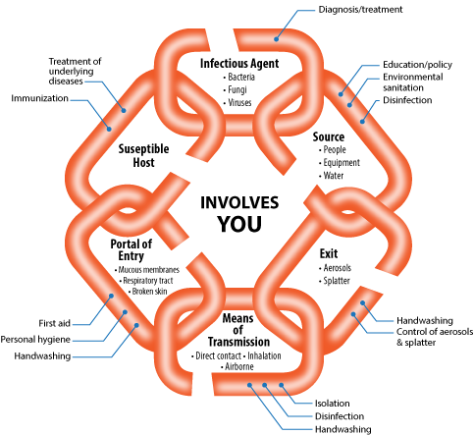
Chain of infection

Slide 11
Categories of Nosocomial Infection
1. Surgical Site Infection
2. Pneumonia
3. Urinary Tract Infection
4. Bacteremia
5. Device Related Infection (VAP-
CLABSI-CA UTI )
6. Gastro – intestinal Tract Infection

Slide 12
ICD And Manual
ICITY ( INTERNT CITY)
http://icity.ksu.edu.sa/Pages/default.aspx
DEPARTMENT
infection control
-refinance staff practice .
patient education .
IC Manual
ICITY ( INTERNT CITY)
http://icity.ksu.edu.sa/Pages/default.aspx
MAIN SERIVCE
IC Manual

