Slide 1
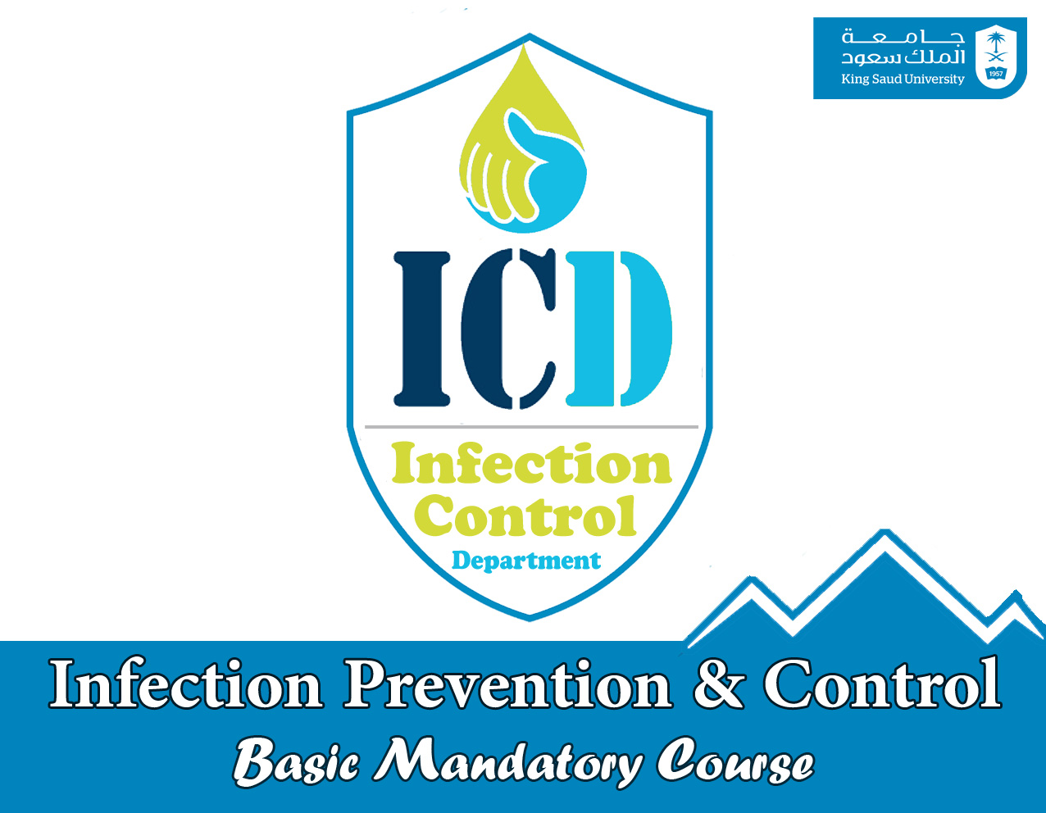

Slide 2


Standard Precaution

Slide 3

To be able to apply essential elements of
standard infection control precautions.
To use knowledge to asses risk in practice.
To work competently to reduce the risk of infection for service users, colleagues and self.

Slide 4
Standard Precaution
a group of practices of infection prevention and control based on a principle that all blood, body fluids secretions, excretions (except sweat), non intact skin and mucous membranes may contain transmissible infectious agents regardless of their diagnosis.
Applied to all patients regardless of the patient diagnoses
MC-ICD-P/24

Slide 5
Elements Of Standard Precaution
1. Hand Hygiene
2. Gown 3. Mask 4. Face Protection 5. Gloves
6. Safe injection practices
7. Patient Care Equipment/ Devices
8. Environmental Control
9. Textile and laundry 10. Worker Safety
11. Patient Placement and Transport
12. Respiratory Hygiene / Cough Etiquette
13. Infection Control Practices for Lumbar Puncture

Slide 6
Hand Hygiene
Healthcare-associated pathogens are most often transmitted from patient to patient through the hands of healthcare workers.
Hand Hygiene is the single most important measure for preventing the spread of microorganisms in healthcare settings. MC-ICD-P/08

Slide 7


Hand Hygiene
What are our hands carrying?
Resident Flora:
Part of body’s natural defence mechanism
Deep seated.
Difficult to remove.
Associated with infection following surgery/invasive procedures.
Transient Flora:
Superficial.
Transferred with ease to and from hands.
Important cause of cross infection.
Easily removed with good hand hygiene.

Slide 8
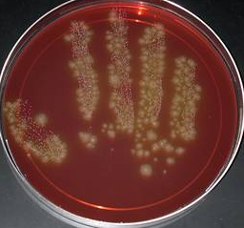
Hand Hygiene
Healthcare Personnel can get 100s to 1000s of bacteria on their hands by doing simple tasks like:
  Pulling patients up in bed
  Taking a blood pressure or pulse
  Touching a patient’s hand
  Touching the patient’s gown or bed sheets
  Touching equipment like bedside rails, over bed tables, IV pumps

Slide 9
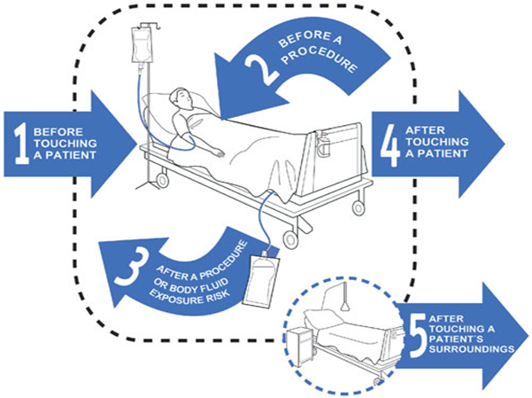
WHO “My five (KEY) moments for hand hygiene”
Hand Hygiene
Before touching a patient.
Before clean/aseptic procedure.
After body fluid exposure risk.
After touching a patient.
After touching patient surroundings.

Slide 10
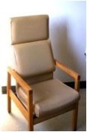
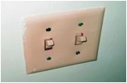
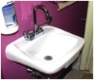

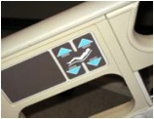
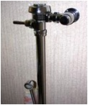
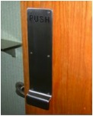
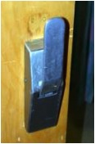
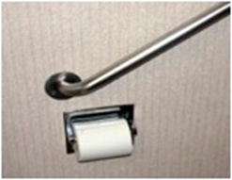
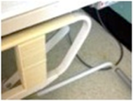


Frequently Touched Surfaces

Slide 11
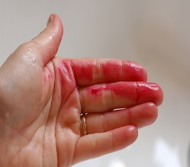
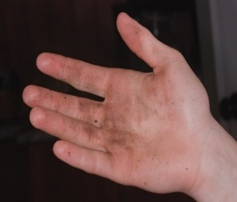
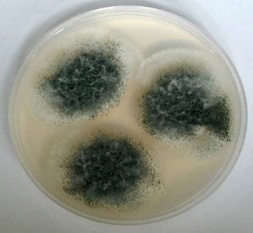



Hand Hygiene
What , When, How ?
What are types of Hand Hygiene?
Hand washing.
40-60 seconds
for visibly soiled hands & after using alcohol gel several times
when handling patients colonized/infected with spore-forming organisms
Use of alcohol rubs/gels.
20-30 seconds
for hands that are not visibly soiled.
Surgical hand ‘scrub.
brush and nail file
5 minutes (first wash of the day); 2-3 minutes (in between operations)

Slide 12
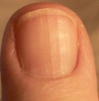

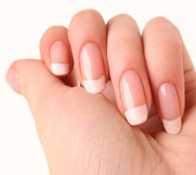
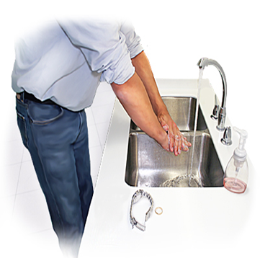
Tips for perfect clean hands
Hand Hygiene
Fingernails:
  Should be short, clean, and free from nail varnish as it harbour micro organisms that are not easily removed during hand hygiene.
  Jewellery:
  For proper hand hygiene REMOVE hand ring and watch

Slide 13
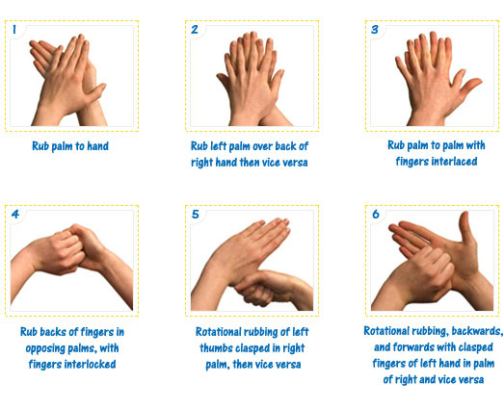
Hand Rub

Slide 14
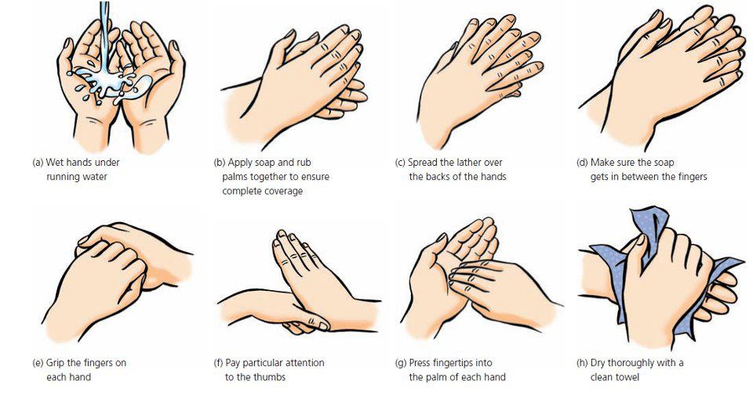
Hand Wash

Slide 15
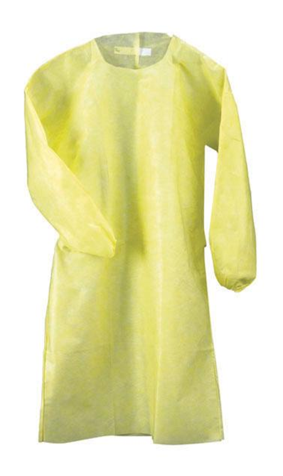
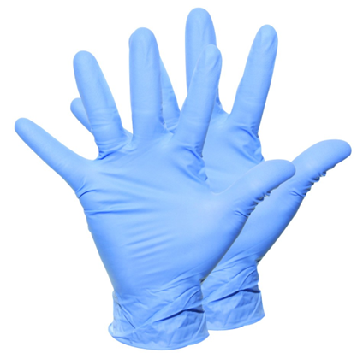
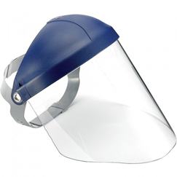
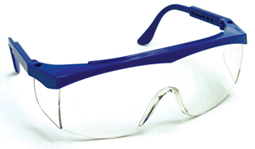
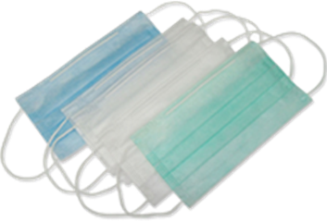
Personal Protective Equipment
A variety of barriers to protect both the patient and HCW’s from the potential risks of cross infection whenever blood/body fluid splashes are expected to come in contact with mucous membranes, airways, skin and clothing

Slide 16
Gown
Gown / apron is use to protect the skin or clothing to be in contact with blood and body fluid that may contain infectious agents

Slide 17


Protective eyewear
The conjunctival mucosa of HCW’s should be protected from spatter and debris created during procedures

Slide 18

Masks
Appropriate masks that cover the nose and mouth should be worn to protect the respiratory mucosa from contact with potentially contaminated droplet material.
Masks lose efficiency over time, as they become moist from the HCW’s breathing. Accordingly, masks should be changed when they become contaminated, wet.

Slide 19
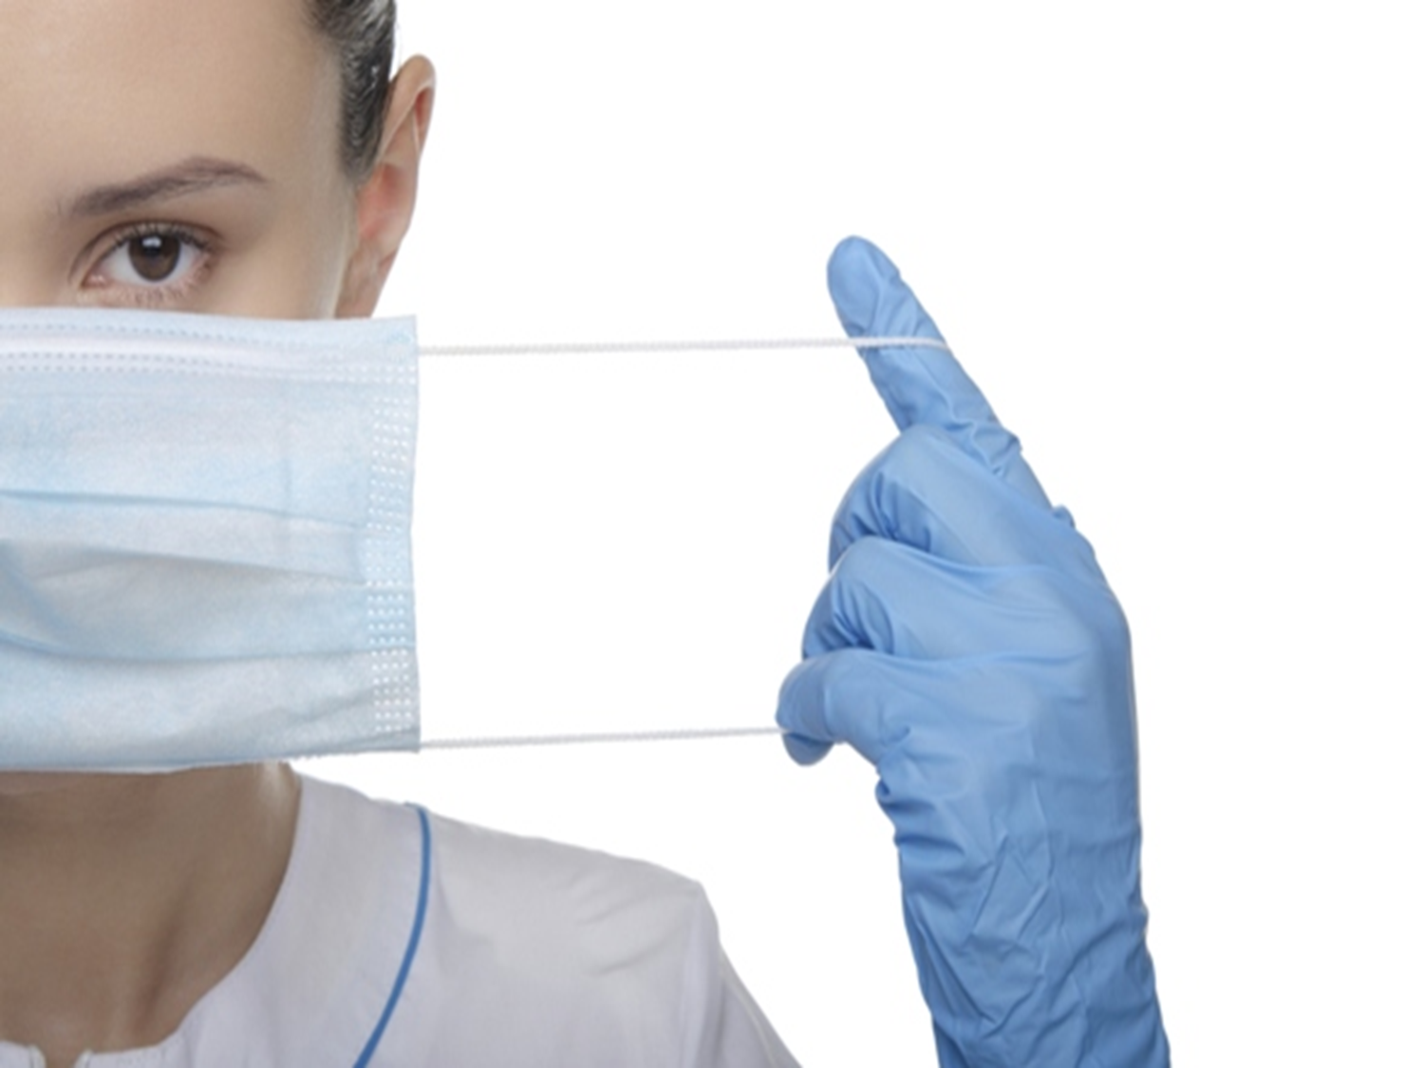
Masks
DON’T TOUCH
THE FRONT OF THE MASK

Slide 20

Gloves
Gloves are worn to protect the hands of the DHCPs from contamination.
Since gloves are not completely free from leaks and may tear, their use does not replace the need for hand hygiene.
Therefore, effective hand hygiene protocols should be followed before donning gloves and after removing them.

Slide 21
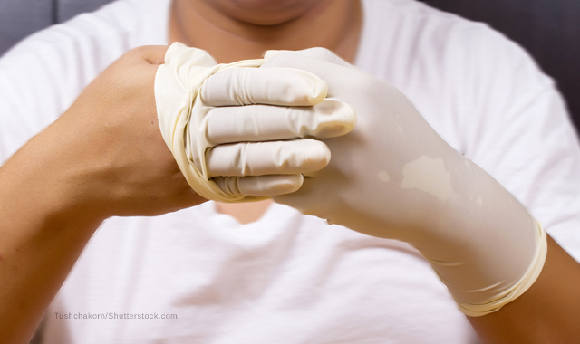
Gloves
The same pair of gloves must be used only for one patient.
Gloves should be put on immediately before the activity .
Gloves must be removed after the activity.
should be procedure-specific, not patient-specific

Slide 22
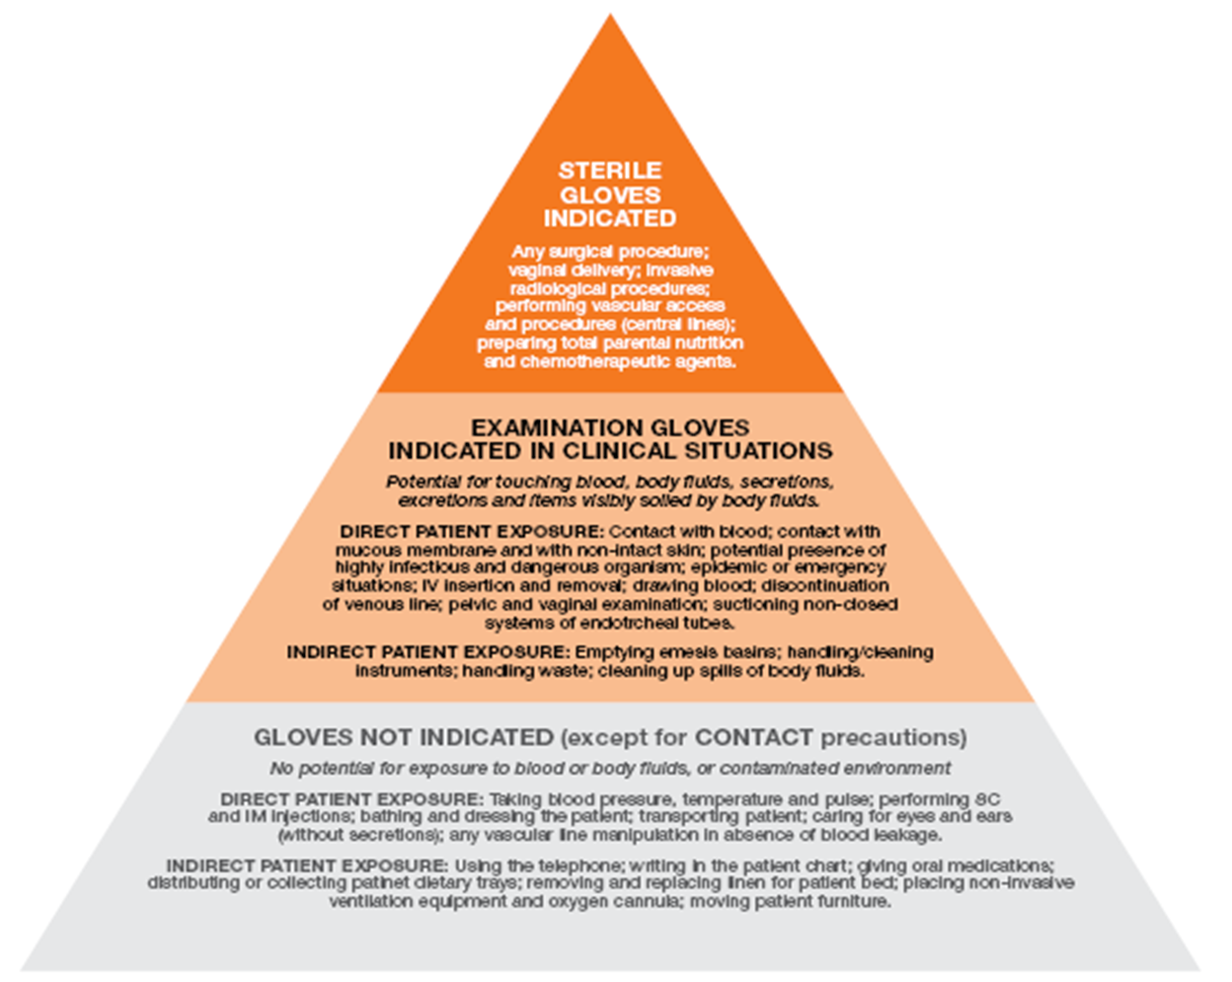
Glove Pyramid

Slide 23
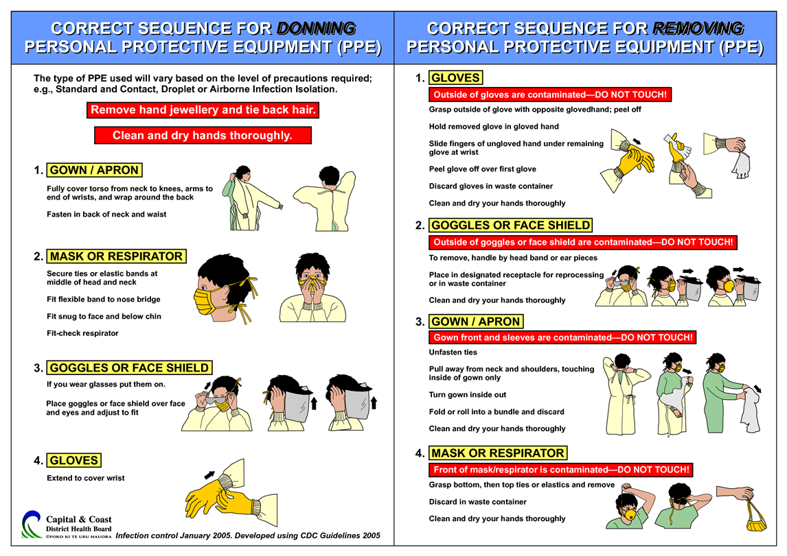
Donning & Doffing

Slide 25
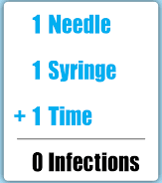
Safe Injection Practices
Do not recap, bend, break, or hand-manipulate used needles.
If recapping is required, use a one-handed scoop technique only.
Use safety features when available.
Place used sharps in puncture-resistant container.
Use Single Dose vials.

Slide 26
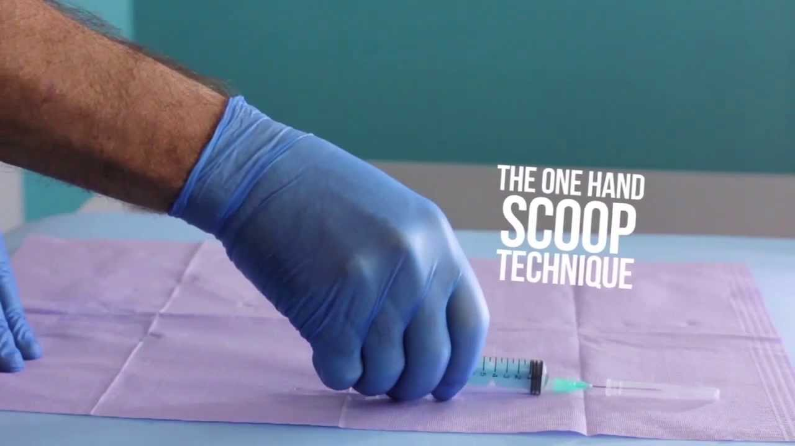
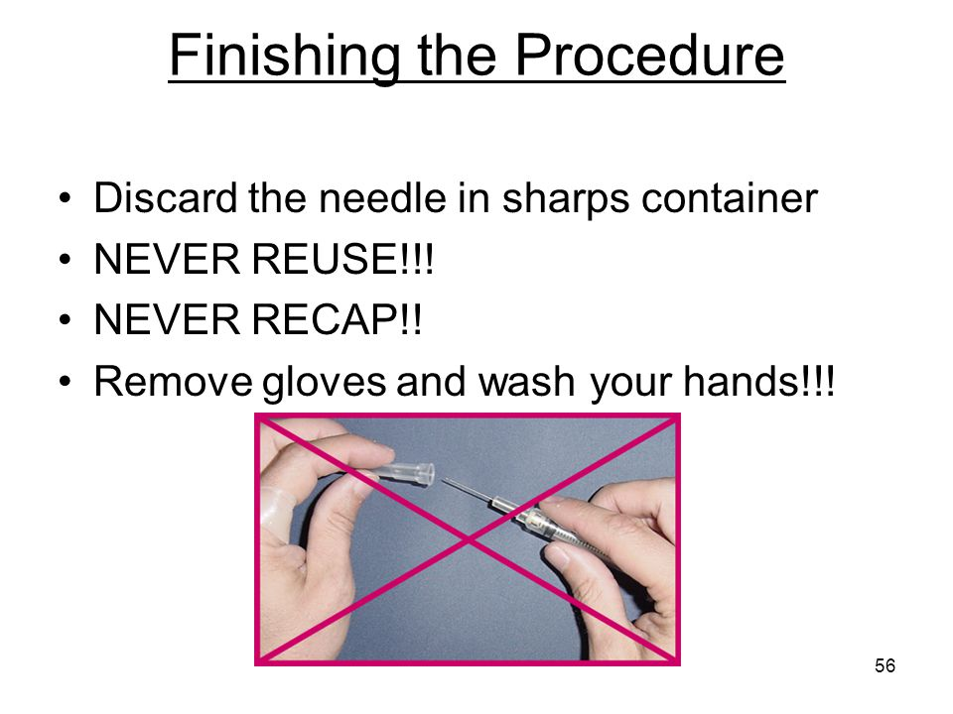

Slide 27
Patient Care Equipment
Handle used patient care equipment soiled with blood, body fluids in a manner that prevents transfer of microorganisms to one’s self, other patients and environments.
Single use, disposable items must be disposed properly.
Reusable items have to be been cleaned and reprocessed appropriately, prior to use on another patient based on the manufacture recommendation and the intended use (Spaulding criteria).

Slide 28
Definitions
Cleaning: Removal of adherent visible soil, blood, protein substances (tissue) and other debris from surfaces by mechanical or manual process.
Disinfection: Destruction of most viable pathogenic microorganisms to a specific level except spores (high, intermediate, and low).
Sterilization: The process by which all forms of microorganism, including bacteria, viruses, spores and fungi are destroyed.
MC-ICD-P/29,30 ,35 &41

Slide 29
Definitions
LOW-LEVEL DISINFECTION (LLD):
Low-level disinfection eliminates vegetative (‘live’) bacteria, some fungi and enveloped viruses. LLD is used for noncritical medical equipment/devices.
HIGH-LEVEL DISINFECTION (HLD):
High-level disinfection eliminates vegetative bacteria, enveloped viruses, fungi, mycobacteria (e.g., Tuberculosis) and non-enveloped viruses. HLD is used for semi critical medical equipment/devices.

Slide 30
The most important step in instrument reprocessing is….
…Cleaning!

Slide 31
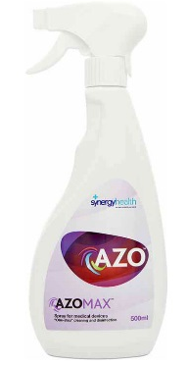
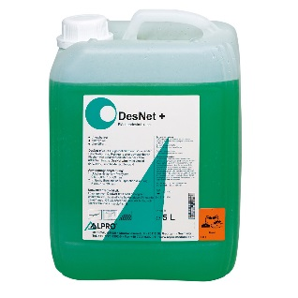
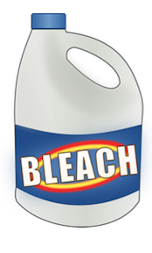
Environmental Control
Routine Cleaning: Hospital approved disinfectant , MC-ICD-P/14
AZO with Contact time 5 min.
DesNet plus with contact time 2 min.
Special Pathogen:
        MDRO/ MRSA: routine cleaning
        VRE: vigorous cleaning.
        Clostridium Defficille: Hypochlorite Releasing Products (contact time 2 min)

Slide 32
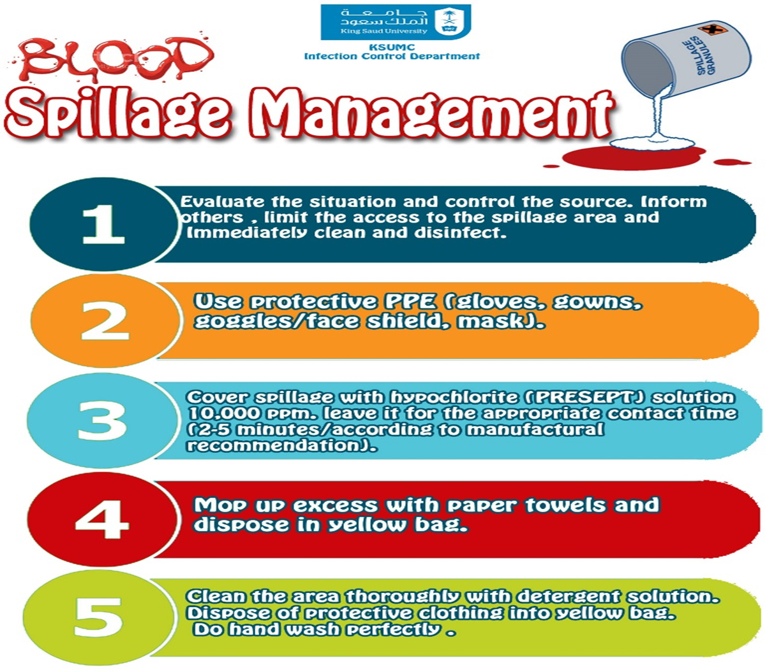
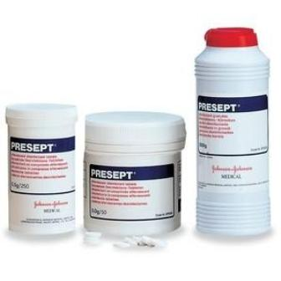

Slide 33

Blood spillage
        MC-ICD-P/01

Slide 34
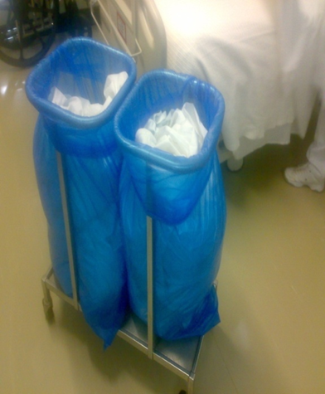
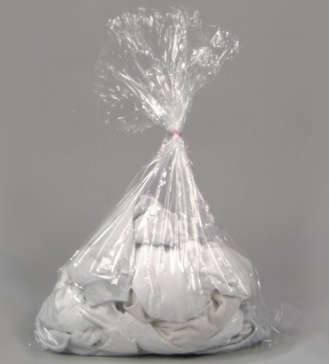
Textile and laundry
Not shaking the items.
Dispose non soiled items in blue bag.
Dispose soiled items transparent water soluble bag.
MC-ICD-P/36

Slide 35
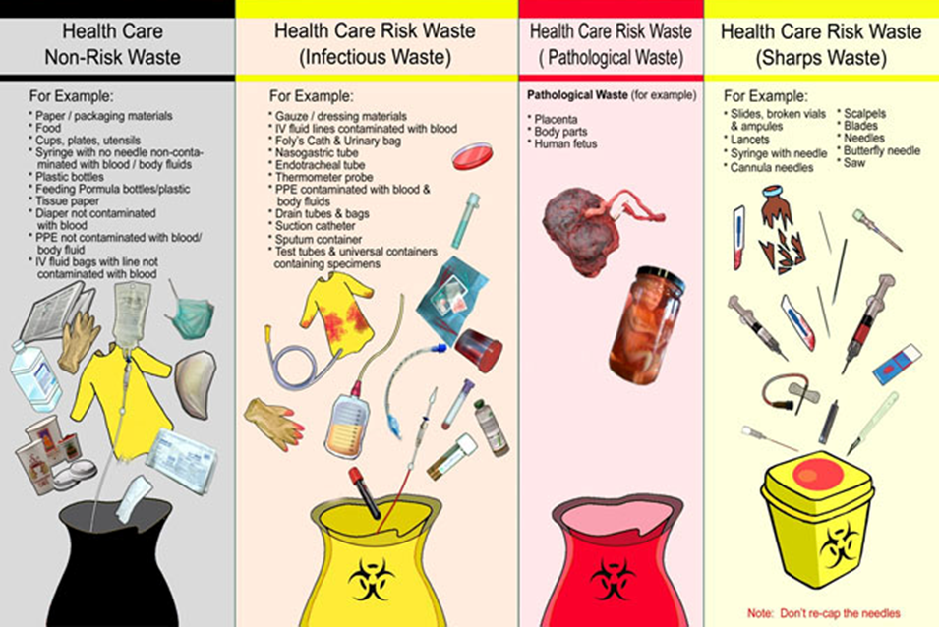
Waste Disposal

Slide 36

Worker Safety
Prevention of sharps-related injuries.
Precautions during aerosol-generating procedures.
Prevention of mucous membrane contact.

Slide 37

Patient Placement and Transport
Prioritize single room for patients with :
increased risk of infection transmission,
likely to contaminate the environment,
at increased risk of acquiring infection or
developing adverse outcome following infection.
During transportation:
any open infection should be contained
MC-ICD-P/06

Slide 38
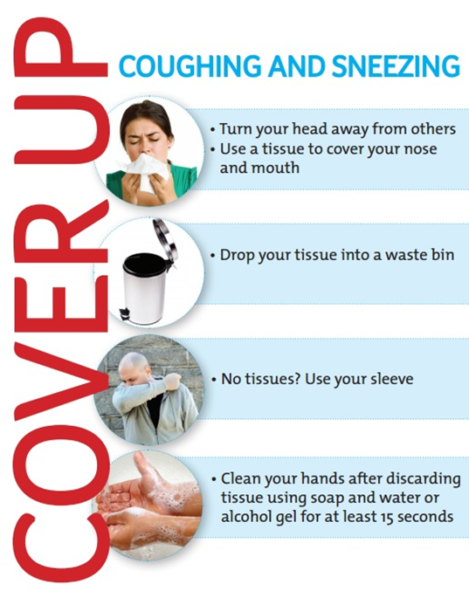
Cough Etiquette

Slide 39
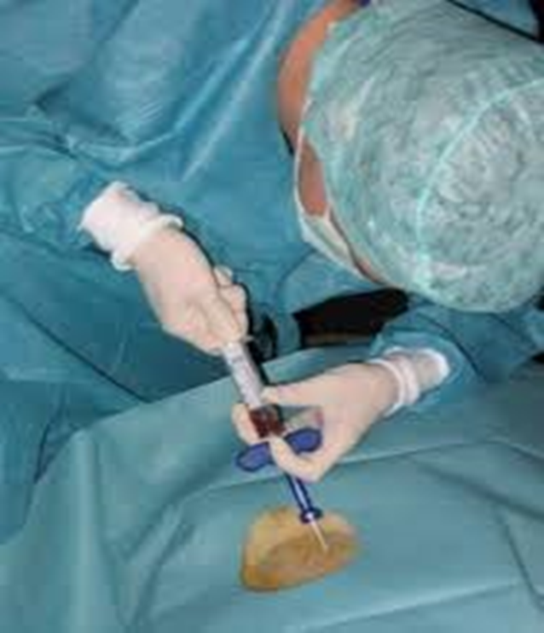
Infection Control Practices for Lumbar Puncture
Use face mask during lumbar puncture, spinal/ epidural anesthesia, intrathecal chemo, myelogram to prevent droplet spread of oral flora during spinal procedures.

Slide 40


