Slide 2
ISOLATION PRECAUTIONS

Slide 3
ISOLATION
The separation of a person with infectious disease from contact with other human beings for the period of communicability
MC-ICD-P/22

Slide 4
Transmission-Based Precautions
Airborne Precautions
Droplet Precautions
Contact Precautions

Slide 5
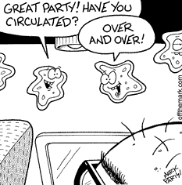
AIRBORNE PRECAUTIONS
Causative agents of diseases under airborne precaution are less than 5 μm, thus can be carried away by air currents

Slide 6
DISEASES UNDER AIRBORNE PRECAUTION
Measles
Tuberculosis (Pulmonary/Laryngeal)
Varicella

Slide 7
AIRBORNE PRECAUTIONS
Patient Placement
Single room with negative air pressure
12 air exchanges per hour(MOH)
Room door closed
MC-ICD-P/43

Slide 8
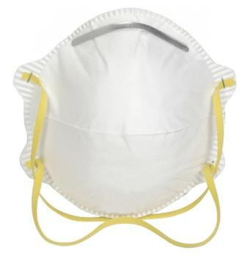
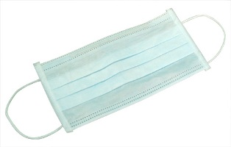
AIRBORNE PRECAUTIONS
Protection for HCW
Standard Precautions
N95 respirator
Patient Transport
Limit movement
Mask the patient
with surgical mask

Slide 9
AIRBORNE PRECAUTIONS
N95 mask is single use

Slide 10
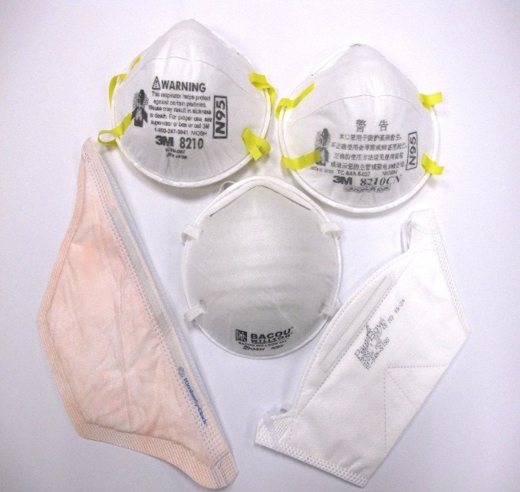
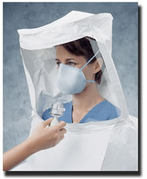
FIT TEST
MC-ICD-P/26

Slide 11
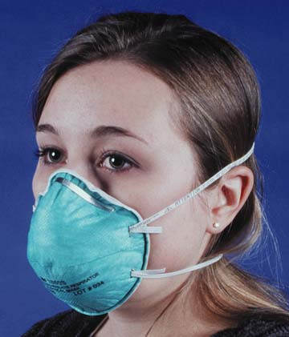
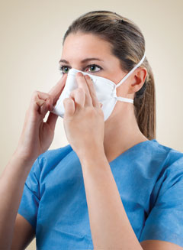
For Airborne Precautions
N95 respirator
Well sealed check
MC-ICD-P/05
Notes:
Proper fit testing is important to maximize the effectiveness of the mask
An N95 respirator will ONLY offer maximally effective protection if it has been tested to show that it fits well.
If the respirator has a bad fit, inhaled air can leak around the edges and be inhaled without going through the filter.
If the respirator has been fit tested, and the edges seal well to the face, inhaled air goes through the filter allowing the majority of the microorganisms and particulate matter to be filtered out of the air before it is inhaled

Slide 12
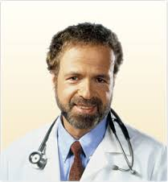
Powered Air purifying respirator (PAPR)

Slide 14
AIRBORNE PRECAUTIONS
Display sign outside the door. Remove sign after room is cleaned.
Common Conditions:
Pulmonary or Laryngeal Tuberculosis Chicken Pox Disseminated Herpes Zoster (Shingles) |  | Rubeola (Measles) Avian Influenza
Family and other visitors to follow precautions
Airborne Infection Isolation Room Use Airborne Isolation room. Nurse to notify Infection Control Preventionist and Facilities/Engineering of room number when starting and stopping precautions Dishes / Utensils: No special precautions. Kitchenware sanitized in dishwasher. Equipment / Supplies: Use dedicated or disposable equipment when available. Clean and disinfect reusable equipment including IV pumps, cell phone, or pagers (if used in room), other electronics, supplies and equipment prior to removing from patient’s room. Ensure blood pressure cuff and stethoscope are cleaned and disinfected between patients. Only essential supplies in room. Linen Management: Bag linen in the patient’s room. Patient Identification Procedure: Use patient’s label for validation of patient identity and destroy in room after use.
Personal Protective Equipment (PPE)
Put ON in order: Wash or sanitize hands Fitted N-95, 99, 100 respirator or PAPR required | Take OFF & dispose outside room, in order Fitted N-95, 99, 100 respirator or PAPR Wash or sanitize hands (even if gloves used)
Room Cleaning: After patient is discharged, keep door closed for one hour to allow complete room air exchange before routine cleaning procedures. Change cubicle curtain if visibly soiled.
Transport: Essential transport only and place surgical mask on patient. Clean and disinfect transport vehicle. Alert receiving department regarding patient’s isolation precaution status. Discontinue precautions as per hospital policy or Infection Preventionist Instructions.

Slide 16
Discontinuation of isolation precautions
Tuberculosis
Laryngeal/Pulmonary TB with positive smear sputum sample for acid fast bacilli is transmitted by airborne.
After 2 weeks from starting effective treatment, 3 sputum samples (with 8 hours in between & at least one morning sample) should be negative to discontinue the isolation.
MC-ICD-P/19

Slide 17
DROPLET PRECAUTIONS
Causative agents of diseases under droplet precaution are greater than 5 μm. They can travel up to 3 feet (1mtr)

Slide 18
DISEASES UNDER DROPLET PRECAUTION
Haemophilus influenzae type B disease, including meningitis, pneumonia, epiglottis and sepsis
Streptococcal (group A) pharyngitis, scarlet fever in infants and young children
Influenza, Mumps

Slide 19
DROPLET PRECAUTIONS
Patient placement
Private room
Cohort nursing

Slide 20
DROPLET PRECAUTIONS
Protection for HCW
Standard precautions
Surgical mask if working within 3 feet of the patient
Patient Transport
Limit movement
Mask the patient with
surgical mask

Slide 22
DROPLET PRECAUTIONS
Display sign outside the door. Remove sign after room is cleaned.
Common Conditions:
Seasonal Influenza Bacterial Meningitis (N. meningitides) |  | Pertussis (Whooping Cough) Mumps
Family and other visitors to follow precautions
Dishes / Utensils: No special precautions. Kitchenware sanitized in dishwasher. Equipment / Supplies: Use dedicated or disposable equipment when available. Clean and disinfect reusable equipment including IV pumps, cell phone, or pagers (if used in room), other electronics, supplies and equipment prior to removing from patient’s room. Ensure blood pressure cuff and stethoscope are cleaned and disinfected between patients. Only essential supplies in room. Linen Management: Bag linen in the patient’s room. Patient Identification Procedure: Use patient’s label for validation of patient identity and destroy in room after use.
Personal Protective Equipment (PPE)
Put ON in order: Wash or sanitize hands Gown (if needed) Mask Eye cover Gloves (if needed) | Take OFF & dispose outside room, in order Gloves (if used) Eye cover Gown (if used) Mask Wash or sanitize hands (even if gloves used)
Private Room: If not available, room with patient that has the same organism but no other infection.
Transport: Essential transport only and place surgical mask on patient. Clean and disinfect transport vehicle. Alert receiving department regarding patient’s isolation precaution status. Discontinue precautions as per hospital policy or Infection Preventionist Instructions.

Slide 23
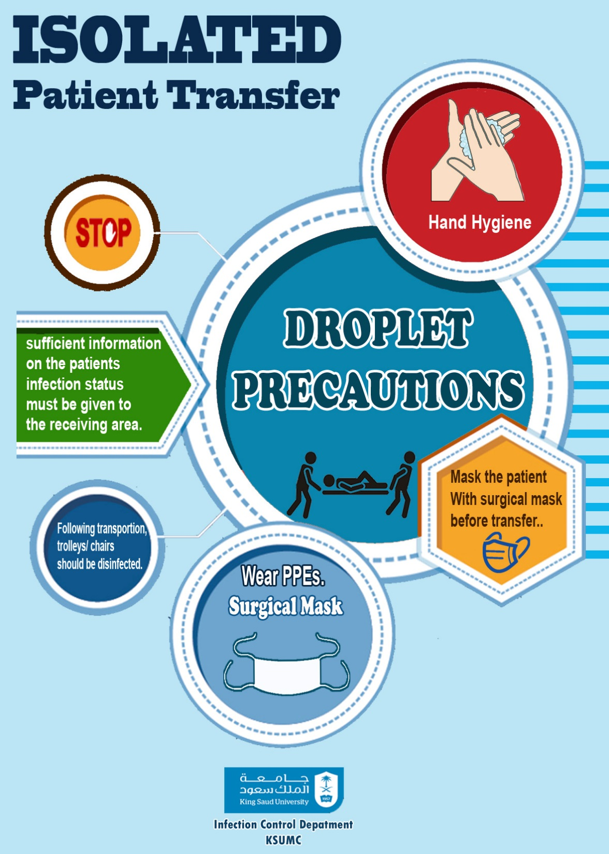

Slide 24
Discontinuation of isolation precautions
Influenza
24 h after resolution of fever, provided
■ Have received 72 hours of anti-influenza
OR
■ 5 days have elapsed since onset of symptoms.
NO need to repeating the nasopharyngeal swab.
Performing aerosol-generating procedures:
Standard & airborne precautions are recommended
MC-ICD-P/02

Slide 25
CONTACT PRECAUTIONS
Use In addition to standard precaution, for patients known or suspected to have serious illness transmitted through contact

Slide 26
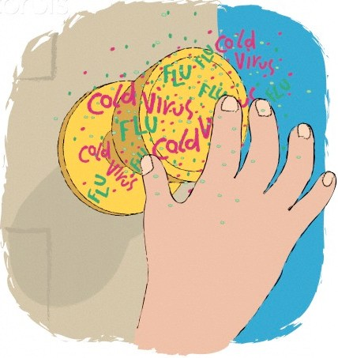
CONTACT PRECAUTIONS
Direct Contact Transmission
In-Direct Contact

Slide 27
DISEASES UNDER CONTACT PRECAUTION
Multi-drug resistant microorganisms (MDRO’s), VRE, MRSA, ESBL, B.cepacia
RSV infection in infants, young childrena nd immunocompromised patients
Clostridium defficile enterocolitis

Slide 28
CONTACT PRECAUTIONS
Patient placement
Private room
Cohort nursing

Slide 29
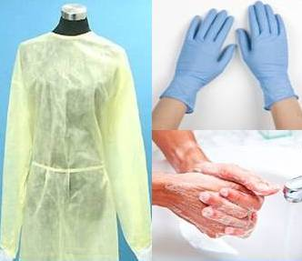
CONTACT PRECAUTIONS
Protection for HCW
Handwashing
Gloves
Gown
Patient Transport
Limit movement

Slide 31
CONTACT PRECAUTIONS
Display sign outside the door. Remove sign after room is cleaned.
Common Conditions:
Multi-Drug Resistant Organism Methicilline Resistant Staphylococcus Aureus (MRSA Vancomycin Resistant Enterococcus (VRE) |  | Clostridium Difficile Infection (C. Diff) Scabies Wounds or abscesses with uncontained drainage
Family and other visitors to follow precautions
Dishes / Utensils: No special precautions. Kitchenware sanitized in dishwasher. Equipment / Supplies: Use dedicated or disposable equipment when available. Clean and disinfect reusable equipment including IV pumps, cell phone, or pagers (if used in room), other electronics, supplies and equipment prior to removing from patient’s room. Ensure blood pressure cuff and stethoscope are cleaned and disinfected between patients. Only essential supplies in room. Linen Management: Bag linen in the patient’s room. Patient Identification Procedure: Use patient’s label for validation of patient identity and destroy in room after use.
Personal Protective Equipment (PPE)
Put ON in order: Wash or sanitize hands Gown Mask (if needed) Eye cover (if needed) Gloves | Take OFF & dispose outside room, in order Gloves Eye cover (if used) Gown Mask (if used) Wash or sanitize hands (even if gloves used)
Private Room: If not available, room with patient that has the same organism but no other infection.
Transport: Essential transport only. Place patient in clean gown. Clean and disinfect transport vehicle. Alert receiving department regarding patient’s isolation precaution status. Discontinue precautions as per hospital policy or Infection Preventionist Instructions.

Slide 33
Discontinuation of isolation precautions
MDRO
All Colonization/Infection patients with MDRO should be under Contact Isolation.
Isolation can be discontinued after receiving 3 negative lab result 48hrs after antimicrobial discontinuation
MC-ICD-P/23 &44

Slide 34
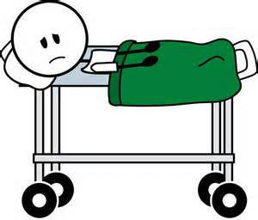
EMPIRIC ISOLATION PRECAUTIONS
The risk of infection transmission may be highest before a definitive diagnosis can be reached
Therefore, patients with certain clinical syndromes should be isolated empirically until we have a definitive diagnosis.

Slide 35
THANK YOU!!!!

