Slide 2
WASTE MANGMENT
INFECTION CONTROL DEPARTMENT

Slide 3
Aim and objectives:
Know different types of wastes.
The proper segregation and disposal of Health Care Waste.
Four steps of waste management.
Minimize the risks of hazardous agents.

Slide 4
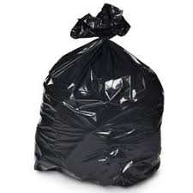
Types Of Hospital Waste
1-Health care non- Risk Waste
Definition:
They represent no potential
infections, chemical or
radioactive risk.
Segregation and disposal:
They are disposed in black plastic
Offensive
Domestic
Packaging
Recyclable
Food

Slide 5
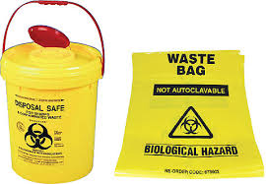
Types Of Hospital Waste
2-Healthcare Risk Waste
Definition:
They are contaminated/ potentially contaminated with infectious, chemical or radioactive . They should be handled & disposed off very carefully.
Infectious waste
Sharp waste
Human and animal parts

Slide 6
Healthcare Risk Waste 1- Infectious waste
Definition: Waste potentially transmit an infectious disease due to its load of bacteria, viruses, parasites, fungi.
Example :
Cultures and stocks of infectious agents from laboratory work.
Waste from surgery and autopsies (e.g. tissues, materials or equipment that have been in contact with blood or other body fluids).
Waste soiled with human blood or other body fluids.

Slide 7
NOTES :
Urine and faeces are not considered infectious waste unless:-
The specimen of urine or faeces is for laboratory testing.
The urine or faeces is contaminated with visible blood.
The urine or faeces are infected with pathogenic micro- organisms. E.g. typhoid fever, enteritis, cholera.

Slide 8
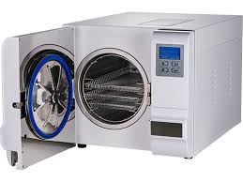
Healthcare Risk Waste Infectious waste (cont.,)
Segregation and disposal:
Handled in yellow plastic bags with Bio- hazard logo
Highly infectious microbial cultures such as viruses, TB, Brucella, are to be collected in yellow bags suitable for pre treatment with autoclave with “Highly Infectious Waste“& Bio- hazard logo

Slide 9
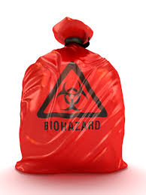
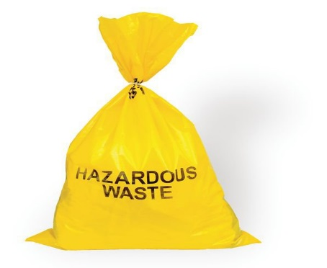
Healthcare Risk Waste 2-Human and Animal parts
Definition:
Organs, human parts, nonviable fetuses, placenta.
Segregation and disposal:
Handled in red plastic bags with Bio- hazard logo
to be kept at mortuary until they are dealt
with in accordance to Islamic Sharia (law). MC-ICD-P/12
Contaminated animal parts are handled in yellow plastic bags.

Slide 10
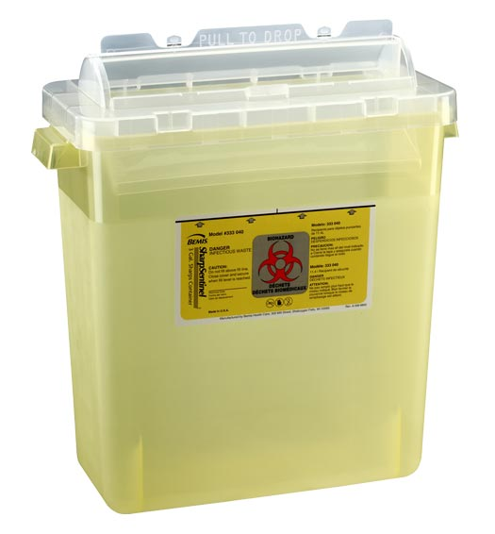
Healthcare Risk Waste 3-Sharp waste
Definition:
Any device with acute rigid edges capable of cutting or piercing, E.g needles, syringes, scalpels, saws, blades and broken glass.
Segregation and disposal:
Collected in yellow puncture resistant sharp containers, with Bio- hazard logo ,date of first use and wall mounted .
*Placed in point of care .

Slide 11
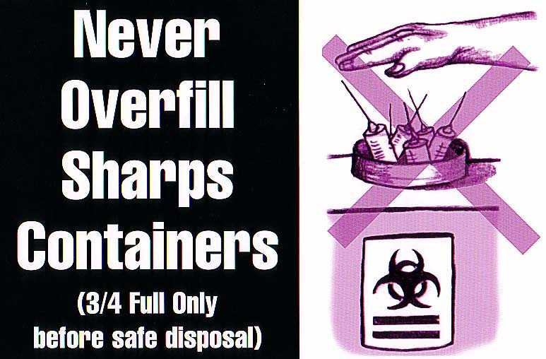
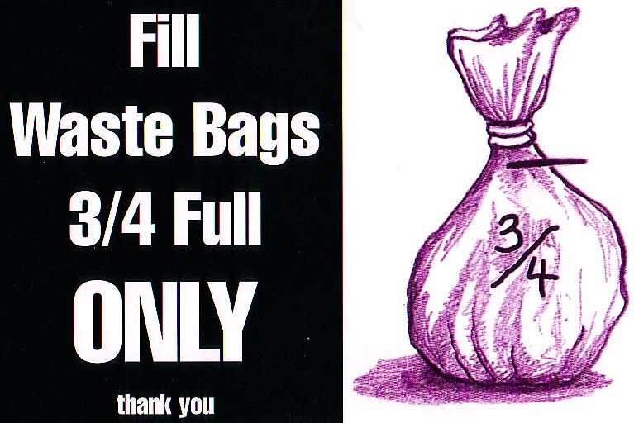
Safe disposal of waste
Disposable bags &puncture resistant containers should be disposed when it is ¾ full.
In case of the yellow puncture resistant containers are not ¾ full dispose after 7 days.
Each type of waste should be separated from the other.
MC-ICD-P/25

Slide 12
Management Four Steps Of Waste Management Four Steps Of Waste Management

Slide 13
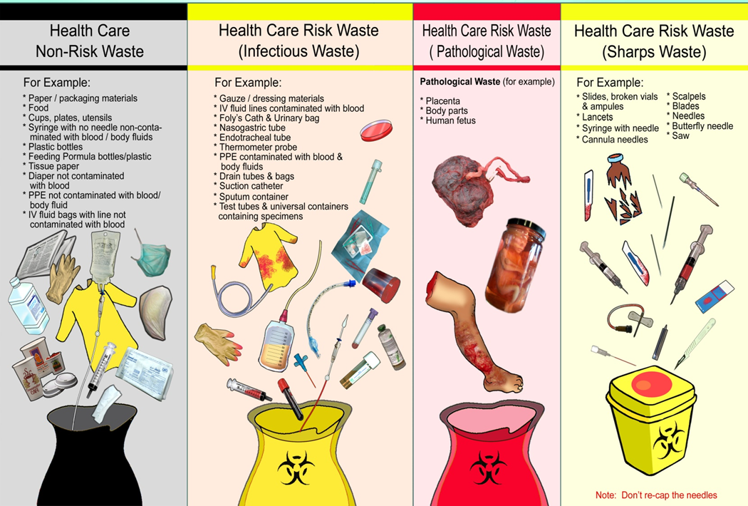
1- Segregation segregation of wastes according to its color cod.

Slide 14
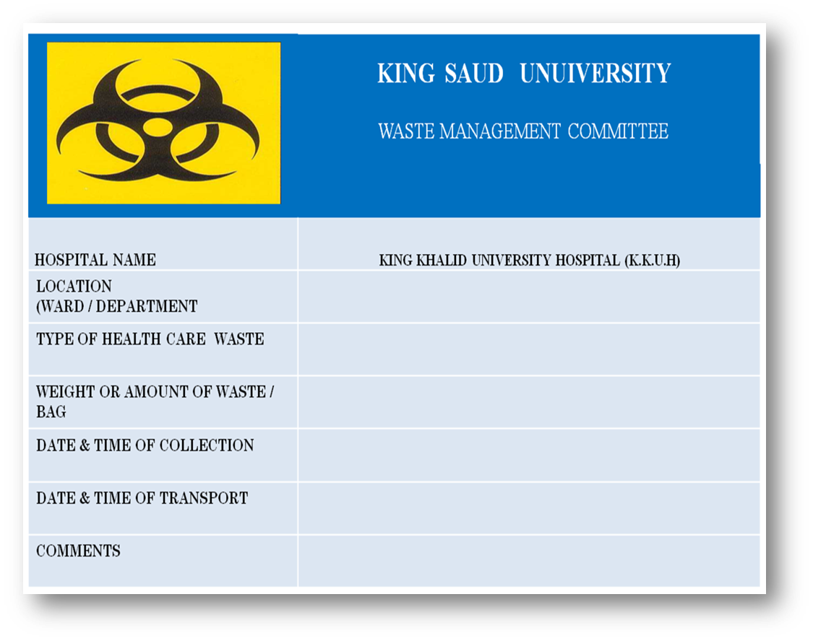
Data Stickers Stickers
Stickers must be attached to the containers and bags of waste prior to their transportation to stores within the health care facility.
Stickers should have the following data:
Waste generator name
Site name
Type of waste
Weight and the quantity of waste
Date and time of collection transportation date and time to disposal facility

Slide 15
2. Handling
Wear heavy utility gloves and shoes.
Wash hands after handling waste & removing gloves.
Containers should be collected when 3 /4 full.
Waste carts should be leak proof and well covered.

Slide 16
3. Internal Storage
Place that is minimally accessible ,away from rodents, insects.
Supply with cleaning equipment &PPE.
Hazardous waste should not be stored longer than 2 days .
It should be easily cleaned and disinfected , with good drainage.

Slide 17
4. Disposal

Slide 19
Questions
1-all the urine and faeces consider as infectious waste :
Yes
No
2- after the mother delivery we dispose the placenta in :
black bag
Yellow bag
Red bag
3-discard the sharp continuers when :
¾ full or after 7 days
Over full
Daily
4- health care non risk waste including food and packaging :
Yes
No
5-wher we should dispose the gloves contaminated by some blood :
Sharp box
Yellow bag
Black bag

