Slide 1
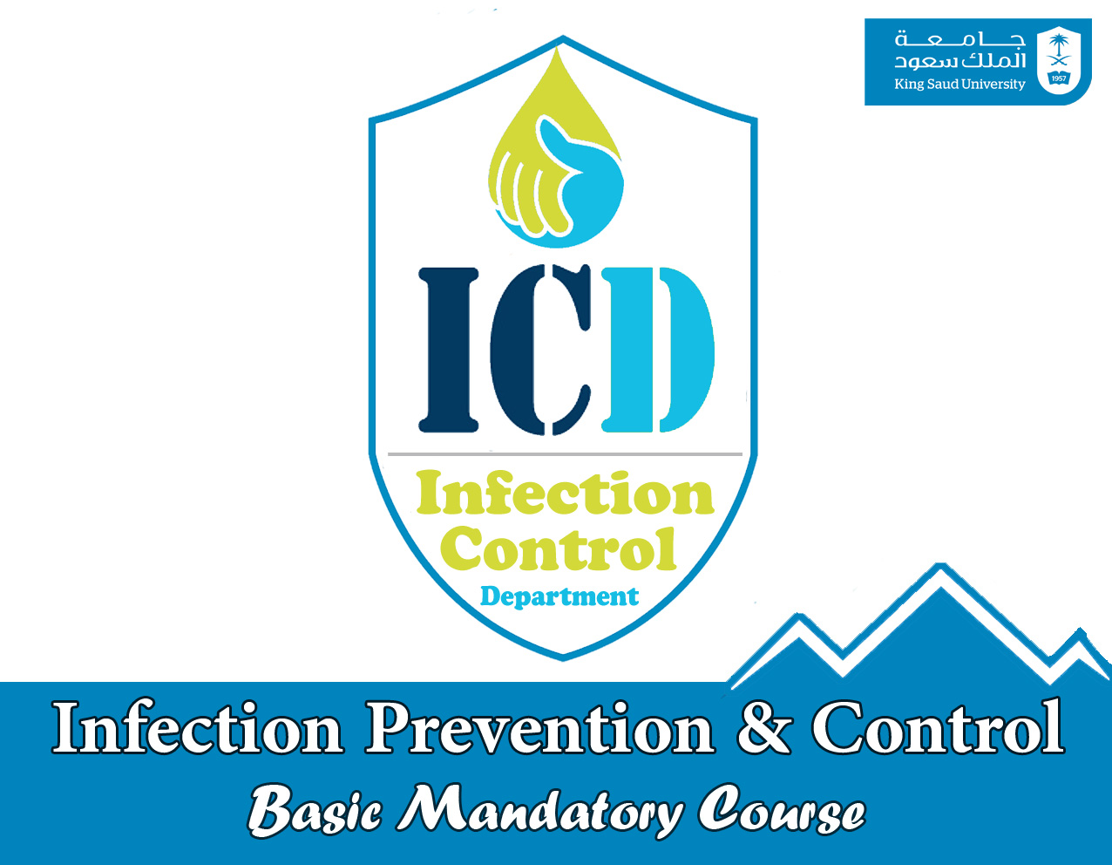

Slide 2

Occupational

Slide 3

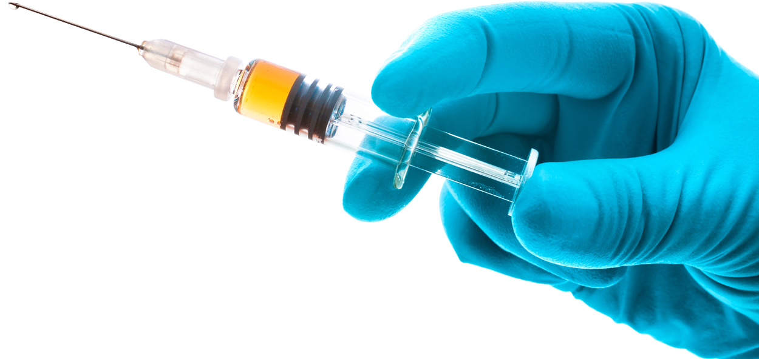
I.C Occupational program
Pre-Employment check-up
TST/ QuantiFERON-TB Annually.
Fit test for N95 Respirator.
Post exposure management.
Staff immunization
Hepatitis B
Measles
Mumps
Rubella
Varicella
Influenza (annually)

Slide 4
Post exposure management
Blood borne pathogen
Tuberculosis
Varicella
MERS-CoV

Slide 5
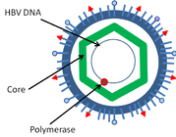

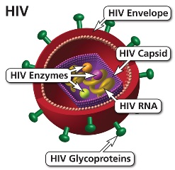

Blood borne pathogens
Blood Borne Viruses include:
Hepatitis B
Hepatitis C
HIV / AIDS

Slide 6

Exposure Prevention
Blood borne pathogens
Hepatitis B (positive source) - 1 in 3
Hepatitis C (positive source) - 1 in 30
HIV (positive source) - 1 in 300
(Estimated risk from person infected)
(UKED 1998) (Alder 1997)

Slide 7
Blood borne pathogens Exposure
A percutaneous injury or contact of mucous membrane or non-intact skin
WITH
Blood ,tissue and body fluids
Semen and vaginal secretions
CSF, synovial , pleural , peritoneal , pericardial , amniotic fluid
Human bites
Contact without barrier protection to concentrated virus in lab
Feces, nasal secretions, saliva, sputum, sweat, tears, and vomitus
are not considered potentially infectious
unless they contain blood.

Slide 8

Exposure Prevention
After exposure:
HCP
Source
Deal with the Exposure Site.
Wash cut wound with soap and water.
Flush splashes to the nose, mouth with water.
Irrigate eyes with clean water, saline.
THEN
Report the incident to your supervisor.
Immediately seek medical treatment.
Evaluation to check the presence of blood born pathogens

Slide 9


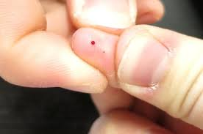
Don't squeeze

Slide 12
HCP evaluation
HCP evaluation is required for proper management
Hepatitis B (Hepatitis B Markers)
Hepatitis C (ANTI- HCV)
HIV (ANTI – HIV)
LFT in HCV POSITIVE Source

Slide 13
Source evaluation
HCP evaluation is required for proper management
Hepatitis B (Hepatitis B Markers)
Hepatitis C (ANTI- HCV)
HIV (ANTI – HIV)
LFT in HCV POSITIVE Source

Slide 14
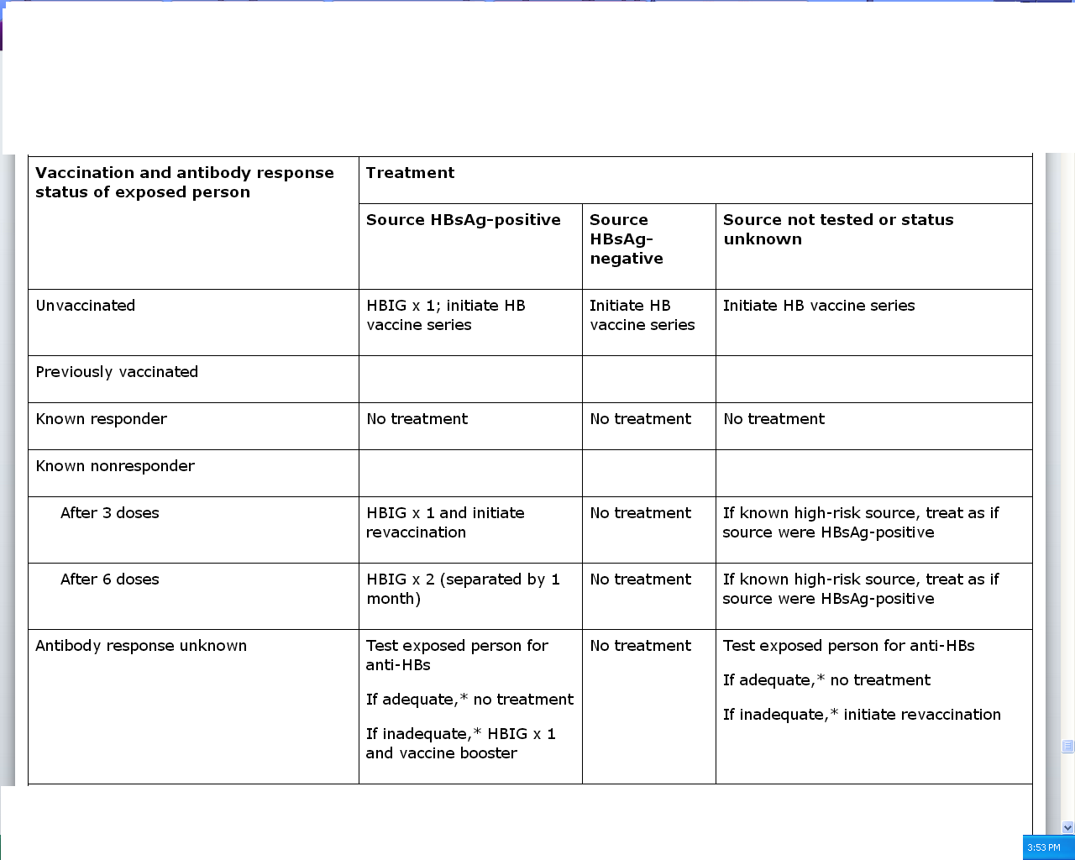
HBV POSITIVE source

Slide 15

Exposure Prevention
HBV vaccine
Hepatitis B vaccine series :
3 Doses at 0,1,6.
after 1-2 M check Anti- HBs.
IF > 10 ml U/ml = Responder
IF less than 10 ml U/ml = Non Responder
For Non Responder, receive a second series and after 1-2 M check Anti- HBs.

Slide 16
What about the Source?
MARKERS | INDICATE
HBsAg
(Hep B Surface Ag)
Infection with Hepatitis B virus
Anti-HBs
IMMUNITY > 10 ml U/ml
HBeAg
(Hep B Envelope Ag)
Active viral replication
Reduced viral replication
Anti- HBe
Anti- HBc IgM
Acute infection
Anti- HBc IgG
Past exposure to HBV

Slide 17

HCV POSITIVE source
Perform baseline testing for anti-HCV and LFT.
Earlier diagnosis of HCV infection is desired, testing for HCV RNA (RT-PCR)
Perform follow-up testing (e.g., at 4 & 6 months) for anti-HCV and ALT .
Confirm all anti-HCV positive results

Slide 18

HIV POSITIVE source
Several Factors may increase the risk of transmission:-
If HCW is exposed to a large quantity of blood.
A procedure that involved a needle is placed directly in a vein or artery or a deep injury.
If the source patient is in the terminal illness.
If the injury is deep with hollow-bore needles or penetrating sharps-related event.

Slide 19

Exposure Prevention
HIV POSITIVE source
Post exposure prophylaxis immediate MEDICATION.
Follow up by Anti- HIV test at 6 weeks, 3 months, 6 months, Extending follow-up to 12 months.
EIA standard test
direct virus assays not recommended

Slide 20
Antiretroviral Agents for PEP
Nucleoside reverse transcriptase inhibitors (NRTIs).
Nucleotide reverse transcriptase inhibitors (NtRTIs).
Nonnucleoside reverse transcriptase inhibitors (NNRTIs),
Protease inhibitors(PIs), and a single fusion inhibitor.
HIV PEP should regimen
(zidovudine (AZT) + lamivudine (3TC)
complete a full 4-week

Slide 21

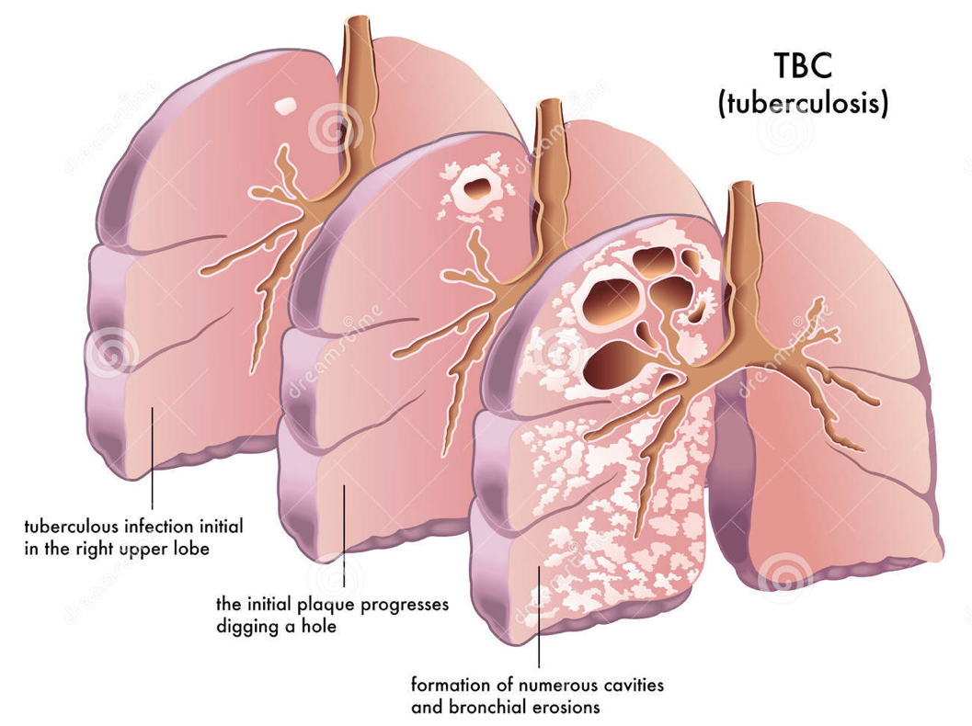
Exposure Prevention
Tuberculosis

Slide 22
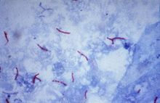
Exposure Prevention
Tuberculosis

Slide 23
T.B. Exposure
T.B. Exposure is defined as:
unprotected exposure to a patient suspected to have pulmonary or laryngeal that represent a possible transmission risk to HCP and others within the medical canter institution.
T.B. Exposure include:
Face-to-face contact with infectious TB patients.
Entering patient rooms ( patient is present or not).
Participating in aerosol-generating procedures.
Participating in specimen processing (culture ).

Slide 24
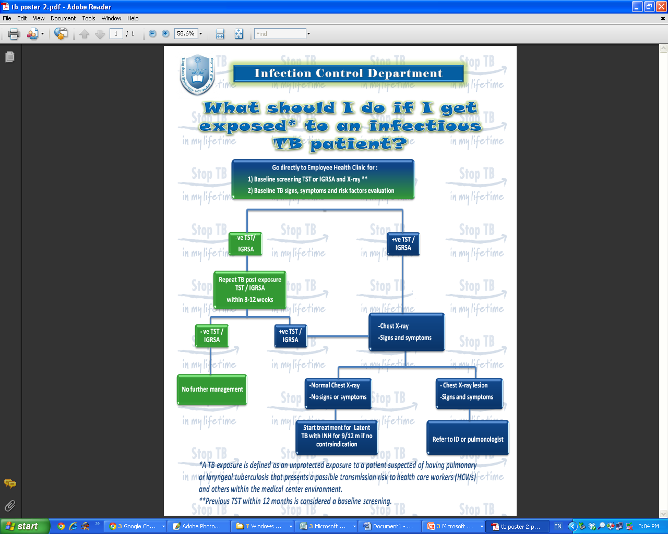

Slide 25
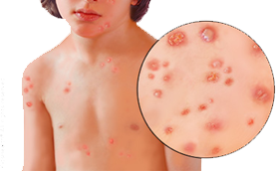
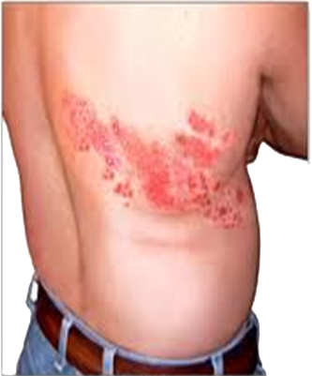
Varicella Exposure
Chicken pox
Varicella Zoster

Slide 26
Varicella Exposure
Chicken pox
Transmission
Mode of transmission:
Airborne
Contact
Examples:
Patients in the same room.
Face to face contact or (5 minutes or more).
Visit by a contagious person.
Period Of Communicability
1 – 2 days before the rash.
4-5 days after until all vesicles are crusted.
Varicella Zoster
Transmission
Mode of transmission:
Contact
Examples:
contact (e.g. touching or hugging) with a contagious person with exposed zoster lesions.
Period Of Communicability
until all vesicles are crusted.

Slide 27

Varicella Post-Exposure
Vaccine
Given to susceptible contacts (within 3 days of exposure) may prevent or significantly modify disease.
Immunoglobulins VZIG ( within 4days of exposure)
Susceptible immunocompromised patients
Susceptible pregnant women. (there is no assurance that VZIG will prevent congenital malformations in the fetus, but it may modify varicella severity ).
Sick leave
Remain off work from days 10-21 post exposure.

Slide 28
Immunization For Healthcare Workers
Vaccine | Schedule
Hepatitis B | 1 ml intramuscularly at 0 (1-4M)/ 1 (2-17)/and 6
Influenza | 0.5 ml intramuscularly annually
Varicella | 0.5 ml subcutaneously 2 doses (4-8 w)

Slide 29
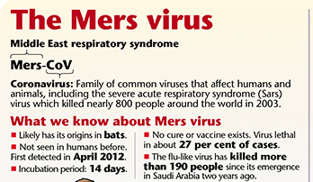
MERS-CoV Exposure

Slide 30
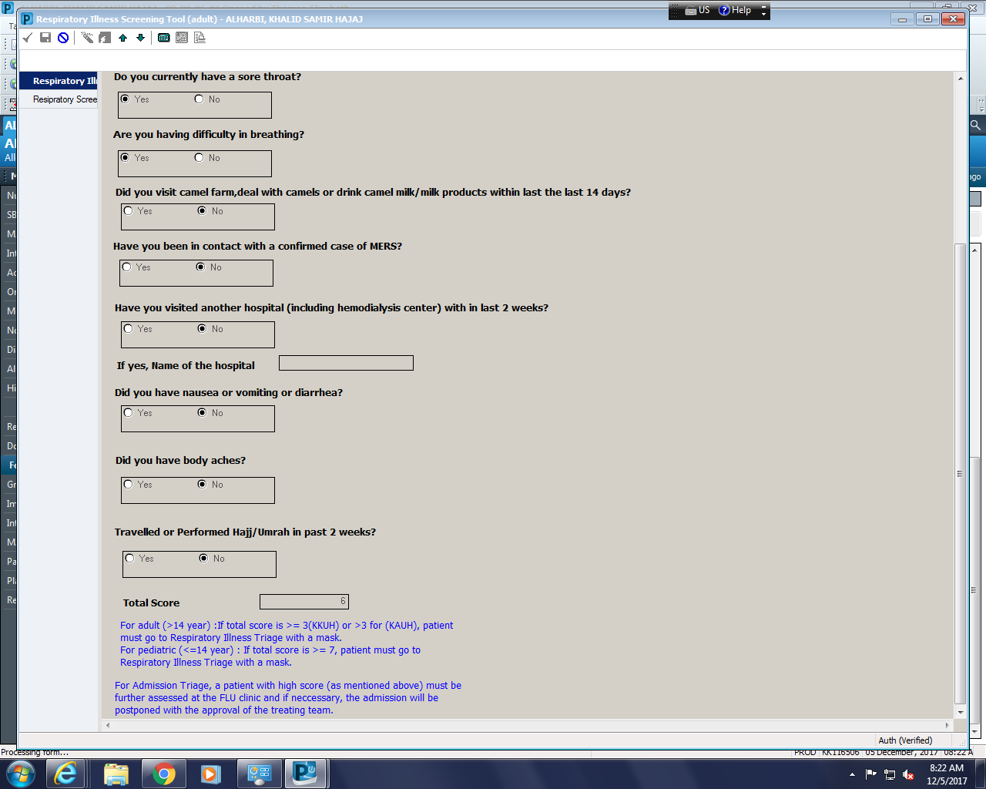
MERS-CoV Exposure

Slide 31
Suspected case of MERS-COV
Adults (> 14 years)*
Acute respiratory illness with clinical and/or radiological, evidence of pulmonary parenchymal disease (pneumonia or Acute Respiratory Distress Syndrome)
A hospitalized patient with healthcare associated pneumonia based on clinical and radiological evidence.
Upper or lower respiratory illness within 2 weeks after exposure to a confirmed or probable case.
Unexplained acute febrile (≥38°C) illness, AND body aches, headache, diarrhea, or nausea/vomiting, with or without respiratory symptoms, AND leucopenia (WBC<3.5x109/L) and thrombocytopenia (platelets<150x109/L) .
Unexplained febrile illness with recent (14 days) exposure to camels or camel products
Pediatrics (≤ 14 years)
Meets the above case definitions and has at least one of the following:
  History of exposure to a confirmed or suspected MERS CoV in the 14 days prior to onset of symptoms
  History of contact with camels or camel products in the 14 days prior to onset of symptoms
II. Unexplained severe pneumonia
*Patient’s receiving dialysis and those with heart failure could present atypically and high index of suspicion is required.

Slide 32
Probable case
A probable case is a patient in category I or II with inconclusive laboratory results and :
close contact of a laboratory-confirmed MERS-CoV case , works in a hospital where MERS-CoV cases are cared for
or had recent contact with camels or camel products
Confirmed case
positive PCR

Slide 33
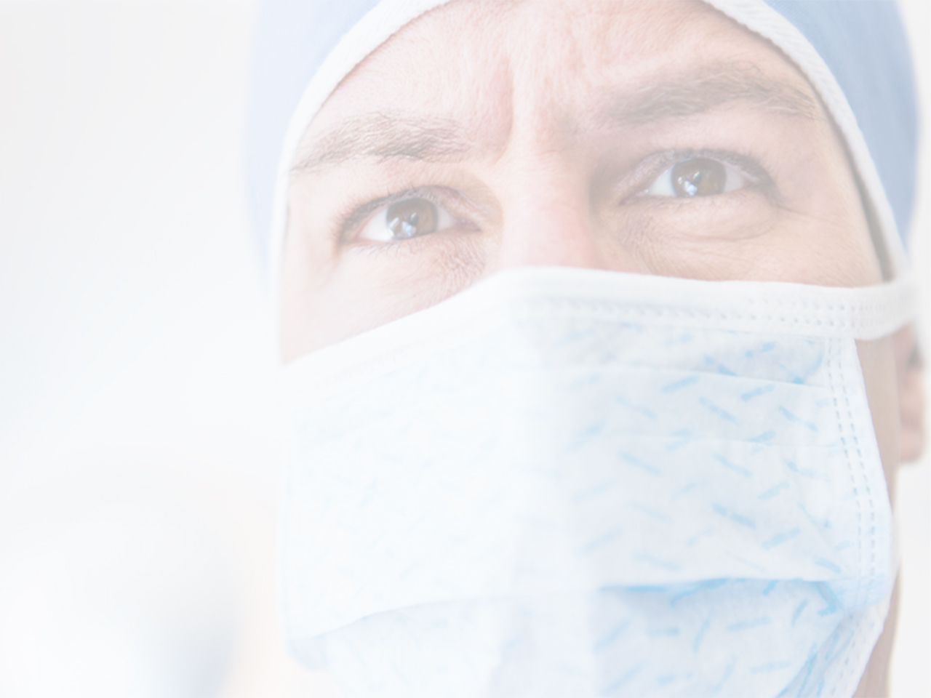
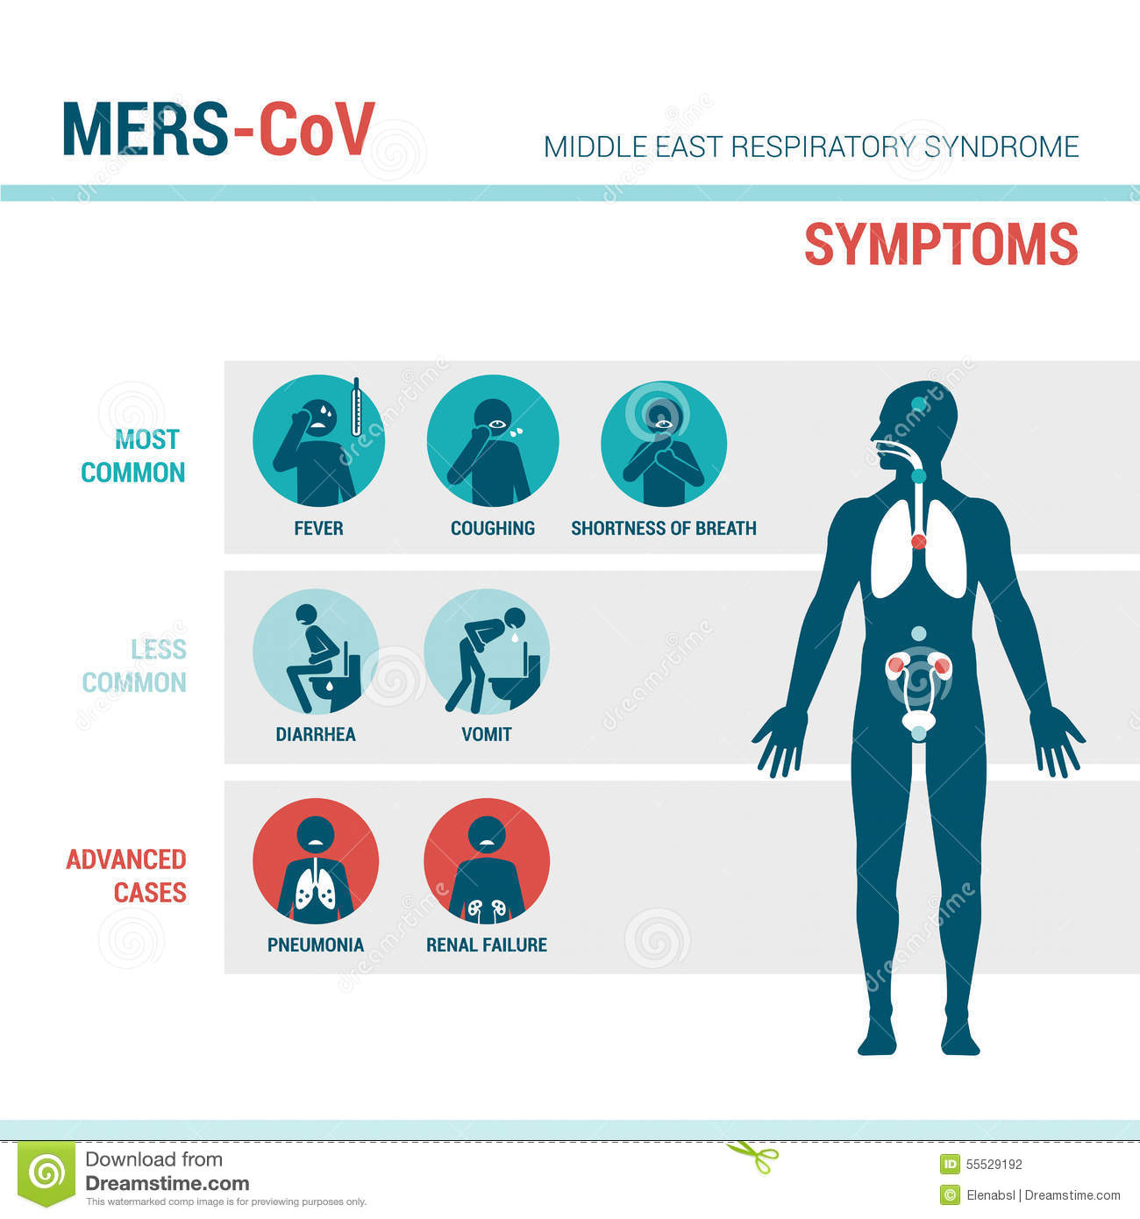

MERS-COV diagnosis

Slide 34
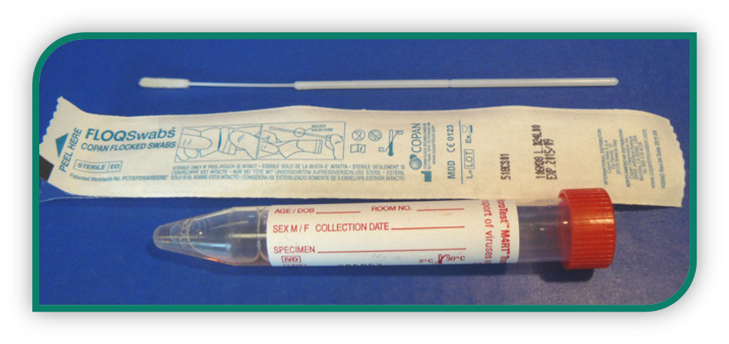
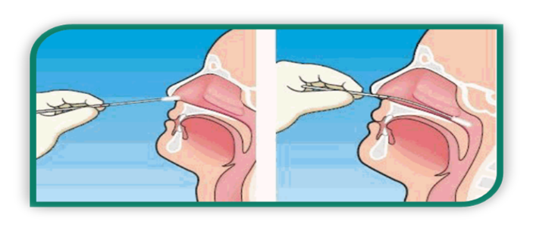
MERS-CoV Diagnosis

Slide 35

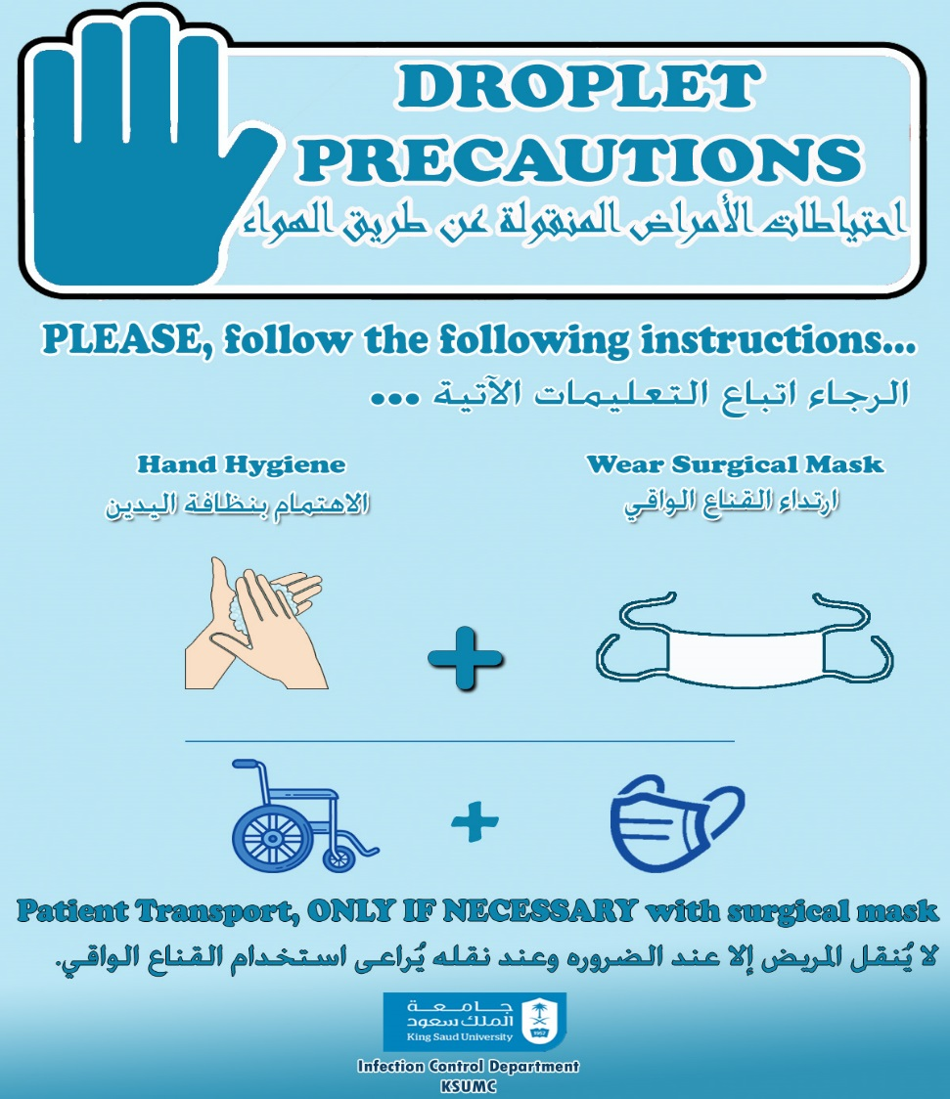
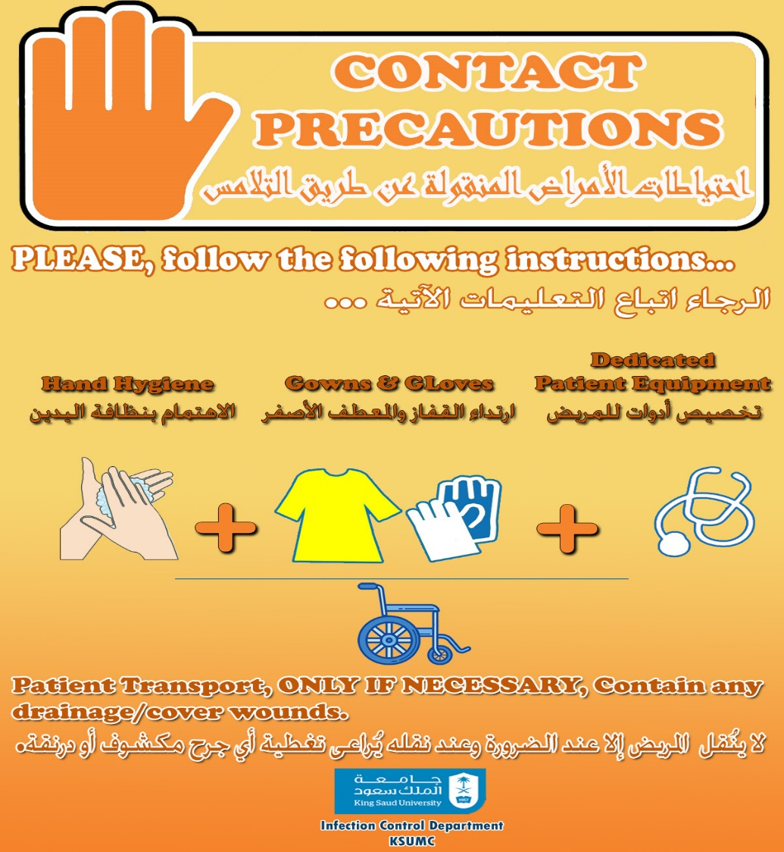
Stable patients & non-aerosolized procedures:
Standard Precautions, plus
Contact and Droplet Isolation Precautions

Slide 36
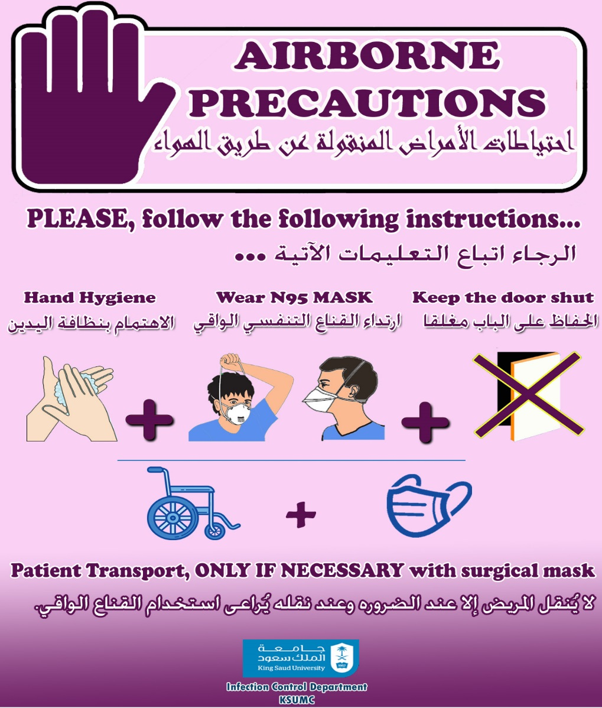

Critically-ill patients & aerosolized procedures:
Standard Precautions, plus
Contact and Airborne Isolation Precautions

Slide 37
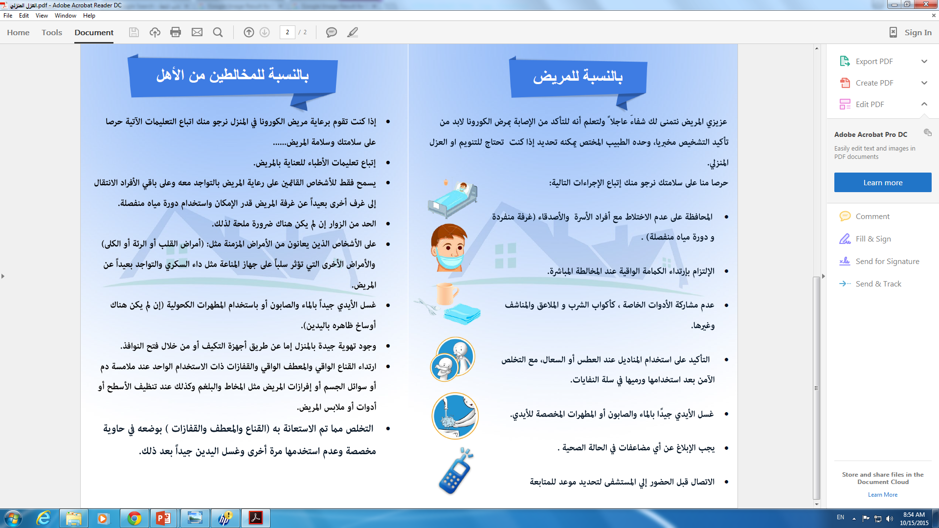
Home isolation

Slide 38
MERS-CoV Post-Exposure
High-risk unprotected exposure
(Contact with confirmed case within 1.5 meters for > 10 minutes)
Testing for MERS-CoV even if asymptomatic.
Test only after 24 h of exposure.
Repeat the testing for symptomatic cases.
Sick leave for contact until the test is reported as negative.
Low-risk unprotected exposure
(Contact with confirmed case > 1.5 meters and/or for < 10 minutes)
Protected exposure
( having appropriate isolation precautions & PPE)
  Testing for MERS-CoV is not recommended if asymptomatic.
  Continue to work in the hospital unless becomes symptomatic.

Slide 39
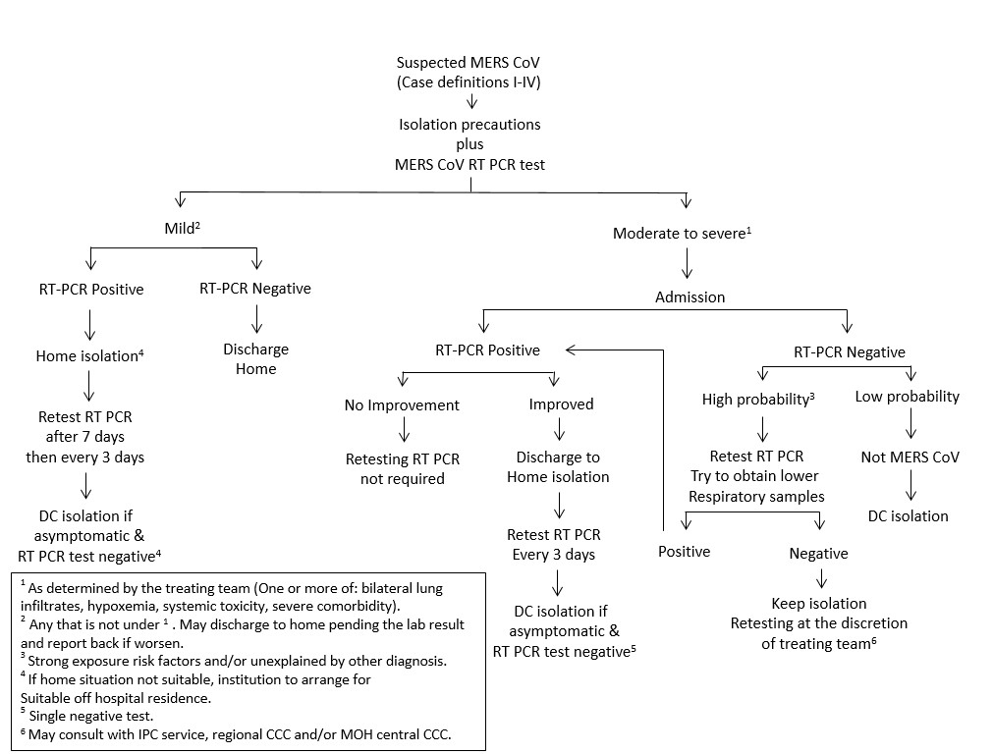
Algorithm for managing suspected patients with

Slide 40


