Slide 1
Patient safety
Understanding Systems and the effect of Complexity on Patient Care
Dr Hussein saad
Assistant Professor and Consultant, MRCP(UK)
FAMILY and COMMUNITY MEDICINE
College of Medicine
King Saud University

Slide 2
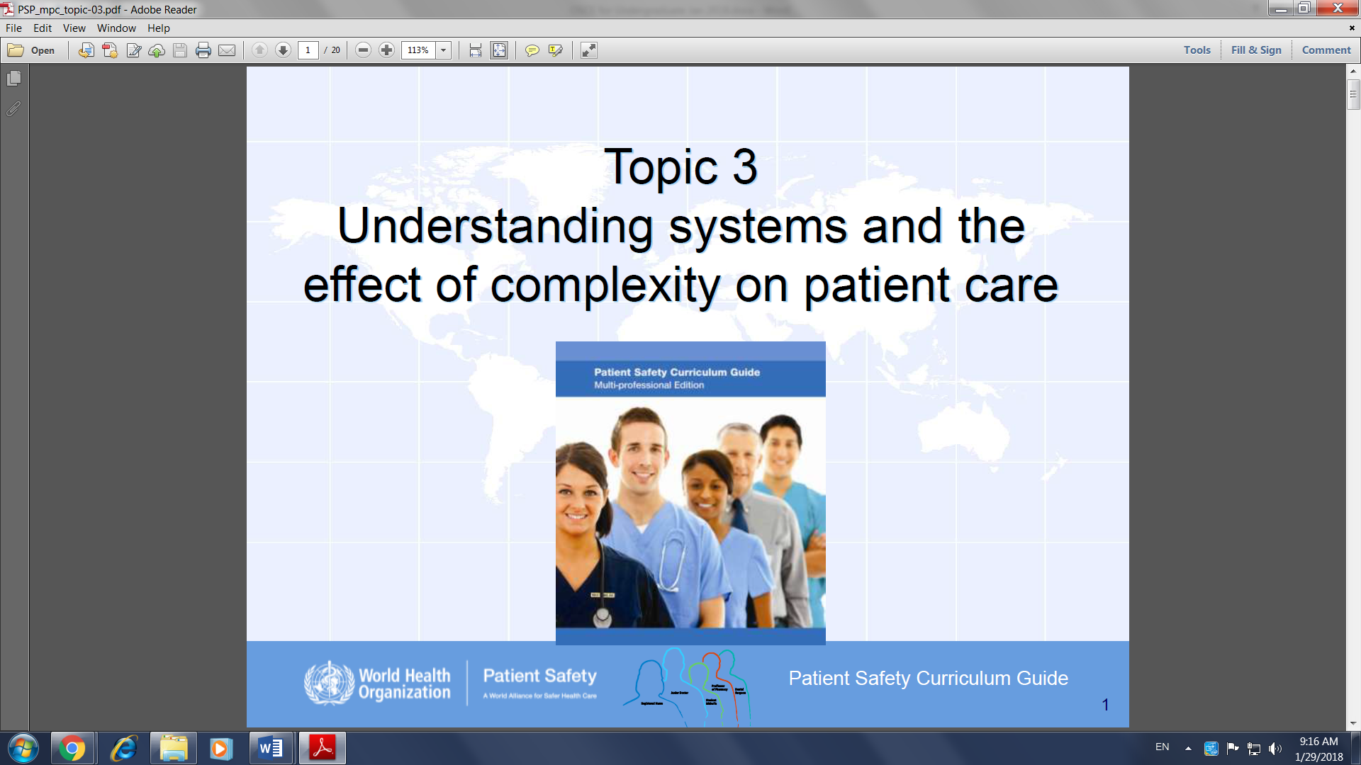

Slide 3
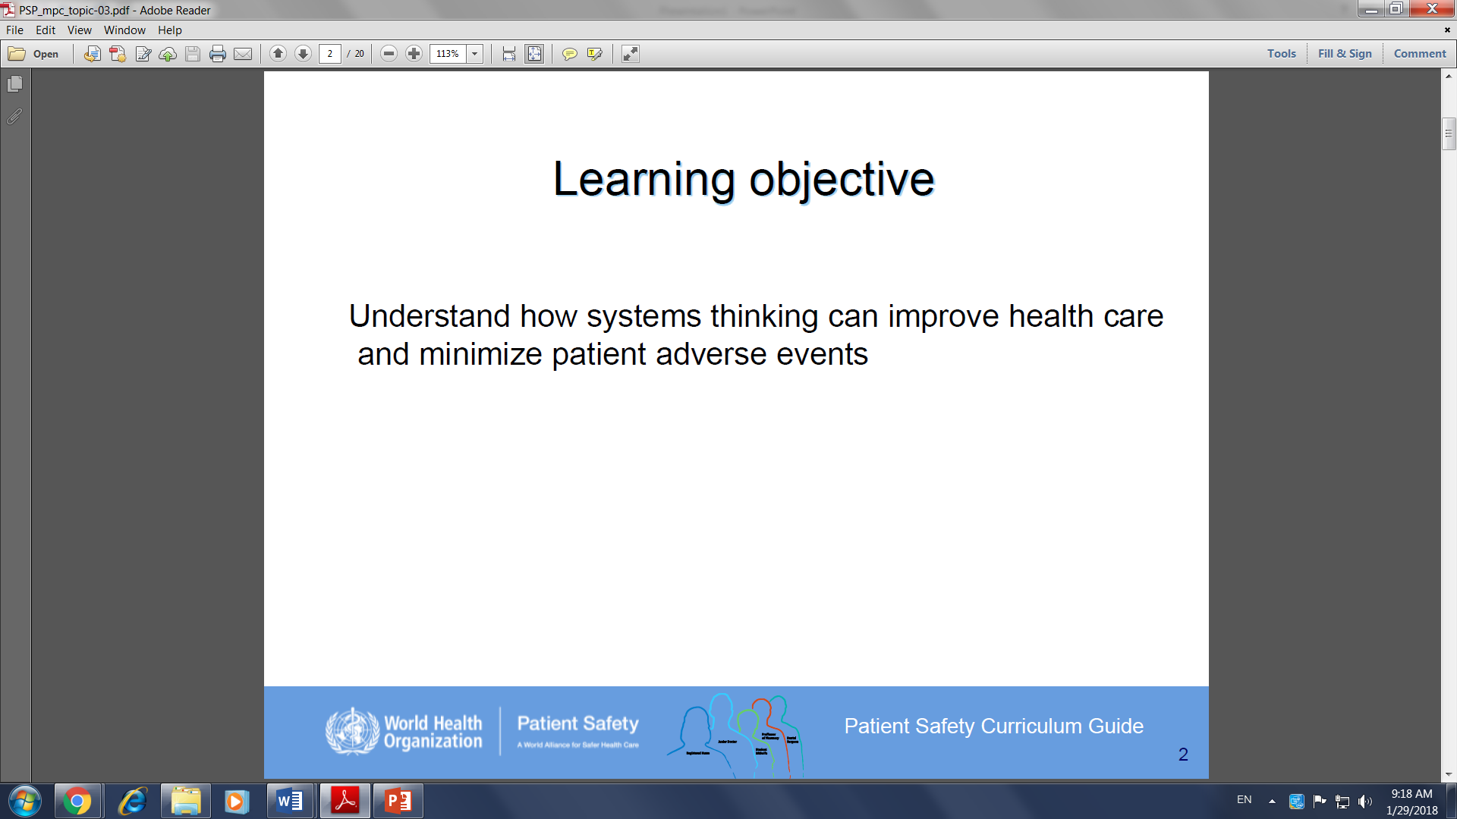

Slide 4
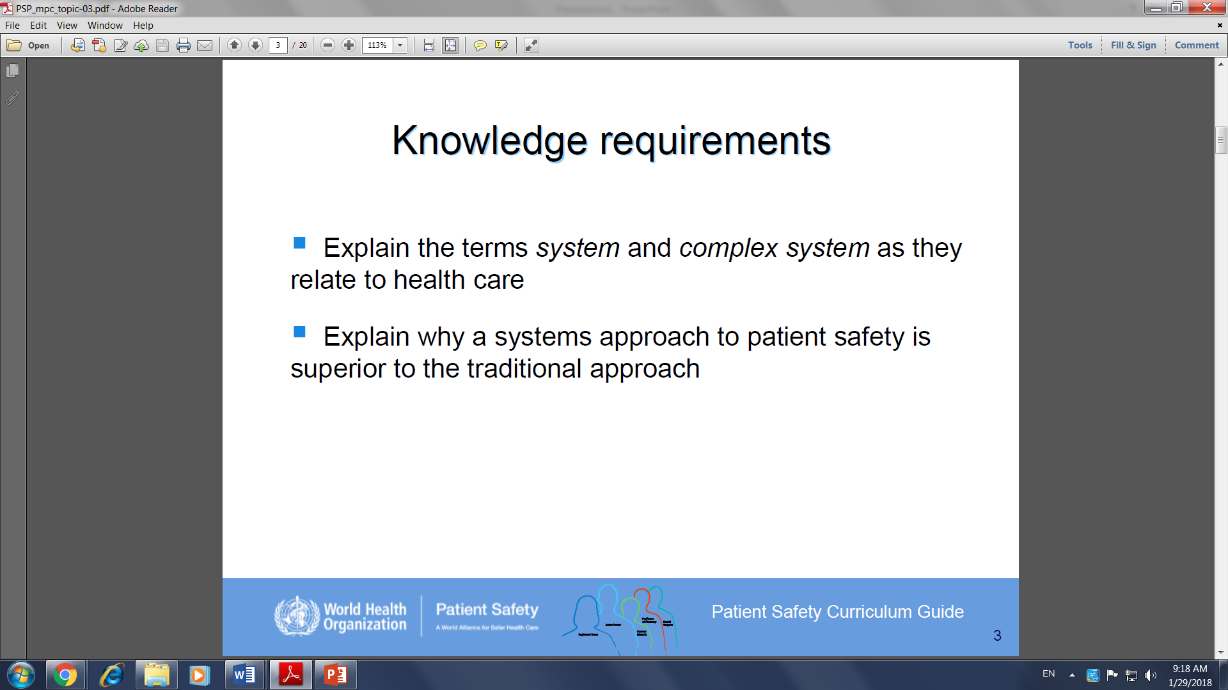

Slide 5
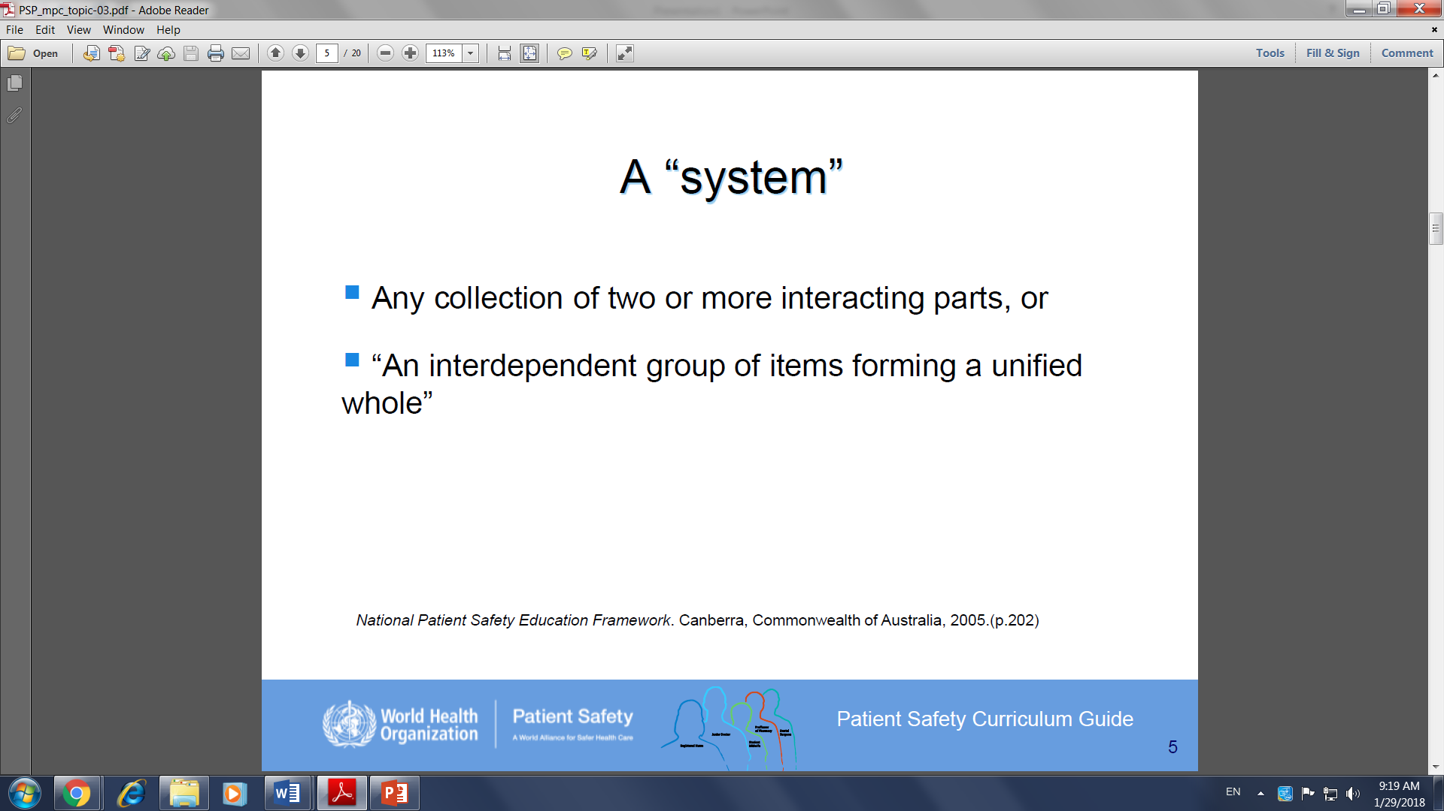

Slide 6
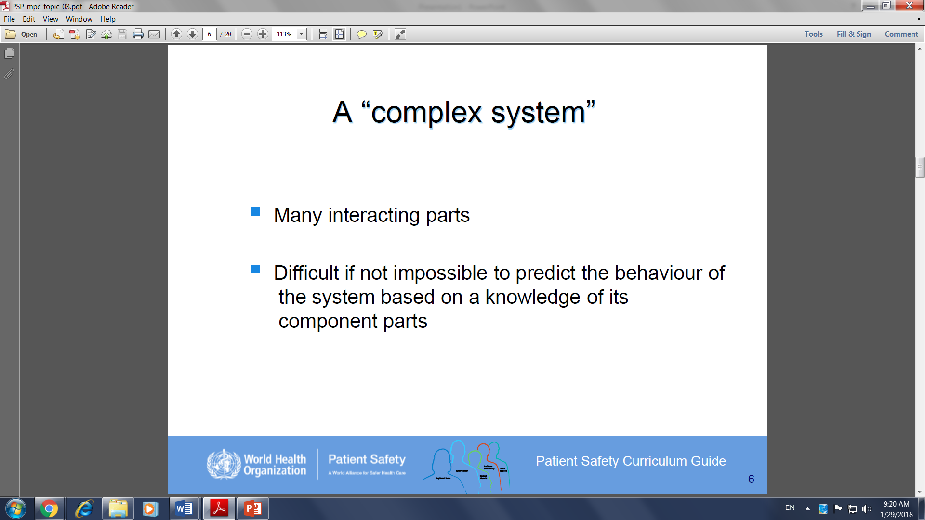

Slide 7
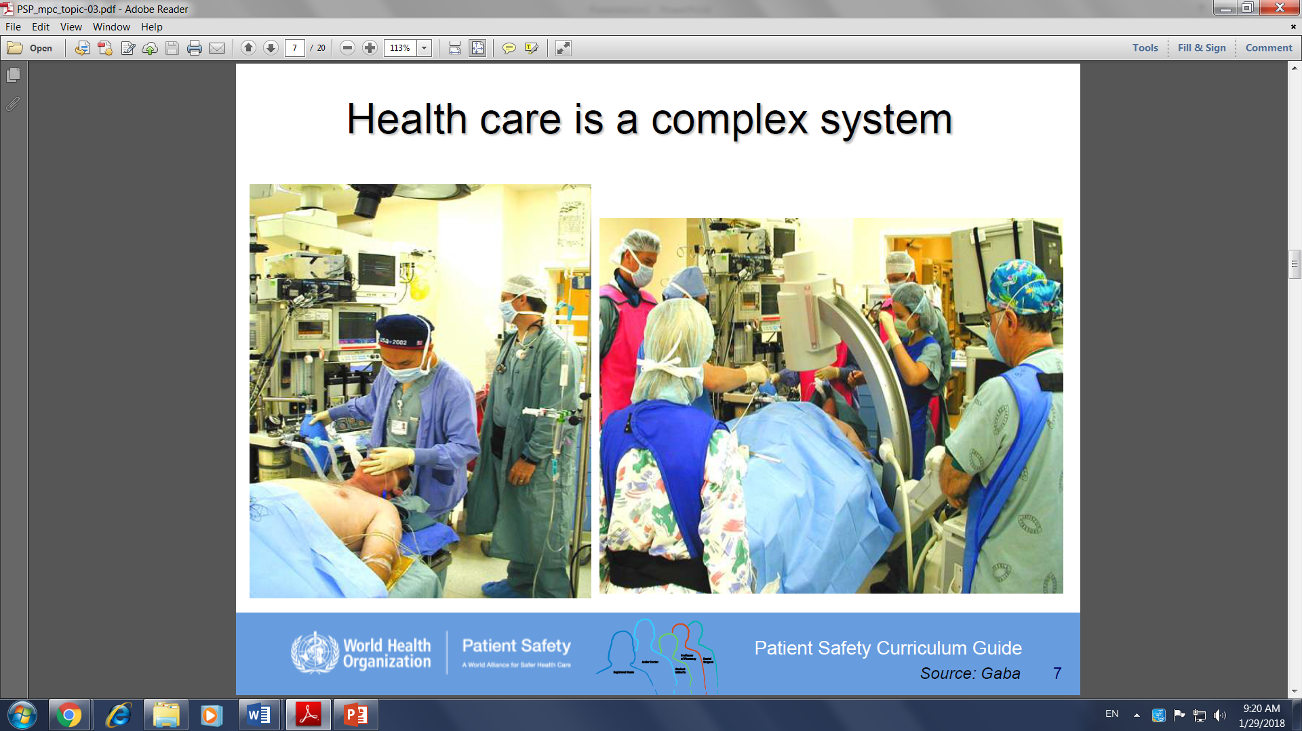

Slide 8
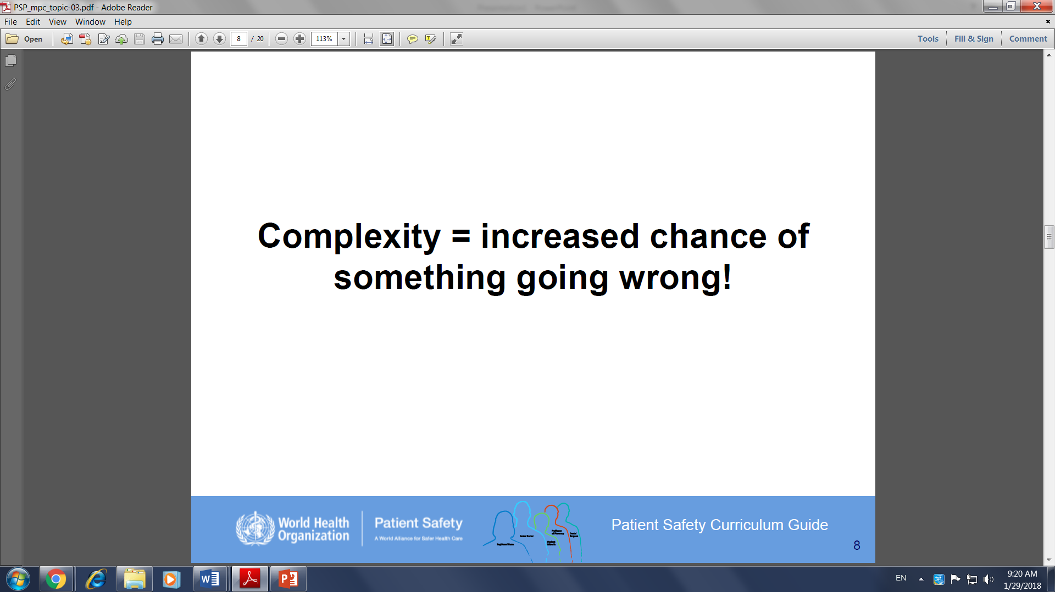

Slide 9
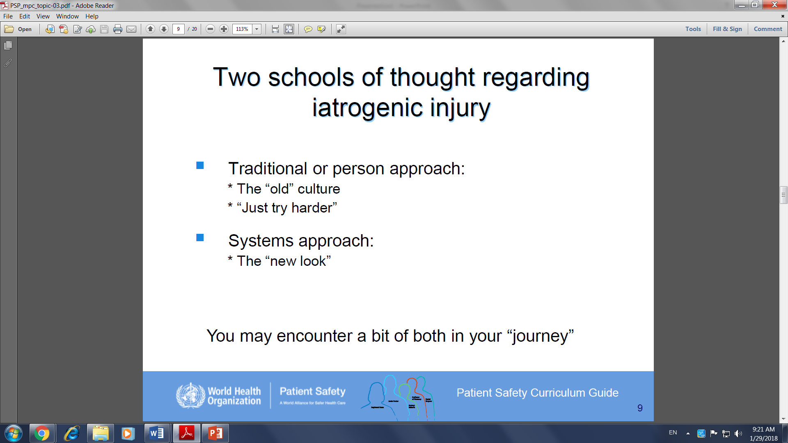

Slide 10
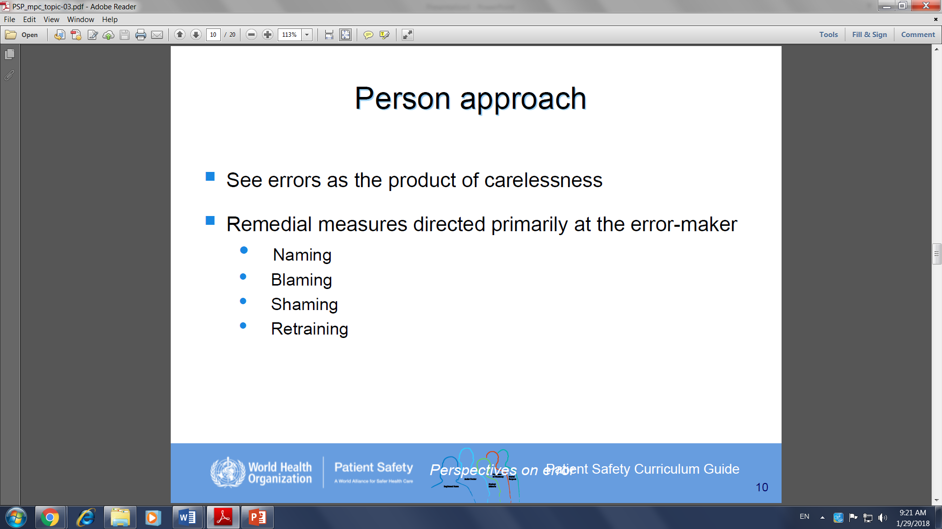

Slide 11
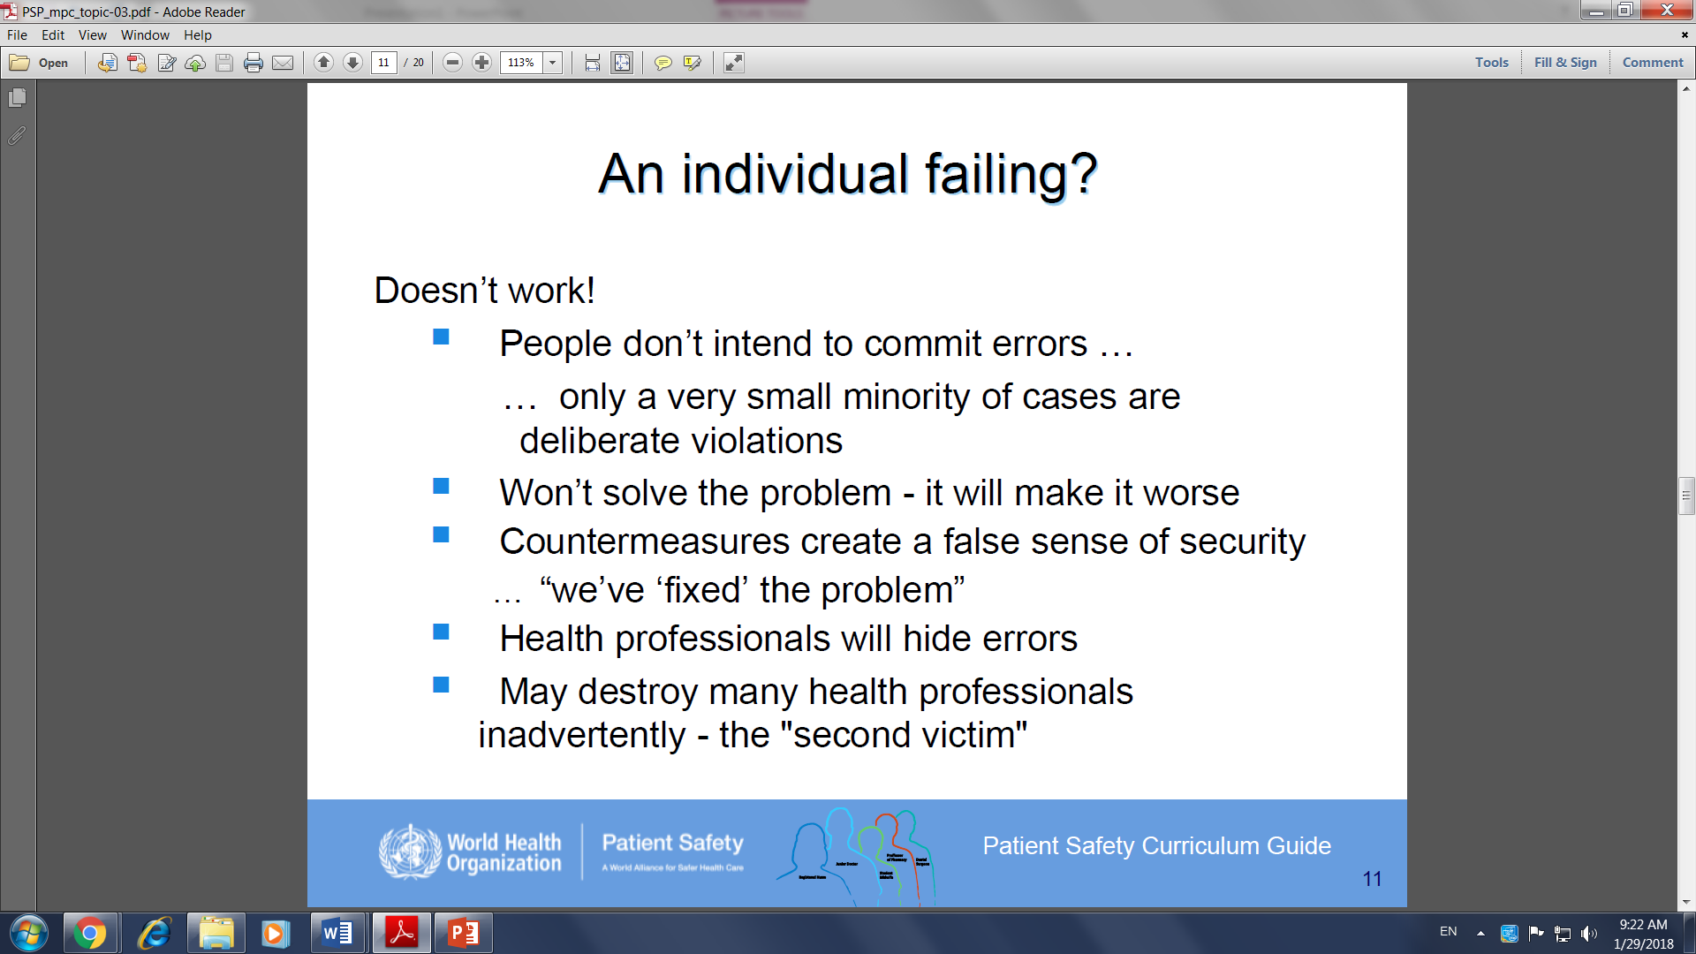

Slide 12
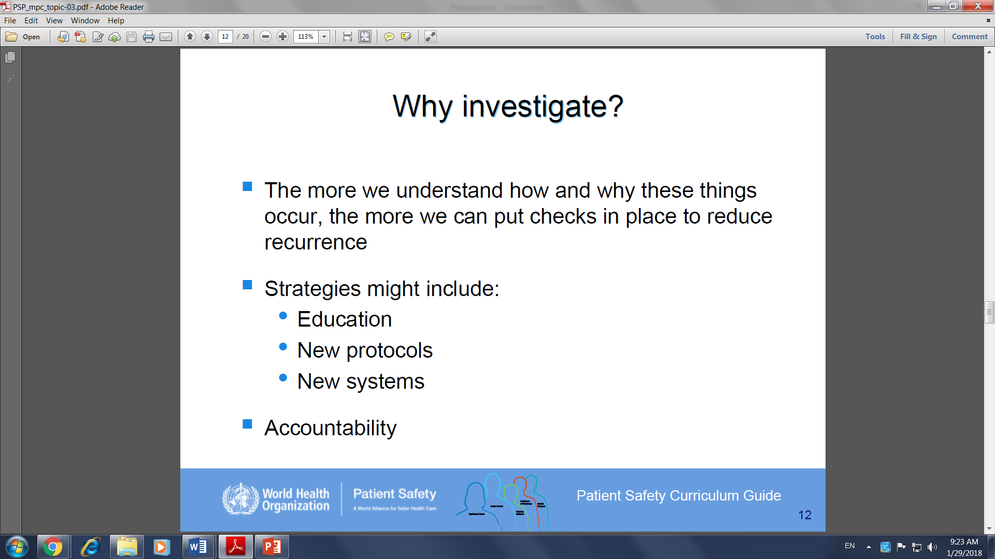
Health professionals have ethical and legal responsibilities

Slide 13
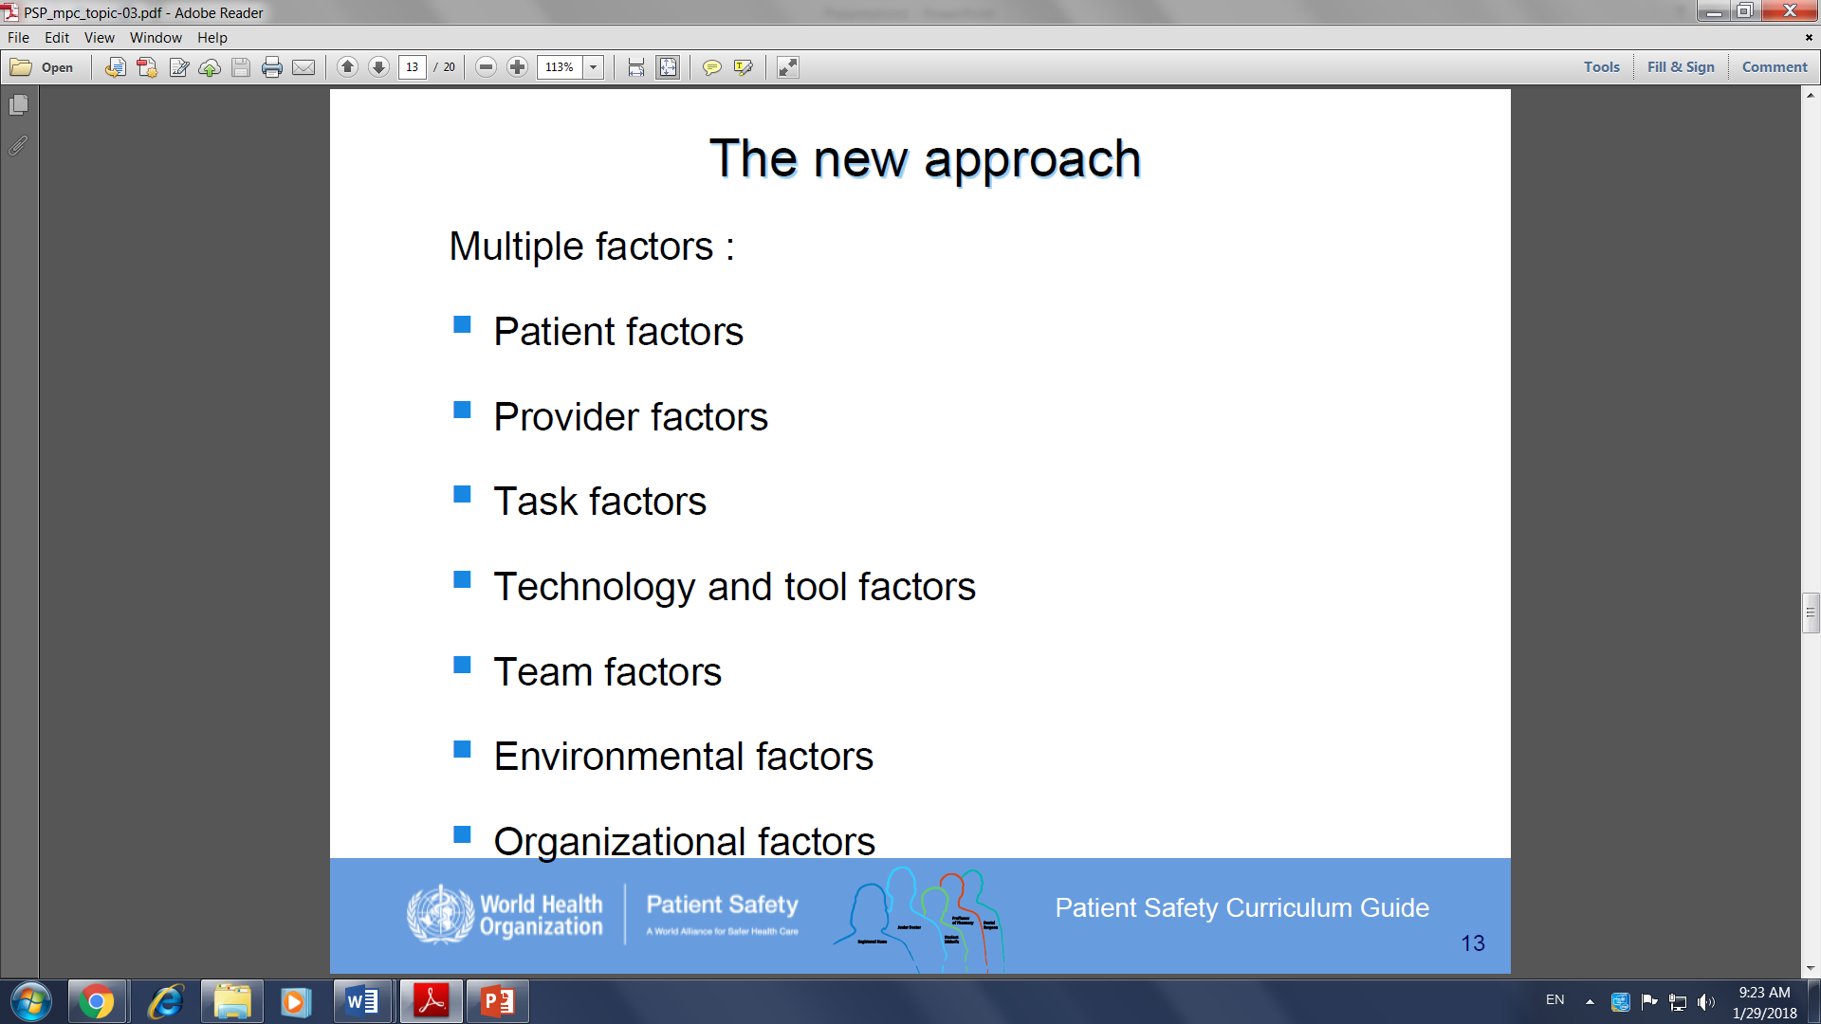

Slide 14
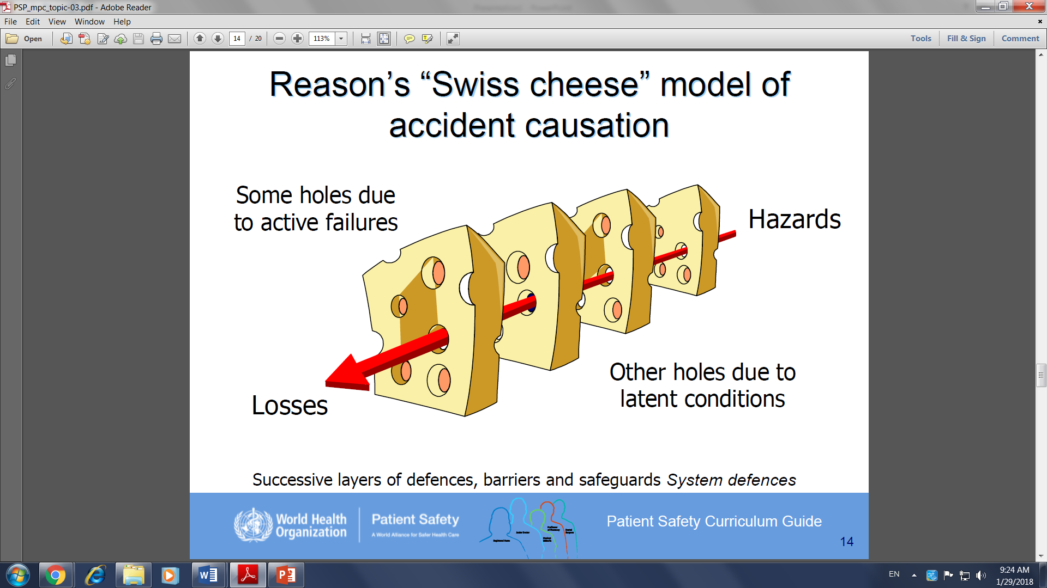
Holes represent the Weaknesses and gaps in the system

Slide 15
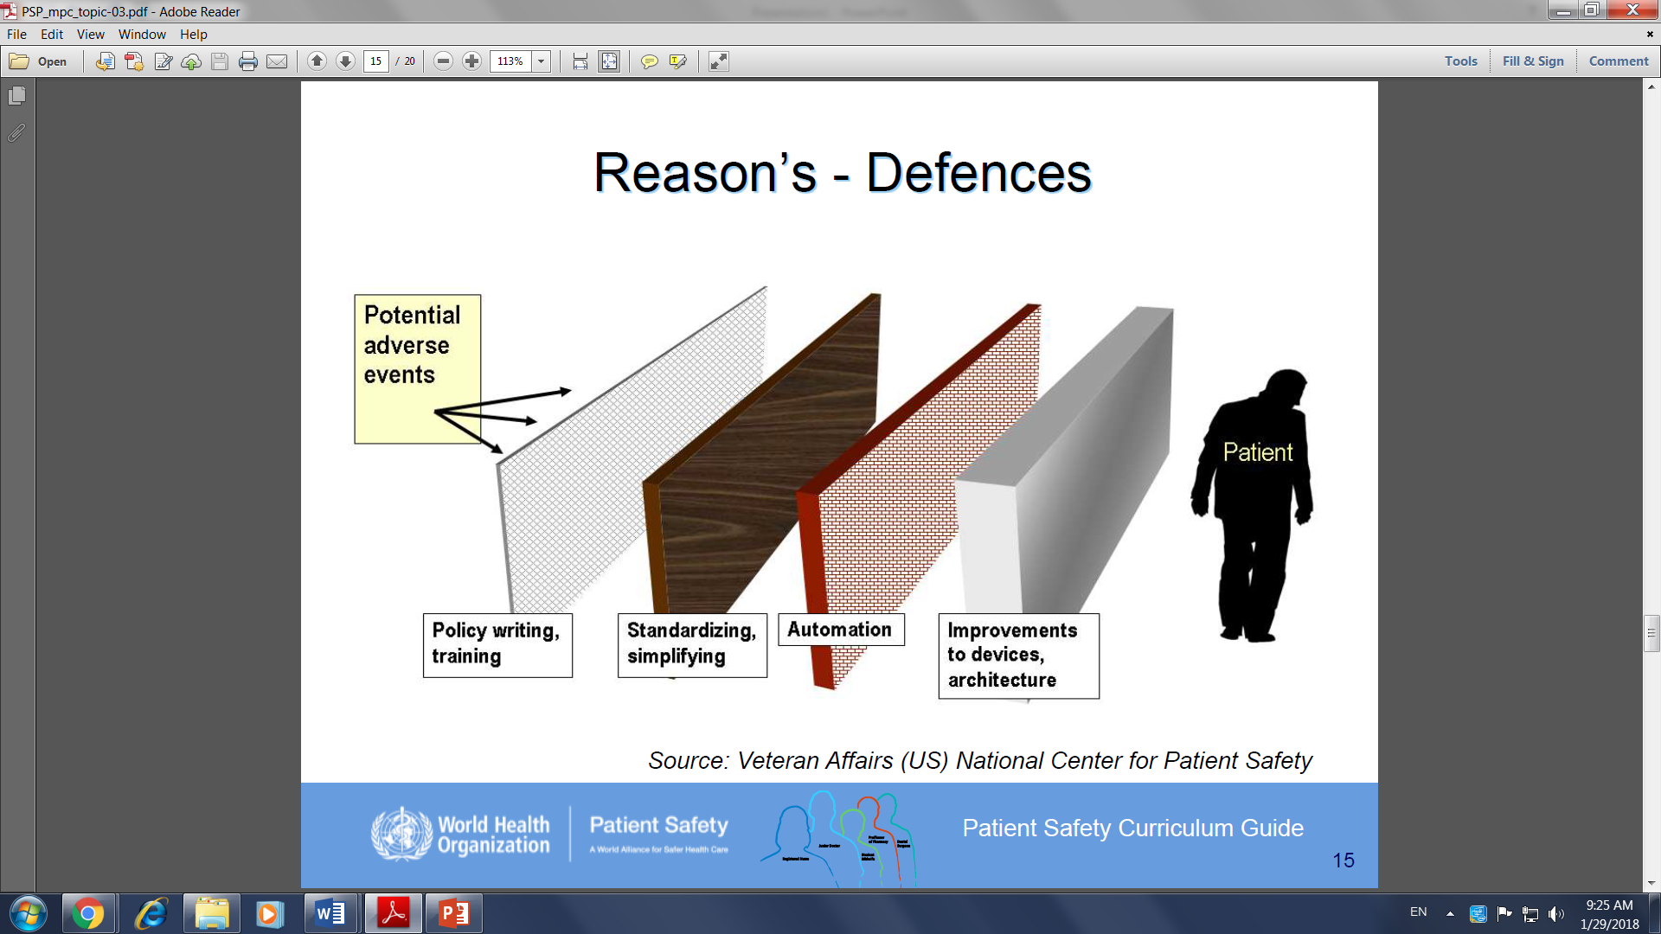

Slide 16
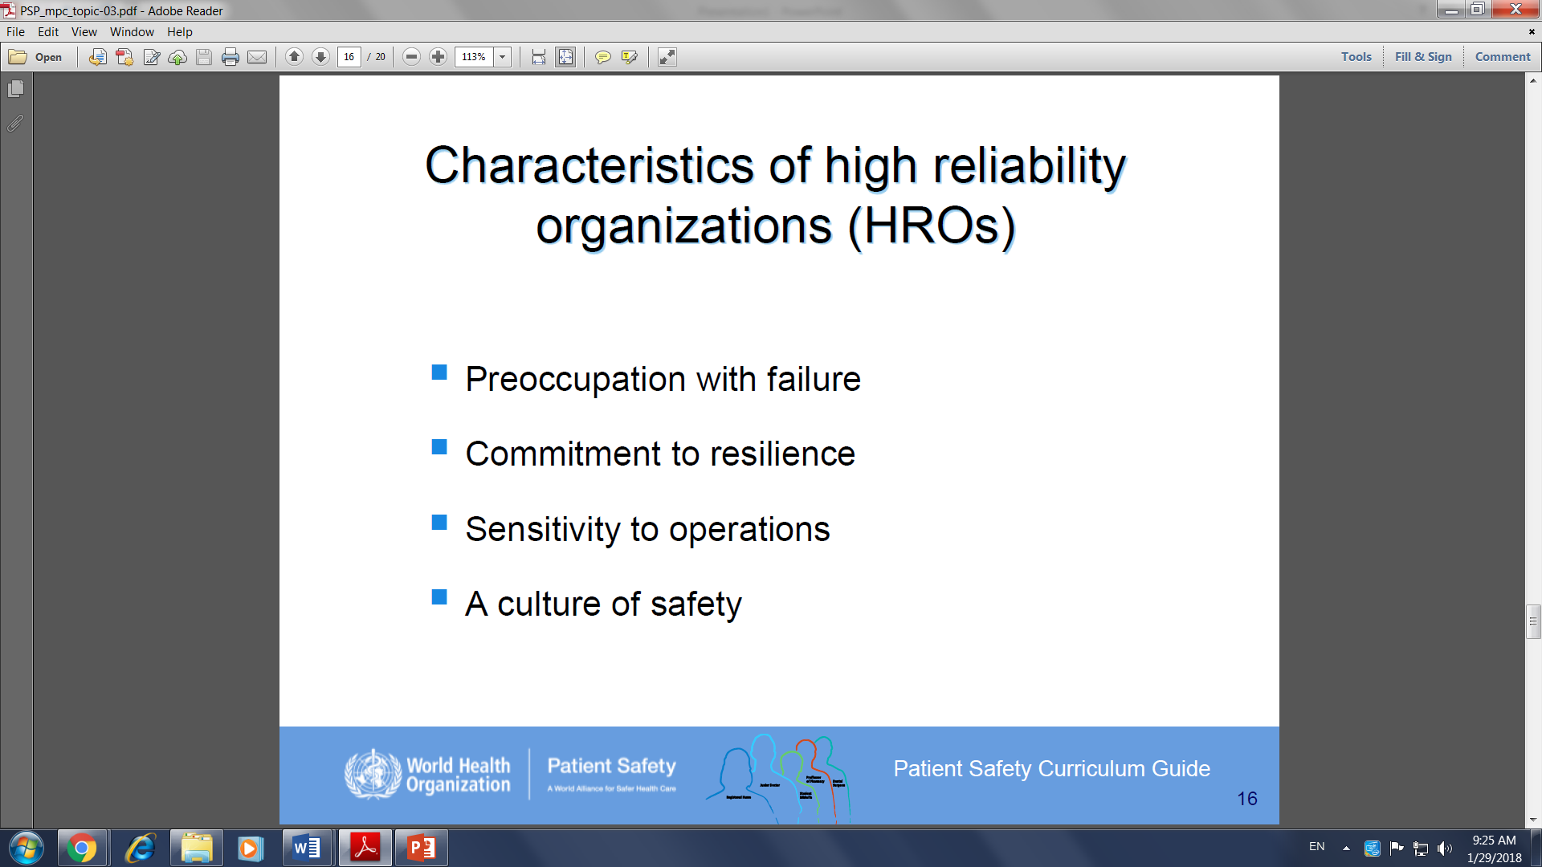
HRO means to reduce and even prevent harmful events near zero
How?
Implementation of Safety
Good system of Communication
Process Improvement

Slide 17
Take precautions and plan for the possibility of failure where risks of harm exists
seek out unexpected threats and contain them before they cause harm
Attention to the issues facing workers and Keenly aware of the processes that affect Pt. care.
individuals feel comfortable

Slide 18
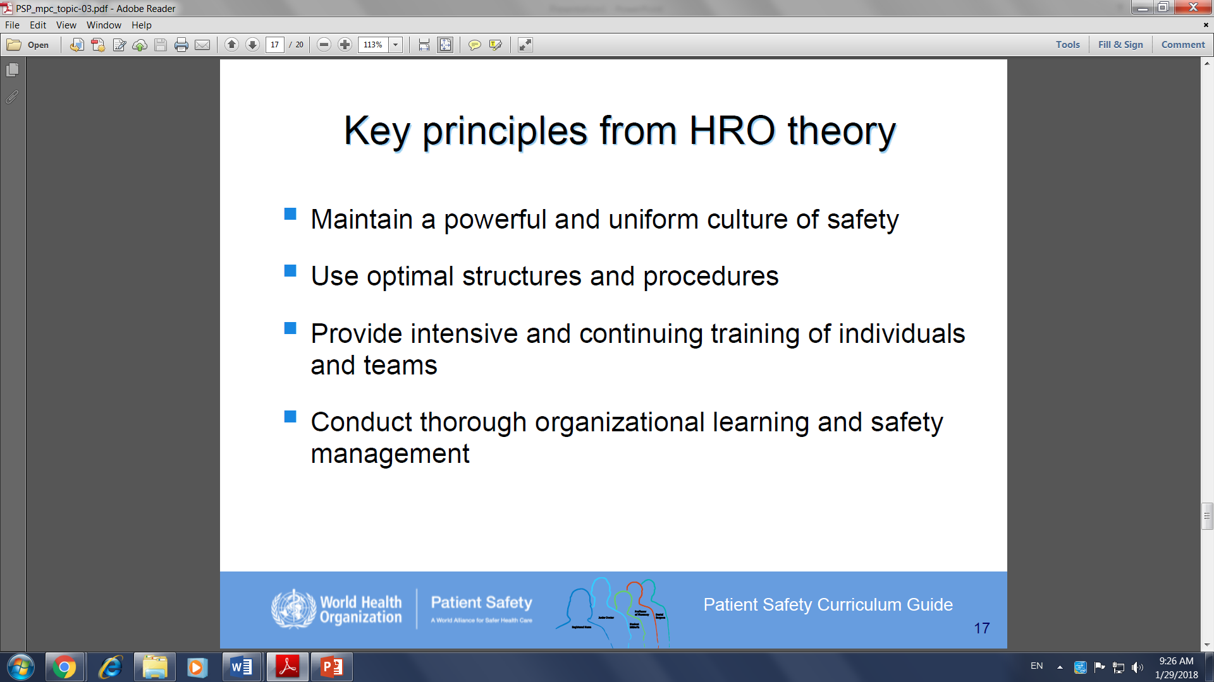

Slide 19
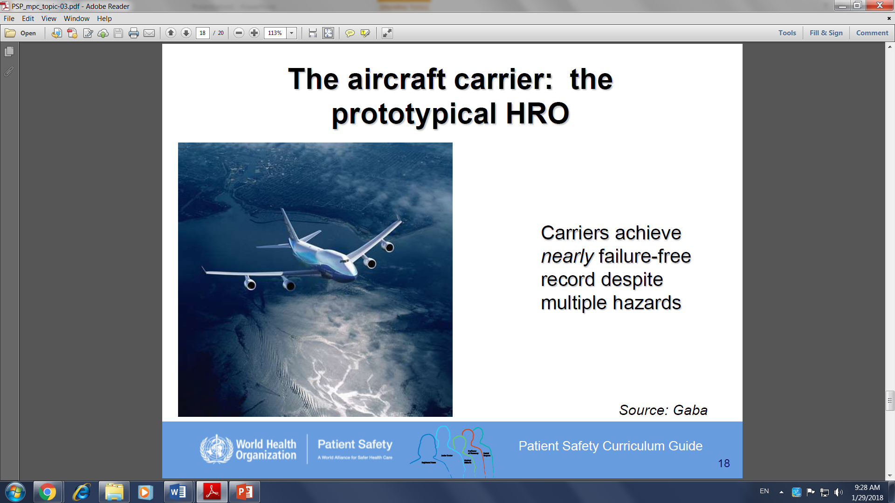

Slide 20
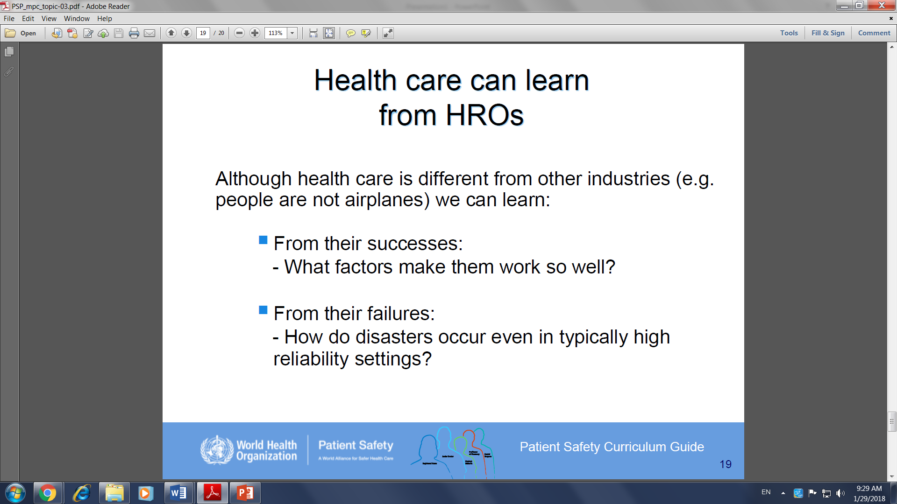

Slide 21
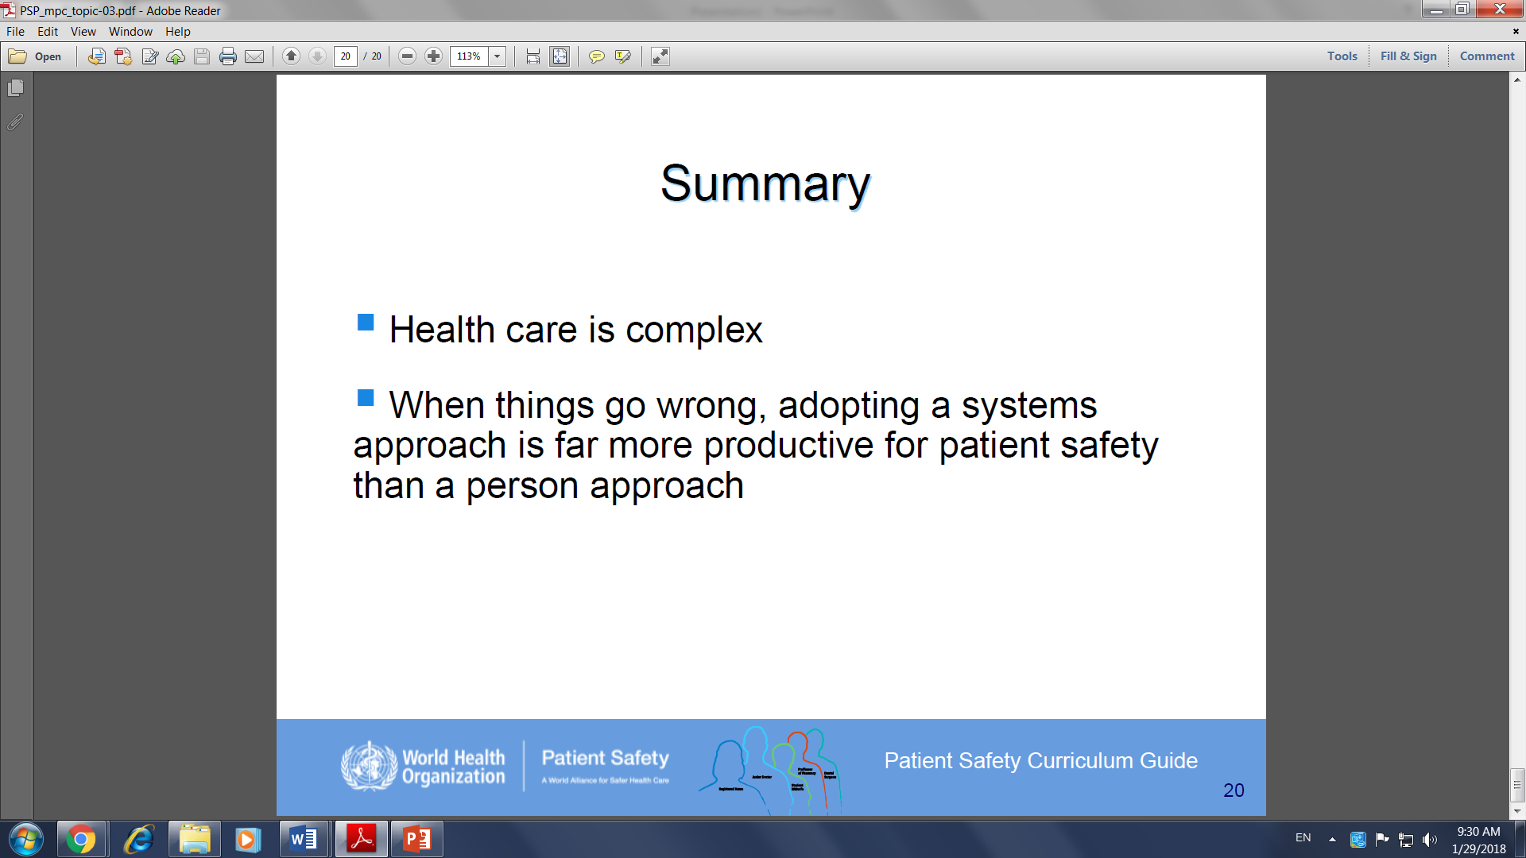

Slide 22
THANK YOU

