Slide 1
Understanding & Managing Clinical Risk

Slide 2
Learning objective
Identify Common terminology used in risk management
Discuss, how you can learn from errors.
Identify situational and personal factors that are associated with the increased risk of error.
Analyses adverse event and discuss strategies to reduce errors.
Recognize risk-management principles in the workplace.
Discuss risks or hazards reporting system in the workplace.

Slide 3
Introduction
Risk management is routine in most industries
Associated with limiting litigation costs:
Patients taking legal action against a health professional or hospital
To avoid problems, hospitals and health organizations use a variety of methods to manage risks
Hospitals are potentially dangerous places for patients as well as medical workers
There are a lot of potential hazards in hospitals,

Slide 4
Clinical risk management
Hazard: is any activity, situation or, substance that potential to cause harm, including ill health, injury, loss of product and/or damage to plant and property.
Blood borne Pathogens
Hazardous Chemicals
Stress
Risk: is the probability that harm (illness or injury) will actually occur.
Risk Management: Organizational effort to identify, assess, control and evaluate the risk to reduce harm to patient, visitors and staff and protect the organization from financial loss

Slide 5
Purpose of Risk Management
Improve organizational and client safety
Identify and minimize the risks and liability losses
Protect the organization resources
Support regulatory, accreditation compliance
Creating and maintaining safe systems of care, designed to reduce adverse events and improve human performance

Slide 6
Process Used to Manage Clinical Risks
1. Identify the risk;
2. Assess the frequency and severity of the risk
3. Reduce or eliminate the risk;
4. Assess the costs:
a. saved by reducing the risk
b. the costs of not managing the risk.

Slide 7
Process Used to Manage Clinical Risks
Identify the risk:
Sources for risk identification:
Adverse event reports.
Mortality and morbidities reports.
Patient complaints reports.
Assess the frequency and severity of the risk;

Slide 8
Process Used to Manage Clinical Risks
2. Assess the frequency and severity of the risk:
SAC (Severity Assessment Code) Score:
it is a matrix scoring system/ numerical scores are given to the severity and likelihood of risks and these scores are multiplied to get a rating for the risk

Slide 9
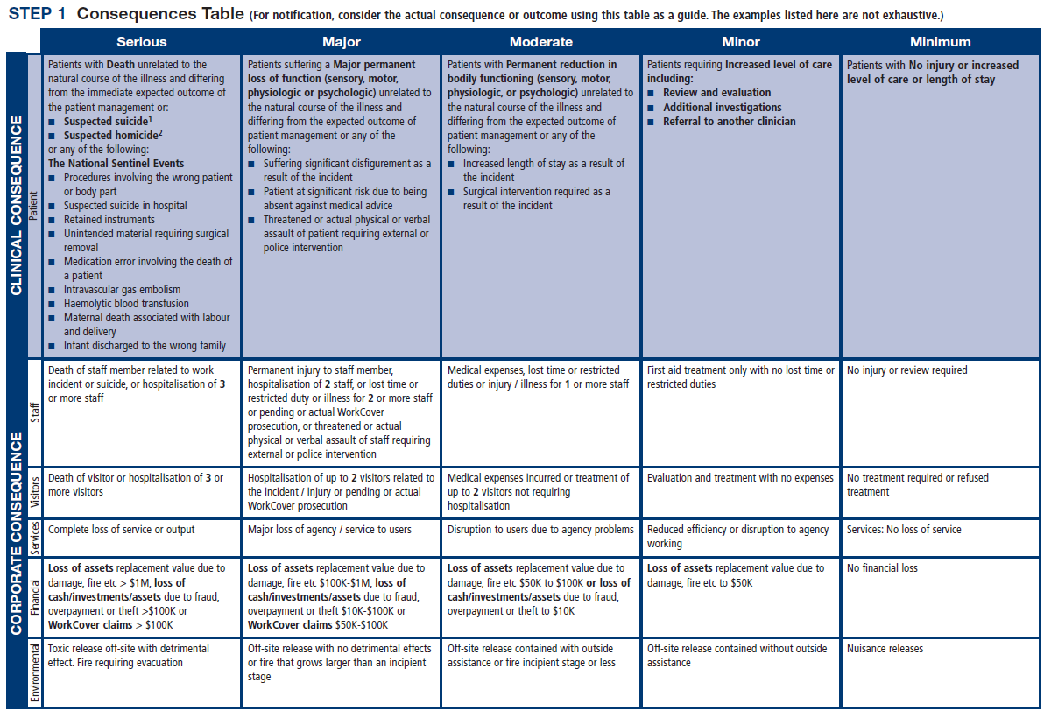

Slide 12
Process Used to Manage Clinical Risks
3. Reduce or eliminate the risk:

Slide 13
Activities Commonly Used to Manage Clinical Risk
Incident monitoring:
An incident: as an event or circumstance that could have or did lead to unintended and/or unnecessary harm to a person and/or a complaint, loss or damage.
Incident monitoring: refers to mechanisms for identifying, processing, analyzing and reporting incidents with a view to preventing their reoccurrence
The key to an effective reporting system is for staff to routinely report incidents and near misses.

Slide 15
Activities Commonly Used to Manage Clinical Risk
Sentinel events:
Is usually unexpected and involving a patient death or serious physical or psychological injury to a patient
e.g. surgery on the wrong patient or body site, incompatible blood transfusion.
Many health-care facilities have mandated the reporting of these types of events because of the significant risks associated with their repetition

Slide 16
Activities Commonly Used to Manage Clinical Risk
The role of complaints in improving care
A complaint : is defined as an expression of dissatisfaction by a patient, family member with the provided health care.
Complaints often highlight problems that need addressing, such as poor communication or suboptimal decision making.
Communication problems are common causes of complaints, as are problems with treatment and diagnosis.

Slide 17
Benefits of complaints
Assist the maintenance of high standards;
Reduce the frequency of litigation;
Help maintain trust in the profession;
Encourage self-assessment;
Protect the public.

Slide 18
Activities Commonly Used to Manage Clinical Risk
Fitness-to-practice requirements
Accountability
Competency of healthcare professionals.
Are they practicing beyond their level of experience and skill?
Are they unwell, suffering from stress or illness
Credentialing
Registration (licensure)
Accreditation

Slide 19
Credentialing
The process of assessing and conferring approval on a person’s suitability to provide specific consumer/patient care and treatment services, within defined limits, based on an individual’s license, education, training, experience, and competence.

Slide 20
Accreditation
Is a formal process to ensure delivery of safe, high-quality health care based on standards and processes devised and developed by health-care professionals for health-care services.
National Accreditation Program: CBAHI
International Accreditation Program:
Joint commission (US),
Accreditation Canada(Canada)

Slide 21
Registration (licensure)
Registration of health-care practitioners with a government authority, to protect the health and safety of the public
e.g. Saudi Commission for Health Specialties
Proper registration/licensure is an important part of the credentialing and accreditation processes

Slide 22
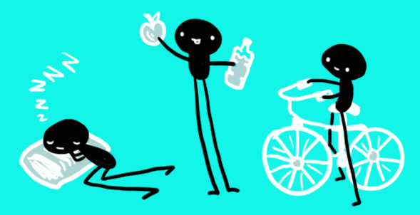
Personal Strategies for Managing Risk and Reduce Errors
Care for one’s self (eat well, sleep well and look after yourself);
Know your environment;
Know your task(s);
Prepare and plan (what if...);
Build checks into your routine;
Practice the good documentation:
A referral or request for consultation : it is important to only include relevant and necessary information:
Keep accurate and complete health-care records
Provide sufficient information
Note any information relevant to the patient’s diagnosis or treatment and outcomes;
Document the date and time

Slide 23
Personal Strategies for Managing Risk and Reduce Errors
Report any risks or hazards/incidents in your workplace
Participate in meetings to discuss risk management and patient safety
Respond appropriately to patients and families after an adverse event
Respond appropriately to complaints
Ask if you do not know. Request that a more experienced person

Slide 24
Summary
Medical error is a complex issue, but error itself is an inevitable part of being human.
These tips are known to limit the potential errors caused by humans
Avoid reliance on memory
Simplify process
Standardize common processes and procedures
Routinely use checklists
Decrease reliance on vigilance
Learning from error can occur at both an individual level and an organizational level through incident reporting and analysis.
Root cause analysis (RCA) is a highly structured systemic approach to incident analysis that is generally reserved for the most serious patient harm episodes

Slide 25
Summary
We are responsible for the treatment, care and clinical outcomes of our patients.
Personal accountability is important, as any person in the chain might expose a patient to risk.
One way for professionals to help prevent adverse events is to identify areas prone to errors.
The proactive intervention of a systems approach for minimizing the opportunities for errors can prevent adverse events.
Individuals can also work to maintain a safe clinical working environment by looking after their own health and responding appropriately to concerns from patients and colleagues.

