Slide 1
Topic 8
Engaging with patients and carers

Slide 2
Learning objective
Understand the ways in which patients and carers can be involved as partners in health care, both in preventing harm and learning from an adverse event

Slide 3
Knowledge requirements
Basic communication techniques
Informed consent procedures
The basics of open disclosure

Slide 4
Performance requirements
Actively encourage patients and carers to share information
Show empathy, honesty and respect for patients and carers
Communicate effectively
Obtaining informed consent
Show respect for each patient’s differences, religious and
cultural beliefs and individual needs
Describe and understand the basic steps in an open disclosure process
Apply patient-engagement thinking in all clinical activities
Demonstrate ability to recognize the place of patient-and carer-engagement in good clinical management

Slide 5
Gaining an informed consent
The diagnosis
The degree of uncertainty in the diagnosis
Risks involved in the treatment
The benefits of the treatment and the risks of not having the treatment
Information on recovery time
Name, position, qualifications and experience of health workers who are providing the care and treatment
Availability and costs of any service required after
discharge from hospital

Slide 6
SEGUE framework
Set the stage
Elicit information
Give information
Understand the patient’s perspective
End the encounter
Source: Northwestern University

Slide 7
Cultural competence
Understand cultural differences
Know one’s own cultural values
Understand that people have different ways of interpreting the world
Know that cultural beliefs impact on health
Be willing to fit in with the patient’s cultural or ethnic
background

Slide 8
Patient role in minimizing adverse events
Patients want to be involved in their health care (depending on which tasks)
85% of patients were comfortable asking about a
medication’s purpose
46% were very uncomfortable about asking health-care
workers whether they had washed their hands

Slide 9
Open disclosure
Informing patients and their families of bad outcomes of health-care treatment, as distinguished from bad outcomes that are expected from the disease or injury being treated

Slide 10
Key principles of open disclosure
Openness and timeliness of communication
Acknowledgement of the incident
Expression of regret/apology
Recognition of the reasonable expectations of the patient and their support person
Support for staff
Confidentiality
10

Slide 11
◘
Patient Safety Curriculum Guide
Source: http://www.health.nsw.gov.au/quality/opendisc/index.html
11

Slide 12
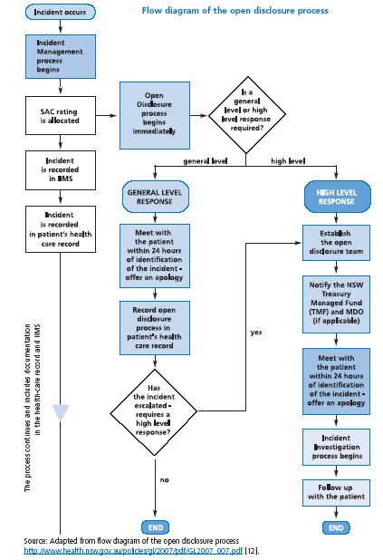
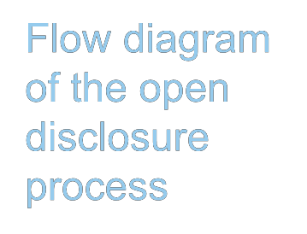
Flow diagram of the open disclosure process

Slide 13
Harvard Framework
Preparing
Initiating conversation
▪
▪
▪
▪
▪
Presenting the facts
Actively listening
Acknowledging what you have heard
Concluding the conversation
Documentation
Source: Harvard Hospitals. Cambridge, MA, Harvard
University, 2006

Slide 14
SPIKES
Sharpen your listening skills
Pay attention to patient perceptions
Invite the patient to discuss details
Know the facts
Explore emotions and deliver empathy
Strategize next steps with patient or family
Source: R. Buckland

