Slide 1
Patient Safety
(Human Factors)
G3

Slide 2
Group Members (G3)
Mohammed Khoja (Group Leader)
Khalid Alsaadi (Writer)
Saud Alshenaifi (Writer)
Meshari Alshepri (Writer & Presenter)
Faisal Habbab (Presenter)
Fahad Alzahrani
Abdulaziz Alsumali
Khalil Alghalayeni
Saad Alqahtani
Abdulaziz Alhothali
Khalid Aldakheel

Slide 3
Human Factors Training Video
(SHELL Model)
Tittle of the Video
https://www.youtube.com/watch?v=t6j2Sz4wbcI&t=113s

Slide 4
Summary of the Case
In this video a doctor has been called to assess and treat an unwell simulated
patient on the medical ward.
The doctor start to assess the patient condition.
Then, asked one of the team members to preform multiple tasks can’t be done by
one person.
The doctor shows lack of professionality and human factors.

Slide 5
Summary of the Case
The video explores the extensive variety of human factors that influence the performance of health care professionals. These include:
individual, team, and task related factors in the wider context of the environment, the equipment used, the protocols followed and the culture of the organization

Slide 6
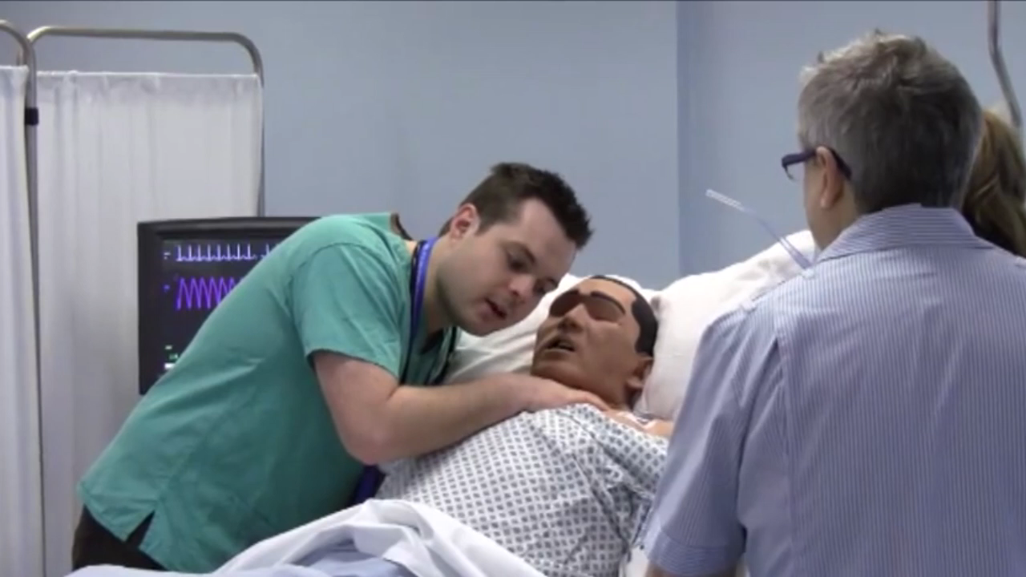
Identify and Discussion
1-Ordering many tests and medications verbally rather than electronically
(0:17-0:35)

Slide 7
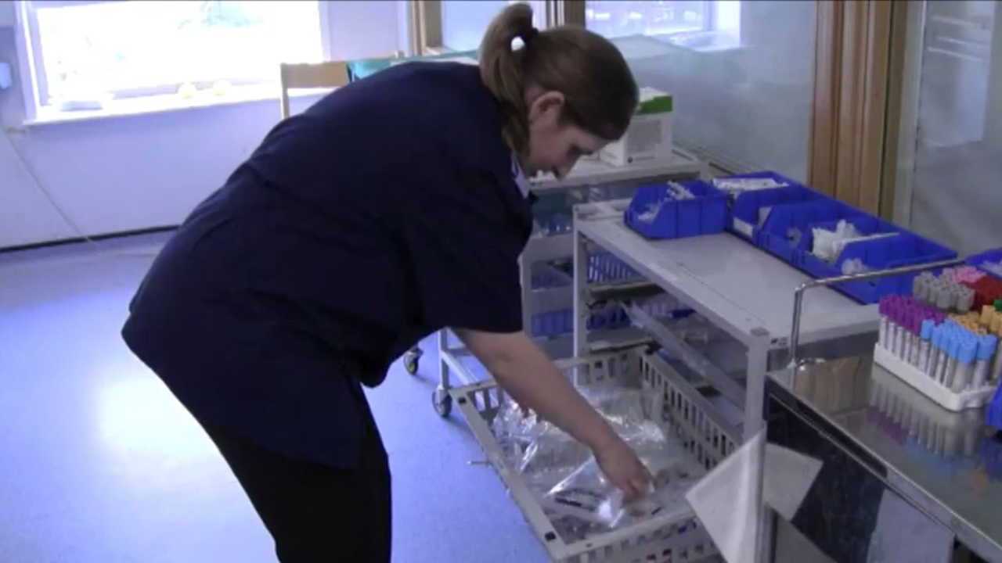
Identify and Discussion
2-No organization for the medications (1:16-1:27)

Slide 8
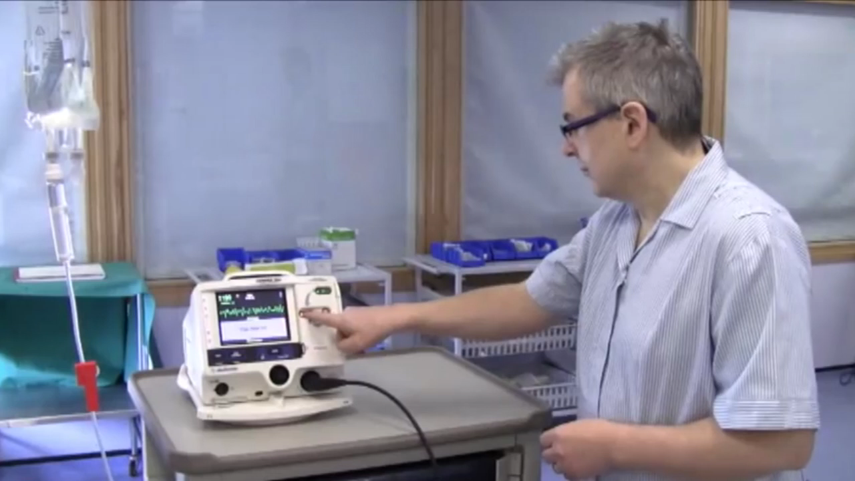
Identify and Discussion
3-Dead batteries in the defibrillator (4:41-4:54)

Slide 9
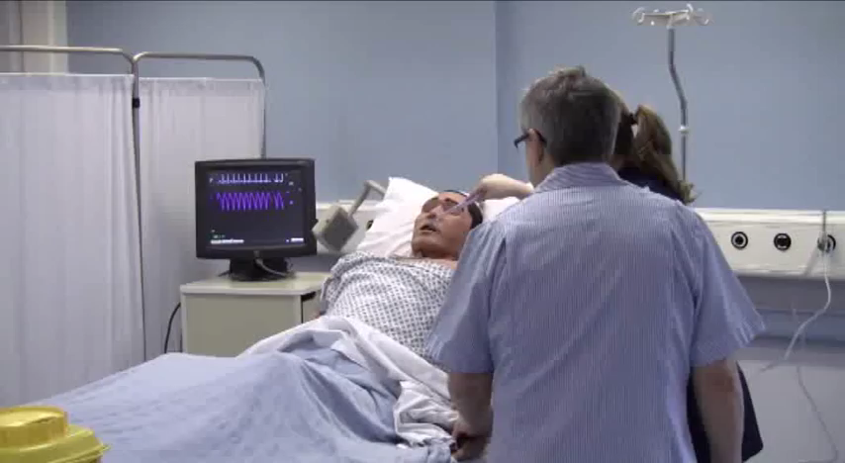
Identify and Discussion
4-Not using sterile technique (Through out the whole video)

Slide 10
Lessons Learned
1-Miscommunication between health workers can lead to devastating results ,make sure that you’re message is
delivered clearly to your colleges and let them ask you if they don’t understand and vice versa.
2-Double check all kinds of materials used ex: defibrillator is charged and ready to be used.
3-Health workers should know their role in treating their patients.
4-Physican should supervise on procedures which requires experience and considered a lifesaving to the patient.
5-Make sure to manage a plan in stressful situations to have the best care results.

Slide 11
Thank You

